Slide 1
Get to Know Nuclear Patch Workshop
For Troop #
Presented By:
Presenter Name

Slide 2
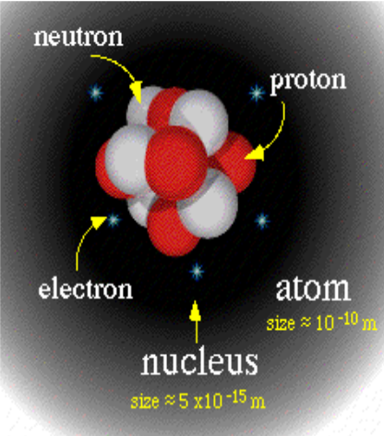
What is an Atom?
The smallest piece of an element
Made up of:
  Protons (+)
  Neutrons ( )
  Electrons (-)
Number of protons determines element

Slide 3
Mass of an Atom
Masses
  Proton: 1 amu
  Neutron: 1 amu
  Electron: .000549 amu
    What is an AMU??? 3.67 *10⁻²⁷ pounds
    0.00000000000000000000000000367 pounds
So mass of atom is about
  # neutrons + # protons

Slide 4
What is the mass of...
Helium?
  2 protons, 2 neutrons, 2 electrons
Oxygen
  8 protons, 8 neutrons, 8 electrons
Fissile Uranium
  92 protons, 143 neutrons, 92 electrons
Alpha particle
  2 protons, 2 neutrons

Slide 5
Radiation
Radiation is:
  “A process in which energetic particles or waves travel through space”
What do you know about radiation?
  What is it? (types)
  What does it do? (effects)
  Where does it come from? (sources)

Slide 6
Types of Radiation
Ionizing radiation
  Produces ions in the material it strikes
    Ions can cause DNA damage
  Alpha particles
  Beta particles
  Gamma rays (high energy photons)
Non-ionizing radiation
  Cannot cause ions
  Low energy gamma rays
Notes:
Figure found at: http://www.uic.com.au/index.htm

Slide 7
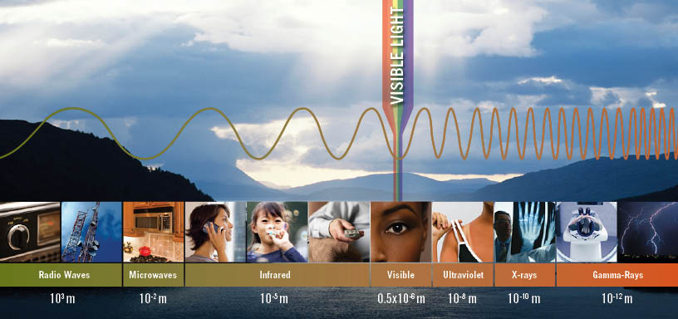
Types of Radiation
High energy photons are ionizing
Low energy photons are non-ionizing

Slide 8
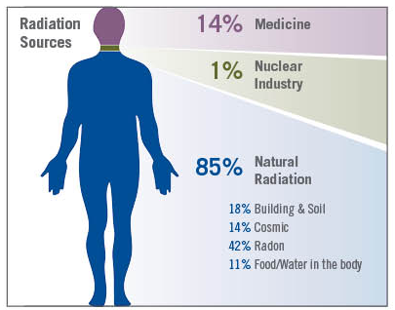
Where does radiation come from?
Natural
  Soil, water and vegetation
  Cosmic, the sun
  Internal sources
    Potassium-40 (bananas)
    Carbon-14 (air)
    Lead-210 (radon)
    Tritium (water)
Man-made sources
  Medical sources
    x-rays, rad. therapy
  Nuclear Power

Slide 9

Radiation Hazards
Humans, Environment, Wildlife:
  Sickness!
  Acute effects: sunburns most common
  Chronic effects: cancers

Slide 10
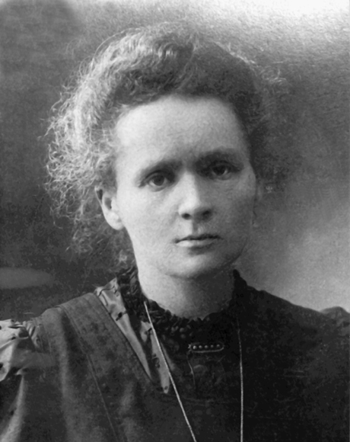
Marie Curie
Discovered the element Polonium
Won Nobel Prize in Chemistry and in Physics
  Only 4 people have earned 2 prizes
Founded the Curie Institute of Oncology in Poland

Slide 11
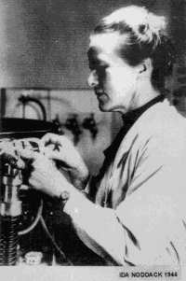
Ida Noddack
Among the first physicists to propose nuclear fission
Discovered the element Rhenium with her husband

Slide 12
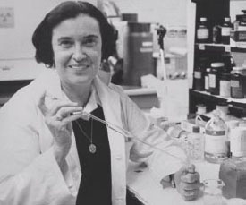
Rosalyn Yalow
Helped develop radioisotope tracing technique
  Can measure tiny quantities of biological substances in blood
Won a Nobel Prize
from that research

Slide 13
Off to Stations!
Group:
  A Cloud Chamber
  B Fission Game
  C Geiger Counters

Slide 14
Wrap-Up
We hope you enjoyed your day
Surveys!
  These are important to me, please fill one out and place on front or back table
Troop Leaders come to the front to receive your troop’s patches
Please clean up your area

Slide 15
Extra Topics

Slide 16

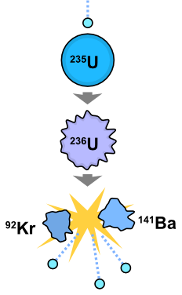
Fission vs. Fusion
Fusion
Fission
  Breaking apart of Heavy Nuclei
  Makes 20% of our electricity
  Further discussed later today
  Example:
    n + U-235 → Ba-139 + Kr-94 + 3n
  Combination of Light Nuclei
  Powers the Sun
  Hard to get on Earth – we’re working on it!
  IEC Fusion Tour later today!
  Example:
    H-3 + H-2 → n + He-4
    Tritium + Deuterium → neutron + Helium
Notes:
This slide is used to clarify the difference between two similarly sounding words. It is particularly relevant for us because we have the scouts go to fission and fusion experiments. It may not be needed for your program.

Slide 17
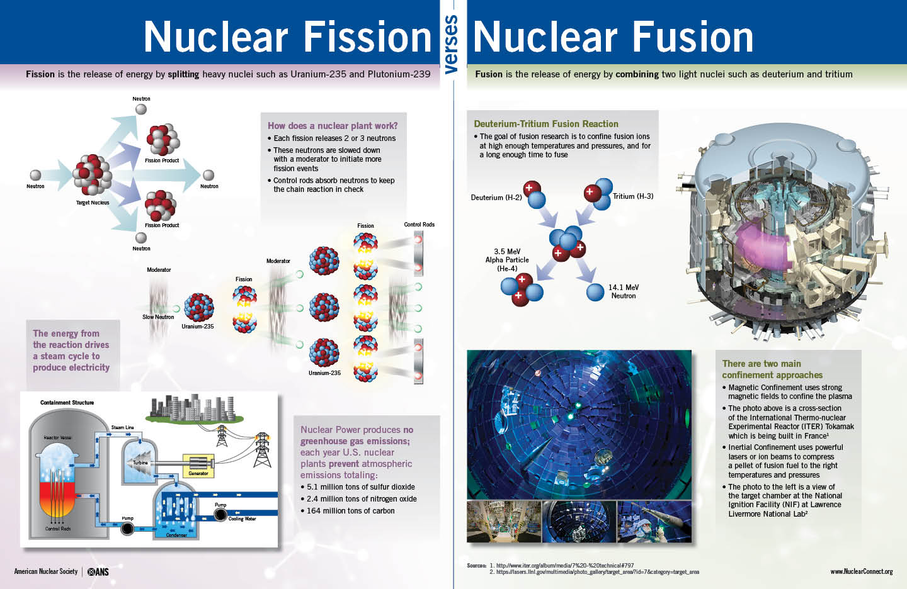
Fission vs. Fusion
Notes:
This slide represents ANS fission vs fusion poster

Slide 18
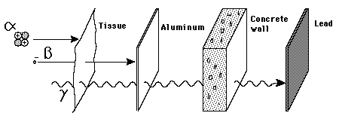
Radiation Shielding
Investigate during counters activity later Today!

Slide 19
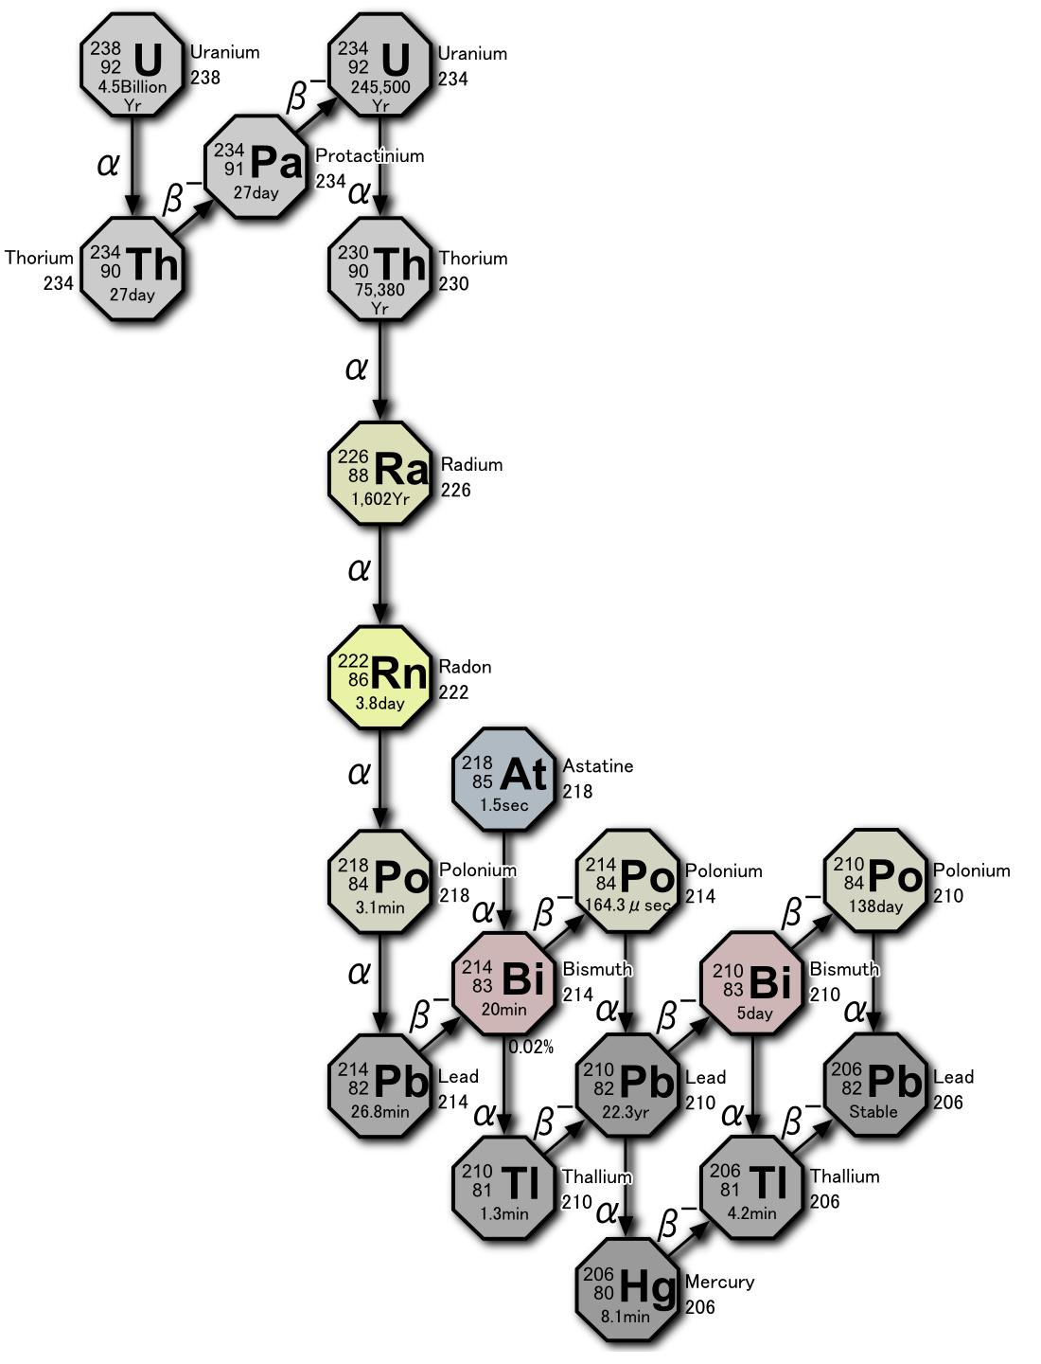
Radioactive Decay
What happens to radioactive material
Radioactive atoms have an associated probability that they will decay
Overtime with a large sample of atoms, this probability averages into a half life
Half-life: Amount of time it takes for half of the radioactive atoms to decay

Slide 20
Types of Effects of Radiation
Acute
  responses which increase in severity with increased dose (sunburn)
  More readily apparent
Chronic
  effects which have an increased probability of occurrence with increased dose, but whose severity is unchanged (skin cancer)

