Slide 1
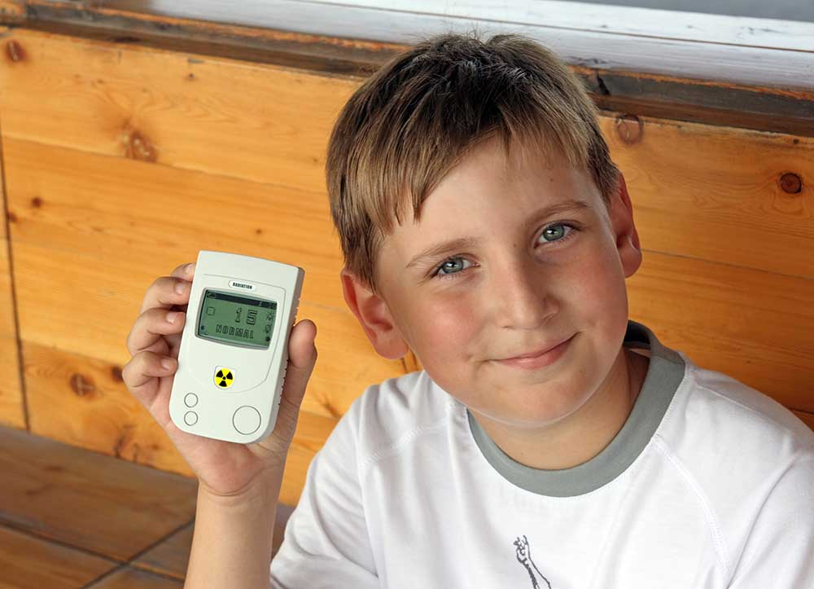
MEASURING RADIATION

Slide 2
Measuring Radiation
What did you learn about…?
Sources of radiation
The amount of radiation in your home
The relative risks of radiation
Radiation exposure from medical sources
Radiation exposure from natural sources
How radiation varies based on where you live

Slide 3
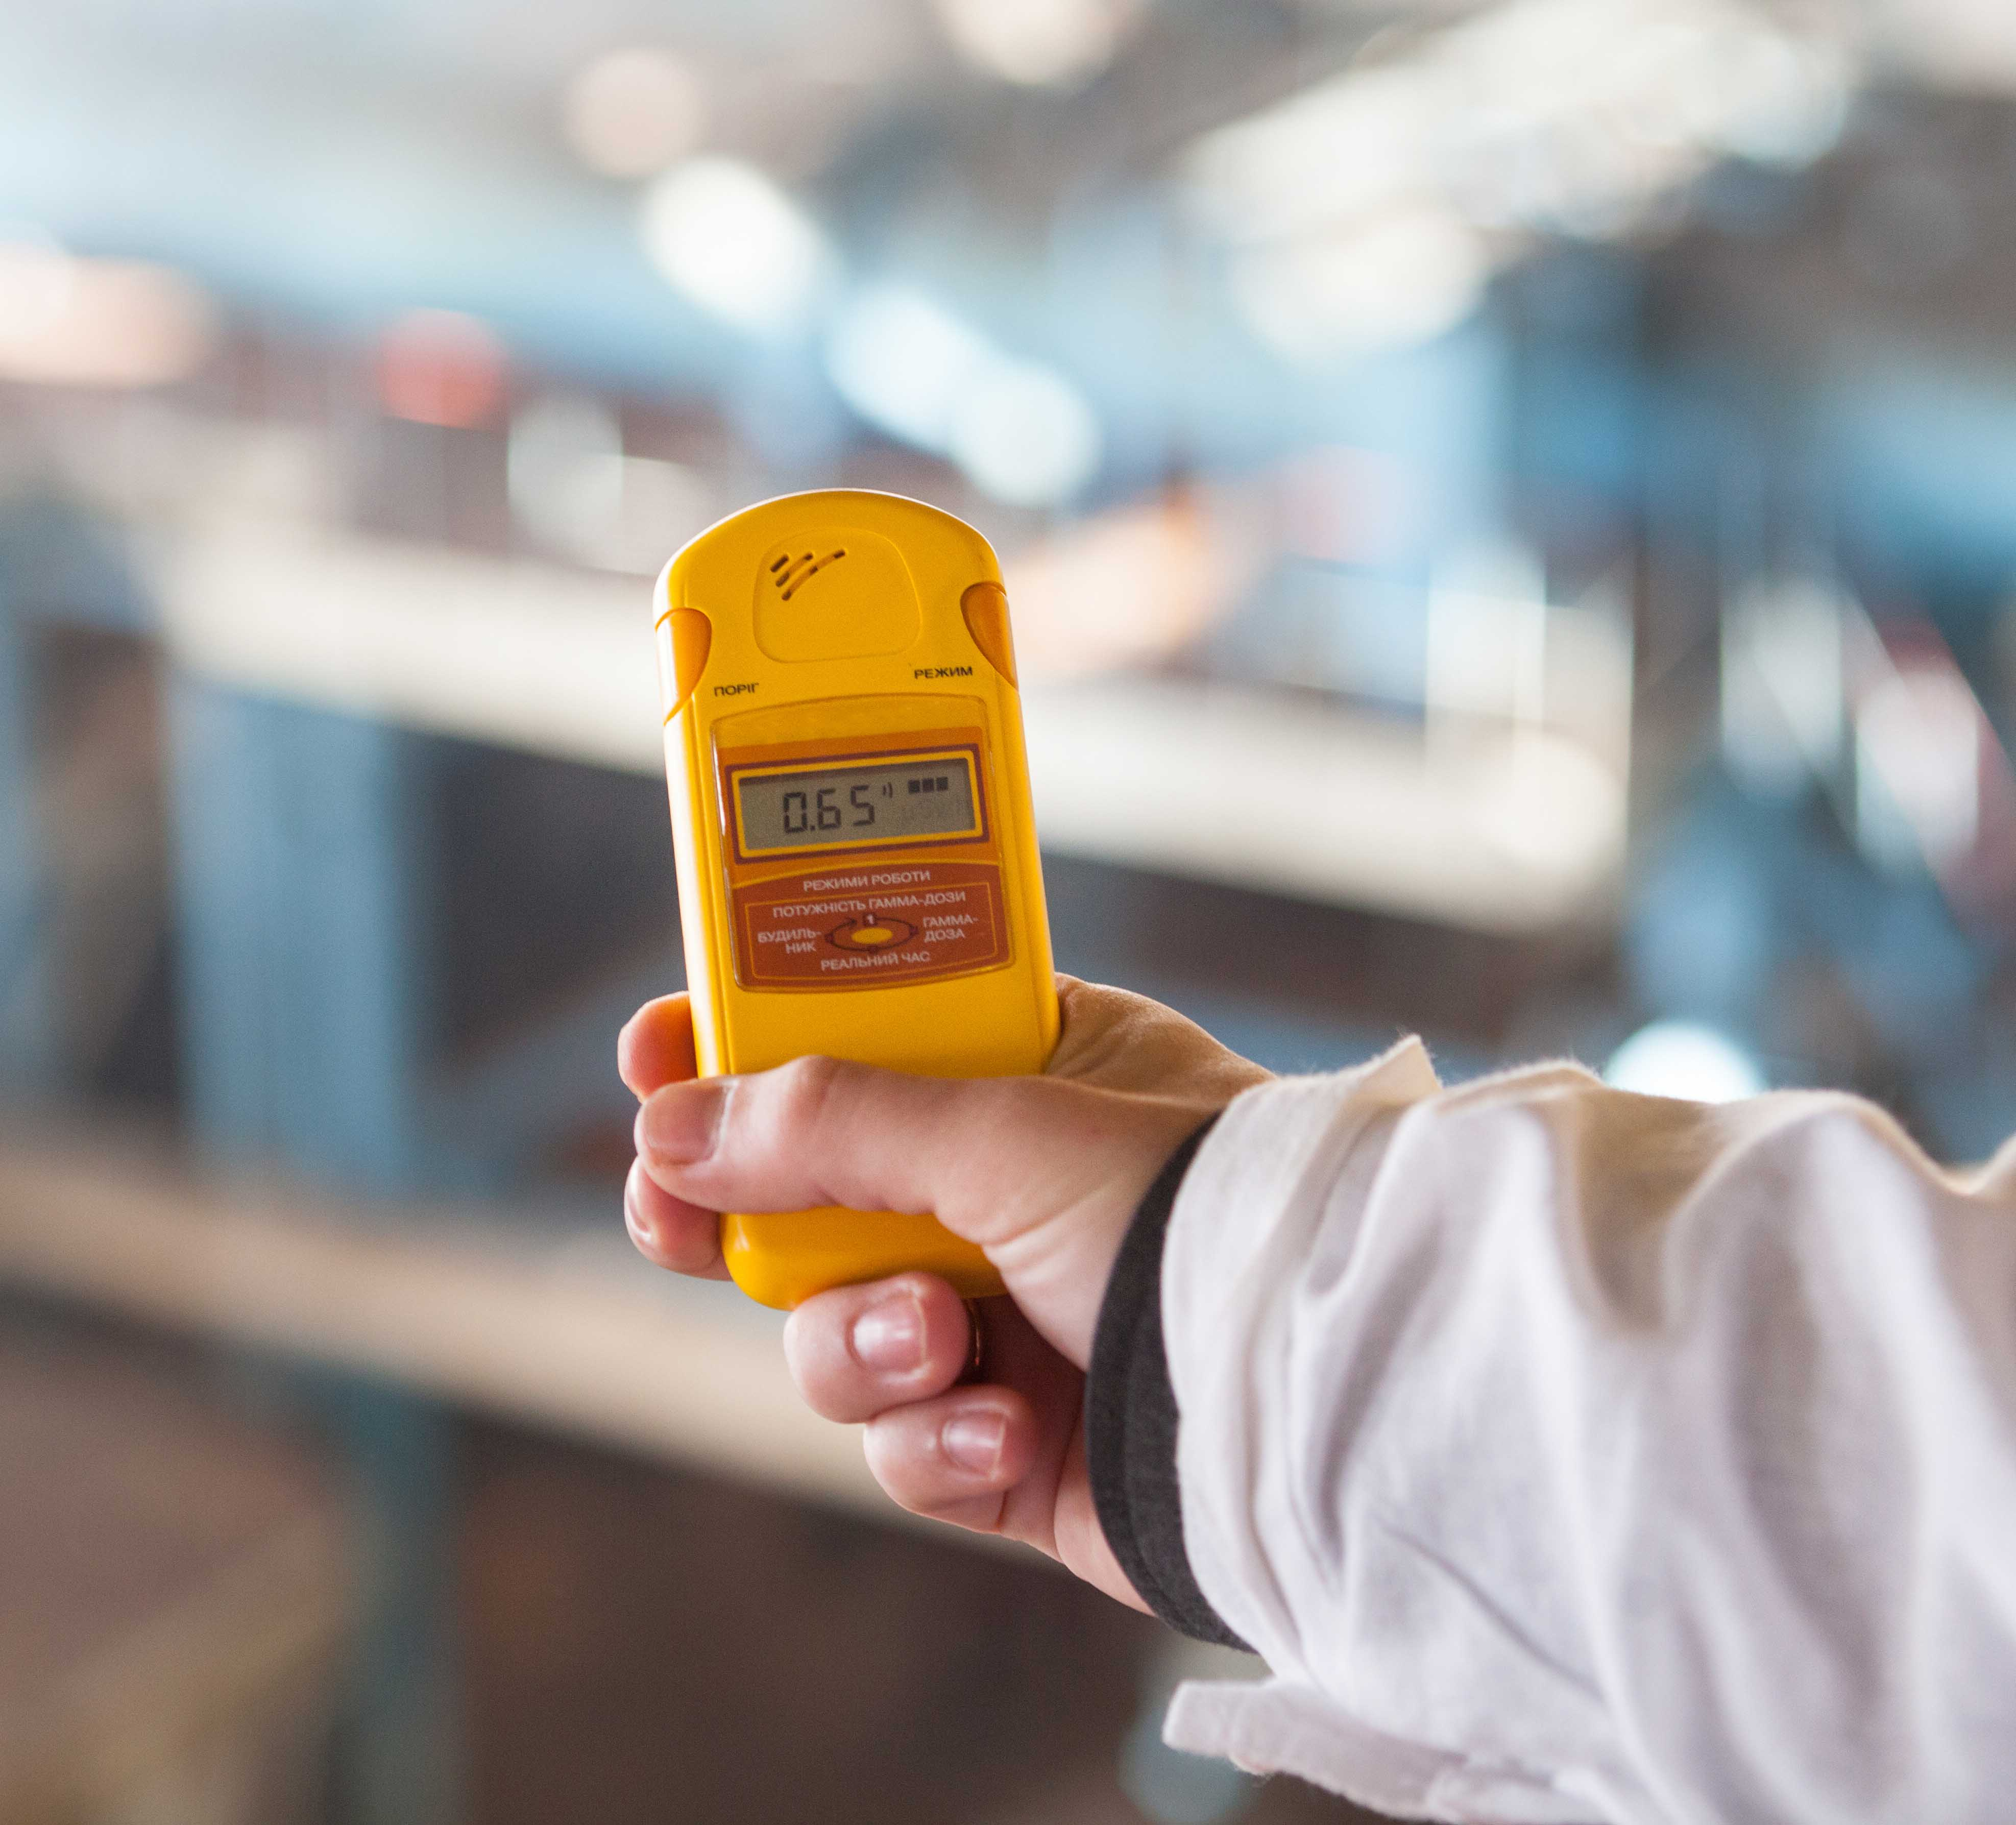
Lesson Objectives
You will:
Describe the radiation we receive and identify relative risks.
Use a Geiger-Müller counter to detect radiation.
Analyze and communicate the science behind uses of radiation.

Slide 4
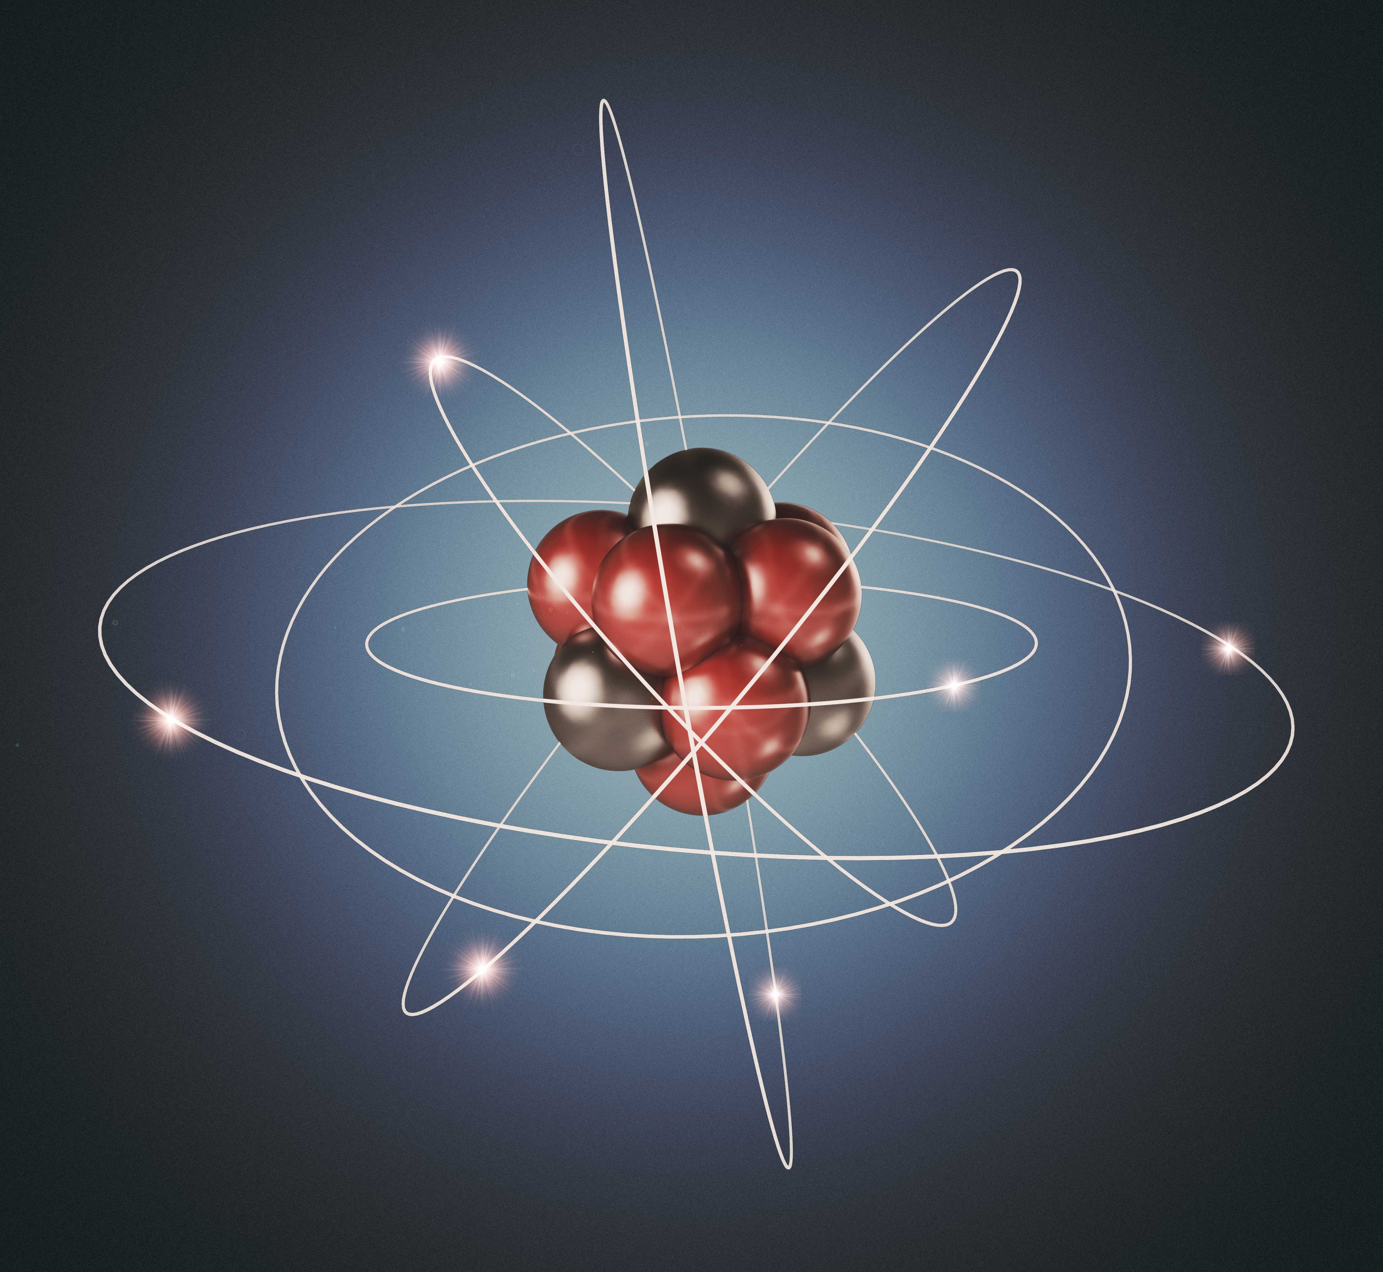
Background
Atoms make up all matter, and they are made up of smaller particles.
The atom has a nucleus.
The atomic nucleus consists of protons and neutrons. The number of protons determines the element.
An atomic nucleus can emit particles.
Electrons circulate around the nucleus.
Electromagnetic radiation is a form of energy traveling in waves, waves we can see – light – and waves we can’t see – X-rays and gamma rays. The wave is determined by the energy.

Slide 5
Myths of Measuring Radiation
Think-Pair-Share:
What is radiation?
What are some risks associated with radiation?
What are some benefits of radiation?
How can we detect radiation?

Slide 6
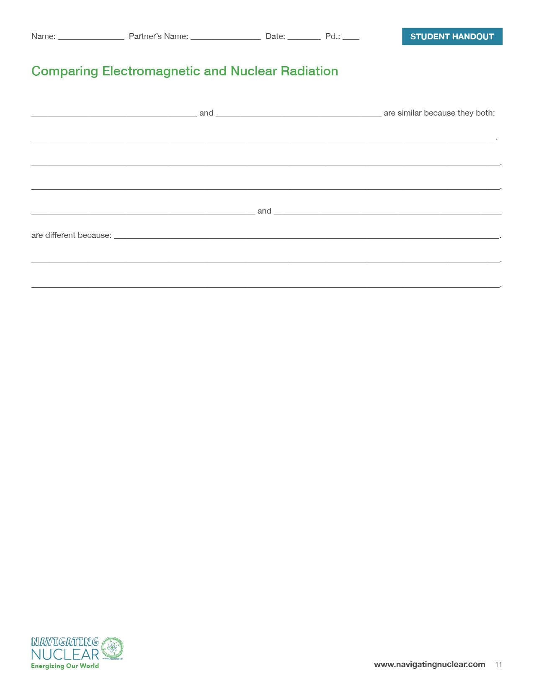
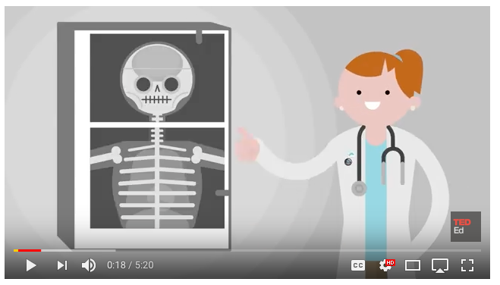
Electromagnetic Radiation and Nuclear Radiation

Slide 7
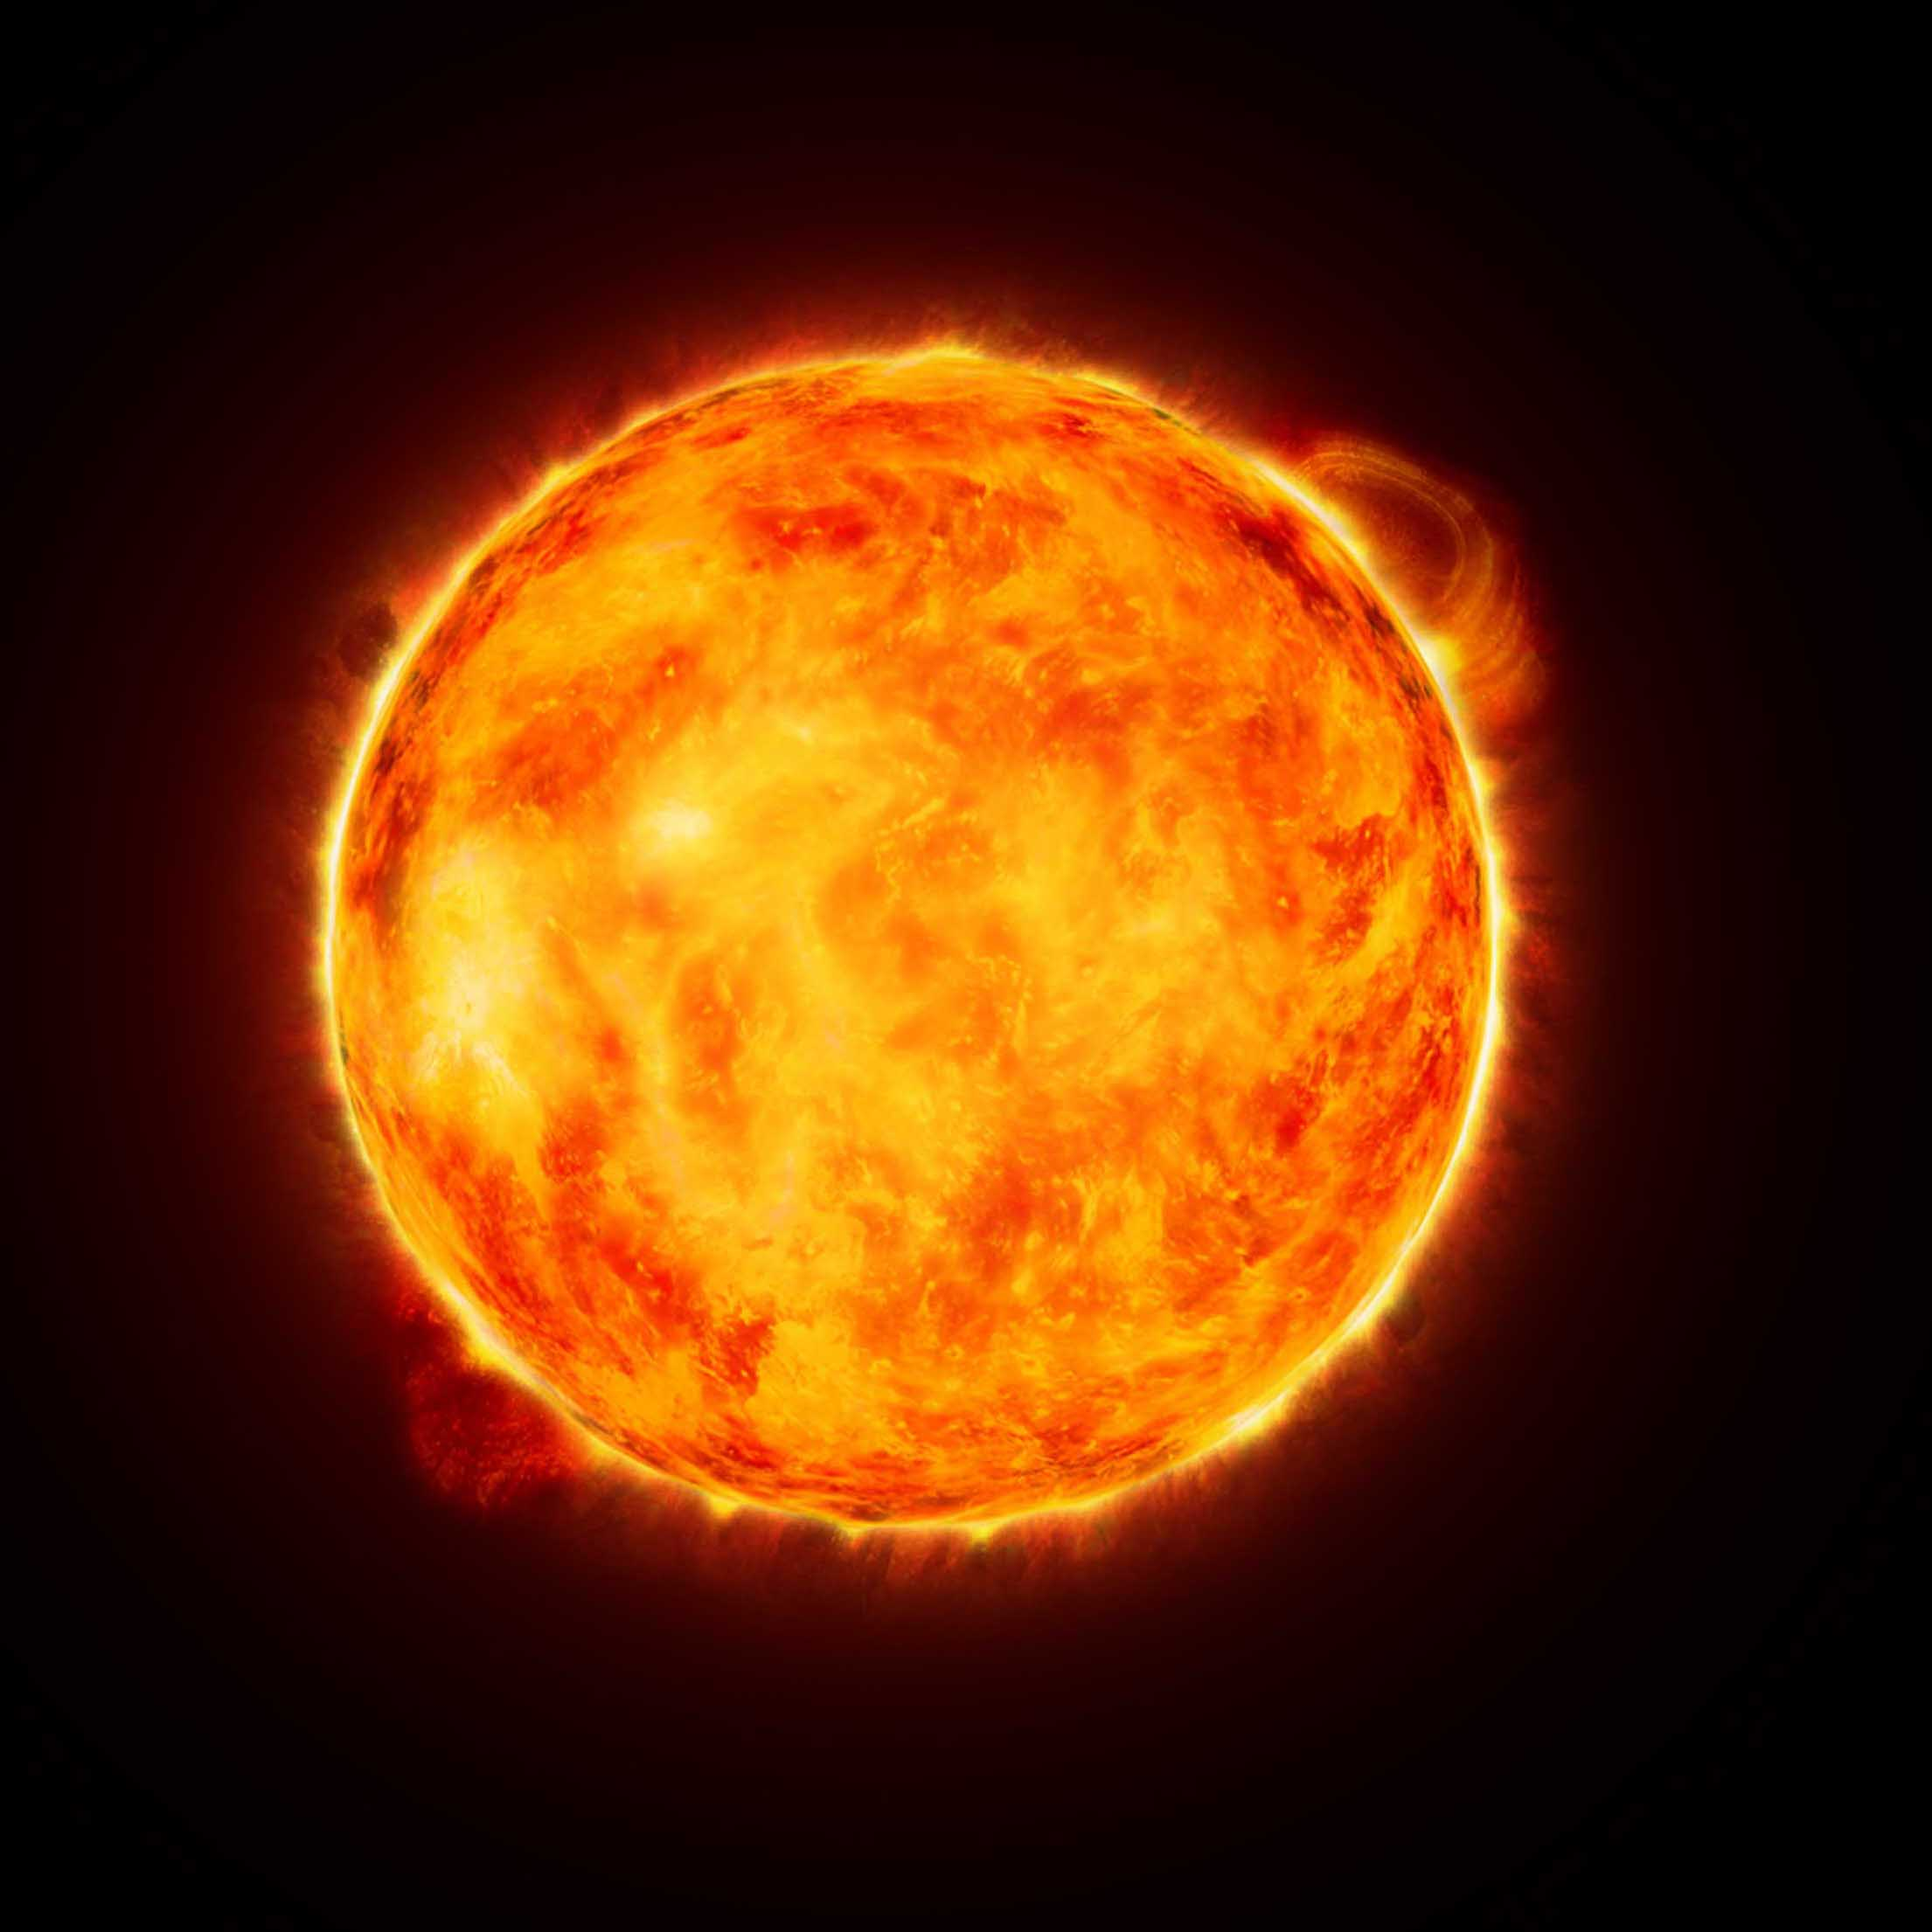
Electromagnetic Radiation and Nuclear Radiation
Radiation is energy that can travel as a wave or stream of particles.
Electromagnetic radiation is a form of energy that travels in waves.
Nuclear radiation originates in the atomic nucleus. It is energy or particles that come out of a nucleus.

Slide 8
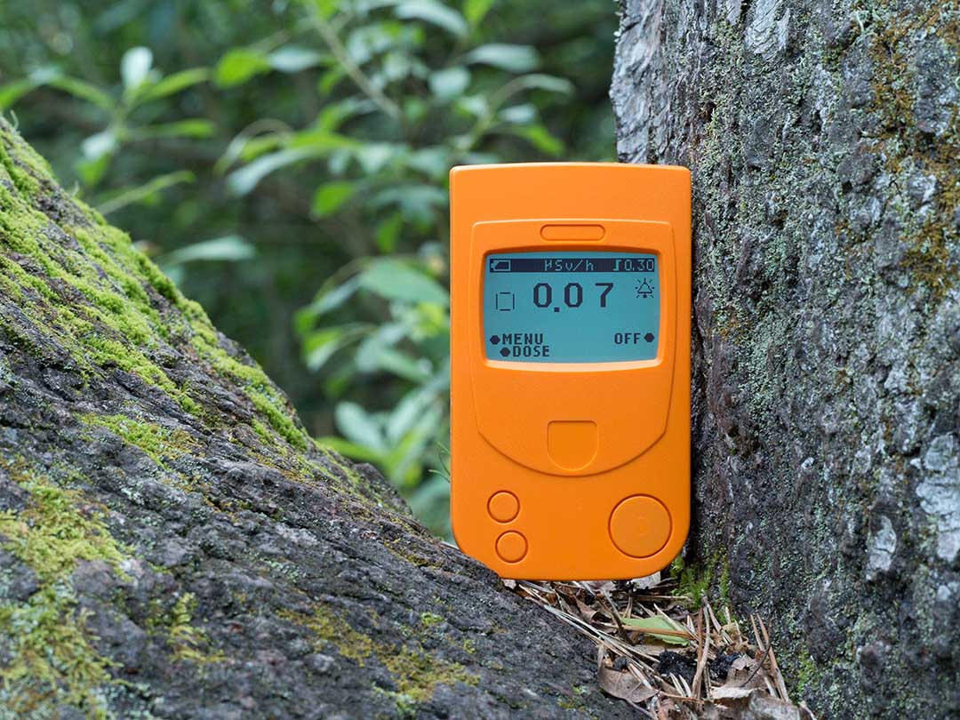
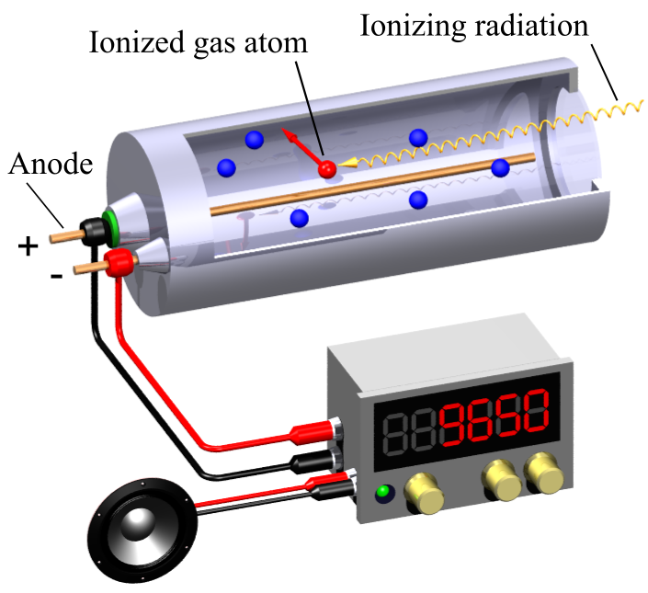
Detecting Radiation
Geiger-Müller counters detect and measure ionizing radiation.
The ionizing radiation enters a chamber that is filled with gas.
When the radiation strikes one of the gas particles, it strips off electrons.
The electrons move onto a wire and down the wire to the detector, which registers the surge of electrons.
The detector registers this as a radiation event.

Slide 9
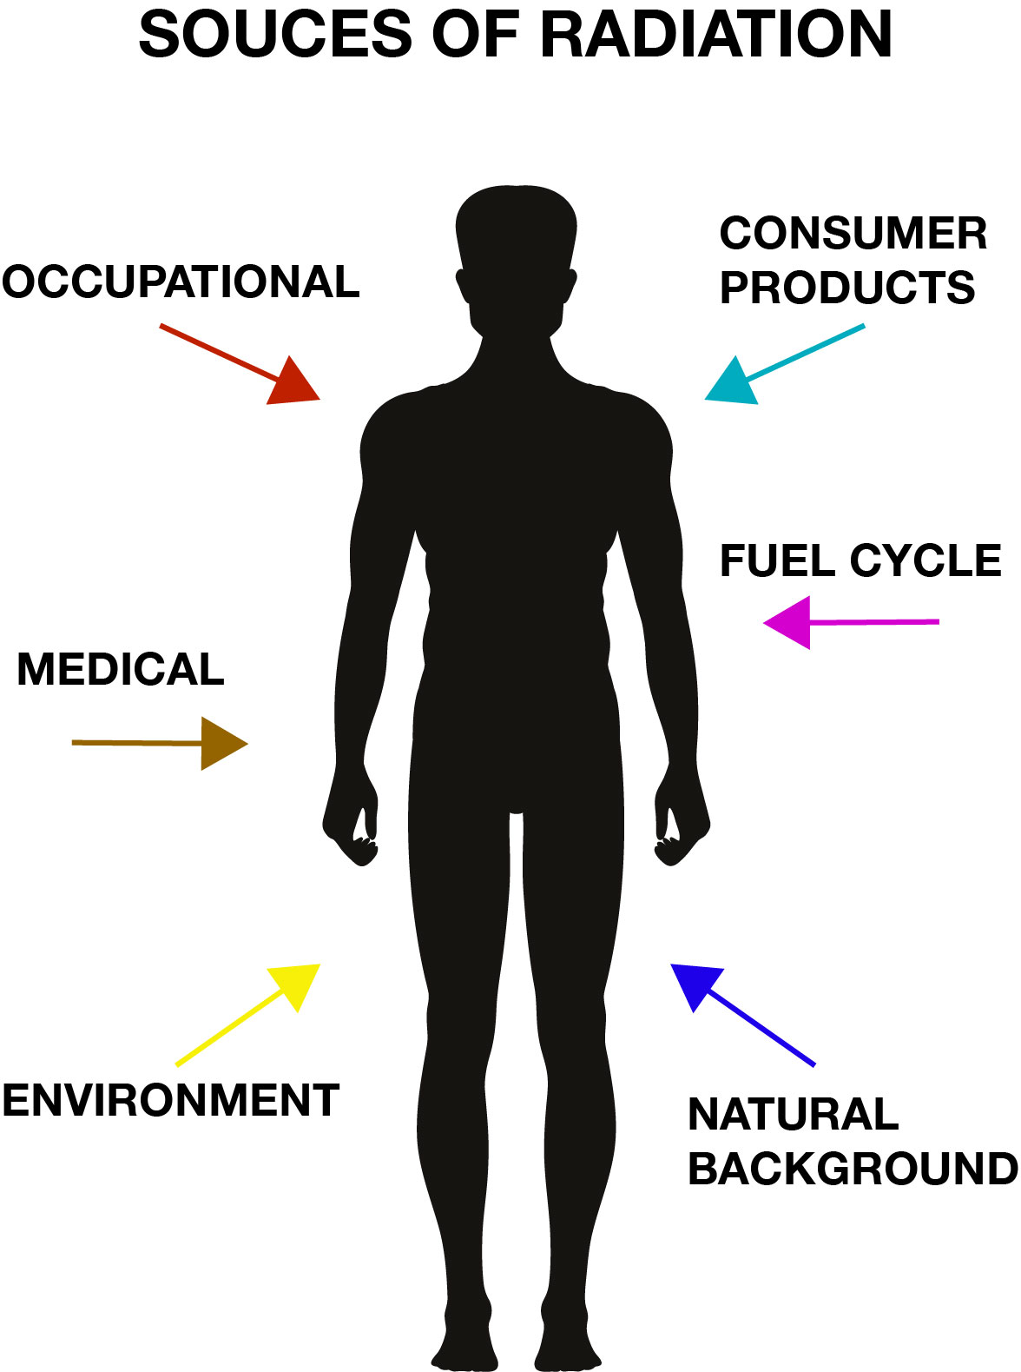
Common Sources of Radiation
Natural background
Radon
Ground
Cosmic Rays
Environment
Stone homes
Granite countertops
Medical
X-rays and gamma rays
Radiation therapy
Radionuclide imaging
Occupational
Consumer products
Food
Smoke detectors
Energy

Slide 10
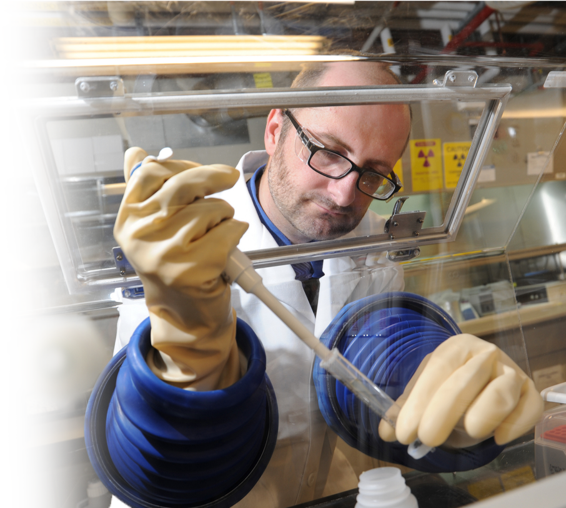
Safely Handling Radiation
All radiation can be dangerous if exposed to it for a long time at close range with no protection. Even non-ionizing radiation like the radiation from the sun can be harmful.
Alpha and beta radiation generally do not get into our bodies because it cannot penetrate the skin. However, they can be harmful when the sources of alpha and beta radiation are breathed in or ingested. Hence, breathing masks are essential.
Gamma radiation and other high-energy photons are best avoided by using thick, dense walls.

Slide 11
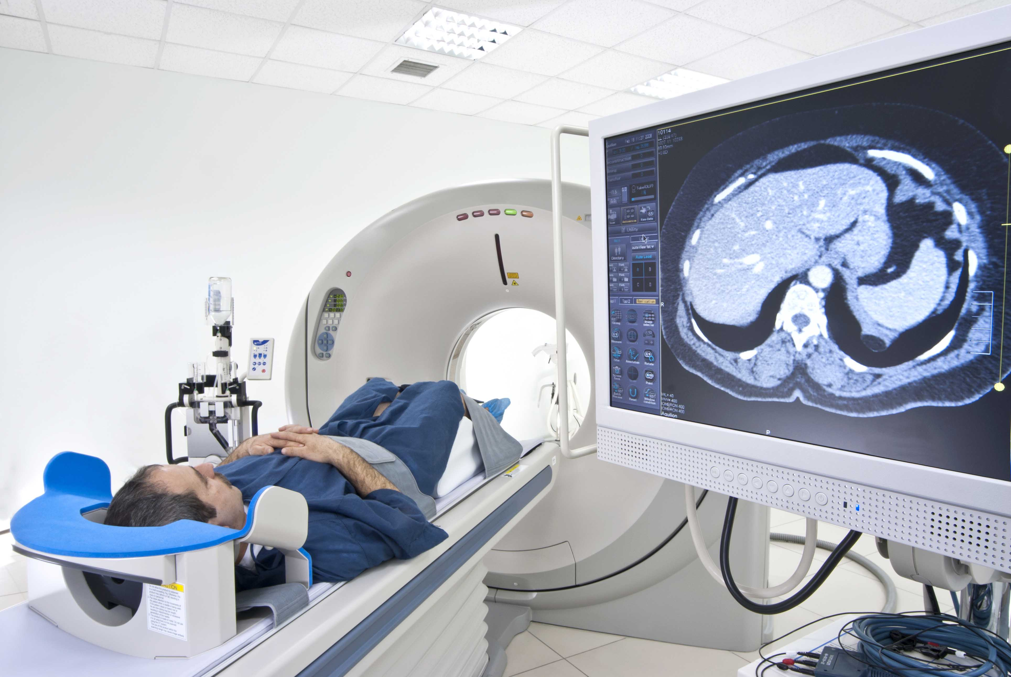
Nuclear Medicine
Nuclear medicine can be used as a direct form of treatment as in radiation therapy. Radiation is directed to cancer cells to destroy them.
Radiation is often used in imaging, such as X-rays.
Radiation can also be used indirectly to image cancer cells.
Because cancer cells use a larger amount of sugar than normal cells, if you could detect where sugar is being most frequently used, you could detect the cancer. A radioactive form of sugar can be made. When it is absorbed by the cancerous tumors, the radiation emitted can be detected and the tumors can be located.

Slide 12
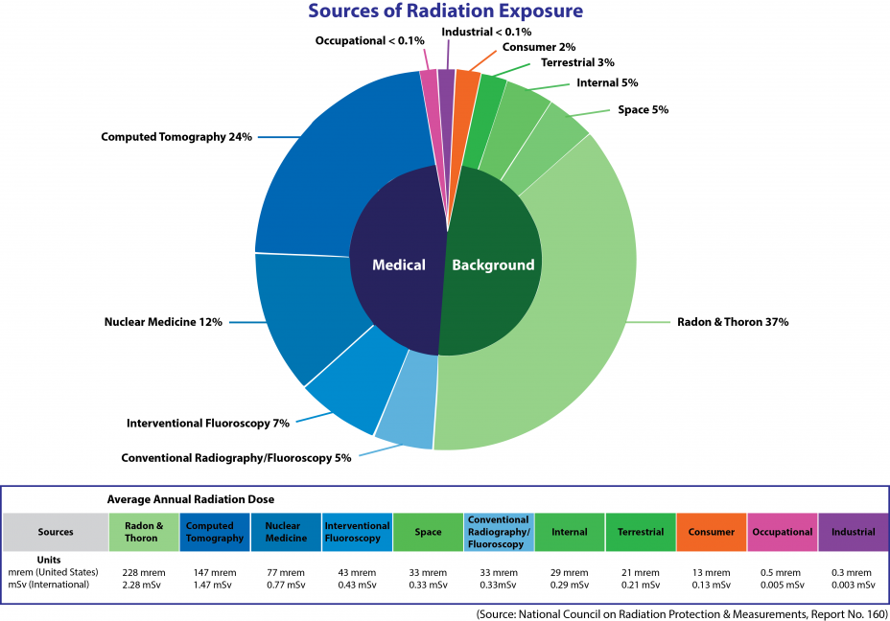
Data on Sources of Radiation

Slide 13
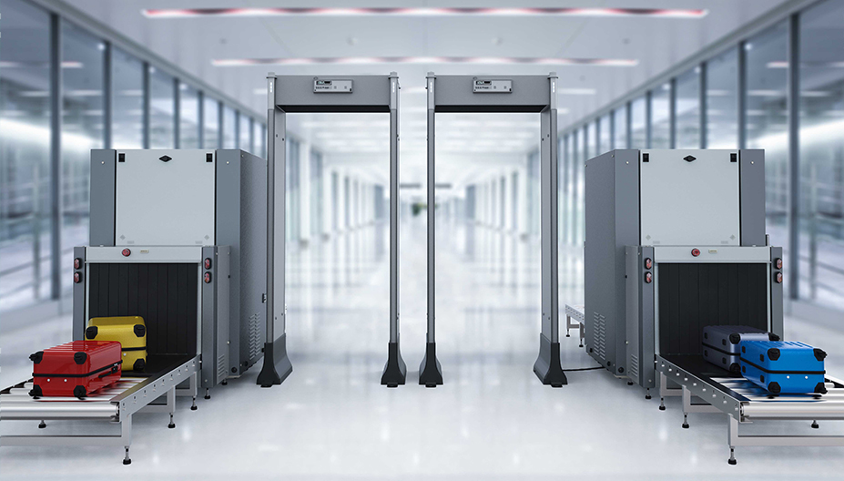
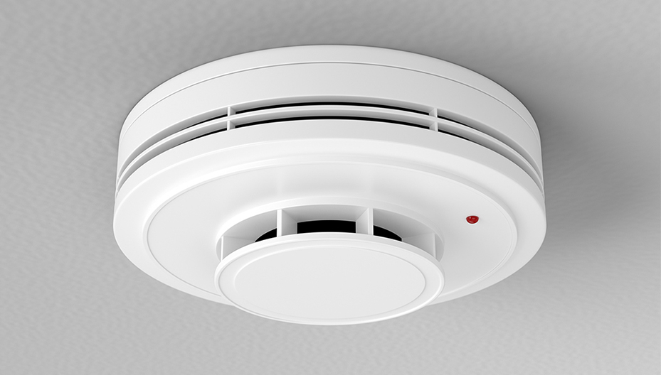
Using Different Types of Radiation
Smoke detector
Scanning technologies used at ports and airports
Smoke detectors

Slide 14
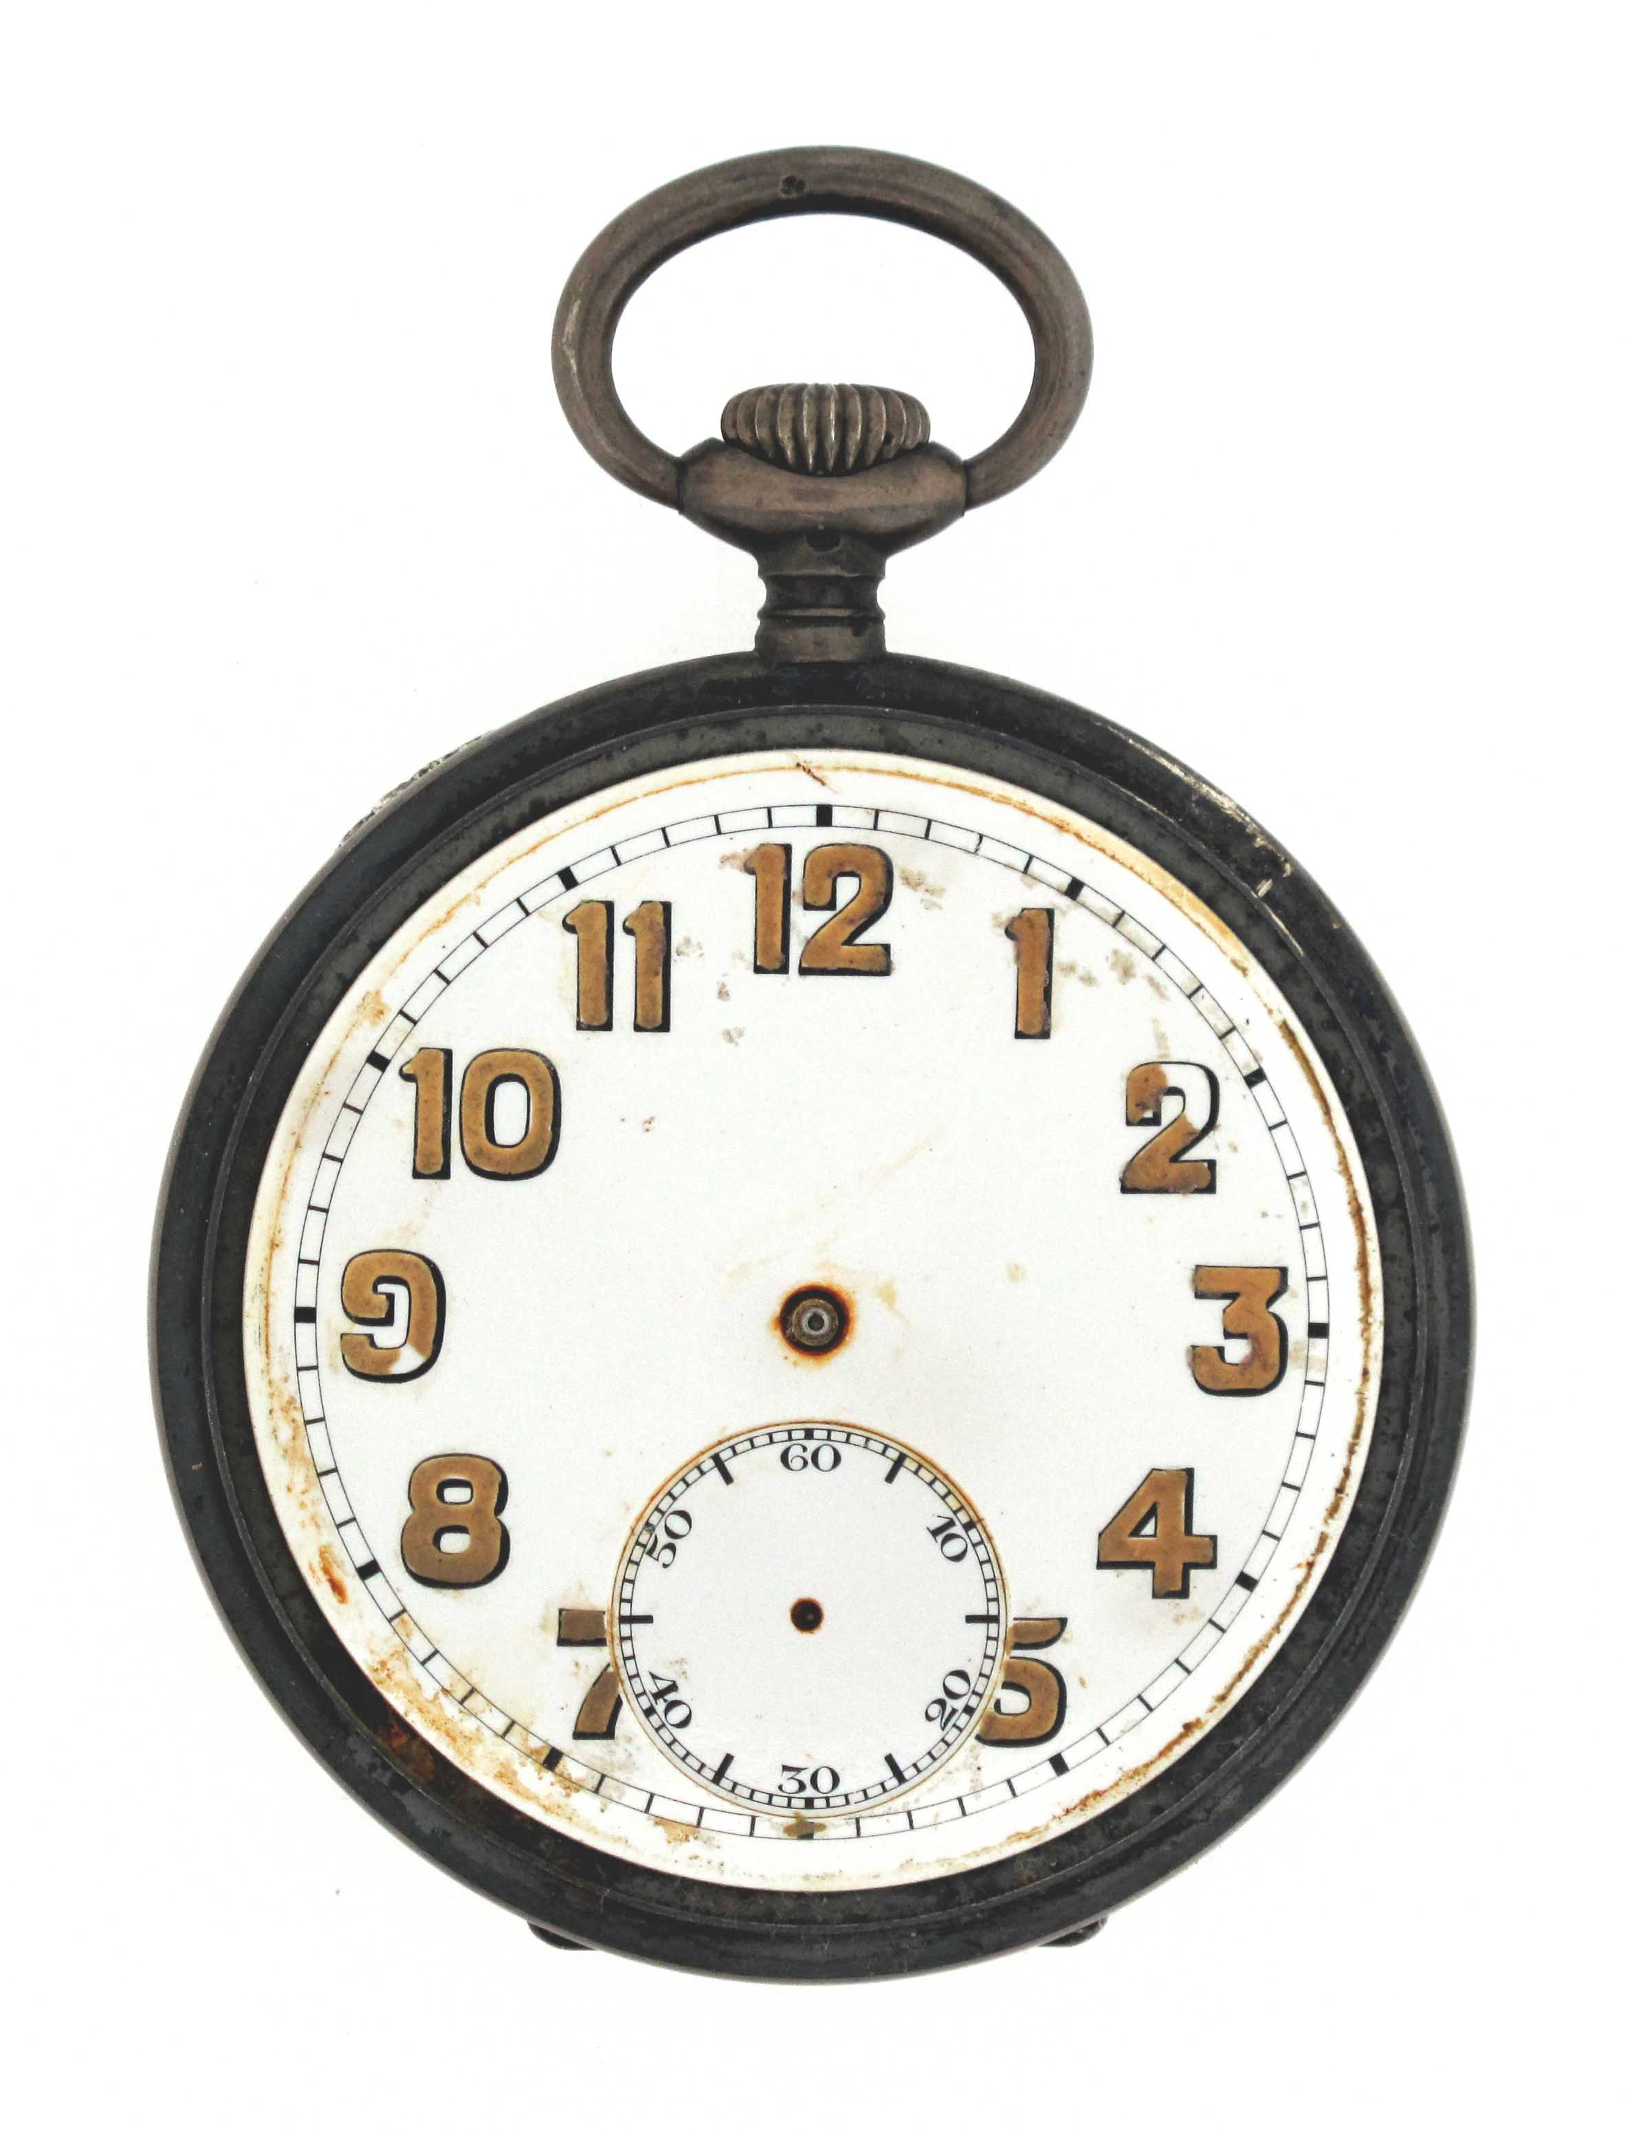
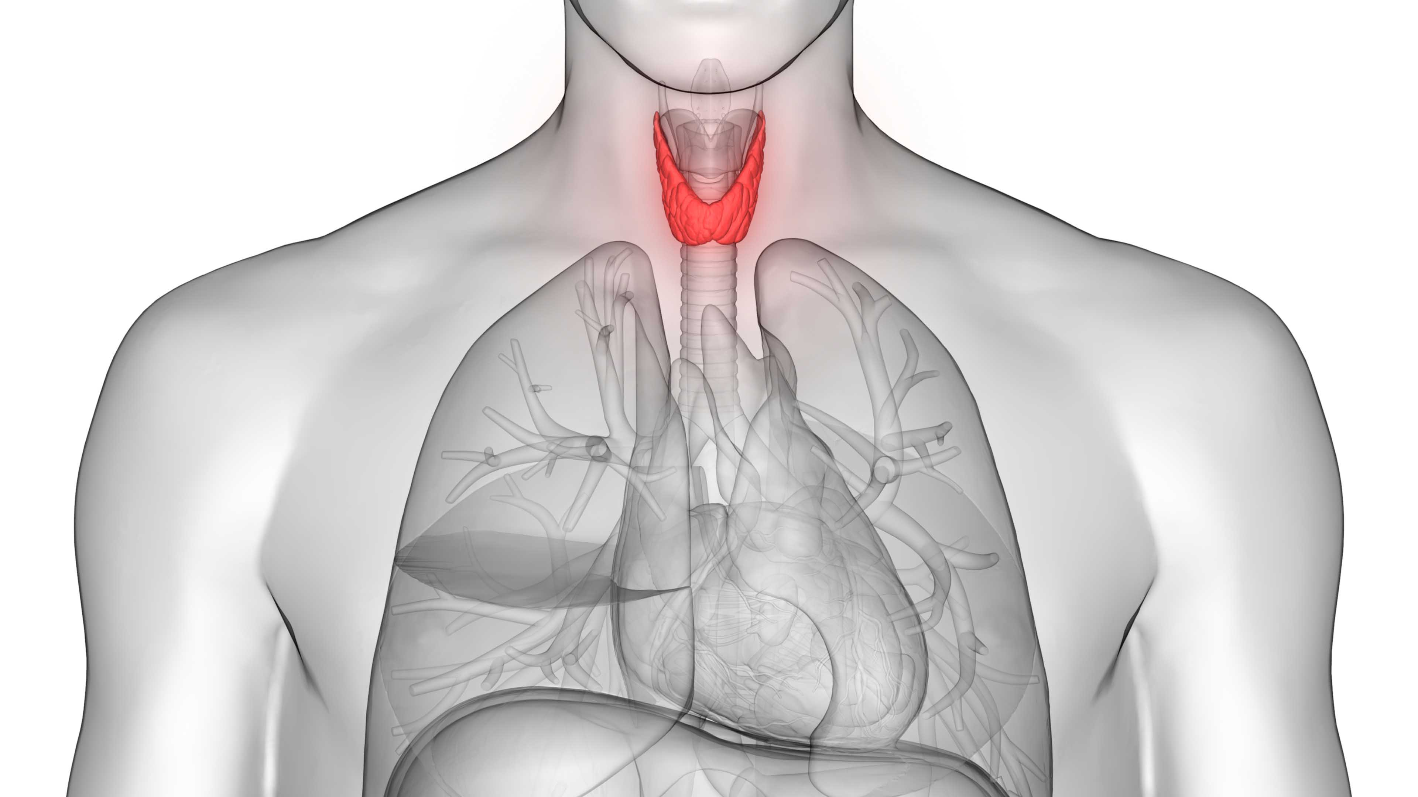
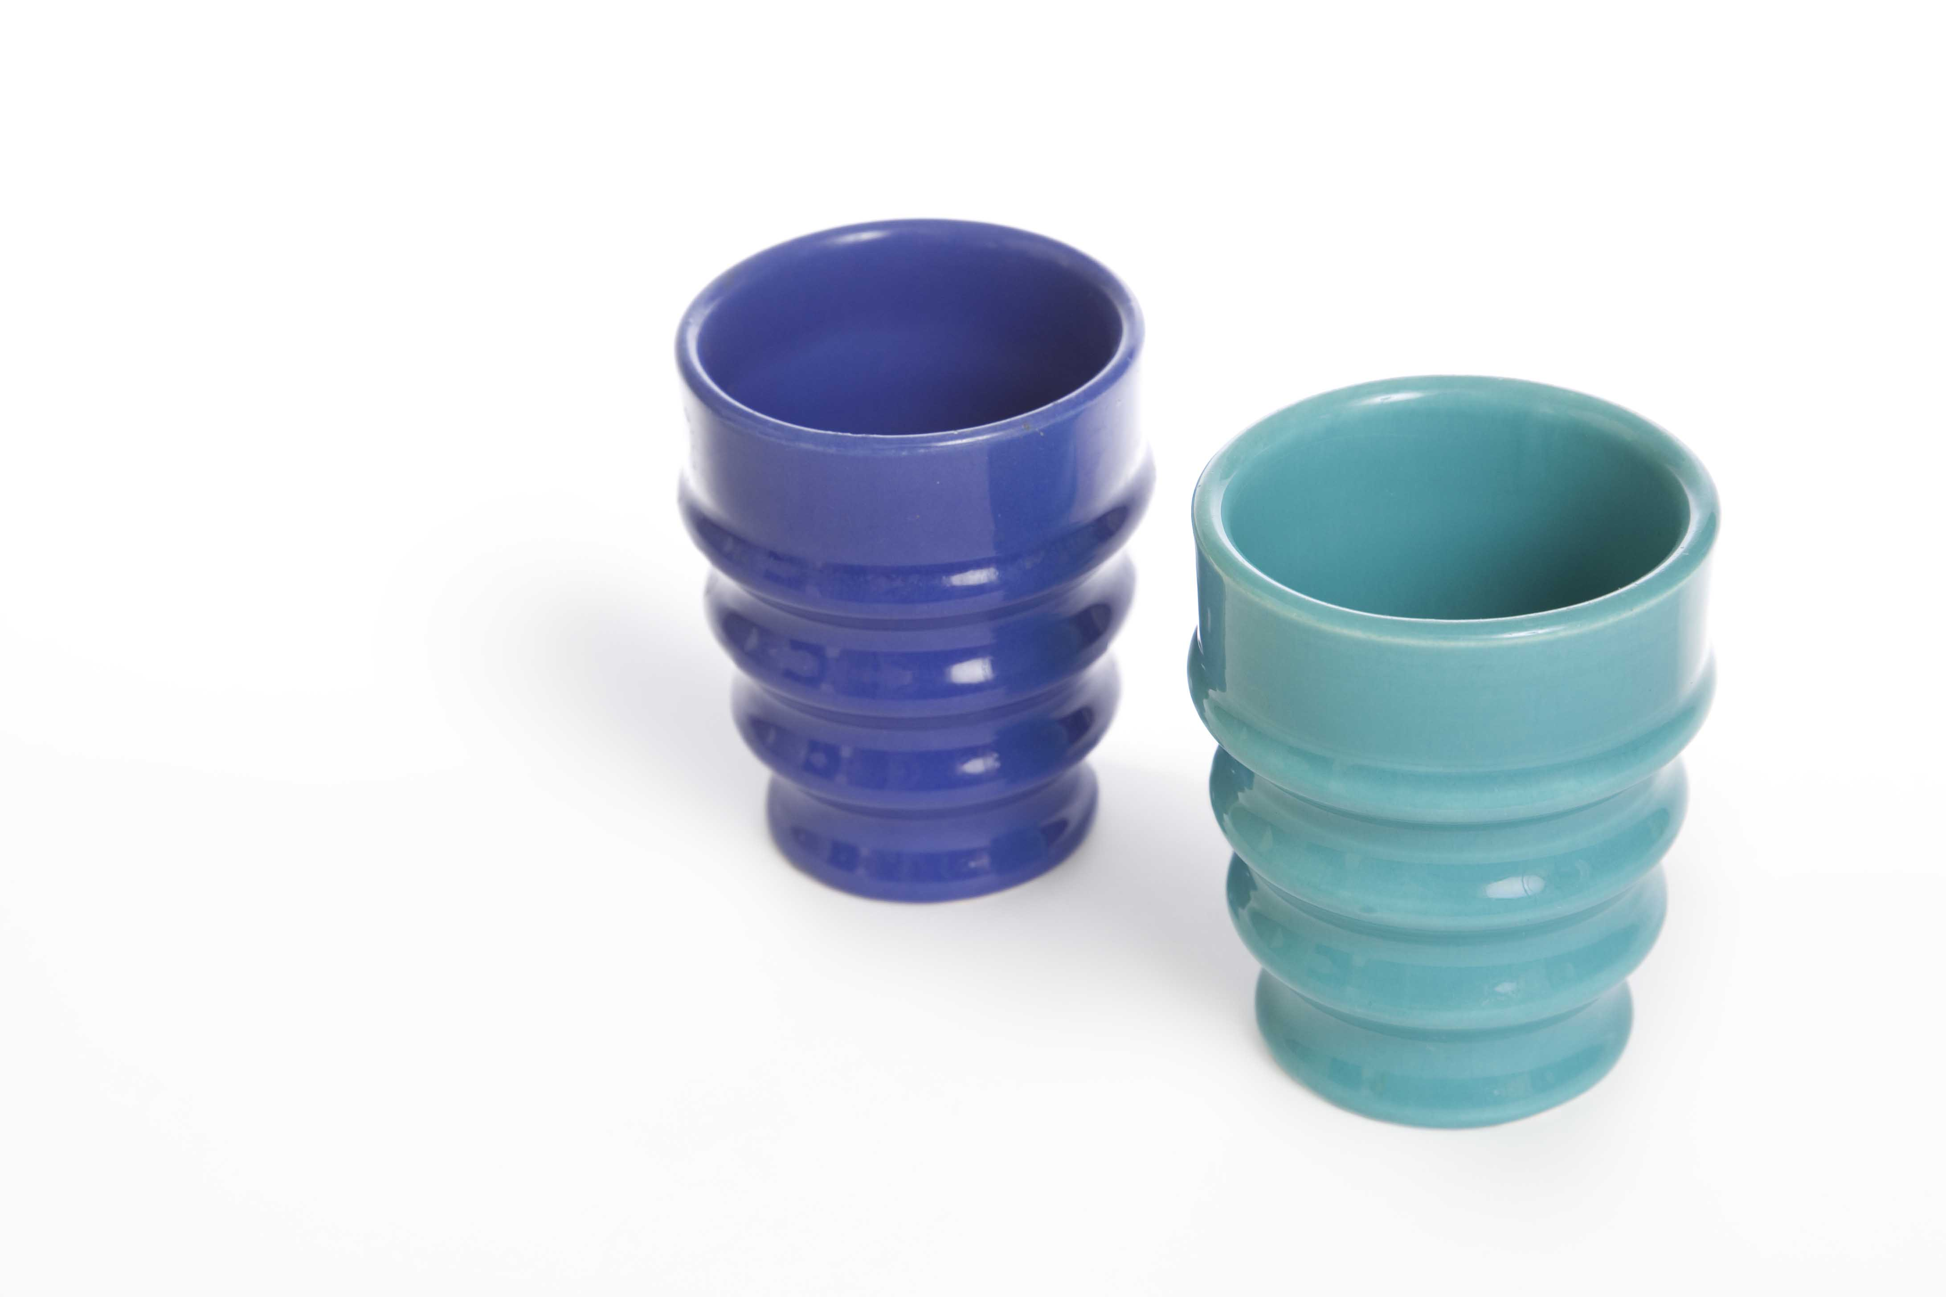
Radiation Case Studies
Radium dial painters
The thyroid and nuclear medicine
Radioactive consumer goods and dishes

