Slide 1
Nuclear Power
Fission, Fusion and the Future
Name
Title
Affiliation

Slide 2
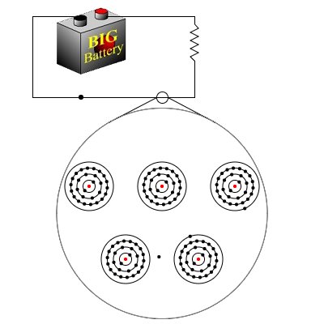
What is electricity?
Mathematically
=
flow of charged particles
Practically
=
flow of electrons (they move faster)
Electrons
flow through conductors
Notes:
Suggest to teachers that they review with their students how electricity is made as many will have learned about it much earlier in their schooling.

Slide 3
Electricity
If you move a conductor through a magnetic field, electric current is produced.
If you move a magnetic field through a conductor, electric current is produced.

Slide 4
Generator
Simply a magnet surrounded by conductors
Magnet
Notes:
Generator converts mechanical energy (input) from an external source into electrical energy (output).
Generator doesn’t create electricity. It moves a magnet near a source of electrons, such as a copper wire, to create a steady stream of electrons

Slide 5
Generator
You have to spin the generator.
  For a power plant, generators are huge and heavy.
  A lot of energy is needed to spin the generator.
  You have to create rotational motion.

Slide 6
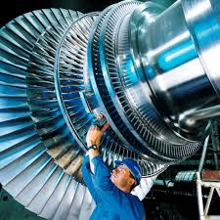
Turbine
A turbine is a device that takes energy from a source and turns it into rotational motion, which turns the generator.
  Basically, it is a large, fancy fan.
Notes:
The turbine moves the generator. All electricity production that depends on a turbine needs a way to move the turbine. So what moves the turbine?

Slide 7
Steam turbine
Most power plants use steam to spin the turbine
  The turbine gets its energy from both the flow motion of the steam and the energy released from cooling the steam.
  Steam cycle advantages:
    Well-understood technology
    Water is relatively inexpensive and available
    Burnable fuel is readily available

Slide 8
Where does the steam come from?
Steam comes from boiling water
  Just like a tea kettle
Boiling occurs in the boiler
  Any heat source can be used
    Coal, Oil, Natural Gas
    Wood, Trash, Biomass
    Nuclear Fission

Slide 9
Nuclear Fission

Slide 10
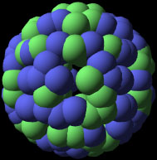
A nuclear power plant uses fission to create heat.
Steam
Generator
Steam produced
Turbine
Heat
Electricity
Notes:
It is this process—creating heat through the splitting of atoms—that turns water to steam. The steam is moved from the reactor to turn the turbine-generator, which makes electricity. All radioactive water stays within the reactor system and is not released into the environment.

Slide 11



Fission begins with neutrons
Neutrons
Uranium atom
Notes:
Fission is the release of energy by splitting heavy nuclei, such as U-235 and Plutonium-239. Fission requires overcoming the strong nuclear force which binds the protons and neutrons.
On start up, neutrons are released and strike the uranium atom. The impact splits the uranium atom, causing it to fission into two or three lighter atoms and two or three neutrons.

Slide 12
Fission releases energy in the form of heat
Heat
Neutrons
Notes:
Breaking the binding force releases a great deal of energy.
See if teachers can guess comparison of uranium to coal
8 kWh of heat can be generated from 1 kg of coal
approx. 12 kWh from 1 kg of mineral oil
around 24,000,000 kWh from 1 kg of uranium-235.

Slide 13
The products of nuclear fission
Two lighter elements
2-3 neutrons
Gammas
≈200 MeV per fission
Notes:
Note that the lighter elements (large pieces in the previous slide) are entirely new elements, not just chunks of uranium. Lighter isotopes may include Cesium-137, Strontium 90, Xenon 140, etc.

Slide 14

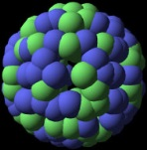

The Chain Reaction
Notes:
The neutrons released strike other uranium atoms, causing them to fission. This continues in a chain reaction, like dominos falling.
Neutrons are fast, so a moderator is used. Moderator slows neutrons to ensure they strike ²³⁵U atoms, continuing the chain reaction
Control rods keep the reaction in check. Reactor operators raise or lower them depending on the need.
When the reaction is self-sustaining, the reactor has achieved criticality.

Slide 15
Modeling fission
Notes:
Assign teachers a few minutes to devise methods of modeling fission and chain reaction. Models can be kinesthetic, manipulatives, drawings, etc. Have a variety of materials available such as balloons, balls, paper, dominos, etc.
Share ideas.

Slide 16
Nuclear reactor
Essential components
  Fissile Fuel (usually enriched uranium)
    Fissions upon absorption of thermal neutron to create heat
  Moderator
    To moderate, or slow, the speed of the fast neutrons
    Made of a material that will scatter neutrons
    H₂O and graphite most common
  Coolant
    Takes heat from reactor fuel core to make steam to make electricity
  Control
    Typically composed of neutron absorbers e.g. boron and cadmium
Notes:
Teachers may wonder what a moderator is and how it is different from the control rods. Moderator is necessary to make sure neutrons strike the uranium atoms. Control rods absorb the neutrons to prevent them from striking the uranium.

Slide 17
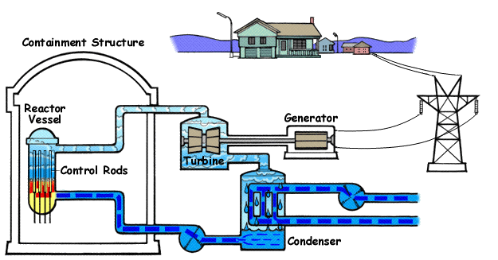
Boiling water reactor
Notes:
Describe how a reactor works using the boiling water reactor first, as it’s often more easily understood than the pressurized water reactor.
The images on this slide and the next are flash animations when in slide show mode.

Slide 18
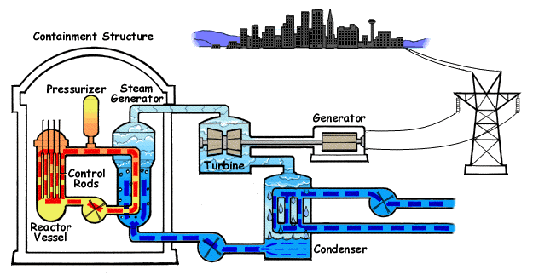
Pressurized water reactor
Notes:
Describe how a pressurized water reactor differs. Ask why pressurize the water?

Slide 19
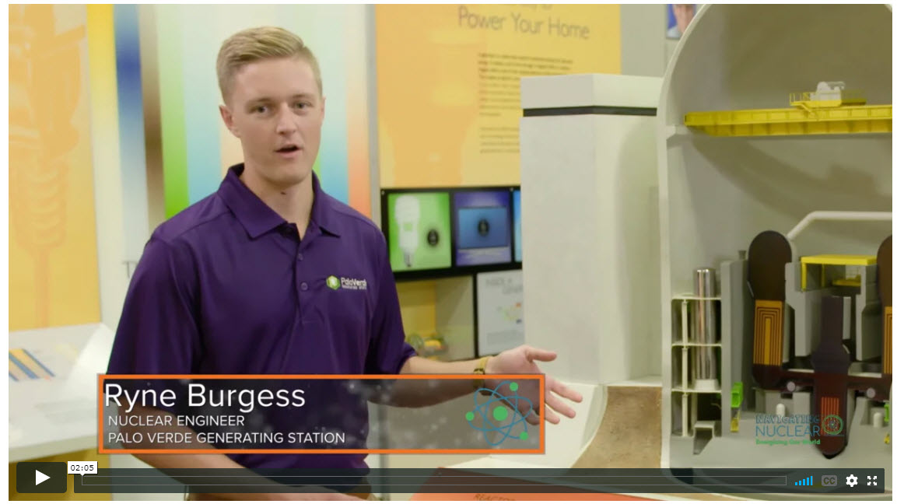
Nuclear energy explained
Notes:
Ryne Burgess, a nuclear engineer at the Palo Verde Generating Station explains the steps in creation of nuclear energy. This clip is a segment from a virtual field trip of the Palo Verde Station created for ANS’s K-12 nuclear energy education program: Navigating Nuclear: Energizing Our World. Clicking on the photo will take you to the virtual field trip page on navigatingnuclear.com. You will need to scroll down the page a little to find the “Nuclear Energy Explained” segment.
You may also choose to show the entire virtual field trip, which is a behind the scenes tour of the largest nuclear power plant in the United States.
Delete this slide if you do not have an internet connection.

Slide 20
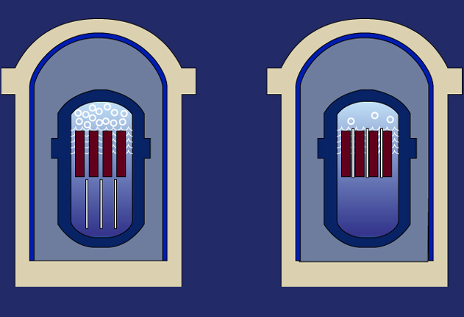
Controlling the chain reaction
Fuel
assembly
Control rods
Withdraw control rods, reaction increases
Insert control rods, reaction decreases
Notes:
Long rods, made of silver, indium or cadmium, are inserted among the fuel assemblies. These "control rods" are made to absorb neutrons, so the neutrons can no longer hit atoms and make them split. To speed up the chain reaction, plant operators withdraw the control rods, either partially or fully. To slow it, they insert the control rods.

Slide 21
Name that energy
Notes:
Distribute worksheets from Navigating Nuclear: Energizing Our World lesson on nuclear energy. Have teachers label the type of energy (potential, kinetic, thermal, etc.) involved in each step of the nuclear reactor. You’ll find the worksheet for this activity in the Educator Guide for the Navigating Nuclear: Energizing Our World lesson Nuclear Energy.
https://www.navigatingnuclear.com/#/classroom-resources

Slide 22
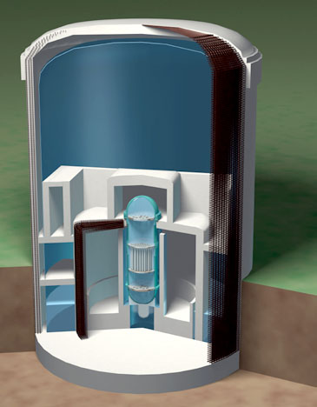
Safety is engineered into reactor designs
Containment vessel
1.5-inch thick steel
Shield building wall
3 foot thick reinforced concrete
Dry well wall
5 foot thick reinforced concrete
Bio shield
4 foot thick leaded concrete with
1.5-inch thick steel lining inside and out
Reactor vessel
4 to 8 inches thick steel
Reactor fuel weir wall
1.5 foot thick concrete
Notes:
Nuclear power plants use a series of physical barriers to make sure radioactive material cannot escape. In today’s water-cooled reactors, the first barrier is the fuel itself: the solid ceramic uranium pellets. Most of the radioactive by-products of the fission process remain inside the pellets. The pellets are sealed in zirconium rods, 12 feet long and half an inch in diameter. The fuel rods are placed inside a large steel reactor vessel, with walls 8 inches thick. The vessel is surrounded by 3 feet of concrete shielding. At most plants, a leak-tight steel liner covers the inside walls of the containment building. The containment building is a massive, reinforced concrete structure with walls 4 feet thick.
Credit: https://slideplayer.com/slide/12471394/, Ethan Nichols

Slide 23
Nuclear Fusion

Slide 24
Fusion
  Opposite of fission
  Combines light nuclei elements
  Powers the sun and stars
  Hard to achieve on Earth
Notes:
Light nuclei element used is hydrogen

Slide 25
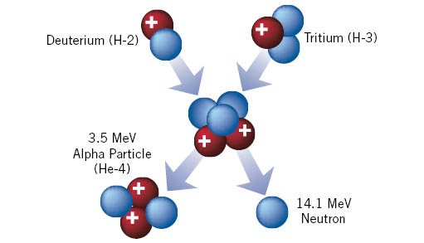
Basic fusion reaction
Notes:
Note that Deuterium and Tritium are isotopes of Hydrogen
Fusion reactions release 3-4 times more energy than fission reactions

Slide 26
Modeling fusion
Notes:
Give participants marshmallows and tell them to model fusion of hydrogen atoms using the marshmallows. Ask what they had to do to the marshmallows to make them fuse. (Apply pressure and heat to mash the marshmallows together. Some may develop another model, but pressure and heat are what is used in fusion reactors). Ask how they would expand on the activity in their classrooms.

Slide 27
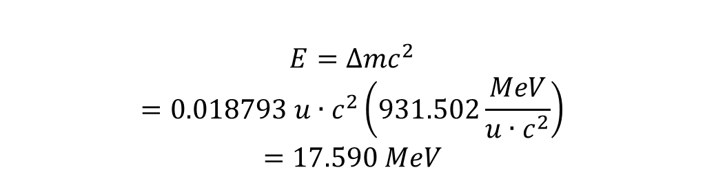
$$E=∆{mc}^{2}$$
$$=0.018793 u∙c^{2}\left(931.502\frac{MeV}{u∙c^{2}}\right)$$
$$=17.590 MeV$$
Neutron (n)
1.008665 u
Deuterium (D)
2.014012 u
Alpha (a)
4.002603 u
Tritium (T)
3.016049 u
5.030061 u
5.011268 u
Notes:
Explaining Einstein’s equation. This is fun for students who’ve probably heard the equation but never really knew that it applied to something useful they can relate to in everyday life.

Slide 28
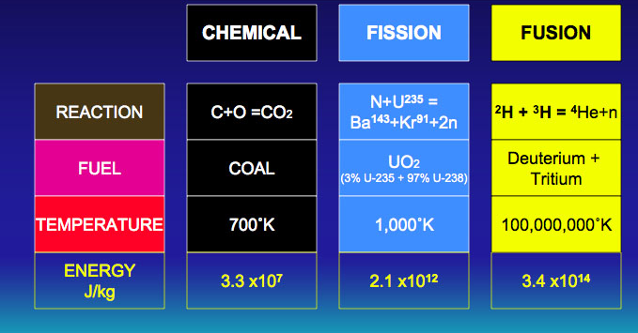
Compared to other sources
Notes:
At equal mass, fusion produces four million times more energy than a chemical reaction such as the burning of coal, oil or gas and four times as much as nuclear fission reactions

Slide 29
Creating fusion on Earth
Very high temperature (150,000,000°C)
High pressure
Plasma particle density
Confinement
Notes:
Three conditions must be fulfilled to achieve fusion in a laboratory: very high temperature (on the order of 150,000,000° Celsius); sufficient plasma particle density (to increase the likelihood that collisions do occur); and sufficient confinement time (to hold the plasma, which has a propensity to expand, within a defined volume).
Credit: ITER, https://www.iter.org/proj/inafewlines

Slide 30
What is plasma?
Electrons separate from nucleus
4th state of matter
SOLID
Ice
Cold
LIQUID
Water
Warm
GAS
Steam
Hot
PLASMA
Hotter
Notes:
At extreme temperatures, electrons are separated from nuclei and a gas becomes a plasma—often referred to as the fourth state of matter.
Fusion plasmas provide the environment in which light elements can fuse and yield energy. Sufficient plasma particle density increases the likelihood that collisions occur.
Credit: ITER

Slide 31
Characteristics of a plasma
Most atoms are ionized
Whole plasma is still neutral
Can exist at any temperature and density
Notes:
For a nuclear fusion reaction to occur, it is necessary to bring two nuclei so close that nuclear forces become active and glue the nuclei together. Nuclear forces are small-distance forces and have to act against the electrostatic forces where positively charged nuclei repel each other. This is the reason nuclear fusion reactions occur mostly in high density, high temperature environment.
Space – 100 K, 10⁶ electrons/m³
Earth’s Ionosphere – 2000 K, 10¹¹ electrons/m³
Fusion Experiment – 10⁹ K, 10²⁰ electrons/m³
Credit: ANS, nuclearconnect.org

Slide 32
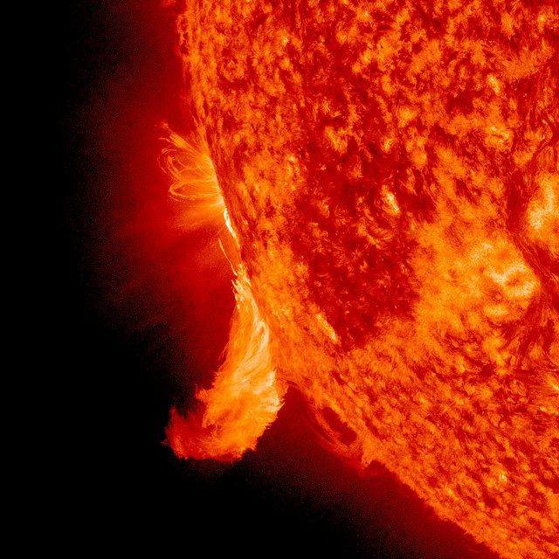
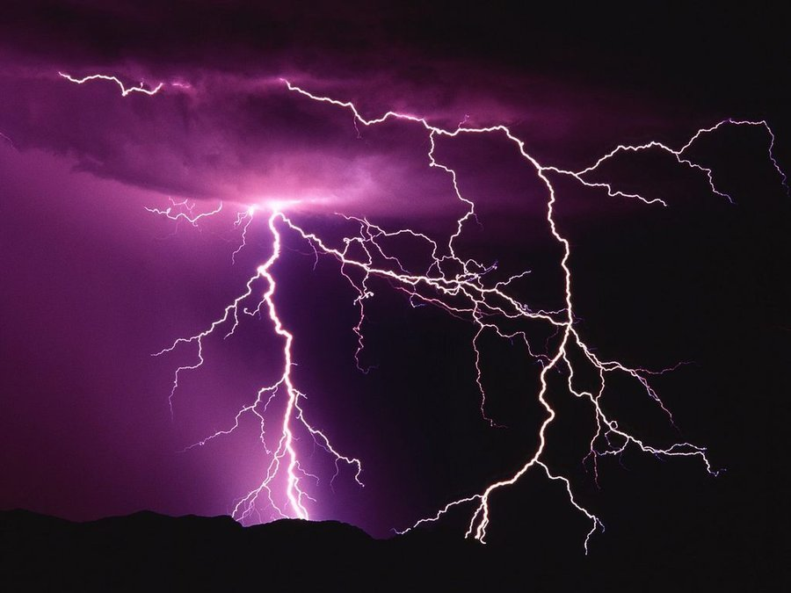
Familiar plasmas
Notes:
Lightning
Fluorescent light bulbs contain mercury plasma.
Stars, such as the sun are hot balls of plasma.
Aurora Borealis and Aurora Australis
Plasma displays for TVs use small cells of plasma to illuminate images.

Slide 33
What’s confinement?
Plasma likes to expand.
Confinement keeps the plasma stable so fusion can occur.
Notes:
The sufficient confinement time (to hold the plasma, which has a propensity to expand, within a defined volume). This is where the pressure is involved, like in the marshmallow model.
Plasma at millions of degrees for fusion
Need to hold in the material and the energy
Use some of the energy from one fusion event to keep the plasma hot

Slide 34
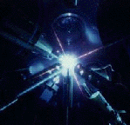
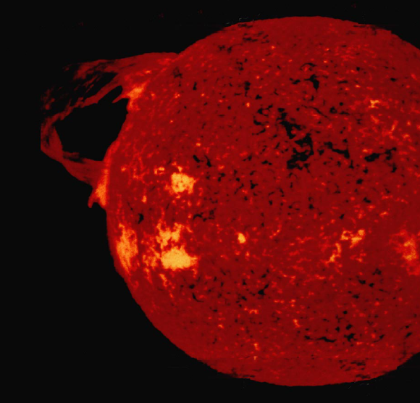
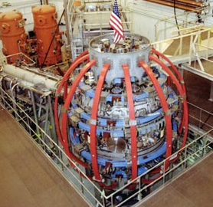
Confinement concepts
Inertial
Gravitational
Magnetic
Notes:
magnetic confinement the hot plasma particles are contained in a magnetic “cage” made by strong magnetic fields which prevent the particles from escaping.
Inertial confinement lasers or particle beams would be used to produce fusion at rates high enough that the inertia of the target material is sufficient to keep the fuel particles where they can fuse. (Beams or laser-produced X-rays rapidly heat the surface of the fusion target, forming a surrounding plasma envelope.)
Fuel is compressed by the rocket-like blowoff of the hot surface material.
During the final part of the capsule implosion, the fuel core reaches 20 times the density of lead and ignites at 100,000,000 ˚C.
Thermonuclear burn spreads rapidly through the compressed fuel, yielding many times the input energy.)
In stars, the confinement is due their gravitational field that creates sufficiently high pressure.
Credit: Dimensional Analysis Beyond the Pi Theorem, Bahman Zohuri
AND: NUPEX nuclear physics experience, http://nupex.eu/index.php?lang=en&g=textcontent/nuclearenergy/nuclearfusion

Slide 35
Overcoming Coulomb repulsion
Nuclei have positive charge & like charges repel
Accelerate atoms to high energy: 30-1000 keV
  accelerator
    used to produce neutrons and isotopes
  heat
    make atoms hot enough that their average random motion is
    at very high energy
    1 eV ≈11000 K
Notes:
At very high temperatures, electrons are stripped from atomic nuclei to form a plasma (ionized gas). Under such conditions, the repulsive electrostatic forces that keep positively charged nuclei apart can be overcome, and the nuclei of select light elements can be brought together to fuse and form other elements. Nuclear fusion of light elements releases vast amounts of energy and is the fundamental energy-producing process in stars.
In this case, the hydrogen nuclei fuse to form helium.
Credit: ANS, nuclearconnect.org

Slide 36
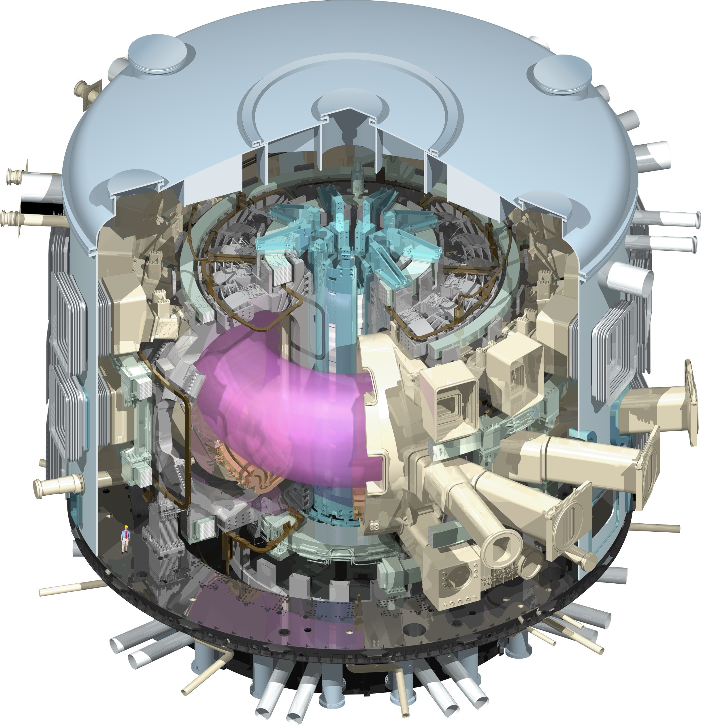
ITER tokamak reactor
Project launched 1985
Members
  China, the European Union,
  India, Japan, Korea, Russia,
  United States
Located in France
First plasma 2025
Deuterium-Tritium 2035
www.iter.org
Notes:
Inside, under the influence of extreme heat and pressure, gaseous hydrogen fuel becomes a plasma—a hot, electrically charged gas. In a star as in a fusion device, plasmas provide the environment in which light elements can fuse and yield energy.
The charged particles of the plasma can be shaped and controlled by the massive magnetic coils placed around the vessel; physicists use this important property to confine the hot plasma away from the vessel walls. The term "tokamak" comes from a Russian acronym that stands for "toroidal chamber with magnetic coils" (тороидальная камера с магнитными катушками).
To start the process, air and impurities are first evacuated from the vacuum chamber. Next, the magnet systems that will help to confine and control the plasma are charged up and the gaseous fuel is introduced. As a powerful electrical current is run through the vessel, the gas breaks down electrically, becomes ionized (electrons are stripped from the nuclei) and forms a plasma.
As the plasma particles become energized and collide they also begin to heat up. Auxiliary heating methods help to bring the plasma to fusion temperatures (between 150 and 300 million °C). Particles "energized" to such a degree can overcome their natural electromagnetic repulsion on collision to fuse, releasing huge amounts of energy.
Credit: ITER

Slide 37
The promise of fusion energy
Plasma cools in seconds
No risk of chain reaction
No fissile materials
Fuel from seawater
No long-lived radioactive waste
Notes:
It is difficult enough to reach and maintain the precise conditions necessary for fusion—if any disturbance occurs, the plasma cools within seconds and the reaction stops. The quantity of fuel present in the vessel at any one time—only grams of it--is enough for a few seconds only and there is no risk of a chain reaction.
Fusion doesn't employ fissile materials like uranium and plutonium. (Radioactive tritium is neither a fissile nor a fissionable material.) There are no enriched materials in a fusion reactor like ITER that could be exploited to make nuclear weapons.
Nuclear fusion reactors produce no high activity, long-lived nuclear waste. The activation of components in a fusion reactor is low enough for the materials to be recycled or reused within 100 years.
Credit: ITER

Slide 38
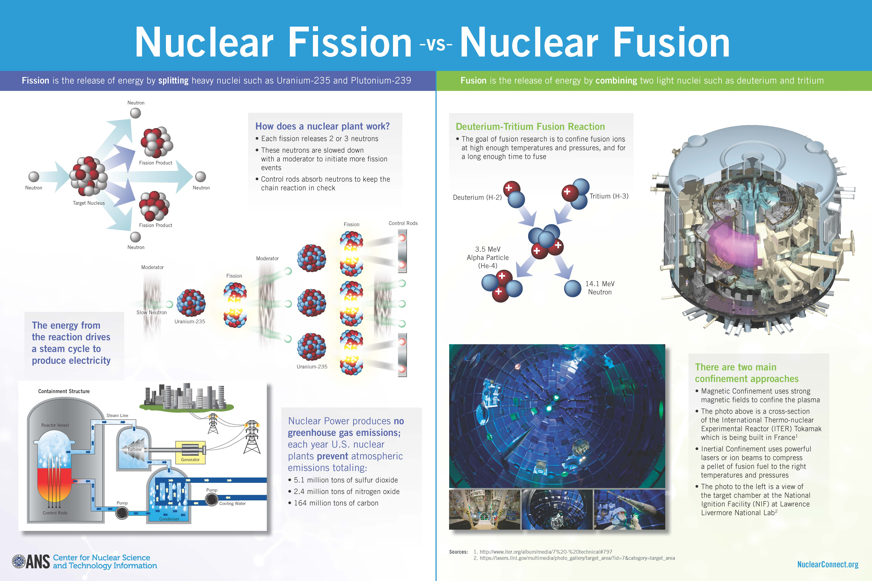
Fission vs Fusion
Notes:
The image produced here is available as a classroom poster from ANS. http://www.ans.org/store/item-750099/. Consider purchasing a copy for each participant.
Navigating Nuclear includes a STEM project starter that guides students in creating a project around nuclear fission and fusion “Fusion and Fission: Think Nucleus.” https://www.navigatingnuclear.com/#/classroom-resources.
Have teachers review and/or complete portions of the lesson.
Alternatively, have teachers work in pairs to create Venn diagrams comparing and contrasting fusion and fission.

Slide 39
Future
U.S. national laboratories are exploring:
advanced fuels
reactor systems
space power systems
safety & risk assessment
Notes:
Department of Energy labs are collaborating on a number of fronts. The listed areas can be found on the Idaho National Laboratory site. https://inl.gov/research-programs/nuclear-energy/

Slide 40
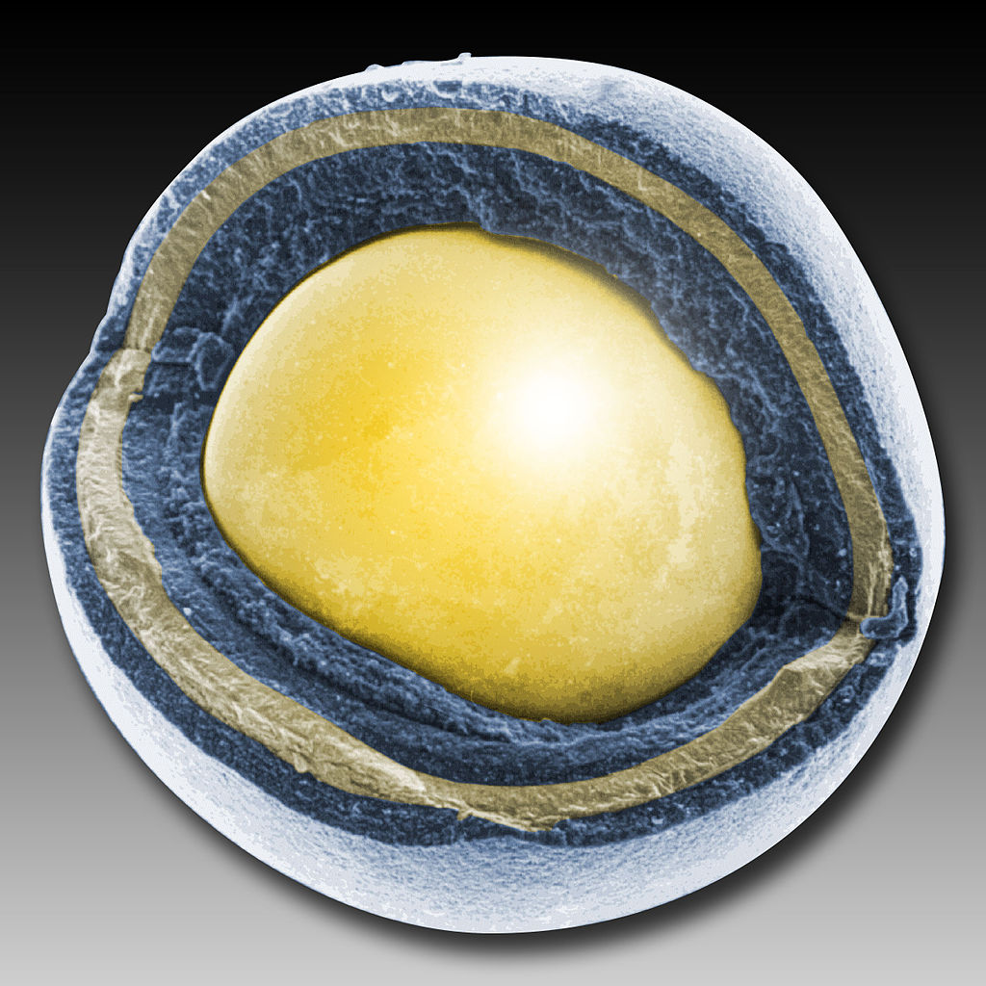
Advanced fuels
TRISO fuel particle
Notes:
TRISO fuel particles have a uranium core that triple coated: a layer of carbon around the uranium, then a layer of silicon carbide, and then another layer of carbon. The coating is essentially a containment system.
utilize energy resources more efficiently
leave fewer long-lived waste isotopes behind.
In accident conditions, the particles are better able to withstand high temperatures and, therefore, release fewer fission products. They are currently under development.

Slide 41
Reactor systems
Extend the life of existing reactors
Advanced Reactor Technologies (ART)
Small modular reactors
Notes:
It is less important for teachers to know the specifics of reactor technologies, such as the Gen IV reactor types. Mention some but focus on their benefits.
Reactors
The Gas-Cooled Fast Reactor (GFR)
Very-High-Temperature Reactor (VHTR)
Supercritical-Water-Cooled Reactor (SCWR)
Sodium-Cooled Fast Reactor (SFR)
Lead-Cooled Fast Reactor (LFR)
Molten Salt Reactor (MSR)
Benefits
Utilize uranium efficiently. Many can employ depleted uranium or “spent” fuel from current reactors.
Destroy a large fraction of nuclear waste from current reactors via transmutation.
Generate hydrogen for transportation and other non-electric energy needs.
Be inherently safe and easy to operate.
Provide built-in resistance to nuclear weapons proliferation.
Provide a clear cost advantage over other forms of energy generation.
Carry a financial risk no greater than other forms of energy generation.
EXAMPLE: For example, one molten-salt reactor designed to consume one ton of uranium per year, could supply sufficient hydrogen to fuel 3 million passenger vehicles. The waste from one year of the plant’s year’s operation would occupy half the volume of a typical domestic refrigerator. The radioactivity of the waste would diminish to background levels in about 500 years.
Idaho National Laboratory (INL) ART
at INL, work is focused specifically on developing a High Temperature Gas-cooled Reactor (HTGR), which will offer enhancements in safety and efficiency. This HTGR has a modularized design, which enables plants with larger power demands to simply build more than one module. Modularization requires no extra design work and increases safety and efficiency by allowing a singular module to run or be stopped at any given time in the event of an incident or a changing need for power. HTGRs also produce process heat during operation, making them ideal for location near other industrial plants that could put this process heat to use in their own production and thus reduce the need for non-renewable energy sources upon which these plants currently rely.
Credit: Idaho National Laboratory

Slide 42
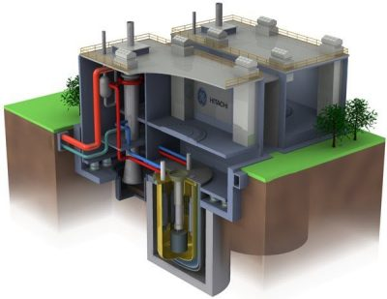
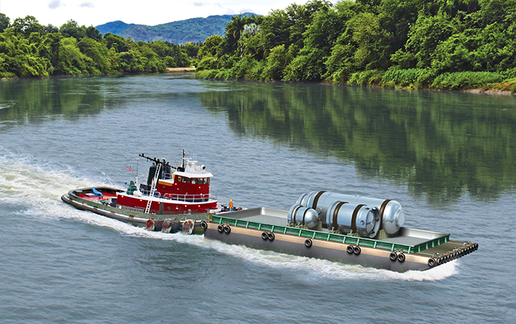
Reactors of the (near) future
Photo: NuScale Power
Photo: GE Hitachi Nuclear Energy
Notes:
GE Hitachi Nuclear Energy PRISM in foreground. PRISM is a fast reactor in a small, modular form.
NuScale Power small module reactor (SMR) on barge emphasizes that SMRs can be manufactured in a factory and shipped where needed.

Slide 43
Nuclear in the energy mix
Benefits
Clean air
    Nearly 60% of US carbon-free energy
Excellent overall safety record
Reliable baseload 24/7
Challenges
Low cost of fracked natural gas
Halt in locating permanent storage
Public perception regarding safety
Notes:
Nuclear energy is an important source of carbon-free energy as the world moves to clean and renewable sources. Wind, solar and others have significant challenges of their own to overcome before they are able to provide electricity consistently and reliably. Nuclear fills a current need without increasing greenhouse gas emissions (such as natural gas does.)
Credit: ANS Center for Nuclear Science and Technology Information nuclearconnect.org

Slide 44
Resources
ANS Center for Nuclear Science
and Technology Information nuclearconnect.org
Navigating Nuclear:
Energizing Our World™
navigatingnuclear.com
ANS Operations and Power Division http://opd.ans.org/
ANS Fusion Energy Division http://fed.ans.org/
Idaho National Laboratory
www.inl.gov
U.S. Department of Energy’s Princeton Plasma Physics Laboratory
www.pppl.gov
Department of Energy https://www.energy.gov/science-innovation/energy-sources/nuclear
Notes:
Links are only active in slide view and with internet access

