Slide 1
Radiation Basics
Journey to the Center of the Atom
-
+
+
-
Name
Title
Affiliation

Slide 2
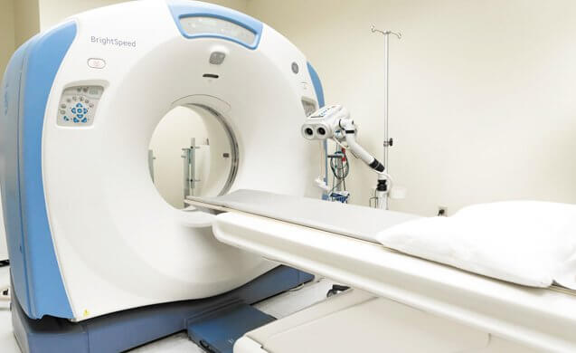
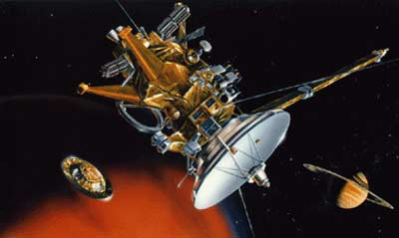
CT scans
What do the following things have in common?
Cassini spacecraft
Notes:
CT scans use x-rays. CT is widely used to help diagnose circulatory (blood) system diseases and conditions, such as coronary artery disease (atherosclerosis), blood vessel aneurysms, and blood clots; spinal conditions; kidney and bladder stones; abscesses; inflammatory diseases, such as ulcerative colitis and sinusitis; and injuries to the head, skeletal system, and internal organs. CT can be a life-saving tool for diagnosing illness and injury in both children and adults.
Credit: National Cancer Institute https://www.cancer.gov/about-cancer/diagnosis-staging/ct-scans-fact-sheet
Cassini - Three Radioisotope Thermoelectric Generators – commonly referred to as RTGs – provided power for the spacecraft, including the instruments, computers, and radio transmitters on board, attitude thrusters, and reaction wheels. Each RTG is made up of a radioisotope heat source, a thermoelectric converter, a gas pressure venting system, temperature transducers, connectors, a heat rejecting cylindrical container, and bracketry. The RTGs are mounted in tandem (end-to-end) on a deployable boom as part of the MM.
The heat source radioisotopic fuel is Plutonium-238 in the form of the oxide Pu02. In the isotopic decay process, alpha particles are released which bombard the inner surface of the container. The energy released is converted to heat and is the source of heat to the thermoelectric converter.
Credit: NASA

Slide 3


Spices
Diapers
Notes:
Spices - Food irradiation is a process that uses radiation to control pests (e.g., microbes and insects) in food and prevent spoilage. Food irradiation is similar to pasteurizing milk and canning fruits or vegetables as it can make food safer for consumption. Irradiation does not make the food radioactive, nor does it change the taste, texture, or appearance of the food. During irradiation, gamma rays, x-rays, or high-energy electrons pass through the food, destroying or inactivating bacteria and viruses that cause foodborne illness.
Credit: EPA
Diapers – One helpful feature of radiation is that it changes the molecular structure of some materials to allow them to absorb huge amounts of liquid. Useful products that rely on this include air fresheners, disposable diapers, and tampons. X-rays are also used to examine the structure of diapers so scientists can improve performance.
Credit: The Energy Reality Project

Slide 4


Fruit flies
Exit signs
Notes:
Fruit flies – a 2015 study showed that weak doses of gamma radiation prolong the life of drosophila flies (fruit flies), and that the effect is stronger in females than in males. These findings could reveal the genes that enable the prolongation of life and in the future lead to the creation of a means to prevent aging in humans. Radiation is also used as a quarantine treatment of fruits imported to the US.
Credit: Moscow Institute of Physics and Technology, press release
Exit signs - In EXIT signs, tritium gas is contained in sealed glass tubes lined with a light-emitting compound. The tritium gives off low-energy beta radiation that causes the lining to glow.
Credit: Nuclear Regulatory Commission https://www.nrc.gov/reading-rm/doc-collections/fact-sheets/fs-tritium.html

Slide 5


Sandpaper
Soda Cans
Notes:
Radiation thickness gauges are used in the production of sandpaper and soda cans. In sandpaper production, the thickness of the paper, the glue and the grit are all measured using radiation. Radiation thickness gauges can also be used to measure fill levels.

Slide 6
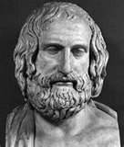
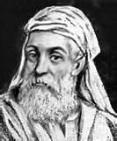
A brief history of atomic theory
Anaxagoras
  Greek, born 500 B.C.
  Infinite divisibility of matter
  “Of what is small, there is no smallest part, but always a smaller.”
Empedocles
  Greek, born 490 B.C.
  Four basic elements: earth, air, fire, water
  Conservation of mass
  “Nothing new comes or can come into being; the only change that can occur is a change in the arrangement of the elements.”
Notes:
The earliest theory about atomic structure was over 2,500 years ago.
Greek philosopher Anaxagoras “reasoned” that matter was comprised of “seeds” or “elements”
A few years later, Empedocles concluded there were four basic elements:
Earth
Air
Fire
Water

Slide 7
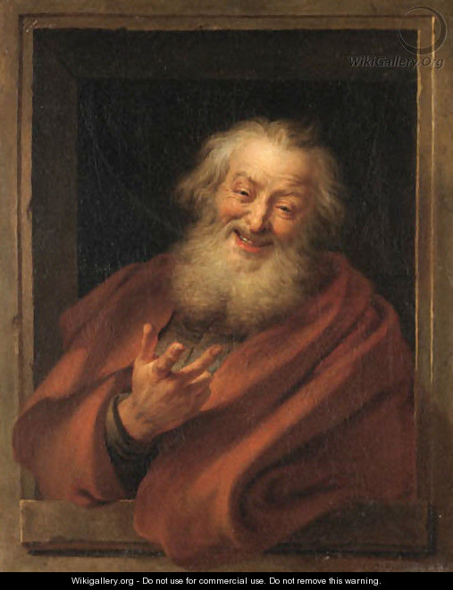
A brief history of atomic theory
Democritus
  Greek, Born 460 B.C.
  Everything is composed of atoms
    Indestructible, indivisible
    Empty space between them
    Always in motion
  Origin of the universe
    Atoms came together to form larger substances
  More than four elements
“Nothing exists but atoms and space, all else
is opinion.”
Notes:
A few decades after Empedocles, Democritus, another Greek who lived from 460 BCE to 370 BCE, developed a new theory of matter that attempted to overcome the problems of his predecessor.
Democritus' ideas were based on reasoning rather than science, and drew on the teachings of two Greek philosophers who came before him, Leucippus and Anaxagoras.
Democritus knew that if you took a stone and cut it in half, each half had the same properties as the original stone.
He reasoned that if you continued to cut the stone into smaller and smaller pieces, at some point you would reach a piece so tiny that it could no longer be divided.
Democritus called these infinitesimally small pieces of matter “atomos” (Greek for atoms) meaning “indivisible.”
He suggested that atoms were eternal and could not be destroyed.
Democritus theorized that atoms were specific to the material that they made up, meaning that the atoms of stone were unique to stone and different from the atoms of other materials such as fur.
This was a remarkable theory that attempted to explain the whole physical world in terms of a small number of ideas.
One of his many famous quotes, “Nothing exists but atoms and space, all else is opinion.”
Credit: https://www.visionlearning.com/img/library/module_viewer.php?mid=49&l=&c3=, http://thehistoryoftheatom.weebly.com/democritus.html

Slide 8
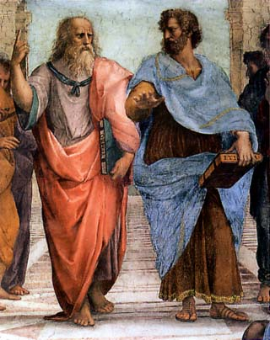
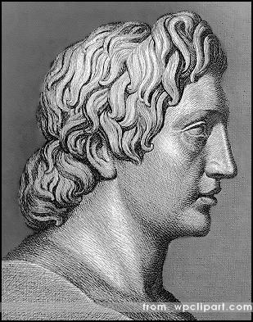
Atomic theory put on hold ~2,000 Years
Aristotle and Plato
  Believed there were only
  four elements
  Elements can transform to
  other elements
FIRE
Hot
Dry
‘MATTER’
AIR
EARTH
Wet
Cold
WATER
Alexander the Great
  King of Macedon
  Tutored by Aristotle
  Alchemy was deemed only science worth pursuing
Notes:
Young Greek philosophers Aristotle and Plato disagreed with Democritus.
They not only endorsed Empedocles’ theory about there only being four elements, but expanded it.
They reasoned the attributes or characteristics of the elements were
Hot,
Dry,
Cold, and
Wet.
They also reasoned that the elements could transform into one another, thus giving birth to the science of alchemy.
Alexander the Great was tutored by Aristotle and sided with his teacher.
Atomic theory was effectively put on hold until the 1600s.

Slide 9
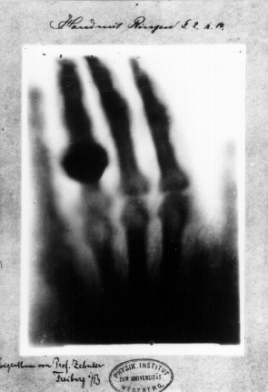
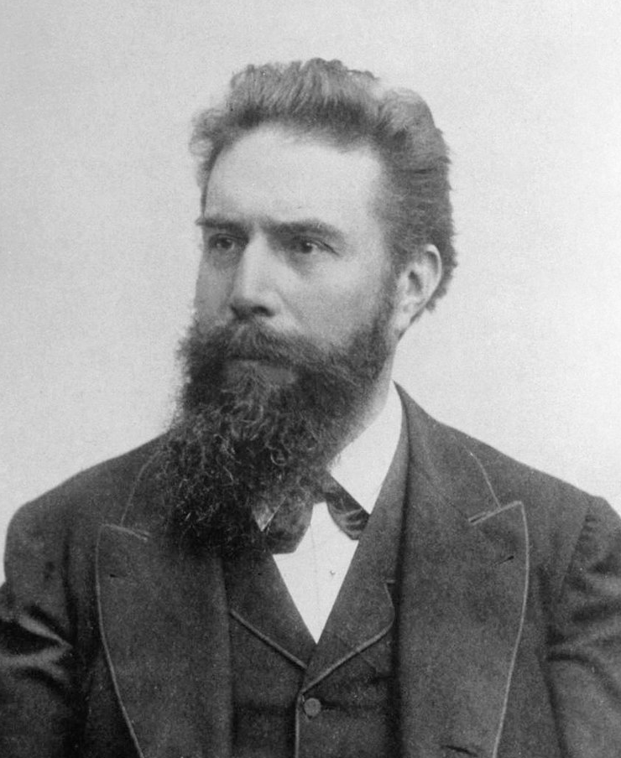
Rapid pace of nuclear discovery begins
Wilhelm Roentgen (1845-1923)
German engineer and physicist
1895 discovered the X-ray
Navigating Nuclear Science
Notes:
Roentgen was a professor of physics at Würzburg University. He was conducting an experiment when he noticed photographic plates near his equipment glowing. He discovered the glowing was caused by mysterious rays emitted by the glass tube used in his investigation. This tube contained a pair of electrodes. As electricity passed between the electrodes, X‑rays were emitted and appeared on the photographic plates. Roentgen called the rays ‘X’ for unknown
The x-ray image is of Roentgen’s wife’s hand. The large knob on the ring finger is, indeed, a ring.

Slide 10
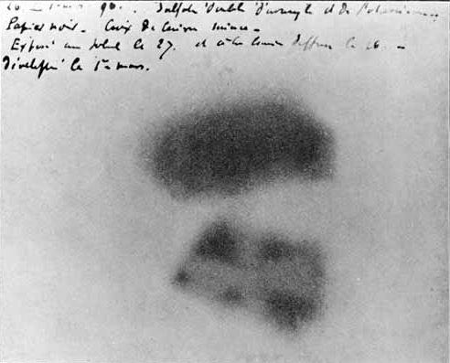
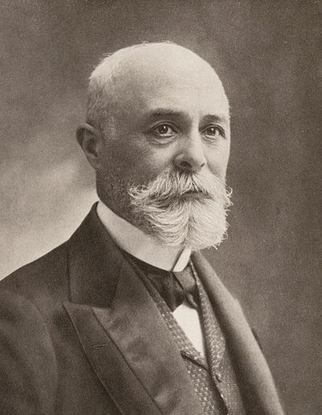
Rapid pace of nuclear discovery, cont..
Henri Becquerel (1852-1908)
French physicist
1896 discovered radioactivity
Navigating Nuclear Science
Notes:
In 1896, Henri Becquerel was using naturally fluorescent minerals to study the properties of x-rays, which had been discovered in 1895 by Wilhelm Roentgen. He exposed potassium uranyl sulfate to sunlight and then placed it on photographic plates wrapped in black paper, believing that the uranium absorbed the sun’s energy and then emitted it as x-rays. This hypothesis was disproved on the 26th-27th of February, when his experiment "failed" because it was overcast in Paris. For some reason, Becquerel decided to develop his photographic plates anyway. To his surprise, the images were strong and clear, proving that the uranium emitted radiation without an external source of energy such as the sun. Becquerel had discovered radioactivity.
Credit: Berkeley National Laboratory, https://www2.lbl.gov/abc/wallchart/chapters/03/4.html

Slide 11
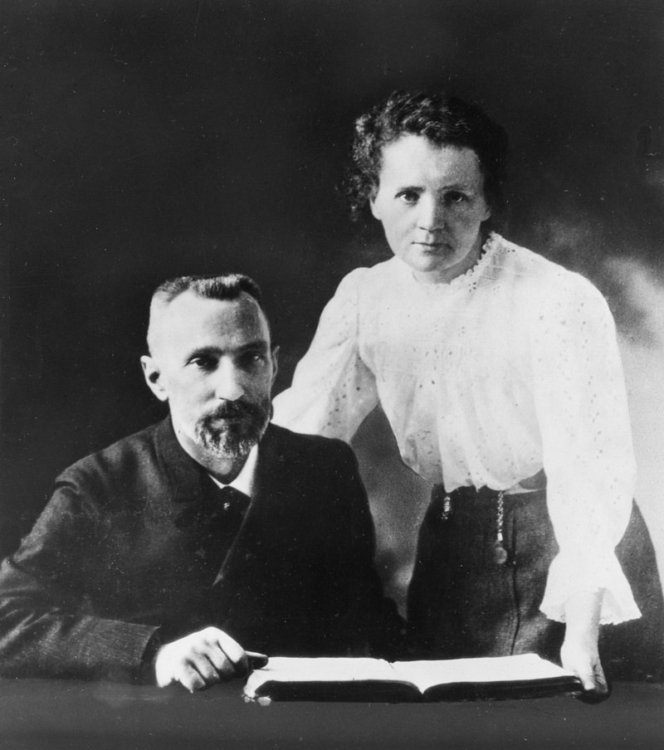
Rapid pace of nuclear discovery, cont..
Marie Curie (1867-1934)
Polish physicist and chemist
Pierre Curie (1859-1906)
French physicist
Discovered polonium and radium
Curie family won 5 Nobel Prizes
Marie
First woman to win a Nobel Prize
First person to win twice
Only person to win a Nobel Prize in two different sciences (Physics in 1903 & Chemistry in 1911)
Navigating Nuclear Science
Notes:
The Curies worked together investigating radioactivity, building on the work of the German physicist Roentgen and the French physicist Becquerel. In July 1898, the Curies announced the discovery of a new chemical element, polonium. At the end of the year, they announced the discovery of another, radium. The Curies, along with Becquerel, were awarded the Nobel Prize for Physics in 1903.
Pierre's life was cut short in 1906 when he was knocked down and killed by a carriage. Marie took over his teaching post, becoming the first woman to teach at the Sorbonne, and devoted herself to continuing the work that they had begun together. She received a second Nobel Prize, for Chemistry, in 1911. Marie Curie was the first woman to win a Nobel Prize and the first person—man or woman—to win the prestigious award twice. She remains the only one to be honored for accomplishments in two separate sciences.
The Curie's research was crucial in the development of x-rays in surgery. During World War One Curie helped to equip ambulances with x-ray equipment, which she herself drove to the front lines. The International Red Cross made her head of its radiological service and she held training courses for medical orderlies and doctors in the new techniques.
Credit: BBC History http://www.bbc.co.uk/history/historic_figures/curie_marie.shtml

Slide 12
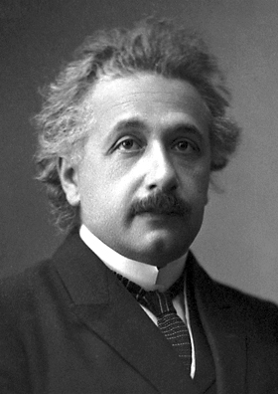
Rapid pace of nuclear discovery, cont..
Albert Einstein (1879-1955)
German physicist
Developed
  theory of relativity
  mass-energy equivalence formula
    E = mc²
Discovered
  photoelectric effect
Notes:
The fission reaction illustrates Einstein’s famous equation. Most students have heard the equation, but probably don’t know what it means. Seeing the fission reaction equation is often the only time students see that there is value in what they are learning.

Slide 13
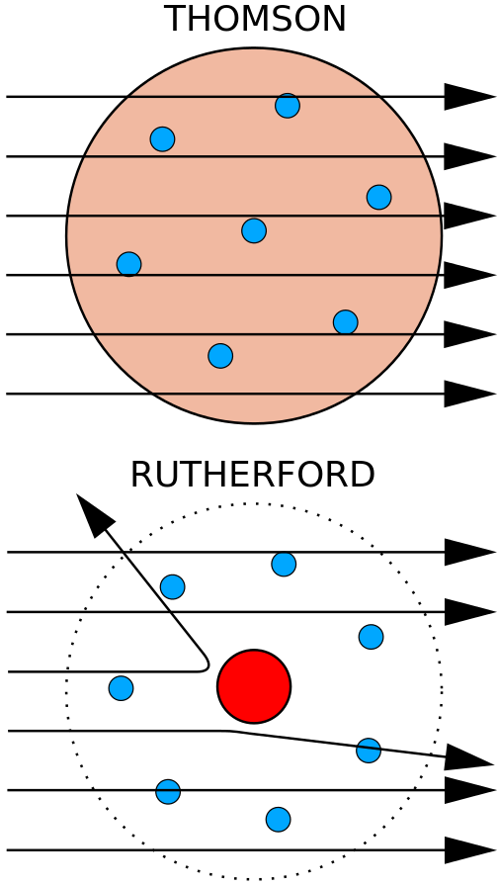
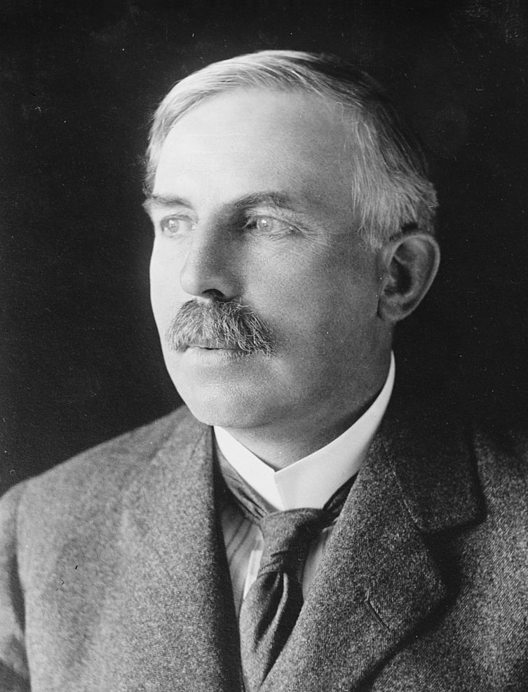
Rapid pace of nuclear discovery, cont..
Ernest Rutherford (1871-1937)
British physicist
Discovered
the nucleus
concept of half-life
radon
Navigating Nuclear Science
Notes:
From 1911 to 1913, British physicists Geiger and Marsden, working in the laboratory of Ernest Rutherford, conducted experiments with beams of positively charged, alpha particles to penetrate gold, silver, and copper foil (atoms). They observed that most of the alpha particles went directly through the foil. However, some particles were deflected and others recoiled back toward the source. Rutherford systematically investigated the results Geiger and Marsden obtained with alpha particles; Rutherford concluded that most of the mass of an atom is concentrated in a small region in its center, now called the nucleus.
Credit: American Nuclear Society, nuclearconnect.org
You may wish to stop here and perform an activity that illustrates how Rutherford discovered the nucleus. There is an ANS lesson plan that details how to make the “Rutherford” boards.
Credit: http://nuclearconnect.org/in-the-classroom/for-teachers/mini_rutherford
Teachers are likely to have done a version of the experiment themselves and have ideas to share about how they do it.

Slide 14
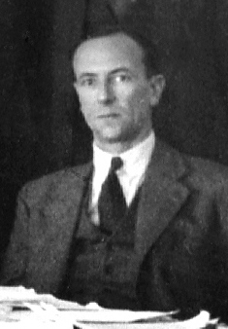
Rapid pace of nuclear discovery, cont..
James Chadwick (1891-1974)
British physicist
Discovered the neutron in 1932
Awarded Nobel Prize
Navigating Nuclear Science
Notes:
In 1923, aged 32, Chadwick became Rutherford’s Assistant Director of Research in the Cavendish Laboratory. In those days, most researchers believed there were electrons within the nucleus as well as outside it. Rutherford, Chadwick, and some others believed in the possibility that particles with no charge could be in the nucleus. Using polonium as a source of (what he believed were) neutrons, he bombarded wax. Protons were released by the wax and Chadwick made measurements of the protons’ behavior.
The protons behaved in exactly the manner they ought to if they had been hit by electrically neutral particles with a mass similar to the proton, rather than negatively charged electrons. Chadwick had discovered the neutron. In 1935, James Chadwick received the Nobel Prize in Physics for his discovery of the neutron
Credit: https://www.famousscientists.org/james-chadwick/

Slide 15
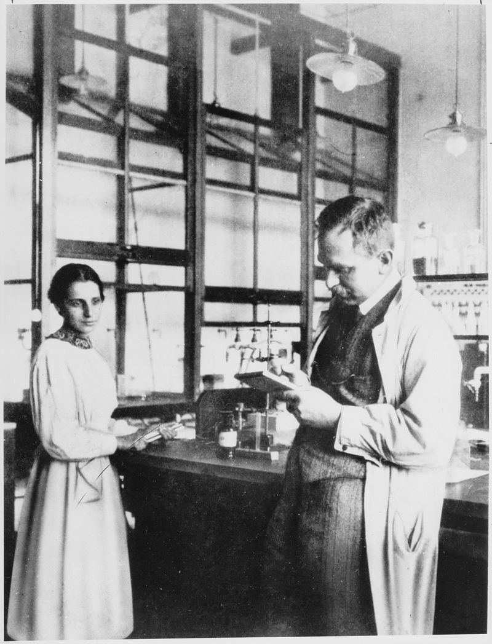
Rapid pace of nuclear discovery, cont..
Otto Hahn (1879-1968)
German chemist
Lise Meitner (1878-1968)
Austrian/Swedish physicist
Discovered fission
  Hahn didn’t include Meitner in paper for which he was awarded the Nobel Prize
  Element 109, meitnerium, was named in her honor.
Navigating Nuclear Science
Notes:
1934, Ida Noddack, from a government laboratory in Berlin, suggested that neutron bombardment might cause uranium nuclei to break apart into lighter elements. Noddack, therefore, was the first person to propose the concept of nuclear fission.
In December 1938, Otto Hahn and Fritz Strassman bombarded uranium with slow moving neutrons, after which Hahn wrote Meitner with a sense of bewilderment. His results seemed to indicate that the element barium was consistently one of the products. Scientific dogma had previously said that the largest particle a nucleus could emit was an alpha particle.
George Gamow and Niels Bohr proposed that atomic nuclei might resemble drops of liquid. Meitner and her nephew Otto Frisch, wondered if a liquid-drop nucleus might break into two smaller drops.
In December 1938, Meitner and Frisch were walking one day when inspiration came to Meitner. She sat down in the woods and began calculating the energy involved when nuclei produced by uranium fission fly apart. Her calculated energy, 200 MeV, was huge. Its source was Einstein’s E = mc². Meitner realized that enough mass was converted to energy to produce an enormous amount of energy.
When World War 2 ended, she was acclaimed as the mother of the atom bomb. In fact, she disapproved of both the acclaim and the bomb. She believed nuclear energy should be used solely for peaceful purposes.
Although, controversially, Lise Meitner was never awarded a Nobel Prize, in 1997 her work was acknowledged in a more exceptional way when chemical element 109 was named Meitnerium in her honor.
Credit: https://www.famousscientists.org/lise-meitner/

Slide 16
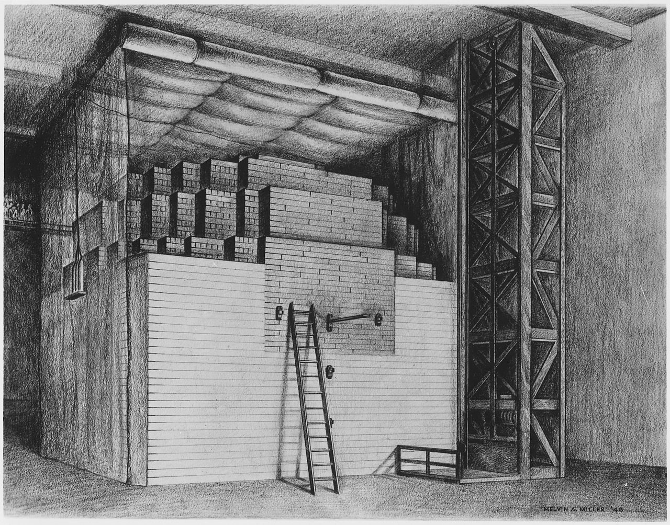
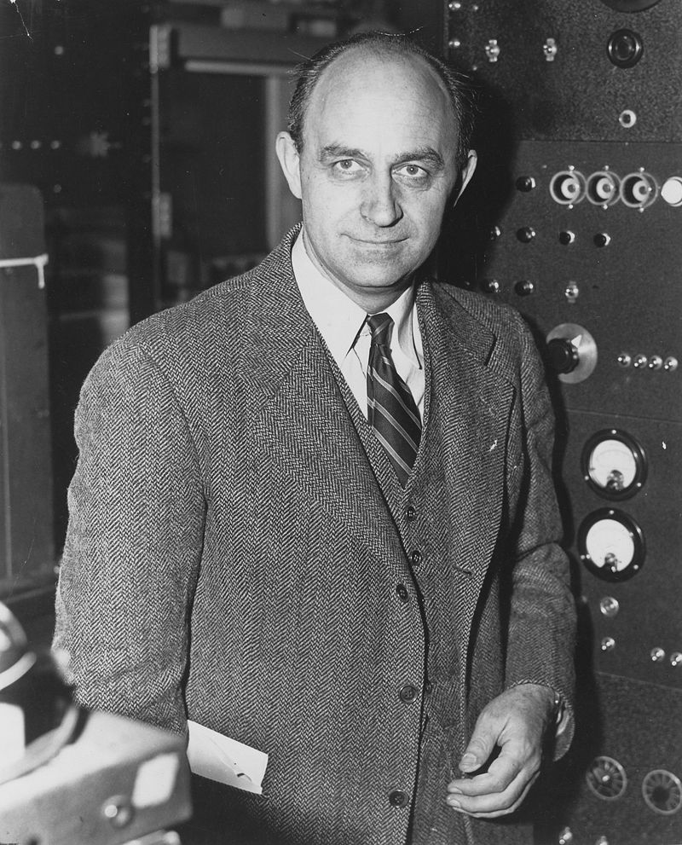
Rapid pace of nuclear discovery, cont..
Enrico Fermi (1901-1954)
Italian physicist
Demonstrated the first artificial, self-sustaining nuclear chain reaction on December 2, 1942
Navigating Nuclear Science
Notes:
Fermi became an American citizen in 1944 and in 1946 he accepted a professorship at the Institute for Nuclear Studies at the University of Chicago, a position which he held till his death.
In 1940, Fermi and his team proved that absorption of a neutron by a uranium nucleus can cause the nucleus to split into two nearly equal parts, releasing numerous neutrons and huge amounts of energy. This was the first nuclear chain reaction.
During the Second World War, Fermi was a key member of the Manhattan Project, working at the Los Alamos project in New Mexico on developing an atomic bomb. On July 16, 1945, the first atomic bomb was detonated at Alamogordo Air Base.
Credit: https://www.famousscientists.org/enrico-fermi/

Slide 17
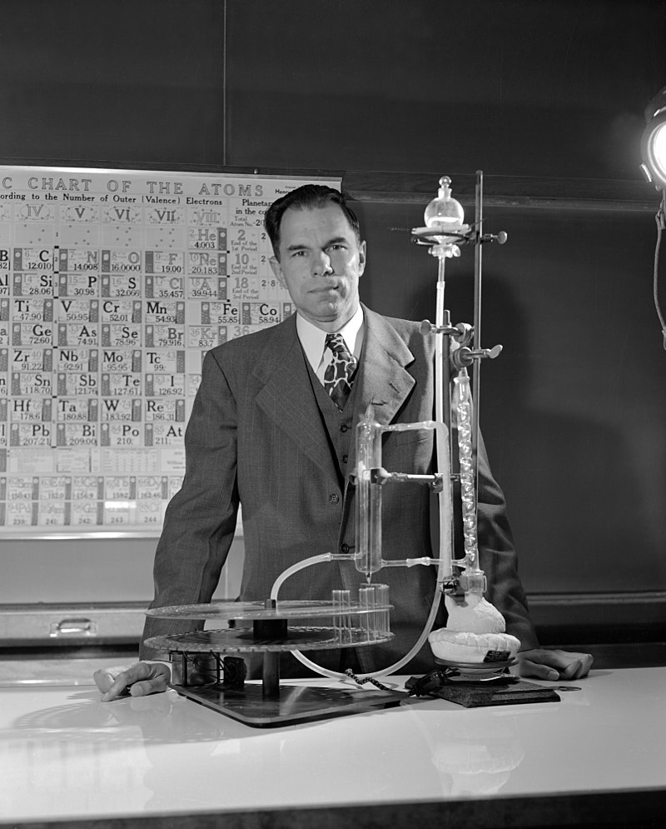
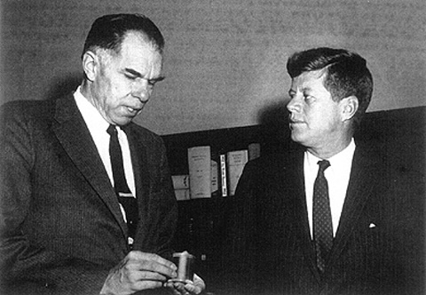
Rapid pace of nuclear discovery, cont..
Glenn Seaborg (1912-1999)
American chemist, founding member of ANS
Developed the actinide concept, requiring
re-draw of periodic table
Discovered 10 transuranic elements
Early pioneer in nuclear medicine
Navigating Nuclear Science
Notes:
Glenn Seaborg took part in the discovery of ten of the periodic table’s chemical elements. He was awarded the Nobel Prize in Chemistry in 1951.
His work on the electronic structure of elements led to the periodic table being rewritten. He also co-discovered technetium-99m, the most commonly used medical radioisotope in the world.
Element 106 is named seaborgium in his honor.
Description of the discovery of plutonium
In 1940, Edwin McMillan and Philip Abelson discovered element 93 using the 60-inch cyclotron at the Lawrence Radiation Laboratory, Berkeley. They named the new element neptunium, after the planet Neptune. Their discovery depended on work Seaborg and his colleagues carried out on a method to isolate the new radioactive metal. In February 1941, Seaborg led his research team to discover element 94 – plutonium. They named the new element after Pluto, keeping up the theme that began with element 92, uranium (Uranus) and element 93, neptunium (Neptune).
Plutonium was made by bombarding uranium with hydrogen-2 (heavy hydrogen) nuclei.
Credit: https://www.famousscientists.org/glenn-seaborg/

Slide 18
Rapid pace of nuclear discovery
Fewer than 50 years …
from the discovery of x-rays
to a sustained fission chain reaction
Navigating Nuclear Science

Slide 19
Structure of the atom
Nucleus
Electron Cloud
Protons: charge = +1
mass = 1 amu*
Electrons: charge = -1
mass = 1/1836 amu
+
Neutrons: charge = 0
mass = 1 amu
*atomic mass unit
Navigating Nuclear Science
Notes:
Describe the structure of the atom

Slide 20
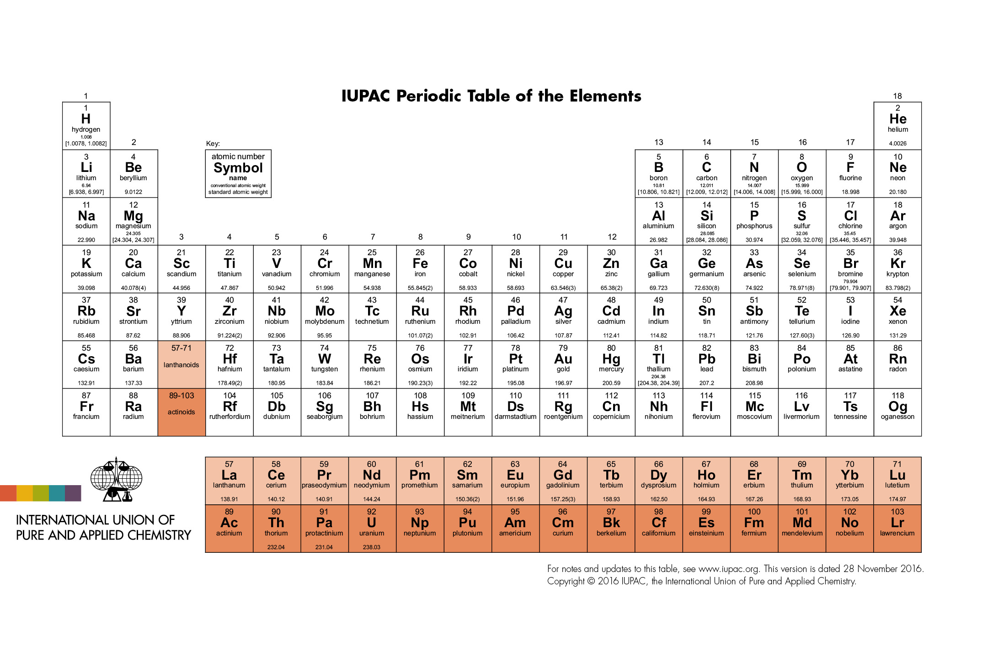
Periodic Table of the Elements
Navigating Nuclear Science
Notes:
Periodic Table
Describes the chemical properties of elements
Arranged by the number of protons

Slide 21

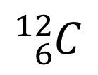



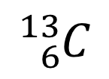
Standard nuclear notation
mass number
A = Z + N
(N = # of neutrons)
A
chemical symbol
X
Z
atomic number
# of protons
$${}_{6}^{12}C$$
$${}_{6}^{13}C$$
$${}_{6}^{14}C$$
or
$${}_{}^{12}C$$
$${}_{}^{13}C$$
${}_{}^{14}C$
Navigating Nuclear Science
Notes:
Standard Nuclear Notation or Standard Atomic notation is used in Chemistry and Physics to indicate the atomic number and mass number of an isotope.
Nuclear notation is formed by writing an elemental symbol preceded by a subscript indicating its atomic number (number of protons) and a superscript indicating its mass number (number of nucleons).
For example, carbon-12 has an atomic
number of 6 and a mass number of 12.
It is common to drop the atomic number; it is redundant with the symbol.

Slide 22
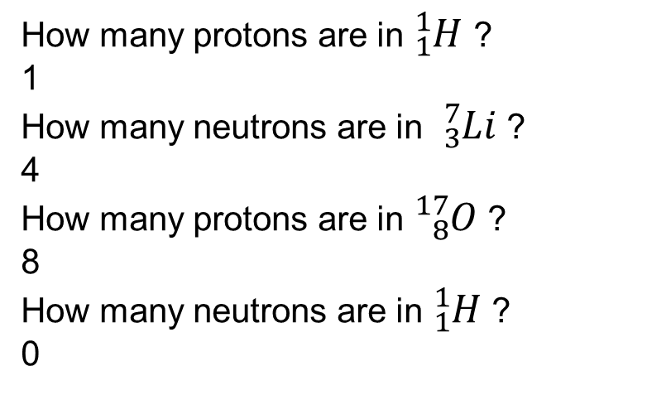
Let’s practice
How many protons are in ${}_{1}^{1}H$ ?
1
How many neutrons are in ${}_{3}^{7}{Li}$ ?
4
How many protons are in ${}_{8}^{17}O$ ?
8
How many neutrons are in ${}_{1}^{1}H$ ?
0
chemical symbol
mass number
A = Z + N
(N = # of neutrons)
A
X
Z
atomic number
# of protons
Navigating Nuclear Science
Notes:
Answers
One
Four
Eight
Zero

Slide 23
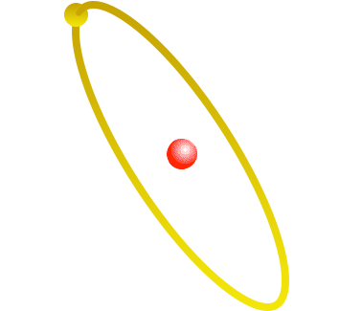
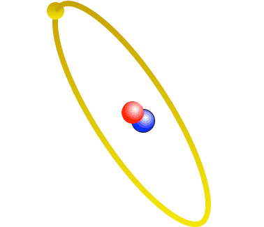
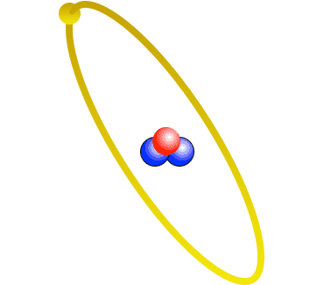
Isotopes
Three isotopes of hydrogen
Hydrogen
H-1
Deuterium
H-2
Tritium
H-3
Navigating Nuclear Science
Notes:
ISOTOPES
Each element can have a varied number of neutrons
This does not change the chemical properties of the element, but it does change the weight of the atom.
Hydrogen – Weighs 1 amu
Deuterium – Weighs 2 amu (same chemical properties as Hydrogen)
Tritium – Weighs 3 amu (same chemical properties as Hydrogen) (Made at SRS)

Slide 24
Atomic structure of helium
-
+
Helium’s sub-atomic composition
+
2 protons
2 neutrons
2 electrons
-
The helium atom
Navigating Nuclear Science

Slide 25
More on this helium isotope . . .
total number of
protons and neutrons
MASS NUMBER
Protons have a large mass and a positive charge. The number of protons identifies an element.
+
42
He
Neutrons have a large mass approximately equal to a proton’s mass. Neutrons have no charge.
ELEMENT SYMBOL
ATOMIC NUMBER number of protons
-
Electrons have a very small mass and a negative charge. Electrons travel outside the nucleus.
Navigating Nuclear Science
Notes:
All elements are isotopes

Slide 26

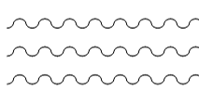
What is radiation?
Transmission of energy via:
Particles
or
Waves
Navigating Nuclear Science

Slide 27
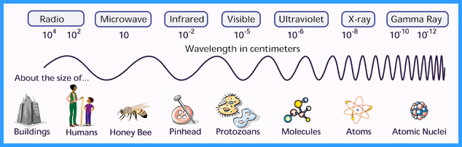
Electromagnetic spectrum
Navigating Nuclear Science
Notes:
Radiation is defined on a spectrum from low frequency waves, such as radio waves, to very high frequency waves, like gamma rays. Note that radiation is on a spectrum, so gamma rays are related to radio waves.

Slide 28
Types of radiation
Non-Ionizing
Radio waves
Microwaves
Infrared
Visible Light
Ultraviolet (UV)
Ionizing
Alpha
Beta
Gamma
X-Rays
Neutrons
Navigating Nuclear Science
Notes:
Radiation is categorized as non-ionizing and ionizing. Though ultraviolet light is classified as non-ionizing, it can induce cellular damage. Note the connection between sunlight and the need to protect themselves. This helps to demonstrate that it isn’t only ionizing radiation that has the potential to be damaging.

Slide 29
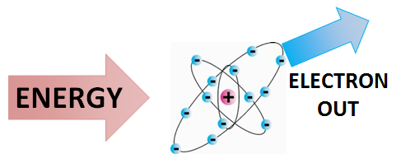
Why is it called ionizing?
Because it creates ions…
atoms with a charge.
Energy Education, University of Calgary
Navigating Nuclear Science
Notes:
Radiation at this level has enough energy to remove an electron from its orbit, creating an ion: an atom with a charge

Slide 30
Where does radiation come from?
The nucleus of unstable atoms
So, we have…
nuclear science
nuclear medicine
nuclear reactors

Slide 31
If radiation comes from atoms and everything is made of atoms, is there radiation around us right now?
Question
Navigating Nuclear Science
Notes:
Poll attendees for answers before moving on to next slide.

Slide 32
Yes!

Slide 33
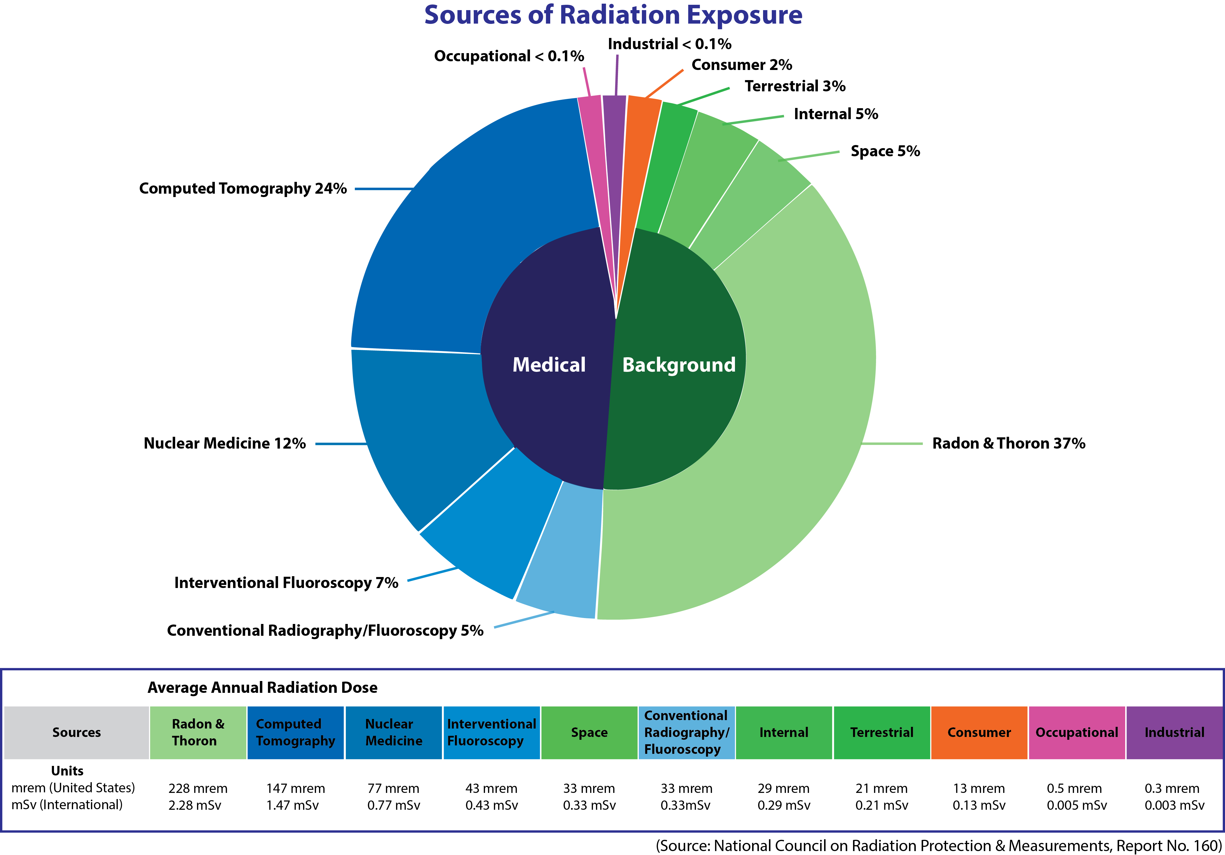
Sources of radiation
Navigating Nuclear Science
Notes:
Explain background radiation.
This is a good time to have attendees use ANS’s “Radiation is a part of our world” personal radiation dose calculator. It can be downloaded from nuclearconnect.org at http://nuclearconnect.org/wp-content/uploads/2015/10/Radiation-Dose-Chart_web.pdf
Printed copies can be purchased from ANS at http://www.ans.org/store/item-750022/

Slide 34
Units of dose and exposure
Roentgen (R)
  unit of exposure - ionization of air by x-rays
  or gamma rays
Rad (radiation absorbed dose)
  energy deposited in material
REM (Roentgen equivalent man)
  unit of dose equivalent
Navigating Nuclear Science
Notes:
Note that REM takes into account what kind of radiation and what was exposed (liver, bone, etc.) Terminology is radiation weighting factor (w(R) It used to be Q factor

Slide 35
Perspective
Dose (mrem) | Source
1 | Dental x-ray
25 | Round trip flight to South Africa
40 | Your body
110 | Head and body CAT scan
620 | Average dose in U.S.
5500 | Average dose in Guarapari, Brazil
10,200 | Average dose in Ramsar, Iran
0 – 25,000 | No observable effect
Navigating Nuclear Science
Notes:
Dental x-ray and CT scan are not background radiation, but are included for comparison

Slide 36
You’ve been irradiated: exposed to radiation.
Which is not to be confused with . . .
So, am I contaminated?
Navigating Nuclear Science

Slide 37
Contamination
Radioactive material in an unwanted place
Material is spread around
Can be carried away
Notes:
The concept of contamination and radiation are commonly confused in the public discussion, including leading news media.
Contamination can be discussed using many substances.
Using a chemical light stick. If the stick was broken and the liquid from inside got on your skin, you would be contaminated with the chemical. The light would go wherever you go, and you could spread it around and make more contamination.
Demonstration showing how contamination can be spread using glitter—place glitter on one hand of one participant and have participants shake hands. Note that the material spreads around and can be carried away, but it can also be cleaned up.

Slide 38
Biological effects
Replaced
Cell dies
Not replaced
Atoms in cells are ionized
Benign
Change in cell
Cell reproduces
Malignant
No or neutral change
Notes:
Note that there are a number of possible biological outcomes of radiation exposure—only one leads to cancer

Slide 39
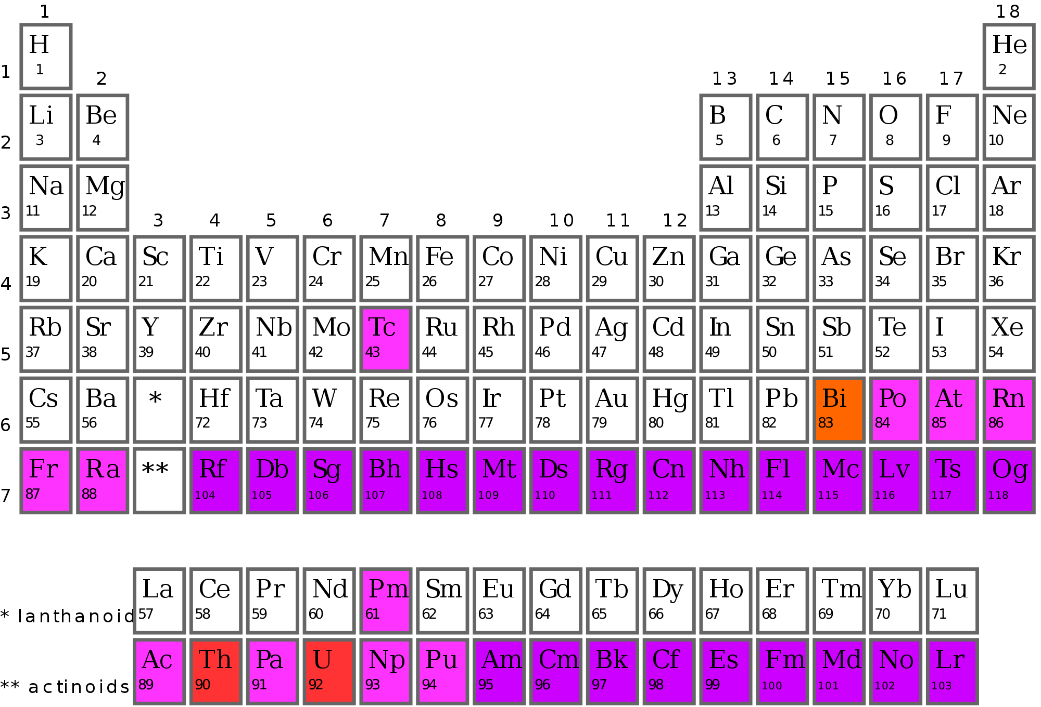
Why are atoms radioactive?
Notes:
Atoms that are radioactive are unstable.

Slide 40
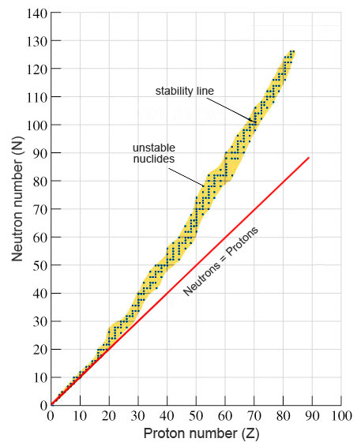
What make a nucleus unstable?
Notes:
Explain what makes a nucleus stable.
Main factors: neutron/proton ratio and the total number of nucleons in the nucleus

Slide 41
Nuclear stability
An unstable nucleus becomes more stable by rearranging its nuclear structure and emitting radiation.
If unstable after radioactive decay, further decay
is possible.
Navigating Nuclear Science
Notes:
This is the transition to discussing decay types. Explain that decay is the name of the process that the nucleus goes through to become stable.
Note that decay results in the element become another element until a stable element is achieved.

Slide 42
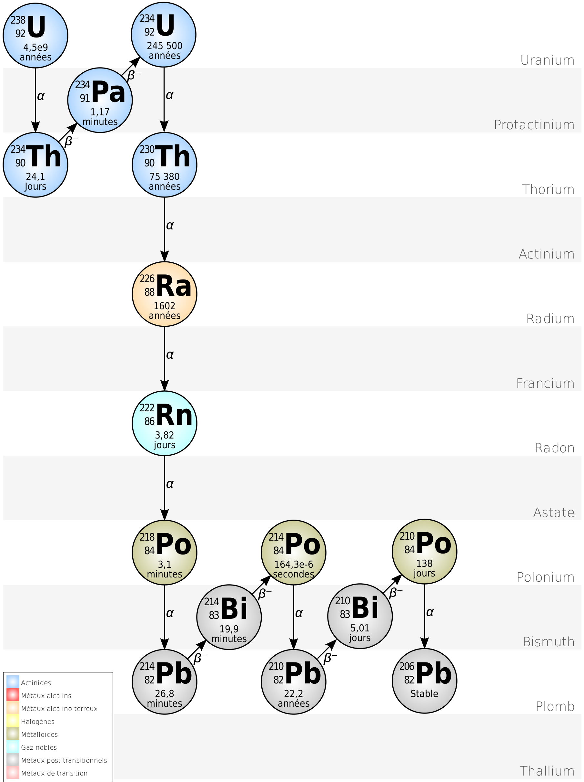
Radioactive decay
By http://commons.wikimedia.org/wiki/User:BatesIsBack
Navigating Nuclear Science
Notes:
There are eight slides in this section, two for each of the four types of radioactive decay: the first slide will describe that type of decay, the next will describe how that radiation interacts with matter. Tell participants to pay attention and ask questions. There will be an assessment (teachers call them assessments; others will likely call them quizzes.)

Slide 43
Alpha particle α
Helium nucleus that is emitted from a radioactive atom’s nucleus
α Particle
Notes:
ALPHA
The largest radiation particle
Comes from elements that are too large or have too many neutrons (like having too much glue)
A large section of the atom is ejected from the radioactive nucleus (the size of a helium nucleus)
Atom wants to return to stability.

Slide 44
Alpha particle α
A high energy helium nucleus ejected from the nucleus
Mass of 4 amu
Charge of +2 ecu
Interacts readily with the electrons of materials it passes through
Opposites attract
α is positive, electrons are negative
Easily shielded by all materials including outer “dead” layers of skin
Severe damage to live tissues if ingested due to large mass and large charge
Notes:
Read the Slide

Slide 45
Beta particle β⁻
Electron emitted from an atom’s nucleus when a neutron converts to a proton
β particle
Notes:
BETA
Smaller particle
Comes from atoms that have a few too many neutrons.
A neutron changes to a proton and ejects energy in the form of an electron

Slide 46
Beta particle β⁻
A high energy “electron” ejected from the nucleus
Mass 1/1836 amu; charge of -1 ecu
Interacts readily with the electrons of materials it passes through
Like charges repel
β is negative, electrons are negative
Easily shielded by light materials including clothing
Shielded by heavy materials as well but generates X-rays
Damage to live tissues due to mass and charge
Notes:
Read and explain the slide

Slide 47
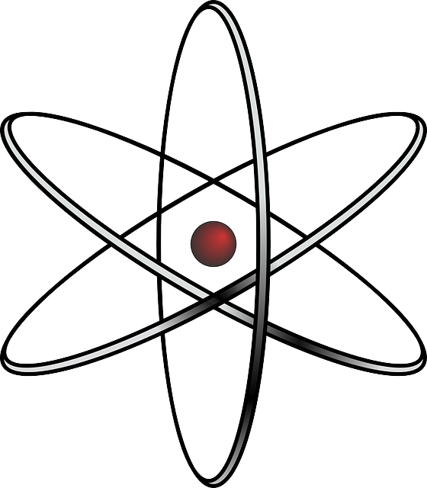
Gamma ray γ
High-energy photon emitted from an atom’s nucleus
Notes:
If the class gets the answer to the quiz following this section, you all get cookies.
GAMMA
Simply – a ray of light (photon) that comes from the nucleus

Slide 48
Gamma ray γ
High-energy light ray beyond our vision.
No mass
No charge
Interacts with the electrons of materials it
passes through
    The more electrons the greater the interaction
Can pass through most matter easily without interaction, including the human body
Easily shielded by heavier materials such as lead
Notes:
Read the Slide

Slide 49

Neutron
Neutron
Fission Fragment
Parent Atom
Energy
Neutron
Energy
Neutron
Fission Fragment
Notes:
NEUTRON
It is not very common for a neutron to be ejected on its own.
If an atom is very large, it can get too big to hold together. This instability causes it to break apart, or fission.
When this happens, some of the neutrons (and energy) are released.
This is what we control to make a nuclear reactor operate safely.
High school students are not assessed on knowledge of neutron radiation.

Slide 50
Neutron
A high energy neutron ejected from
the nucleus
Mass of 1 amu; same as hydrogen
No Charge
Interacts with materials of similar (light) weight
Can pass through most matter easily without interaction
Easily shielded by materials with a lot of hydrogen (water)
Notes:
Read the Slide

Slide 51
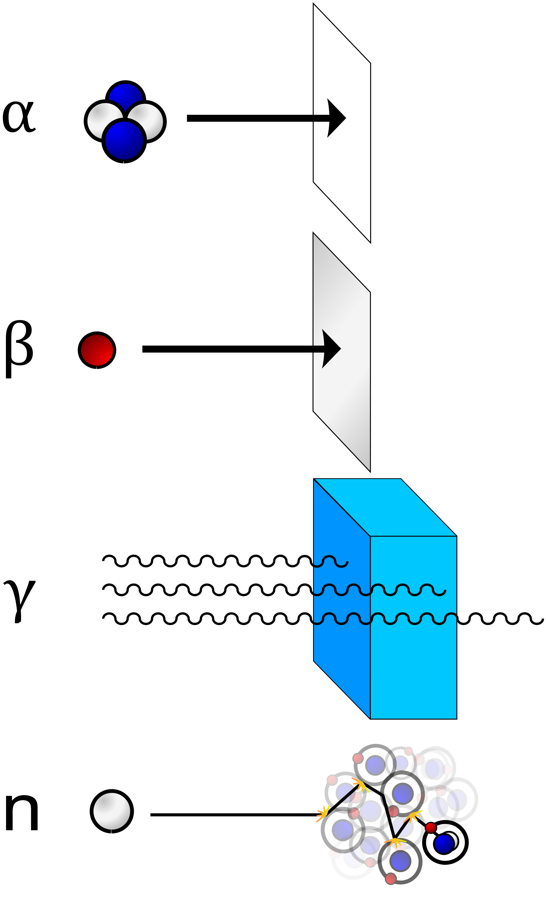
Shielding
Notes:
How different types of radiation can be shielded. Visual representation of what was discussed in prior slides
Demonstration:
Use a cluster of four balloons (two of one color; two of another color) to represent alpha radiation. Toss it. Note that it doesn’t travel far because it is so large.
Use a small ball to represent beta radiation. Toss it. Note that it travels farther.
Use a laser pointer to represent gamma radiation. Turn it on and note that it travels far and fast.

Slide 52

Use common sense
Notes:
How we protect from excessive radiation exposure is very similar to how we protect ourselves from UV exposure.

Slide 53
Cookie Story
Notes:
Title slide

Slide 54
What would you do?
You have four cookies.
You can…
α
eat one
β
hold one in your hand
γ
put one in your pocket
n
throw one away
Notes:
THIS IS A QUIZ (THE REWARD IS COOKIES FOR EVERYONE) Note: you can have attendees work in pairs to answer the quiz. ANS gives each attendee an individual packet of cookies during the quiz.
Now that you know the interactions of radiation with matter, see if you can answer this quiz.
We have an alpha cookie, beta cookie, gamma cookie, and a neutron cookie.
If you had to eat one, hold one in your hand, hold one in your pocket, and throw one away, what would you do with each cookie?
Now I am not promoting eating any radioactivity intentionally, but this gives you a greater understanding of the interactions.
Answer:
Alpha: Hand Shielded by skin
Beta: Pocket Shielded by clothing
Gamma: Eat Whole body dose
Neutron: Throw Away Whole body dose
(Interacts with water in body)

Slide 55
Radioactive decay equations
238
92
U
234
90
4
2
Th +
Alpha Decay
α
234
90
Th
234
91
0
-1
Pa +
β
+
n
Beta Decay
60
56
60
56
γ
Co
Co +
Gamma Decay
Notes:
Now, the presentation shifts to how decay works. Students are required to know how to balance decay equations.

Slide 56
Units of activity
Activity is the number of emissions of radiation per unit time.
dps: disintegrations per second
Becquerel: 1dps
Curie: 37,000,000,000 dps
Picocurie: 0.037 dps or 2.2 dpm

Slide 57
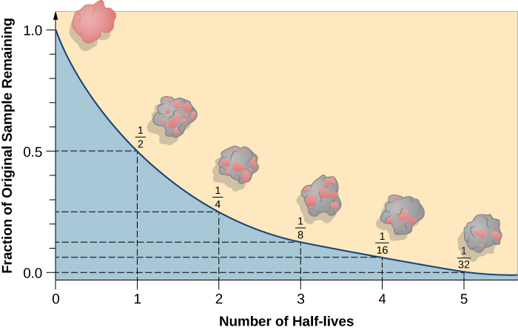
Half life
Navigating Nuclear Science
Notes:
Define half-life. Use the image to illustrate that decay is exponential. Note that the pink blob gradually becomes more and more gray as the element decays. Feel free to create a fanciful name for the element such as bubblegumium or pinkium.
If you will be doing a half-life activity using M&Ms/coins/etc. do the activity here.
If you will be using the ANS Isotope Discovery Kit, proceed to the next slide.

Slide 58
Building a 3D periodic table
Stack isotopes by atomic mass
Smallest on top
Largest on bottom
Navigating Nuclear Science
Notes:
Use this slide to introduce the Isotope Discovery Kit. Delete this slide if not using it.

Slide 59
Nuclear stability
Only certain combinations of neutrons and protons lead to a stable atom.
In a stable atom, the attractive and repulsive forces in the nucleus balance.
Navigating Nuclear Science

Slide 60
Nuclear stability
Atoms with unstable nuclei are radioactive.
If unstable after radioactive decay, further decay is possible.
Nuclei decay toward the line of stability.
Navigating Nuclear Science

Slide 61
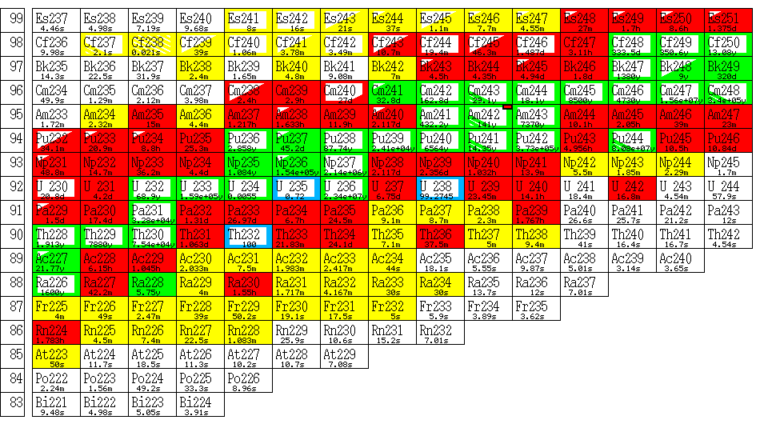
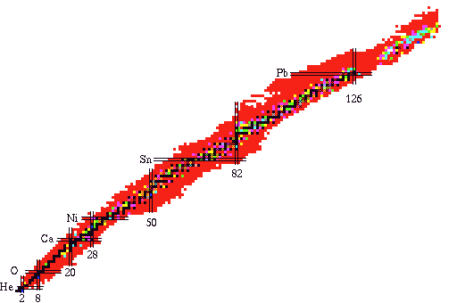
Chart of the nuclides
Notes:
CHART OF NUCLIDES
A different way to look at the Periodic Table.
It contains much more detailed information regarding all of the elements/isotopes known to man.
Describes the radioactive materials that are known.
The details are not important for this lecture, but there is one concept that is important:
LINE OF STABILITY
The chart of nuclides is a graph of protons versus neutrons
The stable isotopes (non-radioactive) are shown along the “Line of Stability”
Low weight elements tend to balance equal number of protons to neutrons. The heavier you get the more neutrons you need to keep things together.
The protons all have a “+” charge and they repel each other (like magnets)
The neutrons act as glue holding everything together with a strong nuclear force

Slide 62
Relative locations of products of various nuclear processes
ρ
³He in
α in
α alpha particle
β⁻ negative electron
β⁺ positron
∈ electron capture
η neutron
ρ proton
d deuteron
t triton (H-3 nucleus)
³He helium-3 nucleus
β⁻ out
ρ in
d in
t in
η out
Original Nucleus
η in
t out
d out
ρ out
β⁺ out
∈
α out
³He out
η
Navigating Nuclear Science

Slide 63
Building a Radioactive Decay Chain
Navigating Nuclear Science
Notes:
Complete Advanced portion of the Isotope Discovery Kit
Alternatively, complete the Radioactive Decay Series Activity in the ANS Teacher Resource Guide. http://nuclearconnect.org/in-the-classroom/for-teachers/teacher-resource-guide-detecting-radiation-in-our-radioactive-world OR this lesson from teachnuclear.ca http://teachnuclear.ca/?tr-search-Jurisdiction&tr-search-Grade&tr-search-Course&tr-search-Concept=14&tr-srch=1
63

Slide 64
Resources
ANS Center for Nuclear Science and Technology Information
nuclearconnect.org
Navigating Nuclear:
Energizing Our World™
navigatingnuclear.com
Office of Nuclear Energy/
Department of Energy
https://www.energy.gov/ne/office-nuclear-energy
(Add your own resources)
Notes:
Make sure you give attendees your contact information. You are one of the best resource for them!

Slide 65
Questions?

