Slide 1

Energía Nuclear:
Fisión, Fusión y el Futuro
Nombre
Título
Afiliación
Explorando la Ciencia Nuclear
Notes:
1

Slide 2
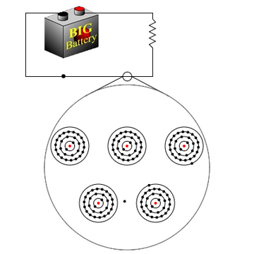
2
¿Qué es la electricidad?
Matemáticamente
=
flujo de partículas cargadas
Prácticamente
=
flujo de electrones (se mueven más rápido)
Los electrones
fluyen a través de los conductores.
Explorando la Ciencia Nuclear
Notes:
2
Suggest to teachers that they review with their students how electricity is made as many will have learned about it much earlier in their schooling.

Slide 3
3
Electricidad
  Cuando un conductor se mueve dentro de un campo magnético, se genera corriente eléctrica.
  Cuando un campo magnético se mueve dentro de un conductor, se genera corriente eléctrica.
Explorando la Ciencia Nuclear
Notes:
3

Slide 4
4
Generador
Sencillamente, un imán con conductores a su alrededor.
Imán
Explorando la Ciencia Nuclear
Notes:
4
Generator converts mechanical energy (input) from an external source into electrical energy (output).
Generator doesn’t create electricity. It moves a magnet near a source of electrons, such as a copper wire, to create a steady stream of electrons

Slide 5
5
Generador
Debes girar el generador.
    En las plantas de energía, los generadores son grandes y pesados.
    Se necesita mucha energía para hacerlo girar.
    Debes generar un movimiento de rotacional.
Explorando la Ciencia Nuclear
Notes:
5

Slide 6
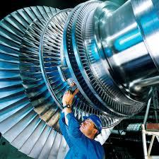
6
Turbina
Una turbina es un dispositivo que utiliza energía de una fuente y la transforma en un movimiento rotatorio, que impulsa el generador.
En pocas palabras, es un ventilador grande y elegante.
Explorando la Ciencia Nuclear
Notes:
6
The turbine moves the generator. All electricity production that depends on a turbine needs a way to move the turbine. So what moves the turbine?

Slide 7
7
Turbina de Vapor
La mayoría de las centrales eléctricas usan vapor para hacer girar la turbina.
    La turbina aprovecha tanto el movimiento del vapor como la energía que se libera al enfriarlo.
    Beneficios del ciclo del vapor:
      Tecnología ampliamente conocida
      El agua es barata y fácil de encontrar
      El combustible para su uso está disponible fácilmente
Explorando la Ciencia Nuclear
Notes:
7

Slide 8
8
¿De dónde proviene el vapor?
El vapor se origina al hervir agua
    igual que cuando hierves agua en una olla sobre el fuego.
    Boiling occurs in the boiler
    La ebullición ocurre cuando el agua se calienta hasta alcanzar su punto de ebullición, convirtiéndose en vapor.
      Carbón, petróleo, gas natural
      Madera, desechos sólidos, biomasa
      Fisión nuclear
Explorando la Ciencia Nuclear
Notes:
8

Slide 9
Fisión Nuclear
Explorando la Ciencia Nuclear
Notes:
9

Slide 10
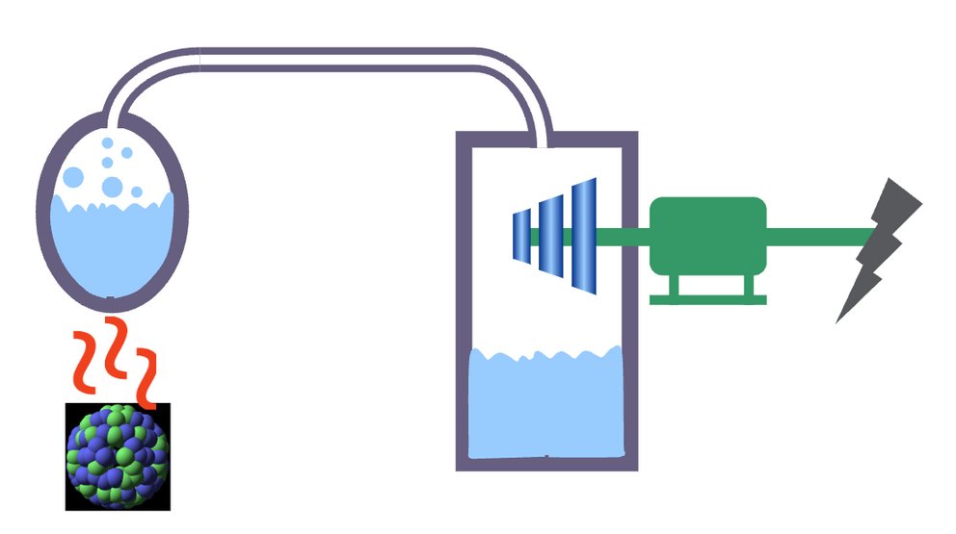
Fisión Nuclear
Vapor
Producción de vapor
Generador
Turbina
Electricidad
Calor
Explorando la Ciencia Nuclear
Notes:
9

Slide 11


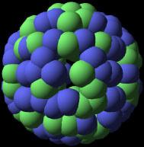

11
Fission begins with neutrons
Neutrones
átomo de Uranio
Explorando la Ciencia Nuclear
Notes:
11
Fission is the release of energy by splitting heavy nuclei, such as U-235 and Plutonium-239. Fission requires overcoming the strong nuclear force which binds the protons and neutrons.
On start up, neutrons are released and strike the uranium atom. The impact splits the uranium atom, causing it to fission into two or three lighter atoms and two or three neutrons.

Slide 12

12
La fisión desprende energía en forma de calor
Calor
Neutrones
Explorando la Ciencia Nuclear
Notes:
12
Breaking the binding force releases a great deal of energy.
See if teachers can guess comparison of uranium to coal
8 kWh of heat can be generated from 1 kg of coal
approx. 12 kWh from 1 kg of mineral oil
around 24,000,000 kWh from 1 kg of uranium-235.

Slide 13
13
Los elementos resultantes de la fisión nuclear
  Dos elementos más ligeros
  2-3 neutrones
  Gamas
  ≈200 MeV por fisión
Explorando la Ciencia Nuclear
Notes:
Note that the lighter elements (large pieces in the previous slide) are entirely new elements, not just chunks of uranium. Lighter isotopes may include Cesium-137, Strontium 90, Xenon 140, etc.
13

Slide 14



14
Reacción en Cadena
Explorando la Ciencia Nuclear
Notes:
14
The neutrons released strike other uranium atoms, causing them to fission. This continues in a chain reaction, like dominos falling.
Neutrons are fast, so a moderator is used. Moderator slows neutrons to ensure they strike 235U atoms, continuing the chain reaction
Control rods keep the reaction in check. Reactor operators raise or lower them depending on the need.
When the reaction is self-sustaining, the reactor has achieved criticality.

Slide 15
15
Simulando el Proceso de Fisión
Explorando la Ciencia Nuclear
Notes:
Assign teachers a few minutes to devise methods of modeling fission and chain reaction. Models can be kinesthetic, manipulatives, drawings, etc. Have a variety of materials available such as balloons, balls, paper, dominos, etc.
Share ideas.
15

Slide 16
16
Reactor Nuclear
Componentes esenciales
  Combustible Nuclear (usualmente enriquecido con Uranio)
Se fisiona al absober un neutrón térmico para generar calor.
2. Moderador
Modera o reduce la velocidad de los neutrones rápidos.
Está hecho de un material que dispersa neutrones.
H₂O y grafito son los más comunes.
3. Refrigerante
Transporta el calor desde el núcleo del combustible del reactor para generar vapor y producir electricidad.
4. Barras de Control
Generalmente compuesto de materiales absorbentes de neutrones, como el boro y el cadmio.
Explorando la Ciencia Nuclear
Notes:
Teachers may wonder what a moderator is and how it is different from the control rods. Moderator is necessary to make sure neutrons strike the uranium atoms. Control rods absorb the neutrons to prevent them from striking the uranium.
16

Slide 17
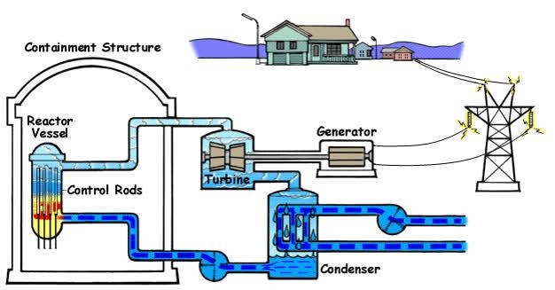
17
BWR (Boiling water reactor)
Explorando la Ciencia Nuclear
Notes:
Describe how a reactor works using the boiling water reactor first, as it’s often more easily understood than the pressurized water reactor.
The images on this slide and the next are flash animations when in slide show mode.
17

Slide 18
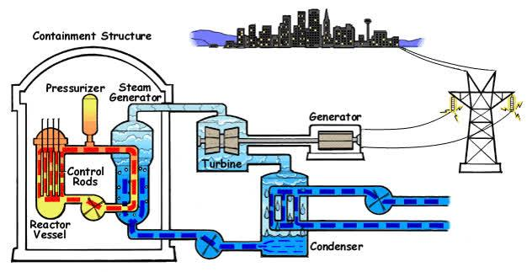
18
PWR (Pressurized water reactor)
Explorando la Ciencia Nuclear
Notes:
Describe how a pressurized water reactor differs. Ask why pressurize the water?
18

Slide 19

19
Explicando la Energía Nuclear
Explorando la Ciencia Nuclear
Notes:
Ryne Burgess, a nuclear engineer at the Palo Verde Generating Station explains the steps in creation of nuclear energy. This clip is a segment from a virtual field trip of the Palo Verde Station created for ANS’s K-12 nuclear energy education program: Navigating Nuclear: Energizing Our World. Clicking on the photo will take you to the virtual field trip page on navigatingnuclear.com. You will need to scroll down the page a little to find the “Nuclear Energy Explained” segment.
You may also choose to show the entire virtual field trip, which is a behind the scenes tour of the largest nuclear power plant in the United States.
Delete this slide if you do not have an internet connection.
19

Slide 20
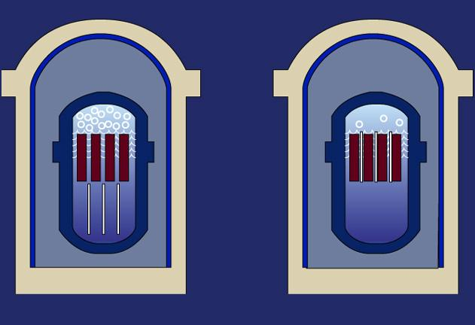
20
Controlando la Reacción en Cadena
Elemento de Combustible
Barras de Control
Retirar las barras de control, incrementa la reacción.
Insertar barras de control, reduce la reacción.
Explorando la Ciencia Nuclear
Notes:
20
Long rods, made of silver, indium or cadmium, are inserted among the fuel assemblies. These "control rods" are made to absorb neutrons, so the neutrons can no longer hit atoms and make them split. To speed up the chain reaction, plant operators withdraw the control rods, either partially or fully. To slow it, they insert the control rods.

Slide 21
21
Ponle nombre a esa energía
Explorando la Ciencia Nuclear
Notes:
Distribute worksheets from Navigating Nuclear: Energizing Our World lesson on nuclear energy. Have teachers label the type of energy (potential, kinetic, thermal, etc.) involved in each step of the nuclear reactor. You’ll find the worksheet for this activity in the Educator Guide for the Navigating Nuclear: Energizing Our World lesson Nuclear Energy.
https://www.navigatingnuclear.com/#/classroom-resources
21

Slide 22
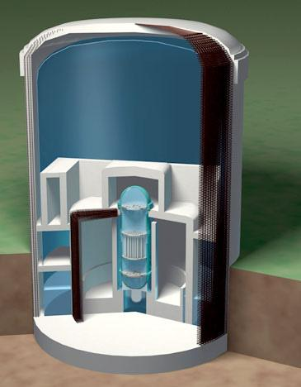
22
La seguridad forma parte integral del diseño de los reactores
Edificio de Contención: acero de 1.5 pulgadas de espesor.
Muro de Protección: hormigón armado de 3 pies de espesor.
Pared de Hielo Seco: 5 pies de concreto reforzado.
Bioprotección: 4 pies de concreto plomado con 1.5 pulgadas en espesor de revestimiento de acero por dentro y por fuera.
Vasija a Presión del Reactor:
acero de 4-8 pulgadas de espesor.
Explorando la Ciencia Nuclear
Notes:
22
Nuclear power plants use a series of physical barriers to make sure radioactive material cannot escape. In today’s water-cooled reactors, the first barrier is the fuel itself: the solid ceramic uranium pellets. Most of the radioactive by-products of the fission process remain inside the pellets. The pellets are sealed in zirconium rods, 12 feet long and half an inch in diameter. The fuel rods are placed inside a large steel reactor vessel, with walls 8 inches thick. The vessel is surrounded by 3 feet of concrete shielding. At most plants, a leak-tight steel liner covers the inside walls of the containment building. The containment building is a massive, reinforced concrete structure with walls 4 feet thick.
Credit: https://slideplayer.com/slide/12471394/, Ethan Nichols

Slide 23
Fusión Nuclear
Explorando la Ciencia Nuclear
Notes:
23

Slide 24
24
Fusión
    Es lo opuesto a la fisión
    Funciona elementos con núcleos ligeros
    Es la fuente de energía del sol y las estrellas
    Es complicado de replicar la fusión en la Tierra
Explorando la Ciencia Nuclear
Notes:
Light nuclei element used is hydrogen
24

Slide 25
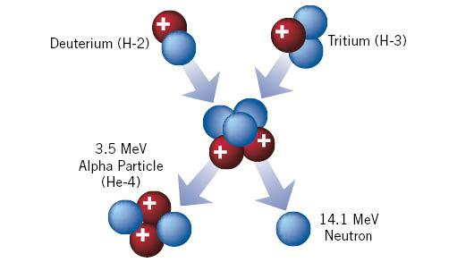
25
Proceso Básico de Fusión
Explorando la Ciencia Nuclear
Notes:
Note that Deuterium and Tritium are isotopes of Hydrogen
Fusion reactions release 3-4 times more energy than fission reactions
25

Slide 26
26
Simulando el Proceso de Fusión
Explorando la Ciencia Nuclear
Notes:
Give participants marshmallows and tell them to model fusion of hydrogen atoms using the marshmallows. Ask what they had to do to the marshmallows to make them fuse. (Apply pressure and heat to mash the marshmallows together. Some may develop another model, but pressure and heat are what is used in fusion reactors). Ask how they would expand on the activity in their classrooms.
26

Slide 27
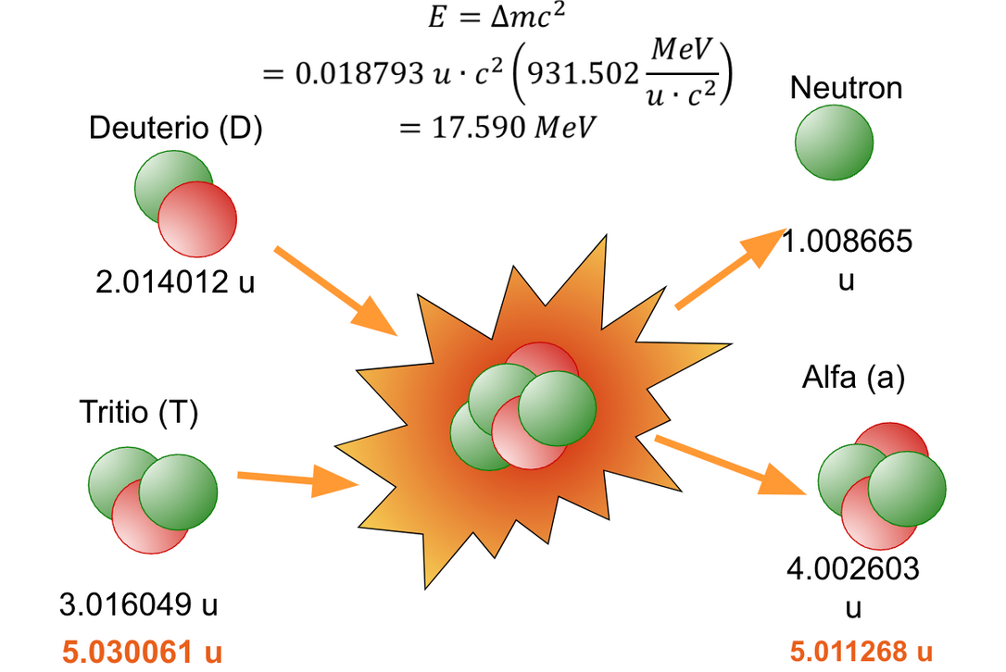
27
Explorando la Ciencia Nuclear
Notes:
Give participants marshmallows and tell them to model fusion of hydrogen atoms using the marshmallows. Ask what they had to do to the marshmallows to make them fuse. (Apply pressure and heat to mash the marshmallows together. Some may develop another model, but pressure and heat are what is used in fusion reactors). Ask how they would expand on the activity in their classrooms.
26

Slide 28




28
Comparación de Tipos de Energía
Química
Fisión
Fusión
N+U =
235
H + H =
He + n
Reacción
C+O =CO
2
3
2
91
Ba + Kr + 2n
143
4
Combustible
Carbón
UO
Deuterio y Tritio
2
(3% U-235 + 97% U-230)
Temperatura
700 K
O
O
1,000 K
O
1,000,000,000 K
Energía
J/kg
7
12
14
3.3x10
2.1x10
3.4x10
28
Explorando la Ciencia Nuclear
Notes:
28
At equal mass, fusion produces four million times more energy than a chemical reaction such as the burning of coal, oil or gas and four times as much as nuclear fission reactions

Slide 29
29
Creando Fusión en la Tierra
  Temperatura muy alta (150,000,000°C)
  Alta presión
  Densidad de partículas en el plasma
  Confinamiento
29
Explorando la Ciencia Nuclear
Notes:
Three conditions must be fulfilled to achieve fusion in a laboratory: very high temperature (on the order of 150,000,000° Celsius); sufficient plasma particle density (to increase the likelihood that collisions do occur); and sufficient confinement time (to hold the plasma, which has a propensity to expand, within a defined volume).
Credit: ITER, https://www.iter.org/proj/inafewlines
29

Slide 30
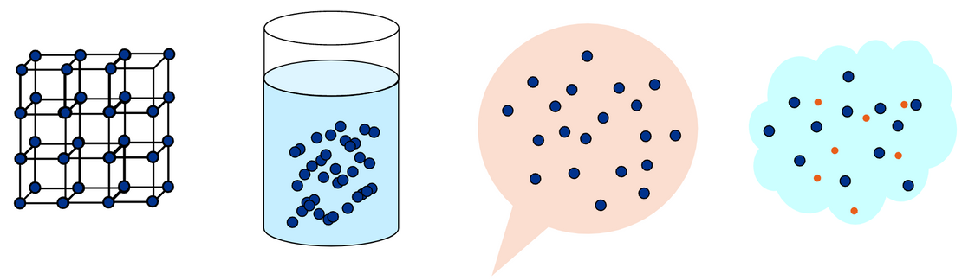
30
¿Qué es el plasma?
  4 electrones separados del núcleo
  4º estado de la materia
SOLID
Hielo
Frío
LIQUIDO
Agua
Tibio
GAS
Agua
Caliente
PLASMA
Más Caliente
29
Explorando la Ciencia Nuclear
Notes:
Three conditions must be fulfilled to achieve fusion in a laboratory: very high temperature (on the order of 150,000,000° Celsius); sufficient plasma particle density (to increase the likelihood that collisions do occur); and sufficient confinement time (to hold the plasma, which has a propensity to expand, within a defined volume).
Credit: ITER, https://www.iter.org/proj/inafewlines
29

Slide 31
31
Características del Plasma
  La mayoría de los átomos están ionizados.
  Todo el plasma sigue siendo neutro.
  Puede existir a cualquier temperatura y densidad.
Explorando la Ciencia Nuclear
Notes:
For a nuclear fusion reaction to occur, it is necessary to bring two nuclei so close that nuclear forces become active and glue the nuclei together. Nuclear forces are small-distance forces and have to act against the electrostatic forces where positively charged nuclei repel each other. This is the reason nuclear fusion reactions occur mostly in high density, high temperature environment.
Space – 100 K, 106 electrons/m3
Earth’s Ionosphere – 2000 K, 1011 electrons/m3
Fusion Experiment – 109 K, 1020 electrons/m3
Credit: ANS, nuclearconnect.org
31

Slide 32
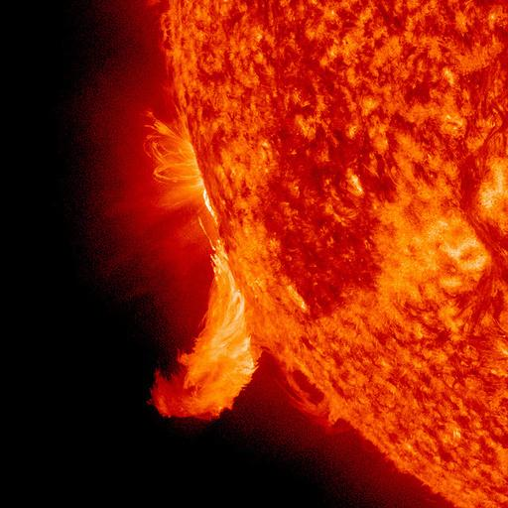
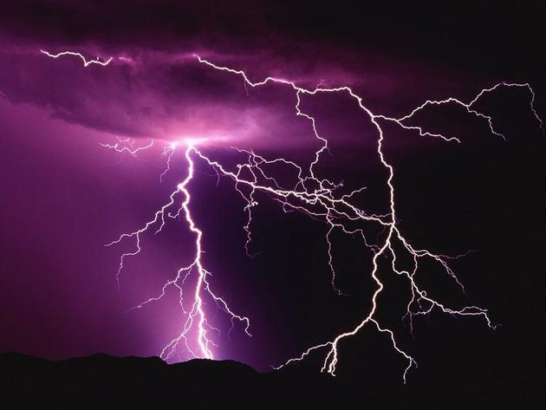
32
Ejemplos de Plasma
Explorando la Ciencia Nuclear
Notes:
Lightning
Fluorescent light bulbs contain mercury plasma.
Stars, such as the sun are hot balls of plasma.
Aurora Borealis and Aurora Australis
Plasma displays for TVs use small cells of plasma to illuminate images.
32

Slide 33
33
¿Qué es el Confinamiento?
  El plasma tiende a expandirse.
  El confinamiento mantiene el plasma estable para que pueda ocurrir la fusión.
Explorando la Ciencia Nuclear
Notes:
The sufficient confinement time (to hold the plasma, which has a propensity to expand, within a defined volume). This is where the pressure is involved, like in the marshmallow model.
Plasma at millions of degrees for fusion
Need to hold in the material and the energy
Use some of the energy from one fusion event to keep the plasma hot
33

Slide 34
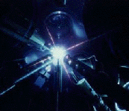
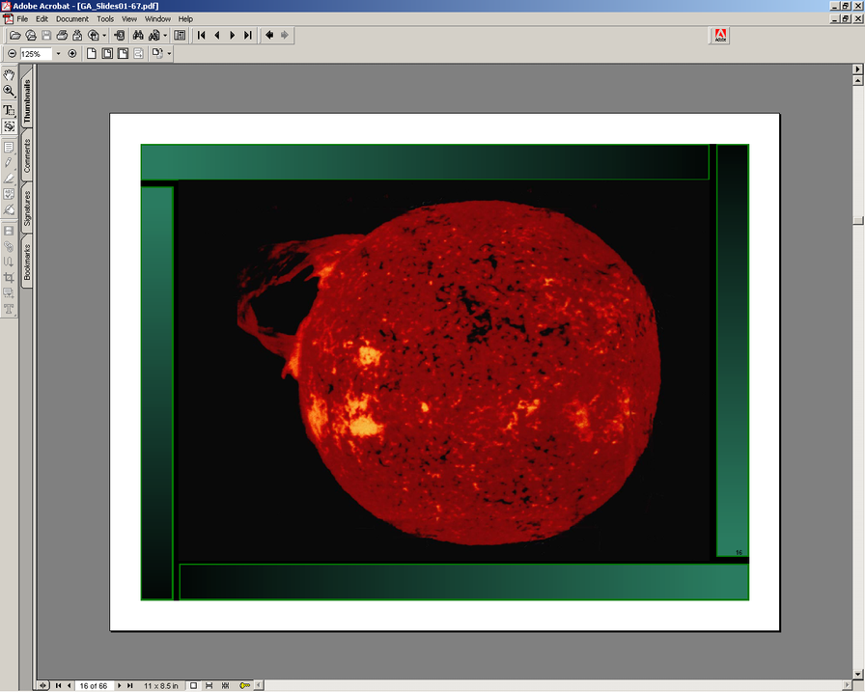
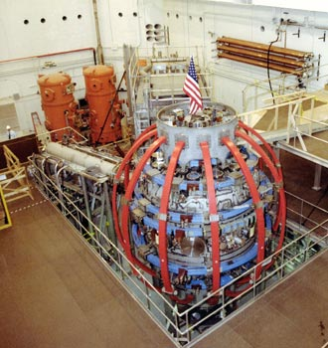
34
Concepto de Confinamiento
Inercia
Gravitacional
Magnético
Explorando la Ciencia Nuclear
Notes:
magnetic confinement the hot plasma particles are contained in a magnetic “cage” made by strong magnetic fields which prevent the particles from escaping.
Inertial confinement lasers or particle beams would be used to produce fusion at rates high enough that the inertia of the target material is sufficient to keep the fuel particles where they can fuse. (Beams or laser-produced X-rays rapidly heat the surface of the fusion target, forming a surrounding plasma envelope.)
Fuel is compressed by the rocket-like blowoff of the hot surface material.
During the final part of the capsule implosion, the fuel core reaches 20 times the density of lead and ignites at 100,000,000 ˚C.
Thermonuclear burn spreads rapidly through the compressed fuel, yielding many times the input energy.)
In stars, the confinement is due their gravitational field that creates sufficiently high pressure.
Credit: Dimensional Analysis Beyond the Pi Theorem, Bahman Zohuri
AND: NUPEX nuclear physics experience, http://nupex.eu/index.php?lang=en&g=textcontent/nuclearenergy/nuclearfusion
34

Slide 35
35
Superando la Repulsión de Coulomb
  Los núcleos tienen carga positiva y las cargas iguales se repelen.
  Acelera los átomos a alta energía: 30-1000 keV.
    acelerador de partículas
      Utilizado para producir neutrones e isótopos
    energía en forma de calor
      Haz que los átomos estén lo suficientemente calientes como para que su movimiento aleatorio promedio esté a una energía muy alta.
      1 eV ~11000 K
Explorando la Ciencia Nuclear
Notes:
At very high temperatures, electrons are stripped from atomic nuclei to form a plasma (ionized gas). Under such conditions, the repulsive electrostatic forces that keep positively charged nuclei apart can be overcome, and the nuclei of select light elements can be brought together to fuse and form other elements. Nuclear fusion of light elements releases vast amounts of energy and is the fundamental energy-producing process in stars.
In this case, the hydrogen nuclei fuse to form helium.
Credit: ANS, nuclearconnect.org
35

Slide 36
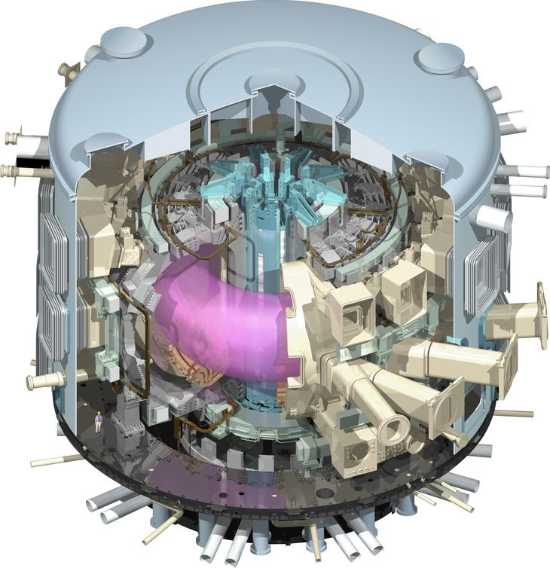
36
Reactor Tokamak (ITER)
  Proyecto lanzado en 1985
  Miembros:
  China, la Unión Europea,
  India, Japón, Corea, Rusia,
  Estados Unidos de América
  Ubicado en Francia
  Primer Plasma en 2025
  Deutero-Tritio 2035
  www.iter.org
Explorando la Ciencia Nuclear
Notes:
Inside, under the influence of extreme heat and pressure, gaseous hydrogen fuel becomes a plasma—a hot, electrically charged gas. In a star as in a fusion device, plasmas provide the environment in which light elements can fuse and yield energy.
The charged particles of the plasma can be shaped and controlled by the massive magnetic coils placed around the vessel; physicists use this important property to confine the hot plasma away from the vessel walls. The term "tokamak" comes from a Russian acronym that stands for "toroidal chamber with magnetic coils" (тороидальная камера с магнитными катушками).
To start the process, air and impurities are first evacuated from the vacuum chamber. Next, the magnet systems that will help to confine and control the plasma are charged up and the gaseous fuel is introduced. As a powerful electrical current is run through the vessel, the gas breaks down electrically, becomes ionized (electrons are stripped from the nuclei) and forms a plasma.
As the plasma particles become energized and collide they also begin to heat up. Auxiliary heating methods help to bring the plasma to fusion temperatures (between 150 and 300 million °C). Particles "energized" to such a degree can overcome their natural electromagnetic repulsion on collision to fuse, releasing huge amounts of energy.
Credit: ITER
36

Slide 37
37
La promesa de la Energía de Fusión
  Plasma se enfría en segundos
  Sin riesgo de reacción en cadena
  Sin materiales fisibles
  Combustible extraído del agua de mar
  Sin desechos radiactivos de larga vida
Explorando la Ciencia Nuclear
Notes:
It is difficult enough to reach and maintain the precise conditions necessary for fusion—if any disturbance occurs, the plasma cools within seconds and the reaction stops. The quantity of fuel present in the vessel at any one time—only grams of it--is enough for a few seconds only and there is no risk of a chain reaction.
Fusion doesn't employ fissile materials like uranium and plutonium. (Radioactive tritium is neither a fissile nor a fissionable material.) There are no enriched materials in a fusion reactor like ITER that could be exploited to make nuclear weapons.
Nuclear fusion reactors produce no high activity, long-lived nuclear waste. The activation of components in a fusion reactor is low enough for the materials to be recycled or reused within 100 years.
Credit: ITER
37

Slide 38
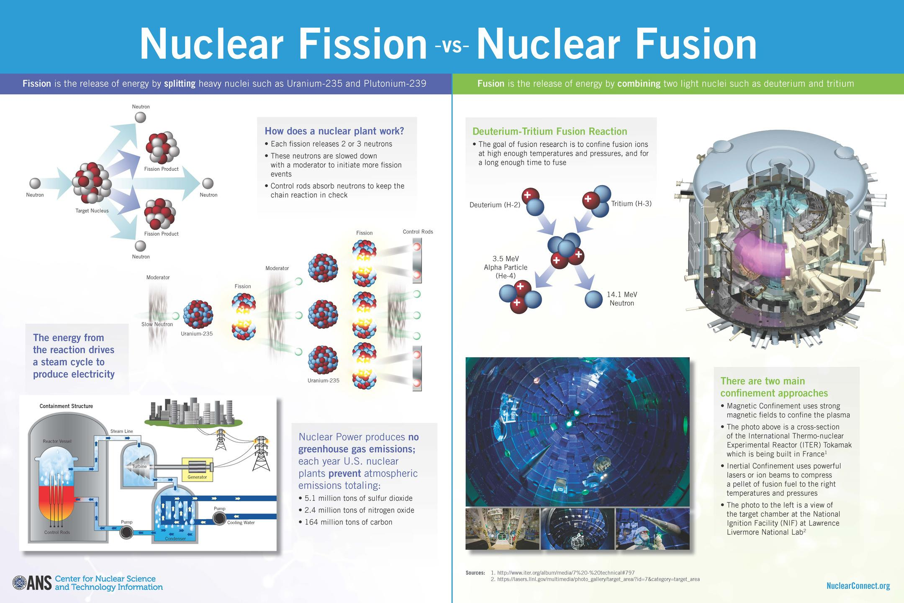
38
Fission vs Fusion
Explorando la Ciencia Nuclear
Notes:
The image produced here is available as a classroom poster from ANS. http://www.ans.org/store/item-750099/. Consider purchasing a copy for each participant.
Navigating Nuclear includes a STEM project starter that guides students in creating a project around nuclear fission and fusion “Fusion and Fission: Think Nucleus.” https://www.navigatingnuclear.com/#/classroom-resources.
Have teachers review and/or complete portions of the lesson.
Alternatively, have teachers work in pairs to create Venn diagrams comparing and contrasting fusion and fission.
38

Slide 39
39
Futuro
Laboratorios Nacionales en Estados Unidos estan explorando:
  Combustibles avanzados
  Sistemas de reactores
  Sistemas de energía espacial
  Evaluación de seguridad y riesgos
Explorando la Ciencia Nuclear
Notes:
Department of Energy labs are collaborating on a number of fronts. The listed areas can be found on the Idaho National Laboratory site. https://inl.gov/research-programs/nuclear-energy/
39

Slide 40
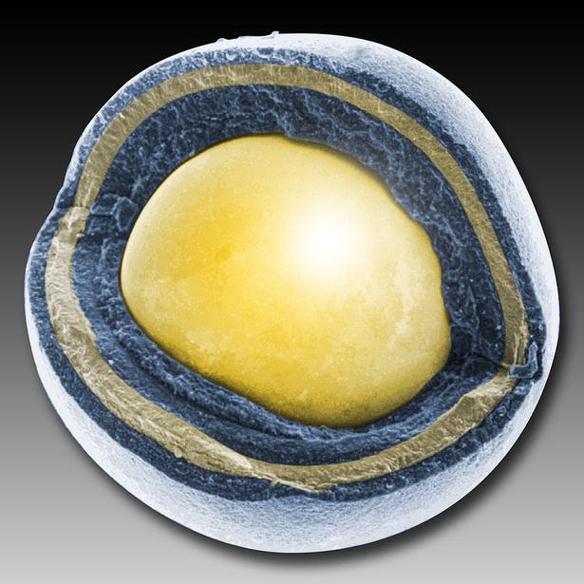
40
Combustibles Avanzados
Partícula de combustible TRISO
Explorando la Ciencia Nuclear
Notes:
TRISO fuel particles have a uranium core that triple coated: a layer of carbon around the uranium, then a layer of silicon carbide, and then another layer of carbon. The coating is essentially a containment system.
utilize energy resources more efficiently
leave fewer long-lived waste isotopes behind.
In accident conditions, the particles are better able to withstand high temperatures and, therefore, release fewer fission products. They are currently under development.
40

Slide 41
41
Sistemas de Reactores
  Extender la vida útil de los reactores existentes
  Tecnologías de Reactores Avanzados (ART)
  Reactores Modulares Pequeños
Explorando la Ciencia Nuclear
Notes:
It is less important for teachers to know the specifics of reactor technologies, such as the Gen IV reactor types. Mention some but focus on their benefits.
Reactors
The Gas-Cooled Fast Reactor (GFR)
Very-High-Temperature Reactor (VHTR)
Supercritical-Water-Cooled Reactor (SCWR)
Sodium-Cooled Fast Reactor (SFR)
Lead-Cooled Fast Reactor (LFR)
Molten Salt Reactor (MSR)
Benefits
Utilize uranium efficiently. Many can employ depleted uranium or “spent” fuel from current reactors.
Destroy a large fraction of nuclear waste from current reactors via transmutation.
Generate hydrogen for transportation and other non-electric energy needs.
Be inherently safe and easy to operate.
Provide built-in resistance to nuclear weapons proliferation.
Provide a clear cost advantage over other forms of energy generation.
Carry a financial risk no greater than other forms of energy generation.
EXAMPLE: For example, one molten-salt reactor designed to consume one ton of uranium per year, could supply sufficient hydrogen to fuel 3 million passenger vehicles. The waste from one year of the plant’s year’s operation would occupy half the volume of a typical domestic refrigerator. The radioactivity of the waste would diminish to background levels in about 500 years.
Idaho National Laboratory (INL) ART
at INL, work is focused specifically on developing a High Temperature Gas-cooled Reactor (HTGR), which will offer enhancements in safety and efficiency. This HTGR has a modularized design, which enables plants with larger power demands to simply build more than one module. Modularization requires no extra design work and increases safety and efficiency by allowing a singular module to run or be stopped at any given time in the event of an incident or a changing need for power. HTGRs also produce process heat during operation, making them ideal for location near other industrial plants that could put this process heat to use in their own production and thus reduce the need for non-renewable energy sources upon which these plants currently rely.
Credit: Idaho National Laboratory
41

Slide 42
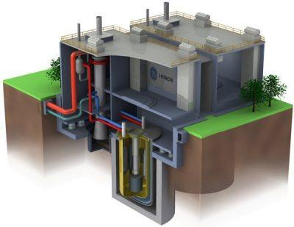
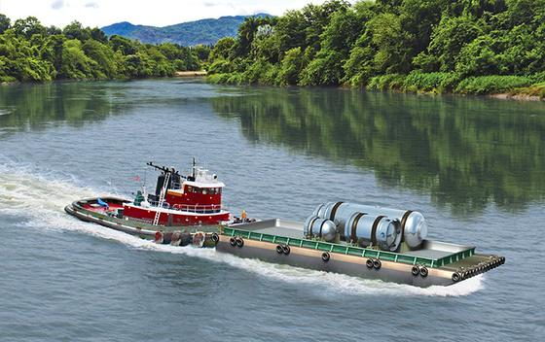
42
Reactores en el Futuro (cercano)
Photo: NuScale Power
Photo: GE Hitachi Nuclear Energy
Explorando la Ciencia Nuclear
Notes:
GE Hitachi Nuclear Energy PRISM in foreground. PRISM is a fast reactor in a small, modular form.
NuScale Power small module reactor (SMR) on barge emphasizes that SMRs can be manufactured in a factory and shipped where needed.
42

Slide 43
43
La energía nuclear en el mix energético
Beneficios
  Aire Limpio
      Cerca del 60% de la energía en los Estados Unidos es libre de carbono
  Excelente historial de seguridad
  Fuente confiable de energía base 24/7
Retos
  Bajo costo del gas natural obtenido por fracking
  Estancamiento en la localización de almacenamiento permanente
  Percepción pública sobre la seguridad
Explorando la Ciencia Nuclear
Notes:
Nuclear energy is an important source of carbon-free energy as the world moves to clean and renewable sources. Wind, solar and others have significant challenges of their own to overcome before they are able to provide electricity consistently and reliably. Nuclear fills a current need without increasing greenhouse gas emissions (such as natural gas does.)
Credit: ANS Center for Nuclear Science and Technology Information nuclearconnect.org
43

Slide 44
44
Recursos
ANS Center for Nuclear Science and Technology Information nuclearconnect.org
Navigating Nuclear: Energizing Our World™ navigatingnuclear.com
ANS Operations and Power Division http://opd.ans.org/
ANS Fusion Energy Division http://fed.ans.org/
Idaho National Laboratory www.inl.gov
U.S. Department of Energy’s Princeton Plasma Physics Laboratory
www.pppl.gov
Department of Energy https://www.energy.gov/science-innovation/energy-sources/nuclear
Explorando la Ciencia Nuclear
Notes:
Links are only active in slide view and with internet access
44

