Slide 1

Conceptos Básicos de la Radiación
Viaje al Centro del Átomo
-
+
+
-
Nombre
Título
Afiliación
Explorando la Ciencia Nuclear
Notes:
1

Slide 2
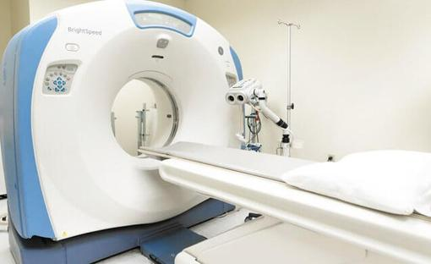
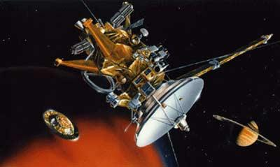
2
¿Qué tienen en común las siguientes cosas?
Tomografías Computarizadas
Nave Espacial Cassini
Explorando la Ciencia Nuclear
Notes:
CT scans use x-rays. CT is widely used to help diagnose circulatory (blood) system diseases and conditions, such as coronary artery disease (atherosclerosis), blood vessel aneurysms, and blood clots; spinal conditions; kidney and bladder stones; abscesses; inflammatory diseases, such as ulcerative colitis and sinusitis; and injuries to the head, skeletal system, and internal organs. CT can be a life-saving tool for diagnosing illness and injury in both children and adults.
Credit: National Cancer Institute https://www.cancer.gov/about-cancer/diagnosis-staging/ct-scans-fact-sheet
Cassini - Three Radioisotope Thermoelectric Generators – commonly referred to as RTGs – provided power for the spacecraft, including the instruments, computers, and radio transmitters on board, attitude thrusters, and reaction wheels. Each RTG is made up of a radioisotope heat source, a thermoelectric converter, a gas pressure venting system, temperature transducers, connectors, a heat rejecting cylindrical container, and bracketry. The RTGs are mounted in tandem (end-to-end) on a deployable boom as part of the MM.
The heat source radioisotopic fuel is Plutonium-238 in the form of the oxide Pu02. In the isotopic decay process, alpha particles are released which bombard the inner surface of the container. The energy released is converted to heat and is the source of heat to the thermoelectric converter.
Credit: NASA
2

Slide 3
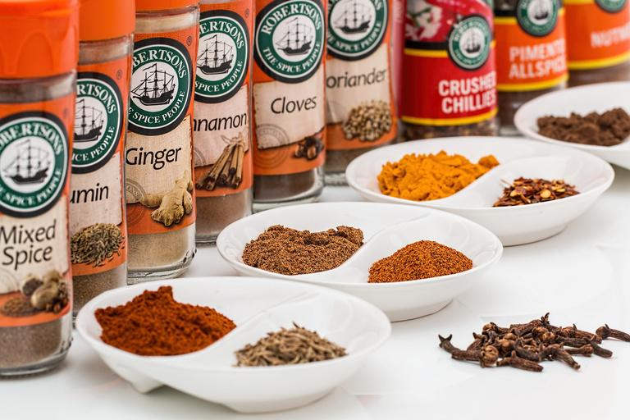

3
Especias
Pañales
Explorando la Ciencia Nuclear
Notes:
Spices - Food irradiation is a process that uses radiation to control pests (e.g., microbes and insects) in food and prevent spoilage. Food irradiation is similar to pasteurizing milk and canning fruits or vegetables as it can make food safer for consumption. Irradiation does not make the food radioactive, nor does it change the taste, texture, or appearance of the food. During irradiation, gamma rays, x-rays, or high-energy electrons pass through the food, destroying or inactivating bacteria and viruses that cause foodborne illness.
Credit: EPA
Diapers – One helpful feature of radiation is that it changes the molecular structure of some materials to allow them to absorb huge amounts of liquid. Useful products that rely on this include air fresheners, disposable diapers, and tampons. X-rays are also used to examine the structure of diapers so scientists can improve performance.
Credit: The Energy Reality Project
3

Slide 4
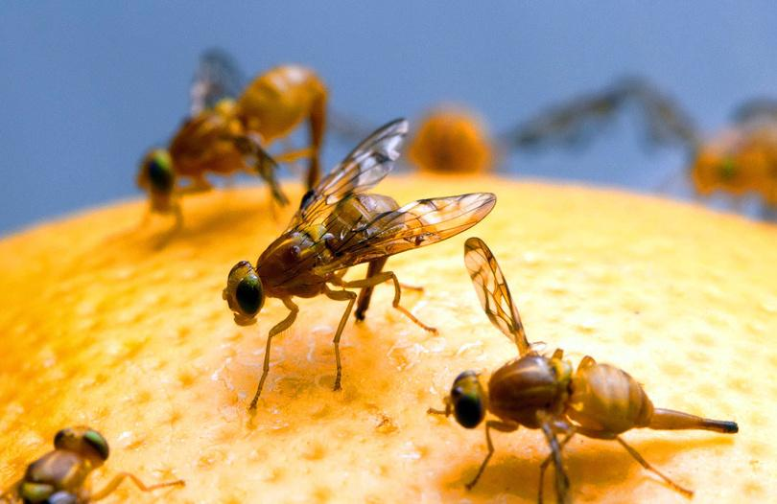

4
Moscas
Señales de Emergencia
Explorando la Ciencia Nuclear
Notes:
Fruit flies – a 2015 study showed that weak doses of gamma radiation prolong the life of drosophila flies (fruit flies), and that the effect is stronger in females than in males. These findings could reveal the genes that enable the prolongation of life and in the future lead to the creation of a means to prevent aging in humans. Radiation is also used as a quarantine treatment of fruits imported to the US.
Credit: Moscow Institute of Physics and Technology, press release
Exit signs - In EXIT signs, tritium gas is contained in sealed glass tubes lined with a light-emitting compound. The tritium gives off low-energy beta radiation that causes the lining to glow.
Credit: Nuclear Regulatory Commission https://www.nrc.gov/reading-rm/doc-collections/fact-sheets/fs-tritium.html
4

Slide 5

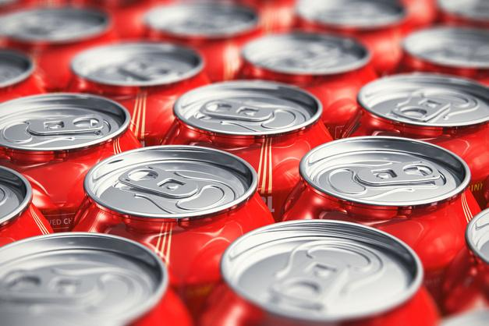
5
Lija de Papel
Latas de Refresco
Explorando la Ciencia Nuclear
Notes:
5
Radiation thickness gauges are used in the production of sandpaper and soda cans. In sandpaper production, the thickness of the paper, the glue and the grit are all measured using radiation. Radiation thickness gauges can also be used to measure fill levels.

Slide 6
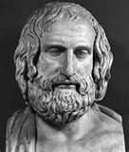
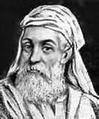
6
Una Breve Historia de la Teoría Atómica
Anaxágoras
Griego, nacido en el año 500 a.C.
Divisibilidad infinita de la materia
“De lo pequeño no hay parte más pequeña, sino siempre algo más pequeño.”
Empédocles
Griego, nacido en 490 a.C.
Cuatro elementos básicos: tierra, aire, fuego, agua.
Conservación de la masa
“Nada nuevo surge ni puede surgir; el único cambio que puede ocurrir es un cambio en la disposición de los elementos”.
Explorando la Ciencia Nuclear
Notes:
The earliest theory about atomic structure was over 2,500 years ago.
Greek philosopher Anaxagoras “reasoned” that matter was comprised of “seeds” or “elements”
A few years later, Empedocles concluded there were four basic elements:
Earth
Air
Fire
Water

Slide 7
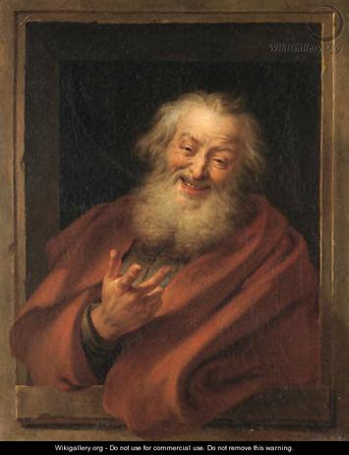
7
Una Breve Historia De la Teoría Atómica
Demócrito
Griego, nacido en 460 a.C.
Todo está compuesto de átomos.
Indestructible, indivisible
Espacio vacío entre ellos
Siempre en movimiento
Origen del universo
Los átomos se unieron para formar sustancias más grandes.
Más de cuatro elementos
“No existe nada más que átomos y espacio, todo lo demás
“es opinión.”
Explorando la Ciencia Nuclear
Notes:
A few decades after Empedocles, Democritus, another Greek who lived from 460 BCE to 370 BCE, developed a new theory of matter that attempted to overcome the problems of his predecessor.
Democritus' ideas were based on reasoning rather than science, and drew on the teachings of two Greek philosophers who came before him, Leucippus and Anaxagoras.
Democritus knew that if you took a stone and cut it in half, each half had the same properties as the original stone.
He reasoned that if you continued to cut the stone into smaller and smaller pieces, at some point you would reach a piece so tiny that it could no longer be divided.
Democritus called these infinitesimally small pieces of matter “atomos” (Greek for atoms) meaning “indivisible.”
He suggested that atoms were eternal and could not be destroyed.
Democritus theorized that atoms were specific to the material that they made up, meaning that the atoms of stone were unique to stone and different from the atoms of other materials such as fur.
This was a remarkable theory that attempted to explain the whole physical world in terms of a small number of ideas.
One of his many famous quotes, “Nothing exists but atoms and space, all else is opinion.”
Credit: https://www.visionlearning.com/img/library/module_viewer.php?mid=49&l=&c3=, http://thehistoryoftheatom.weebly.com/democritus.html

Slide 8
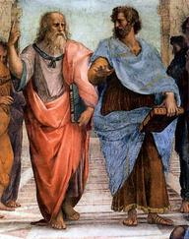
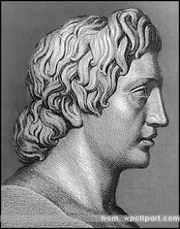
8
La teoría atómica se suspende por unos 2,000 años
FUEGO
Aristóteles y Platón
Creía que sólo había
cuatro elementos
Los elementos pueden transformarse en
Otros elementos
Caliente
Seco
'ASUNTO'
AIRE
TIERRA
Húmedo
Frío
AGUA
Alejandro Magno
Rey de Macedonia
Tutelado por Aristóteles
Se consideraba que la alquimia era la única ciencia que valía la pena seguir.
Explorando la Ciencia Nuclear
Notes:
Young Greek philosophers Aristotle and Plato disagreed with Democritus.
They not only endorsed Empedocles’ theory about there only being four elements, but expanded it.
They reasoned the attributes or characteristics of the elements were
Hot,
Dry,
Cold, and
Wet.
They also reasoned that the elements could transform into one another, thus giving birth to the science of alchemy.
Alexander the Great was tutored by Aristotle and sided with his teacher.
Atomic theory was effectively put on hold until the 1600s.

Slide 9
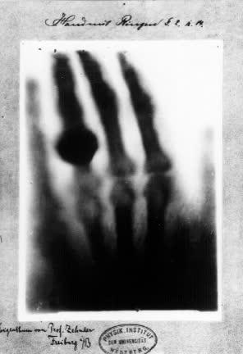
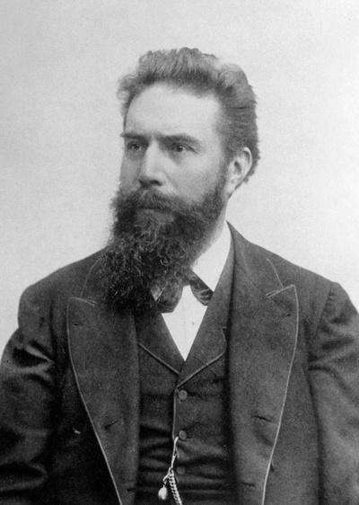
9
Comienza un ritmo rápido de descubrimientos nucleares
Wilhelm Röntgen (1845-1923)
Ingeniero y físico alemán
1895 descubrió los rayos X
Explorando la Ciencia Nuclear
Notes:
Roentgen was a professor of physics at Würzburg University. He was conducting an experiment when he noticed photographic plates near his equipment glowing. He discovered the glowing was caused by mysterious rays emitted by the glass tube used in his investigation. This tube contained a pair of electrodes. As electricity passed between the electrodes, X‑rays were emitted and appeared on the photographic plates. Roentgen called the rays ‘X’ for unknown
The x-ray image is of Roentgen’s wife’s hand. The large knob on the ring finger is, indeed, a ring.
9

Slide 10
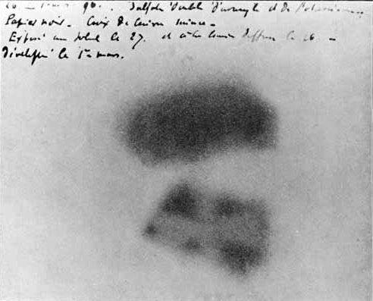
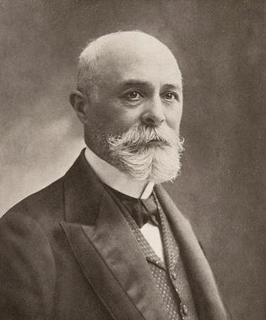
10
El rápido ritmo del descubrimiento nuclear, cont.
Henri Becquerel (1852-1908)
Físico francés
1896 se descubrió la radiactividad
Explorando la Ciencia Nuclear
Notes:
In 1896, Henri Becquerel was using naturally fluorescent minerals to study the properties of x-rays, which had been discovered in 1895 by Wilhelm Roentgen. He exposed potassium uranyl sulfate to sunlight and then placed it on photographic plates wrapped in black paper, believing that the uranium absorbed the sun’s energy and then emitted it as x-rays. This hypothesis was disproved on the 26th-27th of February, when his experiment "failed" because it was overcast in Paris. For some reason, Becquerel decided to develop his photographic plates anyway. To his surprise, the images were strong and clear, proving that the uranium emitted radiation without an external source of energy such as the sun. Becquerel had discovered radioactivity.
Credit: Berkeley National Laboratory, https://www2.lbl.gov/abc/wallchart/chapters/03/4.html
10

Slide 11
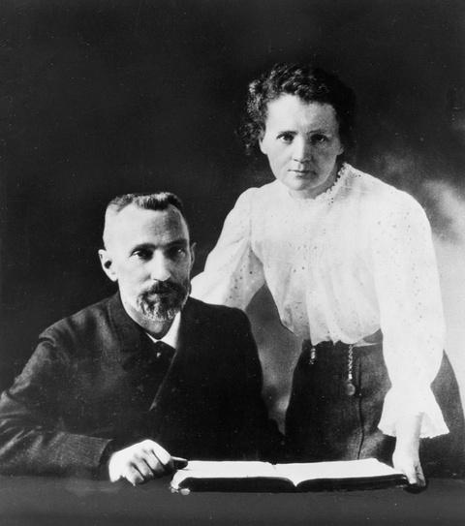
11
El rápido ritmo del descubrimiento nuclear, cont.
María Curie (1867-1934)
Físico y químico polaco
Pedro Curie (1859-1906)
Físico francés
Descubrió el polonio y el radio La familia Curie ganó 5 premios Nobel
María
Primera mujer en ganar un Premio Nobel
Primera persona en ganar dos veces
Única persona que ganó un Premio Nobel en dos ciencias diferentes (Física en 1903 y Química en 1911)
Explorando la Ciencia Nuclear
Notes:
The Curies worked together investigating radioactivity, building on the work of the German physicist Roentgen and the French physicist Becquerel. In July 1898, the Curies announced the discovery of a new chemical element, polonium. At the end of the year, they announced the discovery of another, radium. The Curies, along with Becquerel, were awarded the Nobel Prize for Physics in 1903.
Pierre's life was cut short in 1906 when he was knocked down and killed by a carriage. Marie took over his teaching post, becoming the first woman to teach at the Sorbonne, and devoted herself to continuing the work that they had begun together. She received a second Nobel Prize, for Chemistry, in 1911. Marie Curie was the first woman to win a Nobel Prize and the first person—man or woman—to win the prestigious award twice. She remains the only one to be honored for accomplishments in two separate sciences.
The Curie's research was crucial in the development of x-rays in surgery. During World War One Curie helped to equip ambulances with x-ray equipment, which she herself drove to the front lines. The International Red Cross made her head of its radiological service and she held training courses for medical orderlies and doctors in the new techniques.
Credit: BBC History http://www.bbc.co.uk/history/historic_figures/curie_marie.shtml
11

Slide 12
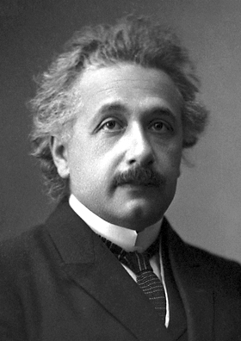
12
El rápido ritmo del descubrimiento nuclear, cont.
Albert Einstein (1879-1955)
Físico alemán
Desarrollado
teoría de la relatividad
fórmula de equivalencia masa-energía
E = mc²
Descubierto
efecto fotoeléctrico
Explorando la Ciencia Nuclear
Notes:
The fission reaction illustrates Einstein’s famous equation. Most students have heard the equation, but probably don’t know what it means. Seeing the fission reaction equation is often the only time students see that there is value in what they are learning.
12

Slide 13
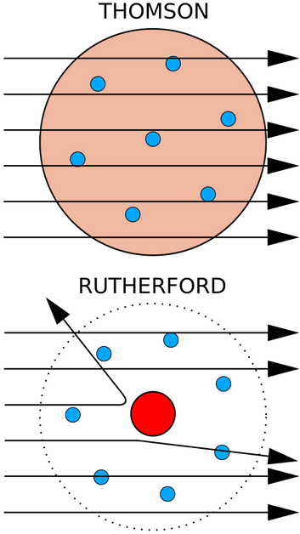
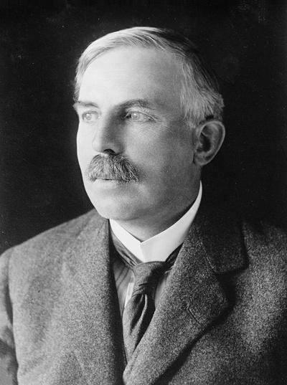
13
El rápido ritmo del descubrimiento nuclear, cont.
Ernest Rutherford (1871-1937)
Físico británico
Descubierto
El núcleo
concepto de vida media
radón
Explorando la Ciencia Nuclear
Notes:
From 1911 to 1913, British physicists Geiger and Marsden, working in the laboratory of Ernest Rutherford, conducted experiments with beams of positively charged, alpha particles to penetrate gold, silver, and copper foil (atoms). They observed that most of the alpha particles went directly through the foil. However, some particles were deflected and others recoiled back toward the source. Rutherford systematically investigated the results Geiger and Marsden obtained with alpha particles; Rutherford concluded that most of the mass of an atom is concentrated in a small region in its center, now called the nucleus.
Credit: American Nuclear Society, nuclearconnect.org
You may wish to stop here and perform an activity that illustrates how Rutherford discovered the nucleus. There is an ANS lesson plan that details how to make the “Rutherford” boards.
Credit: http://nuclearconnect.org/in-the-classroom/for-teachers/mini_rutherford
Teachers are likely to have done a version of the experiment themselves and have ideas to share about how they do it.
13

Slide 14
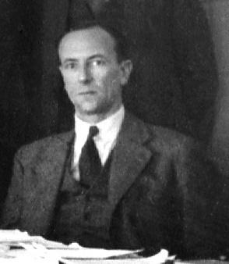
14
El rápido ritmo del descubrimiento nuclear, cont.
James Chadwick (1891-1974)
Físico británico
Descubrió el neutrón en 1932
Galardonado con el premio Nobel
Explorando la Ciencia Nuclear
Notes:
In 1923, aged 32, Chadwick became Rutherford’s Assistant Director of Research in the Cavendish Laboratory. In those days, most researchers believed there were electrons within the nucleus as well as outside it. Rutherford, Chadwick, and some others believed in the possibility that particles with no charge could be in the nucleus. Using polonium as a source of (what he believed were) neutrons, he bombarded wax. Protons were released by the wax and Chadwick made measurements of the protons’ behavior.
The protons behaved in exactly the manner they ought to if they had been hit by electrically neutral particles with a mass similar to the proton, rather than negatively charged electrons. Chadwick had discovered the neutron. In 1935, James Chadwick received the Nobel Prize in Physics for his discovery of the neutron
Credit: https://www.famousscientists.org/james-chadwick/
14

Slide 15
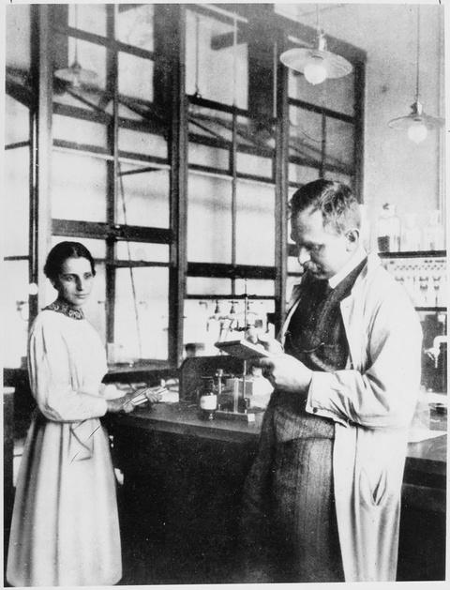
15
El rápido ritmo del descubrimiento nuclear, cont.
Otto Hahn (1879-1968) químico alemán
Lisa Meitner (1878-1968)
Físico austríaco/sueco
Descubrimiento de la fisión
Hahn no incluyó a Meitner en el artículo por el que recibió el Premio Nobel
El elemento 109, meitnerio, recibió su nombre en su honor.
Explorando la Ciencia Nuclear
Notes:
1934, Ida Noddack, from a government laboratory in Berlin, suggested that neutron bombardment might cause uranium nuclei to break apart into lighter elements. Noddack, therefore, was the first person to propose the concept of nuclear fission.
In December 1938, Otto Hahn and Fritz Strassman bombarded uranium with slow moving neutrons, after which Hahn wrote Meitner with a sense of bewilderment. His results seemed to indicate that the element barium was consistently one of the products. Scientific dogma had previously said that the largest particle a nucleus could emit was an alpha particle.
George Gamow and Niels Bohr proposed that atomic nuclei might resemble drops of liquid. Meitner and her nephew Otto Frisch, wondered if a liquid-drop nucleus might break into two smaller drops.
In December 1938, Meitner and Frisch were walking one day when inspiration came to Meitner. She sat down in the woods and began calculating the energy involved when nuclei produced by uranium fission fly apart. Her calculated energy, 200 MeV, was huge. Its source was Einstein’s E = mc2. Meitner realized that enough mass was converted to energy to produce an enormous amount of energy.
When World War 2 ended, she was acclaimed as the mother of the atom bomb. In fact, she disapproved of both the acclaim and the bomb. She believed nuclear energy should be used solely for peaceful purposes.
Although, controversially, Lise Meitner was never awarded a Nobel Prize, in 1997 her work was acknowledged in a more exceptional way when chemical element 109 was named Meitnerium in her honor.
Credit: https://www.famousscientists.org/lise-meitner/
15

Slide 16
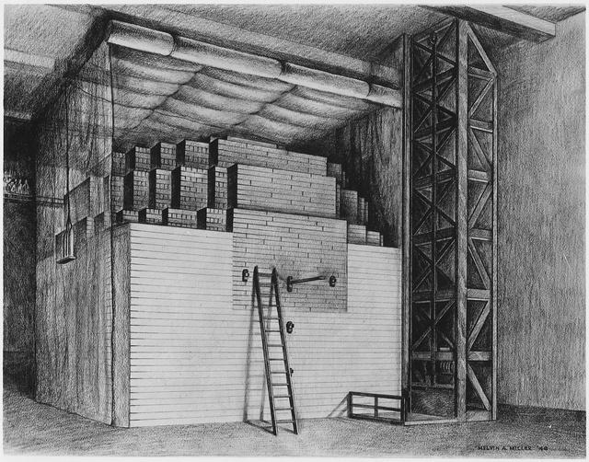
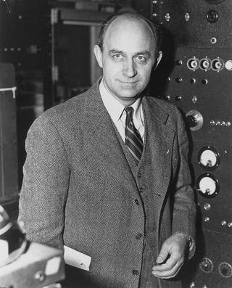
16
El rápido ritmo del descubrimiento nuclear, cont.
Enrico Fermi (1901-1954)
Físico italiano
Demostró la primera reacción nuclear en cadena artificial y autosostenible el 2 de diciembre de 1942
Explorando la Ciencia Nuclear
Notes:
Fermi became an American citizen in 1944 and in 1946 he accepted a professorship at the Institute for Nuclear Studies at the University of Chicago, a position which he held till his death.
In 1940, Fermi and his team proved that absorption of a neutron by a uranium nucleus can cause the nucleus to split into two nearly equal parts, releasing numerous neutrons and huge amounts of energy. This was the first nuclear chain reaction.
During the Second World War, Fermi was a key member of the Manhattan Project, working at the Los Alamos project in New Mexico on developing an atomic bomb. On July 16, 1945, the first atomic bomb was detonated at Alamogordo Air Base.
Credit: https://www.famousscientists.org/enrico-fermi/
16

Slide 17
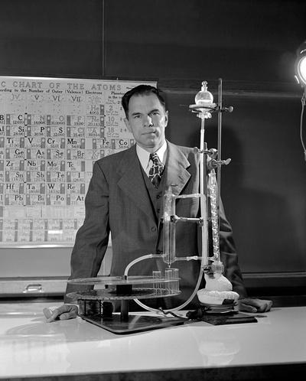
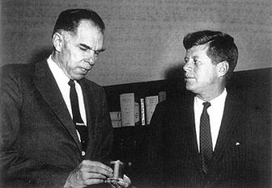
17
El rápido ritmo del descubrimiento nuclear, cont.
Glenn Seaborg (1912-1999)
Químico estadounidense, miembro fundador de la ANS
Desarrolló el concepto de actínido, que requiere
Rediseño de la tabla periódica
Descubiertos 10 elementos transuránicos
Pionero en medicina nuclear
Explorando la Ciencia Nuclear
Notes:
Glenn Seaborg took part in the discovery of ten of the periodic table’s chemical elements. He was awarded the Nobel Prize in Chemistry in 1951.
His work on the electronic structure of elements led to the periodic table being rewritten. He also co-discovered technetium-99m, the most commonly used medical radioisotope in the world.
Element 106 is named seaborgium in his honor.
Description of the discovery of plutonium
In 1940, Edwin McMillan and Philip Abelson discovered element 93 using the 60-inch cyclotron at the Lawrence Radiation Laboratory, Berkeley. They named the new element neptunium, after the planet Neptune. Their discovery depended on work Seaborg and his colleagues carried out on a method to isolate the new radioactive metal. In February 1941, Seaborg led his research team to discover element 94 – plutonium. They named the new element after Pluto, keeping up the theme that began with element 92, uranium (Uranus) and element 93, neptunium (Neptune).
Plutonium was made by bombarding uranium with hydrogen-2 (heavy hydrogen) nuclei.
Credit: https://www.famousscientists.org/glenn-seaborg/
17

Slide 18
18
El rápido ritmo del descubrimiento nuclear
Menos de 50 años…
desde el descubrimiento de los rayos X
a una reacción en cadena de fisión sostenida
Explorando la Ciencia Nuclear
Notes:
18

Slide 19
19
Estructura del átomo
Núcleo
Nube de electrones
Protones: carga = +1
masa = 1 uma*
+
Electrones: carga = -1
masa = 1/1836 uma
Neutrones: carga = 0
masa = 1 uma
*unidad de masa atómica
Explorando la Ciencia Nuclear
Notes:
19
Describe the structure of the atom

Slide 20
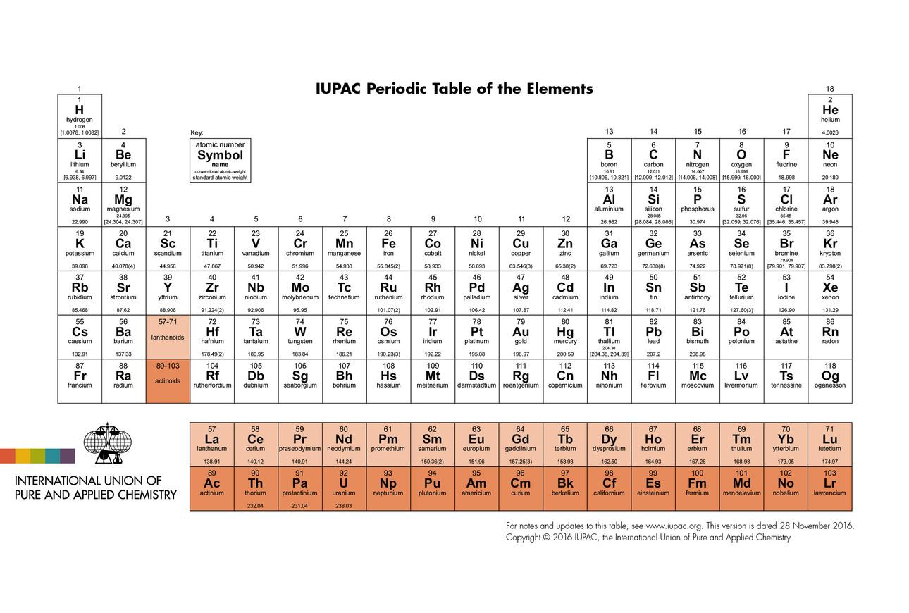
20
Tabla periódica de los elementos
Explorando la Ciencia Nuclear
Notes:
20
Periodic Table
Describes the chemical properties of elements
Arranged by the number of protons

Slide 21


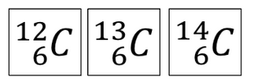

21
Notación nuclear estándar
número de masa atómica
A = Z + N
(N = # de neutrones)
A
X
símbolo químico
Z
número atómico
# de protones
o
Explorando la Ciencia Nuclear
Notes:
Standard Nuclear Notation or Standard Atomic notation is used in Chemistry and Physics to indicate the atomic number and mass number of an isotope.
Nuclear notation is formed by writing an elemental symbol preceded by a subscript indicating its atomic number (number of protons) and a superscript indicating its mass number (number of nucleons).
For example, carbon-12 has an atomic
number of 6 and a mass number of 12.
It is common to drop the atomic number; it is redundant with the symbol.
21

Slide 22
22
Vamos a practicar
1
¿Cuántos protones hay en H?
1
¿Cuántos neutrones hay en Li?
4
¿Cuántos protones hay en O?
8
¿Cuántos neutrones hay en H?
0
1
7
3
17
8
1
1
número de masa atómica
A = Z + N
(N = # de neutrones)
A
X
símbolo químico
Z
número atómico
# de protones
Explorando la Ciencia Nuclear
Notes:
Answers
One
Four
Eight
Zero
22

Slide 23
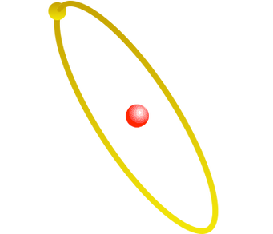
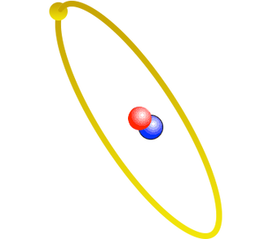
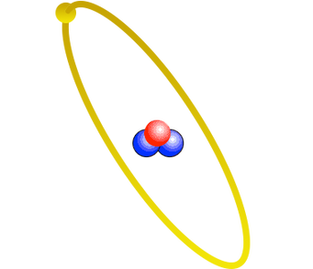
23
Isótopos
Tres isótopos del hidrógeno
Hidrógeno H-1
Deuterio H-2
Tritio H-3
Explorando la Ciencia Nuclear
Notes:
23
ISOTOPES
Each element can have a varied number of neutrons
This does not change the chemical properties of the element, but it does change the weight of the atom.
Hydrogen – Weighs 1 amu
Deuterium – Weighs 2 amu (same chemical properties as Hydrogen)
Tritium – Weighs 3 amu (same chemical properties as Hydrogen) (Made at SRS)

Slide 24
24
Estructura atómica del helio
-
+
Composición subatómica del helio
+
2 protones
2 neutrones
2 electrones
-
El átomo de helio
Explorando la Ciencia Nuclear
Notes:
24

Slide 25


25
‹#›
Más sobre este isótopo de helio...
Número total de
protones y neutrones
NÚMERO DE LA MASA (Atómica)
Los protones tienen una masa grande y una carga positiva. La cantidad de protones identifica a un elemento.
42
+
He
Los neutrones tienen una masa grande, aproximadamente igual a la masa de un protón. Los neutrones no tienen carga.
SÍMBOLO DEL ELEMENTO
NÚMERO ATÓMICO
número de protones
-
Los electrones tienen una masa muy pequeña y una carga negativa. Los electrones viajan fuera del núcleo.
Explorando la Ciencia Nuclear
Navegando por la ciencia nuclear
Navegando por la ciencia nuclear
Notes:
All elements are isotopes
25

Slide 26

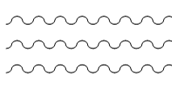
26
¿Qué es la Radiación?
Transmisión de energía a través de:
Partículas
o
Ondas
Explorando la Ciencia Nuclear
Notes:
26

Slide 27
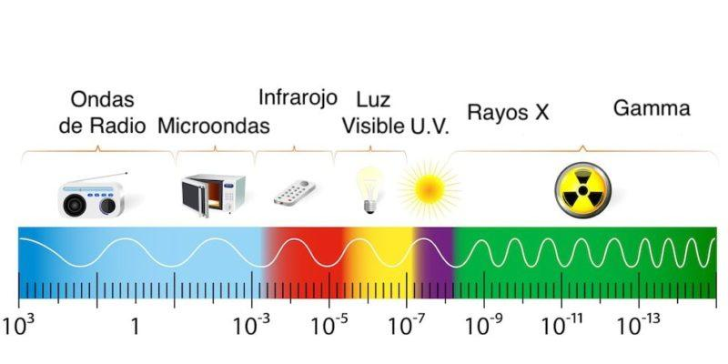
27
‹#›
Espectro Electromagnético
Explorando la Ciencia Nuclear
Notes:
Radiation is defined on a spectrum from low frequency waves, such as radio waves, to very high frequency waves, like gamma rays. Note that radiation is on a spectrum, so gamma rays are related to radio waves.
27

Slide 28
28
Tipos de radiación
No Ionizante
Ondas de radio Microondas Infrarrojos Luz visible Ultravioleta (UV)
Ionizante
Alfa Beta Gamma Rayos X Neutrones
Explorando la Ciencia Nuclear
Notes:
Radiation is categorized as non-ionizing and ionizing. Though ultraviolet light is classified as non-ionizing, it can induce cellular damage. Note the connection between sunlight and the need to protect themselves. This helps to demonstrate that it isn’t only ionizing radiation that has the potential to be damaging.
28

Slide 29
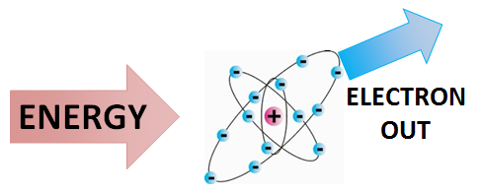
29
¿Por qué se llama ionizante?
Porque crea iones… átomos con carga.
Educación energética, Universidad de Calgary
Explorando la Ciencia Nuclear
Notes:
Radiation at this level has enough energy to remove an electron from its orbit, creating an ion: an atom with a charge
29

Slide 30
30
¿De donde proviene la radiación?
El núcleo de los átomos inestables
Entonces, tenemos…
ciencia nuclear
Medicina nuclear
reactores nucleares
Explorando la Ciencia Nuclear
Notes:
30

Slide 31
31
Pregunta
Si la radiación proviene de los átomos y todo está hecho de átomos,
¿hay radiación a nuestro alrededor en este momento?
Explorando la Ciencia Nuclear
Notes:
Poll attendees for answers before moving on to next slide.
31

Slide 32
32
¡Sí!
Explorando la Ciencia Nuclear
Notes:
32

Slide 33
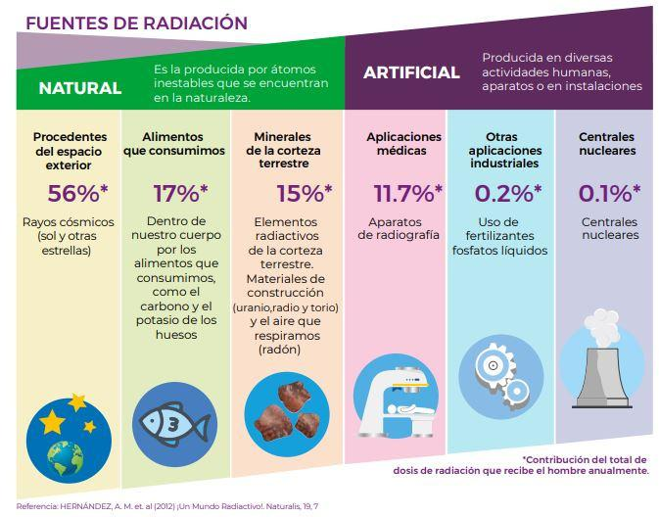
33
Fuentes de Radiación
Explorando la Ciencia Nuclear
Notes:
Explain background radiation.
This is a good time to have attendees use ANS’s “Radiation is a part of our world” personal radiation dose calculator. It can be downloaded from nuclearconnect.org at http://nuclearconnect.org/wp-content/uploads/2015/10/Radiation-Dose-Chart_web.pdf
Printed copies can be purchased from ANS at http://www.ans.org/store/item-750022/
33

Slide 34
34
Unidades de Dosis y Exposición
Rayos X (R)
Unidad de exposición: ionización del aire por rayos X.
o rayos gamma
Rad (dosis de radiación absorbida)
energía depositada en el material
REM (hombre equivalente a Roentgen)
unidad de dosis equivalente
Explorando la Ciencia Nuclear
Notes:
Note that REM takes into account what kind of radiation and what was exposed (liver, bone, etc.) Terminology is radiation weighting factor (w(R) It used to be Q factor
34

Slide 35
35
Perspectiva
Dosis (mrem) | Fuente
1 | Radiografía dental
25 | Vuelo de ida y vuelta a Sudáfrica
40 | Tu cuerpo
110 | Tomografía computarizada de cabeza y cuerpo
620 | Dosis promedio en EE.UU.
5500 | Dosis media en Guarapari, Brasil
10.200 | Dosis media en Ramsar, Irán
0 – 25.000 | Ningún efecto observable
Explorando la Ciencia Nuclear
Notes:
Dental x-ray and CT scan are not background radiation, but are included for comparison
35

Slide 36
36
Entonces ¿estoy contaminado?
Usted ha sido irradiado: expuesto a la radiación.
Lo cual no debe confundirse con...
Explorando la Ciencia Nuclear
Notes:
36

Slide 37
37
Contaminación
Material radiactivo en un lugar no deseado
El material está esparcido por todas partes
Se puede llevar
Explorando la Ciencia Nuclear
Notes:
37
The concept of contamination and radiation are commonly confused in the public discussion, including leading news media.
Contamination can be discussed using many substances.
Using a chemical light stick. If the stick was broken and the liquid from inside got on your skin, you would be contaminated with the chemical. The light would go wherever you go, and you could spread it around and make more contamination.
Demonstration showing how contamination can be spread using glitter—place glitter on one hand of one participant and have participants shake hands. Note that the material spreads around and can be carried away, but it can also be cleaned up.

Slide 38
38
Efectos Biológicos
Reemplazado
La célula muere
No reemplazado
Los átomos en las células están ionizados.
Benigno
Cambio en la celda
La célula se reproduce
Maligno
Ningún cambio o cambio neutral
Explorando la Ciencia Nuclear
Notes:
Note that there are a number of possible biological outcomes of radiation exposure—only one leads to cancer
38

Slide 39
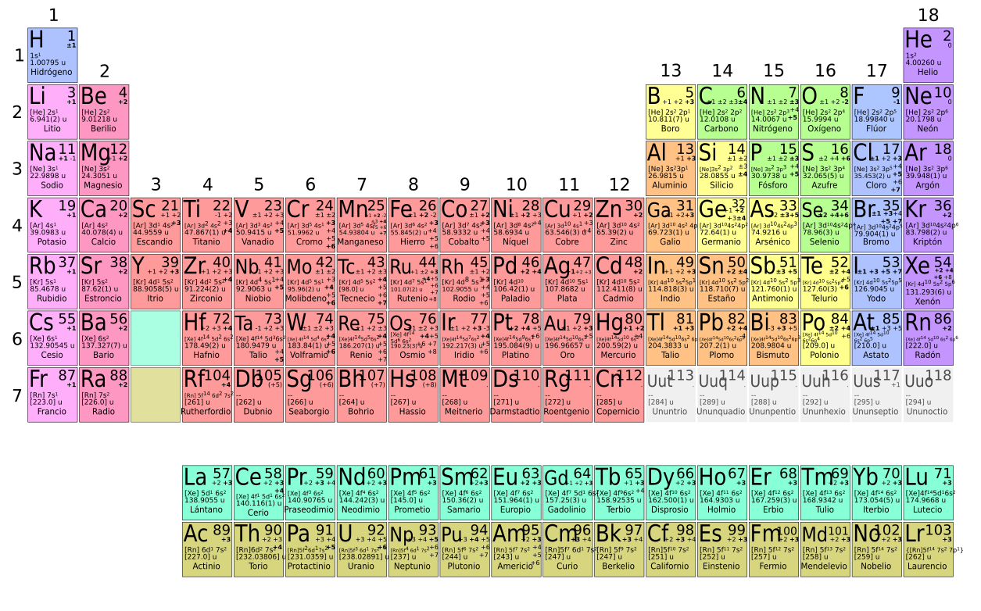
39
¿Por qué los átomos son radiactivos?
Explorando la Ciencia Nuclear
Notes:
Atoms that are radioactive are unstable.
39

Slide 40
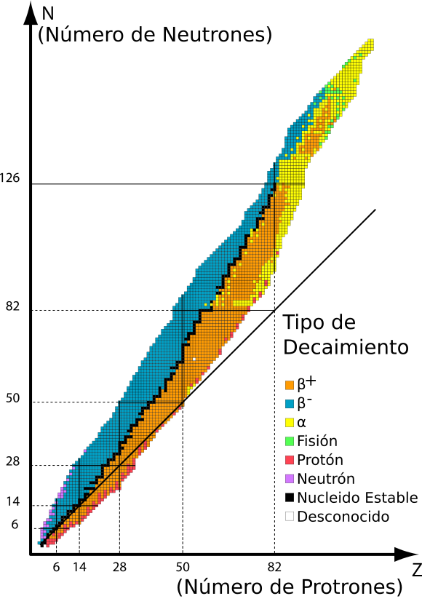
40
¿Qué hace que un núcleo sea inestable?
Unstable
Nuclides
Stability Line
Neutrones = Protones
Explorando la Ciencia Nuclear
Notes:
Explain what makes a nucleus stable.
Main factors: neutron/proton ratio and the total number of nucleons in the nucleus
40

Slide 41
41
Estabilidad Nuclear
Un núcleo inestable se vuelve más estable al reorganizar su estructura nuclear y emitir radiación.
Si es inestable después de la desintegración radiactiva, se producirá una mayor desintegración.
Es posible.
Explorando la Ciencia Nuclear
Notes:
1/8/2021
ETS20008H0200
41
This is the transition to discussing decay types. Explain that decay is the name of the process that the nucleus goes through to become stable.
Note that decay results in the element become another element until a stable element is achieved.

Slide 42
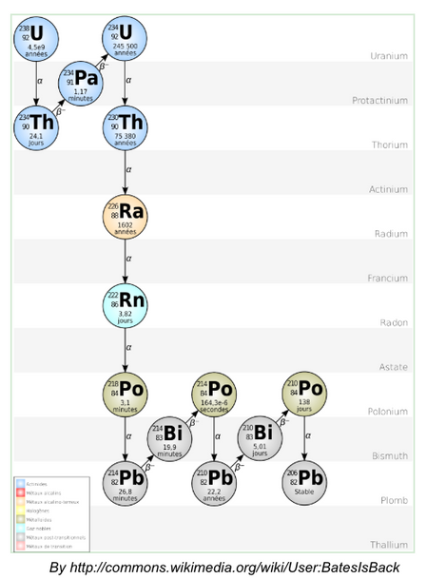
42
Desintegración Radioactiva
Explorando la Ciencia Nuclear
Notes:
1/8/2021
ETS20008H0200
41
This is the transition to discussing decay types. Explain that decay is the name of the process that the nucleus goes through to become stable.
Note that decay results in the element become another element until a stable element is achieved.

Slide 43
43
Partícula Alfa α
Núcleo de helio que se emite desde el núcleo de un átomo radiactivo.
una partícula
Explorando la Ciencia Nuclear
Notes:
43
ALPHA
The largest radiation particle
Comes from elements that are too large or have too many neutrons (like having too much glue)
A large section of the atom is ejected from the radioactive nucleus (the size of a helium nucleus)
Atom wants to return to stability.

Slide 44
44
Partícula Alfa α
Un núcleo de helio de alta energía expulsado del núcleo.
Masa de 4 uma
Carga de +2 ecu
Interactúa fácilmente con los electrones de los materiales por los que pasa.
Los opuestos se atraen
α es positivo, los electrones son negativos
Se protege fácilmente de todos los materiales, incluidas las capas externas “muertas” de piel.
Daño grave a los tejidos vivos si se ingiere debido a su gran masa y gran carga.
Explorando la Ciencia Nuclear
Notes:
44
Read the Slide

Slide 45
45
Partícula Beta β⁻
Electrón emitido desde el núcleo de un átomo cuando un neutrón se convierte en un protón.
partícula b
Explorando la Ciencia Nuclear
Notes:
45
BETA
Smaller particle
Comes from atoms that have a few too many neutrons.
A neutron changes to a proton and ejects energy in the form of an electron

Slide 46
46
Partícula Beta β⁻
Un “electrón” de alta energía expulsado del núcleo
Masa 1/1836 uma; carga de -1 ecu
Interactúa fácilmente con los electrones de los materiales por los que pasa.
Las cargas iguales se repelen
β es negativo, los electrones son negativos
Se protege fácilmente con materiales ligeros, incluida la ropa.
También está protegido por materiales pesados ​​pero genera rayos X.
Daños a tejidos vivos debido a la masa y la carga.
Explorando la Ciencia Nuclear
Notes:
46
Read and explain the slide

Slide 47

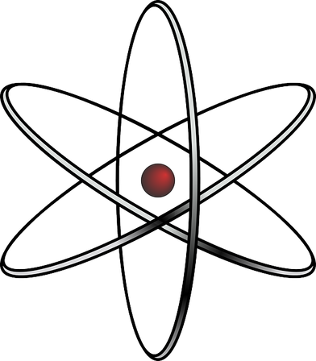
47
Rayos Gamma γ
Fotón de alta energía emitido desde el núcleo de un átomo
Explorando la Ciencia Nuclear
Notes:
47
If the class gets the answer to the quiz following this section, you all get cookies.
GAMMA
Simply – a ray of light (photon) that comes from the nucleus

Slide 48
48
Rayos Gamma γ
Rayo de luz de alta energía más allá de nuestra visión.
Sin masa
Sin cargo
Interactúa con los electrones de los materiales que
pasa a través
Cuanto más electrones mayor será la interacción
Puede atravesar fácilmente la mayoría de la materia sin interacción, incluido el cuerpo humano.
Se protege fácilmente con materiales más pesados ​​como el plomo.
Explorando la Ciencia Nuclear
Notes:
48
Read the Slide

Slide 49

49
Neutrón
Neutrón
Fragmento de fisión
Átomo padre
Energía
Neutrón
Energía
Neutrón
Fragmento de fisión
Explorando la Ciencia Nuclear
Notes:
49
NEUTRON
It is not very common for a neutron to be ejected on its own.
If an atom is very large, it can get too big to hold together. This instability causes it to break apart, or fission.
When this happens, some of the neutrons (and energy) are released.
This is what we control to make a nuclear reactor operate safely.
High school students are not assessed on knowledge of neutron radiation.

Slide 50
50
Neutrón
Un neutrón de alta energía expulsado de
El núcleo
Masa de 1 uma; igual que el hidrógeno
Sin cargo
Interactúa con materiales de peso similar (ligero)
Puede atravesar la mayoría de la materia fácilmente sin interacción.
Se protege fácilmente con materiales con mucho hidrógeno (agua).
Explorando la Ciencia Nuclear
Notes:
50
Read the Slide

Slide 51
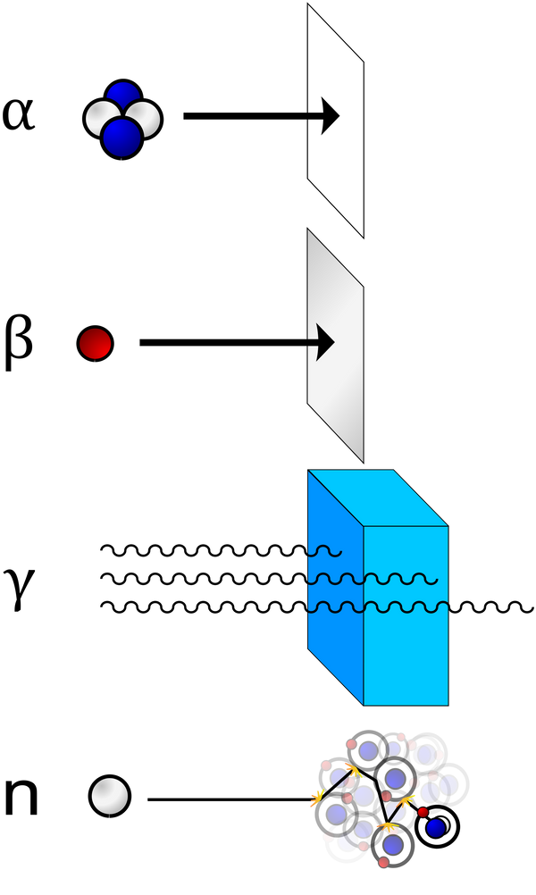
51
Barreras de Protección Radiológica (Blindaje)
Explorando la Ciencia Nuclear
Notes:
How different types of radiation can be shielded. Visual representation of what was discussed in prior slides
Demonstration:
Use a cluster of four balloons (two of one color; two of another color) to represent alpha radiation. Toss it. Note that it doesn’t travel far because it is so large.
Use a small ball to represent beta radiation. Toss it. Note that it travels farther.
Use a laser pointer to represent gamma radiation. Turn it on and note that it travels far and fast.
51

Slide 52



52
Utilice el Sentido Común
¿Cómo nos resguardamos en el dia a dia?
Tiempo
Distancia
Blindaje
Mantener la menor cantidad de tiempo cerca de fuentes radiactivas.
Mantener la mayor distancia de las fuentes radiactivas.
Utilizar barreras físicas entre nosotros y las fuentes radiactivas.
Explorando la Ciencia Nuclear
Notes:
How we protect from excessive radiation exposure is very similar to how we protect ourselves from UV exposure.
52

Slide 53
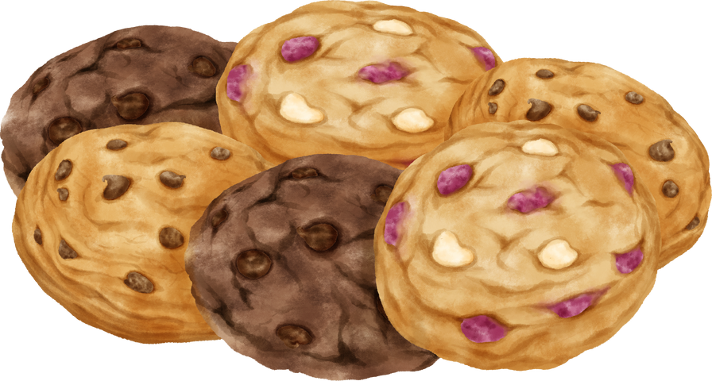
53
Una Historia de Galletas
Explorando la Ciencia Nuclear
Notes:
53
Title slide

Slide 54
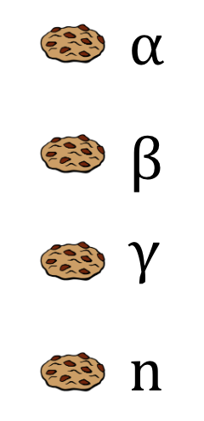
54
¿Qué harías?
Tienes cuatro galletas.
Puedes…
comer una
Sosténer una en tu mano
poner uno en tu bolsillo
Tirar una a la basura
Explorando la Ciencia Nuclear
Notes:
54
THIS IS A QUIZ (THE REWARD IS COOKIES FOR EVERYONE) Note: you can have attendees work in pairs to answer the quiz. ANS gives each attendee an individual packet of cookies during the quiz.
Now that you know the interactions of radiation with matter, see if you can answer this quiz.
We have an alpha cookie, beta cookie, gamma cookie, and a neutron cookie.
If you had to eat one, hold one in your hand, hold one in your pocket, and throw one away, what would you do with each cookie?
Now I am not promoting eating any radioactivity intentionally, but this gives you a greater understanding of the interactions.
Answer:
Alpha: Hand Shielded by skin
Beta: Pocket Shielded by clothing
Gamma: Eat Whole body dose
Neutron: Throw Away Whole body dose
(Interacts with water in body)

Slide 55
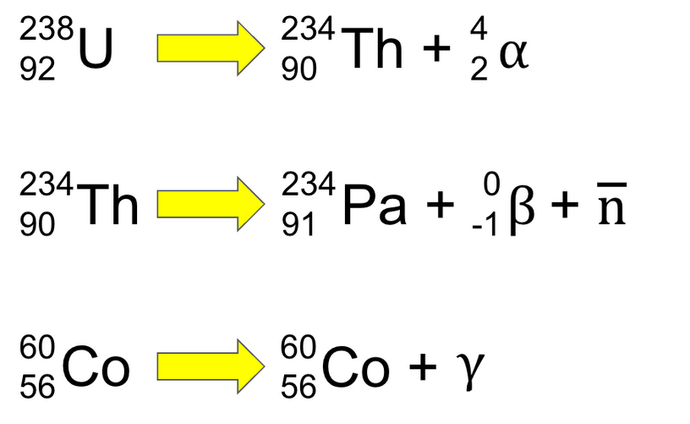
55
‹#›
Ecuaciones de desintegración radiactiva
238
92
234
90
4
2
EN
El +
a
Desintegración Alfa
234
90
El
234
91
0
-1
+
Bueno +
b
norte
Desintegración Beta
60
56
60
56
Co
Co +
do
Desintegración Gamma
Explorando la Ciencia Nuclear
Navegando por la ciencia nuclear
Navegando por la ciencia nuclear
Notes:
Now, the presentation shifts to how decay works. Students are required to know how to balance decay equations.
55

Slide 56
56
Unidades de Actividad (Radiactiva)
La actividad es el número de emisiones de radiación por unidad de tiempo.
dps: desintegraciones por segundo
Becquerel: 1dps
Curie: 37.000.000.000 dps
Picocurio: 0.037 dps o 2.2 dpm
Explorando la Ciencia Nuclear

Slide 57
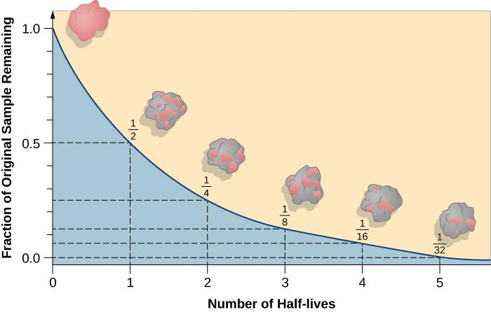
57
Vida Media
Explorando la Ciencia Nuclear
Notes:
Define half-life. Use the image to illustrate that decay is exponential. Note that the pink blob gradually becomes more and more gray as the element decays. Feel free to create a fanciful name for the element such as bubblegumium or pinkium.
If you will be doing a half-life activity using M&Ms/coins/etc. do the activity here.
If you will be using the ANS Isotope Discovery Kit, proceed to the next slide.
57

Slide 58
58
Construyendo una Tabla Periódica en 3D
Apilar isótopos por masa atómica
El más pequeño en la parte superior
El más grande en la parte inferior
Explorando la Ciencia Nuclear
Notes:
58
Use this slide to introduce the Isotope Discovery Kit. Delete this slide if not using it.

Slide 59
59
Estabilidad Nuclear
Sólo ciertas combinaciones de neutrones y protones conducen a un átomo estable.
En un átomo estable, las fuerzas de atracción y repulsión en el núcleo se equilibran.
Explorando la Ciencia Nuclear
Notes:
1/8/2021
ETS20008H0200
59

Slide 60
60
Estabilidad Nuclear
Los átomos con núcleos inestables son radiactivos.
Si es inestable después de la desintegración radiactiva, es posible que se produzca una mayor desintegración.
Los núcleos se desintegran hacia la línea de estabilidad.
Explorando la Ciencia Nuclear
Notes:
1/8/2021
ETS20008H0200
60

Slide 61
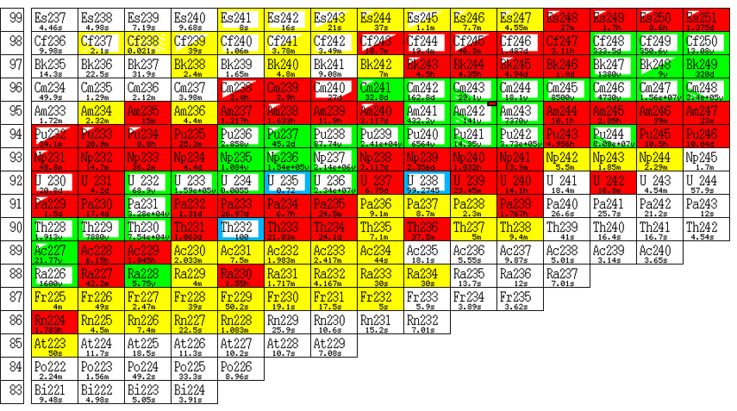
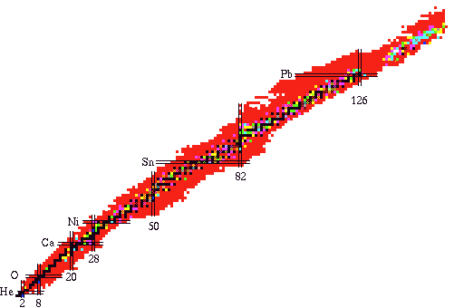
61
Diagrama de Isótopos
Explorando la Ciencia Nuclear
Notes:
61
CHART OF NUCLIDES
A different way to look at the Periodic Table.
It contains much more detailed information regarding all of the elements/isotopes known to man.
Describes the radioactive materials that are known.
The details are not important for this lecture, but there is one concept that is important:
LINE OF STABILITY
The chart of nuclides is a graph of protons versus neutrons
The stable isotopes (non-radioactive) are shown along the “Line of Stability”
Low weight elements tend to balance equal number of protons to neutrons. The heavier you get the more neutrons you need to keep things together.
The protons all have a “+” charge and they repel each other (like magnets)
The neutrons act as glue holding everything together with a strong nuclear force

Slide 62
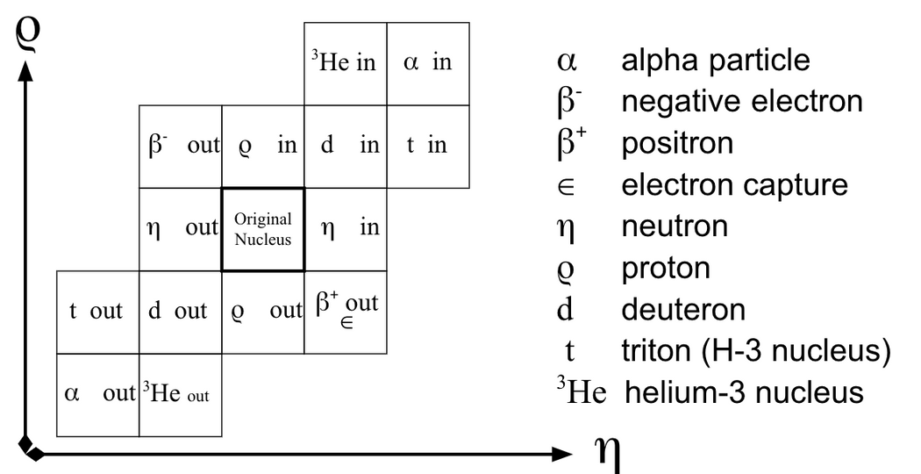
62
‹#›
Ubicaciones Relativas de Productos de Varios Procesos Nucleares
Explorando la Ciencia Nuclear
Navegando por la ciencia nuclear
Navegando por la ciencia nuclear
Notes:
1/8/2021
ETS20008H0200
62

Slide 63
63
Construyendo una Cadena de Desintegración Radiactiva
Explorando la Ciencia Nuclear
Notes:
Complete Advanced portion of the Isotope Discovery Kit
Alternatively, complete the Radioactive Decay Series Activity in the ANS Teacher Resource Guide. http://nuclearconnect.org/in-the-classroom/for-teachers/teacher-resource-guide-detecting-radiation-in-our-radioactive-world OR this lesson from teachnuclear.ca http://teachnuclear.ca/?tr-search-Jurisdiction&tr-search-Grade&tr-search-Course&tr-search-Concept=14&tr-srch=1
63

Slide 64
64
Recursos
Centro de Información sobre Ciencia y Tecnología Nuclear ANS
nuclearconnect.org
Navegando en el ámbito nuclear:
Energizando nuestro mundo™
navegandonuclear.com
Oficina de Energía Nuclear/
Departamento de Energía
https://www.energy.gov/ne/office-nuclear-energy
(Agrega tus propios recursos)
Explorando la Ciencia Nuclear
Notes:
Make sure you give attendees your contact information. You are one of the best resource for them!
64

Slide 65
65
¿Preguntas?
Explorando la Ciencia Nuclear
Notes:
65

