Slide 1

Beyond electricity . . .
Mary Lou Dunzik-Gougar, PhD

Slide 2
Many applications of nuclear technology
Nuclear reactors have been producing electricity since the 1950s
  ~20% of world’s electricity
  ~25% of non-fossil electricity
  ~40% of reliable, non-fossil electricity
Nuclear technology outside civil electricity production less well known
  Medicine
  Industry
  Food and Agriculture
  Transportation
  Water resources

Slide 3
How do we get energy from the nucleus?
Energy of nuclear reactors
In reactors
  Nuclear fission reaction occurs
  Heat is produced
  Ionizing radiation is released (alpha, beta, gamma and neutrons)
Energy of radiation
Radioisotopes
  Under go radioactive decay reaction
  Release radiation (alpha, beta, gamma)
Machines can also produce radiation (e.g. x-ray machines)
Notes:
https://world-nuclear.org/information-library/non-power-nuclear-applications/overview/the-many-uses-of-nuclear-technology#trans

Slide 4

In a nuclear reactor, ²³⁵U fissions to produce . . .
Neutron
Lighter element
Uranium-235
Heat energy
Neutron
Neutron
Heat energy
Neutron
Lighter element
Neutrons may
  Cause new fissions to occur
  Be absorbed to form unstable, radioactive nuclide

Slide 5

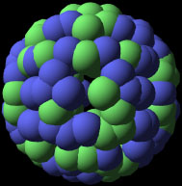


Reactor designed to facilitate ²³⁵U fission chain reaction
Notes:
When a nuclear power plant starts up, neutrons are released. When they strike the uranium atoms in the fuel pellets, the atoms split—or fission.
x

Slide 6
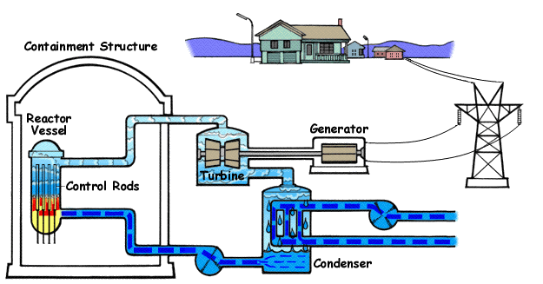
Heat from fission chain reaction is used to produce steam, steam turns turbine and generator produces electricity . . .
Notes:
This process continues in a chain reaction, producing a great deal of heat. It is this process—creating heat through the splitting of atoms—that turns water to steam. The steam is moved from the reactor to turn the turbine-generator, which makes electricity. All radioactive water stays within the reactor system and is not released into the environment.

Slide 7
How else can we use the heat from a nuclear reactor?
Propulsion of submarines, aircraft carriers and ice breaker ships
Hydrogen production
  Currently created by steam reforming of natural gas or coal gasification
  Nuclear could produce hydrogen without CO₂ emissions (via electrolysis of water)
  Used in fuel cells that power transportation
  “Burned” to make electricity
  Used in chemical and refining industries
Notes:
https://world-nuclear.org/information-library/non-power-nuclear-applications/overview/the-many-uses-of-nuclear-technology#trans
https://world-nuclear.org/information-library/energy-and-the-environment/hydrogen-production-and-uses
https://world-nuclear.org/information-library/non-power-nuclear-applications/industry/nuclear-desalination

Slide 8
How else can we use the heat from a nuclear reactor? (cont’d)
Desalination and water purification
  Replaces fossil fuels
  Through distillation or reverse osmosis
Process heat for industry
  Synthetic oil production
  Oil production and refining
  Chemical production
District heating/cooling
Notes:
https://world-nuclear.org/information-library/non-power-nuclear-applications/overview/the-many-uses-of-nuclear-technology#trans
https://world-nuclear.org/information-library/energy-and-the-environment/hydrogen-production-and-uses
https://world-nuclear.org/information-library/non-power-nuclear-applications/industry/nuclear-desalination

Slide 9
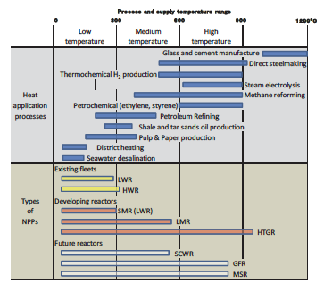
Temperature ranges of heat applications (Source: IAEA)

Slide 10















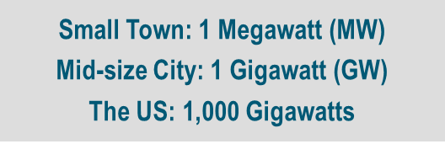
Nuclear Reactor Versatility
Spectrum of Sizes and Options
Variety of Outputs
Multitude of End Uses
Micro
(Few MW)
Mini
(10s of MW)
Small
(100s of MW)
Homes
Vehicles
Businesses
Electricity
Aviation
Rail
Shipping
H₂ Hydrogen
Concrete
Steel
Factories
Large (1,000+ MW)
Process Heat
Water
Space
Notes:
Discuss diversity of advanced nuclear technologies.
Note that there are various technologies involved, but that’s not the lead.
Leading effort is looking at the “end Uses” of the energy which may impact the technology choice that is desired (temperature range required).
Various sizes also under consideration that can provide various options for uses.
1 GW serves 750,000 homes (1.3 kW per home)

Slide 11
Can we use the radiation produced in a nuclear reactor?
Yes!
Radioisotope production
  Medicine
  Research
  Industry
Material irradiation for research

Slide 12
How do we get energy from the nucleus?
Energy of nuclear reactors
In reactors
  Nuclear fission reaction occurs
  Heat is produced
  Ionizing radiation is released (alpha, beta, gamma and neutrons)
Energy of radiation
Radioisotopes
  Under go radioactive decay reaction
  Release radiation (alpha, beta, gamma)

Slide 13

How can we use radioisotopes?
Medicine
  50 million nuclear medicine procedures each year!
  Diagnostic information about functioning of organs
    SPECT (Single Photon Emission Computerized Spectroscopy)
    PET (positron emission spectroscopy) (also PET-CT and PET-MRI)
    Most commonly used isotope is technetium-99
Notes:
Positron Emission Tomography (PET)
• This nuclear medical imaging technique involves the injection into the body of an isotope that decays by positron emission that is the beta plus (ß+) particle. When this positron encounters an electron, a beta minus particle, they annihilate each other and produce two photons. The energy and path of these photons leaving the body can then be used to give an accurate picture of the area where the isotope was absorbed.
Single Photon Emission Computed Tomography (SPECT)
• SPECT is similar to PET in its use of radioactive tracer material and detection of gamma rays. In contrast with PET, however, the tracer used in SPECT emits gamma radiation that is measured directly. Where PET tracers emit positrons that annihilate with electrons up to a few millimeters away, causing two gamma photons to be emitted in opposite directions. A PET scanner detects these emissions coincident in time, which provides more local radiation event information and thus higher resolution images than SPECT. SPECT scans, however, are significantly less expensive than PET scans, in part because they are able to use longer lived, more easily obtainable radioisotopes than PET needs.
New procedures combine PET with computed X-ray tomography (CT) scans to give co-registration of the two images (PET-CT), enabling 30% better diagnosis than with a traditional gamma camera alone. It is a very powerful and significant tool which provides unique information on a wide variety of diseases from dementia to cardiovascular disease and cancer.
Combining PET with MRI (PET-MRI), especially for brain imaging, enables diffusion-weighted imaging in soft tissue with dynamic contrast and magnetic resonance spectroscopy.

Slide 14
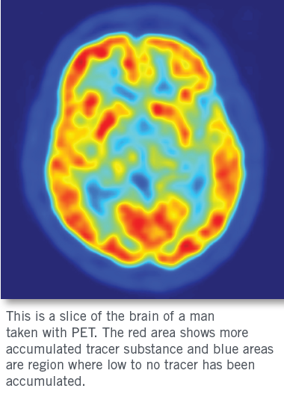
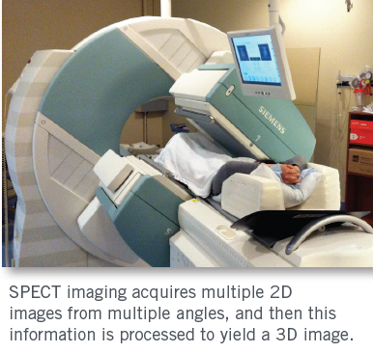
Medicine (continued)
  Diagnostic
Notes:
Positron Emission Tomography (PET)
• This nuclear medical imaging technique involves the injection into the body of an isotope that decays by positron emission that is the beta plus (ß+) particle. When this positron encounters an electron, a beta minus particle, they annihilate each other and produce two photons. The energy and path of these photons leaving the body can then be used to give an accurate picture of the area where the isotope was absorbed.
Single Photon Emission Computed Tomography (SPECT)
• SPECT is similar to PET in its use of radioactive tracer material and detection of gamma rays. In contrast with PET, however, the tracer used in SPECT emits gamma radiation that is measured directly. Where PET tracers emit positrons that annihilate with electrons up to a few millimeters away, causing two gamma photons to be emitted in opposite directions. A PET scanner detects these emissions coincident in time, which provides more local radiation event information and thus higher resolution images than SPECT. SPECT scans, however, are significantly less expensive than PET scans, in part because they are able to use longer lived, more easily obtainable radioisotopes than PET needs.
New procedures combine PET with computed X-ray tomography (CT) scans to give co-registration of the two images (PET-CT), enabling 30% better diagnosis than with a traditional gamma camera alone. It is a very powerful and significant tool which provides unique information on a wide variety of diseases from dementia to cardiovascular disease and cancer.
Combining PET with MRI (PET-MRI), especially for brain imaging, enables diffusion-weighted imaging in soft tissue with dynamic contrast and magnetic resonance spectroscopy.

Slide 15
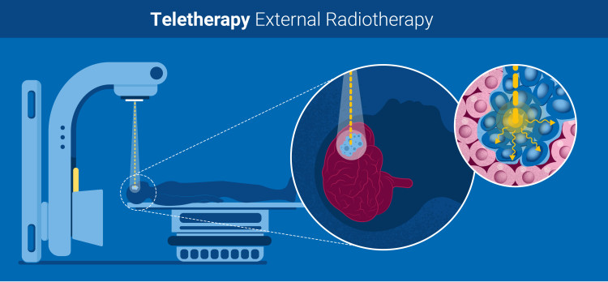
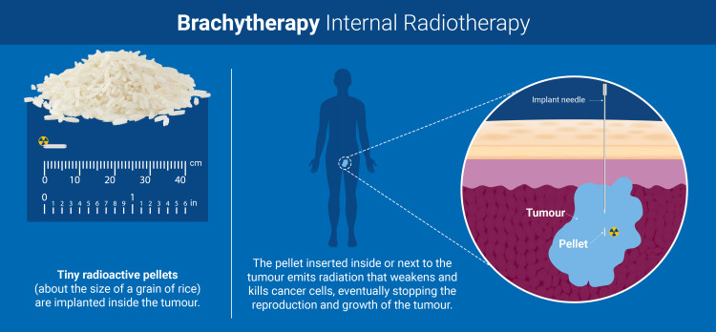
Medicine (continued)
  Therapy/treatment using radiation to weaken/destroy cancer cells
    External radiotherapy/Teletherapy - radiation goes into body from outside body, but may not be from a radionuclide
    Internal radiotherapy/Brachytherapy - small radiation source inserted into cancer
    Some examples include iodine-131 for thyroid, iridium-192 for head and breast, iodine-125, palladium-103, iridium-192 for prostate
  Sterilization of medical products
Notes:
New procedures combine PET with computed X-ray tomography (CT) scans to give co-registration of the two images (PET-CT), enabling 30% better diagnosis than with a traditional gamma camera alone. It is a very powerful and significant tool which provides unique information on a wide variety of diseases from dementia to cardiovascular disease and cancer.
Combining PET with MRI (PET-MRI), especially for brain imaging, enables diffusion-weighted imaging in soft tissue with dynamic contrast and magnetic resonance spectroscopy.
General info source: https://world-nuclear.org/information-library/non-power-nuclear-applications/radioisotopes-research/radioisotopes-in-medicine
Image source: https://www.iaea.org/newscenter/news/what-is-radiation-therapy

Slide 16

How can we use radioisotopes? (continued)
Medicine
Industry
  Tracers
  Radiography
  Gauging
  Dating

Slide 17
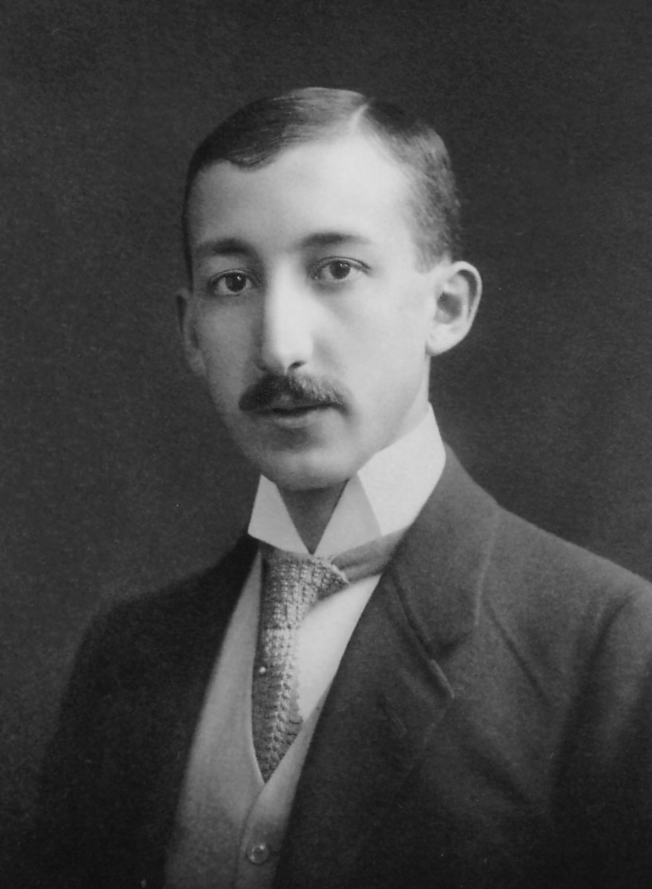
Radioisotopes in Industry: Radiotracers
Radioactive atoms that move and react in a complex system
Radioactivity can be measured independently and with high sensitivity
Can be followed through physical, chemical or biological processes
George de Hevesy
Notes:
Radioisotopes are used by manufacturers as tracers to monitor fluid flow and filtration, detect leaks, and gauge engine wear and corrosion of process equipment.
Small concentrations of short-lived isotopes can be detected whilst no residues remain in the environment.
By adding small amounts of radioactive substances to materials used in various processes it is possible to study the mixing and flow rates of a wide range of materials, including liquids, powders, and gases and to locate leaks.
Radiotracers are used widely in industry to investigate processes and highlight the causes of inefficiency.
They are particularly useful where process optimization can bring material benefits, such as in the transport of sediments.
Radiotracers are also used in the oil and gas industry to help determine the extent of oil fields.
The story goes that George de Hevesy suspected his landlady was using leftovers to make his meals, sometimes over and over again, but he couldn’t prove it. So, he put a small amount of a radioisotope in the leftovers after one meal and detected that isotope in several meals after that, thereby confirming his suspicion! De Hevesy earned a Nobel prize for his work with radiotracers in 1943.

Slide 18
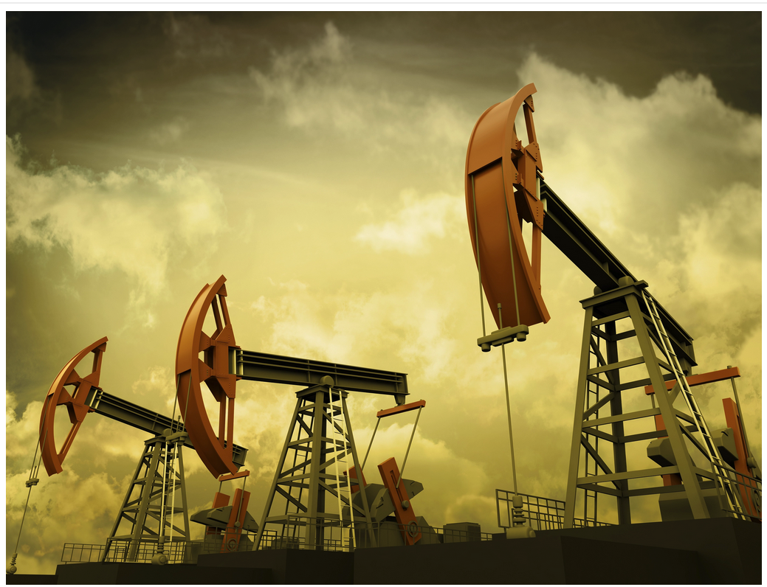
Radioisotopes in Industry: Radiotracers
Used to monitor fluid flow and filtration, detect leaks, and gauge engine wear and corrosion of process equipment
Used to diagnose specific causes of inefficiency in plant/process op
Used to investigate process operations to inform process optimization and troubleshooting
For example, in oil and gas industry
used to determine
  Flow pathways
  Level of oil saturation and relative quantity of gas
  “Communication” between wells
Notes:
Radiotracer technology is playing a more and more important role in industry. It is used to diagnose specific causes of inefficiency in a plant or process operation and to generally investigate processes in industries and those related environments where a great cost-benefit ratio can be gleaned from process optimization and troubleshooting, such as in the transport of sediments.

Slide 19
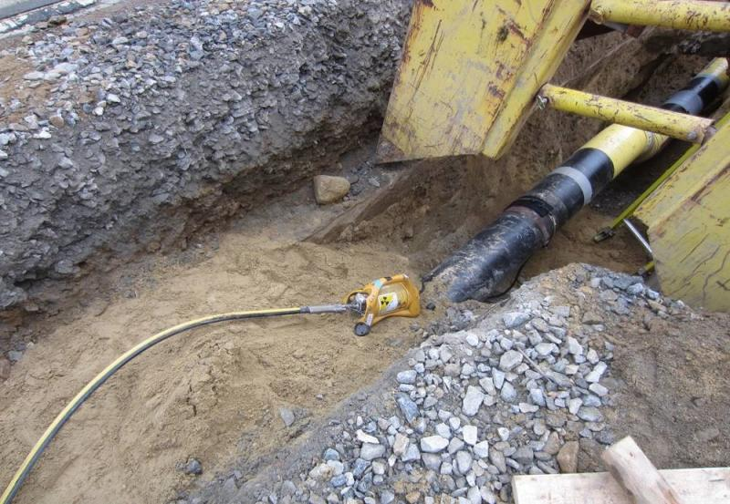
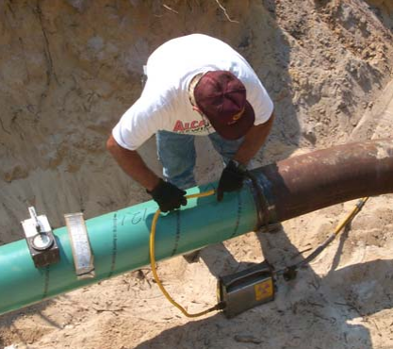
Radioisotopes in Industry: Radiography
Radioactive atoms are placed on one side of the item to be analyzed and a detector is on the other
Testing weld integrity or looking for cracks in piping is common application
Iridum-192 is used for gamma radiography pipe weld examination, with the ability to go operate through mud and grime in subzero temperatures.
Checking weld integrity
Notes:
https://www.nrc.gov/materials/miau/industrial-uses/radiography.pdf
https://www.ornl.gov/news/ornl-produce-critical-industrial-radioisotope-ir-192-part-doe-partnership-private-company
Note that in industry, we call this radiography. The same type of procedure is used in medicine, but it’s called imaging.

Slide 20
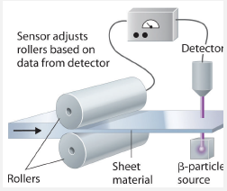
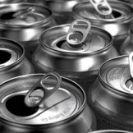
Radioisotopes in Industry: Radiogauging
Radioactive atoms are placed on one side of the item to be analyzed and a detector is on the other
Detector is calibrated to a given thickness or density of material
Change in amount of radiation reaching detector indicates change in thickness/density/etc.
Level of liquid in soda cans measured via radiogauging
Thickness of sheet materials during production controlled via radiogauging
Notes:
IAEA, “Technical data on nucleonic gauges,” IAEA-TECDOC-1495, 2005

Slide 21
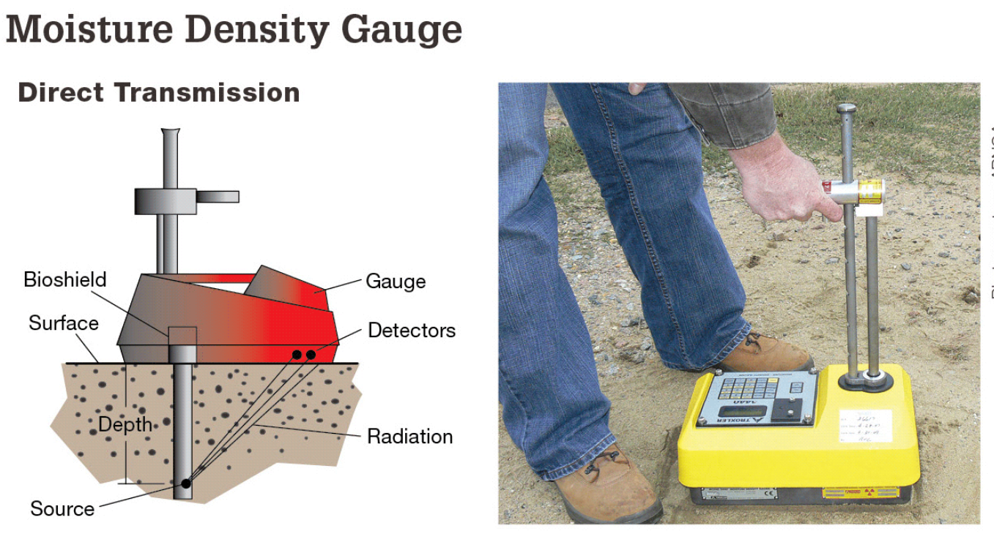
Radioisotopes in Industry: Radiogauging
Notes:
https://www.nrc.gov/images/materials/miau/density-gauge.gif
Allows characterization of the bulk density and the average chemical composition (% moisture) of the matter using two sources: gamma and neutron (AmBe)
Most commonly lost, stolen or damaged sources in NRC Licensee Event Reports, but despite misadventures they seldom leak.

Slide 22
Radioisotopes in Industry: Radiodating
Used to determine the age of relics and geological samples
Activity of certain isotopes in sample compared to activity when the sample was created
Examples
  Uranium-thorium, uranium-lead, argon-argon for rocks and minerals
  Chlorine-36 for time of water underground
  Carbon-14 for age of once living thing (plant or animal)
Notes:
Uranium-thorium
A relatively short-range dating technique is based on the decay of uranium-234 into thorium-230, a substance with a half-life of about 80,000 years. It is accompanied by a sister process, in which uranium-235 decays into protactinium-231, which has a half-life of 32,760 years.^{[citation needed]}
While uranium is water-soluble, thorium and protactinium are not, and so they are selectively precipitated into ocean-floor sediments, from which their ratios are measured. The scheme has a range of several hundred thousand years. A related method is ionium–thorium dating, which measures the ratio of ionium (thorium-230) to thorium-232 in ocean sediment.^{[citation needed]}
Uranium–lead dating, abbreviated U–Pb dating, is one of the oldest^{[1]} and most refined of the radiometric dating schemes. It can be used to date rocks that formed and crystallised from about 1 million years to over 4.5 billion years ago with routine precisions in the 0.1–1 percent range.^{[2][3]}
The method is usually applied to zircon, a silicate mineral with Zr and O.This mineral incorporates uranium and thorium atoms into its crystal structure, but strongly rejects lead when forming. As a result, newly-formed zircon crystals will contain no lead, meaning that any lead found in the mineral is radiogenic. Since the exact rate at which uranium decays into lead is known, the current ratio of lead to uranium in a sample of the mineral can be used to reliably determine its age.
The method relies on two separate decay chains, the uranium series from ²³⁸U to ²⁰⁶Pb, with a half-life of 4.47 billion years and the actinium series from ²³⁵U to ²⁰⁷Pb, with a half-life of 710 million years.
Argon–argon (or ⁴⁰Ar/³⁹Ar) dating is a radiometric dating method invented to supersede potassium–argon (K/Ar) dating in accuracy. The older method required splitting samples into two for separate potassium and argon measurements, while the newer method requires only one rock fragment or mineral grain and uses a single measurement of argon isotopes. ⁴⁰Ar/³⁹Ar dating relies on neutron irradiation from a nuclear reactor to convert a stable form of potassium (³⁹K) into the radioactive ³⁹Ar. As long as a standard of known age is co-irradiated with unknown samples, it is possible to use a single measurement of argon isotopes to calculate the ⁴⁰K/⁴⁰Ar* ratio, and thus to calculate the age of the unknown sample. ⁴⁰Ar* refers to the radiogenic ⁴⁰Ar, i.e. the ⁴⁰Ar produced from radioactive decay of ⁴⁰K. ⁴⁰Ar* does not include atmospheric argon adsorbed to the surface or inherited through diffusion and its calculated value is derived from measuring the ³⁶Ar (which is assumed to be of atmospheric origin) and assuming that ⁴⁰Ar is found in a constant ratio to ³⁶Ar in atmospheric gases.
Large amounts of otherwise rare ³⁶Cl (half-life ~300ky) were produced by irradiation of seawater during atmospheric detonations of nuclear weapons between 1952 and 1958. The residence time of ³⁶Cl in the atmosphere is about 1 week. Thus, as an event marker of 1950s water in soil and ground water, ³⁶Cl is also useful for dating waters less than 50 years before the present. ³⁶Cl has seen use in other areas of the geological sciences, including dating ice^{[36]} and sediments.
Radiocarbon dating (also referred to as carbon dating or carbon-14 dating) is a method for determining the age of an object containing organic material by using the properties of radiocarbon, a radioactive isotope of carbon.

Slide 23
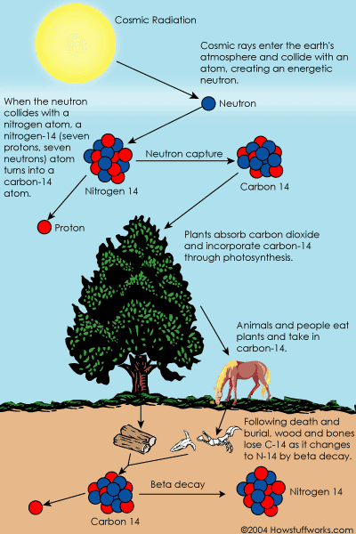
Radioisotopes in Industry:
Radiodating
¹⁴C is formed in our upper atmosphere
Ratio of ¹²C to ¹⁴C in the environment is constant
While plant/animal alive, intake of carbon continues and ratio is same as environment
After death, no more carbon intake, so ratio changes as ¹⁴C decays but ¹²C does not
Notes:
https://science.howstuffworks.com/environmental/earth/geology/carbon-14.htm

Slide 24
How can we use radioisotopes? (continued)
Medicine
Industry
Food and Agriculture
  Food irradiation
  Crop development
  Insect control

Slide 25
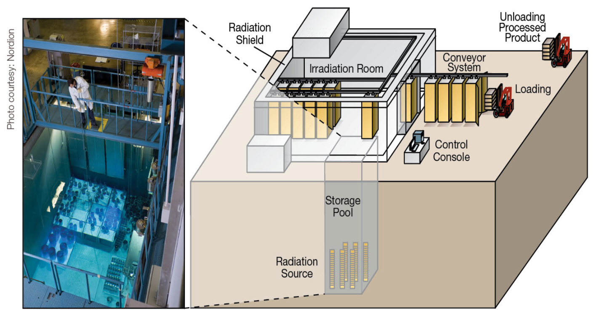
Radioisotopes in Food/Agriculture: Food Irradiation
Most radiation passes through the food without being absorbed. Energy from the small amount that is absorbed
  destroys any insects or pathogens on/inside grains, produce or spices
  extends shelf life
  prevents fruits and vegetables from ripening too fast
Radiation types used
  Gamma (usually from radioisotope such as cobalt-60 or cesium-137)
  Electron beams or x-rays (produced by machine)
Notes:
https://www.nrc.gov/images/materials/miau/commercial-irradiator.gif

Slide 26
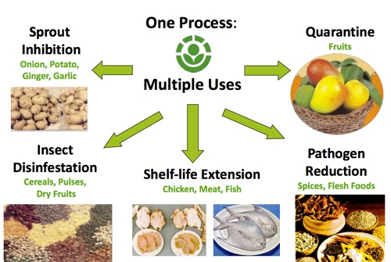
Radioisotopes in Food/Agriculture: Food Irradiation
Notes:
https://foodmicrobiology.academy/2020/07/13/food-irradiation-is-safe/
Based on continual irradiation safety evaluations for more than 40 years, the U.S. Food and Drug Administration (FDA) has approved irradiation of various foodstuffs including wheat, potatoes, processed pork, herbs and spices, poultry, and molluscan shellfish. In 1986, the list was expanded to include fruits and vegetables, and in 1997, red meat was added. In 2008, the FDA allowed for increased irradiation dosages in lettuce and spinach sufficient to destroy disease causing bacteria.1, 2
Over decades of study the FDA and other international organizations such as the International Atomic Energy Agency and the World Health Organization have consistently concluded the following:
• Food does not become radioactive as a result of irradiation.
• The irradiation process is effective in decreasing or eliminating disease-causing microorganisms such as Escherichia coli (E. coli), campylobacter, and salmonella from foods.
• Irradiation reduces spoilage caused by bacteria, insects, and parasites.
• Irradiation inhibits sprouting and delays ripening in some fruits and vegetables.
• Irradiation does not alter in any significant manner the nutritional value of food.
• Alterations in food created by irradiation are like those created by cooking and other processing.
• The irradiation process as regulated by the FDA is safe

Slide 27
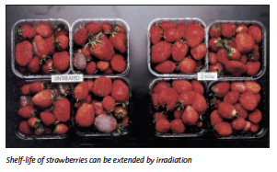
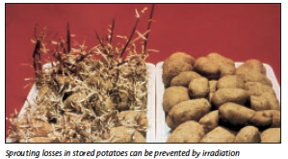
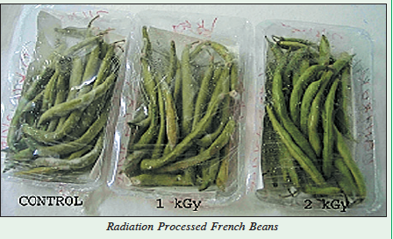
Radioisotopes in Food/Agriculture: Food Irradiation

Slide 28
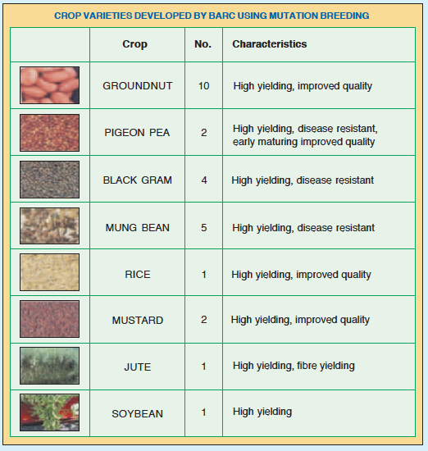
Radioisotopes in Food/Agriculture: Crop Development
Plant seeds/cutting exposed to radiation to cause mutations
Use of radiation accelerates natural mutation
Irradiated material cultivated
Plantlets with desired traits selected and multiplied
  Better yield
  More nutritious
  More resistant to drought,
  extreme temperatures and pests
Notes:
Countries that have used plant mutation breeding have frequently realized great socio-economic benefits:
In Mali, irradiation of sorghum and rice seeds has produced more productive and marketable varieties.
In Bangladesh, new varieties of rice produced through mutation breeding have increased crops three-fold in the last few decades. During a period of rapid population growth, the use of nuclear techniques has enabled Bangladesh, and large parts of Asia in general, to achieve comparative food security and improved nutrition.
In Namibia, mutation breeding has produced seeds of the country’s most important crops – cowpea, sorghum, and pearl millet – that have yields increased by 10-20%. The new varieties are more resistant to drought, temperature stress, and pests – essential attributes in Namibia’s difficult growing environment.
Across many IAEA member states, coffee plants are threatened by a fungal disease known as coffee leaf rust. The IAEA, together with the FAO and the OPEC Fund for International Development (OFID), is training scientists from the plant’s principal growing region, South America, to implement plant mutation breeding.

Slide 29
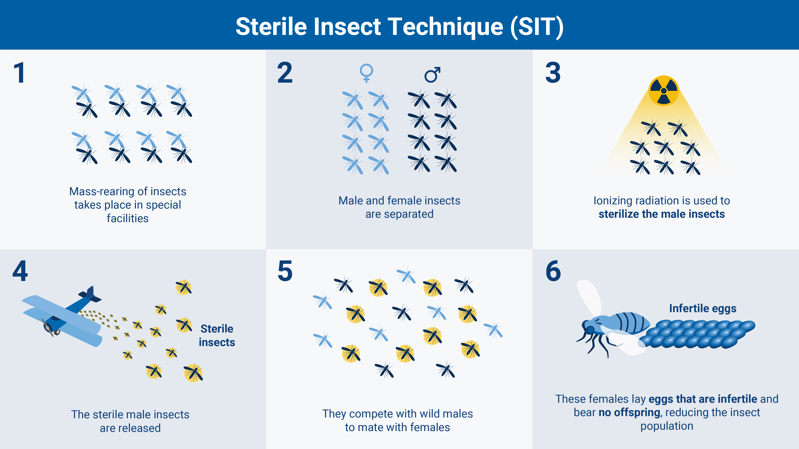
Radioisotopes in Food/Agriculture: Insect Control
Sterile Insect Technique (SIT)
  Sterilize insects via irradiation exposure
  Release into the environment
  Result is population reduction
Benefits
  Reduced use of insecticides
  Process is species specific
  No non-native species involved

Slide 30
Radioisotopes in Food/Agriculture: Insect Control
Notes:
Insect pests spread diseases. Mosquitoes, for example, are responsible for the spread of malaria, which affected 247 million people in 2021 alone and caused over 600 000 deaths. Parasitic insect pests, such as parasitic flies, can threaten whole ecosystems, putting at risk long-term conservation of animals and biodiversity. Other insect pests, such as fruit flies, moths, tsetse flies and screwworms destroy crops and livestock, threatening farmers’ livelihoods, harming international trade and undermining global food security. According to official estimates, pests destroyed up to 40 per cent of global crops and caused $220 billion in losses in 2021.
The use of radiation can help in the regulation or management of pests — known as pest control — effectively preventing insect-related risks to human and animal health, the ecosystems and food security (including crop and livestock production). Methods using radiation for pest control include the sterile insect technique (SIT), inherited sterility and biological control.

Slide 31
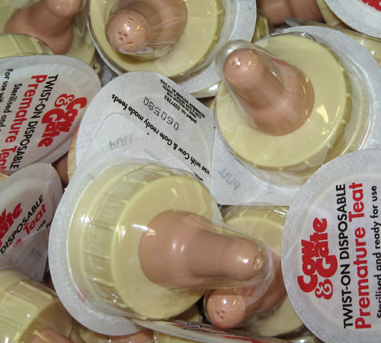
How can we use radioisotopes? (continued)
Medicine
Industry
Food and Agriculture
Sterilization
  Baby bottle nipples and formula
  Eye makeup
  Contact lens solution

Slide 32
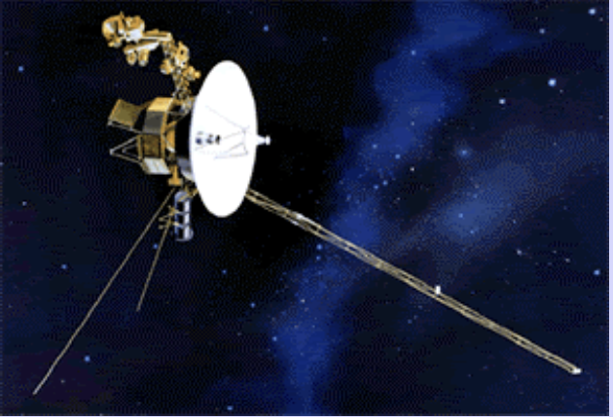
How can we use radioisotopes? (continued)
Medicine
Industry
Food and Agriculture
Sterilization
Space exploration
  Radioisotope thermoelectric generator (RTG) for probes and rovers
  Heat from decay of ²³⁸Pu converted to electricity
  Used since the 1960s
  US launched 25 missions with 40+ RTGs
Notes:
Radioisotope thermal generators (RTGs) are used in space missions. The heat generated by the decay of a radioactive source, often plutionium-238, is used to generate electricity. The Voyager space probes, the Cassini mission to Saturn, the Galileo mission to Jupiter, and the New Horizons mission to Pluto are all powered by RTGs. The Spirit and Opportunity Mars rovers have used a mix of solar panels for electricity and RTGs for heat. The latest Mars rover, Curiosity, is much bigger and uses RTGs for heat and electricity as solar panels would not be able to supply enough electricity.

Slide 33
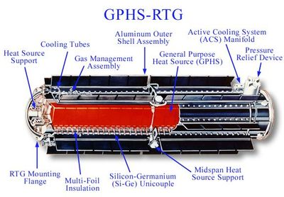
How can we use radioisotopes? (continued)

Slide 34

How can we use radioisotopes?
Medicine
Industry
Food and Agriculture
Sterilization
Space exploration

Slide 35
Thank you!

