Slide 1
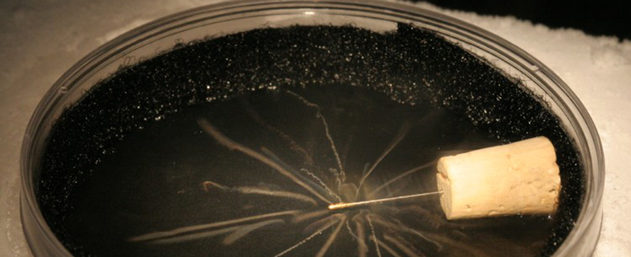
Visualizing Radiation:
Making Radiation Real with Cloud Chambers
Notes:
Use this presentation to introduce working with cloud chambers activity.

Slide 2
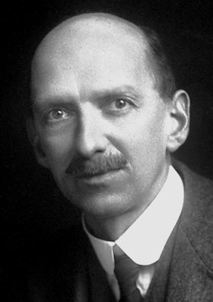
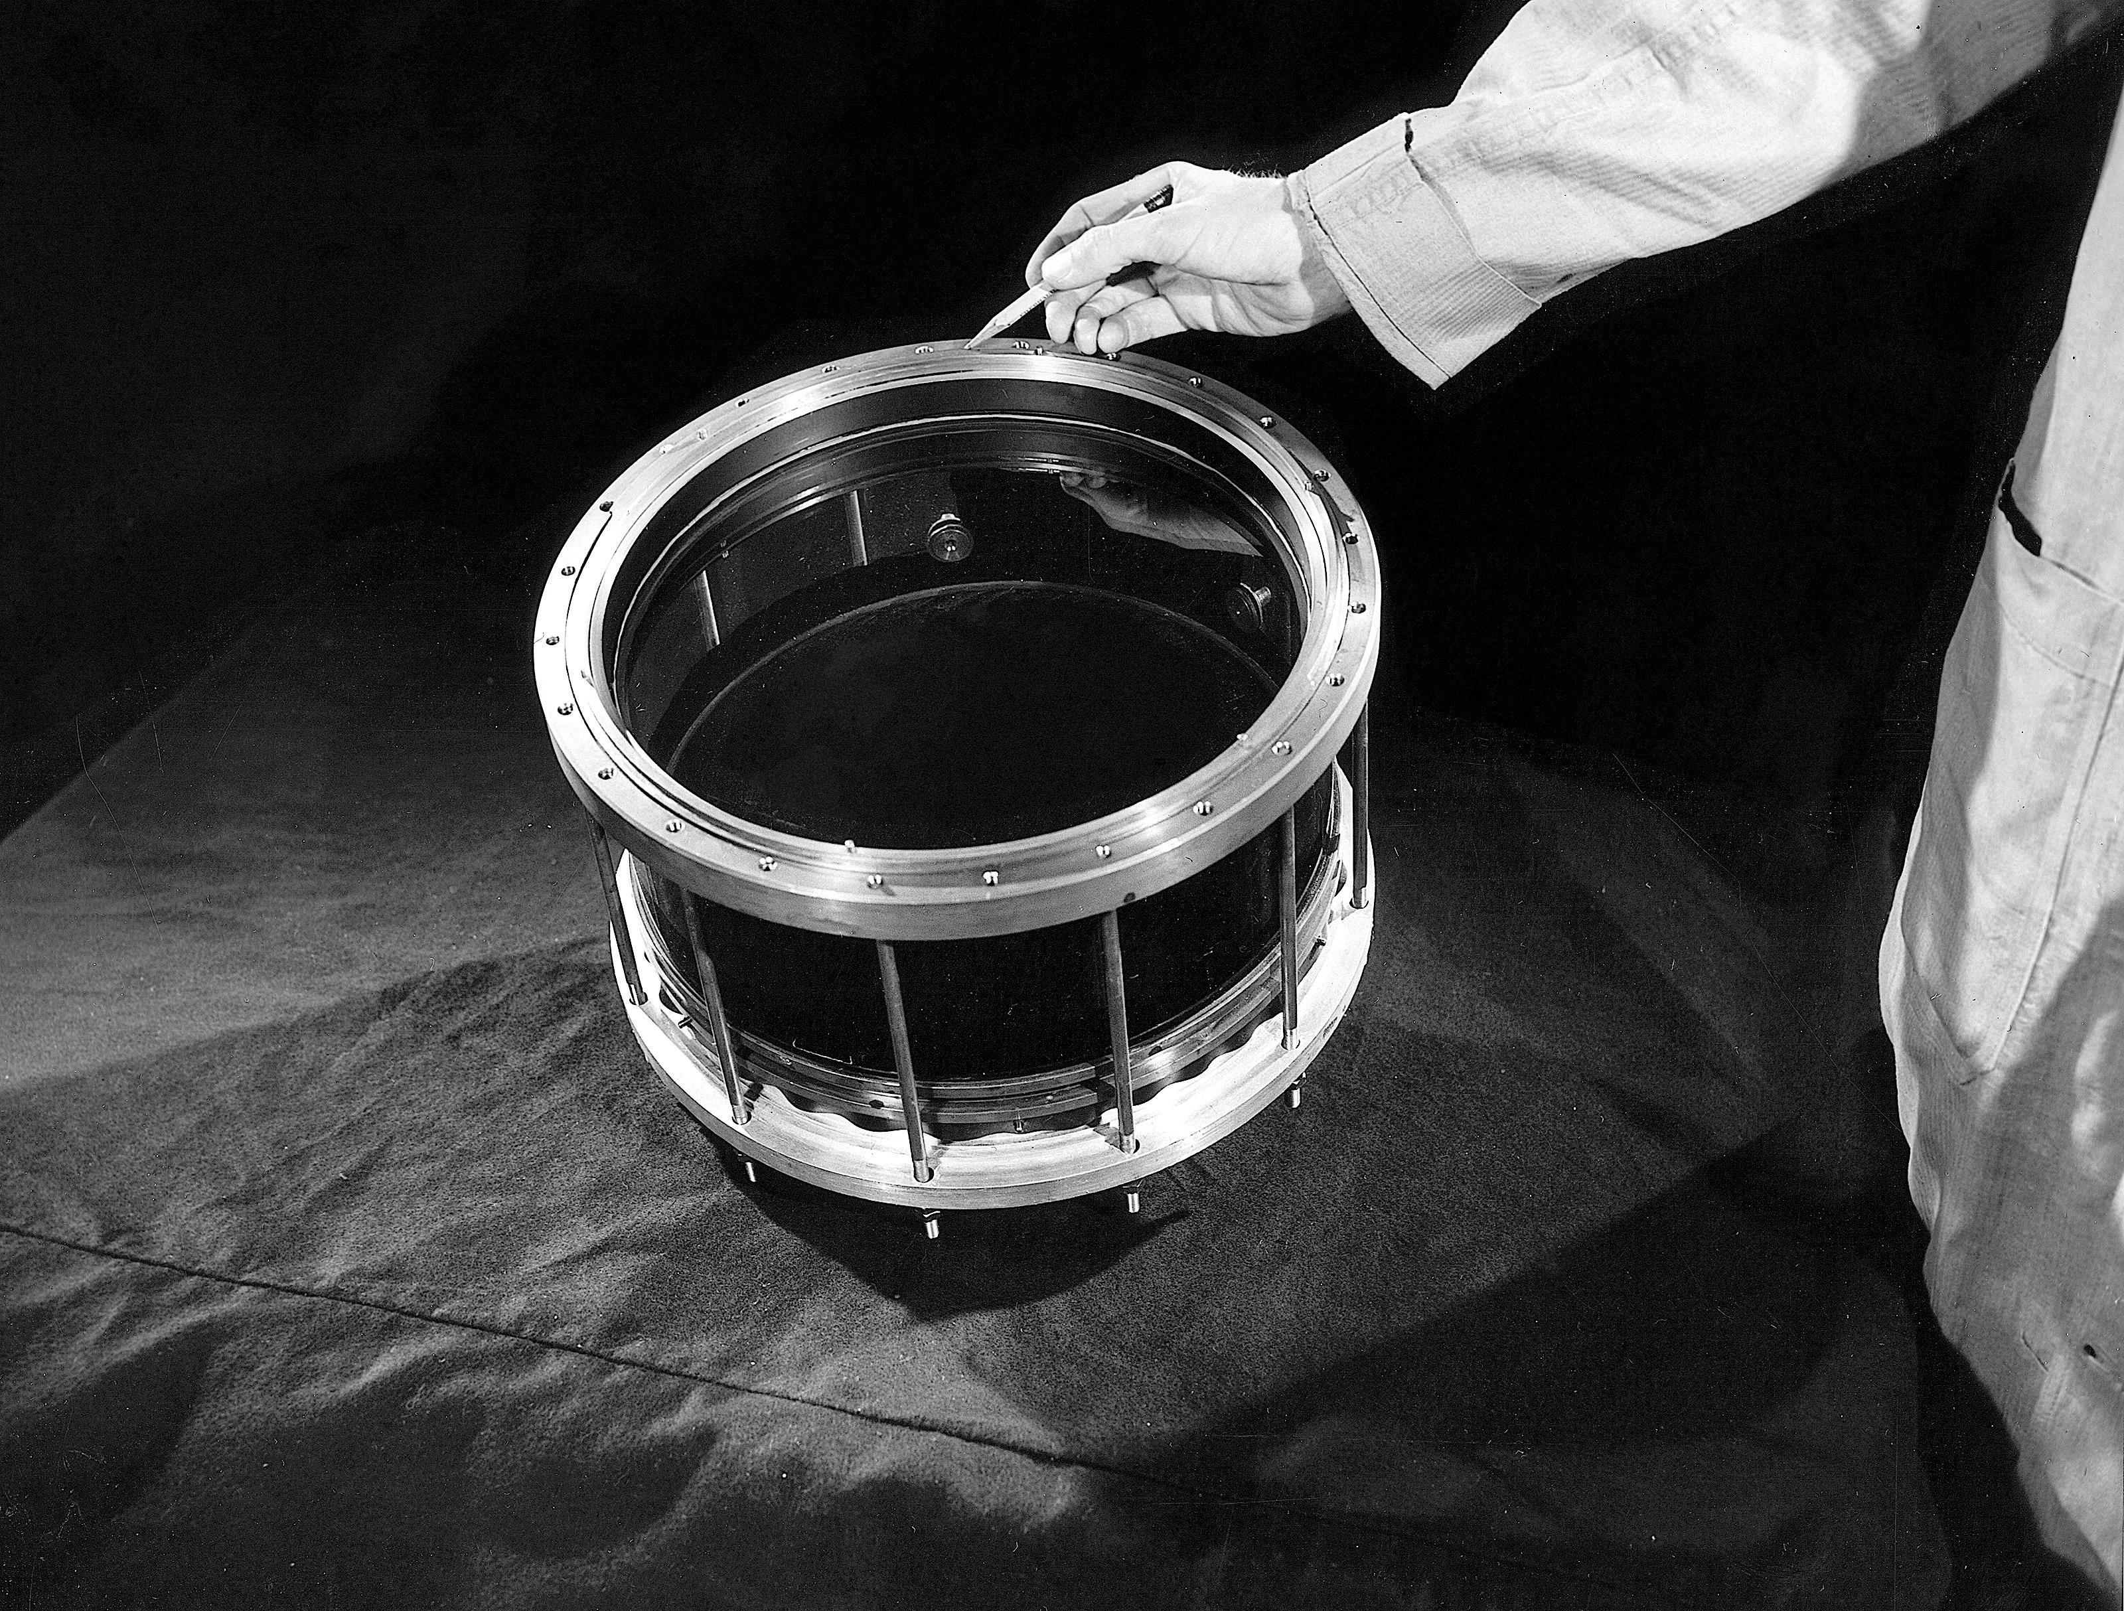
Introducing the Cloud Chamber
Meet Charles Thomas
Rees Wilson
Notes:
Charles Thomas Rees Wilson was a Scottish physicist who, along with Arthur Compton received the Nobel Prize in Physics in 1927 for the invention of the Wilson Cloud Chamber, which became invaluable in the study of radioactivity, X rays, cosmic rays, and other nuclear phenomena.
But Wilson didn’t intend to develop a means of visualizing radiation. In 1895, he was a meteorologist.

Slide 3
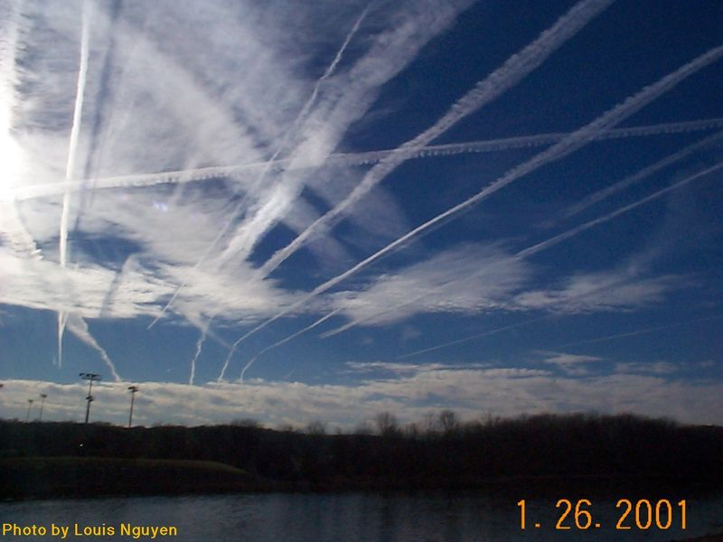
Contrails
Notes:
Cloud chambers detect the paths taken by ionizing radiation. Much like the vapor trail of a jet airplane, the tracks in a cloud chamber mark where ionizing radiation has been traveling. The radiation itself is not visible.

Slide 4
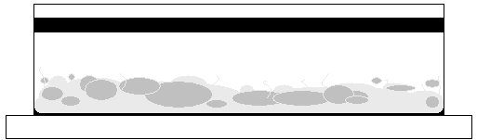
Activity: The Cloud Chamber
Cloud chambers allow observers to “see” ionizing radiation.
Helped discover the positron, the first observed form of antimatter.
Petri Dish
Alcohol Wick
Supercooled >90% (Ethyl Alcohol or Isopropyl Alcohol) Vapor
Liner
Dry Ice
Notes:
Describe the various parts of the cloud chamber. If you are not familiar with cloud chambers, you can find a description on ANS’s nuclearconnect.org website. http://nuclearconnect.org/in-the-classroom/for-teachers/cloud_chamber

Slide 5
Activity: The Cloud Chamber
Materials Needed:
  Dry Ice: >2 pounds plus 1 pound/hour
    Pennsylvania and others – supply-tips
  Alcohol: Ethanol or Isopropyl >90%
    Note: typical concentration is 70% works OK, but higher concentration works better
  Safety Goggles for Teacher/Students
  Thick Gloves (for handling dry ice)
Notes:
Describe the various parts of the cloud chamber. If you are not familiar with cloud chambers, you can find a description on ANS’s nuclearconnect.org website. http://nuclearconnect.org/in-the-classroom/for-teachers/cloud_chamber

Slide 6
Activity: The Cloud Chamber
Materials Needed:
  Plastic boxes with black bottom* or petri dishes with outside bottom painted black
  Flashlights* (function check prior)
  Bottles* (for alcohol)
  Felt*
  Thorium lantern mantles and rubber bands*
  or other small radioactive items
  Thick plates or trays*
  *These items are included in the ANS Visualizing Radiation Kit
Notes:
Describe the various parts of the cloud chamber. If you are not familiar with cloud chambers, you can find a description on ANS’s nuclearconnect.org website. http://nuclearconnect.org/in-the-classroom/for-teachers/cloud_chamber

Slide 7
Activity: The Cloud Chamber
  Helpful hints
  DO NOT TOUCH DRY ICE – leave for a few minutes to supersaturate atmosphere.
  Rub hands together – place on top of petri dish
  Remove hand – shine light across – through the side and look down from the top.
Supercooled 99% IPA (Isopropyl Alcohol) Vapor
Liner
Dry Ice
Notes:
Dry ice will burn hands. In addition, it replaces oxygen in the atmosphere with carbon dioxide as it sublimates.
If possible, use pelleted ice. It doesn’t require chopping into pieces.
Always wear thick gloves when handling the dry ice.
Prepare the cloud chambers 15-30 minutes before observing.
Placing a warm hand on the top of the cloud chamber helps in creating the supersaturation.
A cup of warm water can also be used.

Slide 8
What do you observe?
Describe what you see?
Any patterns?
Are all the "trails" the same size and shape?
Does any action change the observation?
Cause and Effect?
Record Observations
Notes:
ANS uses cloud chambers made from petri dishes, as well as cloud chamber kits that the teachers can take home with them. The kits are available through Carolina Biological. https://www.carolina.com/nuclear-chemistry/carolina-chemonstrations-observing-ionizing-radiation-using-a-cloud-chamber/840374.pr?question=cloud+chamber
Frequently, only a few cloud chambers will be successful in producing trails. This is normal. Allow workshop participants to gather round the chambers that are productive. Turn off as many lights as possible to increase the chances of seeing trails.
Have teachers prepare and observe cloud chambers. This activity is more of a rehearsal for teachers so that they have practice before having their students complete the activity in class.
The ANS lesson is http://nuclearconnect.org/in-the-classroom/for-teachers/cloud_chamber

Slide 10
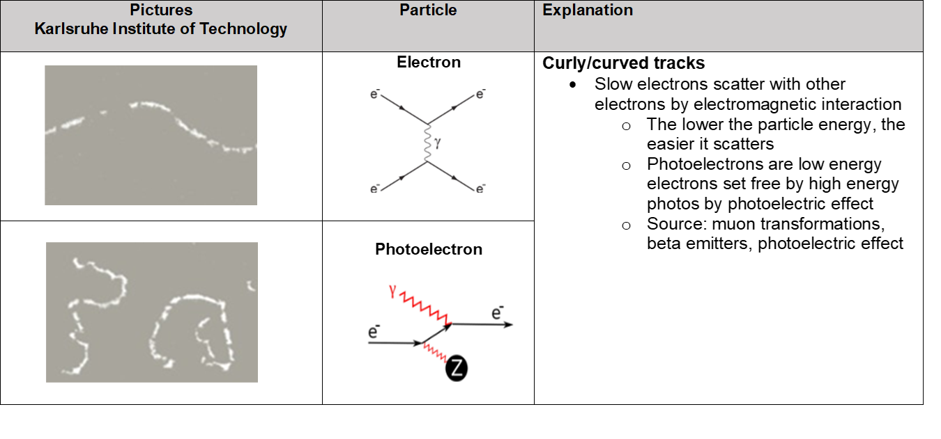

Slide 11
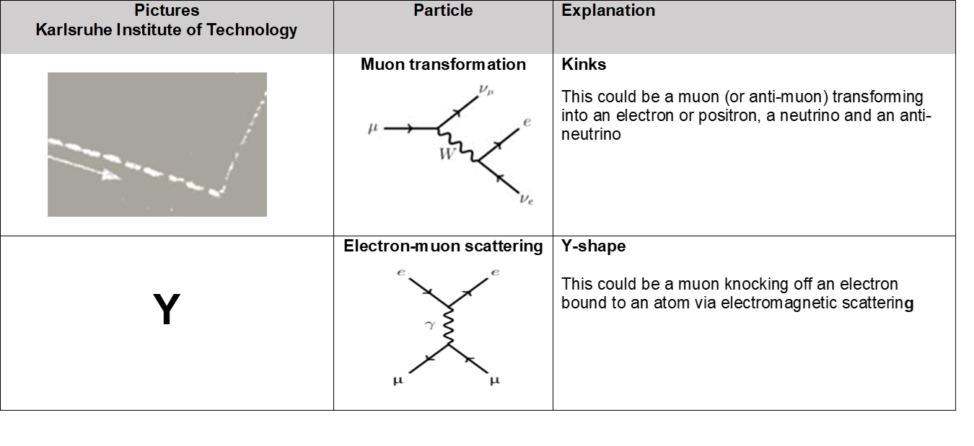

Slide 12
Cloud Chamber Theory
Since the top of the chamber is at room temperature, the alcohol evaporates from the wick and slowly sinks downwards.
The dry ice keeps the bottom extremely cold – so the vapor, once it has fallen, is in a super-cooled state.
      This means that the alcohol is in a vapor form at a temperature that vapor would not normally exist.
Because there is so much vapor, the chamber becomes super-saturated.
      Super-saturation means that a medium (air) is holding more of a material (alcohol) than could be achieved under normal conditions.
The super-cooled, super-saturated vapor is very unstable and will condense into liquid with the slightest disturbance.
  In these conditions, a charged particle will ionize molecules in the vapor as it travels through it, causing condensation around the particle track. It is this condensation trail that is visible in a Cloud Chamber.

Slide 13
Credits/Reference
Contrails
http://contrailscience.com/category/science/
Video – Large Diffusion Cloud Chamber
Advised to mute audio possible language concerns
http://www.youtube.com/watch?v=Efgy1bV2aQo
Notes:
The large diffusion cloud chamber video is only active in slide show mode.
Follow this presentation with practice setting up and using cloud chambers.

Slide 14
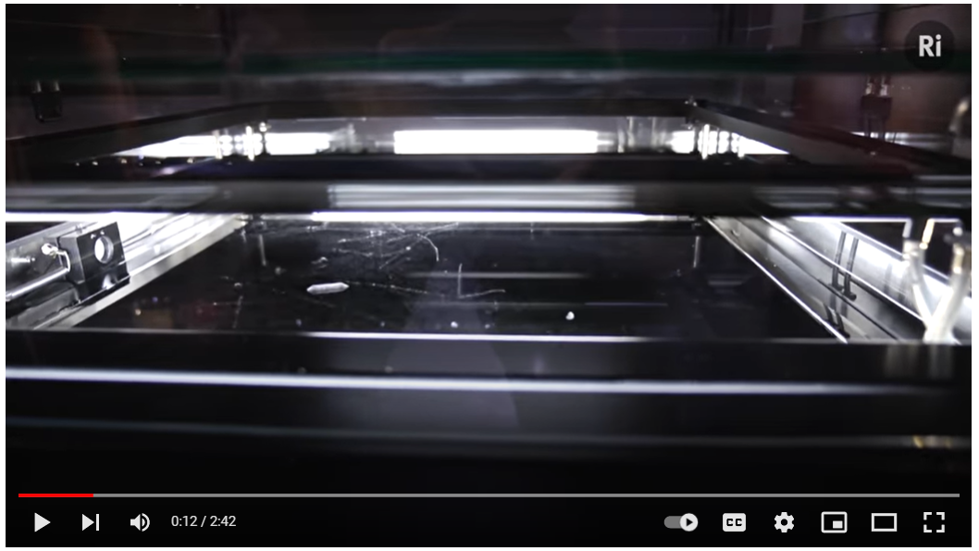
Visualizing Radiation
Note Mute Audio - Language
Credit: Royal Institute
Notes:
In slide show mode with an internet connection, the image is hyperlinked to the YouTube video at https://youtu.be/-OtiTeNWPH4
The narrator explains how a cloud chamber works. At 1:16, stop the video to point out the squiggly beta radiation trails. An americium source will be inserted later in the video which will make it difficult to see the beta trails. Restart the video after pointing out the beta trails.

Slide 15
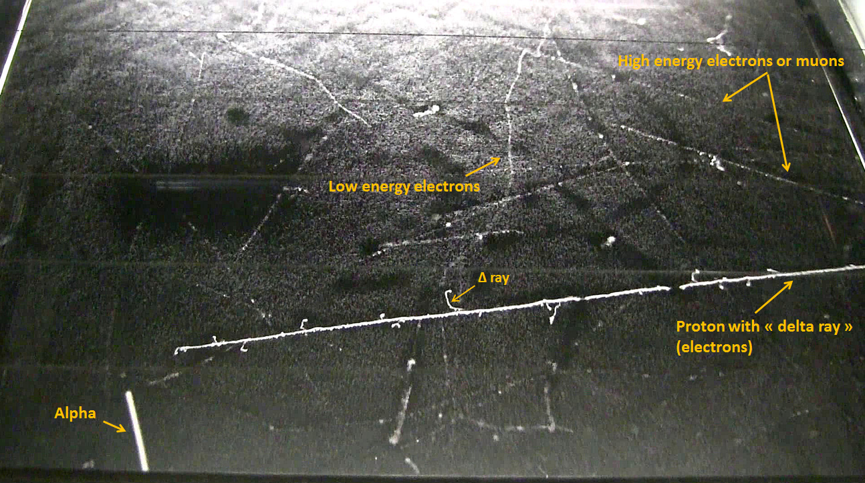
What to Expect from the Cloud Chamber
Notes:
ANS uses cloud chambers made from petri dishes, as well as cloud chamber kits that the teachers can take home with them. The kits are available through Carolina Biological. https://www.carolina.com/nuclear-chemistry/carolina-chemonstrations-observing-ionizing-radiation-using-a-cloud-chamber/840374.pr?question=cloud+chamber
Frequently, only a few cloud chambers will be successful in producing trails. This is normal. Allow workshop participants to gather round the chambers that are productive. Turn off as many lights as possible to increase the chances of seeing trails.
Have teachers prepare and observe cloud chambers. This activity is more of a rehearsal for teachers so that they have practice before having their students complete the activity in class.
The ANS lesson is http://nuclearconnect.org/in-the-classroom/for-teachers/cloud_chamber

Slide 16
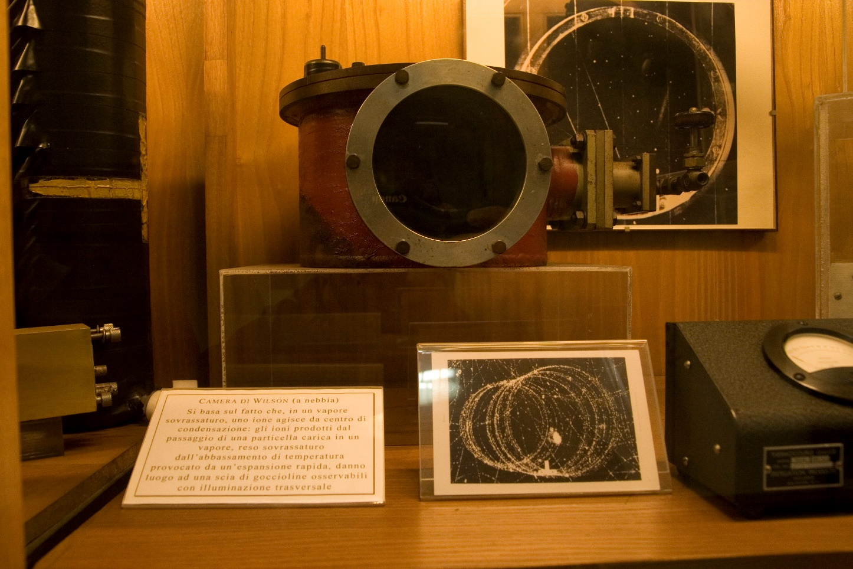
The Wilson Cloud Chamber
Wikimedia Commons
Notes:
Wilson began his work developing expansion chambers to study cloud formation and optical phenomenon. He discovered ions act as condensation centers. He perfected the first could chamber in 1911.
The invention of the cloud chamber was by far Wilson's signature accomplishment, earning him the Nobel Prize for Physics in 1927.^{[12]} The Cavendish laboratory praised him for the creation of "a novel and striking method of investigating the properties of ionized gases"^{[13]}. The cloud chamber allowed huge experimental leaps forward in the study of subatomic particles and the field of particle physics, generally. Some have credited Wilson with making the study of particles possible at all^{[8]}.
The creation of the cloud chamber led to numerous other discoveries and contributions to the fields of meteorology and physics, many of which were made by other scientists. Some of these subsequent contributions include, to name a few, studies into:
the effects of lightning strikes on the atmosphere
the construction and structure of thunderstorms
energetic radiation production by thunderclouds
data supporting the theory of electron runaway in thunderclouds
the discovery of continuous ionization in the atmosphere^{[7]}
the discovery of the positron^{[14]}
Credit: Wikipedia https://en.wikipedia.org/wiki/Charles_Thomson_Rees_Wilson

Slide 17
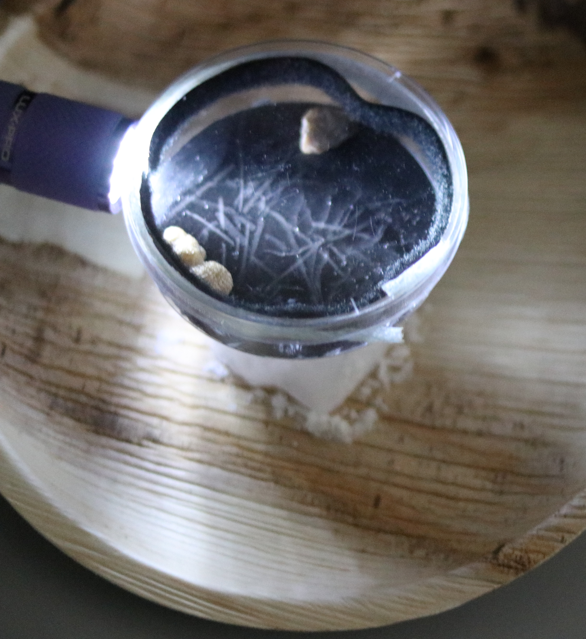
What do you observe?
What are the trails?
Where are they originating?
Notes:
ANS uses cloud chambers made from petri dishes, as well as cloud chamber kits that the teachers can take home with them. The kits are available through Carolina Biological. https://www.carolina.com/nuclear-chemistry/carolina-chemonstrations-observing-ionizing-radiation-using-a-cloud-chamber/840374.pr?question=cloud+chamber
Frequently, only a few cloud chambers will be successful in producing trails. This is normal. Allow workshop participants to gather round the chambers that are productive. Turn off as many lights as possible to increase the chances of seeing trails.
Have teachers prepare and observe cloud chambers. This activity is more of a rehearsal for teachers so that they have practice before having their students complete the activity in class.
The ANS lesson is http://nuclearconnect.org/in-the-classroom/for-teachers/cloud_chamber

Slide 18
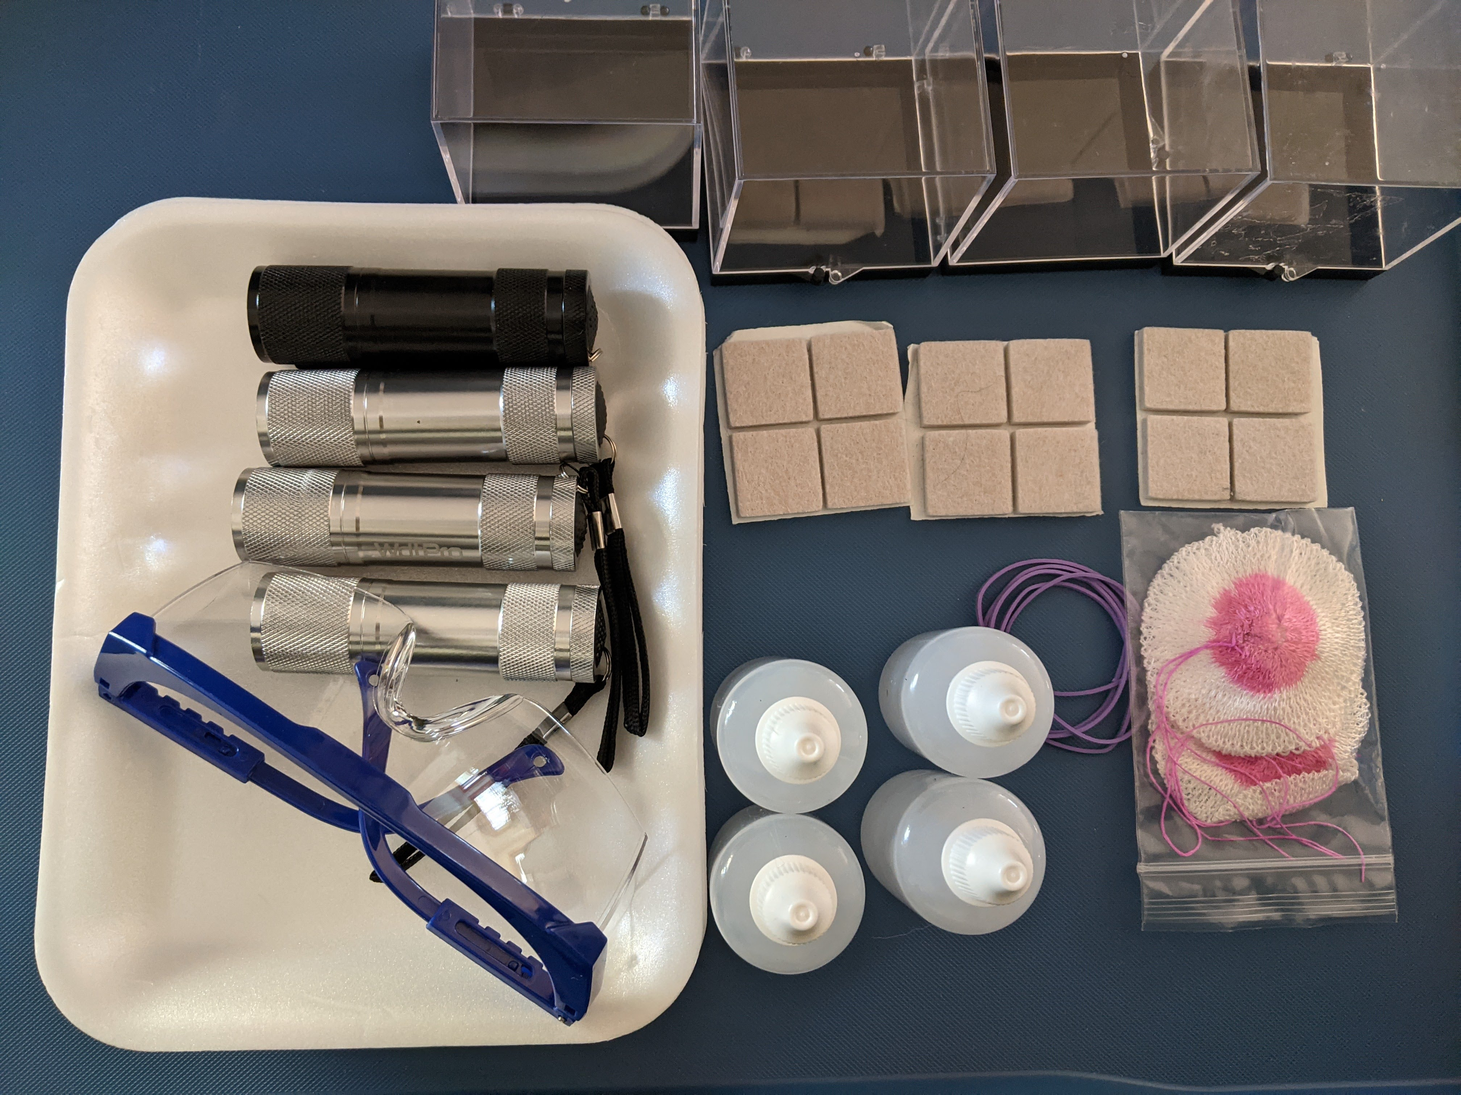
ANS Visualizing Radiation Kit

Slide 19
Body Level One
  Body Level Two
    Body Level Three
      Body Level Four
        Body Level Five

