Slide 1
Overview of the Xe-100 Implementation of NEI 18-04
Kyle Metzroth, PhD
Xe-100 Safety Analysis Manager
NEI 18-04 Implementation Lead
March 31, 2023

Slide 2
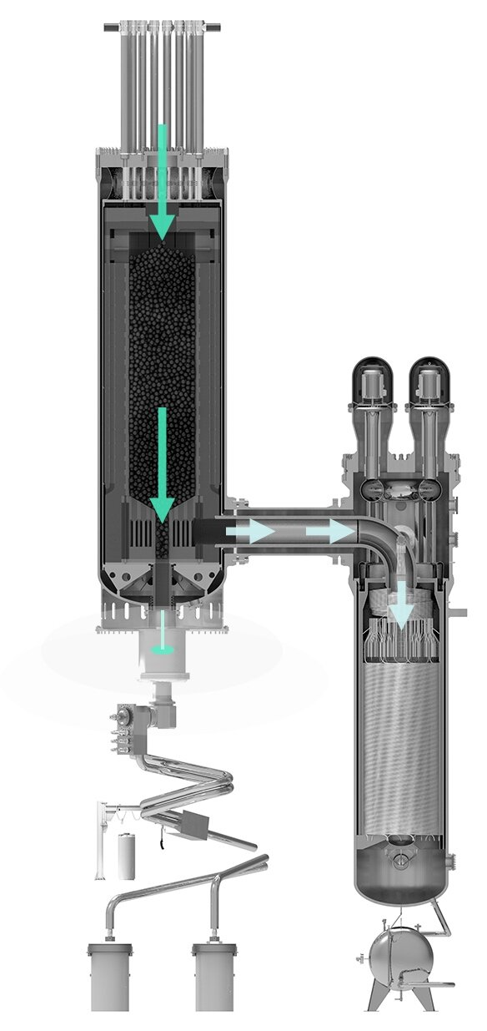


The Xe-100 Design Solution
Pebble Benefits:
Tested up to 1800 °C
Burnup up to 165,000 MWd/t-hm
Long-term robustness for thousands of years
TRISO particle contains 99.999% of fission products
Pebble: ~19,000 TRISO-coated particles
Reactor: ~ 220,000 Fuel pebbles
The primary safety goal: Maintain the geometry of the pebbles, reactor, and reactor building to ensure intrinsic control of heat generation and removal, keeping the fuel particles within their performance envelope and assuring fission product retention at the source.
This fuel allows engineers to think differently about reactor design, ultimate safety and rugged predictable long-term storage
© 2021 X Energy LLC, all rights reserved

Slide 3

Licensing Modernization Project (LMP) / NEI 18-04

Slide 4
NEI 18-04 and Regulatory Guide 1.233
Outgrowth of licensing challenges of the U.S. Department of Energy’s Next Generation Nuclear Plant (NGNP) Program
What are the licensing-basis events, and how to systematically develop that set and select for analysis?
How to classify the structures, systems, and components to credit them appropriately in analyses?
How to evaluate the adequacy of defense-in-depth in a clear, logical, systematic, and consistent manner?
NEI 18-04 Risk-Informed Performance-Based Technology Inclusive Guidance for Non-Light Water Reactor Licensing Basis Development
https://www.nrc.gov/docs/ML1924/ML19241A472.pdf
RG 1.233 Guidance for a Technology-Inclusive, Risk-Informed, and Performance-Based Methodology to Inform the Licensing Basis and Content of Applications for Licenses, Certifications, and Approvals for Non-Light-Water Reactors
https://www.nrc.gov/docs/ML2009/ML20091L698.pdf
© 2021 X Energy LLC, all rights reserved

Slide 5
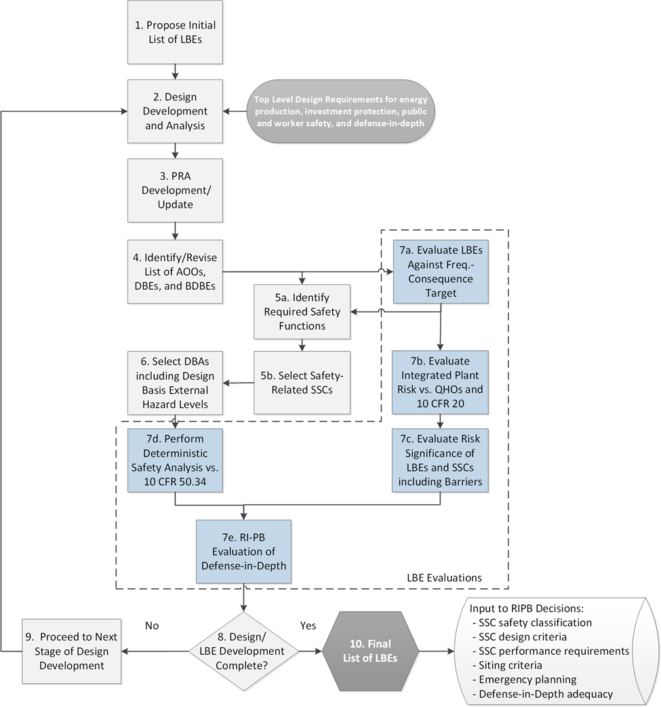
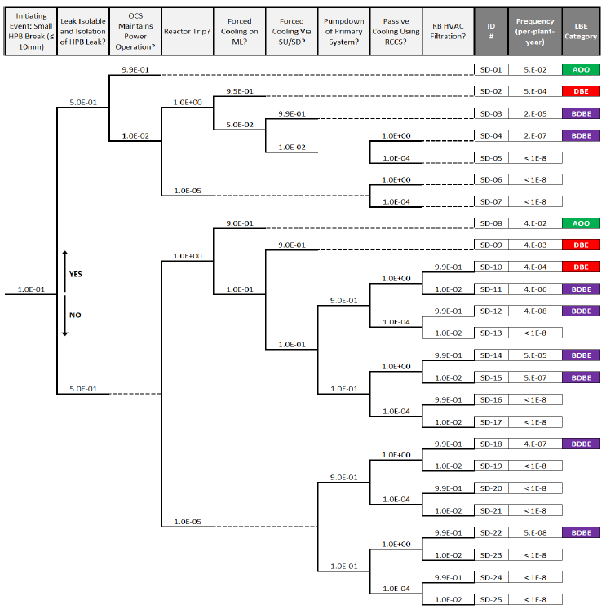
Licensing Basis Events
Approach that incorporates deterministic and probabilistic methods that is:
Systematic and reproducible
Sufficiently complete
Available for timely input to design decisions
Risk-informed and performance-based
Reactor technology-inclusive
Consistent with applicable regulatory requirements
DSA-influenced
PSA-influenced
© 2021 X Energy LLC, all rights reserved

Slide 6
Classification of Structures, Systems, and Components
Maintain Control of Radionuclide Release
Control Radiation
Control Personnel Access
Control Radiation from Core
Control Radiation from Processes
Control Radiation from Storage
Control Direct Radiation
Control Radiation Transport
Control Transport from Core
Control Transport from HPB
Control Transport in Reactor Building
Control Transport from Site
Control Radionuclides in Fuel Particles
Retain Radionuclides in Fuel Spheres
Denotes Minimum Functions to Meet 10 CFR 50.34
Remove Core Heat
Control Core Heat Generation
Control Chemical Attack
Decomposing the Required Safety Functions across the spectrum of LBEs leads to a systematic process of assigning classifications to the functions & SSCs that perform them.
Safety-related
Non-safety-related, but with special treatment(s) applied
Non-safety related
© 2021 X Energy LLC, all rights reserved

Slide 7
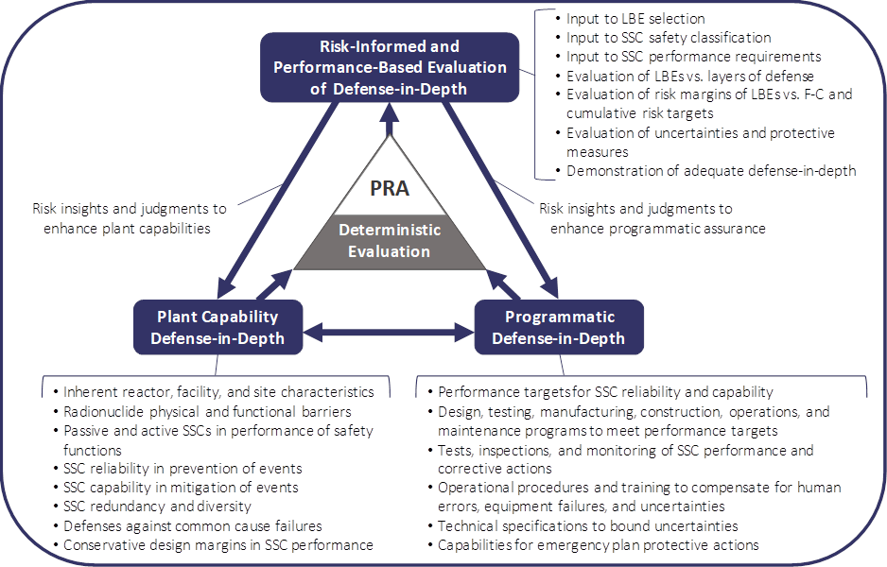
Evaluation of the Adequacy of Defense in Depth
Outcome: A systematic, reproducible, iterative means of evaluating Defense in Depth and representing that to the regulator
Plant Capability DID—This capability is introduced through systems and features designed to prevent occurrence of undesired LBEs or mitigate the consequences of such events.
Programmatic DID—This capability is introduced through setting design targets and identifying monitoring or operational programs to assure targets are met.
These capabilities when combined create layers-of-defense response to plant challenges.
© 2021 X Energy LLC, all rights reserved

Slide 8
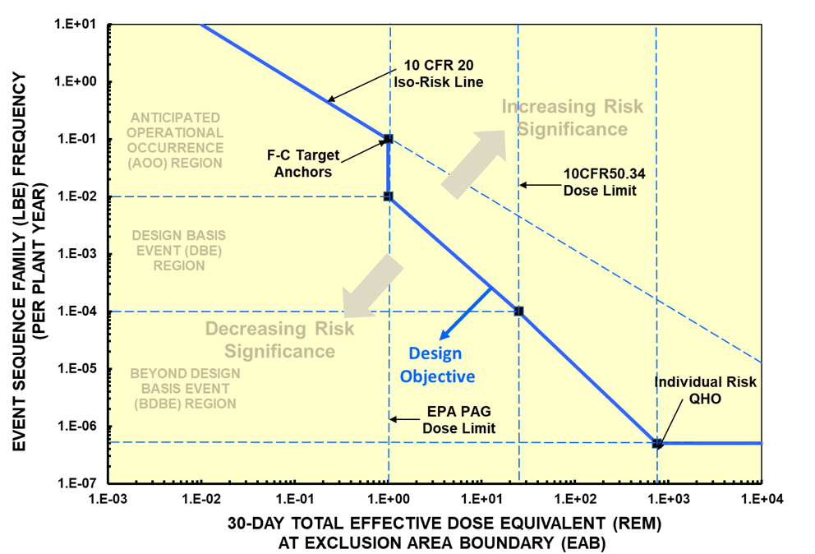
Visualizing Safety: Frequency-Consequence Curve
In formulating the LMP F-C Target, a number of key inputs were considered including:
10 CFR 20 which limits public exposures from normal operation and anticipated events to 100 mrem/year
The 1-rem EPA Protective Action Guide dose, which if exceeded would lead to offsite protective actions
10 CFR 50.34 which limits exposures from the most severe and least likely design basis accidents to 25 rem
NRC Safety goal Quantitative Health Objectives which limit the individual risks to the population within 1 mile of the site boundary to 5×10⁻⁷/year
Not the complete answer for licensing, but a means of systematically evaluating off-normal and unplanned events throughout plant life
© 2020 X Energy LLC, all rights reserved

Slide 9
Current Status and Select Topics in Xe-100 NEI 18-04 Implementation

Slide 10
Progress
NEI 18-04 process
  Guideline for execution
  Overall approach – Implementation team / IDPP
Decomposition of requirements from PRA / safety analysis to system requirements
  Alignment with Principal Design Criteria
LBE identification – multiple PRA iterations that have corresponded to conceptual and preliminary design phases
Multiple safety analysis rounds corresponding with LBEs
  Identifying requirements and performance characteristics for SSCs
SSC classification
  Focused on system level
  Planning decomposition to component level over the summer
First round of DID adequacy
Reliability and capability targets and special treatments

Slide 11
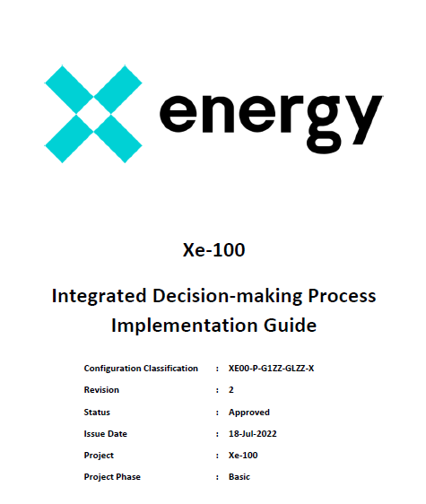
NEI 18-04 Process Development and Implementation Approach
X-energy has developed an Xe-100 specific implementation of NEI 18-04
Ensure a repeatable approach that produces a consistent documentable basis for all safety decisions
IDPP formed, reviewed and approved initial SSC classification and DID adequacy
CNO
Design Safety Review Board (DSRB)
Engineering
Integrated Decision-Making Process
NEI 18-04 Implementation Team
Integrated Decision-Making Process Panel (IDPP)
PRA
Licensing
Safety Analysis
Operations
Direction of oversight

Slide 12
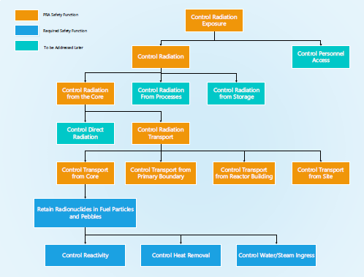
Requirements Decomposition
Safety functions and design requirements derived from NEI 18-04 must be translated into a systems engineering process to ensure appropriate incorporation in the design
PRA
Safety Analysis
NEI 18-04
Systems Engineering
Licensing

Slide 13
Requirements Decomposition
Safety functions and design requirements derived from NEI 18-04 must be translated into a systems engineering process to ensure appropriate incorporation in the design
SSC Classification
PRA Safety Functions
NEI 18-04 Guidance
Plant Level and System Level Reliability and Capability Targets
Component-Level Reliability and Capability Targets
Requirements Management
Interface Management

Slide 14
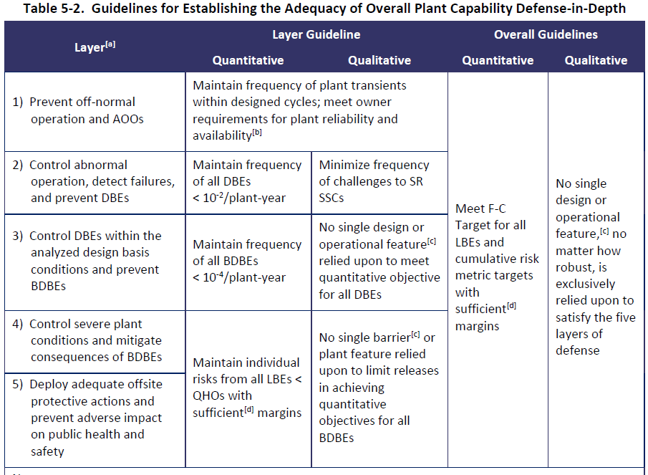
Reliability Targets – Starting Point

Slide 15
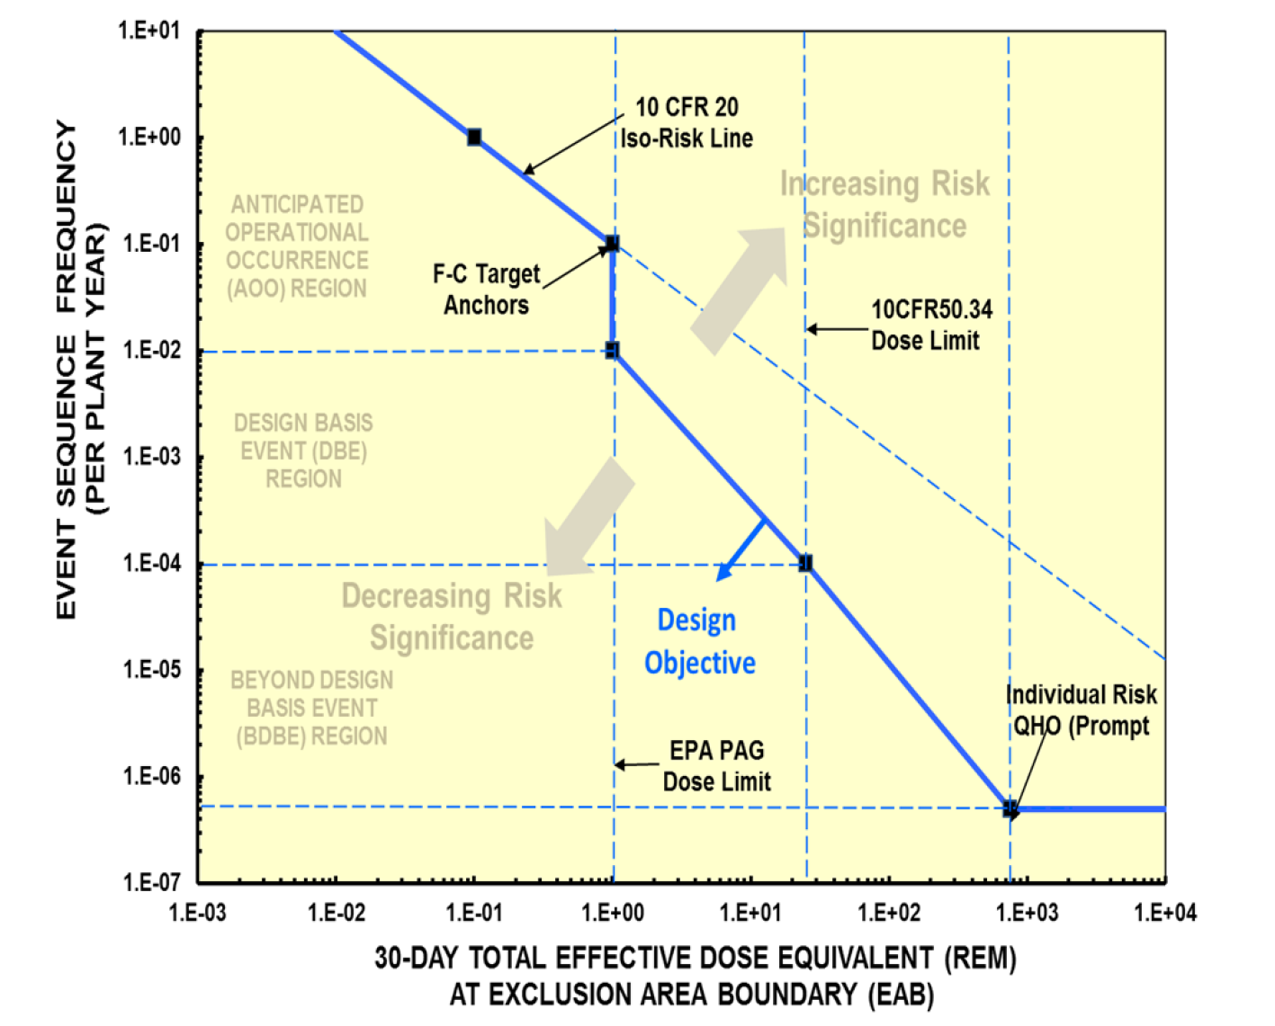
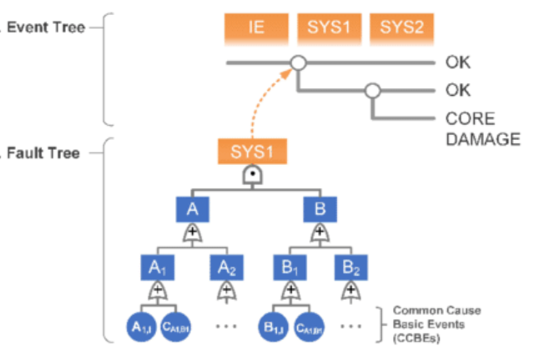
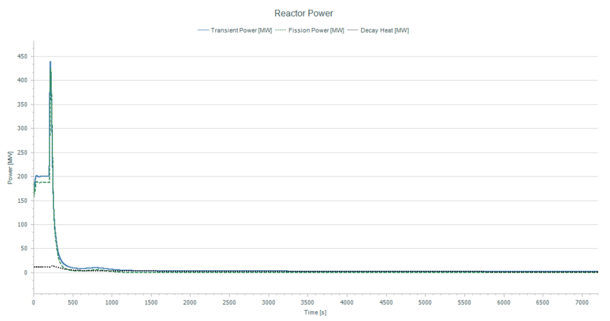
Reliability and Capability Targets
PRA
AOOs
DBE-1
DBE-2
DBEs
Safety Analysis
BDBEs
Incredible Events

Slide 16
Reliability and Capability Targets
PRA
AOOs
DBE-1
Keep in DBE region (< 1e-2 /yr)
DBE-2
DBEs
Safety Analysis
BDBEs
Incredible Events

Slide 17
Reliability Target Allocation – Function and System Level
Initiating Event
System A
System B
Frequency
Probability
Probability
DBE-1
Ensure the frequencies of DBE-1 and DBE-2 stay < 1e-2 /yr
Allocate targets for reliability to meet the above goal for:
  Initiating event
  System A
  System B
Initiating events and NST SSCs targets often driven by plant owner requirements (i.e., keep the plant running)
NSRST and SR reliability targets come under the purview of the SAR
DBE-2

Slide 18
Reliability Target Allocation – Component Level
Based on system reliability target allocation, allocate targets to important components (i.e., those that drive the reliability)
  Reliability drivers could be active or passive components
PRA frequencies and probabilities not directly used in developing targets
  Used as a “sanity check”
  Leverage fault tree logic
Monitoring and other special treatments are used to validate reliability targets
  Integral risk metrics are used to track overall risk posture
Initiating Event
System A
System B
Frequency
Probability
Probability

Slide 19
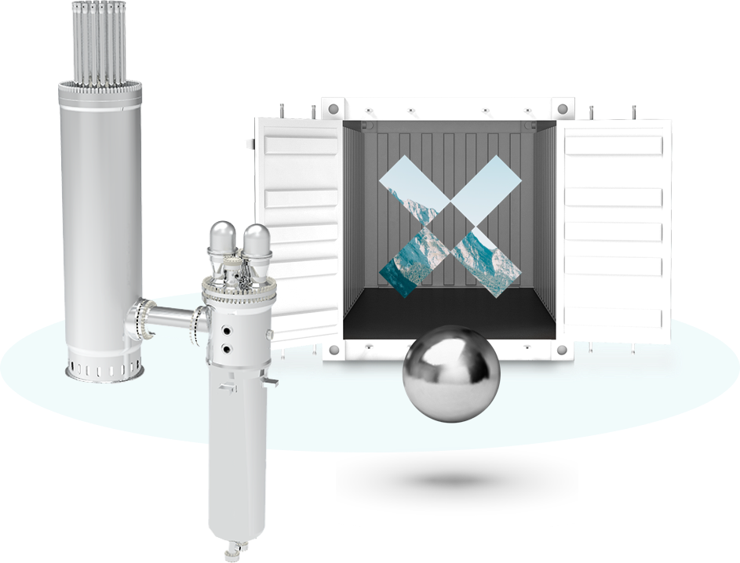
Lessons Learned in Implementing NEI 18-04
Its important to have an early approach for interfacing with engineering processes
How to get NEI 18-04-derived requirements into the design process and organization?
Special Treatments
The need to communicate a “negative” result
Avoid overly burdensome design assumptions early on
Construction Permit Application
NEI 21-07 provides a good framework for constructing an NEI 18-04 based SAR, PSAR guidance is more limited
Need to make early decisions on:
  Level of PRA to support the PSAR
  Level of NEI 18-04 implementation
How to interface with other radiological safety considerations?
Normal operations releases
Worker protection

Slide 21
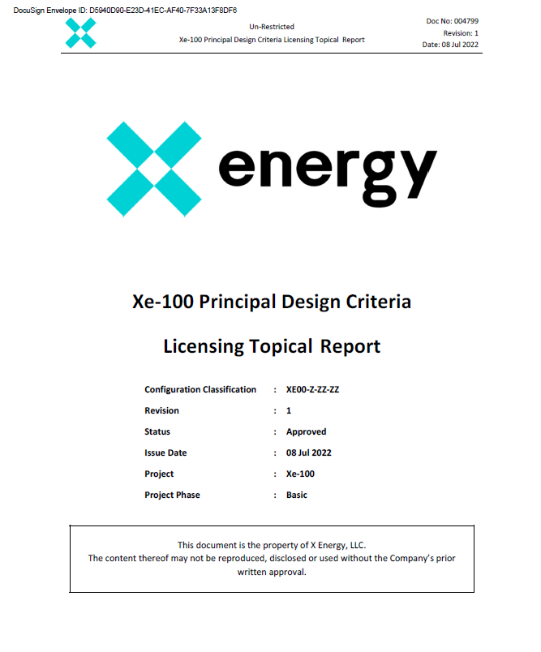
Alignment of NEI 18-04 and Principal Design Criteria
X-energy submitted its licensing topical report on Principal Design Criteria in Summer 2022
Both NEI 18-04 and RG 1.232 provide frameworks for developing PDCs
  NEI 18-04 RSFs/PSFs have many similar qualities to PDCs
  NEI 18-04 covers requirements to address LBEs
  RG 1.232 covers more than NEI 18-04 including normal operations
Xe-100 approach
  Utilize NEI 18-04 to develop PDCs addressing performance of SSCs during LBEs
    Draw guidance from RG 1.232
  For PDCs outside of NEI 18-04 purview, leverage RG 1.232
  Grouping PDCs based on whether they are based on Required Functional Design Criteria (safety related), Complementary Design Criteria (NSRST), or not safety significant (NST)

