Slide 1
The Nuclear Fuel Cycle
Mary Lou Dunzik-Gougar, PhD
ANS Teachers’ Workshop
2013

Slide 2
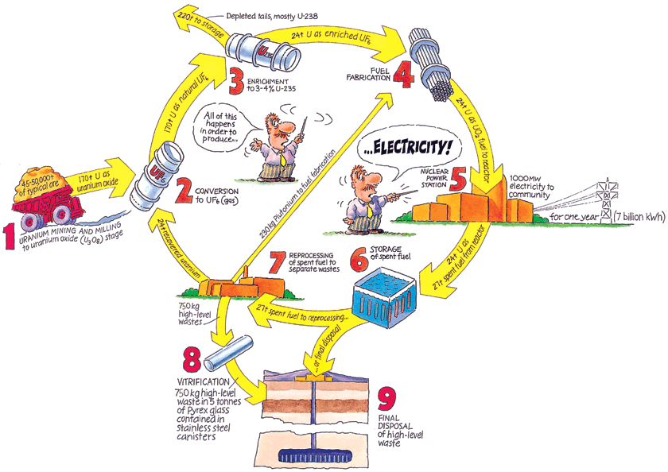

Slide 3
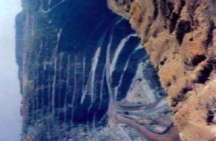
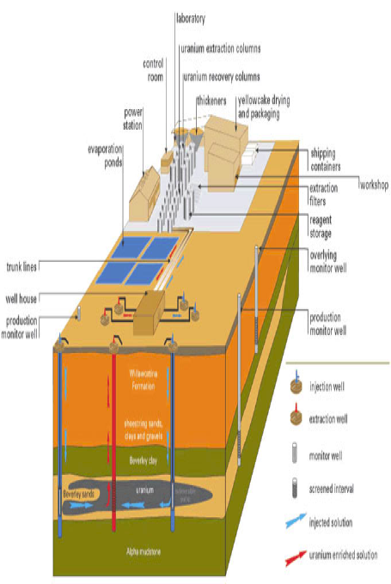
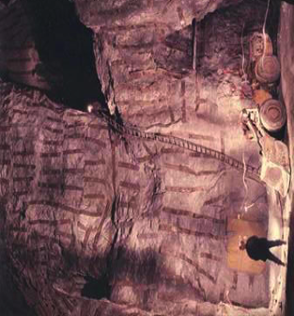
Uranium Mining
Open pit (strip) mining
Underground mining
In situ leaching

Slide 5
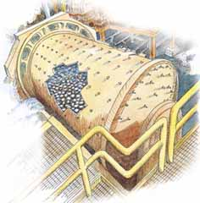
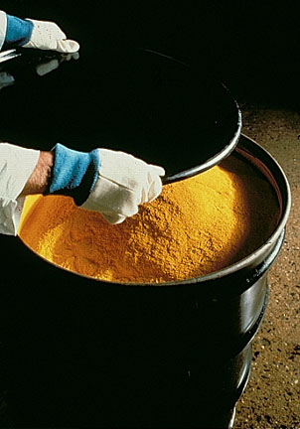
Uranium Milling
Ore is crushed
Uranium is separated
U₃O₈ “yellow cake” produced

Slide 7
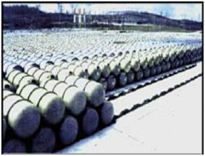
Uranium Conversion (to UF₆ gas)
Impurities removed
Uranium combined with fluorine
UF₆ gas produced
- Gaseous form facilitates
enrichment
UF6 containers

Slide 9
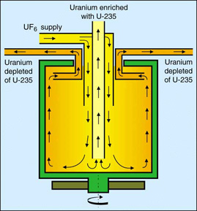
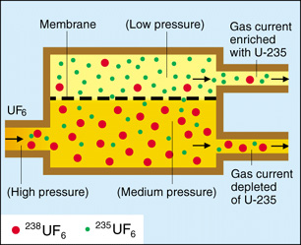
U Enrichment
Natural U is > 99% ²³⁸U and only ~ 0.7% ²³⁵U
Separation of ²³⁵UF₆ and ²³⁸UF₆ based on (very small) mass difference
UF₆ enriched from 0.7% ²³⁵U to 3%-5% ²³⁵U
Diffusion
Centrifugation

Slide 11
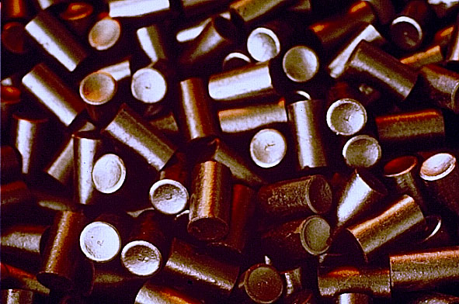
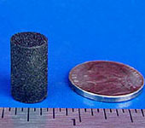
Fuel Fabrication
Enriched UF₆ gas converted to uranium oxide (UO₂) solid
Uranium Oxide Ceramic Fuel Pellets
Notes:
Finally, the uranium hexafluoride is shipped to a fuel fabricator, where it is manufactured into solid ceramic pellets, about the size of the end of a finger.

Slide 12
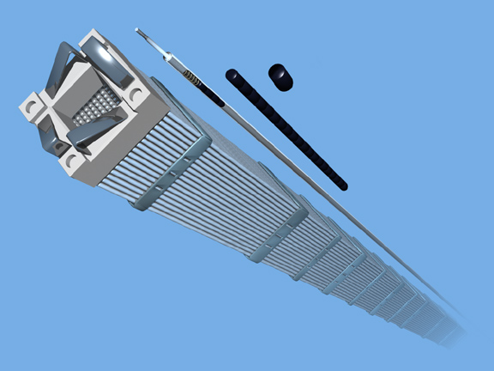
Fuel Fabrication
Fuel rods filled with ceramic pellets are
grouped into fuel assemblies

Slide 13
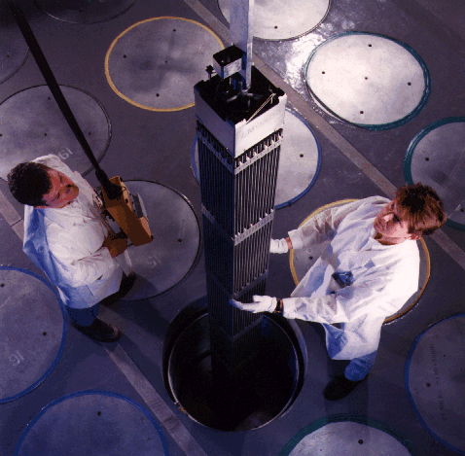
Fuel Fabrication
A pressurized water reactor fuel assembly

Slide 15
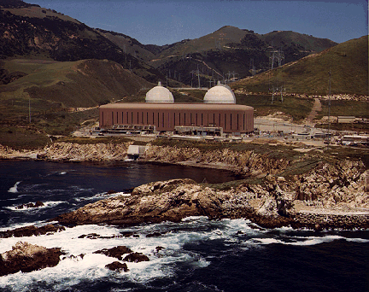
Reactors
Diablo Canyon nuclear power plant in the U.S.

Slide 17
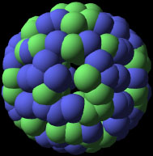
In the reactor, ²³⁵U fissions to produce . . .
Energy
Neutrons
Neutron
Fission Products
Neutrons may
Cause new fissions to occur
Be absorbed to form unstable, radioactive nuclide

Slide 18
Fuel Consumption in the Reactor
Fuel is in reactor for 4 – 6 years
U consumed, fission products and transuranics (mostly Pu) produced
Fresh Fuel
4%
96%
²³⁵U
²³⁸U
Pu
3.5%
94%
Used Fuel
Fission
Products
Transuranics
(or Actinides)
Notes:
I like to talk about this in a simple way as: things lighter than U <---> U <---> things heavier than U

Slide 19
Radioactive Decay Equations
Alpha Decay
Beta Decay
Gamma Decay
238
92
234
90
4
2
α
U
Th +
Fuel isotope
90
38
0
−1
Sr
90
39
Y +
β
+
ν
Fission product
Fission product
60m
56
Co
60
56
γ
Co +

Slide 20
Sources of radiation
Consumer Products
(2%)
Cosmic
(5%)
Nuclear Power
(<0.1%)
Human Body
(5%)
The average
American receives a
radiation dose of 620 millirem per year.
Source: National Council on Radiation Protection and Measurement Report 160 (2006)

Slide 21
Units of Dose and Exposure
Roentgen (R) - unit of exposure - ionization of air by x or gamma rays
RAD (Radiation Absorbed Dose) - energy deposited in material (Gray (Gy) is international unit)
rem - (Roengten Equivalent Man)
unit of dose equivalent
Seivert (Sv) is international unit

Slide 22
Units of Radioactivity
Activity - a rate; the number of emissions (of radiation) per unit time.
dps - disintegrations per second
Bequerel = 1 dps
Curie = 37,000,000,000 dps
Picocurie = 0.037 dps or 2.2 dpm

Slide 24
Used Nuclear Fuel Storage
Used fuel first stored in pool at least 5 years
Cooling and shielding
Older fuel can move to dry casks
Air cools
Steel and concrete shields

Slide 26
Fuel recycle/reprocessing
Fresh Fuel
4%
96%
²³⁵U
²³⁸U
Pu
3.5%
94%
Used Fuel
Fission
Products
Transuranics
(or Actinides)

Slide 27
Fuel recycle/reprocessing
Used fuel
Re-enrichment
Fission products and non-Pu TRUs
Vitrified Waste
U
Pu
New fuel

Slide 29
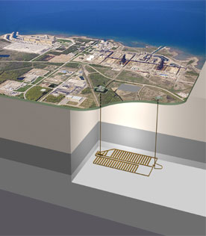
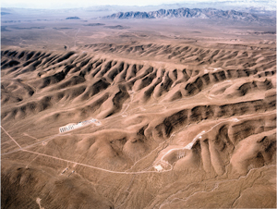
Geologic Repository
The choice of countries worldwide
U.S. has studied Yucca Mt., Nevada as potential location

Slide 30
The Three C's of Used Nuclear Fuel
Compact....
Suppose
You live for 80 years
All electricity is nuclear
Your share of used nuclear fuel

Slide 31
The Three C's of Used Nuclear Fuel
Compact.... Contained....
Solid fuel pellet, inside...
Metal fuel rod, inside...
Steel canister, inside...
Storage or shipping cask

Slide 32
The Three C's of Used Nuclear Fuel
Compact.... Contained.... Cared for....
Carefully tracked
Decades of safe handling experience
Easy to detect and monitor
Paid for in Nuclear Waste Fee

Slide 33
The End . . .

