Slide 1

Understanding Risk by
Rich Denning
The Ohio State University
November 2013

Slide 2
Presentation Objectives
In November 2006, Time Magazine featured the question
  “Why we worry about the things we shouldn’t and ignore the things we should”
In this presentation, we will discuss:
  What we mean when we say something is unsafe.
  The relationship between safety and risk.
  The major health risks are that we face in our daily lives.
  The character and magnitude of nuclear power plant accident risk.

Slide 3
Safety
Is it safe to cross the street?
What could happen to you?
  You could be injured.
  You could die.
  Nothing.
You look both ways and assess the likelihood of being hit.
Safety is not just a question of the potential size of the hazard, it also depends on the likelihood.

Slide 4
Risk
Definition of risk
  “Risk is the potential for some unwanted event to occur. Risk is a function of the likelihood of the unwanted event and its consequences.”
  National Infrastructure Protection Center
Risk always has some element of (unwanted) consequence and some element of likelihood
Simple measure of risk:
  Probability of an event times its consequences.
Risk assessment is a tool that we use to quantify safety.

Slide 5
Disease Risks Dominate
Personal Risk
Accident
Disease

Slide 6
Accident Risks
Type | Annual Fatalities (2010)
Transportation (motor vehicles) | 37,961
Falls | 26,009
Poisoning | 33,041
Drowning | 3,782
Fire/Smoke | 2,782
Other | 17,284
Total | 120,859
Risk per year = 120,859/309 million = 0.0004/yr

Slide 7
Disease Risks
Type | Annual Fatalities (2010)
Total | 2,350,000
Heart | 600,000
Cancer | 575,000
Respiratory | 138,000
Cerebrovascular | 129,000
Alzheimers | 83,000
Diabetes | 69,000
Other | 755,000
Risk per year = 2,350,000/309 million = 0.0076/yr

Slide 8
Odds of Dying
Average ~ 8/1,000 per yr
Accident risk – 4/10,000 per yr
Only period of life in which accident risk is as large as health risk ~1/1000 per yr
  Men in the period 18 to 20 yr due to automobile accidents
Cars kill 100 people per day
Smoking kills 1,200 people per day

Slide 9
What Is the Health Risk of a Nuclear Power Plant Accident?
Extremely small.
  Even for a person living next door to a nuclear power plant, the risk of dying prematurely from cancer from an accident is approximately 1/100,000 th the risk of dying from other causes of cancer.
  Based on risk assessment models developed from severe accident research and 15,000 reactor years of world-wide operating experience.
But health risk is not the dominant risk of nuclear power plant accidents.
  I will explain.

Slide 10
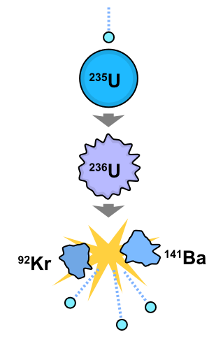
Nuclear Power Basics - Fission
Two isotopes of uranium
  ²³⁸U₉₂ – Not readily fissionable
  99.3% of natural uranium
  ²³⁵U₉₂ – Fissionable
  0.7% of natural uranium
Fission results in
  Radioactive fission products
  Neutrons
  200 MeV of released energy
The concentrated nature of nuclear energy is
what limits its environmental footprint relative
to competitive sources of energy

Slide 11
Fission Products and Reactor Safety
All reactor safety problems are associated with the radioactive fission products.
  Because they are radioactive, they produce heat (decay heat) that must be continually removed to prevent fuel melting.
  Because they are radioactive (emit radiation), if they are release to the environment people can be exposed to the emitted radiation and their health can be affected.

Slide 12
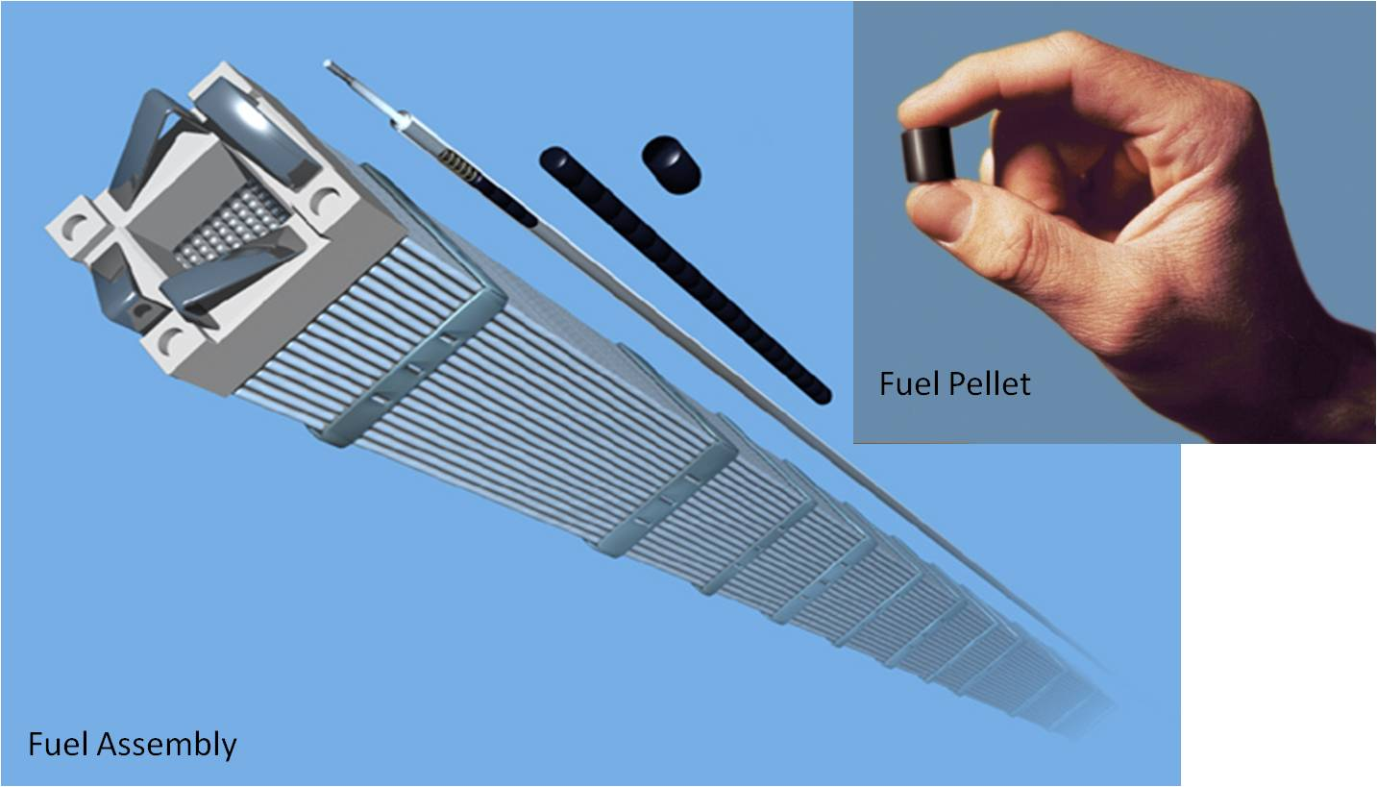
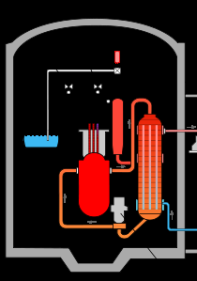
Defense in Depth
Barrier 2
Barrier 1
Multiple Barrier Concept
  1. Fuel matrix (uranium dioxide)
  2. Cladding (zirconium alloy)
  3. Reactor Coolant System (steel)
  4. Containment (steel boundary)
Barrier 3
Although very unlikely, a severe accident can result in the failure of all of four barriers as happened at Fukushima.
Barrier 4

Slide 13
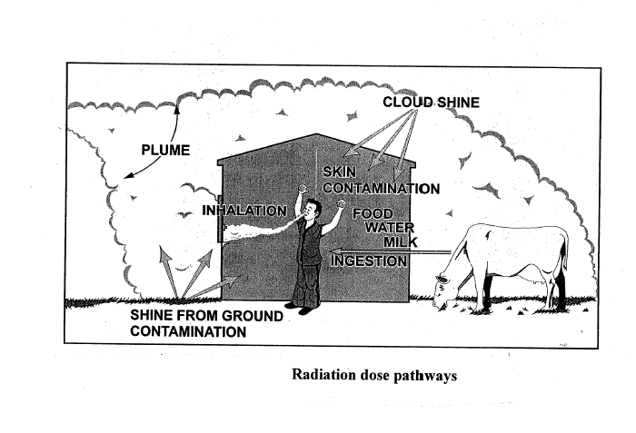
Safety Concern of Severe Accident
Accident in which ability to cool the fuel is lost.
Fuel melts and penetrates the reactor coolant system resulting in release of fission products to the air in the containment building.
Containment building fails leading to an airborne release of radioactive material.
People are exposed:
external, inhalation or
ingestion

Slide 14
Measuring Human Exposure to Radiation
Ionizing radiation damages cells.
Rem is a unit of measure that determines the biological effect of radiation exposure
  It is independent of the type of radiation.
Sievert is the SI unit (=100 rem) but historically rem has been more commonly used in the U.S.

Slide 15
Health Effects of Exposure – High Dose
Radiation sickness (high doses)
LD50/30 is the “lethal dose for 50 percent of the population within 30 days without medical intervention”.
Lethal dose LD50/30 = 450 rem (some variability with age)
Signs of radiation sickness ~100 rem
In risk assessments with modern models, risk to public of early fatality effectively non-existent

Slide 16
Health Effects of Exposure – Low Dose
Cancer possible at lower doses
Random behavior – radiation can increase probability of getting cancer but can’t say who will get cancer
Appear with some delay in time (latency period).
Typically described in terms of mrem (1 millirem = 0.001 rem)

Slide 17
Background Radiation
Humans are unavoidably exposed to radiation that arises from cosmic rays and the decay of naturally occurring radioactive materials.
Average exposure
  Natural sources of radiation (cosmic rays, house construction) – 320 mrem per year
  Medical procedures – 320 mrem per year

Slide 18
Low Dose Issue
Does a high background dose of radiation increase the incidence of cancer in a population?
  We don’t know.
  There is no evidence that people living in Denver with a higher background dose of radiation have a higher incidence of cancer than people in Columbus?
  The effect is so small, it is very difficult to measure.

Slide 19
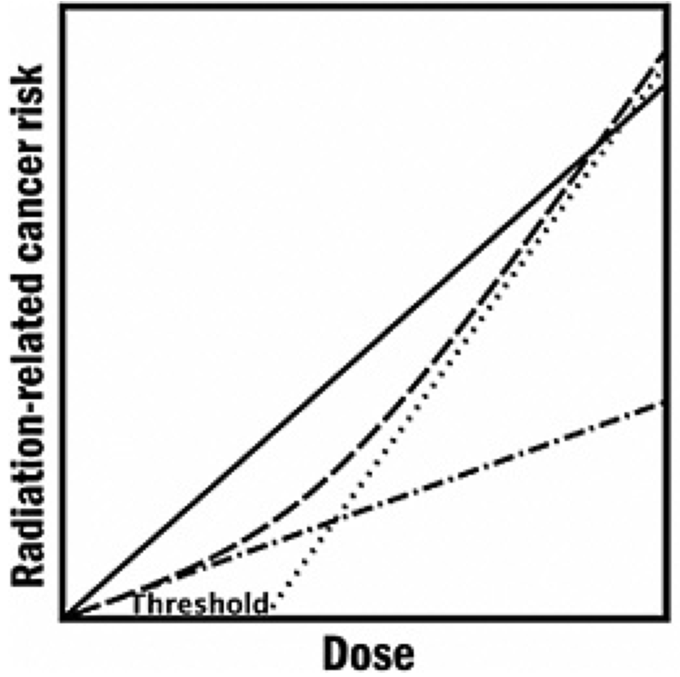

Dose-Response: Linear no Threshold
( LNT) Versus Threshold Model
Linear No-Threshold (high dose rate)
Linear No-Threshold (low dose rate)
Linear Quadratic Model ( Leukemia)
Non linear Model (Threshold)
  The estimation of cancer risk at very low doses (near background) is highly controversial.
  But can be used in establishing conservative regulations.

Slide 20
Terrestrial and Cosmic Sources
Radioactive minerals in the soil
  Potassium - 40
  Decay products of uranium and thorium
  Average of 28 mrem/year (not including radon)
Cosmic radiation
  Shielded by the atmosphere
  Exposure in Denver is about twice as high as in Ohio
  Flying in an airplane at high altitude increases exposure
  Average of 27 mrem/year
Notes:
Terrestrial and Cosmic Sources account for 16% of our yearly dose.
There are definitely radioactive materials in the soil causing about 8% of the total (excluding Radon).
Some of these are Potassium, Uranium, and Thorium.
Recall from the previous slide set that the U-238 decay chain is the source of Radon.
This is about 28 mRem per year – not including radon.
From cosmic radiation, we are well shielded by the atmosphere.
If the atmosphere weren’t there, we would get a much higher dose than we get today.
Actually, living at sea level makes the dose lower than for people living at higher altitudes such as in Denver, Colorado.
The exposure there is almost twice that of Ohio.
On average, people living in Colorado receive about 50% more background radiation than the average person in the U.S.
When you fly in an airplane, you are higher in the atmosphere and you are exposed to more radiation. The added dose from cosmic rays during a coast-to-coast round trip flight in a commercial airplane is about 3 mRem (0.03 mSv).

Slide 21
Internal Radiation
We are Naturally Radioactive !
Potassium-40 enters the body through the food chain
  A natural and necessary nutrient
  Is ~ 0.01% of all potassium
Carbon makes up about 23% of our body weight
  Carbon-14 is produced in the atmosphere by cosmic radiation
  It enters our body through the food chain and by breathing
Average of ~40 mRem/year from internal radiation
Notes:
We ourselves are radioactive. Your date is radioactive!
We are irradiating ourselves from the inside out.
Potassium-40 enters our body through the food chain naturally.
Bananas are a large source of potassium for us.
It is totally natural and necessary.
Potassium is known to prevent cramps.
Potassium-40 has a very low natural abundance, only 0.01% of all potassium.
Another element that we take in on a daily basis as we breathe and eat is Carbon.
Carbon makes up about 23% of our body weight.
Carbon-14 is produced in the atmosphere from cosmic radiation and it enters our body through eating and breathing.
The average person receives about 40 mRem per year from being irradiated internally.
We are actually irradiated by ourselves more than the current regulation permits to the general public from a licensee.

Slide 22
Radiation And Our Body
Radioactive material in the body produces approximately one-half million decays per minute.
Plus, it is exposed to radiation from the environment and cosmic rays.
Billions of our cells are hit each day.
Nearly all the trillions of cells are hit each year, many more than once.
  Cells have effective repair mechanisms.
  Cancer is primarily a disease of the aged.
However, cancer CAN begin with disruption of the DNA of a single cell → minimize radiation exposures
Notes:
22

Slide 23
Public Exposure in Actual Accidents - Chernobyl
Chernobyl was not the same type of reactor as operated in the U.S. and did not have the same level of defense-in-depth.
The release of fission products involved a large fraction of the reactor inventory.
Extensive land contamination occurred.
The only measurable increase in cancer was thyroid cancers in children.
  These consequences would have been avoided if the FSU had admitted that the accident was happening.

Slide 24
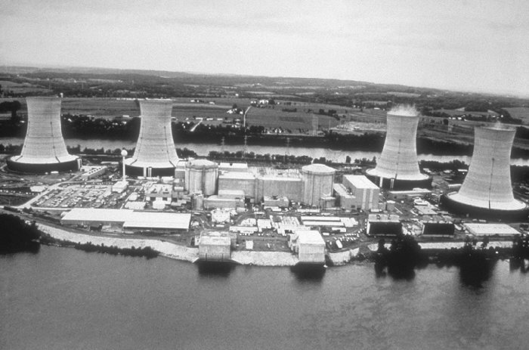
Public Exposure in Actual Accidents – Three Mile Island
Extensive fuel damage occurred and release of fission products from the fuel to the reactor containment building.
Containment maintained its integrity – as is expected in a severe accident.
Only very small doses to
the public.
No radiation-related
health effects.

Slide 25
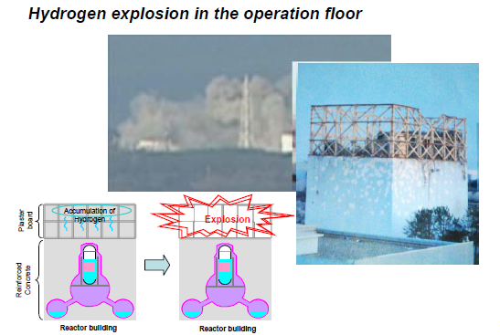
Public Exposure in Actual Accidents – Fukushima
Loss of capability to remove heat from the reactor resulting from damage caused by tsunami.
Extensive fuel melting and release of fission products to containment .
Containment failure of
three reactors.

Slide 26
Public Exposure in Actual Accidents – Fukushima
Substantial release of fission products but much less than at Chernobyl.
Contamination of a large area and the need to relocate a large number of people.
However, the maximum actual exposures will be similar to background radiation.
  No member of the public has received or is likely to receive a dose that would significantly increase their likelihood of incurring cancer.
  Confirmed by WHO and UNSCEAR.

Slide 27
The Real Risk of Nuclear Power Plant Accidents
The risk of radiation-related health effects to members of the public in a reactor accident is extremely small.
The real risk is a societal risk associated with land contamination, the need for relocation of people, loss of produce, loss of land use, and the cost of decontamination.
It is a significant but
manageable risk.

Slide 28
Why Bother?
Why accept any risk? Why don’t we just use a safe alternative?
All forms of energy generation have associated health risks: mining deaths, drilling deaths, natural gas explosions, respiratory deaths.
  Must consider the entire life cycle: mining (drilling), transportation, operations, waste disposal.
Per unit of energy produced, nuclear energy is the safest mode of energy production.

Slide 29
Total Life Cycle Impacts –
Years of Life Lost per GWh
Paul Sherrer Institute (German data on emissions)

Slide 30
The Need
Within the lifespan of the children that we teach, the world will face four converging crises: global warming, inadequate fresh water supply, loss of arable land (and food supply), and the need to replace fossil fuels as an energy source.
Renewables will only be capable of satisfying a fraction of the total energy need.
Nuclear must be a major component of the energy mix.

Slide 31
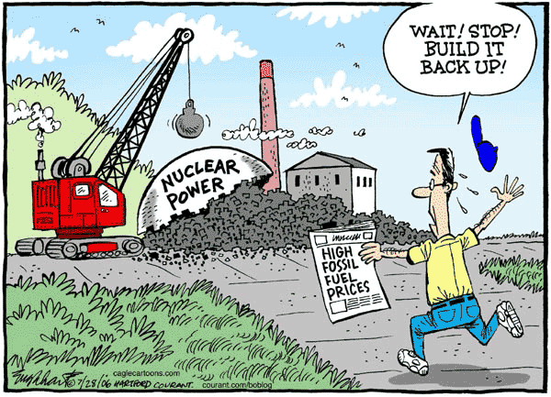

Slide 32
Backup Slides

Slide 33
Total Life Cycle Impacts –
Greenhouse Gas Released
NEA Report, Risks and Benefits of Nuclear Energy
Notes:
33

Slide 34
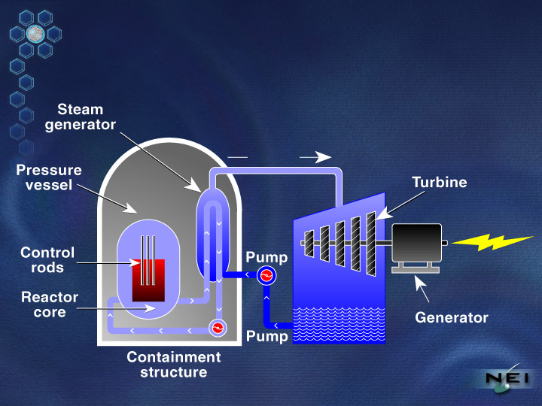
Pressurized Water Reactor
Steam

