Slide 1
Nuclear Energy 101
William Arthur (Art) Wharton III
Westinghouse Electric Company LLC
Credit: W. D. Pointer, Ph. D

Slide 2
About Me
Earned a Bachelor of Science in Mechanical Engineering from the University of Texas in 2006
Employed at Westinghouse Electric Company, LLC
  Lead a program to open a Wholly Foreign Owned Entity (WFOE) in Shanghai, China
  Coordination of ~100 managers & executives with differing opinions and strategies
  My job: One Westinghouse
The American Nuclear Society has shaped me as a nuclear technology professional
  Secretary of the Operations & Power Division
  Member of the Strategic Planning Committee
  Member of Public Policy Committee
  Past Chairman of the Pittsburgh Local Section
My dedication to nuclear science and technology stems from my dedication to leaving the world in better condition than I found it and serving my community.

Slide 3
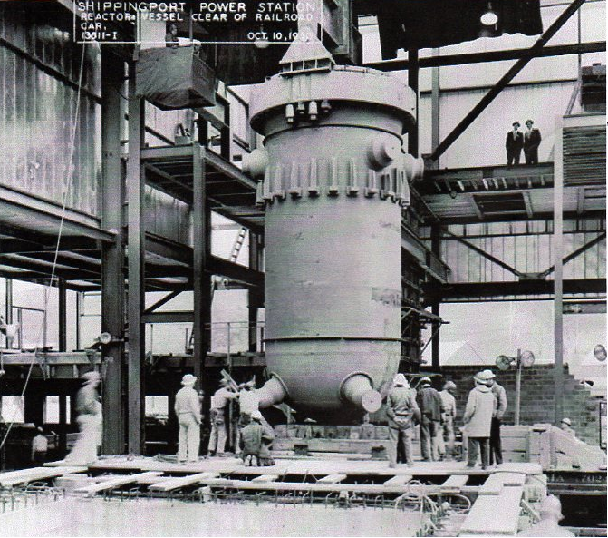
Shippingport Reactor Vessel

Slide 4
We’re going to wrestle with some big questions

Slide 5
HOW?
We’re going to wrestle with some big questions

Slide 6
We’re going to wrestle with some big questions
What if?

Slide 7
We’re going to wrestle with some big questions
When?

Slide 8
WHY?
We’re going to wrestle with some big questions

Slide 9

WHY?

Slide 10
It’s OK if we don’t have the answers.
We’ll engage the scientific method to figure things out.

Slide 11
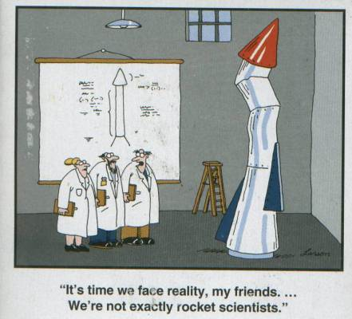

Slide 12
A little creativity can make a big difference.

Slide 13
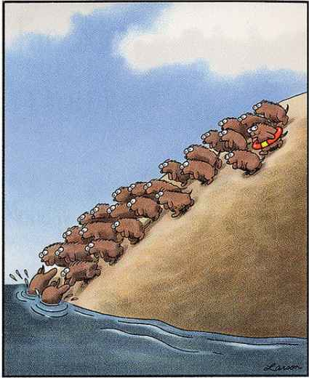

Slide 14
Let’s get started

Slide 15
Why do we need more energy?

Slide 16
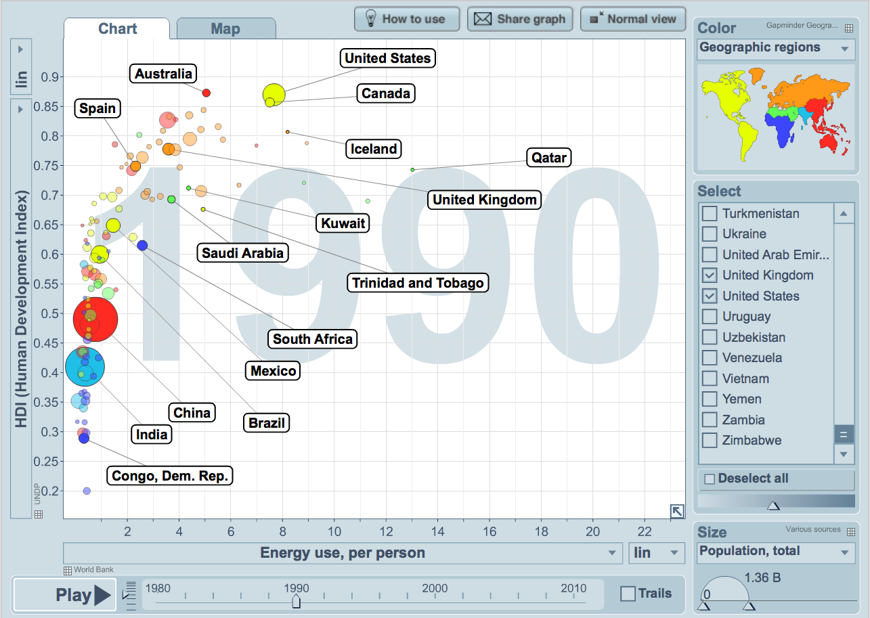
Electricity Enables Human Development
Energy use is shown in Tonnes of Oil Equivalent (or TOE)
Visualization from Gapminder World, powered by Trendalyzer from www.gapminder.org

Slide 17
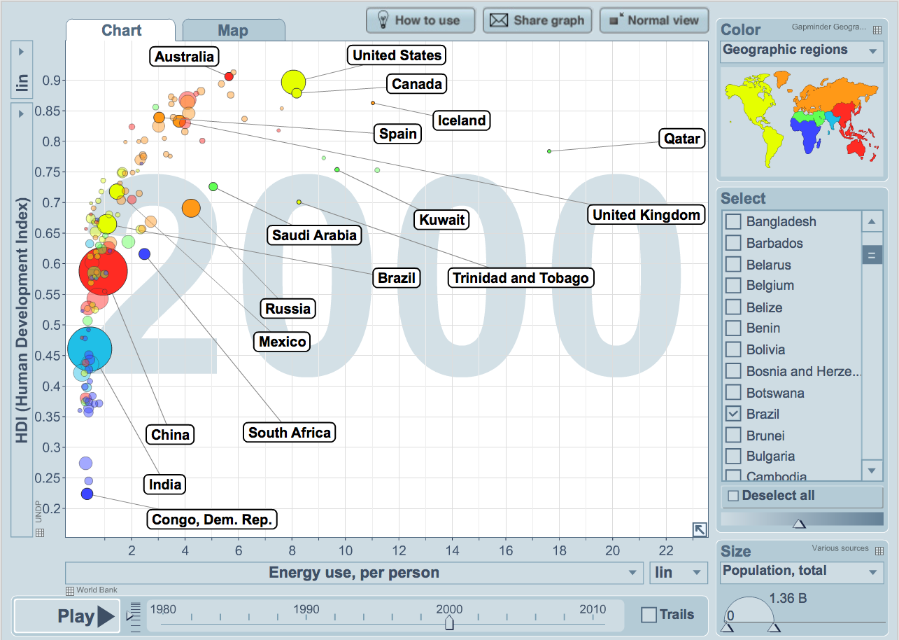
Electricity Enables Human Development
Energy use is shown in Tonnes of Oil Equivalent (or TOE)
Visualization from Gapminder World, powered by Trendalyzer from www.gapminder.org

Slide 18
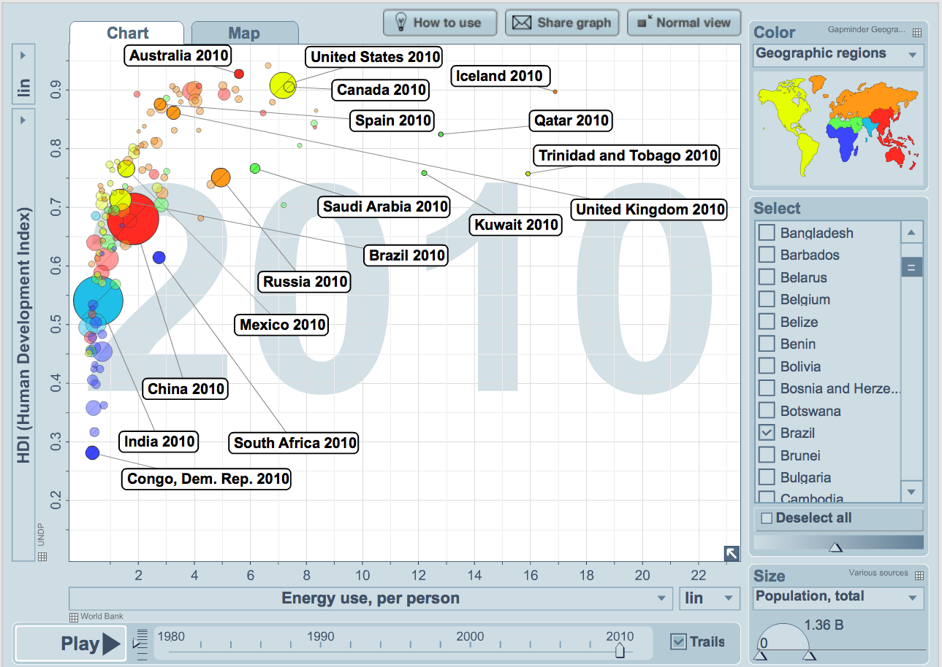
Electricity Enables Human Development
Energy use is shown in Tonnes of Oil Equivalent (or TOE)
Visualization from Gapminder World, powered by Trendalyzer from www.gapminder.org

Slide 19
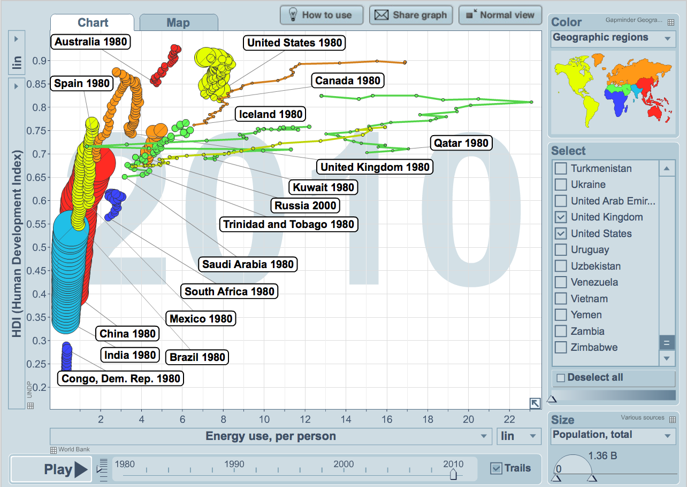
As nations develop they move up and to the right
Energy use is shown in Tonnes of Oil Equivalent (or TOE)
Visualization from Gapminder World, powered by Trendalyzer from www.gapminder.org

Slide 20
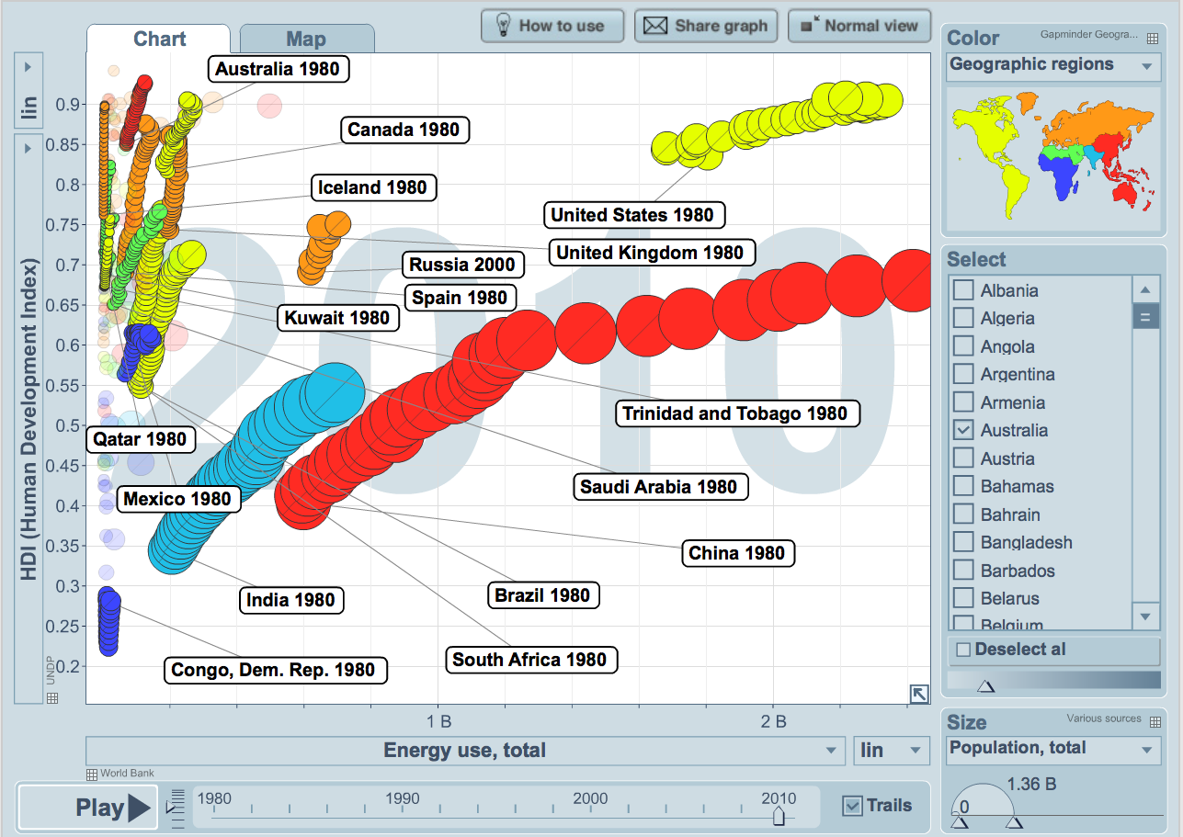
Per Capita Use is Informative, But Can Be Misleading
Energy use is shown in Tonnes of Oil Equivalent (or TOE)
Visualization from Gapminder World, powered by Trendalyzer from www.gapminder.org

Slide 21
Why do we need NUCLEAR energy?

Slide 22
U.S. Electric Generation in 1998
3.620 BILLION Megawatthours Total
Source: Electric Power Annual 2010
U.S. Energy Information Administration

Slide 23
U.S. Electric Generation in 2010
4.125 BILLION Megawatthours Total
Source: Electric Power Annual 2010
U.S. Energy Information Administration

Slide 24
U.S. Electric Generation in 2011
4.105 BILLION Megawatthours Total
13.4% INCREASE since 1998
Source: Electric Power Annual 2010
U.S. Energy Information Administration

Slide 25
Let’s move on to a truly important energy engineering question.

Slide 26
How does your coffee pot work?
Why does the water pour out of your coffee pot’s filter basket into the pot below?
How does the water you put into your coffeepot go from the tank to the filter basket?

Slide 27
Coffee Pots: The Naked Truth
Water absorbs energy
Water’s density decreases with temperature
  Steam’s density is MUCH lower than liquid water
Hot, low density water rises to filter basket
  Added energy enables water to do some useful work
NATURAL CONVECTION
Energy

Slide 28
What does this have to do with NUCLEAR ENERGY?

Slide 29
How is a Power Plant like a Coffee Pot?
Energy
This is worth a closer look.

Slide 30
How is a Power Plant like a Coffee Pot?
Energy
First, we won’t need a coffee pot in a power plant.
Next we should probably look at things from a different angle.

Slide 31

How is a Power Plant like a Coffee Pot?
We need a bigger heat source than a coffee pot’s hot plate.
Now let’s make some electricity!

Slide 32
How is a Power Plant like a Coffee Pot?
Turbine/
Generator
Condenser
How do we control how much electricity we make?

Slide 33
How is a Power Plant like a Coffee Pot?
Turbine/
Generator
Condenser
Pump
How do we control how much electricity we make?

Slide 34
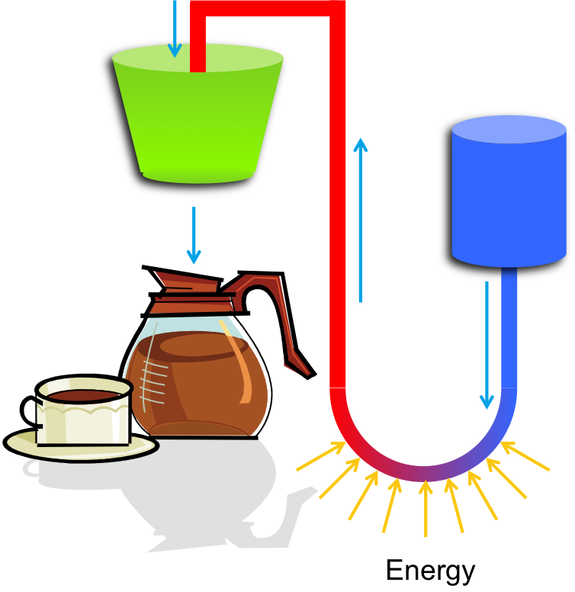
How is a Power Plant like a Coffee Pot?
A closer look at a coal fired power plant.

Slide 35
How is a nuclear power plant different?

Slide 36
It’s the Fuel!
Nuclear power plants use the energy stored in the nucleus of large atoms rather than the energy stored in weaker chemical bonds.

Slide 37

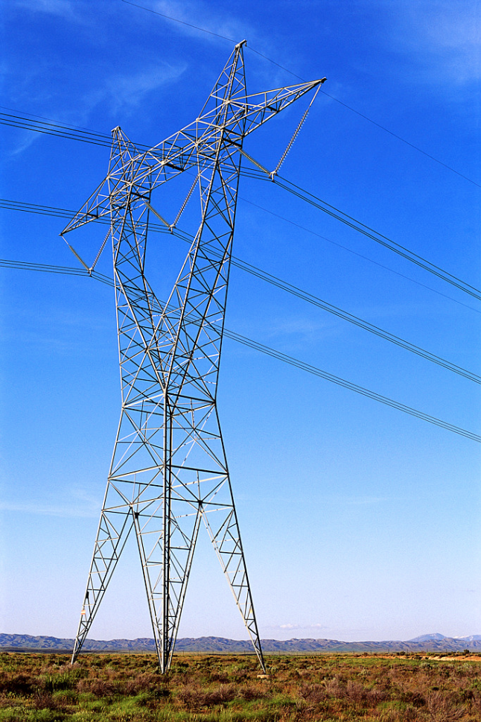
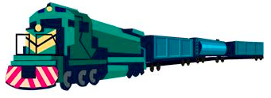
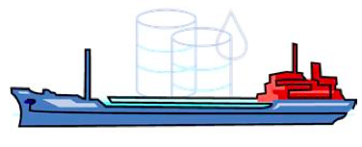
It’s the Fuel!
To Power 1000 Homes
150 Tons of Uranium
2,100,000 Tons of Coal
10,000,000 Barrels of Oil

Slide 38
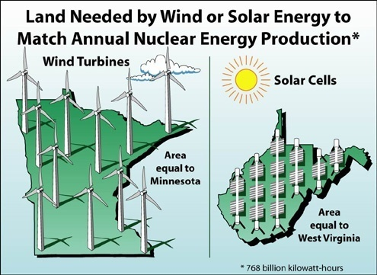

Slide 39
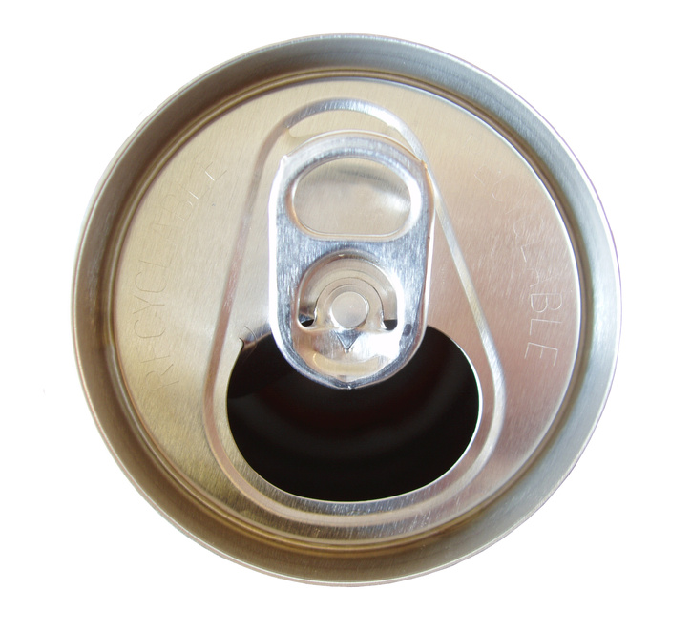
It’s the Fuel!
The spent fuel used to generate all of the energy used in one American’s lifetime would fit in here

Slide 40
What is Nuclear Fission?
If the nucleus of a heavy atom (such as Uranium) absorbs a neutron, the nucleus can become unstable and split.
This is called NUCLEAR FISSION.
Neutron
Uranium
Nucleus
Images: Original art by Dave Pointer

Slide 41
What is Nuclear Fission?
The nucleus splits in two halves and releases some neutrons, and radiation
Images: Original art by Dave Pointer

Slide 42
What is Nuclear Fission?
During fission, a small amount of mass is lost. This mass is transformed into ENERGY, which is also released.
E=mc²
Images: Original art by Dave Pointer

Slide 43
Let’s Build a Nuclear Power Plant

Slide 44
Let’s Build a Nuclear Power Plant
First, ceramic fuel pellets are manufactured from uranium ore

Slide 45
Let’s Build a Nuclear Power Plant
The ceramic fuel pellets are stacked in a column
And sealed inside a metallic alloy case, called the cladding, to form a fuel rod

Slide 46
Let’s Build a Nuclear Power Plant
The fuel rods are grouped together in a regular array or fuel assembly

Slide 47
Let’s Build a Nuclear Power Plant
The fuel rods are grouped together in a regular array or fuel assembly
The fuel assemblies are arranged in a larger regular array or reactor core

Slide 48
Let’s Build a Nuclear Power Plant
The fuel rods are grouped together in a regular array or fuel assembly
The fuel assemblies are arranged in a larger regular array or reactor core
The reactor core is contained inside a heavy steel reactor pressure vessel (RPV)

Slide 49
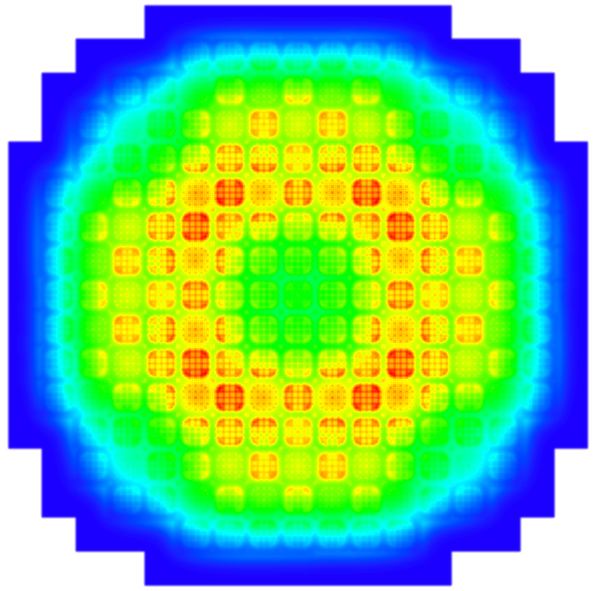
A Reality Check
Fuel Assembly and Reactor Core Design are Complex Engineering Challenges

Slide 50
Let’s Build a Nuclear Power Plant
The fuel rods are grouped together in a regular array or fuel assembly
The fuel assemblies are arranged in a larger regular array or reactor core
The reactor core is contained inside a heavy steel reactor pressure vessel (RPV)

Slide 51
Let’s Build a Nuclear Power Plant
Turbine/
Generator
Condenser
Pump
In a nuclear power plant, the reactor core replaces the burning fossil fuel as the energy source

Slide 52
Let’s Build a Nuclear Power Plant
Turbine/
Generator
Condenser
Pump
Control rods absorb neutrons and are used to stop/start the reaction

Slide 53
Let’s Build a Nuclear Power Plant
Turbine/
Generator
Condenser
Pump
Control rods absorb neutrons and are used to stop/start the reaction

Slide 54
What’s so CRITICAL?
CRITICAL → k=1
  # of Neutrons Produced = # of Neutrons Absorbed
SUB-Critical → k<1
  # of Neutrons Produced < # of Neutrons Absorbed
SUPER-Critical → k>1
  # of Neutrons Produced > # of Neutrons Absorbed

Slide 55
Boiling Water Reactor (BWR)
Turbine/
Generator
Condenser
Pump
39 of the 104 nuclear power plants in the U.S. look like this
They’re called BWRs or Boiling Water Reactors

Slide 56
Pressurized Water Reactor (PWR)
Turbine/
Generator
Condenser
Pump
Most U.S. nuclear power plants are PWRs or Pressurized Water Reactors
Steam is made in a steam generator rather than directly in the reactor core
Pump

Slide 57
PWR Containment
Turbine/
Generator
Condenser
Pump
Pump
The entire reactor sits inside a large concrete and steel containment building

Slide 58
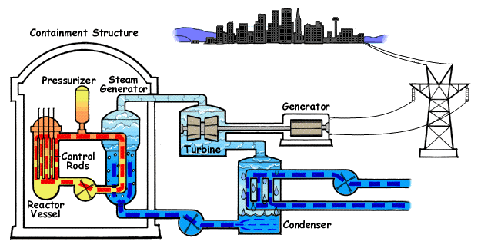
Pressurized Water Reactor

Slide 59
BWR Containment
Turbine/
Generator
Condenser
Pump
The entire reactor sits inside a large concrete and steel containment building

Slide 60
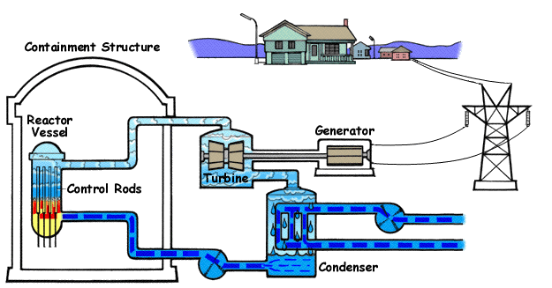
Boiling Water Reactor

Slide 61
POP QUIZ!!!

Slide 62
Where is the Reactor?

Slide 63
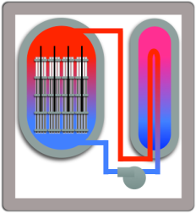
Where is the Reactor?

Slide 64
Then what are these?

Slide 65
Cooling Towers
They chill the cold water used by the condenser.

Slide 66
BWR Containment
Turbine/
Generator
Condenser
Pump
The entire reactor sits inside a large concrete and steel containment building

Slide 67
Boiling Water Reactor

Slide 68
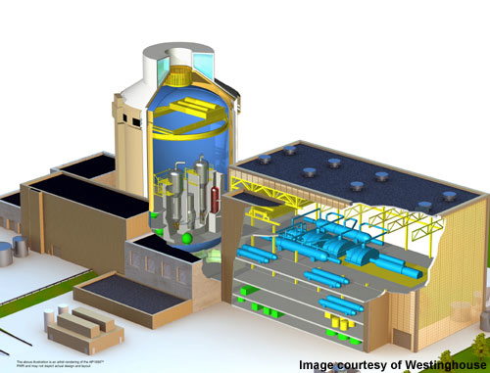
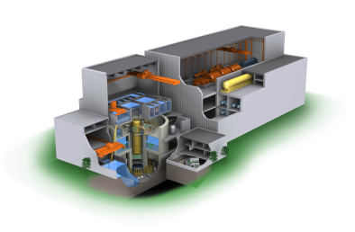
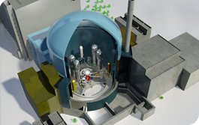
What have we left out?
Instrumentation
Systems for optimizing efficiency
  Control system components used by operators
  Steam system components for thermodynamic efficiency
Equipment to support outages and refueling
Safety Systems

Slide 69
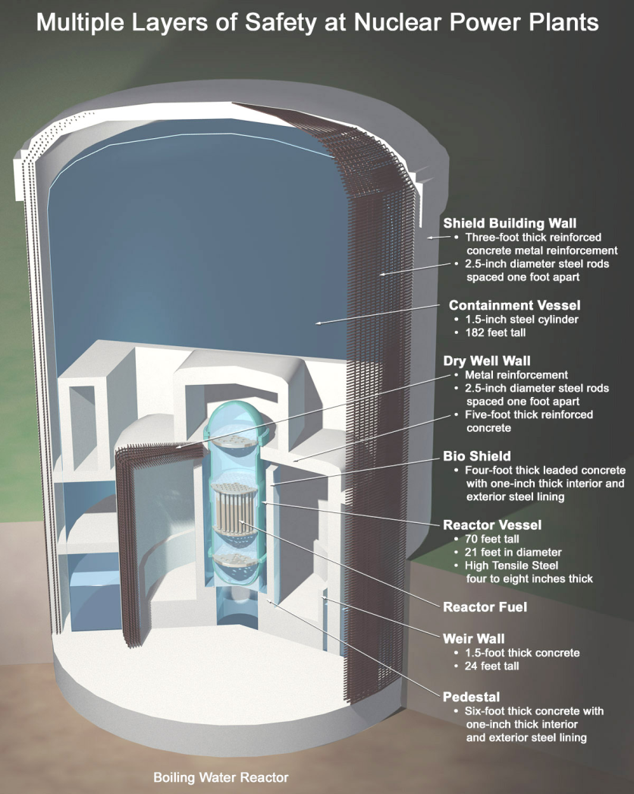
A few words about SAFETY
Two primary safety functions
Contain radioactive material to protect the public
  Many layers of containment
Maintain ability to cool the fuel
  Emergency Core Cooling Systems to move additional cooling water through the core during accident scenarios
  Pumps driven by offsite power
    Backup battery power
    Backup diesel generators

Slide 70
Advanced Reactors
Generation III+ reactors have more safety systems that are driven by natural forces like gravity and natural convection.
  Less susceptible to interruptions in offsite power and less reliant on backup diesel generators
  Small Modular Reactors
Generation IV reactors use alternative coolants such as helium, liquid metals, or molten salts.
  Operate at higher temperatures and offer improved efficiency
  Stronger passive safety features which rely on natural forces
  Enable alternative fuel cycles

Slide 71
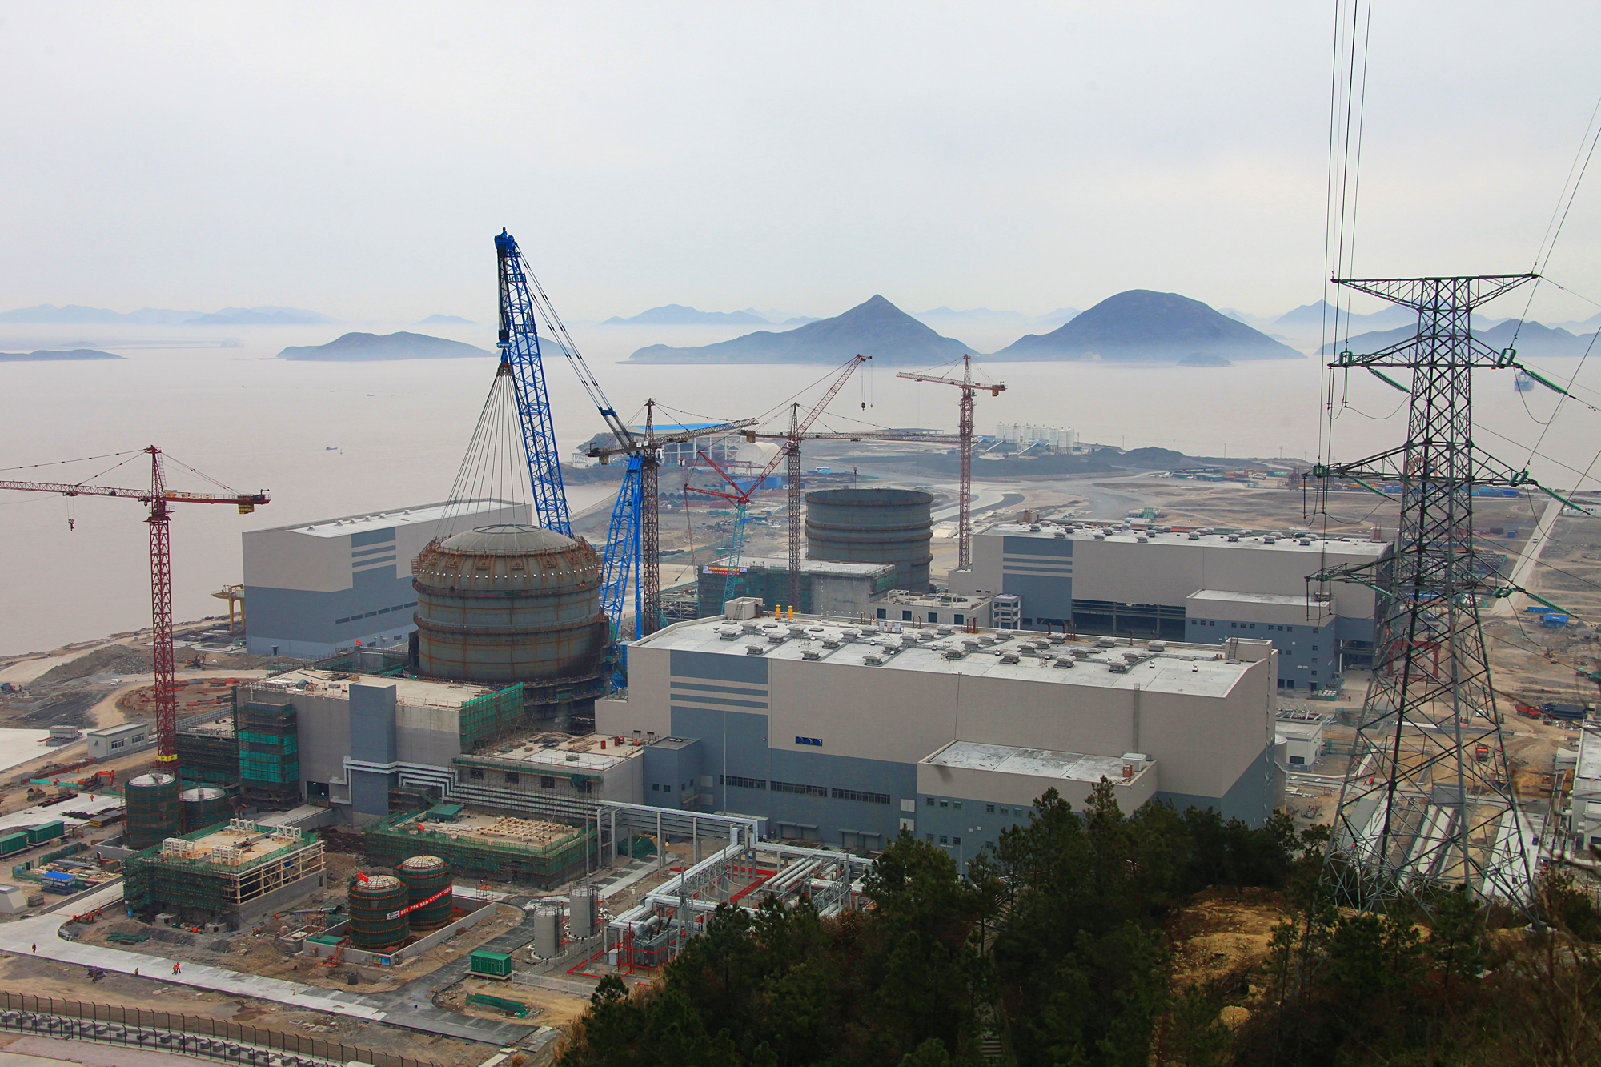
Progress in China – January 29 Photo

Slide 72
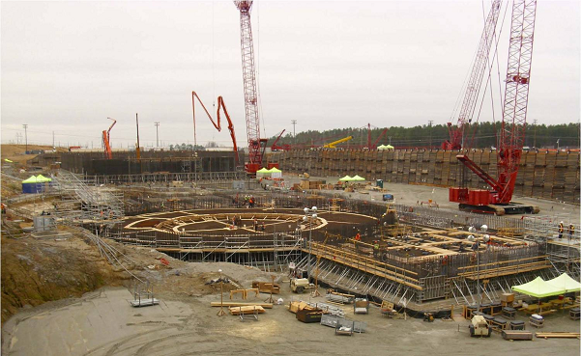
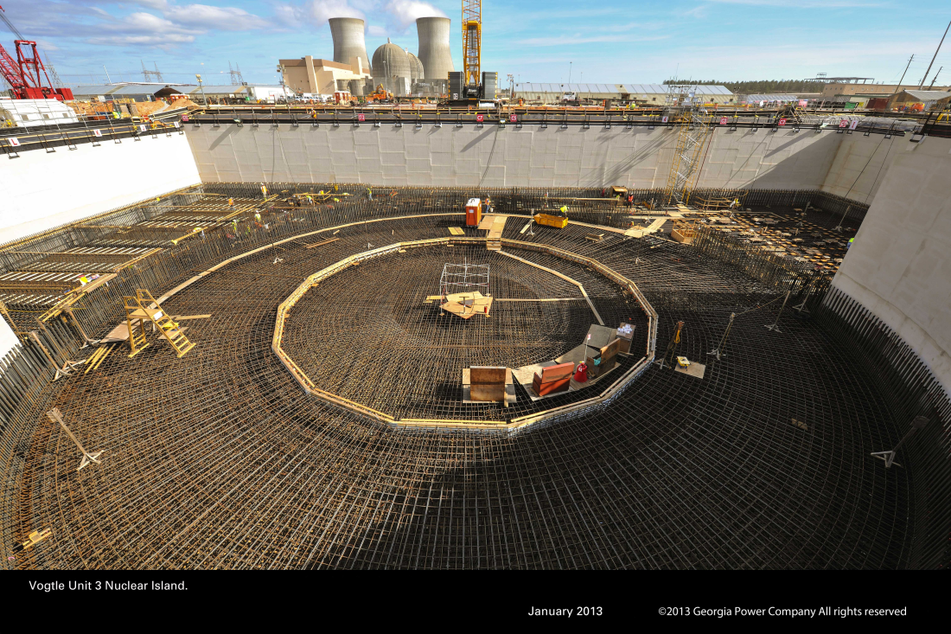
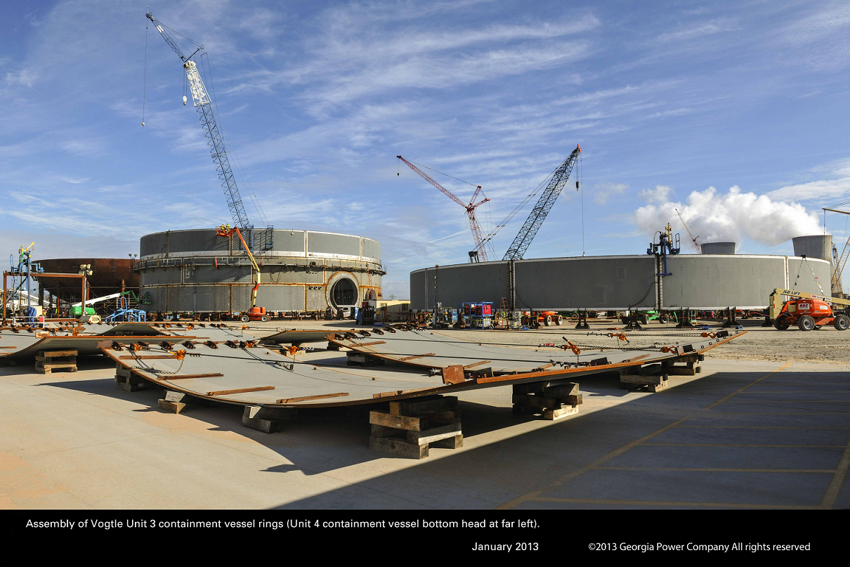
Progress in USA – VC Summer & Vogtle

Slide 73
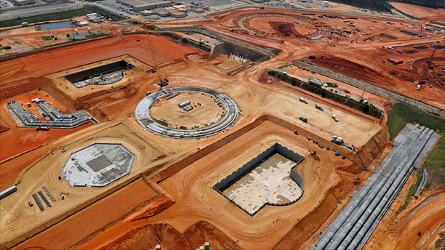
Nuclear Energy 101
Questions?

Slide 74
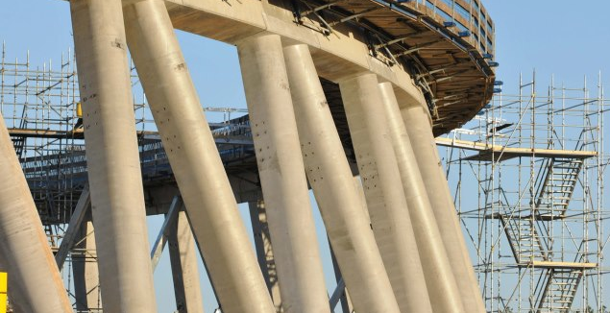
Nuclear Energy 101
Questions?

Slide 75
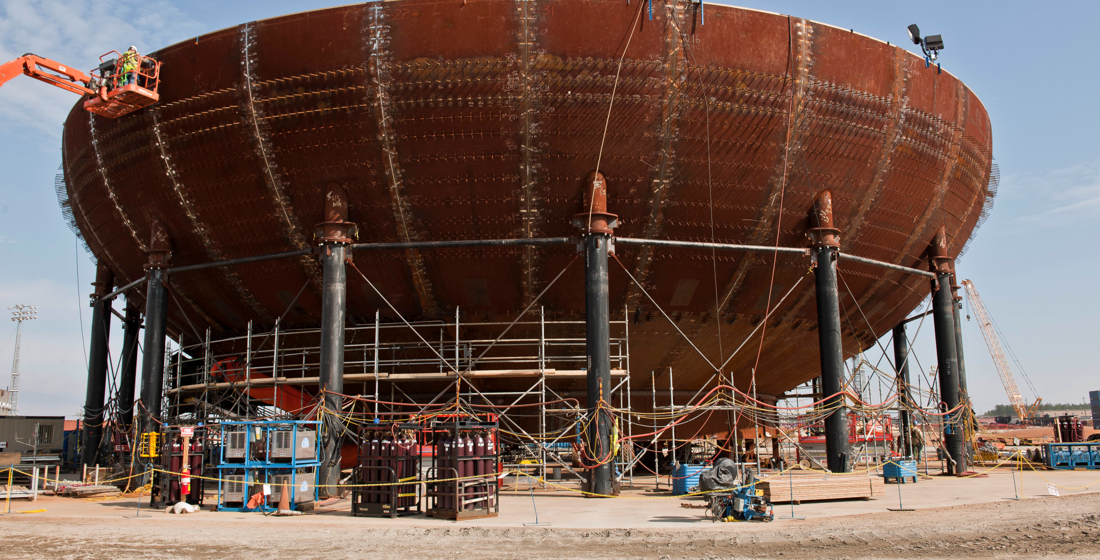
Nuclear Energy 101
Questions?

Slide 77
Additional Slides

Slide 78
The Whiffle Ball Power Plant

Slide 79
Materials Required
10 signs that students can wear around their neck to identify which component they represent (boiler, steam pipe, turbine, generator, condenser, inlet pump, reactor, steam generator, hot water pipe, feed water pump)
30 balls in three colors
  red, white and blue are relatively easy to find at sporting goods stores
  you can also by foam pool noodles and cut them into small pieces
3 bags (preferably reusable bags)
Pinwheel
Flashlight (the hand crank kind work great!)
Paper towel tube

Slide 80
ACT 1 – Fossil Fueled
Provide one sign to each of 6 volunteers (boiler, steam pipe, turbine, generator, condenser, inlet pump). As you arrange the components as they would be placed in a plant schematic, ask each volunteer what sound they think the component they represent would make.
Provide a bag of white balls to the boiler, a bag of blue balls to the condenser, the pinwheel to the turbine and the flashlight to the generator.
Instruct the volunteers to simulate a boiler’s operation by passing water (blue balls) from the condenser to the pump, and from the pump to the boiler. The boiler converts the water (blue balls) to steam (white balls) and passes the steam to the steam line. The steam line passes the steam (white balls) to the turbine, who must make the pinwheel spin and pass the steam (white balls) to the condenser where it is converted back to water (blue balls). Whenever the turbine turns, the generator should provide electricity to the flashlight and light the lamp.
Start the demonstration by “igniting” the fossil fuel (tough the boiler) and continue until all balls have been converted from blue to white. Be sure to remind the volunteers to make the sounds their components would make during the demo. If possible, playing background music that accelerates in tempo during the demonstration increases the entertainment value for those in the audience.

Slide 81
The Whiffle Ball Power Plant
Steam Line
Turbine
Generator
Boiler
Pump
Condenser
Act 1- Fossil Fueled

Slide 82
The Whiffle Ball Power Plant
Act 1- Fossil Fueled

Slide 83
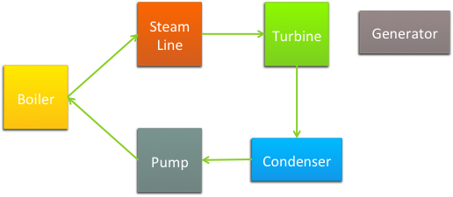
The Whiffle Ball Reactor
What changes if we use uranium instead of coal?
Act 2- Boiling Water Reactor

Slide 84
The Whiffle Ball Reactor
Steam Line
Turbine
Generator
Reactor
Pump
Condenser
Act 2- Boiling Water Reactor

Slide 85
The Whiffle Ball Reactor
Steam Line
Turbine
Generator
Reactor
Pump
Condenser
Act 2- Boiling Water Reactor

Slide 86
The Whiffle Ball Reactor
Act 2 – Boiling Water Reactor

Slide 87

The Whiffle Ball Reactor
What changes if we build a PWR instead?
Act 3- Pressurized Water Reactor

Slide 88
The Whiffle Ball Reactor
Steam Line
Turbine
Generator
Reactor
Pump
Condenser
Act 3 – Pressurized Water Reactor

Slide 89
The Whiffle Ball Reactor
Steam Line
Steam Line
Turbine
Generator
Reactor
Steam Generator
Pump
Pump
Condenser
Act 3 – Pressurized Water Reactor

Slide 90
The Whiffle Ball Reactor
Act 3 – Pressurized Water Reactor

