Slide 1
Careers In Nuclear Science & Technology
ANS Teacher Workshop
Reno, NV
June 2014

Slide 2
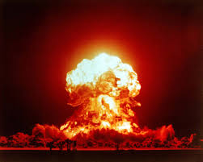
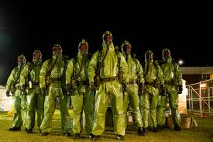

What is nuclear engineering?
What people think nuclear engineers do:
Blow ourselves up!
Wear Hazmat suits to work.
Glow green in the dark.

Slide 3
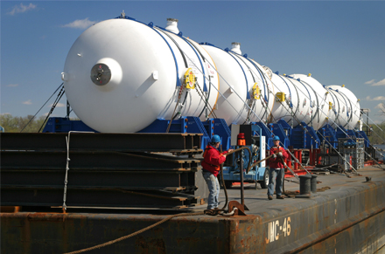
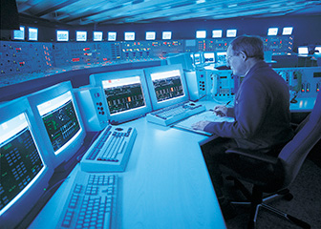
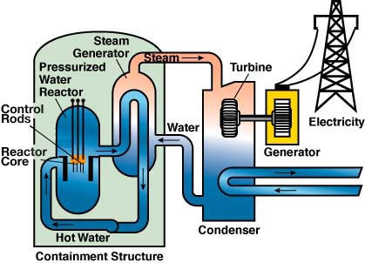
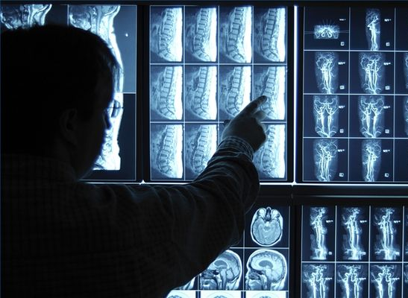
What is nuclear engineering?
What they actually do:
- Nuclear engineers harness the power of the atom to help solve large and difficult problems facing humanity.
Problems such as:
- Pollution
- Diseases
- Medical diagnostics
- Security for radioactive materials
- Clean energy

Slide 4


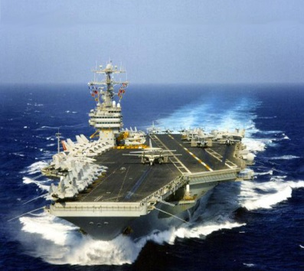

How do you get there?
Many naval programs pay for further schooling as well
Prepare with math and physics courses in high school
Accredited college programs
The “Nuclear” Navy

Slide 5






Accredited Universities
Most companies require at least a bachelor’s degree in Nuclear Engineering from an accredited university.
Universities that offer accredited (ABET) nuclear engineering programs:
- Penn State University!
- Michigan University
- North Carolina State University
- Oregon State University
- Georgia Tech University
- University of New Mexico

Slide 6
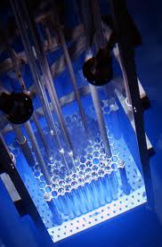
Engineering:
Research, design, and operation
Design power plants that create a greener form of energy compared to other energy sources
The design, production, handling, and use of nuclear fuel
Safe disposal of waste produced by the generation of nuclear energy
New nuclear applications and detecting radioactive materials

Slide 7
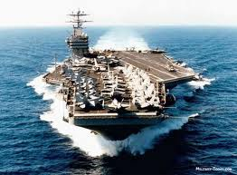
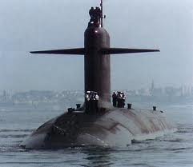
Non-weaponry military applications
The Nuclear Navy
-A global force for good! The Navy protects our country using nuclear technology
-Nuclear Aircraft Carriers -Nuclear Submarines

Slide 8
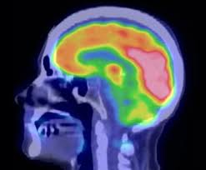
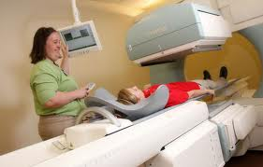
Medicine
Develop machines that image the human body
Radiation therapy to treat different types of cancer
Sterilize medical equipment such as rubber gloves, gauze, and bandages

Slide 9
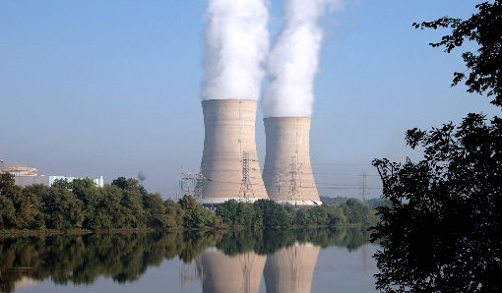
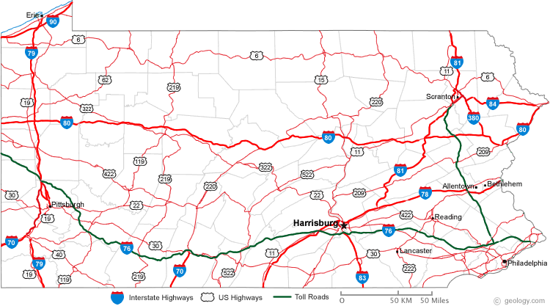
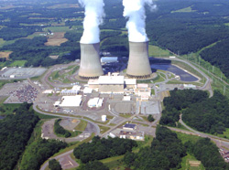

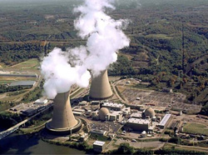
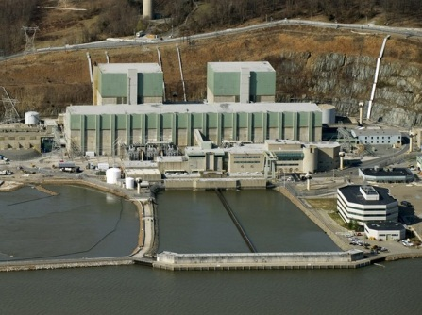
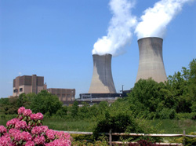
33% of net electricity generated in PA came from Nuclear Power (Energy information Administration, July 2012).
Map of Operating Power Reactors in Pennsylvania
Three Mile Island Nuclear Station
(Middletown, PA)
EST: 1974
Type: PWR
Output: 786 MWe
Susquehanna Steam Electric Station
(Luzerne County, PA)
EST: 1982
Type: BWR
Output: 1149 MWe
Beaver Valley Power Station
(Shippingport, PA)
EST: 1976
Type: PWR
Output: 892 MWe
Peach Bottom Atomic Power Station
(Delta, PA)
EST: 1973
Type: BWR
Output: 1112 MWe
Limerick Generating Station
(Limerick, PA)
EST: 1985
Type: BWR
Output: 1134 MWe

Slide 10






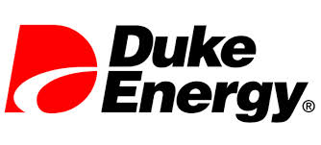
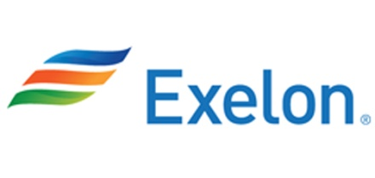

Nuclear Energy & Research
Government Contractor
Utility Company
Utility Provider and Research Company
Utility Provider and Research Company
Utility Provider and Research Company
Utility Company
Utility Company
Utility Company
Utility Company

Slide 11
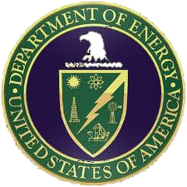
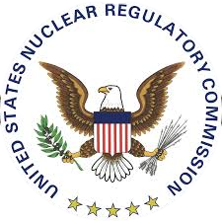




Government agencies
National Labs
Monitor and control safety regulations
Foreign Intelligence
Protect against terrorism and other hazards
Provide Military Forces
National Intelligence

Slide 12
$15,080
$45,230
$101,930

