Slide 1
Radon
Indoor Air Quality in Tribal Communities
Institute for Tribal Environmental Professionals

Slide 2
Radon
Where does Radon come from
What is Radon
Radioactive Decay
Risk of Exposure
Radon Testing
Education and Outreach
Radon Mitigation
Radon Resistant Construction

Slide 3
Where does radon come from?
Caused by breakdown of Uranium in earth’s crust.
Amount of radon in soil depends on soil chemistry, which varies greatly from one house to next
Moves up through ground into atmosphere, where it can enter through cracks/holes in foundation

Slide 4
Most mitigation systems are known as “active soil depressurization” and attempt to prevent the radon from entering the home.

Slide 5
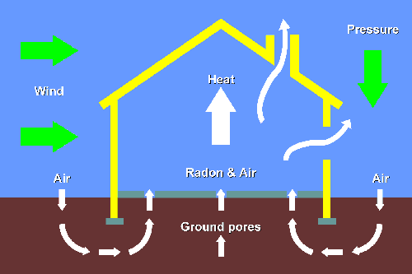
Radon in Buildings
From soil
Lower parts of building at greatest risk
“Stack effect”

Slide 6
Radon
Radon in air is ubiquitous
Radon: odorless, colorless, radioactive gas
Found in outdoor air and indoor air of buildings
Form of radiation that damages lung tissue
# 1 cause of lung cancer among non-smokers
Estimated 21,000 deaths year, rising
Smoking increases your risk 4 times!
Elevated indoor levels found in every state

Slide 7
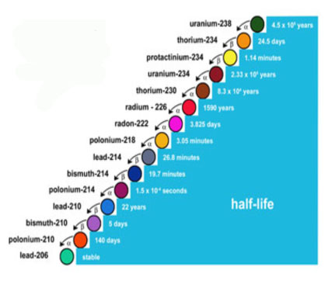
Radon “Daughters”
Notes:
Mansel: USE POINTER
Radon is the decay product from Uranium as shown in this chart. The precursors to radon are all solid, so it is difficult for them to move around. Once radium decays to radon, radon is a gas and can move around. Another factor to consider is the short half life of radon and its daughters. Within a short amount of time there are several decays, each releasing radiation that can lead to damage in the lungs.

Slide 8
Radon-222
4 day
α,γ
Polonium-218
3 min
α,γ
Lead-214
27 min
β,γ
Bismuth-214
20 min
Radon Decay Products
β,γ
Polonium-214
0.2 ms
α,γ
Lead-210
22 yrs
β,γ
Po-218 and Po-214
Deliver majority of radiation dose to lungs
Bismuth-210
5 day
β,γ
Polonium-210
138 day
α,γ
Lead-206
Stable

Slide 9
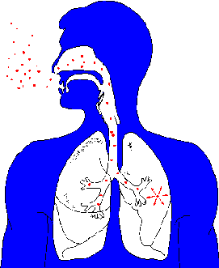
Radon in Lungs
Radon or decay products inhaled
Particles irradiate lungs
Irradiation can cause lung cancer
Radon

Slide 12
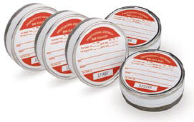
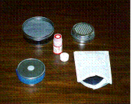
Radon Testing

Slide 13
Radon Levels
Red alert - radon level above 4 pCi/L (pico Curies per Liter)
Yellow alert - radon levels between 2 pCi/L and 4 pCi/L
Average radon indoor air about 1.3 pCi/L

Slide 14
www.epa.gov/radon

Slide 15
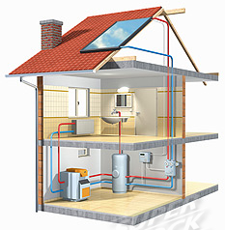
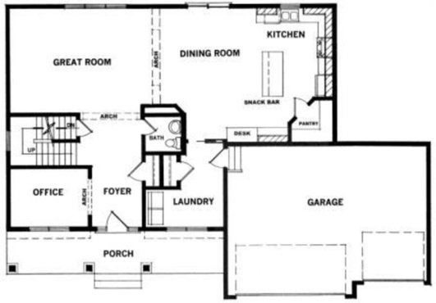
Initial Test: 2-7 days
Non-real estate: Lowest lived in
Real Estate: Lowest suitable for Occupancy w/o Renovation
Test in livable and frequently occupied room.
Keep away from drafts and moisture. No bathrooms, kitchen, crawlspace.
YES
NO
YES

Slide 16
Location of Device in Room
In a room with low traffic, where it will not be disturbed
Away from drafts
Away from extreme heat and areas of high humidity.
Avoid direct sunlight.
At least 20 inches from floor.

Slide 17
Location of Device in Room
If the device is hung, it should be suspended 6 to 8 feet from the floor.
More than 3 feet from exterior doors, windows, or other openings to the outside.
12 inches or more from an exterior wall.
At least 4 inches from other objects (including another test device)

Slide 18
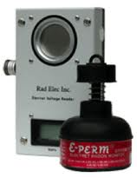
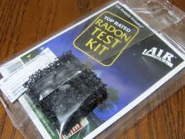
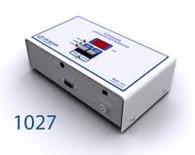
Radon Measurement Devices
Activated charcoal device
Electret Ion Chamber
Continuous Radon Monitor

Slide 19
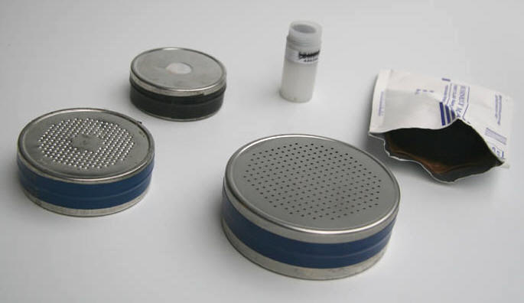
Activated Charcoal Devices
For short-term tests
Must be analyzed within 6 days
Each device has its own test length

Slide 20
Activated Charcoal Devices
Advantages
Disadvantages
Compact, convenient and economical
Can be used for 48-hour test
Can be easily mailed to lab for analysis
Passive, does not require power and silent
Quick and accurate analysis
Limited to short-term sampling
Provides no indication of changes in radon during measurement.
If radon peaks and valleys are dramatic, the results validity is questioned because of a possible bias over the last 12 hours.
Tampering detection difficult.

Slide 21
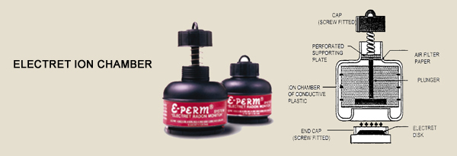
Electret Ion Chamber (E-Perm)
Short-term and long-term measurements, measures radon in water with additional kit
2 days-1 year, dependent upon:
Configuration
Type of disk used
Anticipated radon concentration

Slide 22
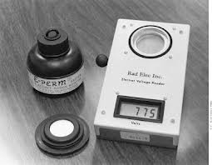
Measuring Electret Voltages
Electrets are pre-charged, can be reused.
Electret voltages are measured and recorded before and after deployment.
Math: (~2 volts drop per day per pCi/L)

Slide 23
Electret Ion Chambers
Advantages
Disadvantages
Short-term and long-term measurements
Electret can be re-used until voltage falls below the desired operating voltage for the device used (200 volts)
Can be recharged by manufacturer ($15 each)
Sensitive to external gamma radiation. Correction needed.
Sensitive to altitude changes. Correction needed.
Can be damaged by touching surface, surface contamination or impact.
Pre/post voltages must be measured at the same temperature.

Slide 24
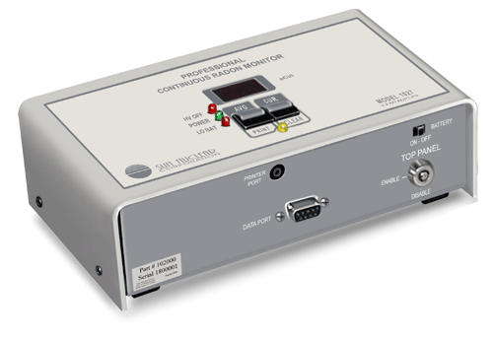
Continuous Radon Monitors
Sun Nuclear (Solid State Silicon Detector)
Impacts from alpha particles are counted.
Data plotted and averaged
Relatively low efficiency
Provides continuous measurements
Used for diagnostics

Slide 25
Continuous Radon Monitors
Advantages
Disadvantages
Exposure variable: 48 hrs to many months
Relatively good precision
Can track hourly variations
Options to down load or print on site
Can indicate tampering or ventilation.
Higher priced
Requires trained operator
Annual calibration
Bi-annual performance tests.
Can only test one room at a time.

Slide 26
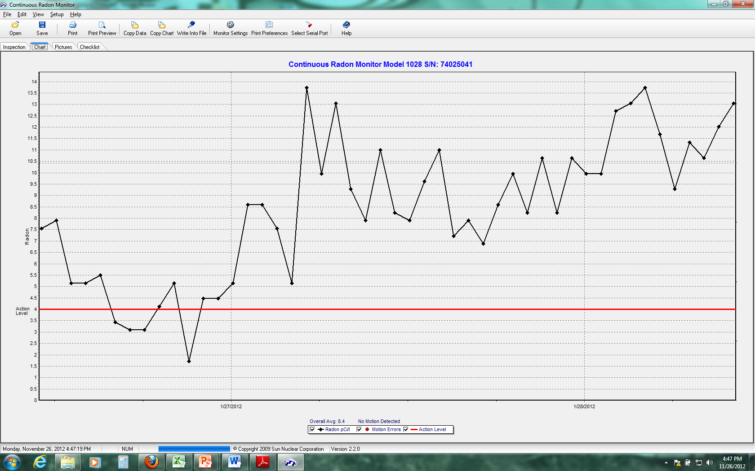
Results from a CRM
EPA Action Level 4.0 pCi/L

Slide 27
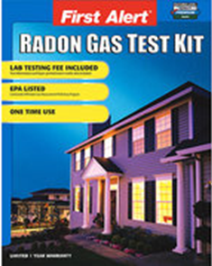
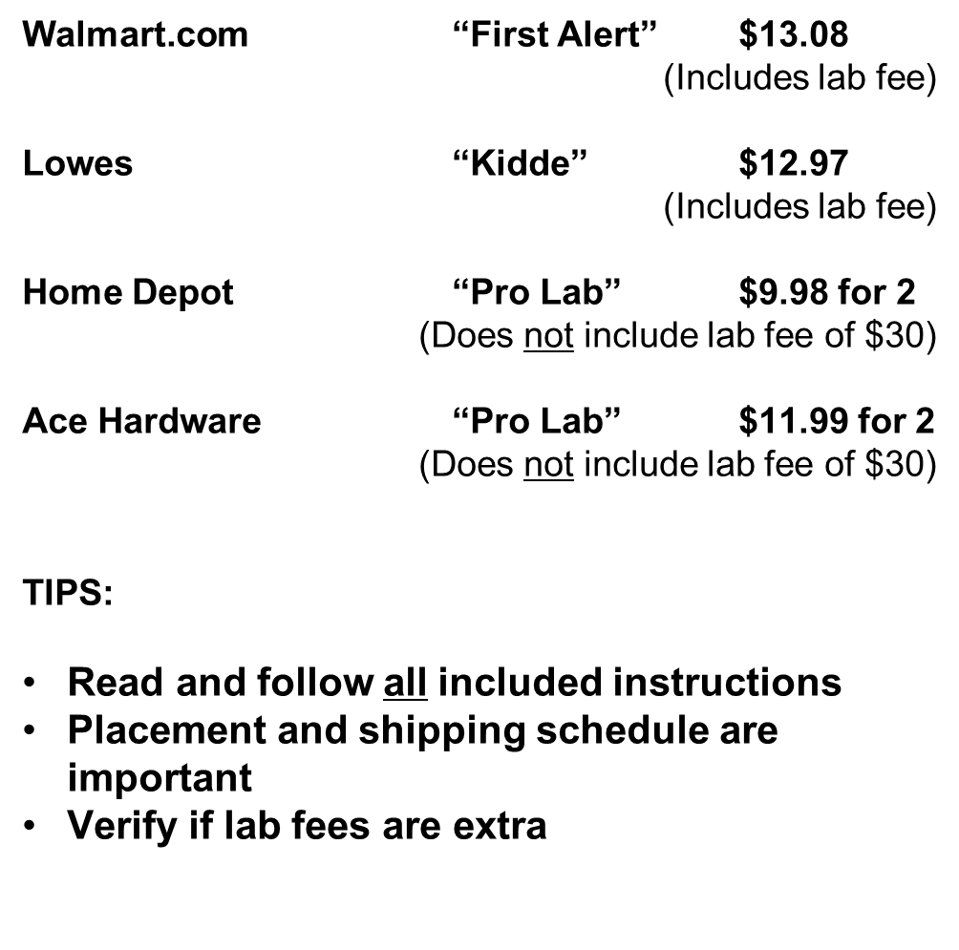
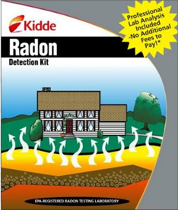
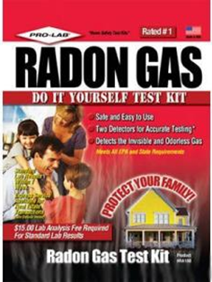
Do It Yourself Test Kits

Slide 28
What next?
Test your own homes, offices, schools.
Organize
Develop a Systematic Approach
Build an Effective Team
Standard Operating Procedures Available from many EPA sources (Radon, Tools for Schools)
Communicate With Everyone All the Time! Be Transparent and Inclusive
Act to Address Structural, Institutional and Behavioral Issues
Test for Radon
Implement Radon Reduction Plans (Radon Resistant New Construction Building Codes)
Educate Construction and Maintenance Staff about Radon Mitigation

Slide 29
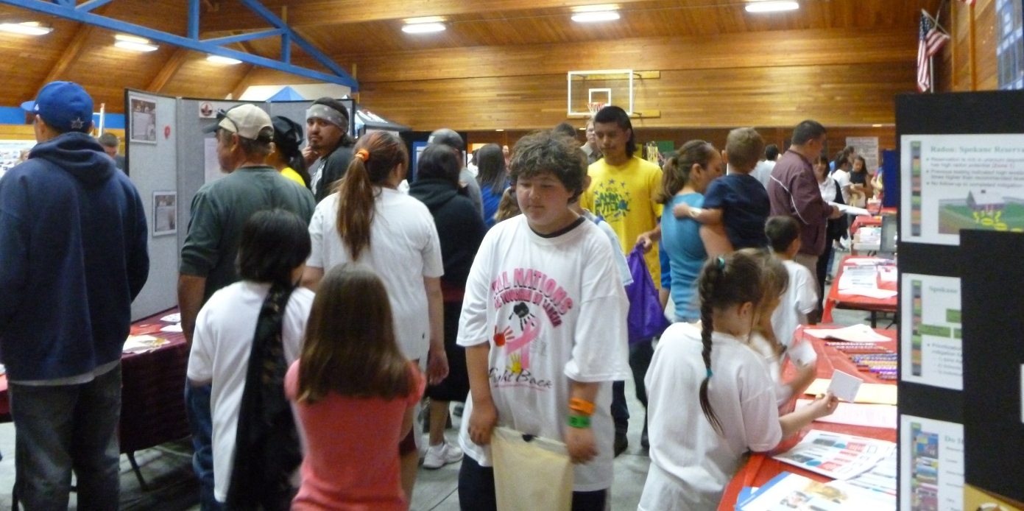
Outreach
Twa-le Abrahamson-Swan
Spokane Tribal Air Quality Department
Brandi Toft, Air Quality Specialist
Leech Lake Band of Ojibwe

Slide 30
Start by researching local radon data
Possible Sources: Online, State Radon Office, IHS, Housing

Slide 31
Create outreach materials: locally focused brochures, webpage, tribal news papers, etc.

Slide 32
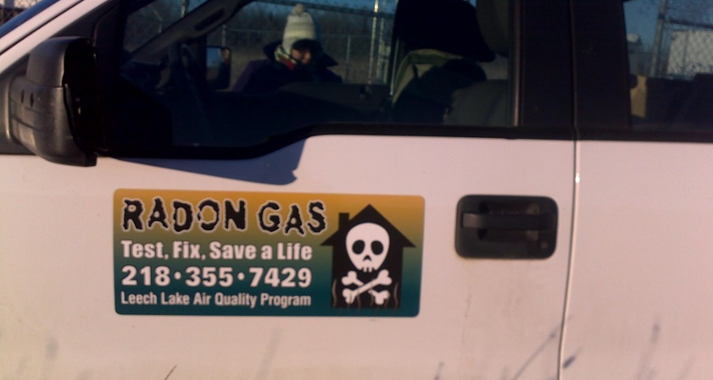
Posters, billboards, truck magnets

Slide 33
EPA Living Green Campaign in 2012
TV, Radio, Newspaper, Magazines, Stickers, E-Cards, Web Banners, etc.
http://www.epapsa.com/campaigns/greensox/
Modified for Tribal Outreach

Slide 34
Direct Community Outreach
Information tables at Health Fairs, Housing Fairs, Powwows

Slide 35
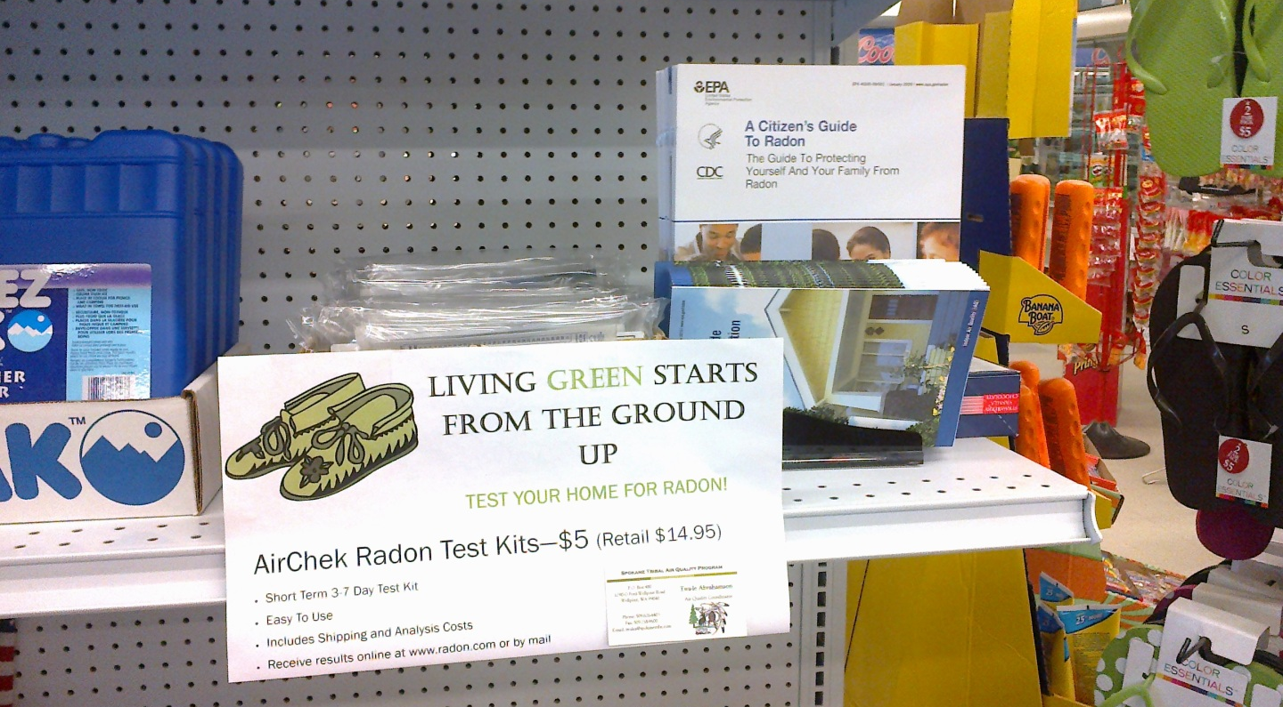
Are radon kits readily available?
Spokane Tribe purchased kits in bulk, placed at the Tribal Trading Post with outreach materials
Reminders and signs throughout the community
Post-testing follow up

Slide 36
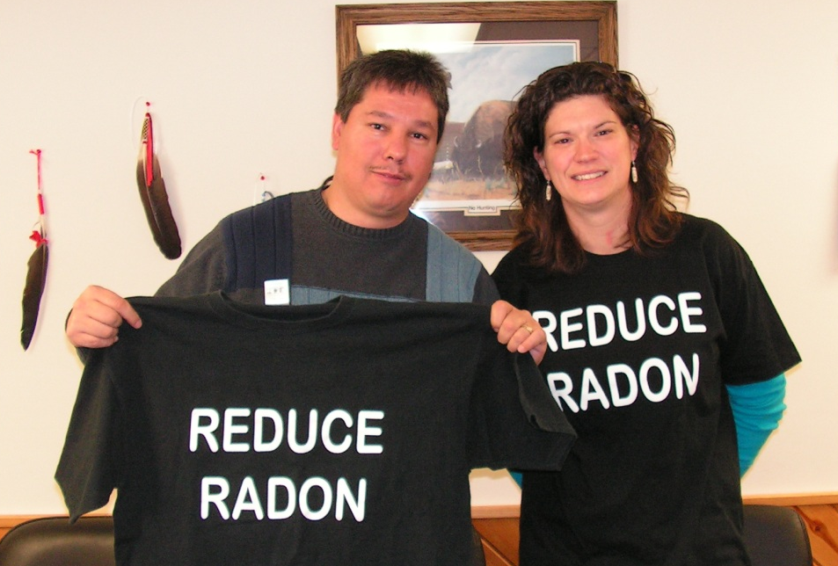
Leech Lake
Provides test kits free of charge to Leech Lake Members and Employees
Incentives! Free CO detector to households who complete a radon test.

Slide 37
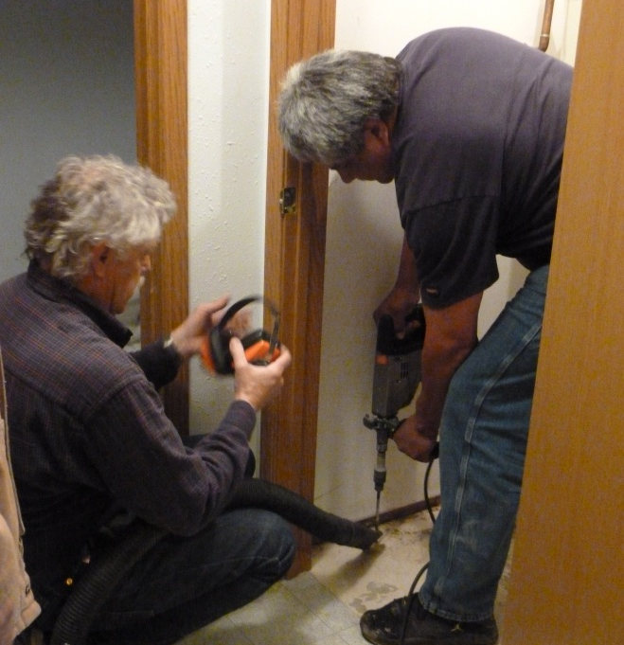
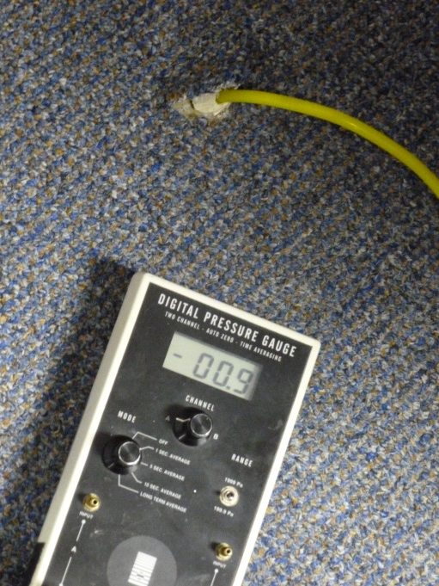
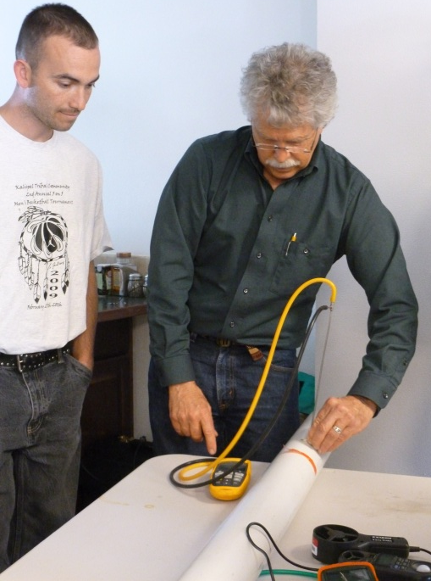
Focused Outreach: Tribal housing, construction and weatherization staff, architects, bidders, etc.

Slide 38
Radio Outreach
Effective to reach rural reservation communities
Host a weekly show, InnerTribal Beat on KYRS Thin Air Community Radio in Spokane, WA
Tuesdays 2-4 Pacific
88.1 FM and online at www.kyrs.org
Incorporate Tribal environmental news, air quality tips, burn ban notifications, with some great music, community announcements, etc.
Photo: Spokane Tribal Air Quality Coordinator and InnerTribal Beat Host, accepting a 2012 EPA Clean Air Excellence Award in Washington DC from Gina McCarthy, EPA Assistant Administrator for the Office of Air and Radiation.

Slide 39
Look for other media outlets
Radio Outreach: Native America Calling
Native America Calling is heard on 52 stations in the United States and in Canada by approximately 500,000 listeners each week.
http://www.nativeamericacalling.com/nac_past2012.shtml
Or Google “Native America Calling AND Radon”
Contact the producers, watch the schedule, propose new shows, speakers, etc.
Build relationships with local TV news, newspapers, etc.

Slide 40
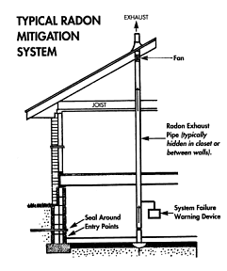
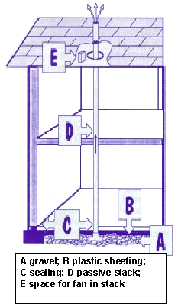
Radon Mitigation

Slide 41
Different Types of Mitigation
Active soil depressurization (ASD) and mechanical ventilation (most common)
Above slab air pressure differential barrier
Heat recovery ventilators
There can be potentially serious issues with installing mitigation systems.
Mitigation systems installed in humid regions can compound moisture issues such as mold and mildew.
Poorly installed mitigation systems can greatly increase winter heating costs.

Slide 42
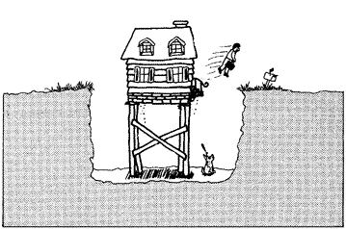
One way to ensure that your home is safe from radon
Ambient outdoor radon levels average 0.4 pCi/L

Slide 43
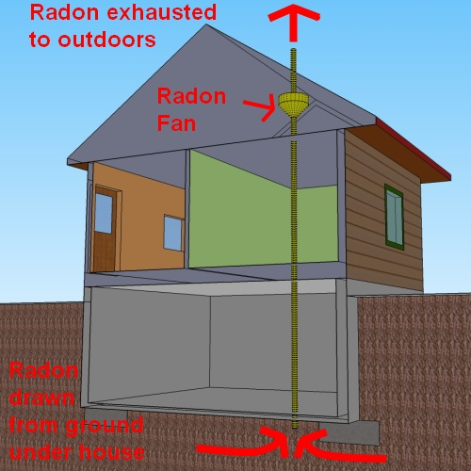
Basic Radon Mitigation
The cost of radon mitigation is between $800 to $2,500 with an average of about $1,200

Slide 44
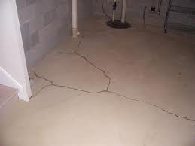
-Cracks in basement floors and walls need to be sealed. -The floor/wall joint is a common culprit. -Cinderblock walls are an open invite for radon to come into the house.

Slide 45
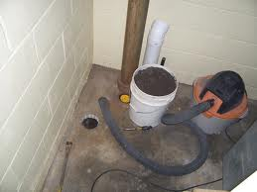
This image shows a hole drilled in the basement floor to draw air from under the concrete slab.
The tools necessary for radon mitigation will vary depending on the individual circumstances.

Slide 46
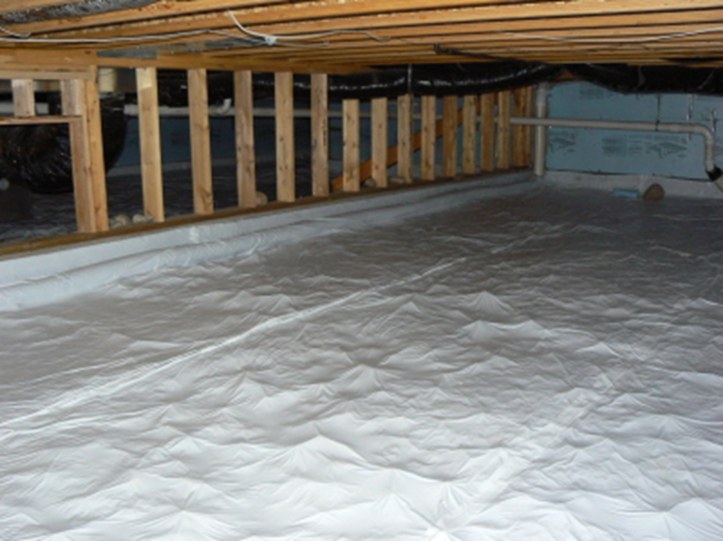
Mitigation in crawlspace
Pipe to fan
Active soil depressurization. Notice the piping under the plastic

Slide 47
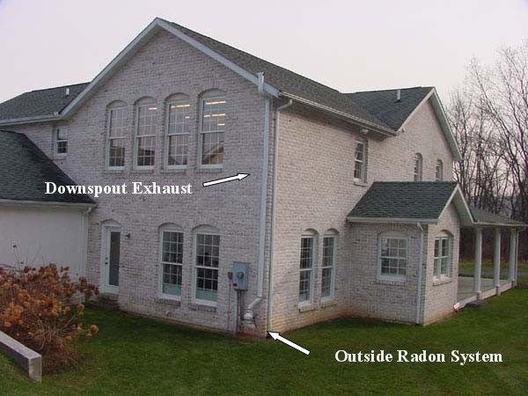
Actual Mitigation Photo
Most mitigation systems can be designed to blend into the natural structure and utilities of the home

Slide 48
Summary
The most common type of mitigation is the active soil depressurization.
There is no “one system fits all” approach to radon mitigation and care should be taken to install the right system for each unique circumstance.
Annual inspection of mitigation system should be completed

Slide 49
Radon Resistant Construction (RRC)
Radon-resistant construction typically costs a builder between $250 and $750.
RRC could cost less than $250 if the builder already uses some of the same techniques for moisture control.
For a builder, it is much less expensive to install a radon-resistant system during construction than to go back and fix a radon problem identified later.
If a new homeowner tests for radon and has to mitigate high levels, it could cost the builder or the owner as much as $2,500.
http://www.epa.gov/radon/rrnc/index.html

