Slide 1
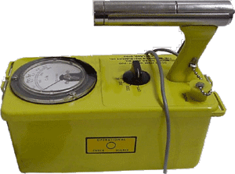
The proper care and feeding of your CVD 700

Slide 2
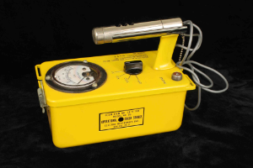
Probe with Geiger Mueller tube
Range Switch
Meter
Check Source

Slide 3
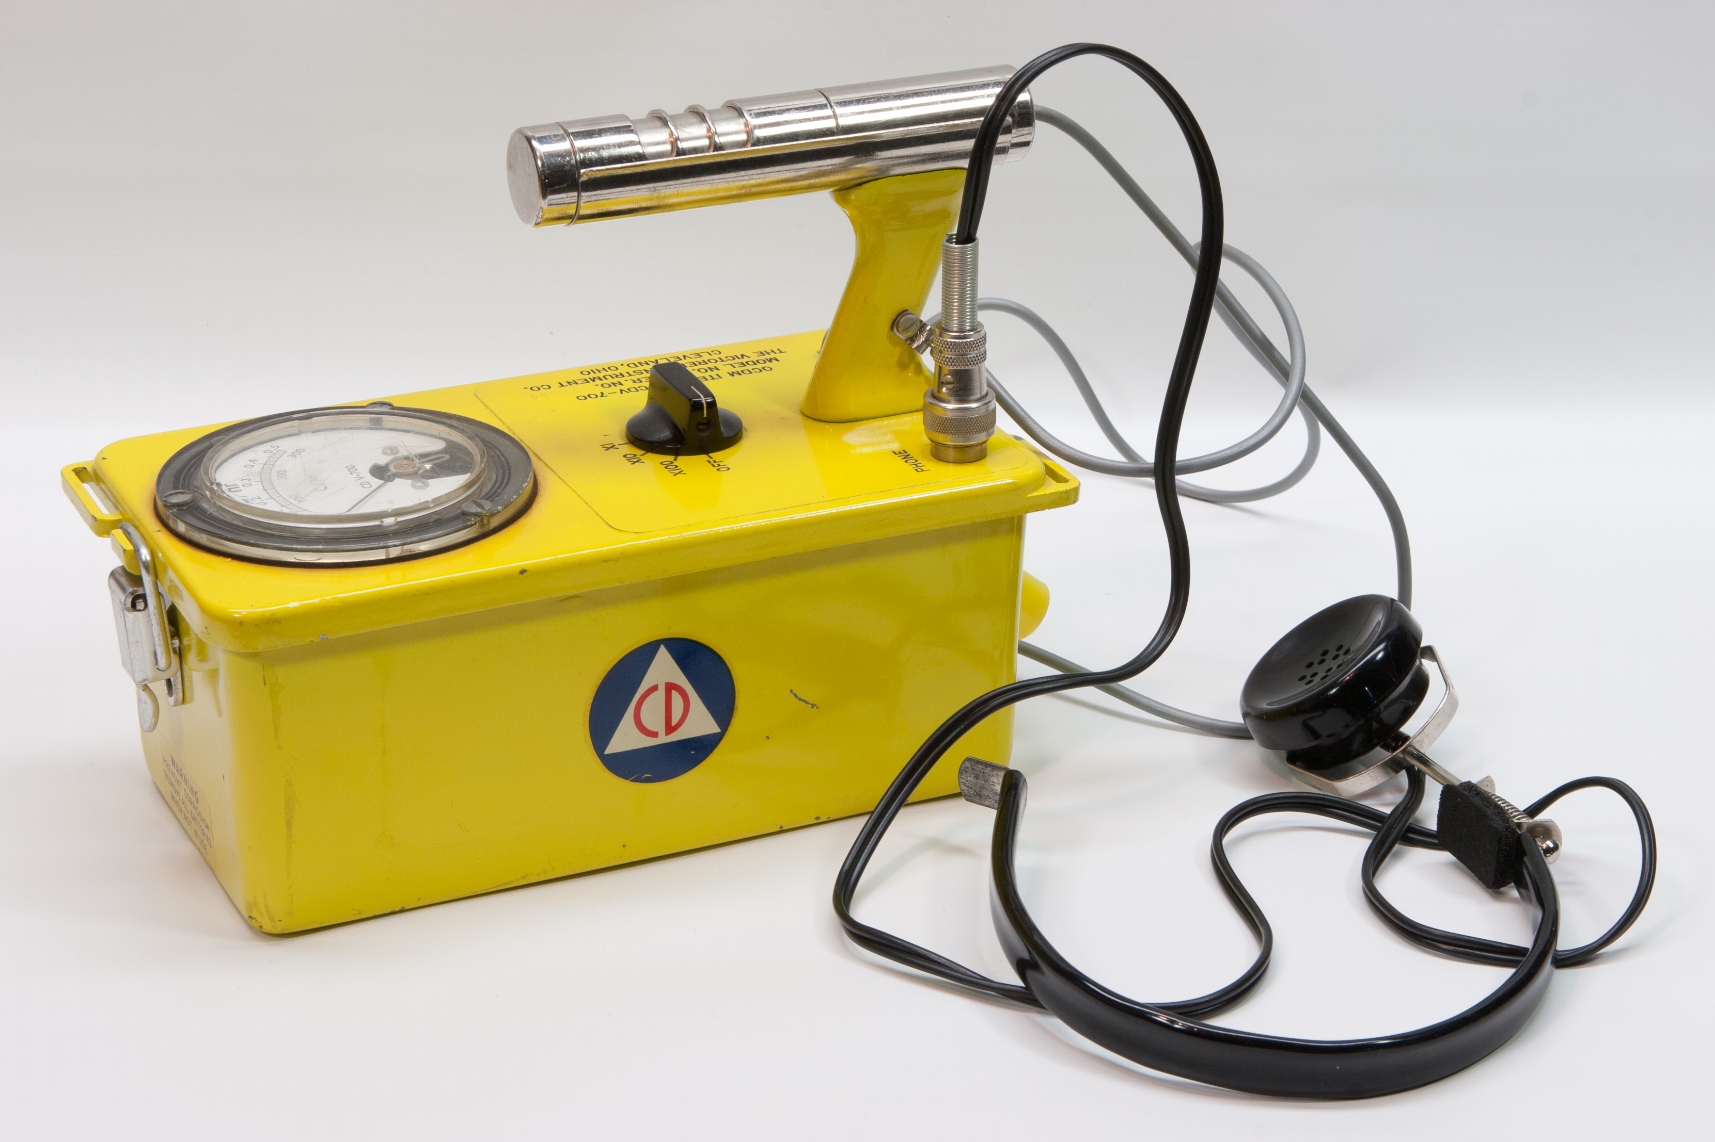

Slide 4
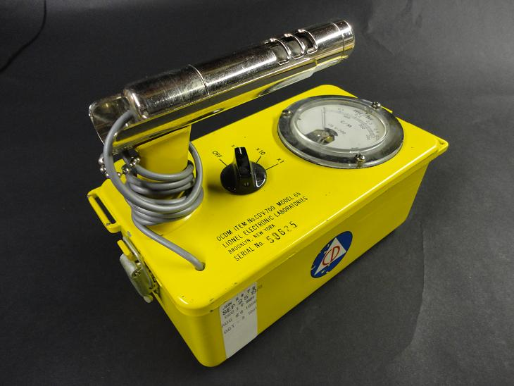

Slide 7
Units of Dose and Exposure
Roentgen (R) - unit of exposure - ionization of air by x or gamma rays
mR = milliRoentgen
RAD (Radiation Absorbed Dose) - energy deposited in material (Gray (Gy) is international unit)
rem - (Roengten Equivalent Man)
unit of dose equivalent (Avg. US dose 620 mrem)
Seivert (Sv) is international unit

Slide 8
Units of Radioactivity
Activity – rate of decay
- the number of emissions (of radiation) per unit time.
dps - disintegrations per second
Bequerel = 1 dps
Curie = 37,000,000,000 dps
Picocurie = 0.037 dps or 2.2 dpm
CPM = counts per minute

Slide 9
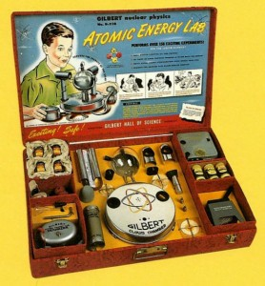

Slide 10
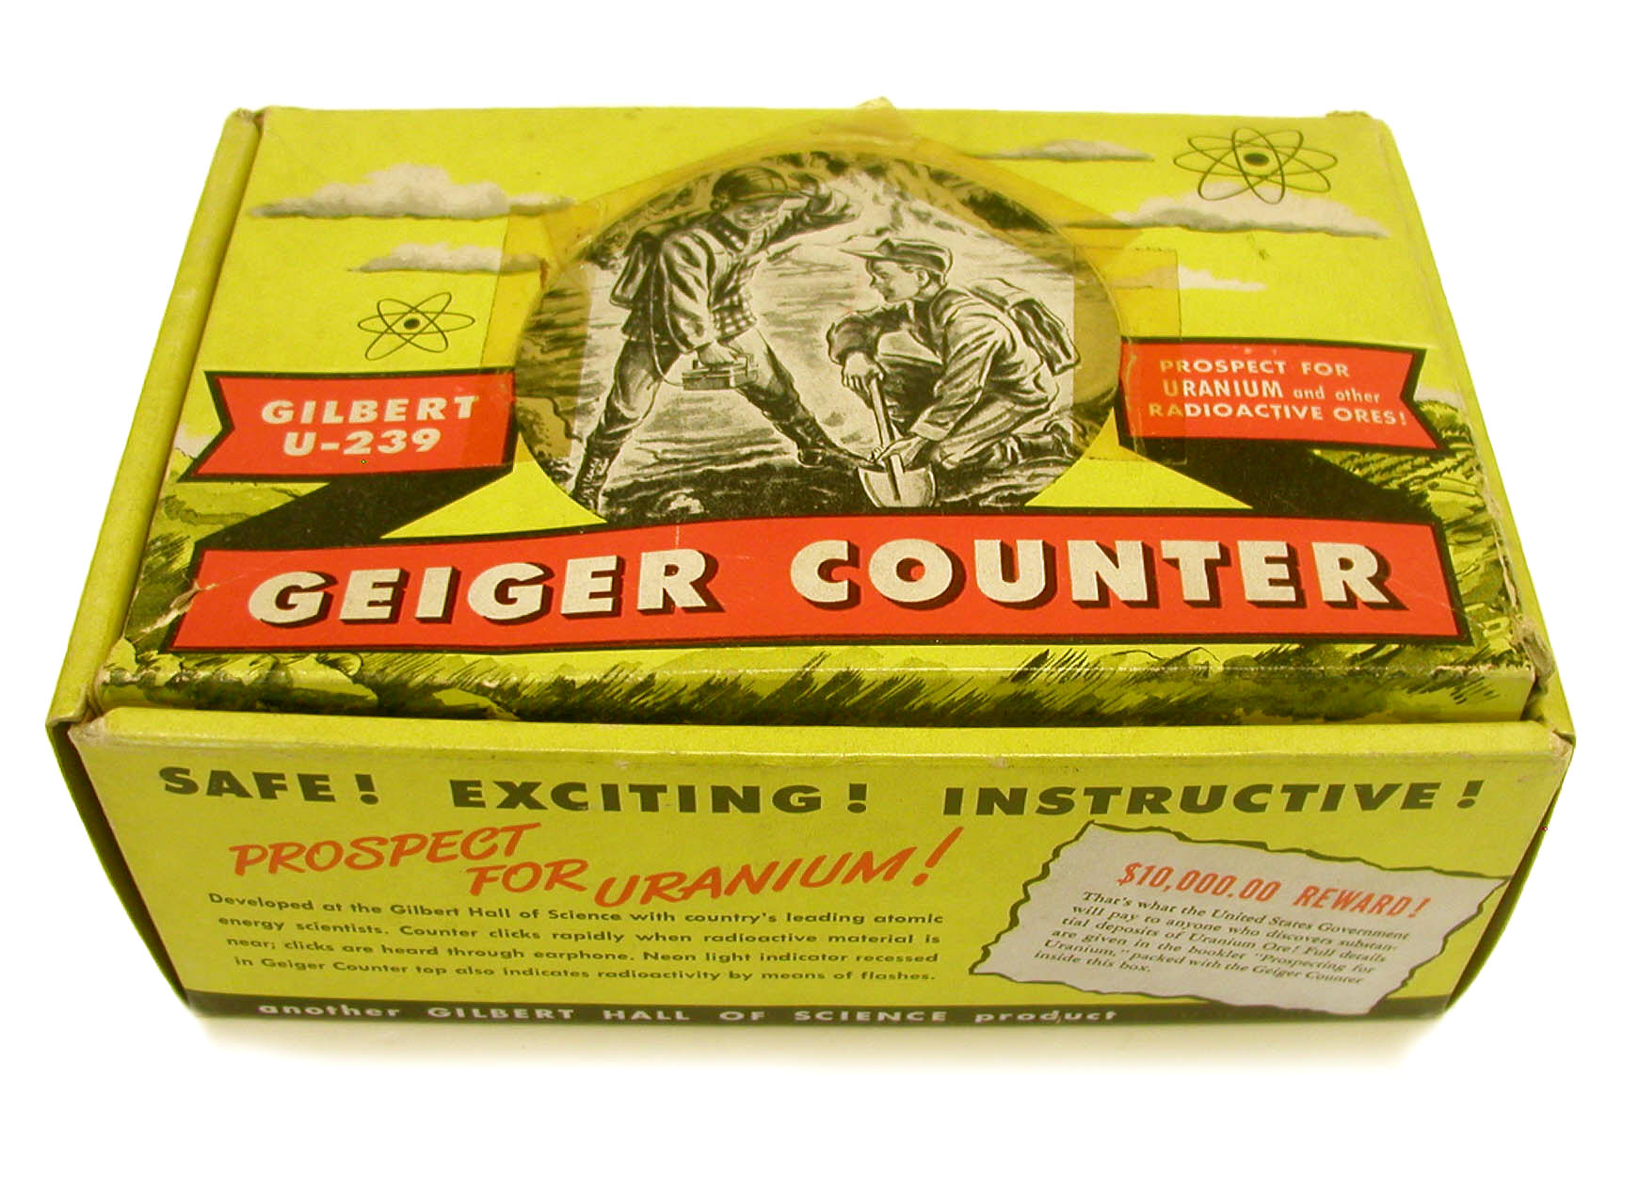

Slide 11
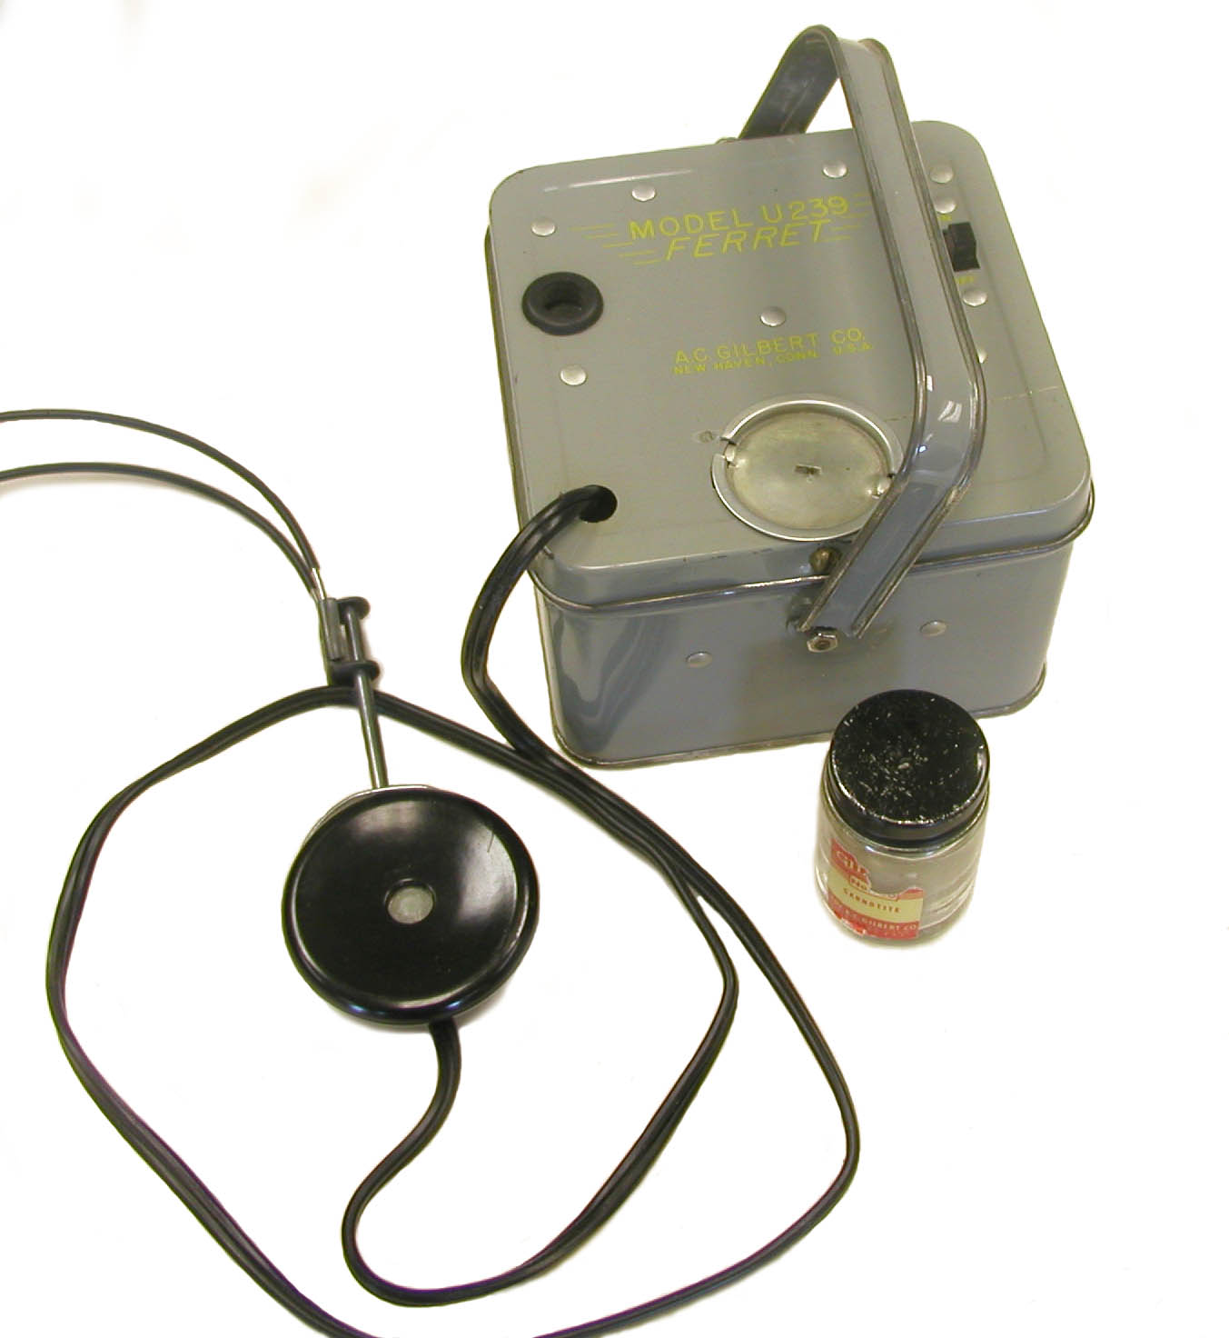

Slide 12
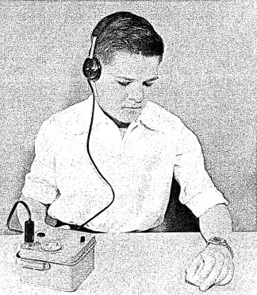

Slide 13
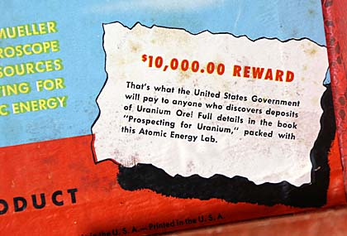

Slide 14
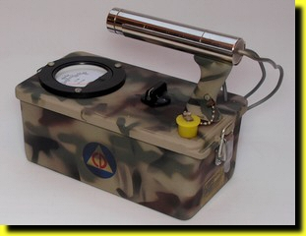

Slide 15
