Slide 1
Welcome To RadTown USA
Click to Explore RadTown USA

Slide 2


Fundamentals of
Ionizing Radiation
The Alpha, Beta, Gammas of
Nuclear Education
March 15th , 2015
Debra N Thrall, PhD
Executive Director

Slide 3
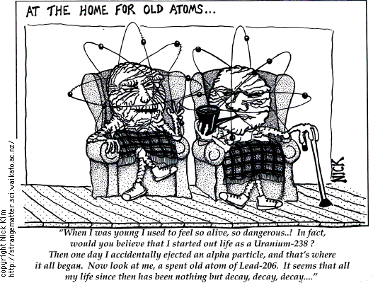

Slide 4

Radiation Fundamentals
What is radiation?
Where does it come from?
How does it interact with matter?
What is radioactivity?
What are fission and fusion?
How are radiation and radioactivity quantified?
Notes:
Here are the topics we’ll be covering. Some of these are just definitions. Some of them involve concepts that may be new or not well-established in your mind. Some of this will require you to “unlearn” pre-conceived notions you have and internalize a different conceptual picture.

Slide 5


Do you think of these people when I say RADIATION?

Slide 6

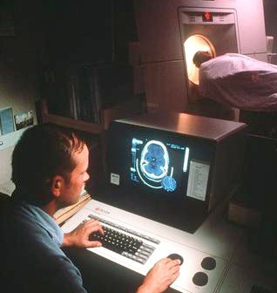
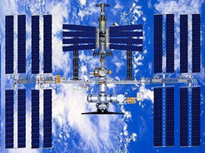


Do you think of these things as well?
Food
Space
Utilities
Consumer Products
Medicine

Slide 7
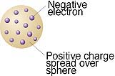
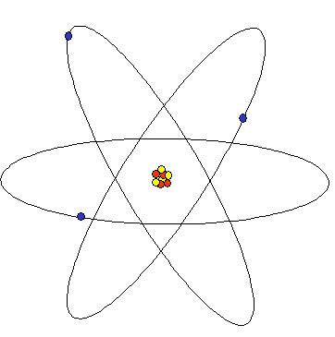
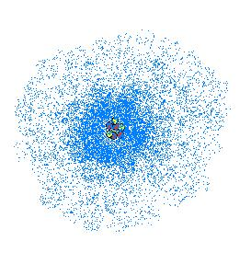
Brief History of the Atom
500 BC Democritus Atom
Long time (Romans → Dark Ages)
1808 AD Dalton Plum Pudding
1911 Rutherford Nucleus
1913 Bohr Orbits
1920’s Many People Quantum Mechanics
Notes:
This is meant simply as a brief introduction. The scouts should already have completed their homework and should be somewhat familiar with this material. The two takeaways are 1) scientific thought has changed dramatically over the ages and 2) We now believe that the quantum model is correct, but we will use the Bohr model for simplicity.

Slide 8
So, What is an Atom?
Atoms are made up of protons, neutrons & electrons
  Protons: + charge p⁺
  Neutrons: no charge n⁰
  Electrons: - charge e⁻
Atoms want to have a stable energy level
  This translates to having no net charge
  #protons = #electrons

Slide 9
Mass of an Atom
Masses
  Proton: 1.000000 amu
  Neutron: 1.000000 amu
  Electron: 0.000549 amu
The mass of an atom is approximately due to the mass of the protons and neutrons
Mass atom = number p⁺ + number n⁰

Slide 10
Atomic Structure of Helium
THE HELIUM
ATOM
HELIUM’S SUBATOMIC COMPOSITION
2 Protons
e⁻
p⁺
2 Neutrons
n
n
p⁺
2 Electrons
e⁻

Slide 11
Isotopes – Defined
Isotopes are elements with different amounts of neutrons
The number of protons is identical
They have similar properties
There are stable and unstable versions of atoms
They are naturally occurring & man made

Slide 12
Examples of Isotopes
  H-1 Hydrogen 1 proton 0 neutron
  H-2 Deuterium 1 proton 1 neutron
      Heavy hydrogen
  H-3 Tritium 1 proton 2 neutrons

Slide 13
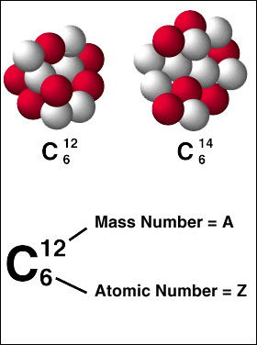
More on atomic structure . . .
Protons have a large mass and a positive charge. The number of protons identifies an element.
p⁺
Neutrons have a large mass approximately equal to a proton’s mass. Neutrons have no charge.
n
is the total number of protons and neutrons
Electrons have a very small mass and a negative charge. Electrons travel outside the nucleus.
e⁻
is the number of protons

Slide 14
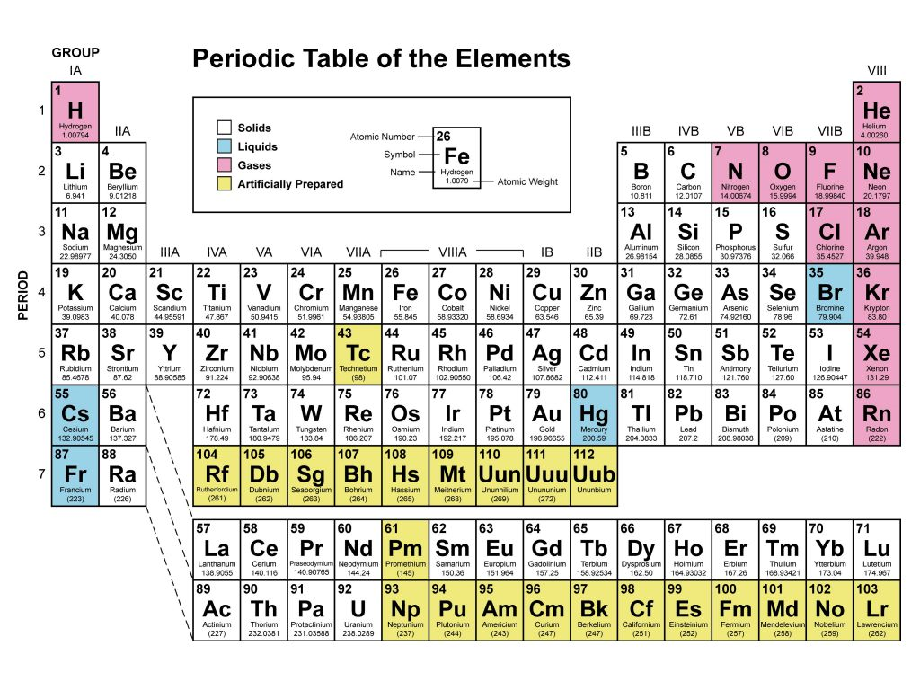

Slide 15
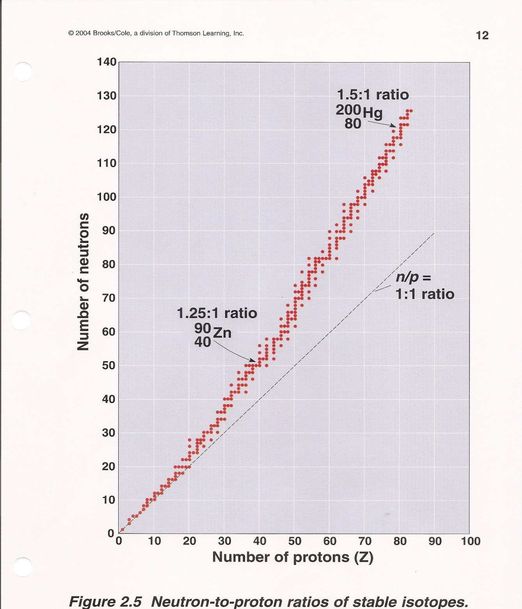
Predict Radioactivity of an Isotope
Stable Isotopes have a specific ratio of neutrons to protons.
Unstable Isotopes which are radioactive fall outside the ‘stable zone’ of neutron to proton ratios.

Slide 16
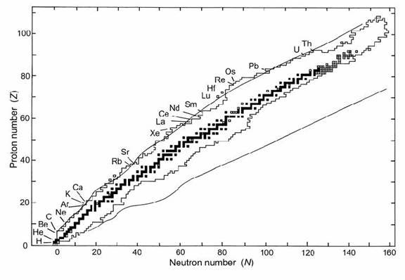
Chart of the Nuclides

Slide 17
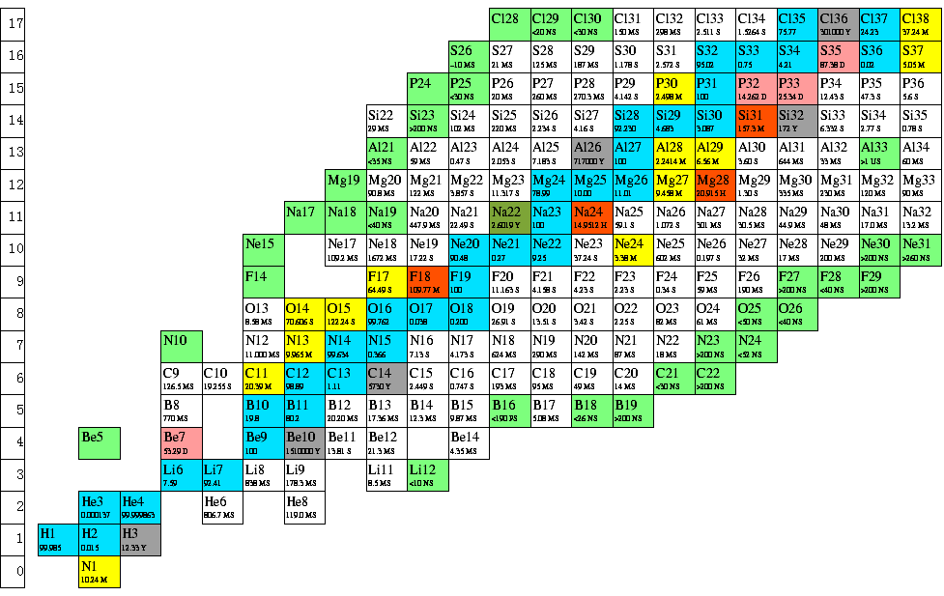

Slide 18
Where Does Radiation Come From?
Nuclear Decay - Radioactivity
Atomic Processes - X-rays
Nuclear Reactions
Fission
Fusion
Others
Notes:
Now that we’ve looked at some important nuclear physics concepts, we’ll move on to specifics on radiation. We’ll look at the common sources of ionizing radiation. We will look at the process of radioactivity, a fundamental physical process associated with atoms. In contrast to radiation from radioactivity, which originates with a nuclear transformation, we’ll take a look at how radiation is produced outside the nucleus in the form of X-rays. Then we’ll examine the common nuclear reactions. All of these processes and reactions are natural, and occur abundantly in nature. In our discussion of the production mechanisms of radiation, we’ll also talk about the characteristics of the radiations themselves.

Slide 19

Background Radiation Sources
INDUSTRIAL
CONSUMER PRODUCTS
ATMOSPHERIC TESTING
MEDICAL
INTERNAL
RADON
TERRESTRIAL
COSMIC
NATURAL
MANMADE

Slide 20
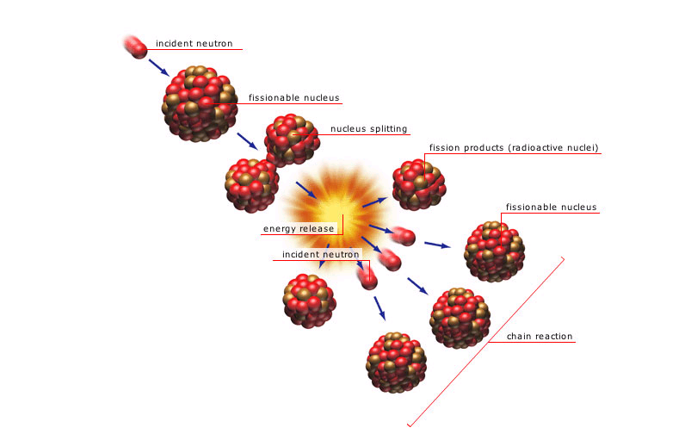
Nuclear Reactions - Fission
Neutron induced in U²³⁵
Products:
  Energy
    ~ 200 MeV
  Fission Products
    Radioactive
  Neutrons
    2.47 per fission

Slide 21
Types of Radiation
Non-Ionizing
Radiowaves
Microwaves
Infrared
Ultraviolet
Visible Light
Ionizing
Alpha
Beta
Gamma
X-Rays
Neutrons

Slide 22
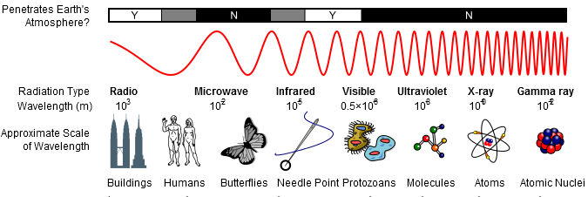
Electromagnetic Spectrum
Particles can also be described by a wave function!
Notes:
Here is a depiction of the electromagnetic spectrum showing the wavelengths of different categories of radiations. Note that the actual threshold energy or crossover from one type to another is not an exactly defined thing. For instance, the upper end of the UV range can cause ionization in some materials.
Note: The use of the term “x-ray” to define a radiation energy range is somewhat misleading. X-rays originate in the electron cloud of an atom, rather than from the nucleus, and therefore have historically been associated with an energy range on order of electron binding energies (which holds true for “characteristic” X-rays). However, X-rays produced by high energy machines (diagnostic X-rays ~ 100 keV, accelerators ~ GeV) are much higher. A clearer way to categorize it is by sticking to the point of origin – gamma rays come from nuclear decay processes, X-rays come from atomic processes outside the nucleus. Their energies are arbitrary and overlap.

Slide 23
Why is it called ionizing?
Because it creates ions --atoms with a charge.
Neutrons
and Protons
Ejected Electron
Ionizing Radiation

Slide 24
Radiation Types
Alpha (α)
  2 protons, 2 neutrons
  positively charged particle
p+
n
n
p+
Beta (β)
  like an electron
  negatively charged particle
⁻
Gamma (γ)
  Wave energy (not a particle)

Slide 25
RADIOACTIVE DECAY REACTIONS
ALPHA DECAY
238
92
234
90
4
2
α
U
Th +
BETA DECAY
0
−1
234
90
Th
234
91
Pa +
β
+
ν
GAMMA DECAY
137m
56
Ba
137
56
γ
Ba +

Slide 26
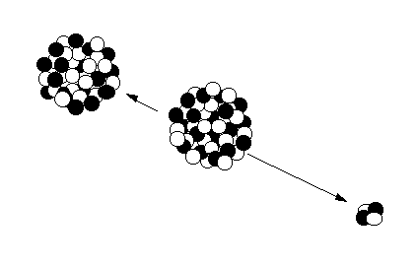

Radioactivity: α Decay
^{A} X
^{A-4} Y + α
z
Z-2
Daughter Nucleus
Rn-222
Parent Nucleus
Ra-226
  ⁴₂α ⁺⁺
Alpha tracks in a cloud chamber
Alpha Particle
(Helium Nucleus)
Notes:
Remember, we said there were four main types of ionizing radiations. Three were particles. The first is the alpha particle.
Alpha because they were the first discovered – A, B, C, etc.
Notice that the examples listed are all heavy nuclei. Heavy elements are the ones for whom alpha decay is energetically likely. An alpha particle is actually a helium nucleus. For lighter elements, other decay processes become much more likely (decay processes “compete”).
Look at the result of the decay. The equation shows the effect of losing the alpha particle. (Look at the key for the Chart of Nuclides)
The alpha particle is the radiation. It is ejected with a considerable amount of kinetic energy. Where does that energy come from? It is the energy equivalence of the difference in the binding energy between the parent and daughter. In essence, each nucleon in the daughter weighs slightly less than in the parent. That difference in mass must go somewhere – it is turned into the kinetic energy of the alpha particle (actually shared between the alpha and the nucleus). Alpha particles are highly charged, therefore are heavily interactive with electrons as they penetrate matter. How penetrating are they?

Slide 27
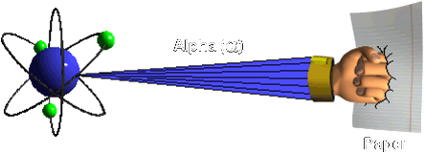
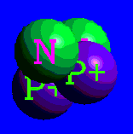
Alpha Radiation (α)
Characteristics
Particle, Large Mass,
+2 Charge
Range
Very Short
1 - 2” in air
Shielding
Paper
Outer layer of skin
Hazards
Internal
Sources
Plutonium, Uranium,
Americium

Slide 28
Uses of Alpha Radiation
• Pacemakers (Older models)
• Airplanes
• Copy Machines
•Smoke Detectors
•Space exploration

Slide 29
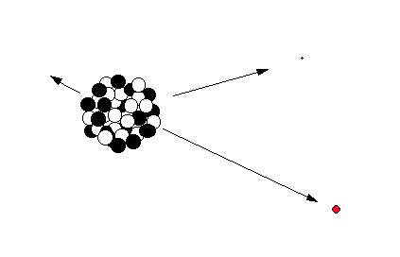
Radioactivity: β⁻ Decay
^{A} X
^{A} Y + β⁻ + ν
z
Z+1
Daughter Nucleus
Nickel-60
ν
Antineutrino
Parent Nucleus
Cobalt -60
β⁻
Beta Particle
(electron)
Notes:
Beta-minus decay occurs when a parent nucleus has an imbalance of neutrons and protons in which the nucleus is “neutron rich”. In lighter nuclei, beta decay is more probable than alpha, and it results in a daughter product with more binding energy per nucleon than the parent. The model for beta decay is that a neutron within the atom changes into a proton and an electron (and an electron-neutrino). The electron cannot exist within the nucleus and is ejected carrying the kinetic energy equivalent in the difference between the parent and daughter total mass-energy (actually the energy is shared by the beta and the neutrino, resulting in a continuum of energy possible from the beta, up to the total transition energy).

Slide 30
Beta Radiation is used in thickness gauging
The thicker the material the less radiation will pass through the material.

Slide 31
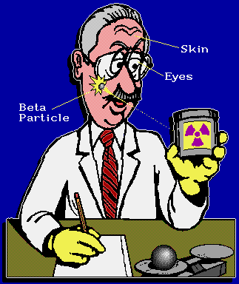
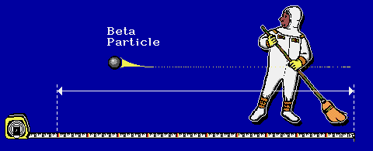
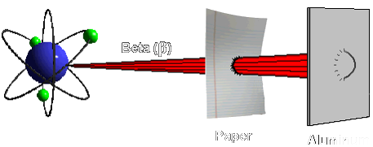

Beta Radiation (β)
Characteristics
Particle, Small Mass,
-1 Charge
Range
12ft / MeV in air
Shielding
Plastic, glass,
aluminum, wood
Hazards
Internal and the
skin and eyes
Sources
Tritium, Sr-90,
Fission products

Slide 32
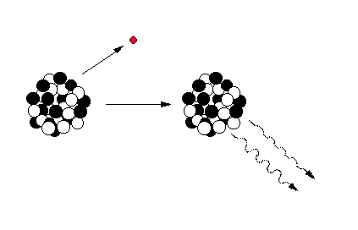
Gamma Emission
β⁻
Daughter Nucleus
Nickel-60
Parent Nucleus
Cobalt-60
(Beta decay)
Gamma Rays
Notes:
After a decay reaction, the nucleus is often in an “excited” state. This means that the decay has resulted in producing a nucleus which still has excess energy to get rid of. Rather than emitting another beta or alpha particle, this energy is lost by emitting a pulse of electromagnetic radiation called a gamma ray. The gamma ray is identical in nature to light or microwaves, but of very high energy.
Like all forms of electromagnetic radiation, the gamma ray has no mass and no charge. Gamma rays interact with material by colliding with the electrons in the shells of atoms. They lose their energy slowly in material, being able to travel significant distances before stopping. Depending on their initial energy, gamma rays can travel from 1 to hundreds of meters in air and can easily go right through people.
It is important to note that most alpha and beta emitters also emit gamma rays as part of their decay process. However, their is no such thing as a “pure” gamma emitter.
Important gamma emitters including technetium-99m which is used in nuclear medicine, and cesium-137 which is used for calibration of nuclear instruments.

Slide 33
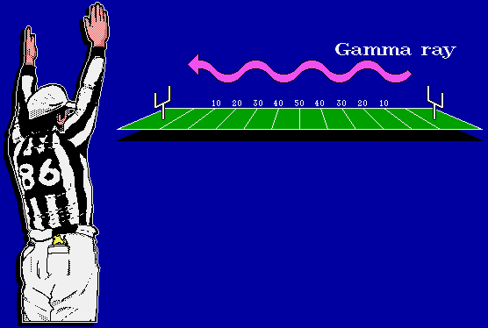

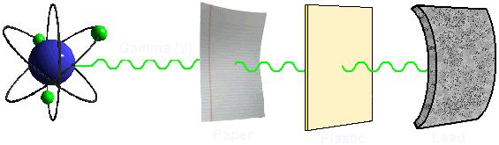

Gamma Rays (γ) and X-Rays
Characteristics
No electromagnetic
mass, no charge
Range
Hundreds of feet
in air
Shielding
Lead, Steel
Concrete
Hazards
External Source
Whole Body
Penetrating
Sources
Co-60, Kr-88, Cs-137

Slide 34
Uses for Gamma Radiation:
Food irradiation
Sterilization of medical equipment
Creation of different varieties of flowers
Inspect bridges, vessel welds and Statue Of Liberty.

Slide 35

The End . . .
  Dr. Debra N Thrall
  Executive Director
  AIP Foundation
  505-883-3114
  dthrall@nmsu.edu

