Slide 1
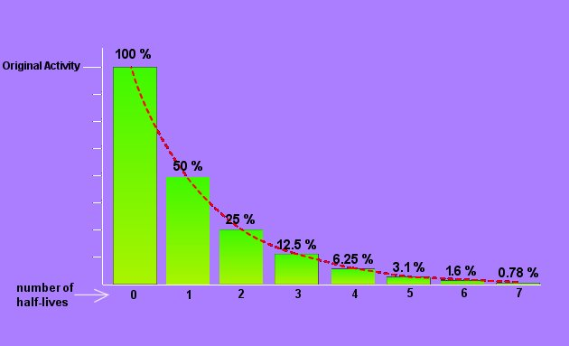
Radioactive Half-life
Notes:
Half-life is a common way to relate the rate of decay of a particular radioactive nuclide. Half-life is a convenient way to express the decay rate, but the fundamental quantity that determines the half life is the decay constant. The decay constant is the probability that any atom may occur per unit time. Half life expresses the effect of the decay constant by identifying the period of time required for a given quantity of the material to decay to half that amount.

Slide 2
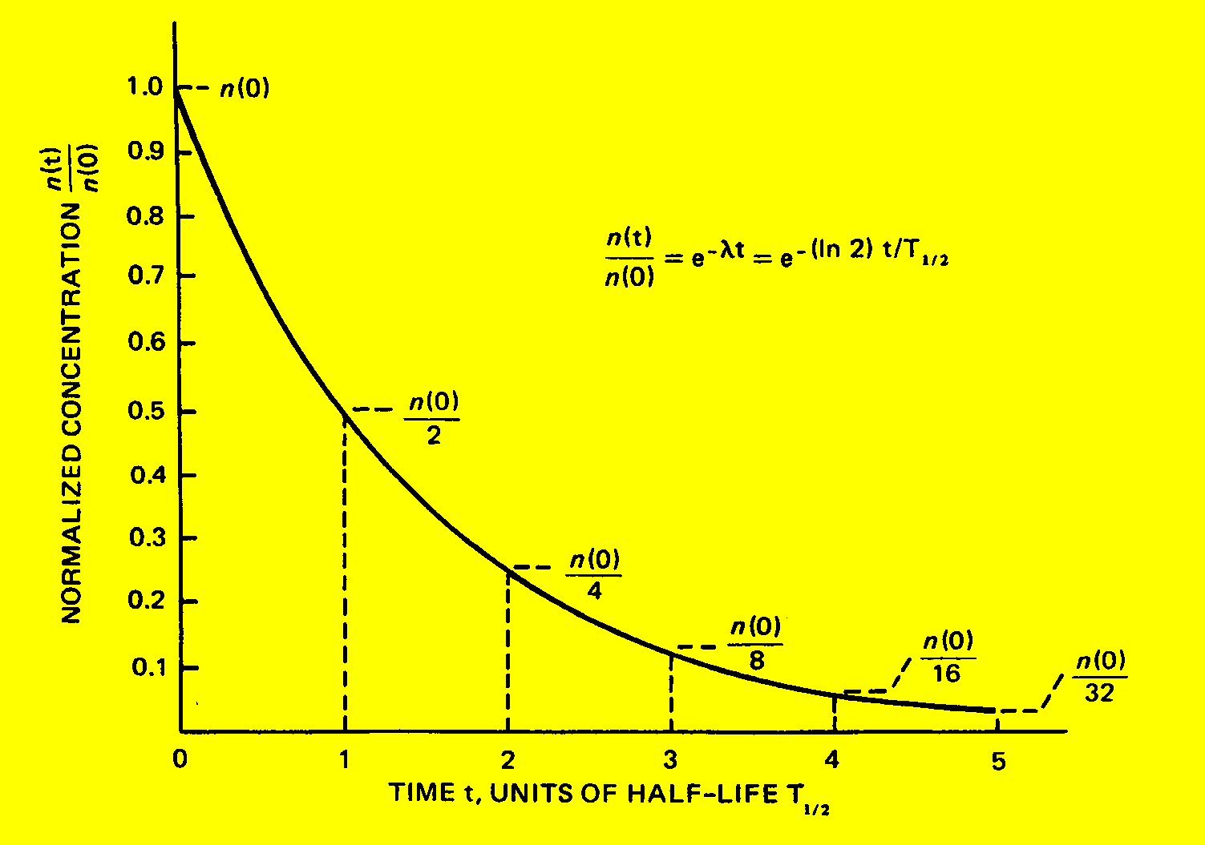
Half-Life

Slide 3
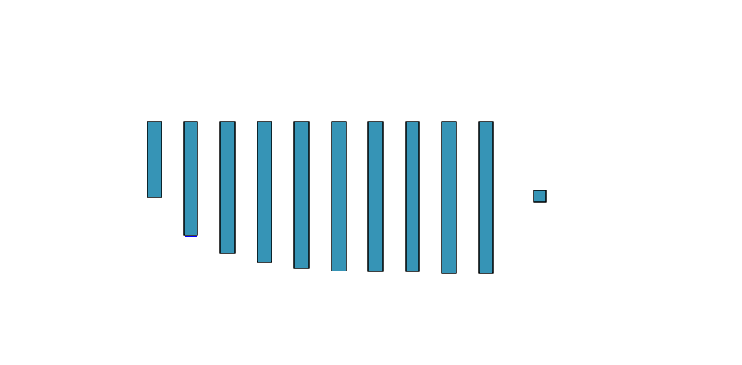
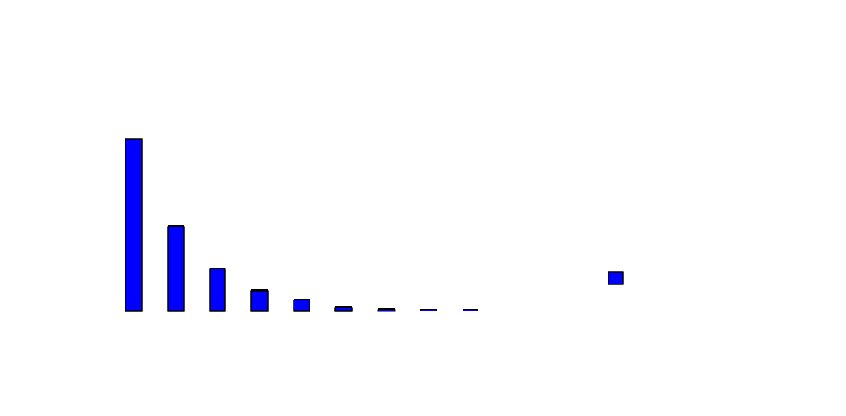
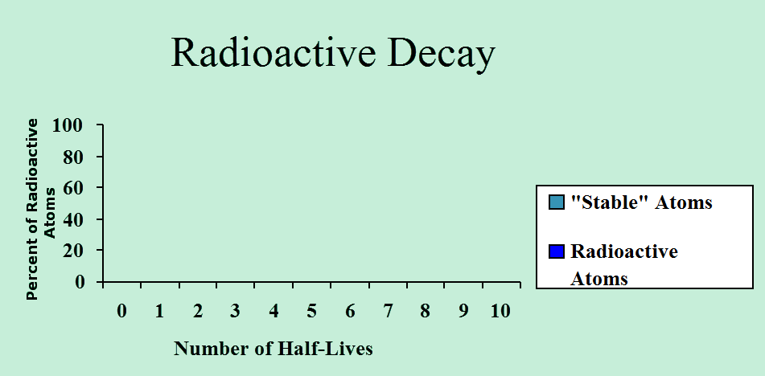
Half Life

Slide 4
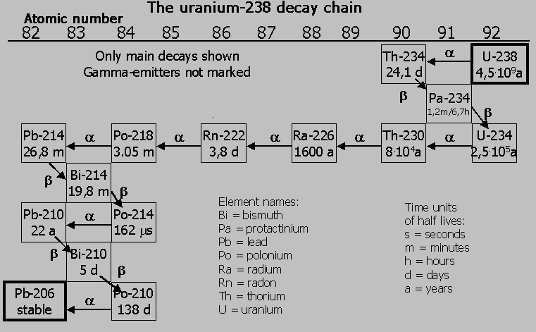

Slide 5
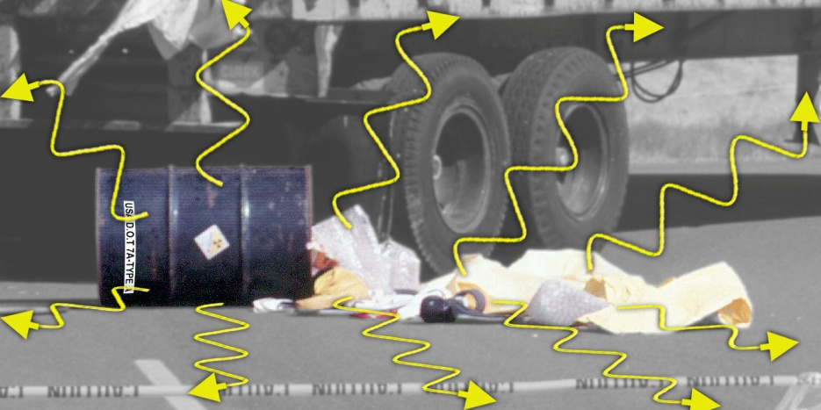
Exposure
Radiation = Energy Contamination = Material
Radioactive contamination emits radiation
Exposure to radiation will NOT contaminate you

Slide 6
Units for Exposure and Dose
Exposure (X): Generically, exposure is the condition of being exposed. Exposure is also used to quantify the amount of ionization produced by photons as they pass through air. The unit of exposure is the Roentgen (R).
1R = 1 esu/cc in air
Absorbed Dose (D): Absorbed dose is the amount of energy deposited in any material by ionizing radiation. The unit of absorbed dose used in the U.S., the rad, is a measure of energy absorbed per gram of material. The S.I. unit is the Gray (Gy). One Gray equals 100 rad.
1Gy = 1 J/kg in any material
Dose Equivalent (H): A special concept relating absorbed dose to biological detriment. In the U.S. the unit is the rem. The S.I. unit is the Sievert (Sv). One Sievert equals 100 rem.
Notes:
Units for exposure and dose may take several forms. In the English system, the common units are the Roentgen, the Rad and the Rem. The Roentgen is a measure of ionization in air by photons and is a useful unit for making real-time measurements (and for gamma radiation, the Roentgen equates almost exactly to the rem). The rad is a measure of energy deposition in any material. It does not provide information on the relative biological effect of that dose. By applying a “quality factor” (next slide), the rad is converted to the Rem, the unit used to express biological harm, thus providing a unit that is normalized for any kind of radiation.

Slide 7
Radiation Reduction
Guiding principle: ALARA (as low as reasonably achievable)
Restrict Proximity TIME
Increase the DISTANCE from the Source
Use SHIELDING Material

Slide 8
Human Experience: Ionizing Radiation
Lethal
w.b.
Thyroid
Treatment
Malignant Tissue Treatment
(5 - 6 weeks)
Accident
(whole body - w.b.)
> 0.0
1000
5000
10,000 rem
DNA modifying rate
equivalent to normally
occurring rate
mouse experiment
(yearly)
Lethal
w.b.
> 0.0
100
500
1000 rem
U.S. Radworker limit thru
mid-fifties w.b. (yearly)
U.S. Radworker
limit thru WWII
w.b. (yearly)
Ramsar,
Iran
w.b. (yearly)
Soviet
Radworker limit
w.b. (yearly)
Guarapari, Brazil
(yearly)
> 0.0
10
50
100 rem
Monazite
Sands,
India
w.b. (yearly)
Full Mouth
(18 film)
x-ray
exam
Shuttle
Mission
w.b.
X-ray
lower
spine
U.S.
Radworker limit
w.b. (yearly)
Skylab
Mission
w.b. (90 days)
> 0.0
1
5
10 rem
natural
background
w.b. (yearly)
CT
Scan
(center
line)
medical
chest
x-ray
mouse
experiment
(daily)
medical x-ray
technician
w.b. (yearly)
antique
(per hour)
Airline Pilot
w.b. (yearly)
0.000002
0.1
0.5
1 rem

Slide 9
Human Experience: Ionizing Radiation
Lethal
w.b.
Thyroid
Treatment
Malignant Tissue Treatment
(5 - 6 weeks)
Accident
(whole body - w.b.)
> 0.0
1000
5000
10,000 $
DNA modifying rate
equivalent to normally
occurring rate
mouse experiment
(yearly)
Lethal
w.b.
> 0.0
100
500
1000 $
U.S. Radworker limit thru
mid-fifties w.b. (yearly)
U.S. Radworker
limit thru WWII
w.b. (yearly)
Ramsar,
Iran
w.b. (yearly)
Soviet
Radworker limit
w.b. (yearly)
Guarapari, Brazil
(yearly)
> 0.0
10
50
100 $
Monazite
Sands,
India
w.b. (yearly)
Full Mouth
(18 film)
x-ray
exam
Shuttle
Mission
w.b.
X-ray
lower
spine
U.S.
Radworker limit
w.b. (yearly)
Skylab
Mission
w.b. (90 days)
> 0.0
1
5
10 $
natural
background
w.b. (yearly)
CT
Scan
(center
line)
medical
chest
x-ray
mouse
experiment
(daily)
medical x-ray
technician
w.b. (yearly)
antique
(per hour)
Airline Pilot
w.b. (yearly)
0.000002
0.10
0.50
1 $

Slide 10
The End . . .
Dr. Debra N Thrall
Executive Director
AIP Foundation
505-883-3114
dthrall@nmsu.edu

