Slide 1
What is the risk of radiation?

Slide 2
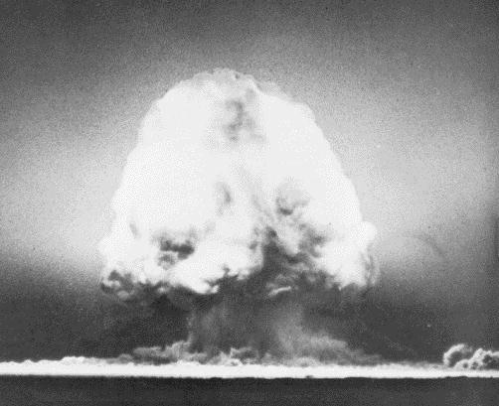
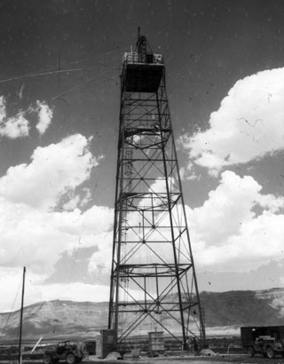
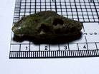
Trinity Test Site July 16th, 1945
Above: Bomb Detonation
Top Middle: “The Gadget”
Bottom Middle: Trinitite
Right: Bomb Drop Tower

Slide 3
Some members of the public seem to equate anything nuclear with the concept of nuclear weapons.

Slide 4
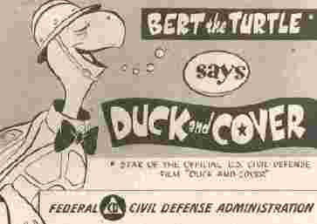
Mass Paranoia
Mass fear of Nuclear holocaust
Fall out shelters and bomb drills constructed and conducted

Slide 5
When Trinity was detonated it was the bang of a starting gun for B-movie makers everywhere!
They saw visions of mutants, plagues, nuclear holocaust, empty cities covered in gray ash; and mushroom clouds rising like dollar signs on the screens of drive-ins everywhere.

Slide 6
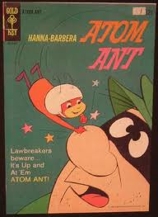

Slide 9
Radiation Interaction and Penetration Through Matter
alpha
+
alpha
+
High charge, dense ionization, short path
-
beta
Less charge than alpha, longer, erratic path
gamma
No charge or mass, much less interaction
neutron
No charge, interacts by nuclear scattering

Slide 10
Cell Damage

Slide 11
Direct vs. Indirect Ionization
Direct
Radiation that ejects orbital electrons from absorber atoms like charged particles (alphas and betas)
Indirect
Transfer energy to charged particles (protons/electrons) of the absorber atoms, like neutrons and gamma rays.

Slide 12
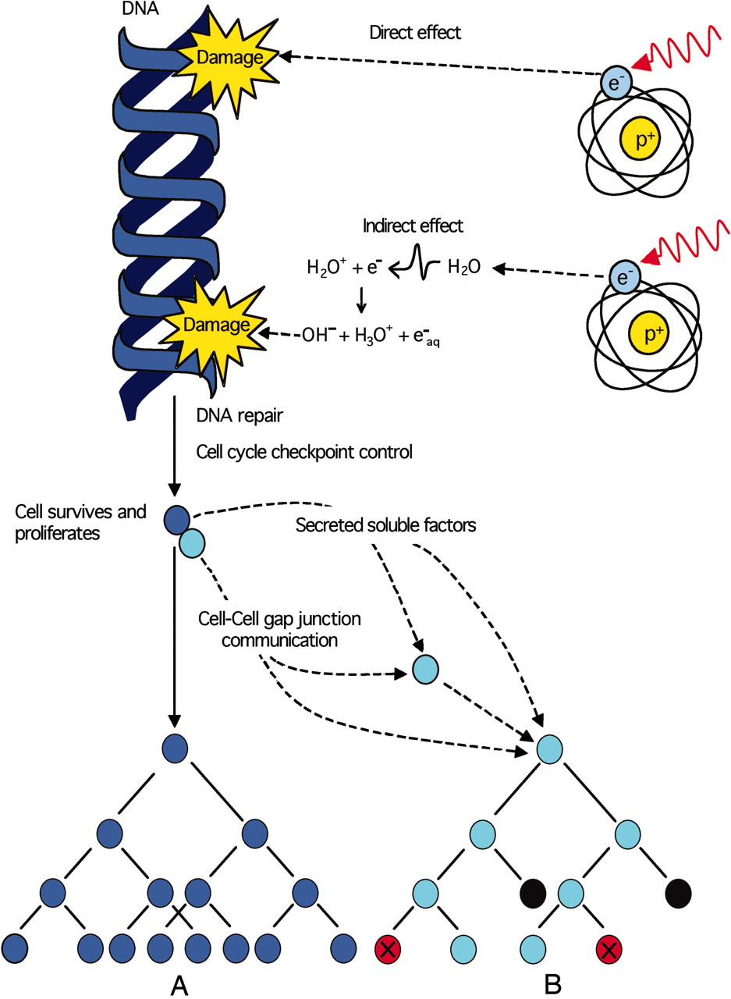
Ionizing radiation induces:
Direct DNA damage
Indirect damage through the radiolysis of water
©2005 by National Academy of Sciences
Notes:
Ionizing radiation induces direct DNA damage and indirect damage through the radiolysis of water. This damage is either eliminated or fixed in the cell as a mutation or chromosomal rearrangement by DNA repair processes. After release by cell cycle checkpoint control mechanisms, an irradiated surviving cell (blue) may proliferate, passing on the legacy of radiation to its progeny (diagram A), potentially initiating the carcinogenic process. The irradiated cell (blue) can also communicate with nonirradiated neighboring cells (cyan) by cell-to-cell gap junction communication and/or secretion of soluble factors eliciting nontargeted apoptosis (black) or micronucleation (red) in cells that have never been exposed to radiation (diagram B).

Slide 13
Sensitivity of Cells
Lymphocytes MOST SENSITIVE
Speratogonia
Hematopoietic (Blood Forming)
Intestinal Epithelium
Skin
Nerve Cells
Muscle Tissue
Bone
Collagen LEAST SENSITIVE

Slide 14
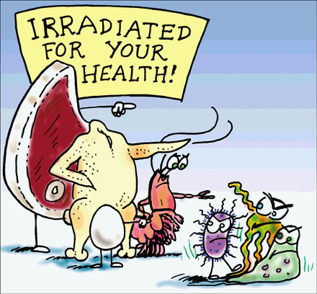
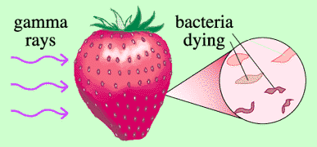
Irradiated Food
Longer shelf life
Less food spoilage
Reduced risk of food-borne illness
Less need for pesticides

Slide 15
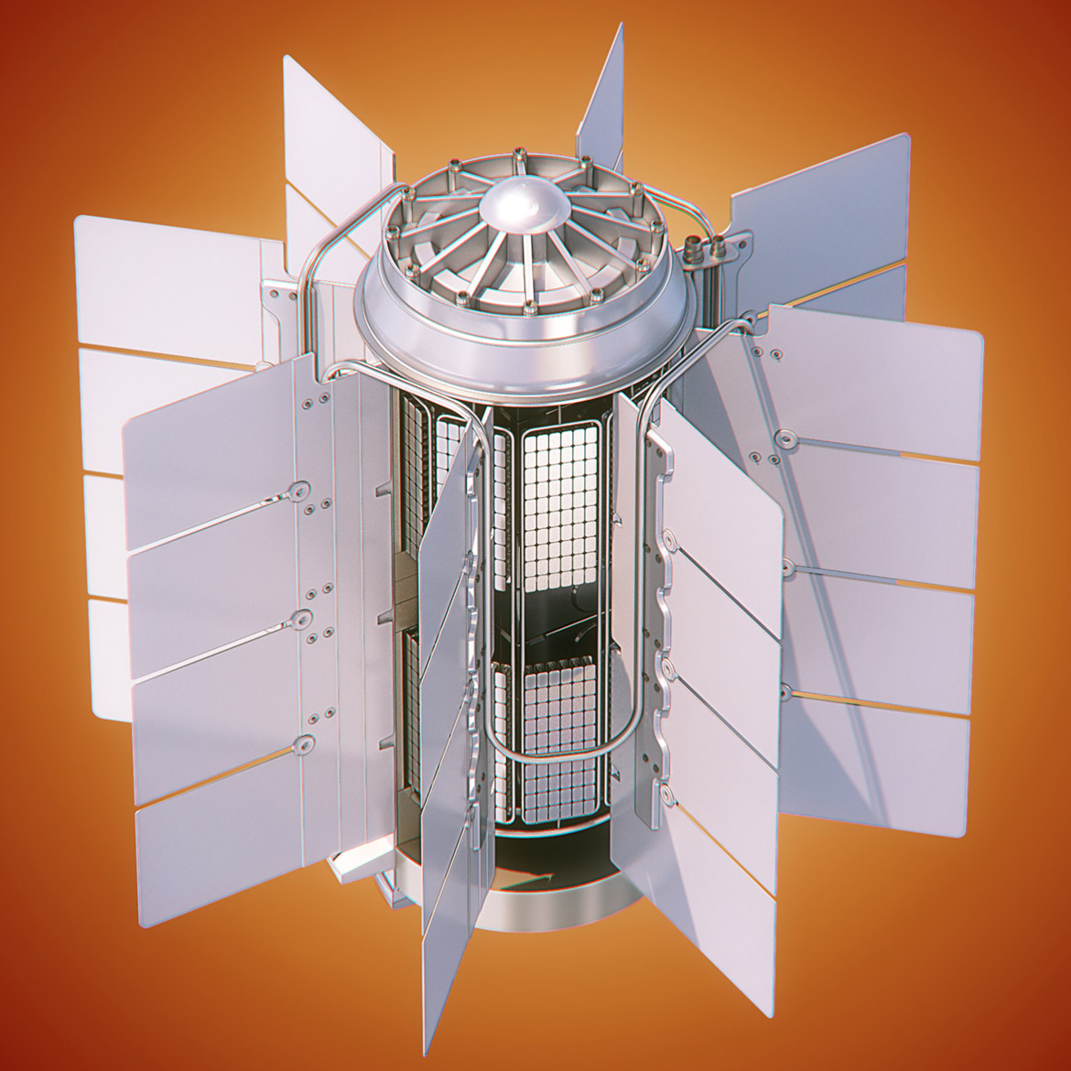
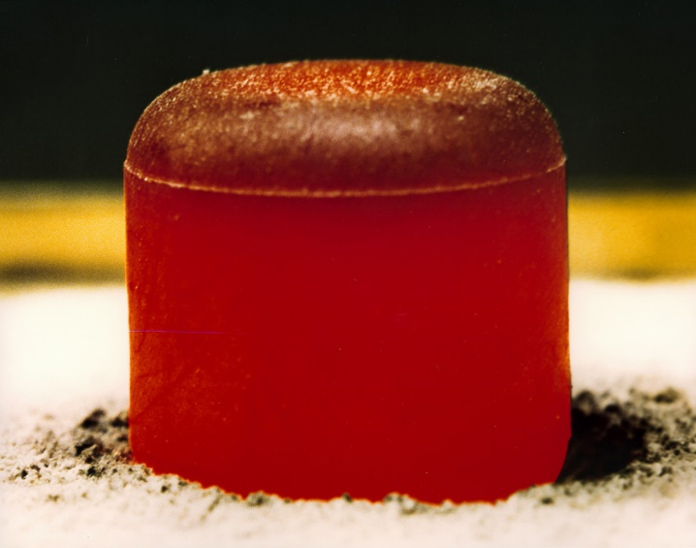
Space
Satellites are powered by “radioisotope thermoelectric generators”
The generators convert heat from the radioactive source into electricity.

Slide 16
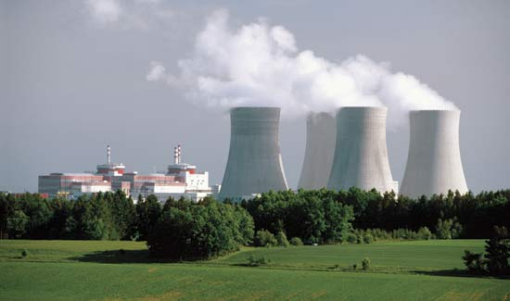
Utilities
Electricity generated by nuclear power plants can offer enough clean energy to power entire cities.

Slide 17
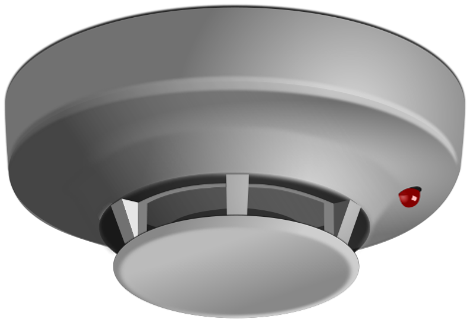
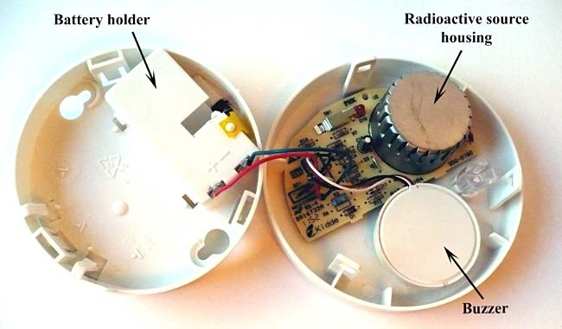
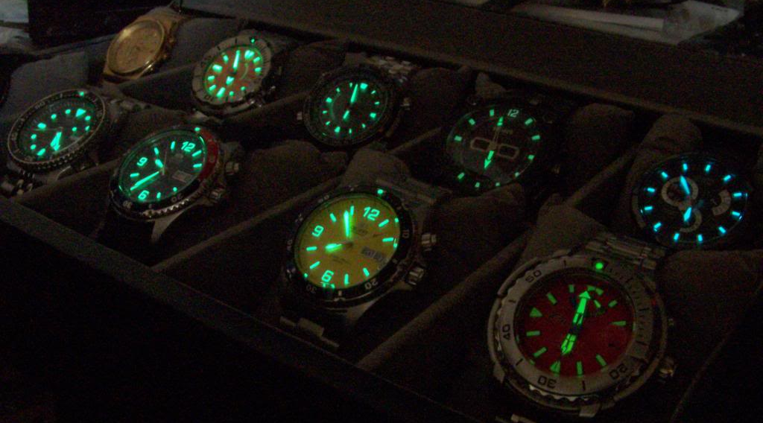
Consumer products
Smoke detectors use α-particles from Americium to detect smoke.
Watches use radium dials that glow in the dark.
Bandages are irradiated for sterilization purposed.

Slide 18
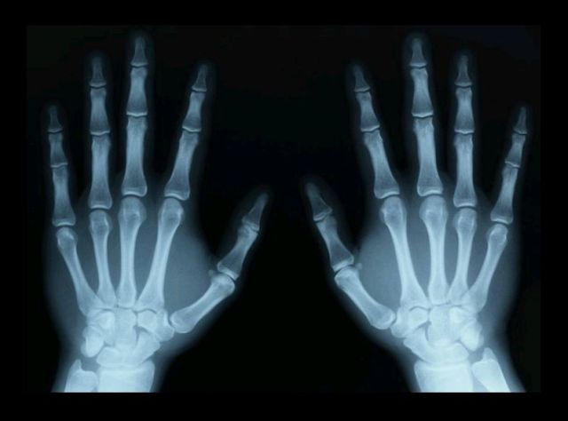
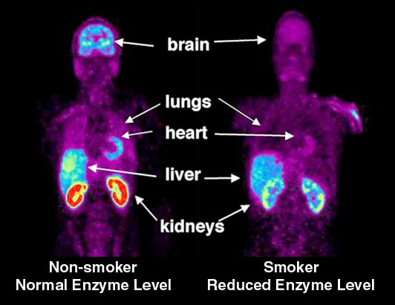
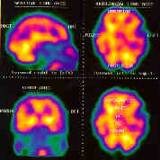
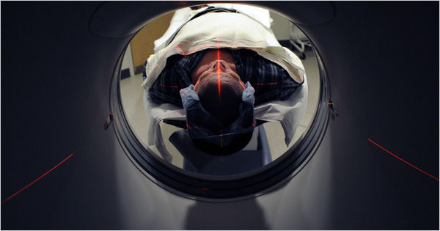
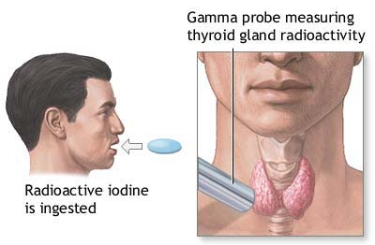
Medical
X-rays have been used for decades.
Radiology
Radioactive Tracers
Nuclear Medicine

Slide 19
Radioactive Contamination
It is not like a spreading contagion (think of a flashlight)
Can be solid, liquid, or gaseous
In solid form can be thought of as dust or dirt

Slide 20
Radioactive
Contamination Types
External
Secondary contamination
Primarily skin
and wounds
Internal
Can be difficult to remove
Ingestion and
Inhalation

Slide 21
Nuclear Decay - Radioactivity
Radioactivity: The spontaneous transformation (“decay”) of unstable nuclei, resulting in a more stable “daughter”, accompanied by emission of ionizing radiation
Radioactive Material: A substance that contains unstable atoms, and therefore emits ionizing radiation
Radioisotope (radionuclide): An unstable, radioactive isotope of an element. Well over 2000 radioisotopes have been identified.
Notes:
Radioactivity is the name we give to the spontaneous transformation of nuclei which exist in an unstable configuration. Radioactive material is simply anything that exhibits the characteristic of radioactivity (and radioactive materials are everywhere in various quantities). Isotopes are nuclei of the same element (same proton number) but different mass numbers (more or less neutrons). A radionuclide is a specific unstable isotope of a given element, for example, Co-60. What is it that makes nuclei unstable? Nuclear matter is only stable in certain combinations of neutrons and protons. A stable nucleus will always be stable (in the absence of enough energy being applied to disrupt the nucleus), for example, a combination like 6 protons and 6 neutrons (C-12). But the seemingly minor change of one neutron makes for instability. So 6 protons and 5 neutrons (C-11) is an unstable nucleus or radioisotope.

Slide 22
Manure Analogy

Slide 23
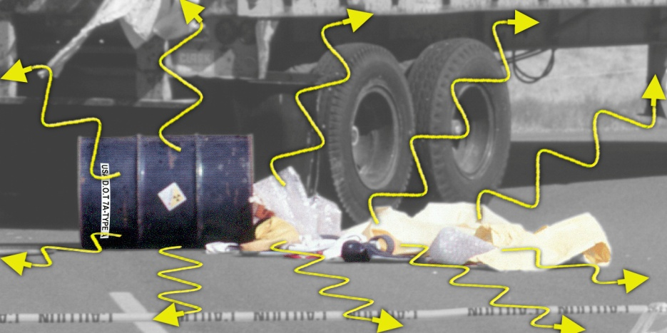
Exposure
Radiation = Energy Contamination = Material
Radioactive contamination emits radiation
Exposure to radiation will NOT contaminate you

Slide 24
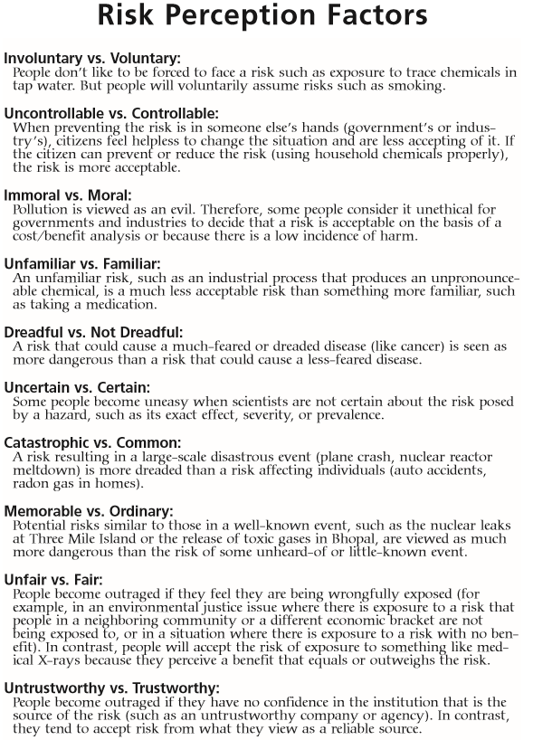

Slide 25
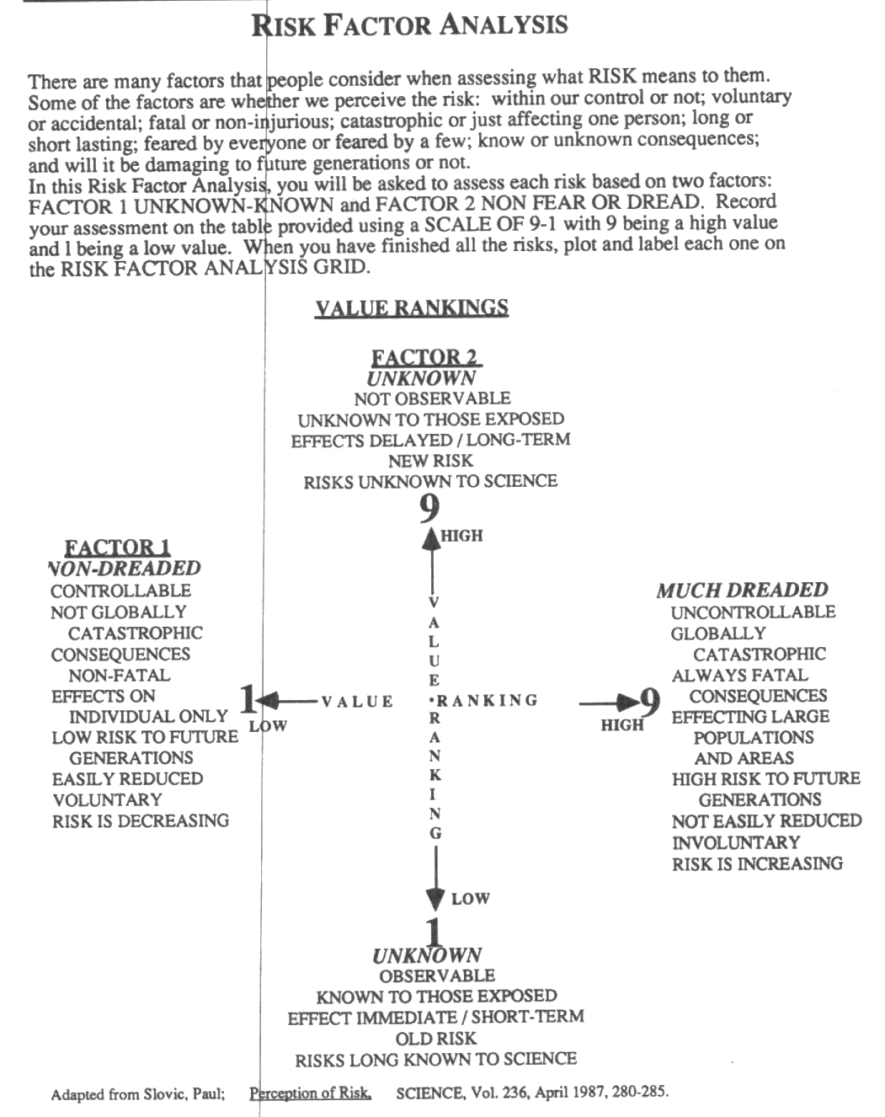
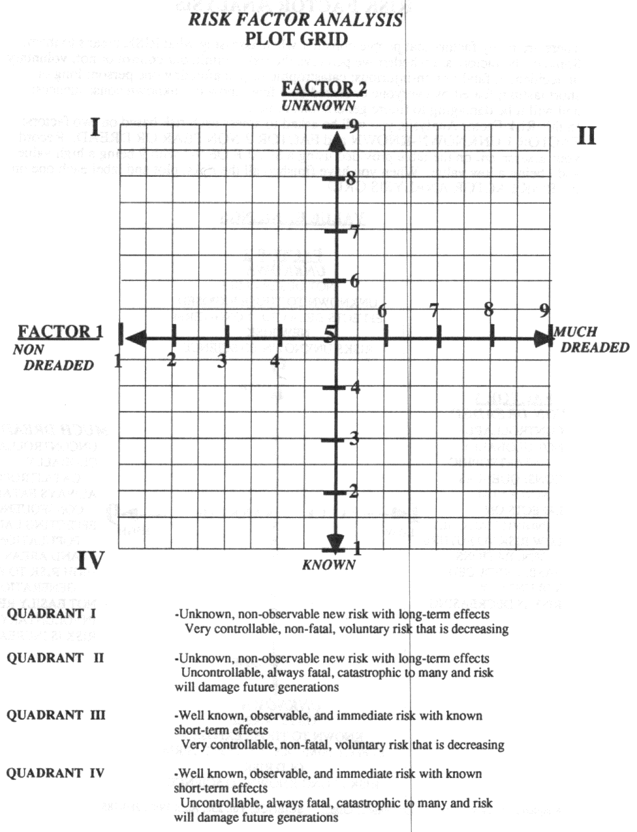

Slide 26
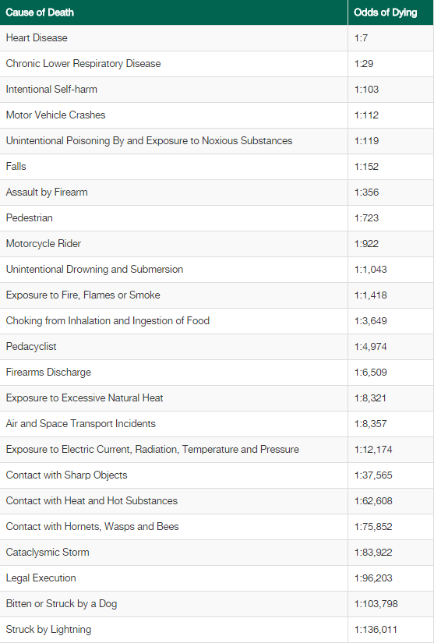
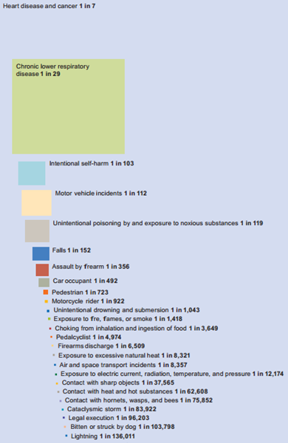
Top 30 causes

Slide 28
Relative Risk: Equivalencies to 1 mrem
Crossing a street 5 times
A few puffs on one cigarette
Being 0.0007 ounce overweight
Driving 5 miles
Getting out of bed every morning for a year
3 minutes of living if you are 65 years old
Using a bathtub for a few months

Slide 29
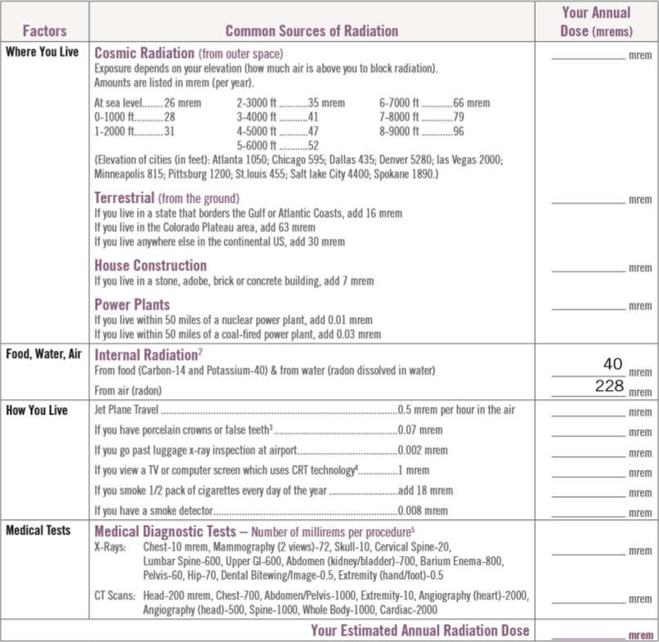
Personal Dose Chart

Slide 30
Human Experience: Ionizing Radiation
Lethal
w.b.
Thyroid
Treatment
Malignant Tissue Treatment
(5 - 6 weeks)
Accident
(whole body - w.b.)
> 0.0
1000
5000
10,000 rem
DNA modifying rate
equivalent to normally
occurring rate
mouse experiment
(yearly)
Lethal
w.b.
> 0.0
100
500
1000 rem
U.S. Radworker limit thru
mid-fifties w.b. (yearly)
U.S. Radworker
limit thru WWII
w.b. (yearly)
Ramsar,
Iran
w.b. (yearly)
Soviet
Radworker limit
w.b. (yearly)
Guarapari, Brazil
(yearly)
> 0.0
10
50
100 rem
Monazite
Sands,
India
w.b. (yearly)
Full Mouth
(18 film)
x-ray
exam
Shuttle
Mission
w.b.
X-ray
lower
spine
U.S.
Radworker limit
w.b. (yearly)
Skylab
Mission
w.b. (90 days)
> 0.0
1
5
10 rem
natural
background
w.b. (yearly)
CT
Scan
(center
line)
medical
chest
x-ray
mouse
experiment
(daily)
medical x-ray
technician
w.b. (yearly)
antique
(per hour)
Airline Pilot
w.b. (yearly)
0.000002
0.1
0.5
1 rem

Slide 31
Human Experience: Ionizing Radiation
Lethal
w.b.
Thyroid
Treatment
Malignant Tissue Treatment
(5 - 6 weeks)
Accident
(whole body - w.b.)
> 0.0
1000
5000
10,000 $
DNA modifying rate
equivalent to normally
occurring rate
mouse experiment
(yearly)
Lethal
w.b.
> 0.0
100
500
1000 $
U.S. Radworker limit thru
mid-fifties w.b. (yearly)
U.S. Radworker
limit thru WWII
w.b. (yearly)
Ramsar,
Iran
w.b. (yearly)
Soviet
Radworker limit
w.b. (yearly)
Guarapari, Brazil
(yearly)
> 0.0
10
50
100 $
Monazite
Sands,
India
w.b. (yearly)
Full Mouth
(18 film)
x-ray
exam
Shuttle
Mission
w.b.
X-ray
lower
spine
U.S.
Radworker limit
w.b. (yearly)
Skylab
Mission
w.b. (90 days)
> 0.0
1
5
10 $
natural
background
w.b. (yearly)
CT
Scan
(center
line)
medical
chest
x-ray
mouse
experiment
(daily)
medical x-ray
technician
w.b. (yearly)
antique
(per hour)
Airline Pilot
w.b. (yearly)
0.000002
0.10
0.50
1 $

Slide 32
Radiation Reduction
Guiding principle: ALARA (as low as reasonably achievable)
Restrict Proximity TIME
Increase the DISTANCE from the Source
Use SHIELDING Material

Slide 33
As Gandhi so eloquently put it,
“The enemy is fear. We think it is hate; but, it is fear”.

Slide 34
The End . . .
Dr. Debra N Thrall
Executive Director
AIP Foundation
505-883-3114
dthrall@nmsu.edu

