Slide 1
Reactions Welcome!

Slide 2
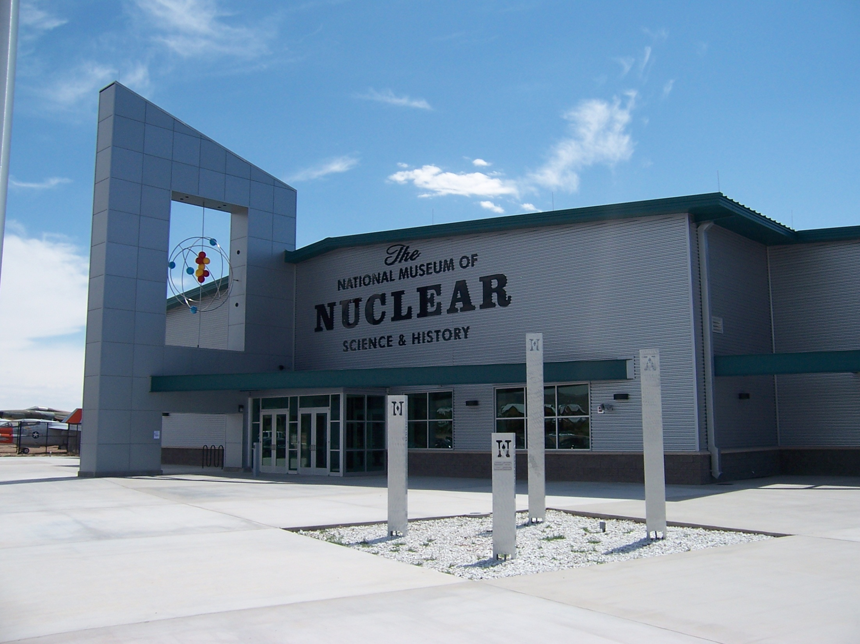
The National Museum of Nuclear Science & History

Slide 3
Mission Statement
The National Museum of Nuclear Science & History’s mission is to serve as America’s resource for nuclear history and science, presenting exhibits and quality educational programs that convey the diversity of individuals and events that shape the historical and technical context of the nuclear age.

Slide 4
Background & Organization History
The only national museum in the state of New Mexico
The only nuclear science museum chartered by the U.S. Congress
The Museum was established in 1969, chartered by Congress as a NATIONAL institution in 1991, and has been Affiliated with the Smithsonian Institution since 2002.

Slide 5
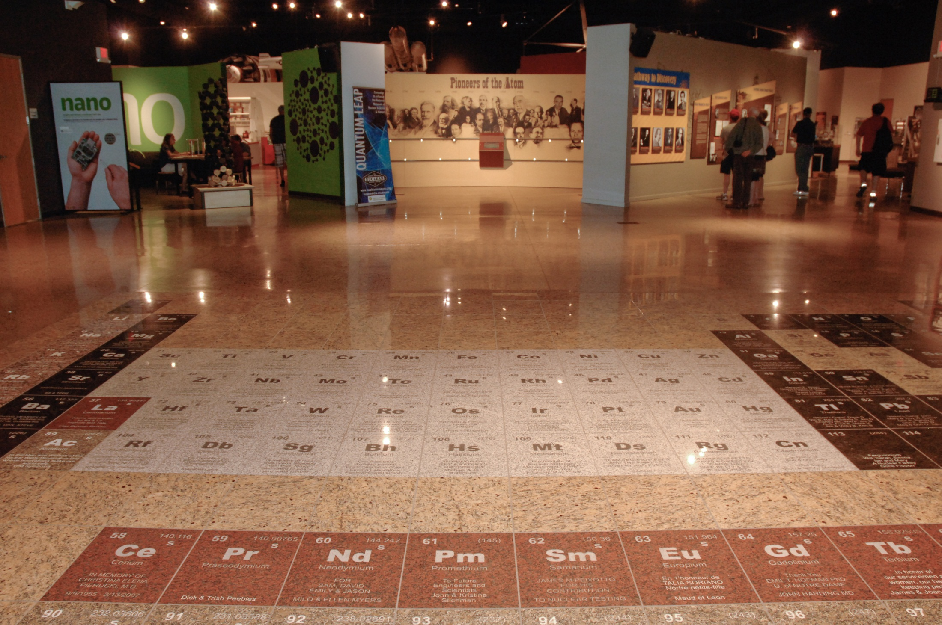

Slide 6
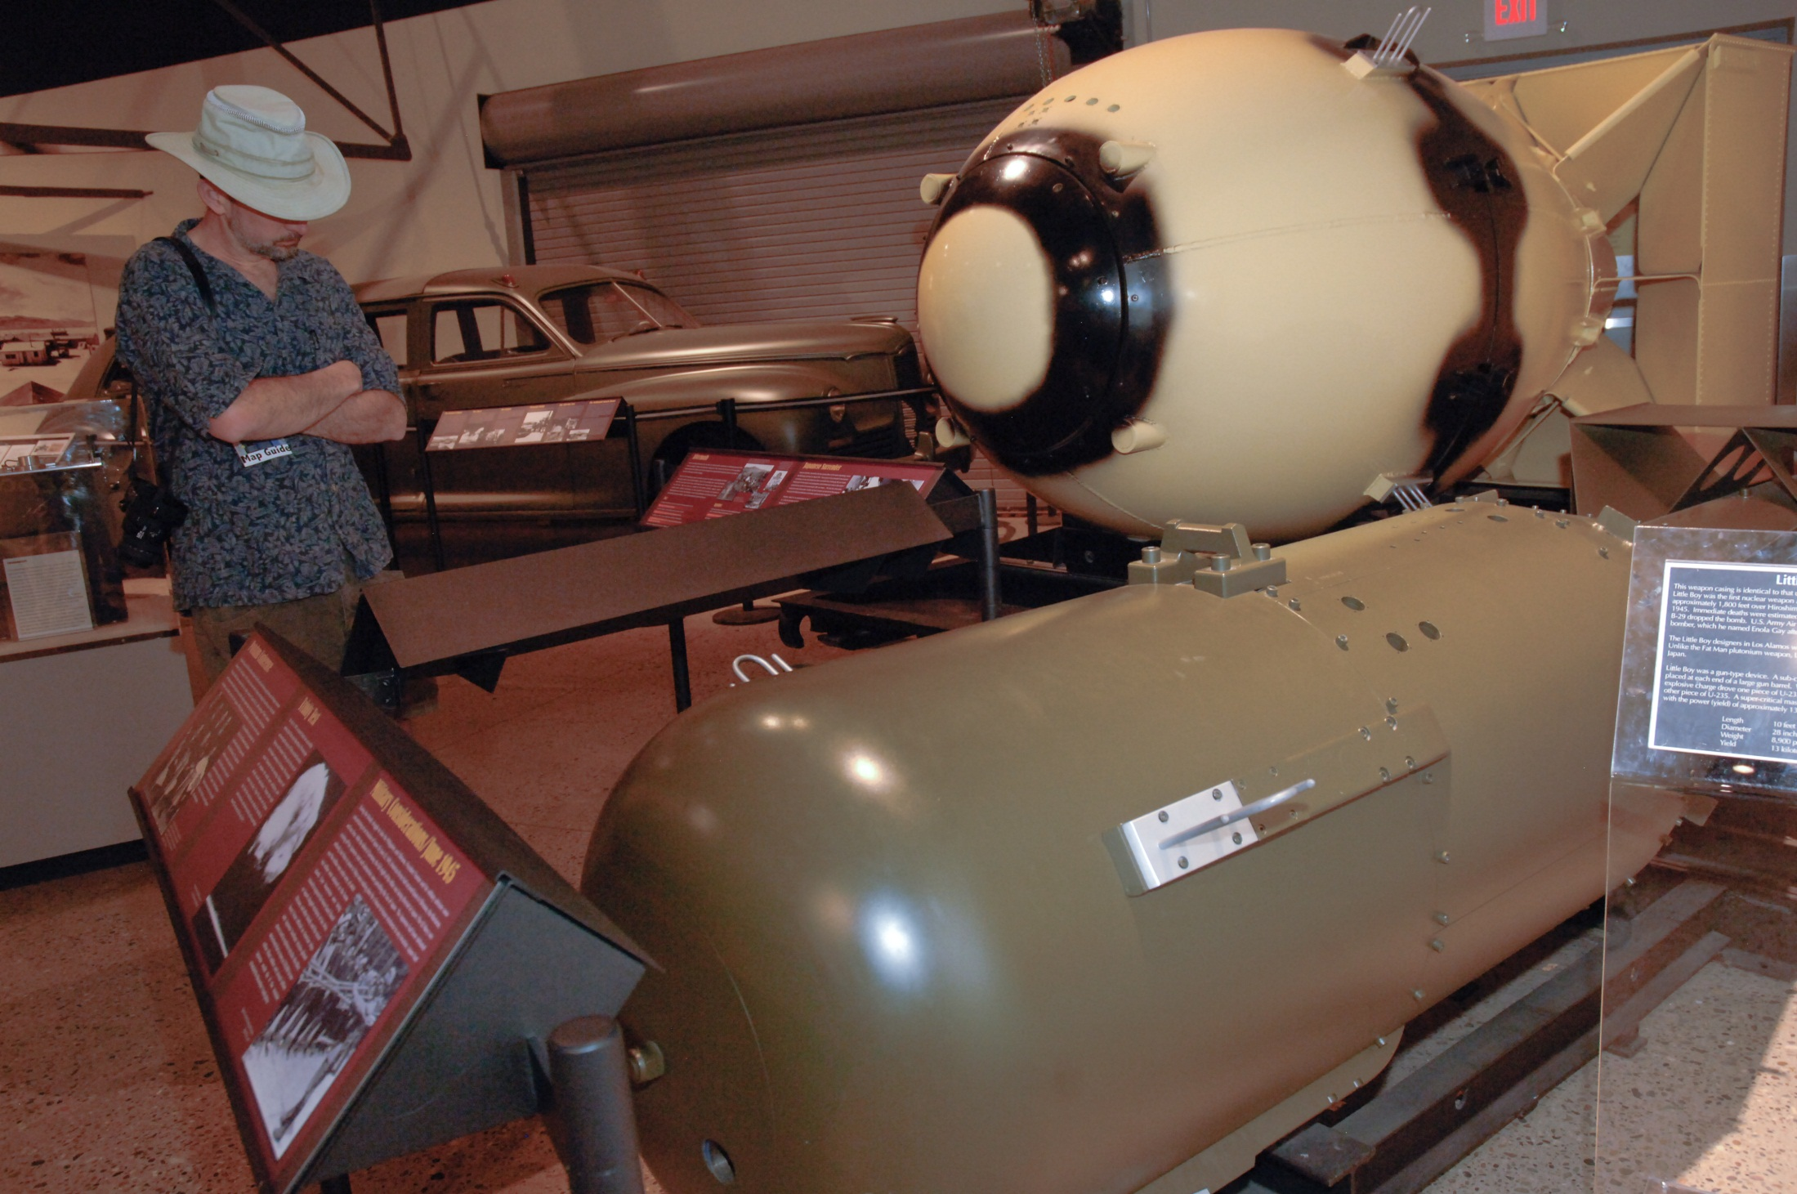

Slide 7
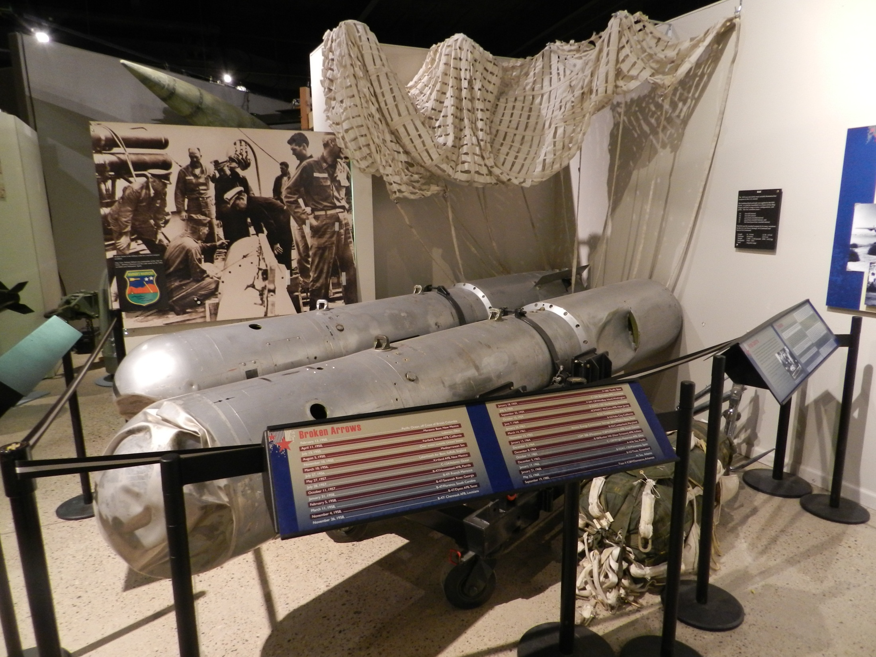

Slide 8
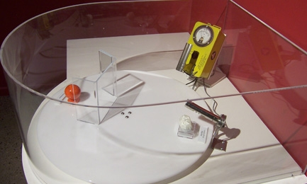

Slide 9
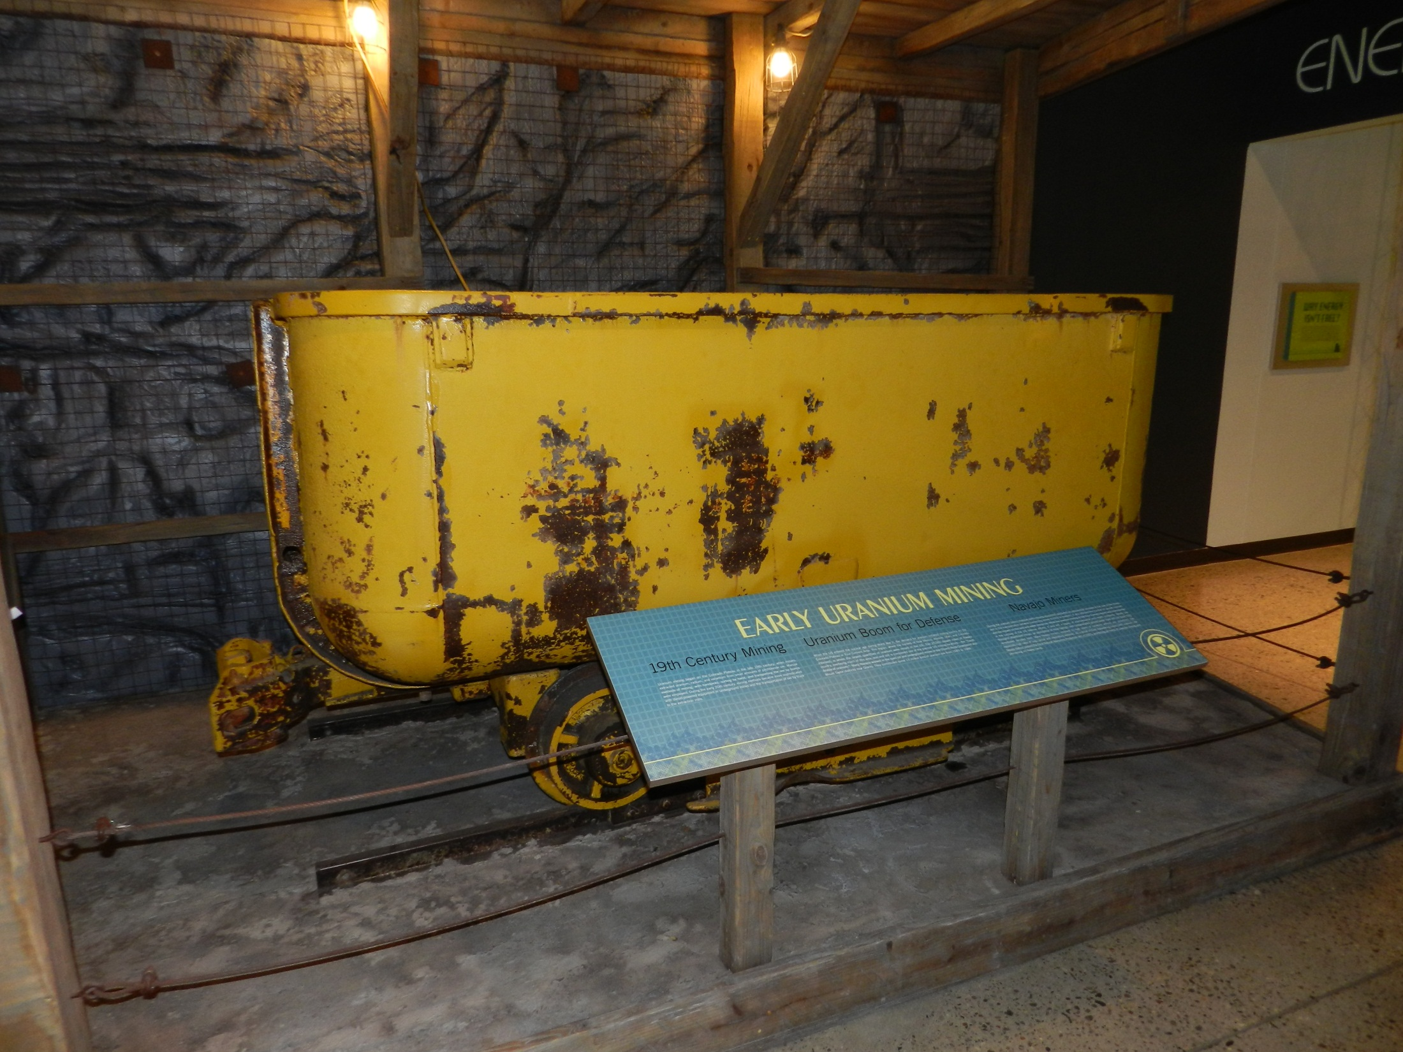

Slide 10
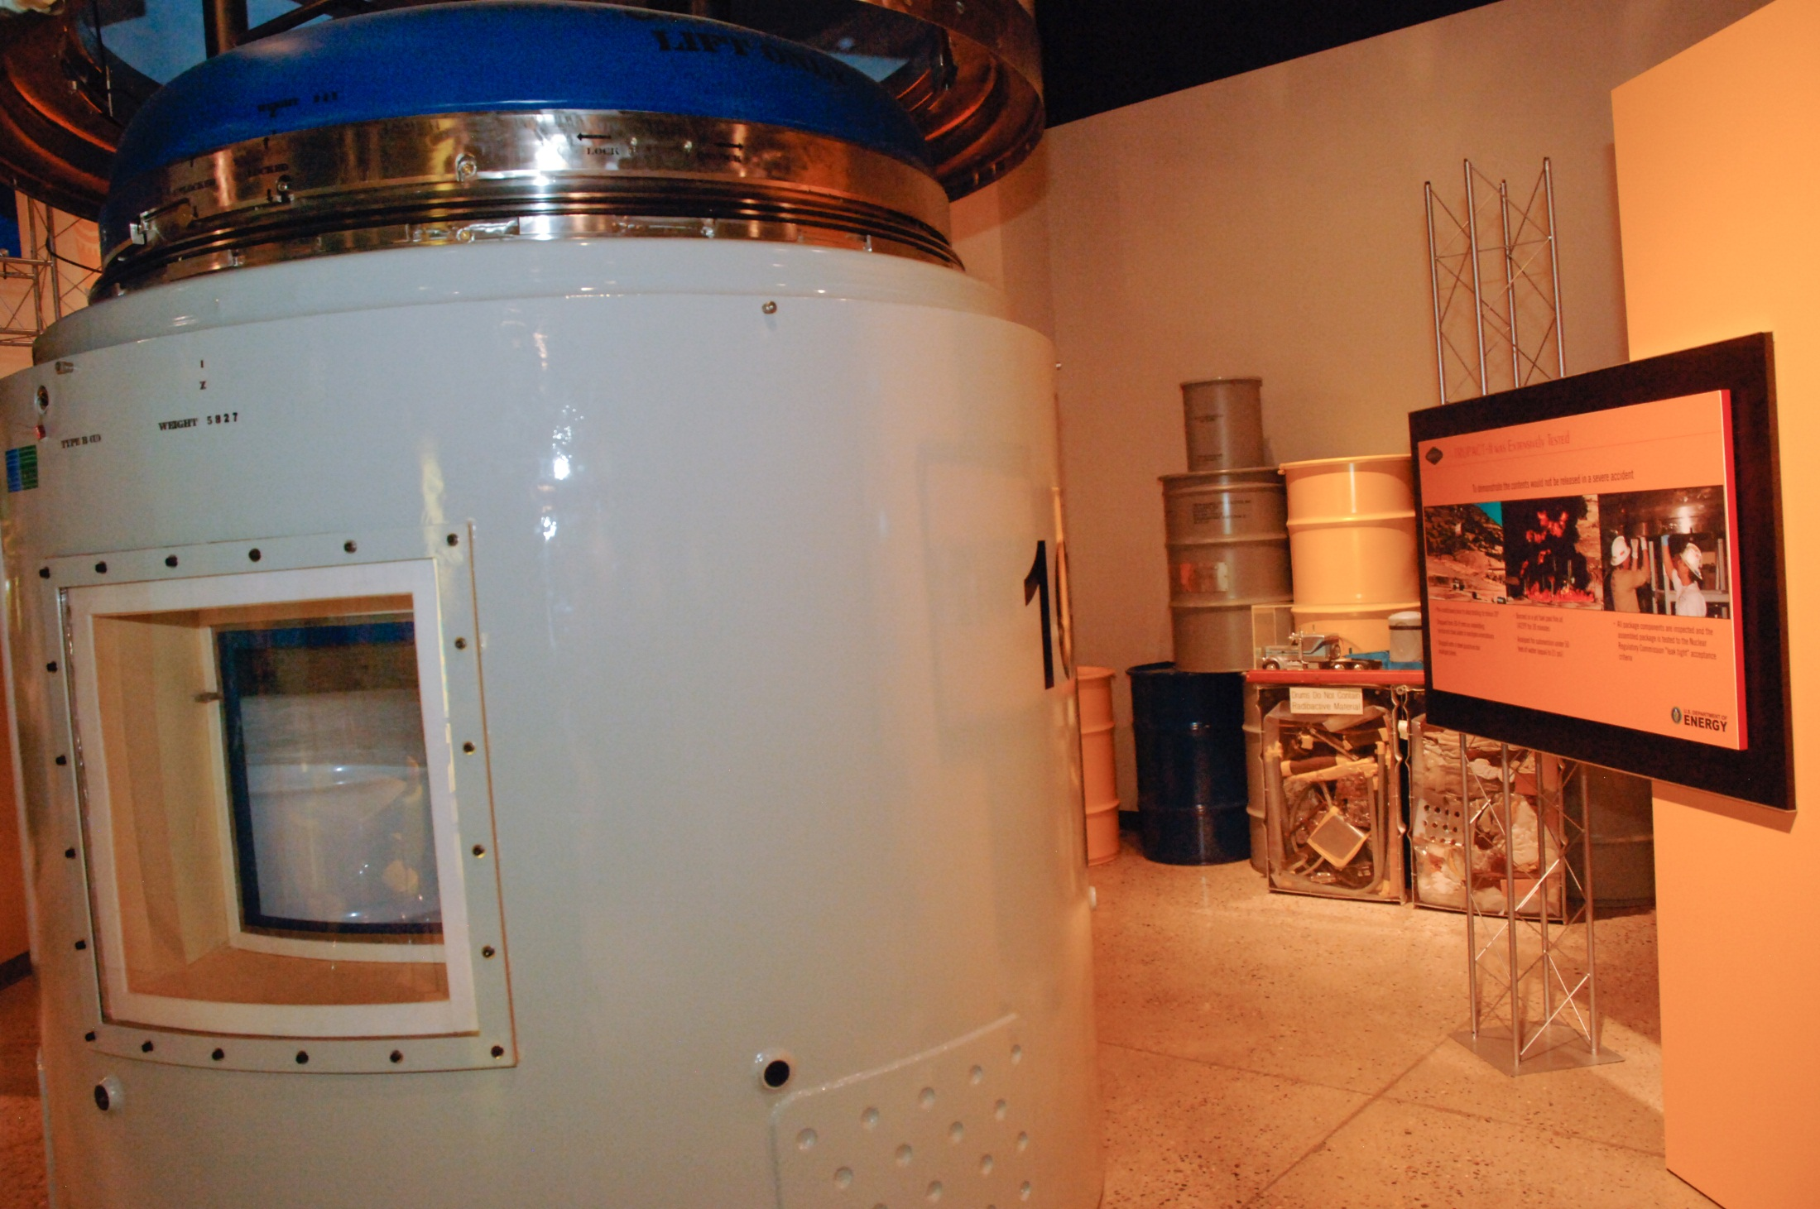

Slide 12
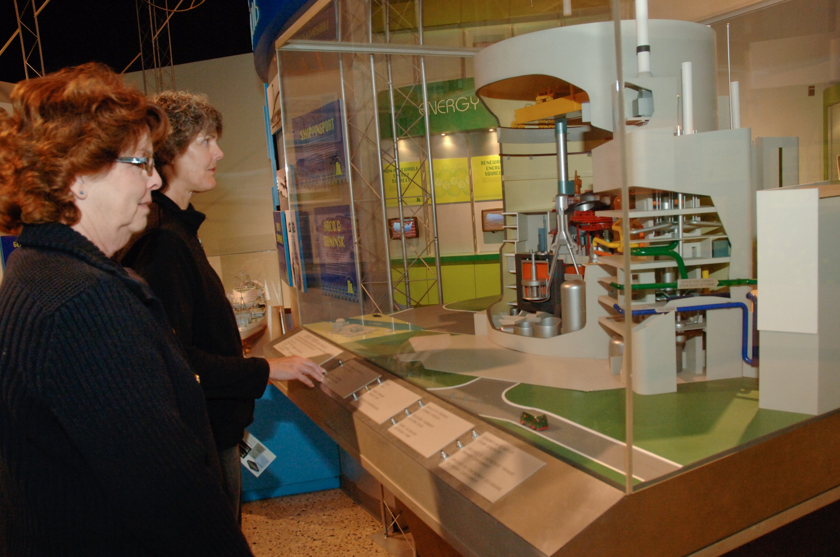

Slide 13
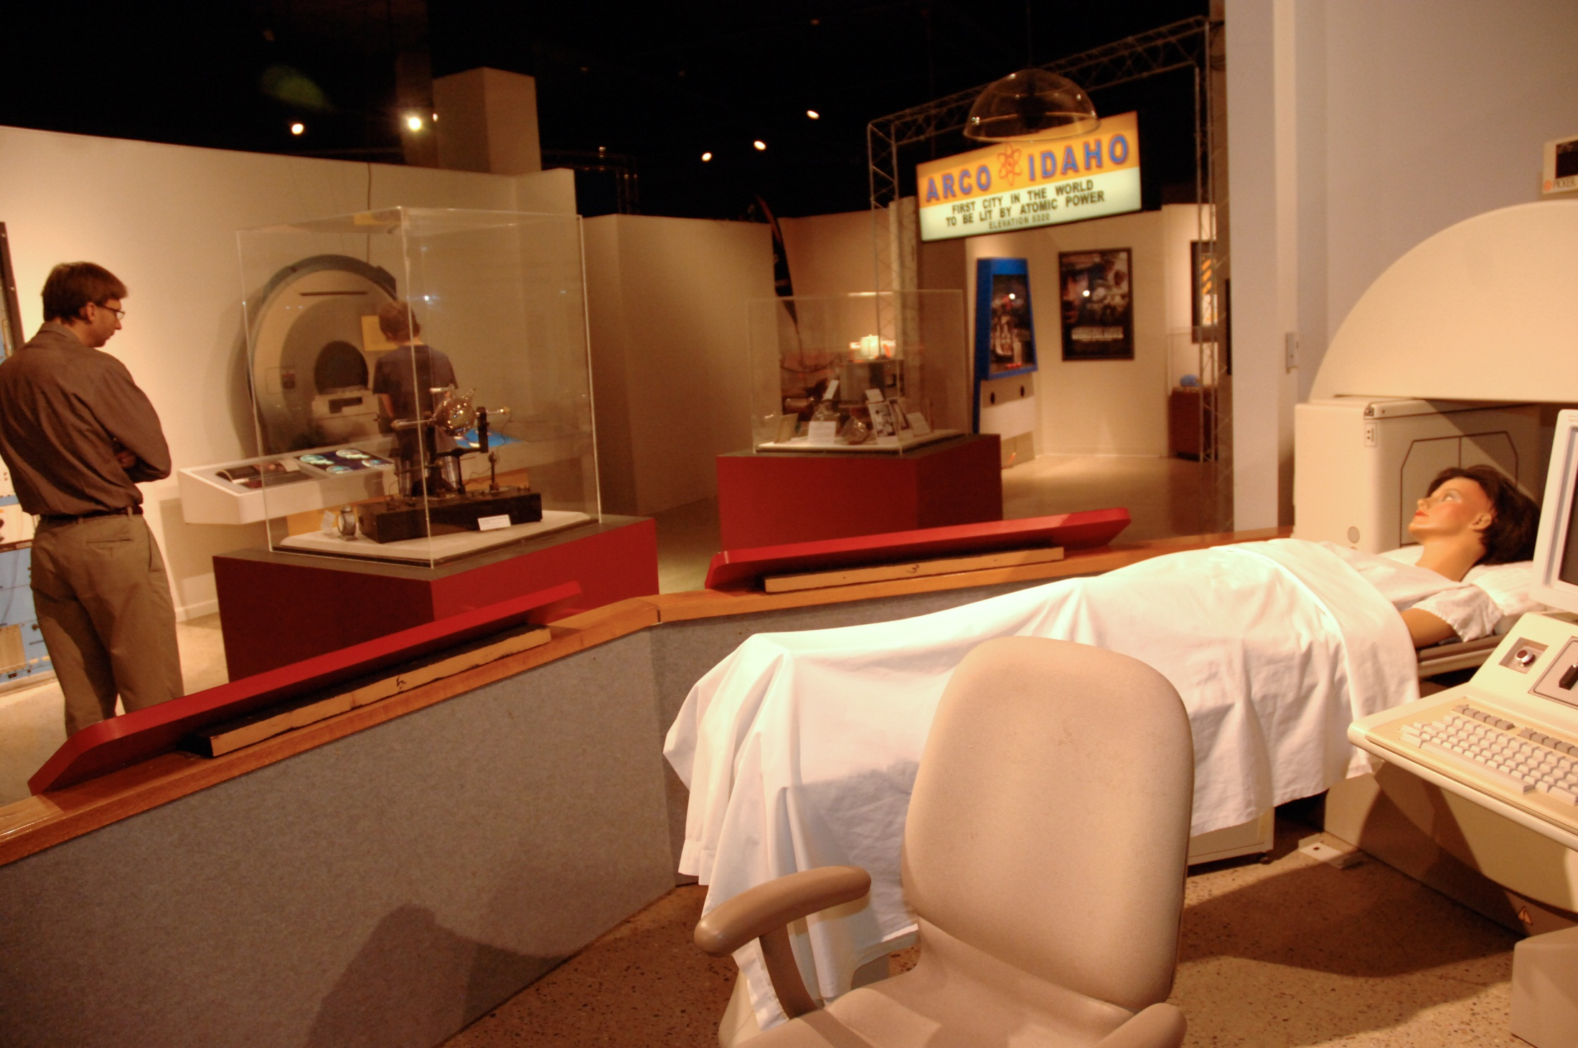

Slide 14
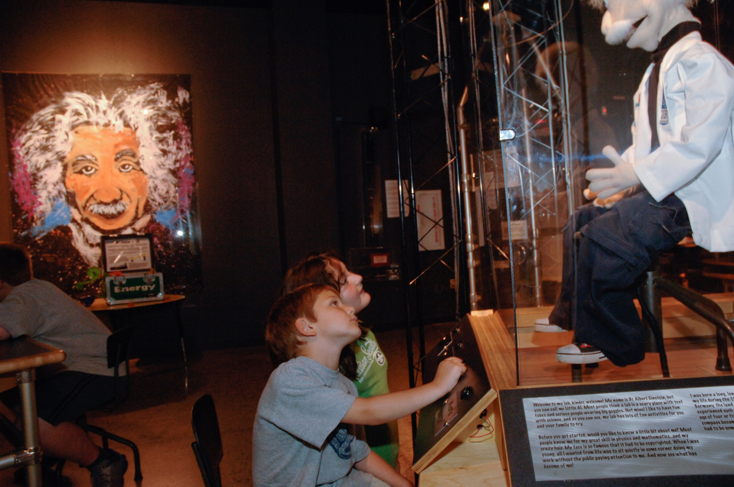

Slide 15
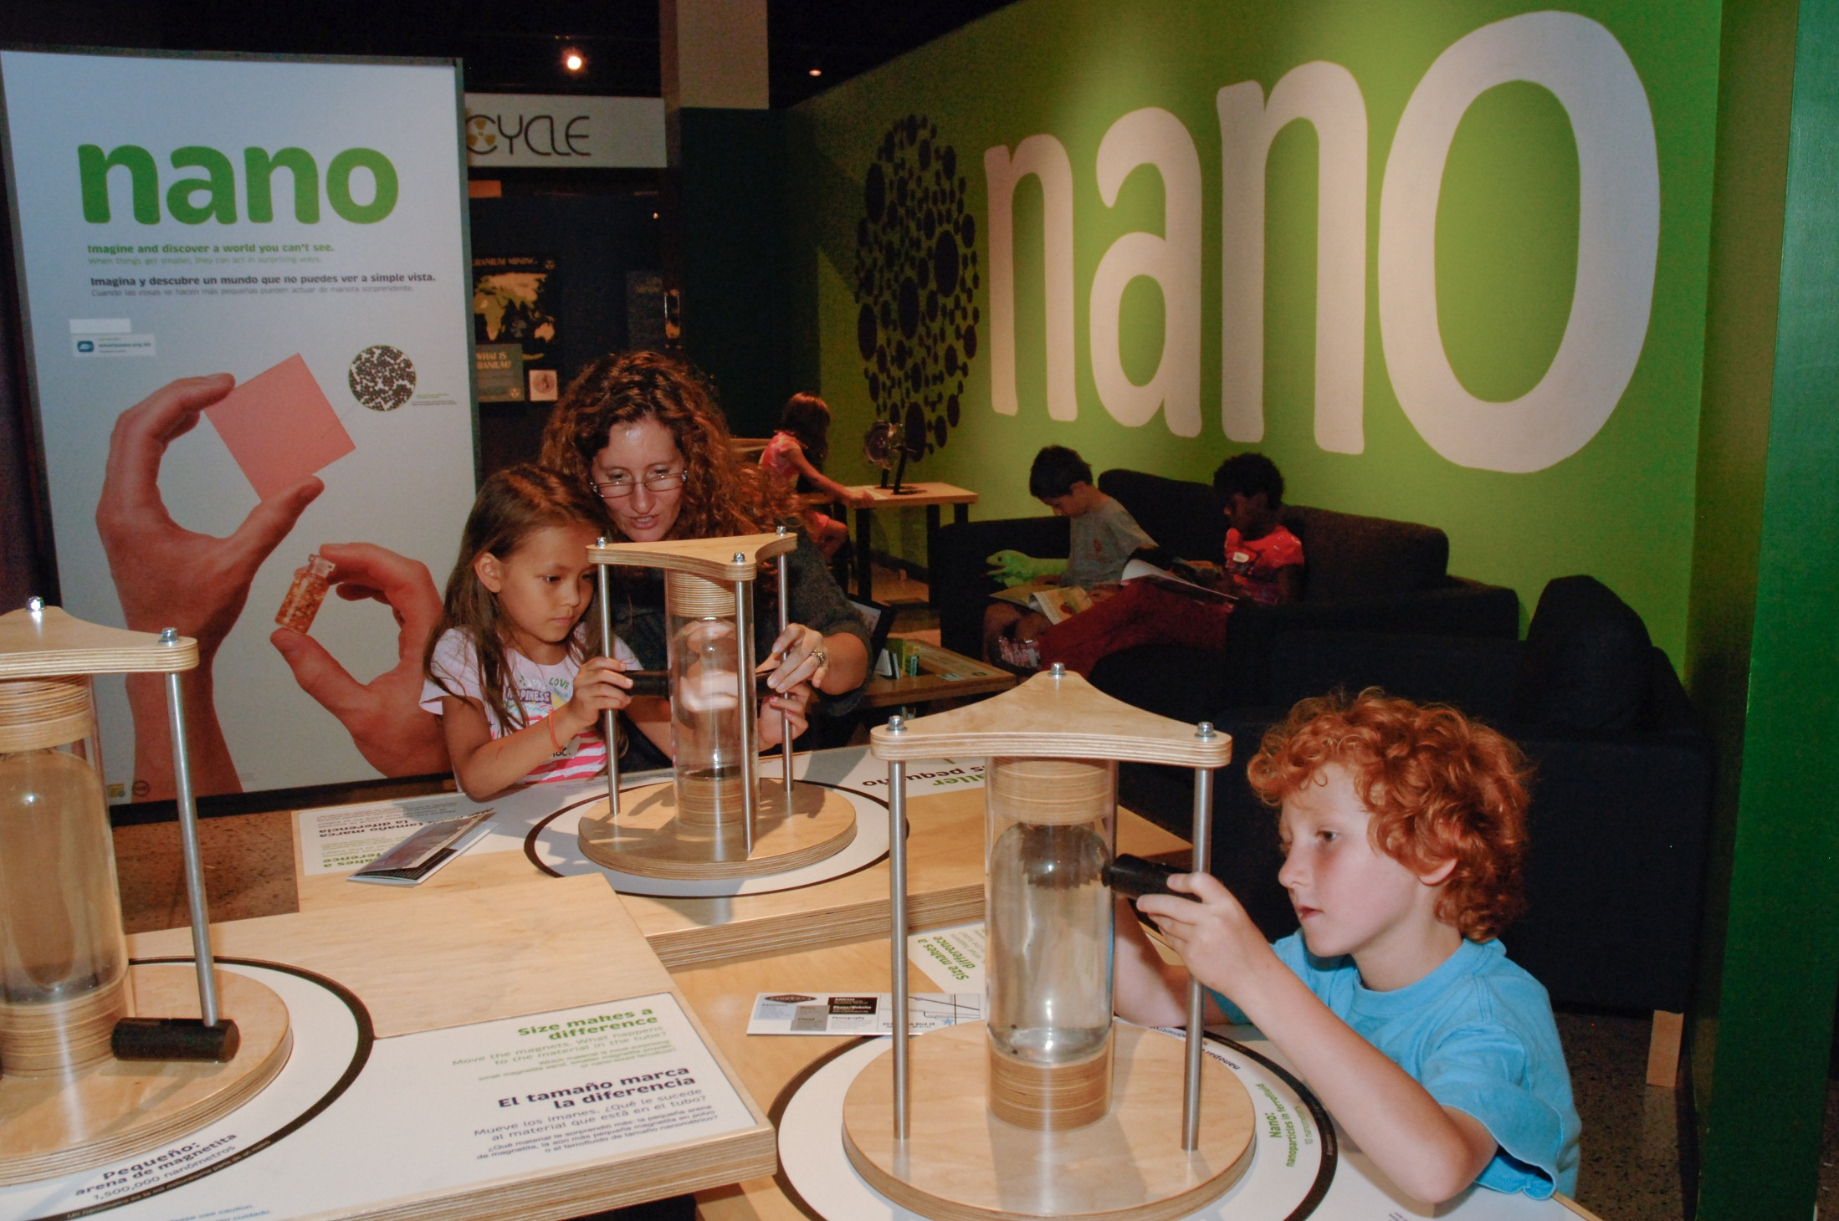

Slide 16
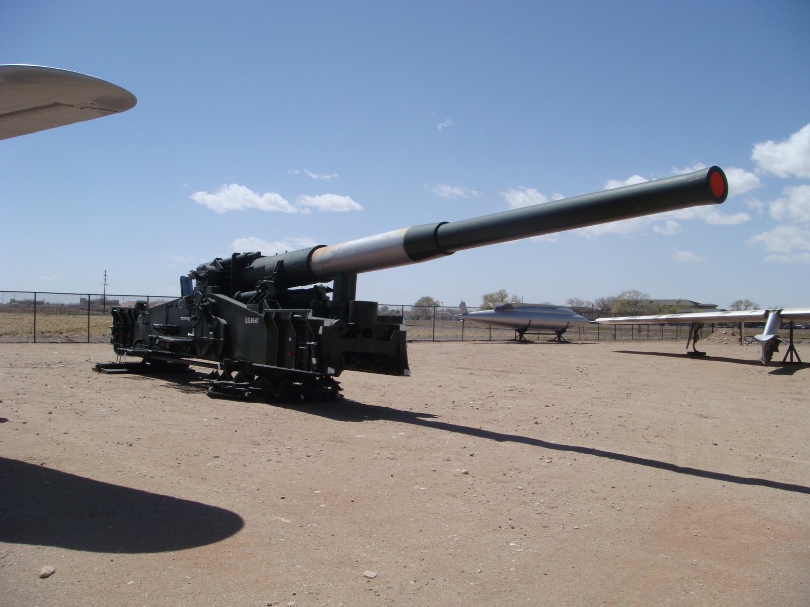

Slide 17
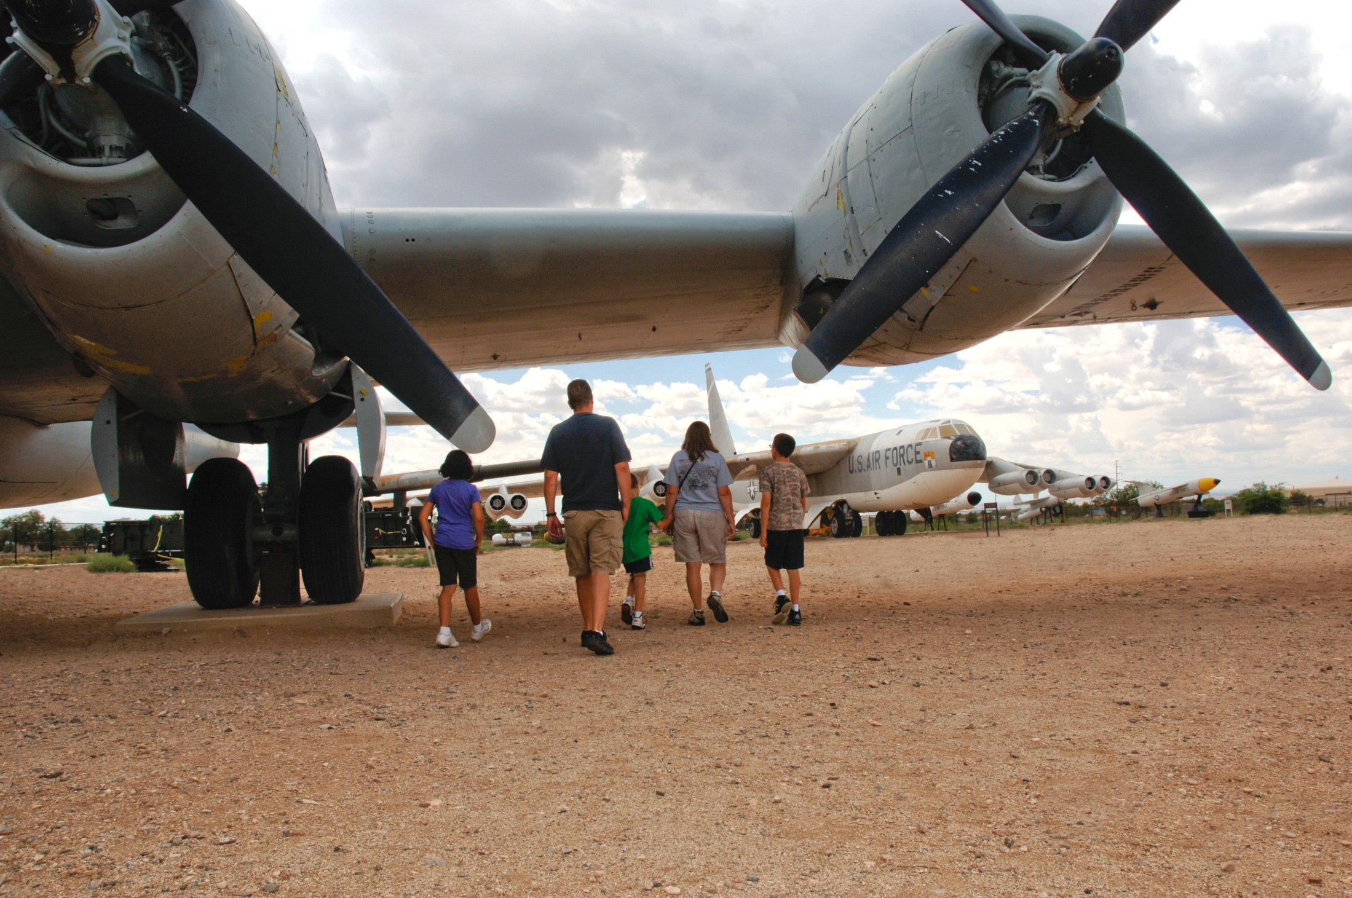

Slide 18
“Quality educational programs that convey the diversity of individuals and events that shape the historical and technical context of the nuclear age.” www.nuclearmuseum.org

Slide 20
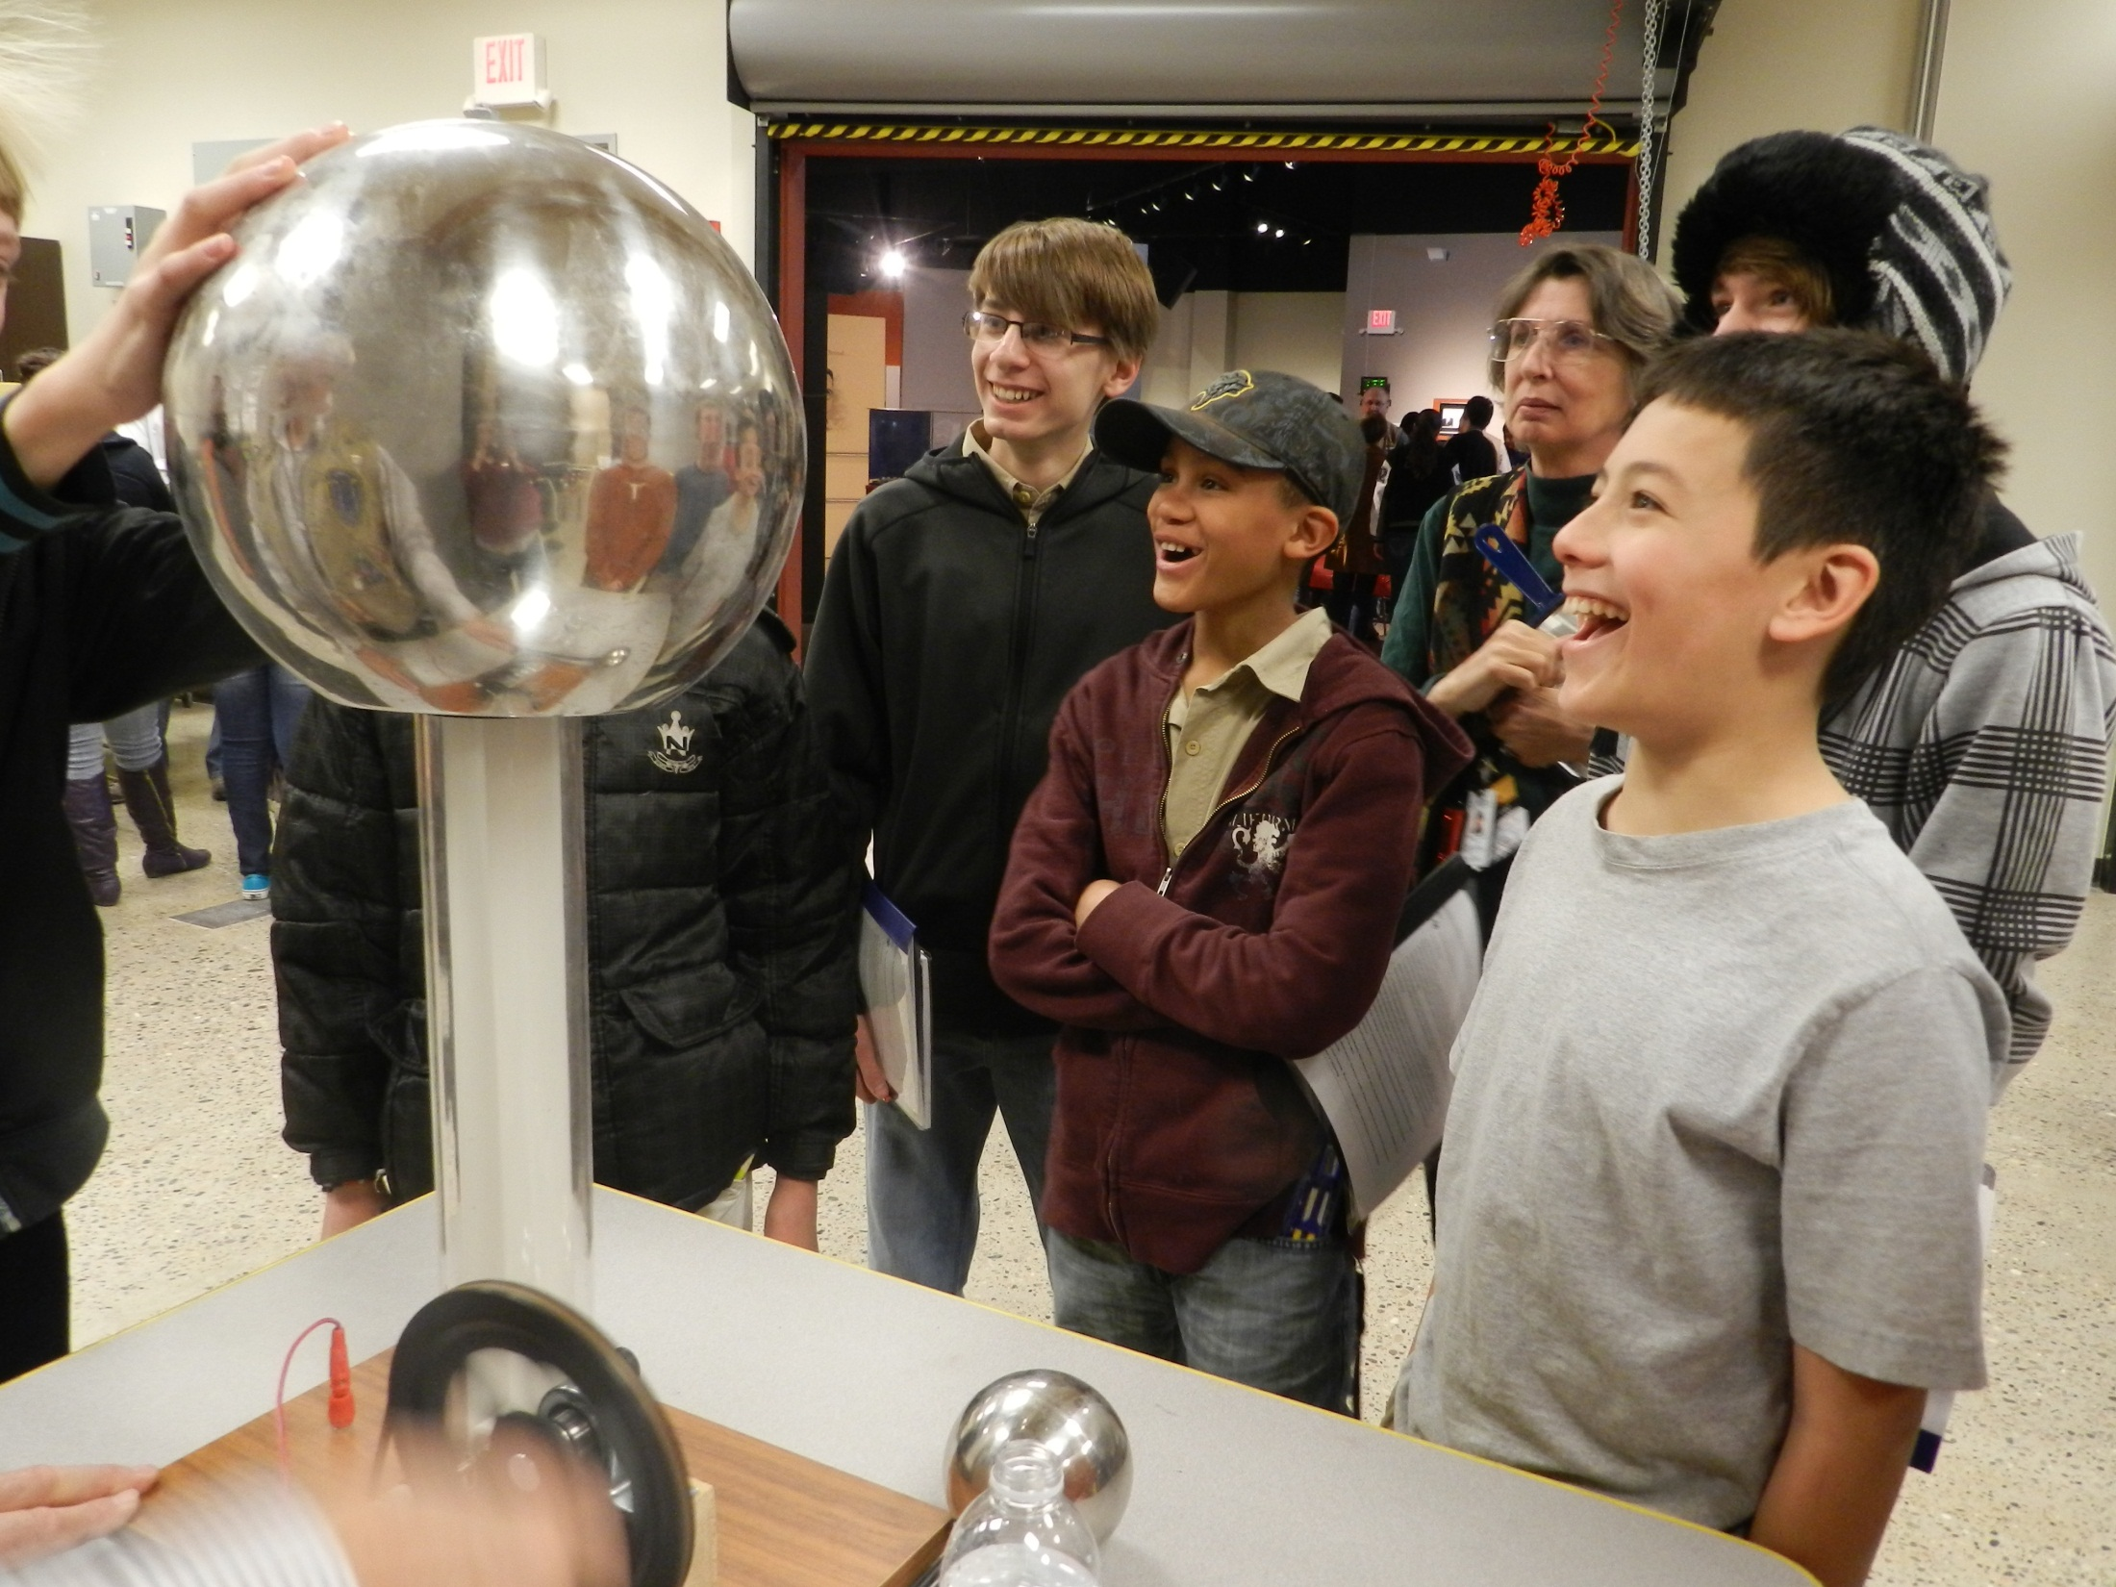

Slide 21
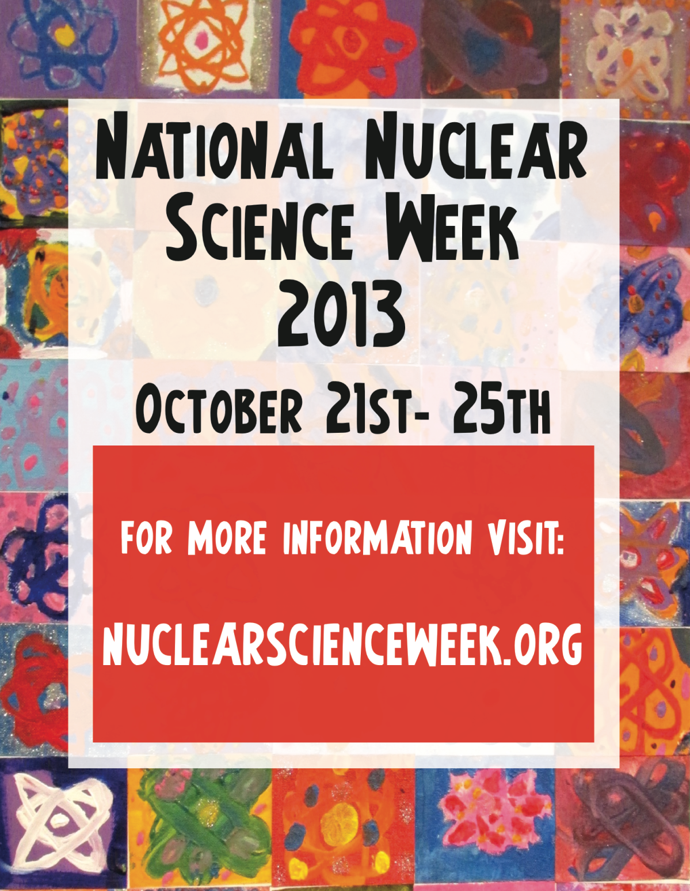

Slide 22
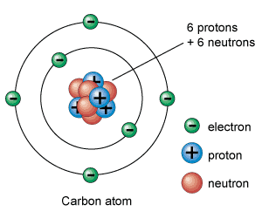
Monday: Get to Know Nuclear

Slide 23
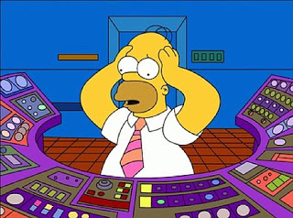
Tuesday: Careers in the Nuclear Field

Slide 24
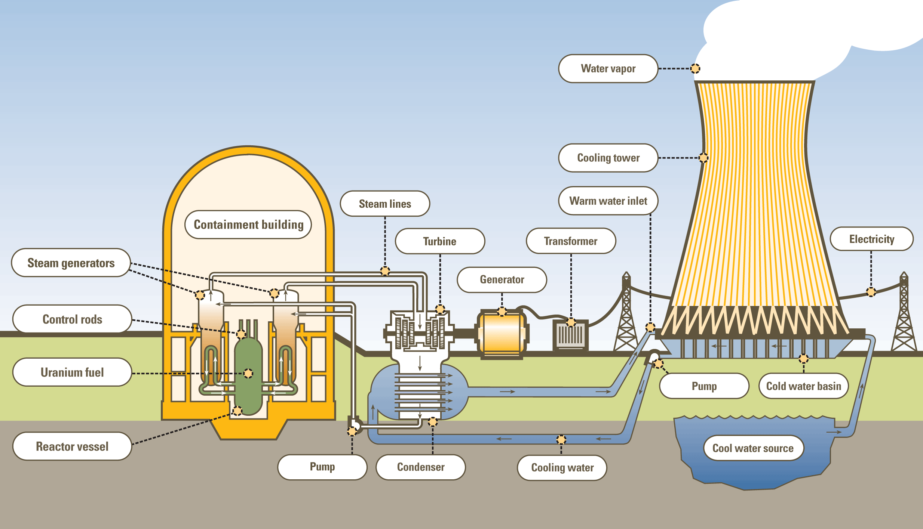
Wednesday: Nuclear Energy Generation

Slide 25
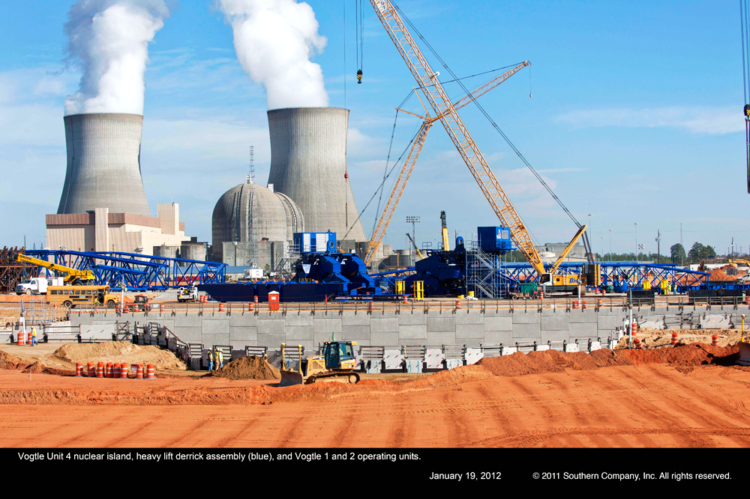
The Nuclear Renaissance
Plant Vogtle near Waynesboro, GA

Slide 26
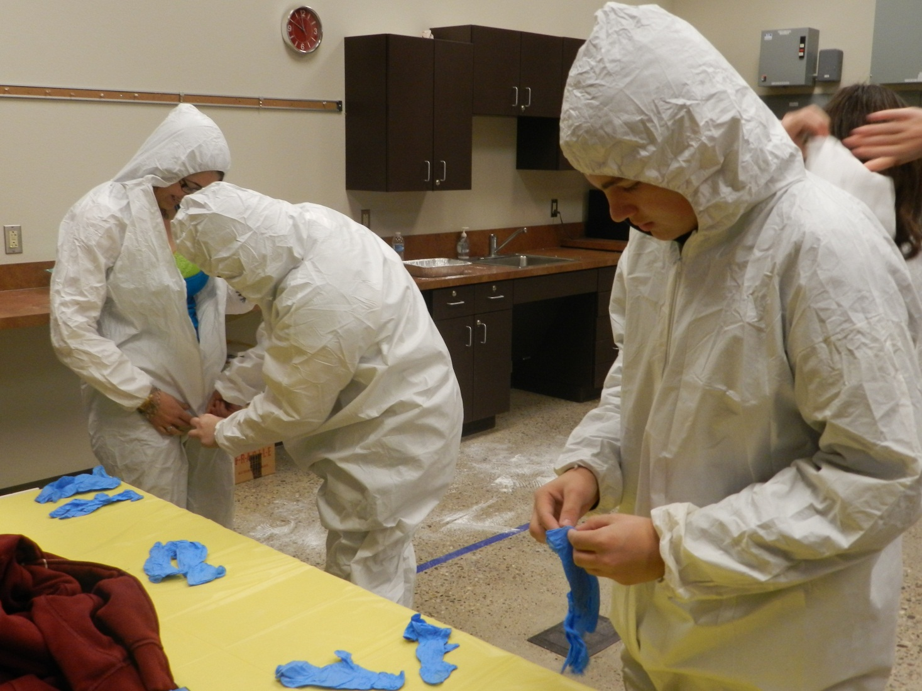
Thursday: Nuclear Safety

Slide 27
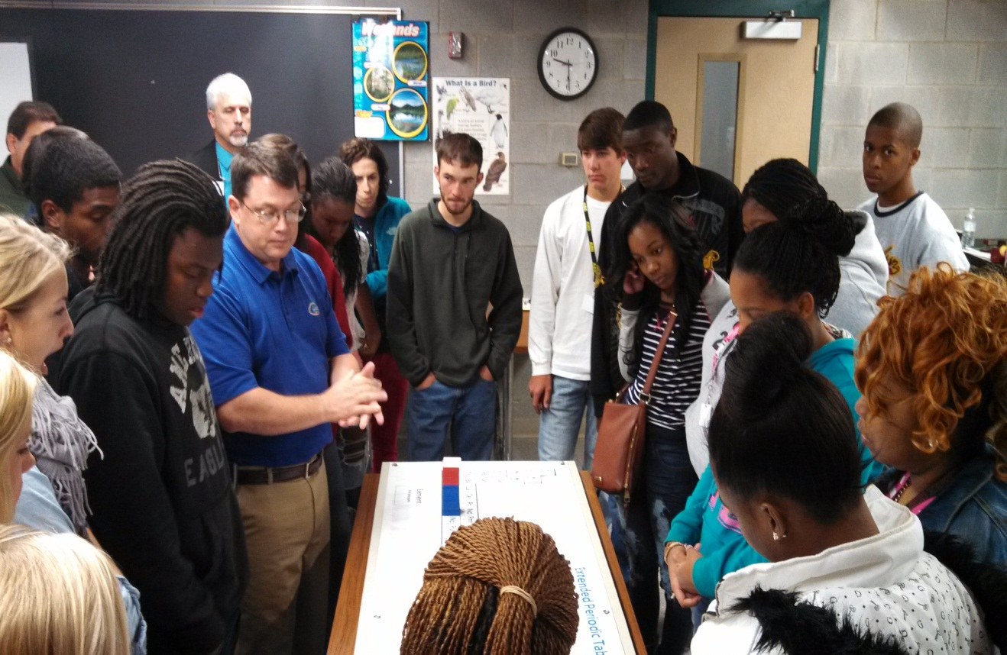
Students take a “Journey to the Center of the Atom” at the Ruth Patrick Science Center (Aiken, SC) as part National Nuclear Science Week.

Slide 28
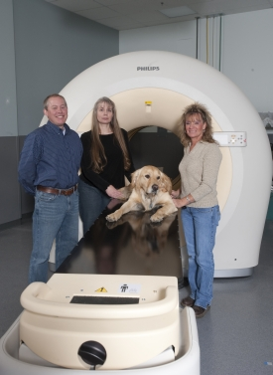
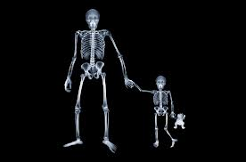
Friday: Nuclear Medicine

Slide 29
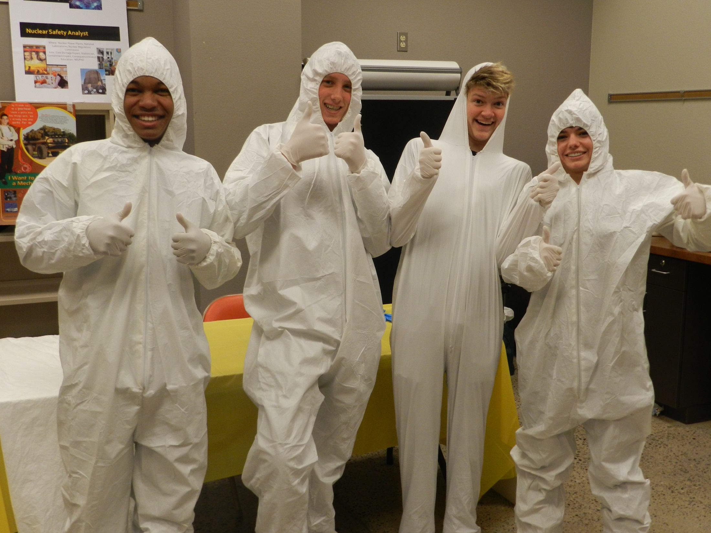

Slide 30
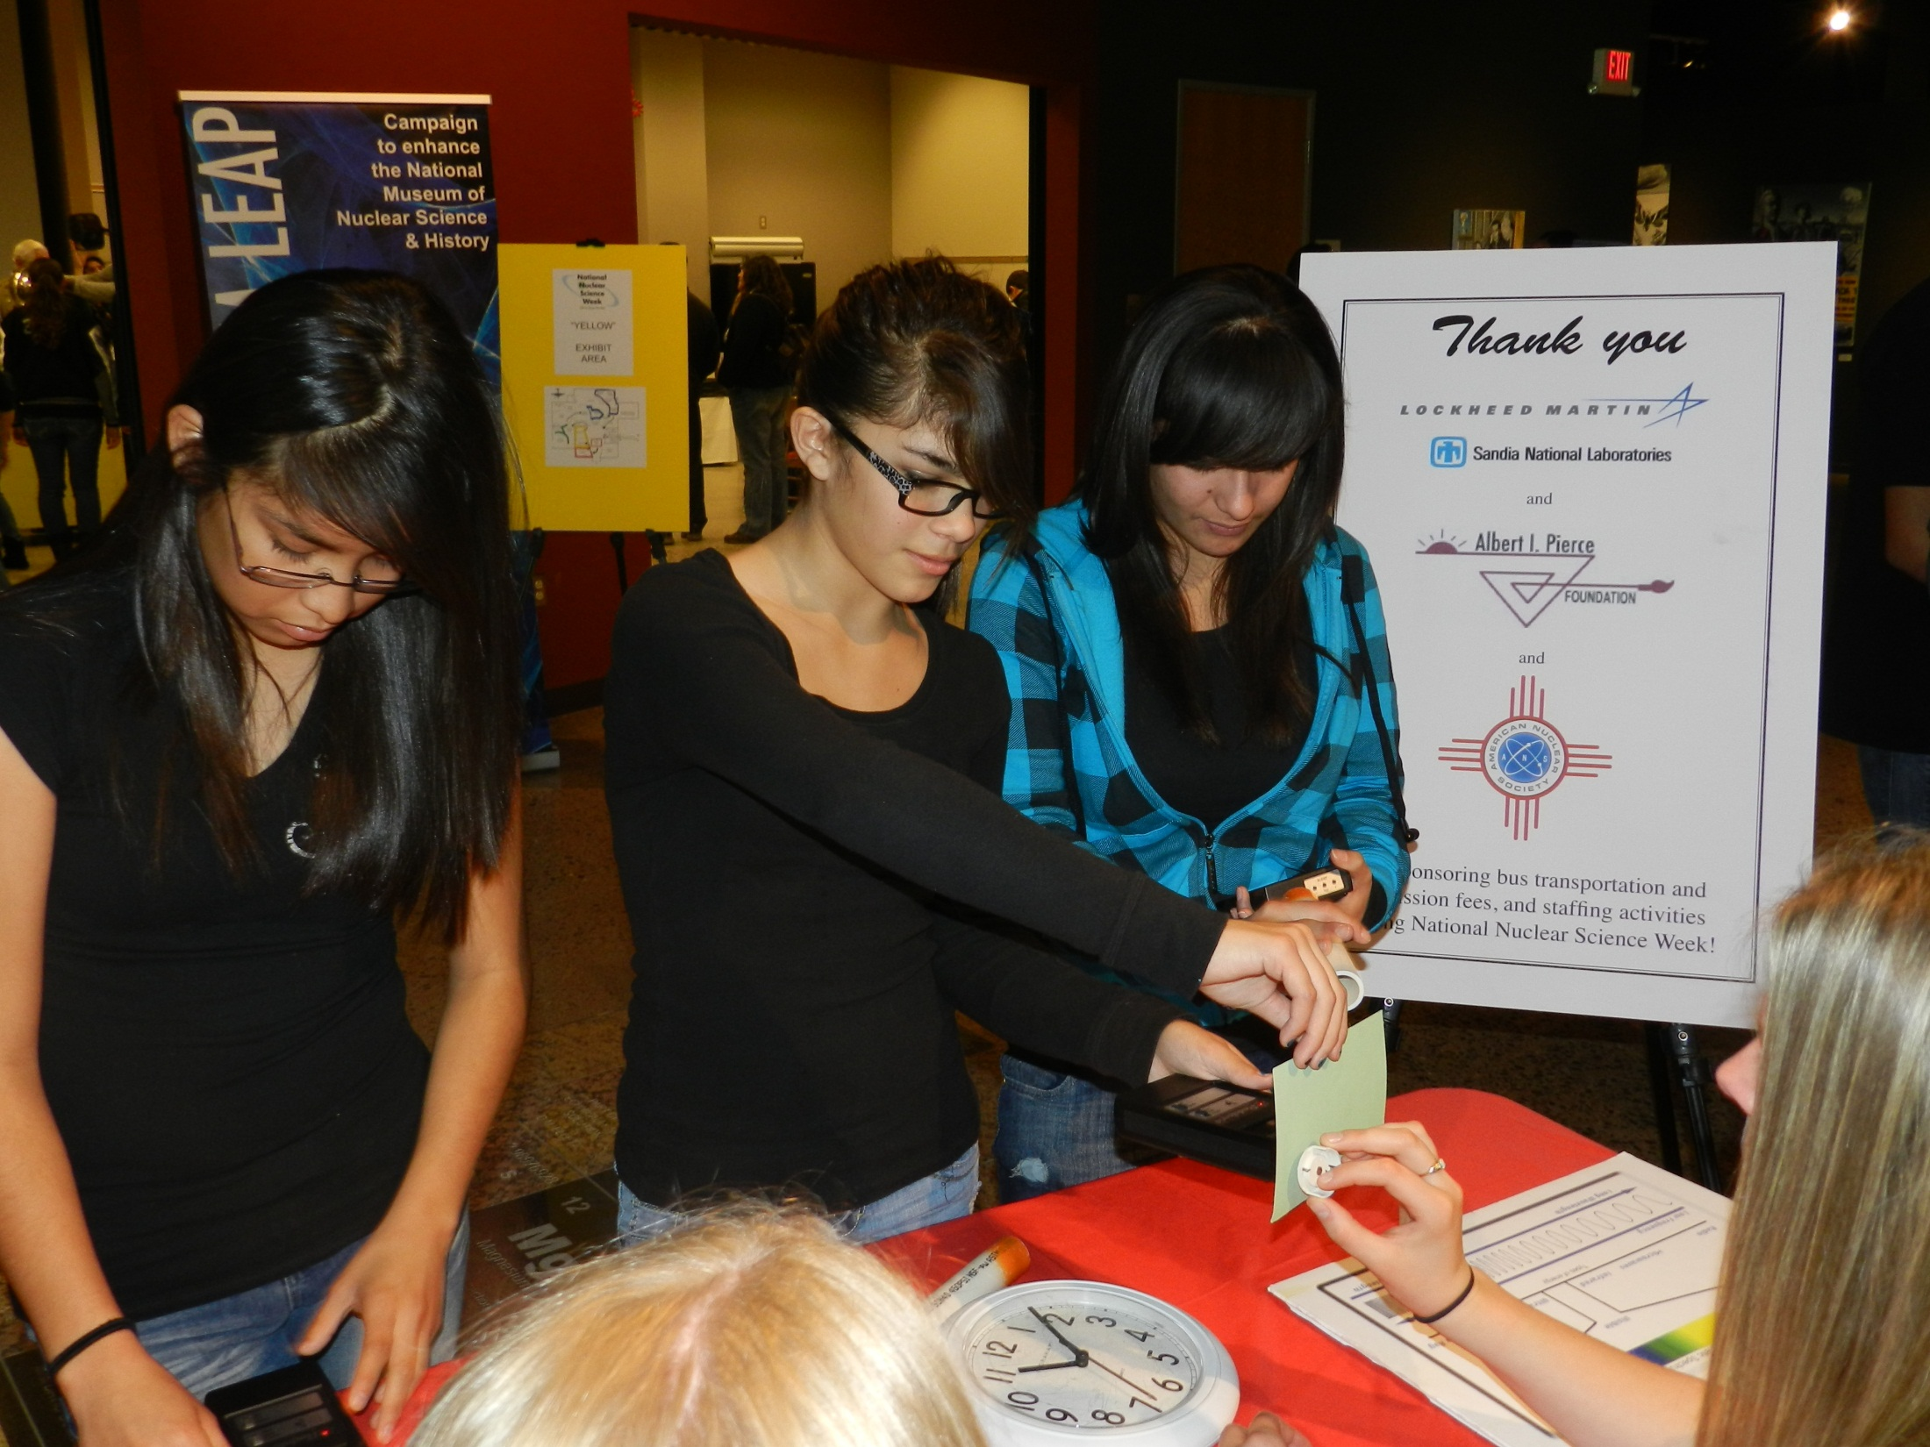
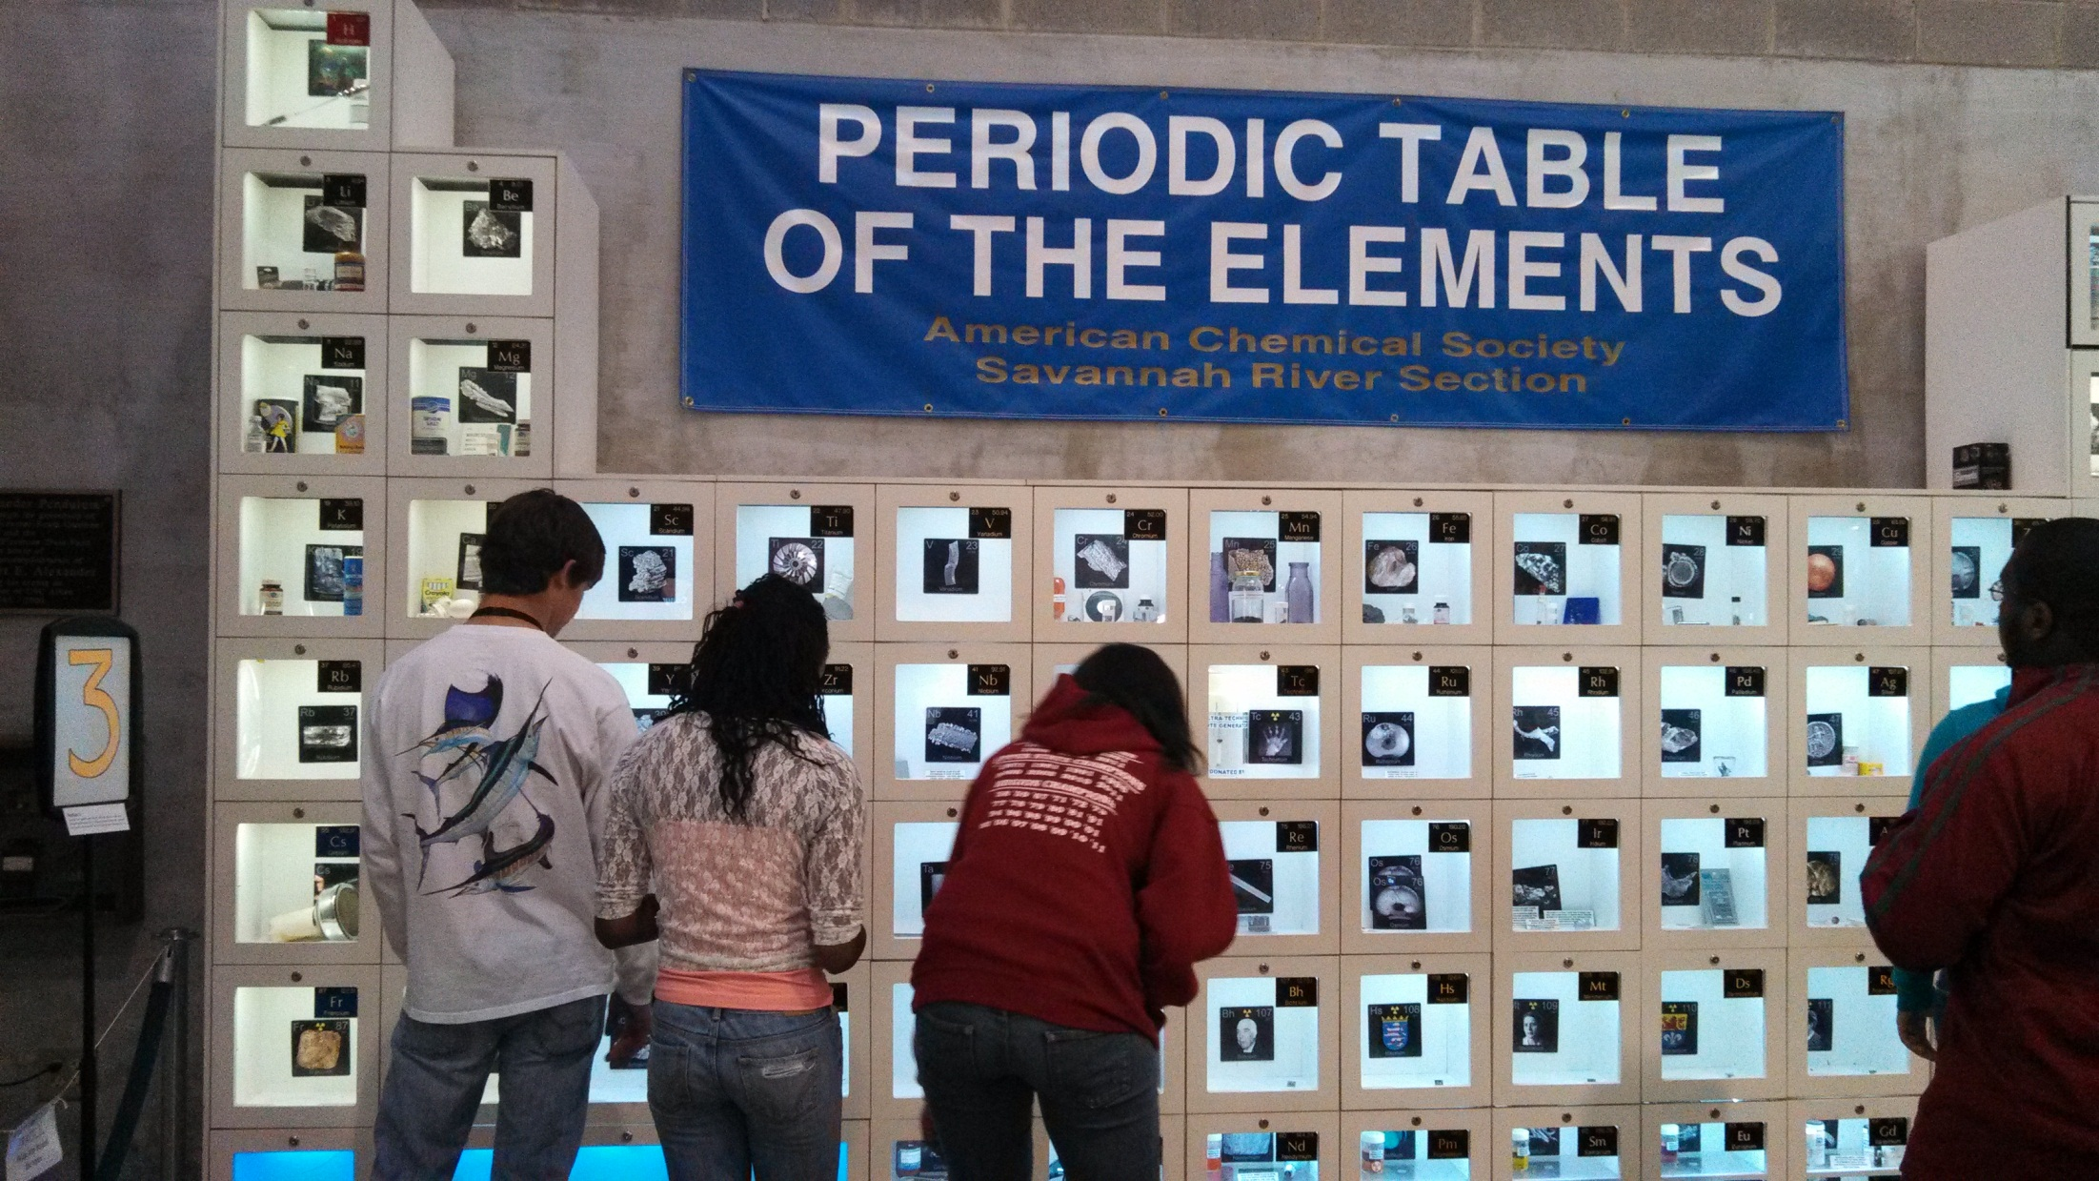

Slide 31
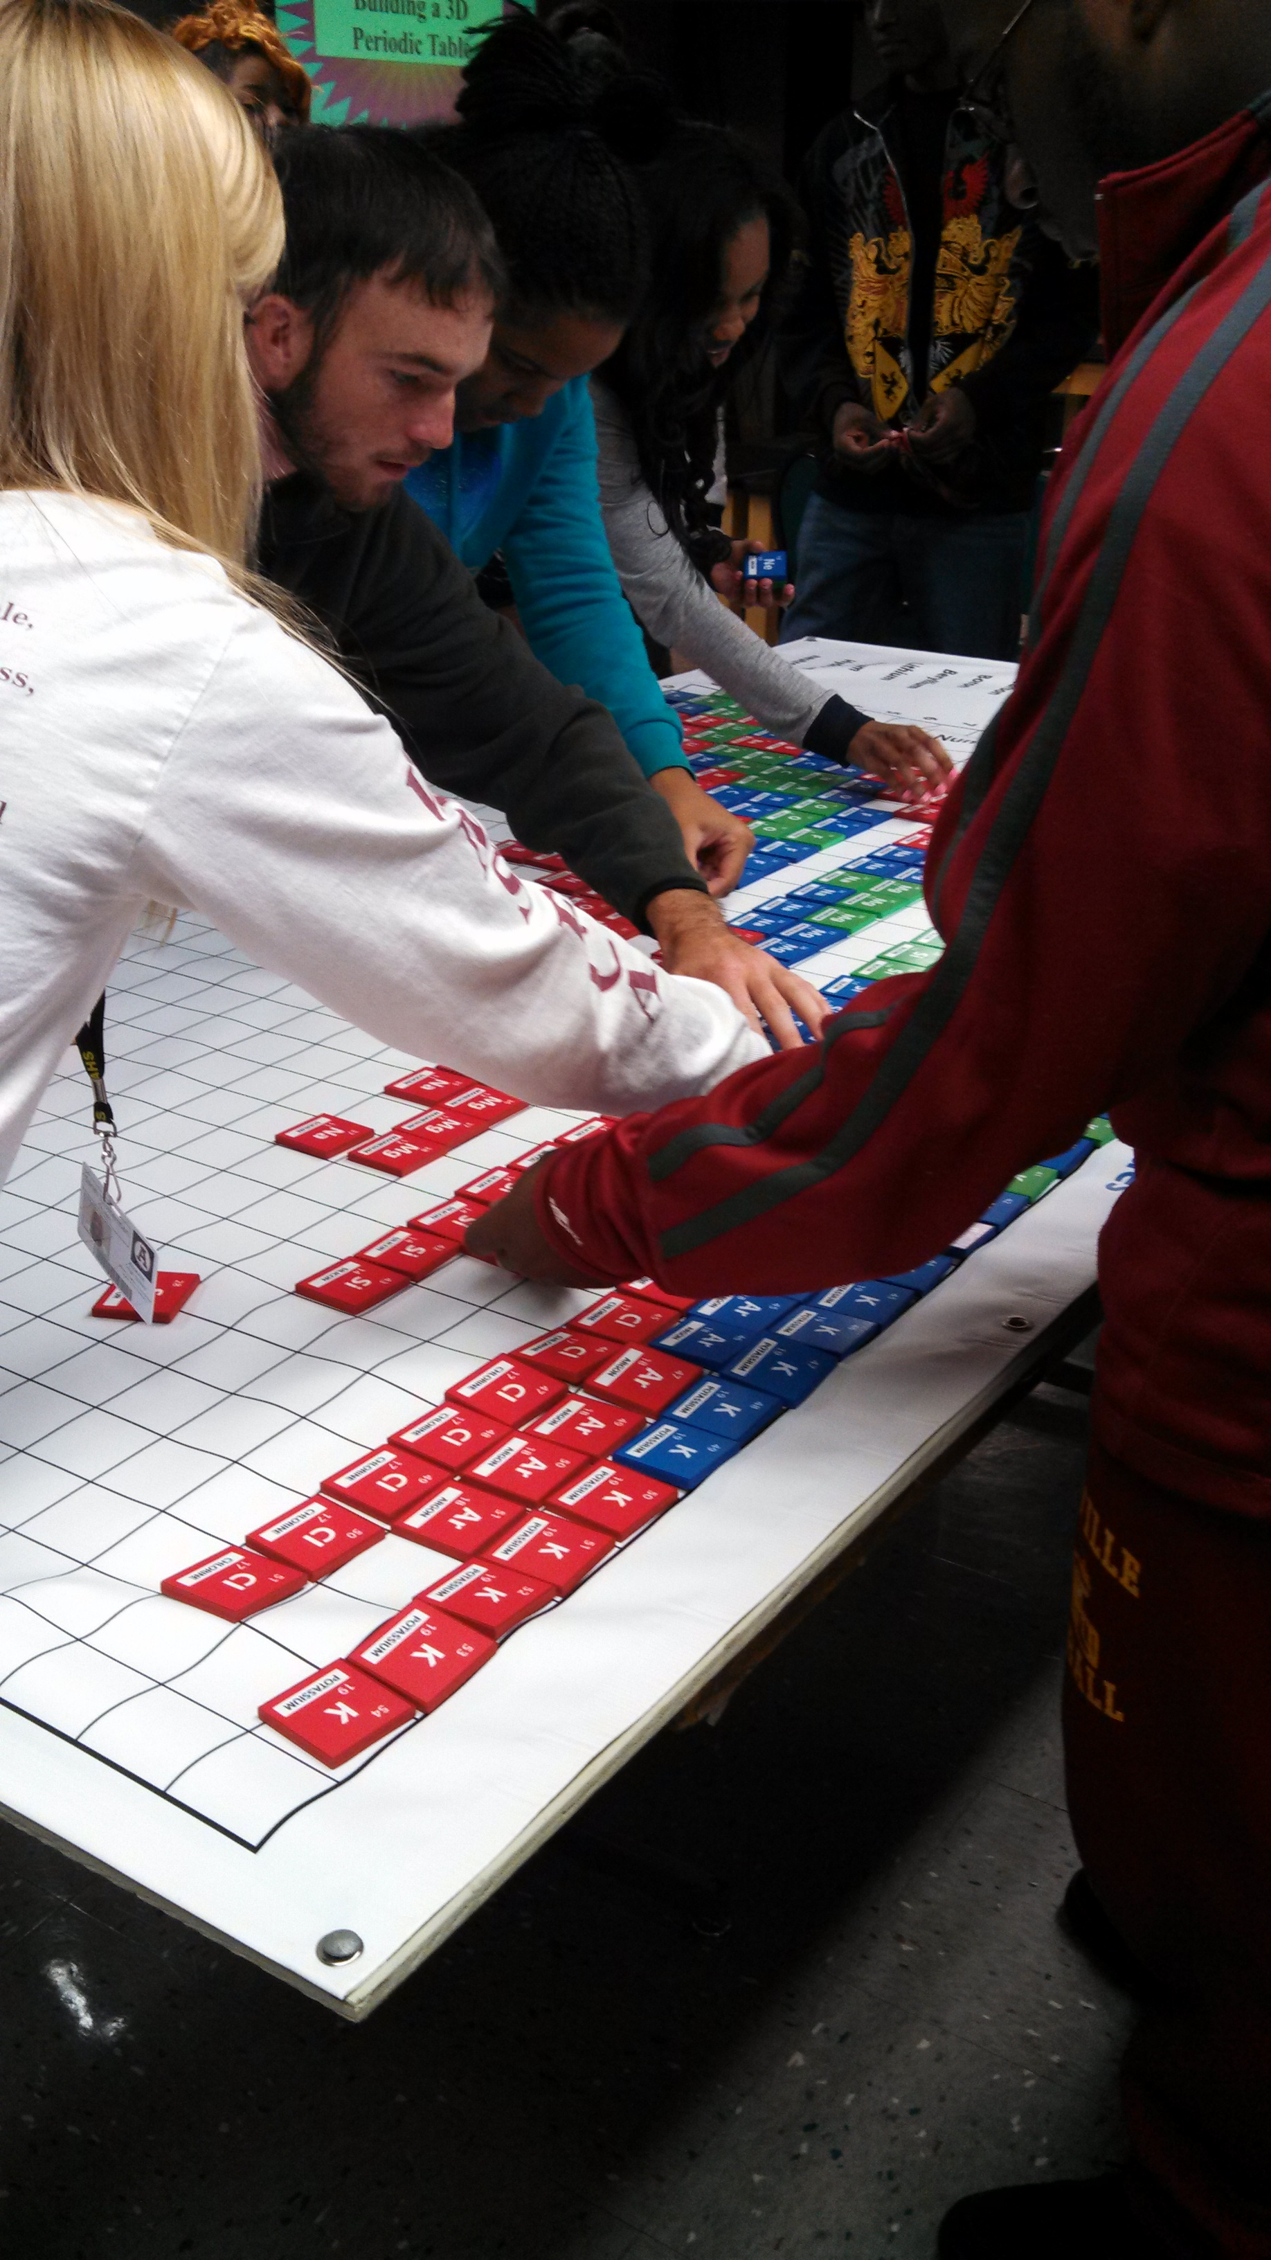
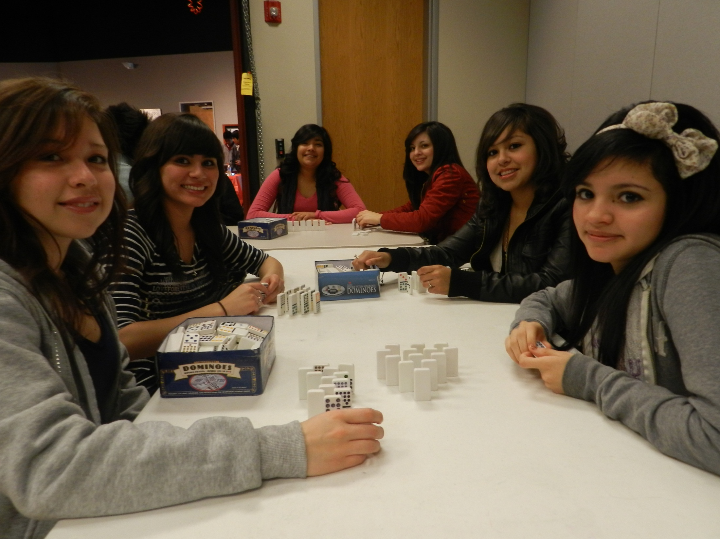

Slide 32
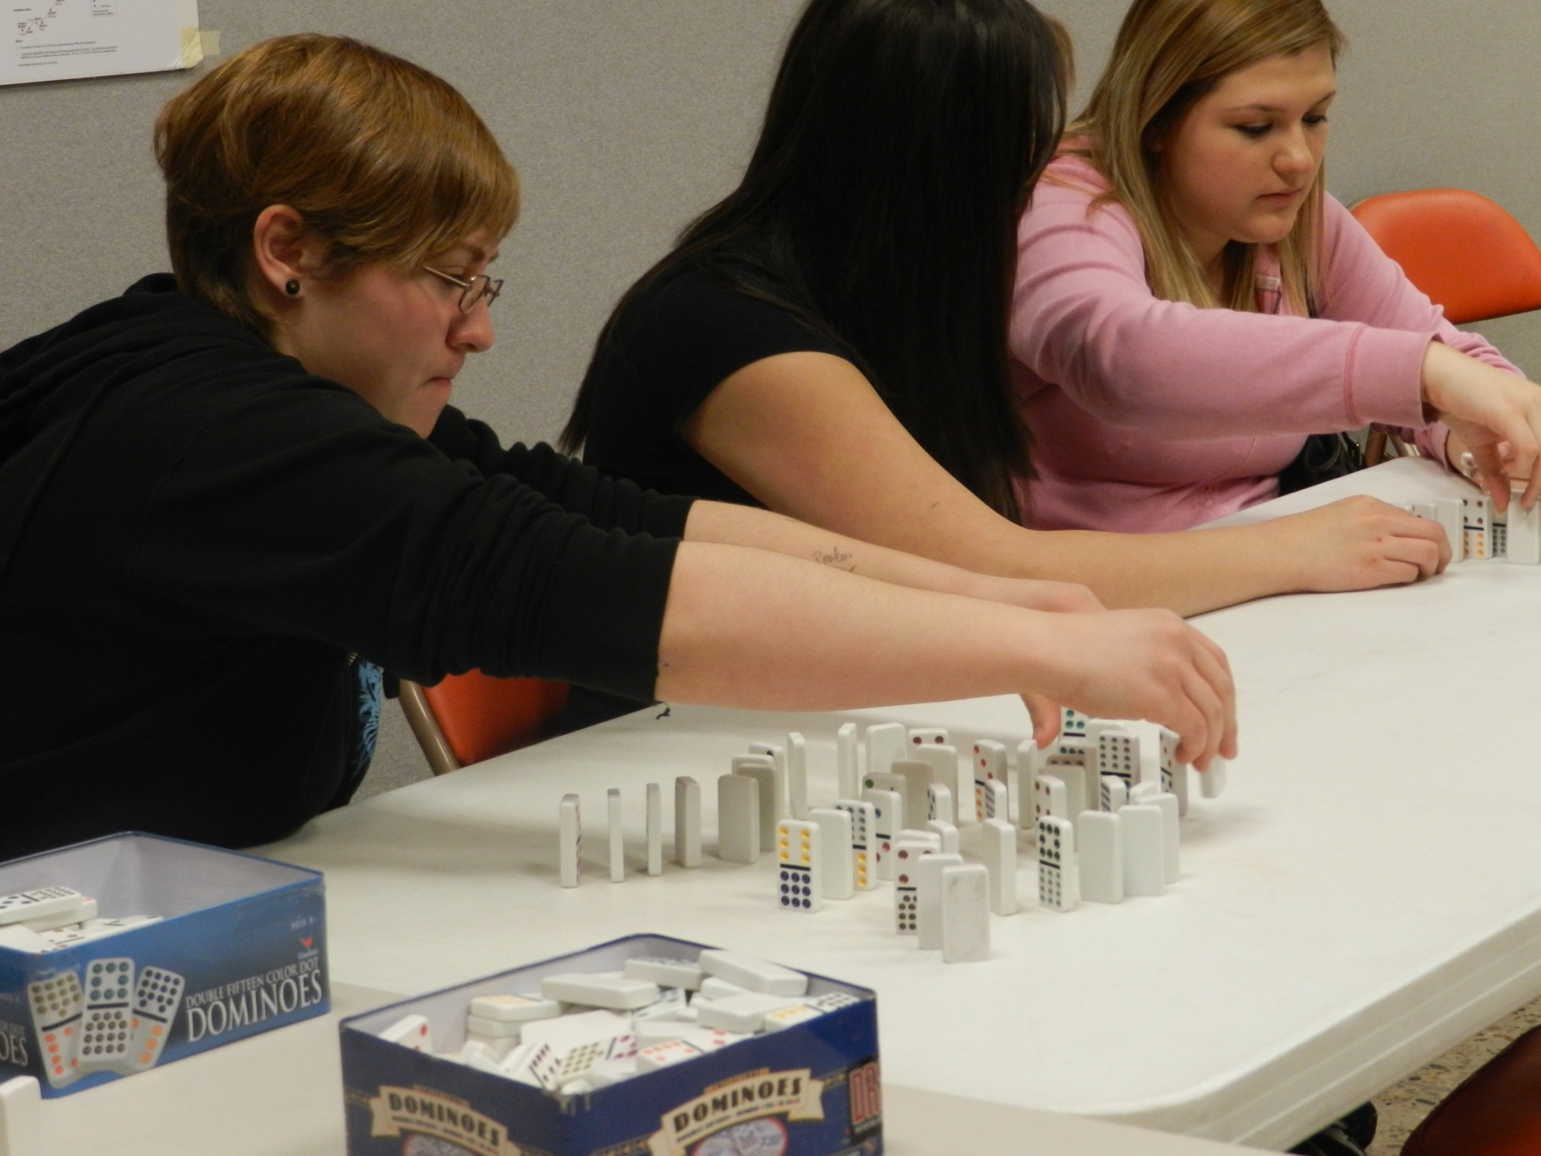

Slide 33
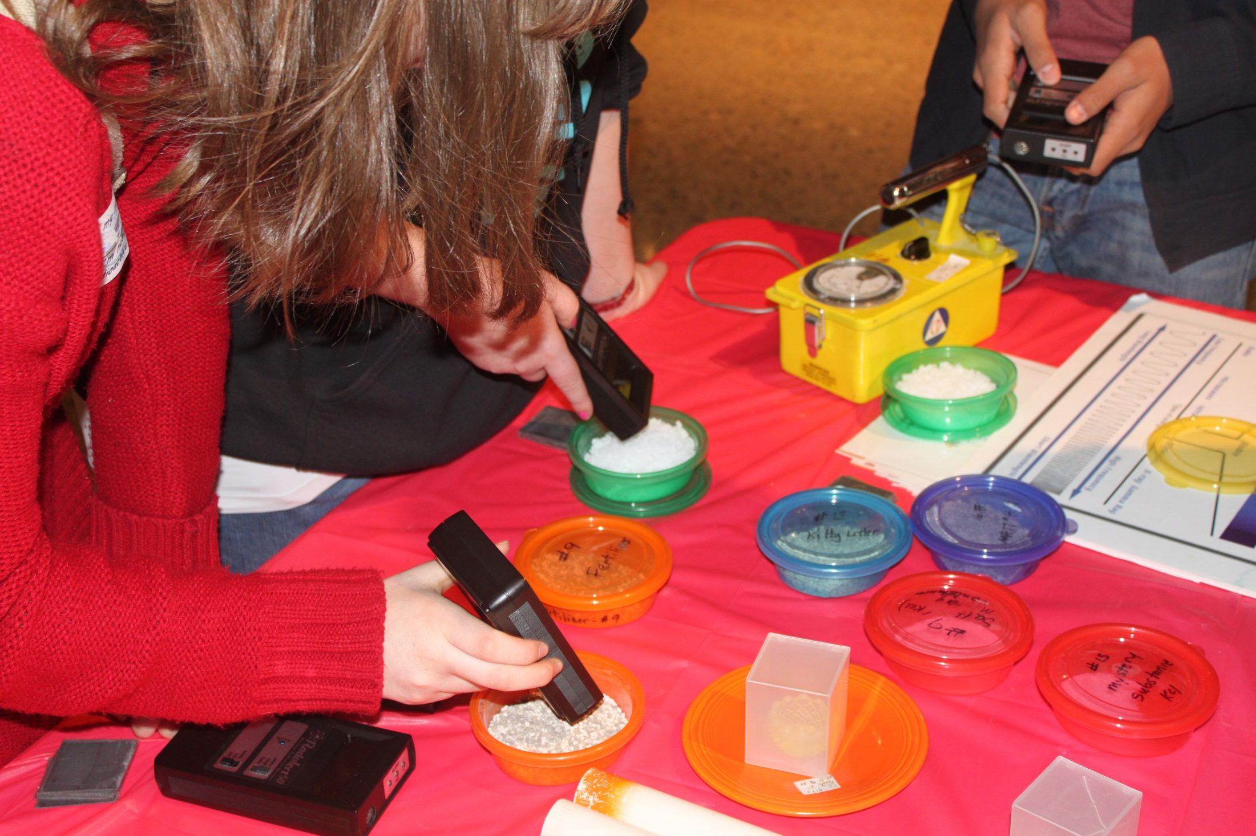

Slide 34
Without the support of corporations and partner organizations, NNSW would not exist.
Supporter and Partners
Sponsors of 2013 National Celebration Event in SC and GA
Albert I. Pierce Foundation
American Nuclear Society
Arizona Public Service
Areva
American Society of Radiologic Technologists
American Crane Company
ATK Aerospace
Department of Energy
EnergySolutions Foundation
Entergy
Execlon
Idaho National Laboratory
Louisiana Energy Services
National Museum of Nuclear Science & History
North American Young Generation in Nuclear
Nuclear Energy Institute
Lockheed Martin/Sandia National Laboratories
Society of Nuclear Medicine
U.S. Women in Nuclear
Platinum Sponsor: SRS Community Reuse Organization
Platinum Sponsor: SRSCRO Nuclear Workforce Initiative
Gold Sponsor: AREVA
Silver Sponsor: Shaw AREVA MOX Services, LLC
Silver Sponsor: Southern Company
Silver Sponsor: Georgia Regents University Augusta
Bronze Sponsor: Energy Solutions
Bronze Sponsor: Savannah River Remediation
Bronze Sponsor: Savannah River Nuclear Solutions

Slide 35
Visit www.nuclearscienceweek.org for National Nuclear Science Week 2014 Updates Visit the National Museum of Nuclear Science & History at Booth 1033 at the WM2014. See you there!

