Slide 1
Welcome To RadTown USA
Click to Explore RadTown USA
Click on any location in RadTown USA and find out about radiation sources or uses at that location.

Slide 2
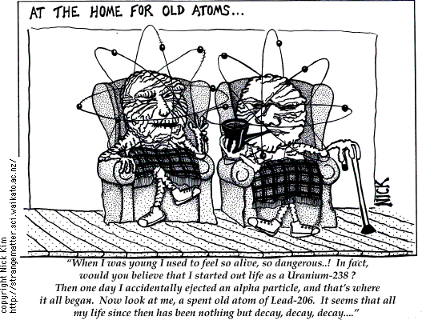

Slide 3


Fundamentals of
Ionizing Radiation
The Alpha, Beta, Gammas of
Nuclear Education
March 2nd, 2014
Debra N Thrall, PhD
Executive Director
Albert I Pierce Foundation

Slide 4
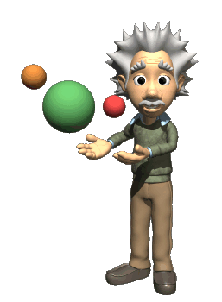
Radiation Fundamentals
What is radiation?
Where does it come from?
How does it interact with matter?
What is radioactivity?
What are fission and fusion?
How are radiation and radioactivity quantified?
Notes:
Here are the topics we’ll be covering. Some of these are just definitions. Some of them involve concepts that may be new or not well-established in your mind. Some of this will require you to “unlearn” pre-conceived notions you have and internalize a different conceptual picture.

Slide 5


Do you think of these “people” when I say RADIATION?

Slide 6

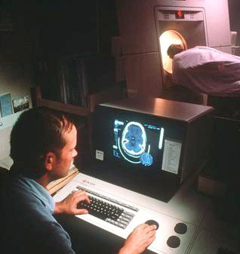
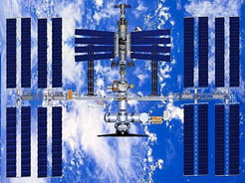


Do you think of these things as well?
Food
Space
Utilities
Consumer Products
Medicine

Slide 7
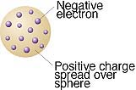
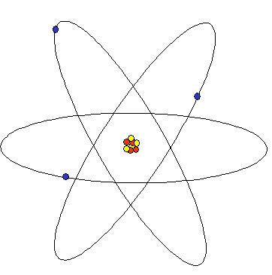
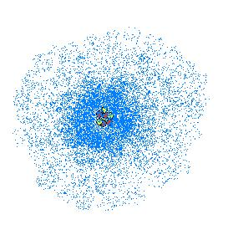
Brief History of the Atom
500 BC Democritus Atom
Long time (Romans → Dark Ages)
1808 AD Dalton Plum Pudding
1911 Rutherford Nucleus
1913 Bohr Orbits
1920’s Many People Quantum Mechanics
Notes:
This is meant simply as a brief introduction. The scouts should already have completed their homework and should be somewhat familiar with this material. The two takeaways are 1) scientific thought has changed dramatically over the ages and 2) We now believe that the quantum model is correct, but we will use the Bohr model for simplicity.

Slide 8
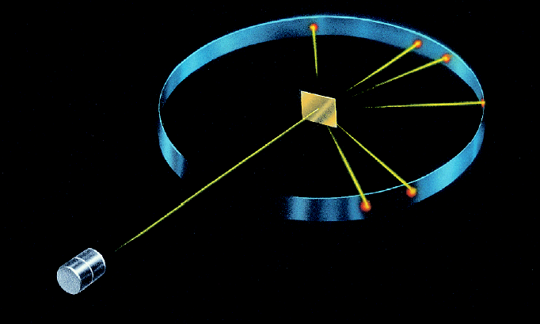
Rutherford’s Gold Foil Experiment

Slide 9
The Design
Bombard positively charged alpha particles into thin gold foil.
Use fluorescent screen to detect particles as they exit the gold foil.
Use angle of deflection to determine interior of the atom.

Slide 10
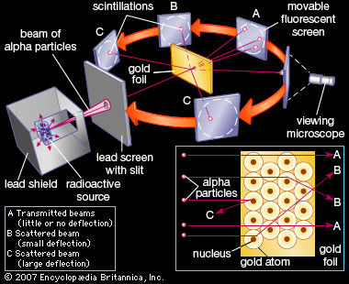

Slide 11
So, What is an Atom?
Atoms are made up of protons, neutrons & electrons
  Protons: + charge p⁺
  Neutrons: no charge n⁰
  Electrons: - charge e⁻
Atoms want to have a stable energy level
  This translates to having no net charge
  # protons = # electrons

Slide 12
Mass of an Atom
Masses
  Proton: 1.000000 amu
  Neutron: 1.000000 amu
  Electron: 0.000549 amu
  (Translates to 1.2 lbs/1 ton ~ a kitten on an elephant!)
The mass of an atom is approximately due to the mass of the protons and neutrons
Mass atom = number p⁺ + number n⁰

Slide 13
Atomic Structure of Helium
THE HELIUM
ATOM
HELIUM’S SUBATOMIC COMPOSITION
2 Protons
e⁻
p⁺
2 Neutrons
n
n
p⁺
2 Electrons
e⁻

Slide 14
Isotopes – Defined
Isotopes are elements with different amounts of neutrons
The number of protons is identical
They have similar properties
There are stable and unstable versions of atoms
They are naturally occurring & man made

Slide 15
Examples of Isotopes
  H-1 Hydrogen 1 proton 0 neutron
  H-2 Deuterium 1 proton 1 neutron
      Heavy hydrogen
  H-3 Tritium 1 proton 2 neutrons

Slide 16
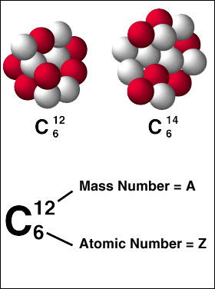
More on atomic structure . . .
Protons have a large mass and a positive charge. The number of protons identifies an element.
p⁺
Neutrons have a large mass approximately equal to a proton’s mass. Neutrons have no charge.
n
is the total number of protons and neutrons
Electrons have a very small mass and a negative charge. Electrons travel outside the nucleus.
e⁻
is the number of protons

Slide 17
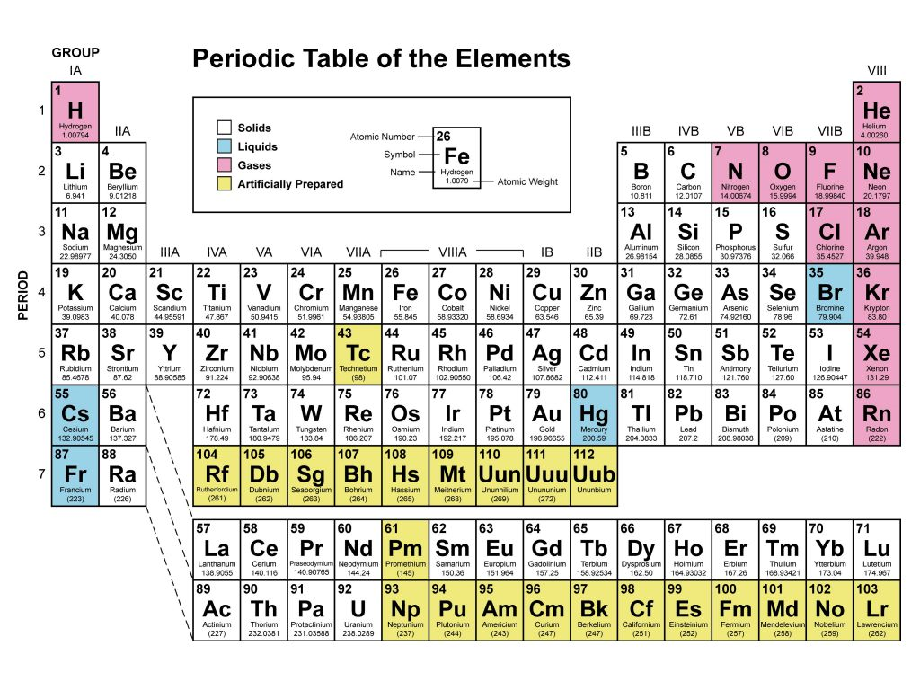

Slide 18
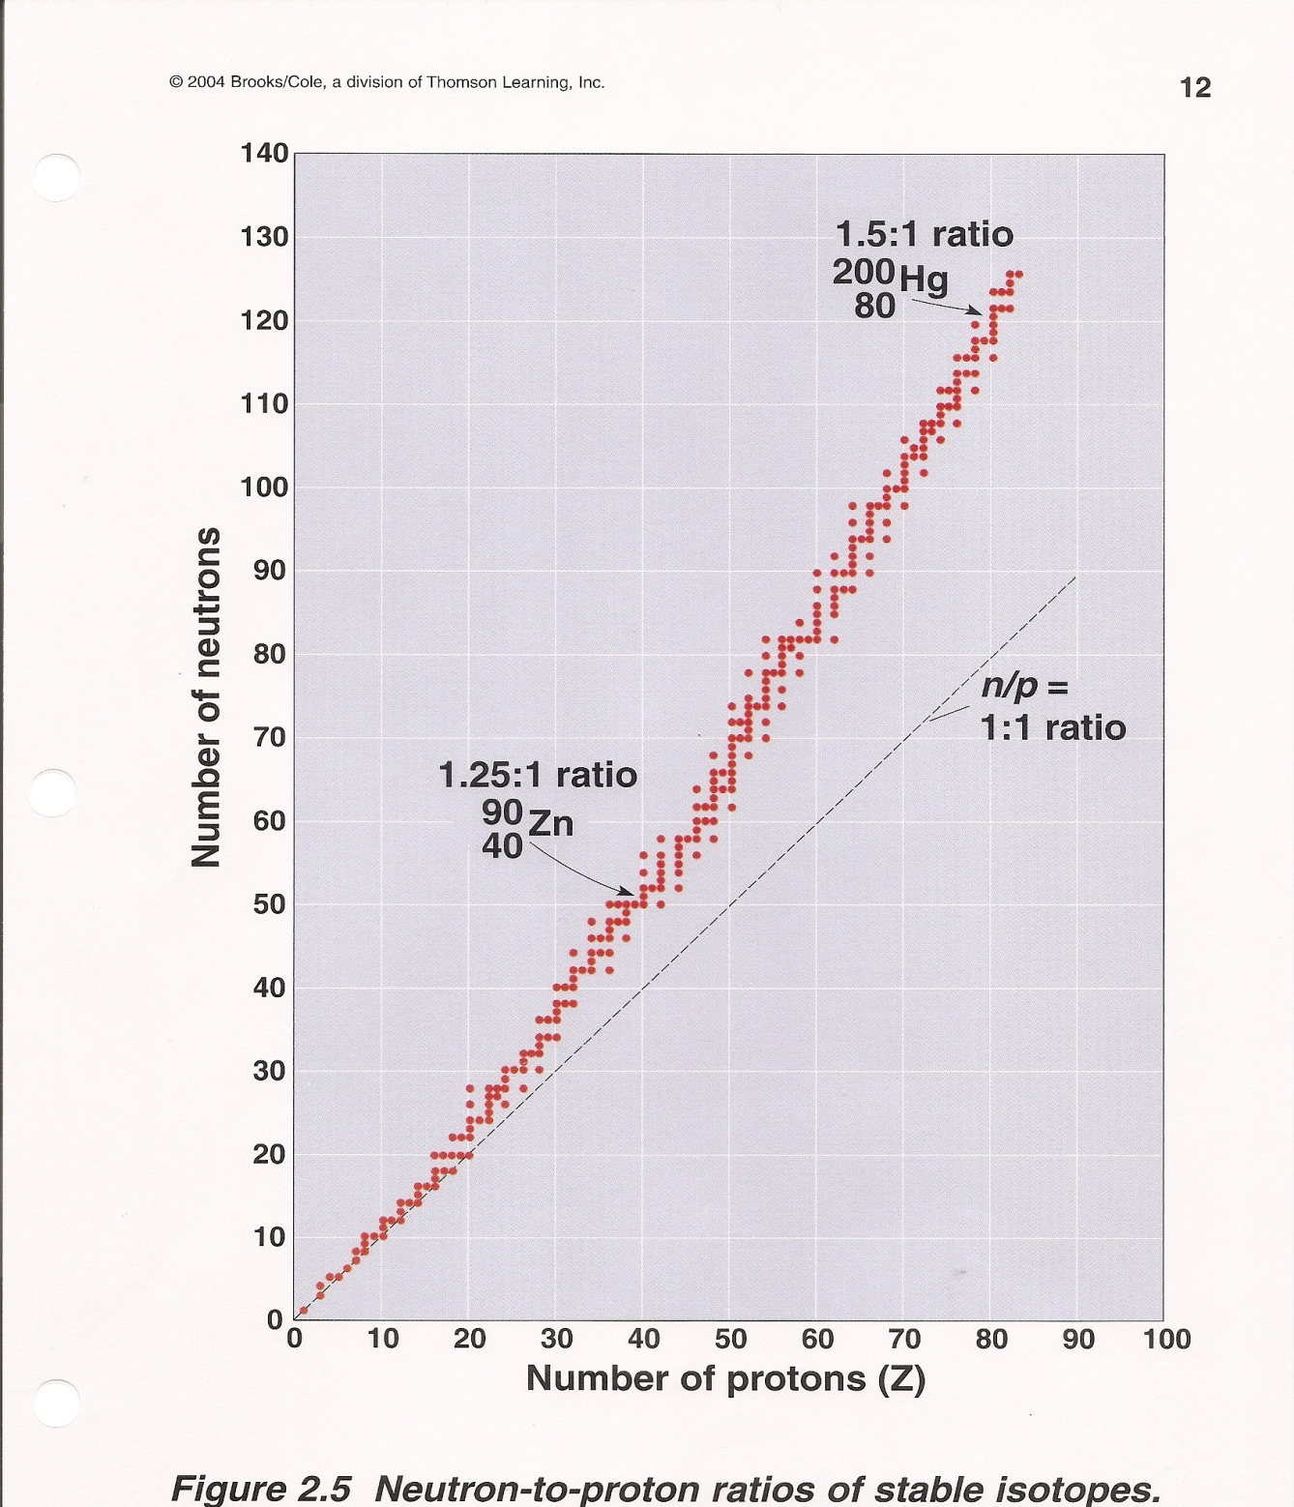
Predict Radioactivity of an Isotope
Stable Isotopes have a specific ratio of neutrons to protons.
Unstable Isotopes which are radioactive fall outside the ‘stable zone’ of neutron to proton ratios.

Slide 19
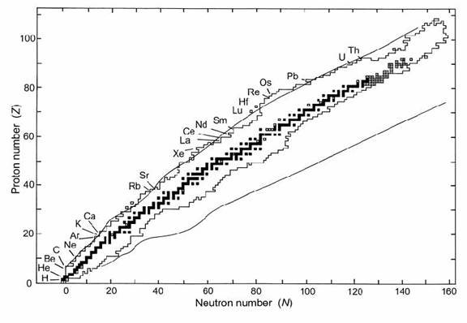
Chart of the Nuclides

Slide 20
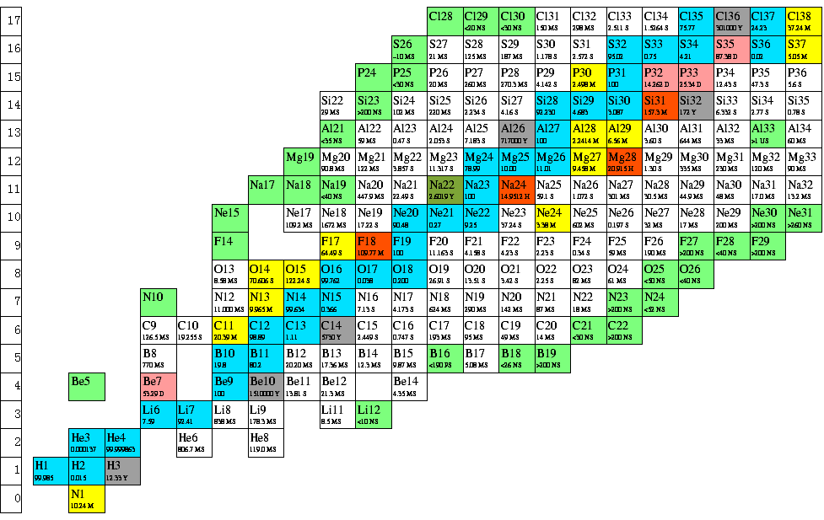

Slide 21
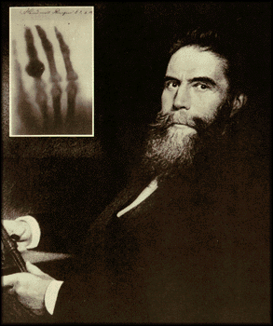
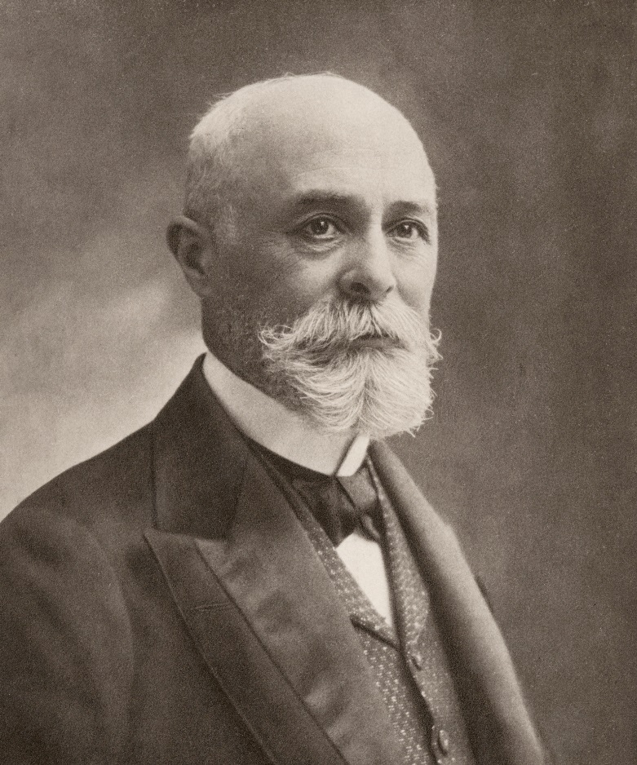
100 Years of Radiation Discovery
Wilhelm Roentgen
Discovered the X-ray
Nov. 8, 1895
Henri Becquerel
Discovered radioactivity
1896

Slide 22
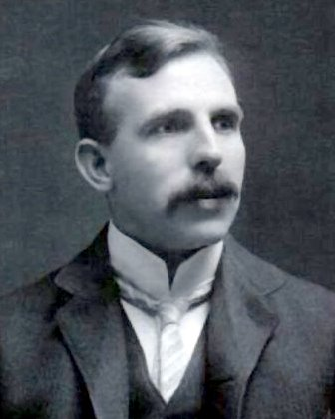
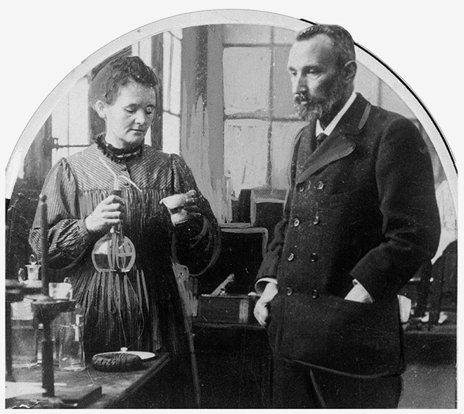
100 Years of Radiation Discovery
Pierre & Marie Curie
Discovered Radium
Coined the term, radioactivity
Ernest Rutherford
Father of Nuclear Physics
Named and Categorized:
Proton; Alpha, Beta Particle

Slide 23
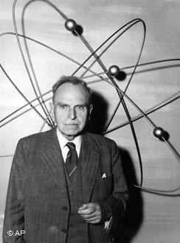
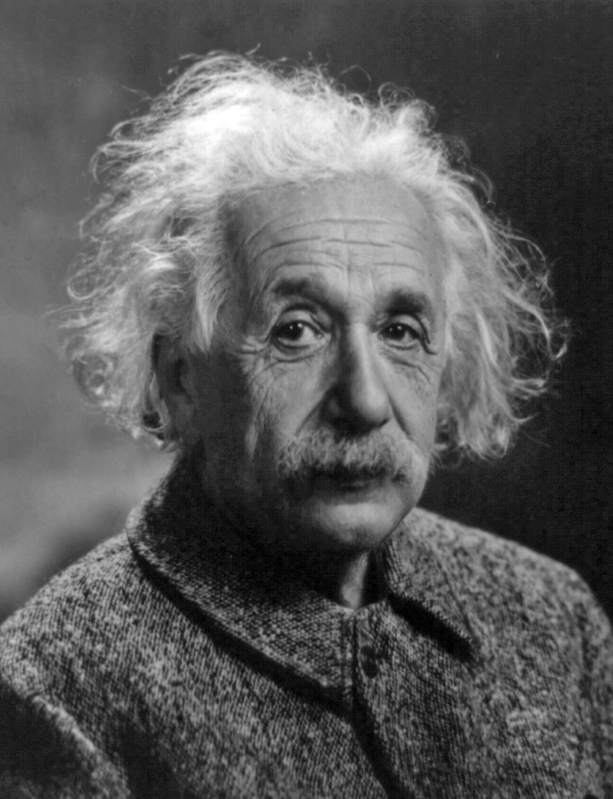
100 Years of Radiation Discovery
Albert Einstein
Theory of Relativity led to new ideas about space, time, matter, energy, gravity
Ernest Rutherford
Discovered Nuclear Fission
1939

Slide 24
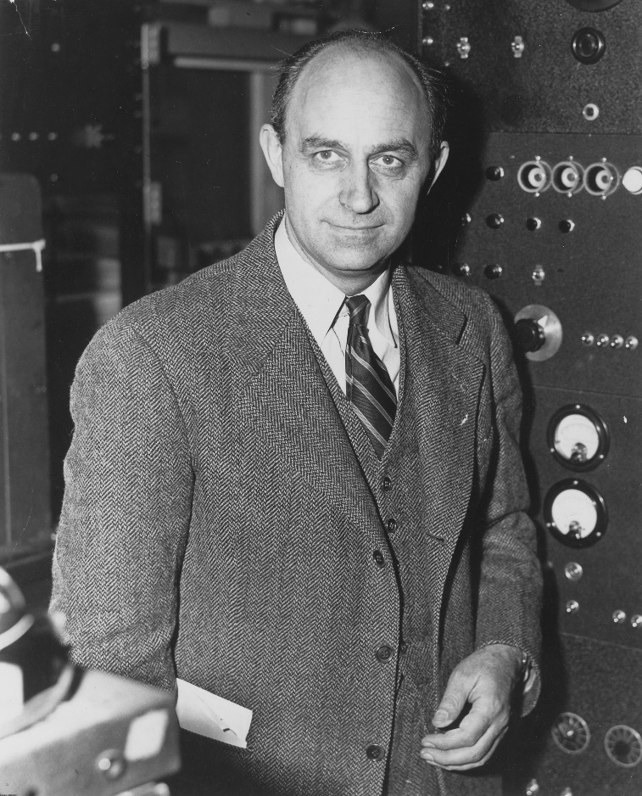
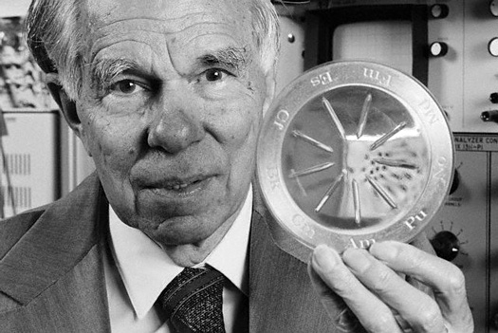
100 Years of Radiation Discovery
Glenn Seaborg
Discovered Plutonium
1941
Enrico Fermi
Produced the first man-made, self-sustaining nuclear chain reaction with his team on
Dec. 2, 1942

Slide 25
NM and AZ have a long and diverse past with the nuclear industry.
They are almost synonymous with nuclear and the nuclear industry.
Nuclear research, mining and miling have changed the face of these states completely and irreversibly.

Slide 26
NM is considered to be the birthplace of the atomic bomb.
In 1943 - J. Robert Oppenheimer moved the Manhattan Project to Los Alamos, New Mexico which resulted in the creation of the Los Alamos National Laboratory

Slide 27
Why White Sands, New Mexico?
“The critical requirement for a site for an atomic bomb design laboratory was enhanced security.
Such a site needed to be safe from bombing by enemy aircraft and equally safe from curious citizens.”

Slide 28
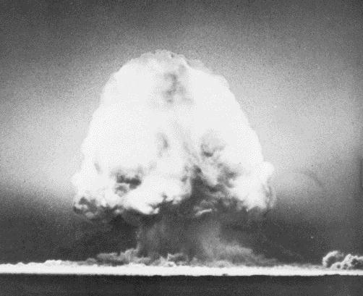

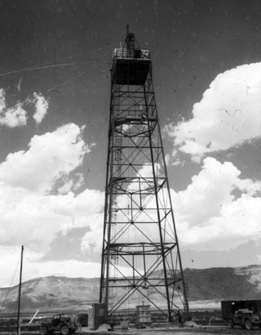
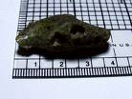
Trinity Test Site
July 16th, 1945
Above: Bomb Detonation
Top Middle: “The Gadget”
Bottom Middle: Trinitite
Right: Bomb Drop Tower

Slide 29
August 1945
  Little Boy and Fat Man, dropped on Hiroshima and Nagasaki
  Sandia National Laboratories’ forerunner, known as Z Division on Sandia Base established as a site convenient to Los Alamos to continue weapon development.

Slide 30
Some members of the public seem to equate anything nuclear with the concept of nuclear weapons.

Slide 31
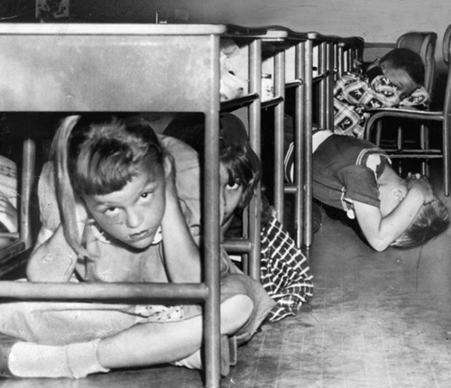

Mass Paranoia
Mass fear of Nuclear holocaust
Fall out shelters constructed and bomb drills conducted – DUCK AND COVER!

Slide 32

When Trinity was detonated it was the bang of a starting gun for B-movie makers everywhere!
They saw visions of mutants, plagues, nuclear holocaust, empty cities covered in gray ash; and mushroom clouds rising like dollar signs on the screens of drive-ins everywhere.

Slide 33

Some

Slide 34
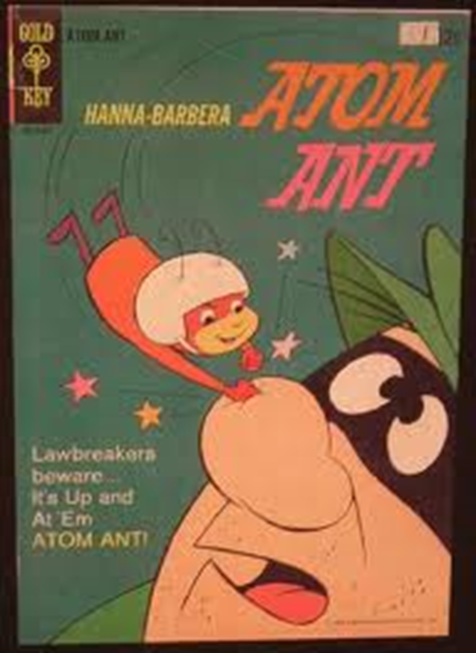

Slide 35


Slide 36


Slide 37


Slide 38
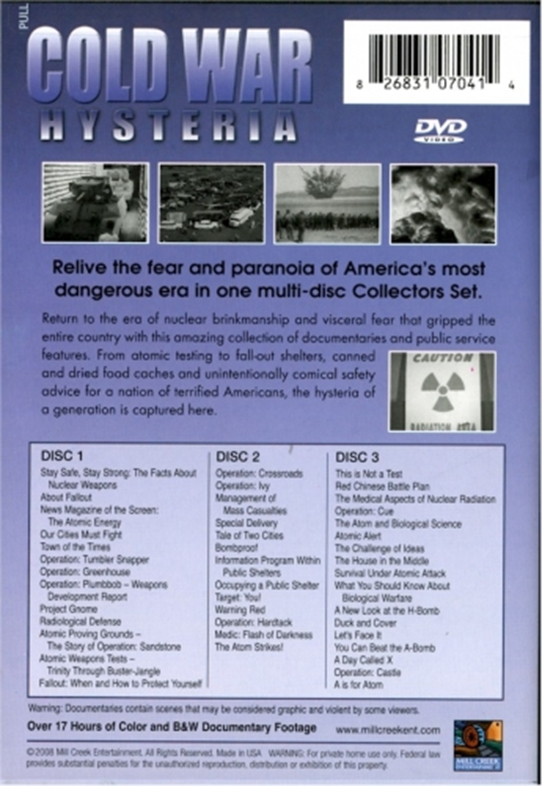
Notes:
Now that we’ve looked at some important nuclear physics concepts, we’ll move on to specifics on radiation. We’ll look at the common sources of ionizing radiation. We will look at the process of radioactivity, a fundamental physical process associated with atoms. In contrast to radiation from radioactivity, which originates with a nuclear transformation, we’ll take a look at how radiation is produced outside the nucleus in the form of X-rays. Then we’ll examine the common nuclear reactions. All of these processes and reactions are natural, and occur abundantly in nature. In our discussion of the production mechanisms of radiation, we’ll also talk about the characteristics of the radiations themselves.

Slide 39
Where Does Radiation Come From?
Nuclear Decay - Radioactivity
Atomic Processes - X-rays
Nuclear Reactions
Fission
Fusion
Others
Notes:
Now that we’ve looked at some important nuclear physics concepts, we’ll move on to specifics on radiation. We’ll look at the common sources of ionizing radiation. We will look at the process of radioactivity, a fundamental physical process associated with atoms. In contrast to radiation from radioactivity, which originates with a nuclear transformation, we’ll take a look at how radiation is produced outside the nucleus in the form of X-rays. Then we’ll examine the common nuclear reactions. All of these processes and reactions are natural, and occur abundantly in nature. In our discussion of the production mechanisms of radiation, we’ll also talk about the characteristics of the radiations themselves.

Slide 40

Background Radiation Sources
INDUSTRIAL
CONSUMER PRODUCTS
ATMOSPHERIC TESTING
MEDICAL
INTERNAL
RADON
TERRESTRIAL
COSMIC
NATURAL
MANMADE

Slide 41
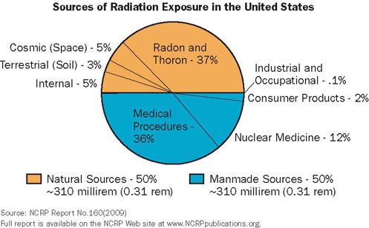

Slide 42
What is Radiation?
Radiation = Energy in transit
…The transfer of energy by waves or particles
Ionizing Radiation: Has sufficient energy to produce energetic ions in ordinary matter
…must result in the production of charged particles
and eventual absorption of their kinetic energy
Alpha and Beta particles, Gamma & X-rays, Neutrons
Non-Ionizing Radiation: Does not produce energetic ions
Radio, Microwaves, UV, IR, Visible
Notes:
Radiation is the transfer of energy – through the motion of particles or electromagnetic waves.
(Throw a small object back and forth to demonstrate the transfer of energy – ask how the energy is manifested – kinetic energy)
A critical aspect of the particular nature of ionizing radiation is that it liberates energetic charged particles – the absorption of the kinetic energy of these particles is what causes “dose”.
The four types of radiation – listed here - all produce energetic charged particles as they penetrate matter – some directly, and some indirectly.
Mention that Alpha and Beta are charged particles themselves, so the production of ions is usually a direct charged particle interaction, whereas absorption of gamma and neutron radiations involves the conversion of these into charged particles (i.e. converting electromagnetic energy into kinetic energy).
Non-ionizing radiations do not result in energetic ion production, therefore there is no “dose” in the same sense used above. However, some of these radiations can definitely cause biological damage, they just do it by different means.
We’ll discuss the types of radiation and their origins a little later.

Slide 43
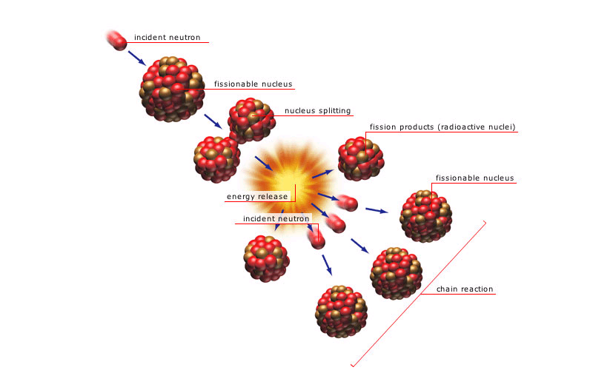
Nuclear Reactions - Fission
Neutron induced in U²³⁵
Products:
  Energy
    ~ 200 MeV
  Fission Products
    Radioactive
  Neutrons
    2.47 per fission

Slide 44
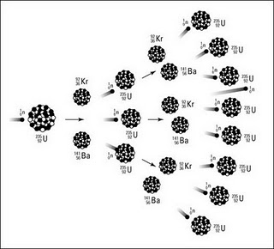

Slide 45
Types of Radiation
Non-Ionizing
Radiowaves
Microwaves
Infrared
Ultraviolet
Visible Light
Ionizing
Alpha
Beta
Gamma
X-Rays
Neutrons

Slide 46
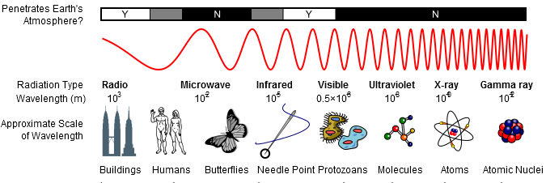
Electromagnetic Spectrum
Particles can also be described by a wave function!
Notes:
Here is a depiction of the electromagnetic spectrum showing the wavelengths of different categories of radiations. Note that the actual threshold energy or crossover from one type to another is not an exactly defined thing. For instance, the upper end of the UV range can cause ionization in some materials.
Note: The use of the term “x-ray” to define a radiation energy range is somewhat misleading. X-rays originate in the electron cloud of an atom, rather than from the nucleus, and therefore have historically been associated with an energy range on order of electron binding energies (which holds true for “characteristic” X-rays). However, X-rays produced by high energy machines (diagnostic X-rays ~ 100 keV, accelerators ~ GeV) are much higher. A clearer way to categorize it is by sticking to the point of origin – gamma rays come from nuclear decay processes, X-rays come from atomic processes outside the nucleus. Their energies are arbitrary and overlap.

Slide 47
Why is it called ionizing?
Because it creates ions --atoms with a charge.
Neutrons
and Protons
Ejected Electron
Ionizing Radiation

Slide 48
Radiation Types
Alpha (α)
  2 protons, 2 neutrons
  positively charged particle
p+
n
n
p+
Beta (β)
  like an electron
  negatively charged particle
⁻
Gamma (γ)
  Wave energy (not a particle)

Slide 49
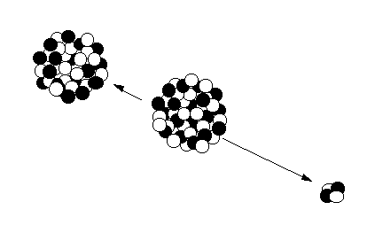

Radioactivity: α Decay
^{A} X
^{A-4} Y + α
z
Z-2
Daughter Nucleus
Rn-222
Parent Nucleus
Ra-226
  ⁴₂α ⁺⁺
Alpha tracks in a cloud chamber
Alpha Particle
(Helium Nucleus)
Notes:
Remember, we said there were four main types of ionizing radiations. Three were particles. The first is the alpha particle.
Alpha because they were the first discovered – A, B, C, etc.
Notice that the examples listed are all heavy nuclei. Heavy elements are the ones for whom alpha decay is energetically likely. An alpha particle is actually a helium nucleus. For lighter elements, other decay processes become much more likely (decay processes “compete”).
Look at the result of the decay. The equation shows the effect of losing the alpha particle. (Look at the key for the Chart of Nuclides)
The alpha particle is the radiation. It is ejected with a considerable amount of kinetic energy. Where does that energy come from? It is the energy equivalence of the difference in the binding energy between the parent and daughter. In essence, each nucleon in the daughter weighs slightly less than in the parent. That difference in mass must go somewhere – it is turned into the kinetic energy of the alpha particle (actually shared between the alpha and the nucleus). Alpha particles are highly charged, therefore are heavily interactive with electrons as they penetrate matter. How penetrating are they?

Slide 50
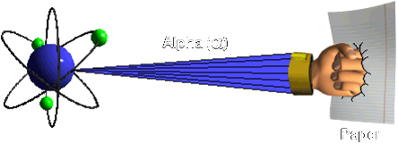
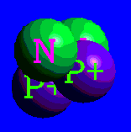
Alpha Radiation (α)
Characteristics
Particle, Large Mass,
+2 Charge
Range
Very Short
1 - 2” in air
Shielding
Paper
Outer layer of skin
Hazards
Internal
Sources
Plutonium, Uranium,
Americium

Slide 51
Uses of Alpha Radiation
• Pacemakers
(Older models)
• Airplanes
• Copy Machines
• Smoke Detectors
• Space exploration

Slide 52
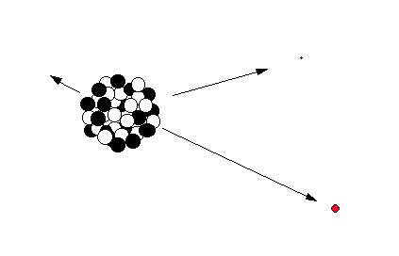
Radioactivity: β⁻ Decay
^{A} X
^{A} Y + β⁻ + ν
z
Z+1
Daughter Nucleus
Nickel-60
ν
Antineutrino
Parent Nucleus
Cobalt -60
β⁻
Beta Particle
(electron)
Notes:
Beta-minus decay occurs when a parent nucleus has an imbalance of neutrons and protons in which the nucleus is “neutron rich”. In lighter nuclei, beta decay is more probable than alpha, and it results in a daughter product with more binding energy per nucleon than the parent. The model for beta decay is that a neutron within the atom changes into a proton and an electron (and an electron-neutrino). The electron cannot exist within the nucleus and is ejected carrying the kinetic energy equivalent in the difference between the parent and daughter total mass-energy (actually the energy is shared by the beta and the neutrino, resulting in a continuum of energy possible from the beta, up to the total transition energy).

Slide 53
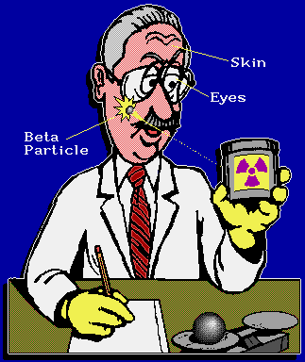
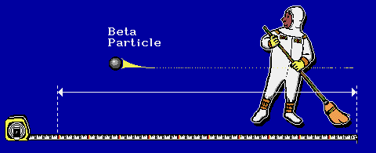
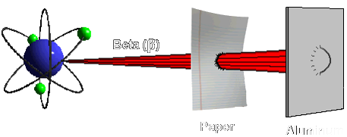

Beta Radiation (β)
Characteristics
Particle, Small Mass,
-1 Charge
Range
12ft / MeV in air
Shielding
Plastic, glass,
aluminum, wood
Hazards
Internal and the
skin and eyes
Sources
Tritium, Sr-90,
Fission products

Slide 54
Beta Radiation is used in thickness gauging
The thicker the material the less radiation will pass through the material.

Slide 55
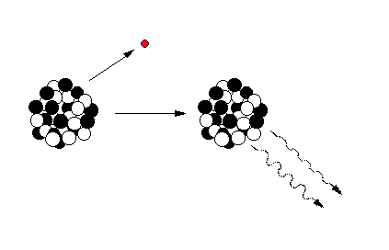
Gamma Emission
β⁻
Daughter Nucleus
Nickel-60
Parent Nucleus
Cobalt-60
(Beta decay)
Gamma Rays
Notes:
After a decay reaction, the nucleus is often in an “excited” state. This means that the decay has resulted in producing a nucleus which still has excess energy to get rid of. Rather than emitting another beta or alpha particle, this energy is lost by emitting a pulse of electromagnetic radiation called a gamma ray. The gamma ray is identical in nature to light or microwaves, but of very high energy.
Like all forms of electromagnetic radiation, the gamma ray has no mass and no charge. Gamma rays interact with material by colliding with the electrons in the shells of atoms. They lose their energy slowly in material, being able to travel significant distances before stopping. Depending on their initial energy, gamma rays can travel from 1 to hundreds of meters in air and can easily go right through people.
It is important to note that most alpha and beta emitters also emit gamma rays as part of their decay process. However, their is no such thing as a “pure” gamma emitter.
Important gamma emitters including technetium-99m which is used in nuclear medicine, and cesium-137 which is used for calibration of nuclear instruments.

Slide 56
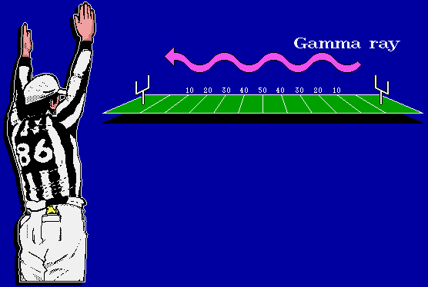
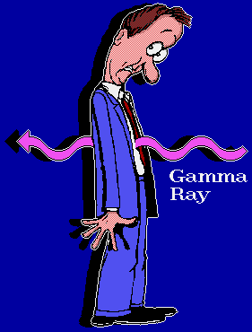
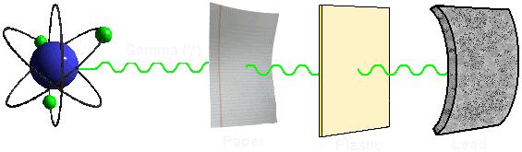

Gamma Rays (γ) and X-Rays
Characteristics
No electromagnetic
mass, no charge
Range
Hundreds of feet
in air
Shielding
Lead, Steel
Concrete
Hazards
External Source
Whole Body
Penetrating
Sources
Co-60, Kr-88, Cs-137

Slide 57
Uses for Gamma Radiation:
Food irradiation
Sterilization of medical equipment
Creation of different varieties of flowers
Inspect bridges, vessel welds and Statue Of Liberty.

Slide 58
RADIOACTIVE DECAY REACTIONS
ALPHA DECAY
238
92
234
90
4
2
α
U
Th +
BETA DECAY
0
−1
234
90
Th
234
91
Pa +
β
+
ν
GAMMA DECAY
137m
56
Ba
137
56
γ
Ba +

Slide 59
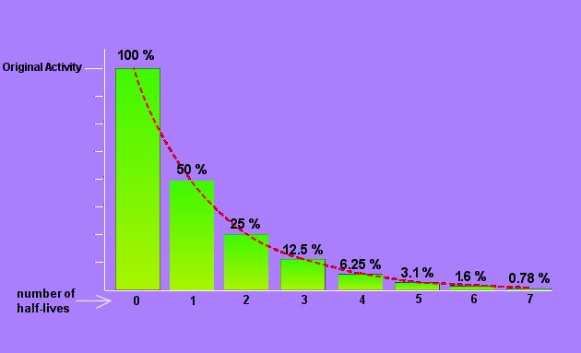
Radioactive Half-life
Notes:
Half-life is a common way to relate the rate of decay of a particular radioactive nuclide. Half-life is a convenient way to express the decay rate, but the fundamental quantity that determines the half life is the decay constant. The decay constant is the probability that any atom may occur per unit time. Half life expresses the effect of the decay constant by identifying the period of time required for a given quantity of the material to decay to half that amount.

Slide 60
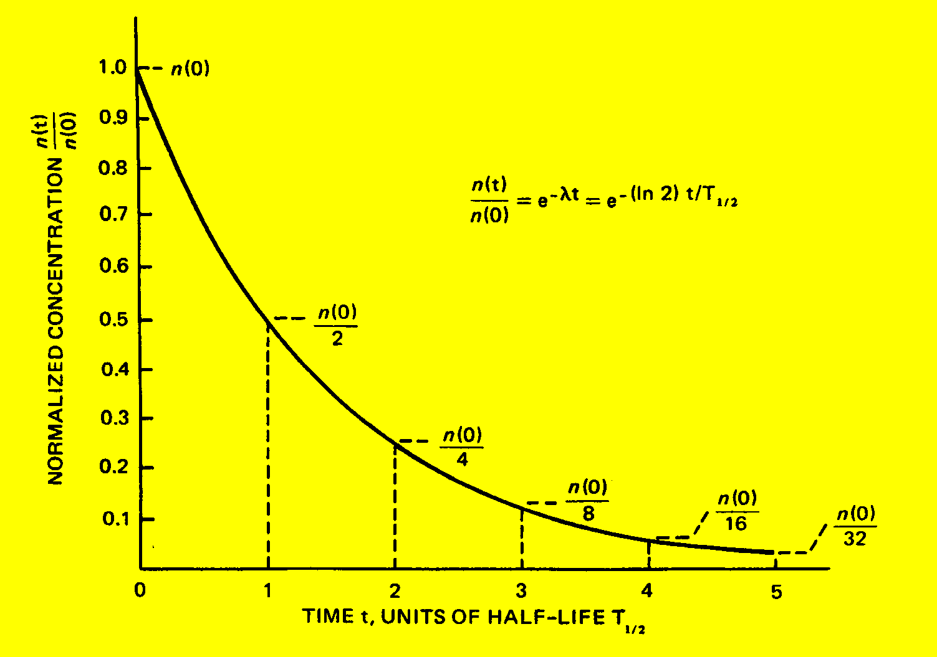
Half-Life

Slide 61
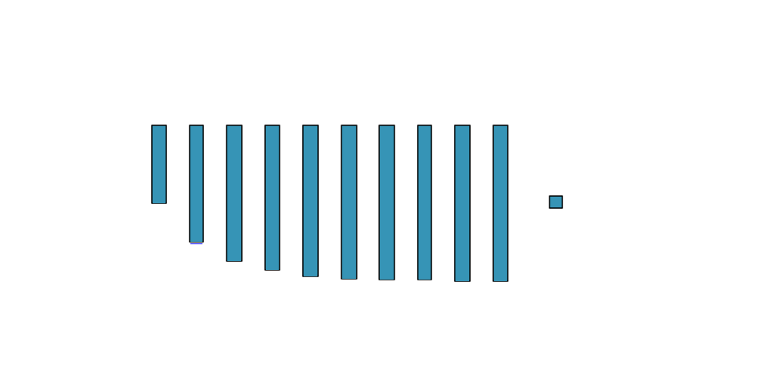

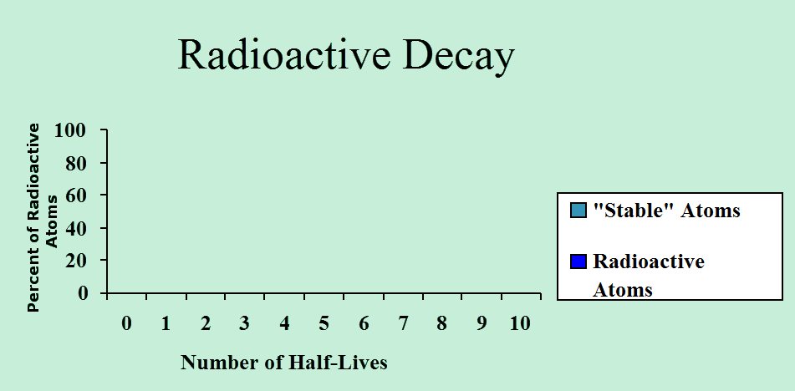
Half Life

Slide 62
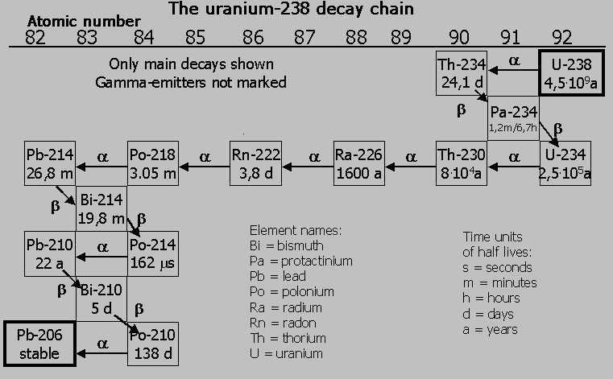

Slide 63
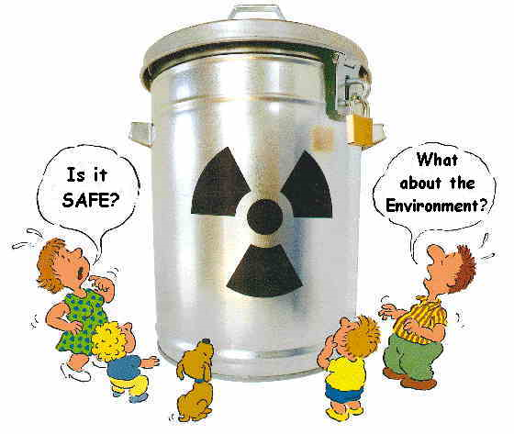

Slide 64
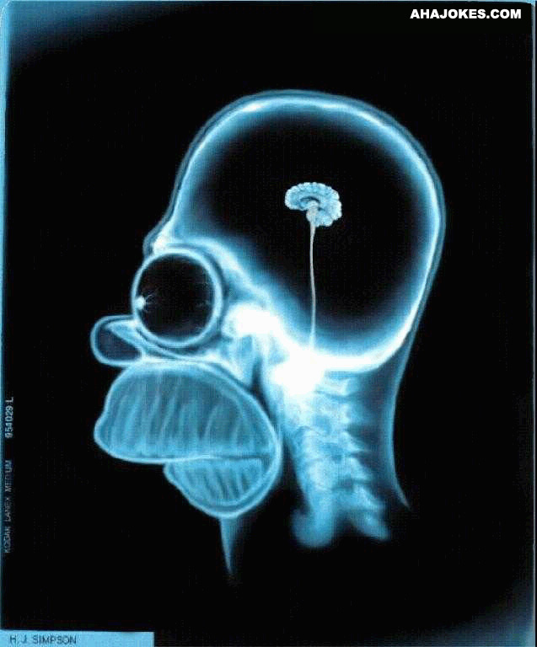
HOW RADIATION AFFECTS YOUR BRAIN

Slide 65

Radiation Interaction and Penetration Through Matter
alpha
+
alpha
+
High charge, dense ionization, short path
-
beta
Less charge than alpha, longer, erratic path
gamma
No charge or mass, much less interaction
neutron
No charge, interacts by nuclear scattering

Slide 66

Cell Damage

Slide 67
Direct vs. Indirect Ionization
Direct
Radiation that ejects orbital electrons from absorber atoms like charged particles (alphas and betas)
Indirect
Transfer energy to charged particles (protons/electrons) of the absorber atoms, like neutrons and gamma rays.

Slide 68

Ionizing radiation induces:
  Direct DNA damage
  Indirect damage through the radiolysis of water
©2005 by National Academy of Sciences
Notes:
Ionizing radiation induces direct DNA damage and indirect damage through the radiolysis of water. This damage is either eliminated or fixed in the cell as a mutation or chromosomal rearrangement by DNA repair processes. After release by cell cycle checkpoint control mechanisms, an irradiated surviving cell (blue) may proliferate, passing on the legacy of radiation to its progeny (diagram A), potentially initiating the carcinogenic process. The irradiated cell (blue) can also communicate with nonirradiated neighboring cells (cyan) by cell-to-cell gap junction communication and/or secretion of soluble factors eliciting nontargeted apoptosis (black) or micronucleation (red) in cells that have never been exposed to radiation (diagram B).

Slide 69
Sensitivity of Cells
Lymphocytes MOST SENSITIVE
Spermatogonia
Hematopoietic (Blood Forming)
Intestinal Epithelium
Skin
Nerve Cells
Muscle Tissue
Bone
Collagen LEAST SENSITIVE

Slide 70
Radioactive Contamination
It is not like a spreading contagion
(think of a flashlight)
Can be solid, liquid, or gaseous
In solid form can be thought of as dust or dirt

Slide 71


Radioactive
Contamination Types
External
  Secondary
  contamination
  Primarily skin
  and wounds
Internal
  Can be difficult
  to remove
  Ingestion and
  Inhalation

Slide 72
Nuclear Decay - Radioactivity
Radioactivity: The spontaneous transformation (“decay”) of unstable nuclei, resulting in a more stable “daughter”, accompanied by emission of ionizing radiation
Radioactive Material: A substance that contains unstable atoms, and therefore emits ionizing radiation
Radioisotope (radionuclide): An unstable, radioactive isotope of an element. Well over 2000 radioisotopes have been identified.
Notes:
Radioactivity is the name we give to the spontaneous transformation of nuclei which exist in an unstable configuration. Radioactive material is simply anything that exhibits the characteristic of radioactivity (and radioactive materials are everywhere in various quantities). Isotopes are nuclei of the same element (same proton number) but different mass numbers (more or less neutrons). A radionuclide is a specific unstable isotope of a given element, for example, Co-60. What is it that makes nuclei unstable? Nuclear matter is only stable in certain combinations of neutrons and protons. A stable nucleus will always be stable (in the absence of enough energy being applied to disrupt the nucleus), for example, a combination like 6 protons and 6 neutrons (C-12). But the seemingly minor change of one neutron makes for instability. So 6 protons and 5 neutrons (C-11) is an unstable nucleus or radioisotope.

Slide 73


Manure Analogy

Slide 74
Units of Radioactivity
Activity: The quantity of radioactive material
decaying per unit time
  Curie (Ci) : 3.7x10¹⁰ disintegration per
  second (dps)
  Becquerel (Bq): 1 dps
Specific Activity: The amount of radioactivity in a given mass or volume - e.g. Ci/liter or Ci/gram
Note: Activity is the number of atoms decaying, not the number of atoms present.
Notes:
In the English system, the basic unit of radioactivity is the Curie. A Curie corresponds to 3.7E10 decays per second. In the international system, the basic unit of activity is the Becquerel, which is one dps. Specific activity is a way of expressing the decay rate per unit mass or unit volume of a material. It is important to remember that these radioactivity units express the DECAY RATE, that is the number of radioactive atoms decaying per unit time, not the number of atoms present. The decay rate is a function of the number of atoms present and the decay constant, which means that the decay rate will constantly decrease as the number of radioactive atoms decreases (also see the next slide).

Slide 75

Exposure
Radiation = Energy
Contamination = Material
Radioactive contamination emits radiation
Exposure to radiation will NOT contaminate you

Slide 76
Units for Exposure and Dose
Exposure (X): Generically, exposure is the condition of being exposed. Exposure is also used to quantify the amount of ionization produced by photons as they pass through air. The unit of exposure is the Roentgen (R).
  1R = 1 esu/cc in air
Absorbed Dose (D): Absorbed dose is the amount of energy deposited in any material by ionizing radiation. The unit of absorbed dose used in the U.S., the rad, is a measure of energy absorbed per gram of material. The S.I. unit is the Gray (Gy). One Gray equals 100 rad.
        1Gy = 1 J/kg in any material
Dose Equivalent (H): A special concept relating absorbed dose to biological detriment. In the U.S. the unit is the rem. The S.I. unit is the Sievert (Sv). One Sievert equals 100 rem.
Notes:
Units for exposure and dose may take several forms. In the English system, the common units are the Roentgen, the Rad and the Rem. The Roentgen is a measure of ionization in air by photons and is a useful unit for making real-time measurements (and for gamma radiation, the Roentgen equates almost exactly to the rem). The rad is a measure of energy deposition in any material. It does not provide information on the relative biological effect of that dose. By applying a “quality factor” (next slide), the rad is converted to the Rem, the unit used to express biological harm, thus providing a unit that is normalized for any kind of radiation.

Slide 77
Relative Risk: Equivalencies to 1 mrem
Crossing a street 5 times
A few puffs on one cigarette
Being 0.0007 ounce overweight
Driving 5 miles
Getting out of bed every morning for a year
3 minutes of living if you are 65 years old
Using a bathtub for a few months

Slide 78
Radiation Reduction
Guiding principle: ALARA
(as low as reasonably achievable)
Restrict Proximity TIME
Increase the DISTANCE from the Source
Use SHIELDING Material

Slide 79
Human Experience: Ionizing Radiation
Lethal
w.b.
Thyroid
Treatment
Malignant Tissue Treatment
(5 - 6 weeks)
Accident
(whole body - w.b.)
> 0.0
1000
5000
10,000 rem
DNA modifying rate
equivalent to normally
occurring rate
mouse experiment
(yearly)
Lethal
w.b.
> 0.0
100
500
1000 rem
U.S. Radworker limit thru
mid-fifties w.b. (yearly)
U.S. Radworker
limit thru WWII
w.b. (yearly)
Ramsar,
Iran
w.b. (yearly)
Soviet
Radworker limit
w.b. (yearly)
Guarapari, Brazil
(yearly)
> 0.0
10
50
100 rem
Monazite
Sands,
India
w.b. (yearly)
Full Mouth
(18 film)
x-ray
exam
Shuttle
Mission
w.b.
X-ray
lower
spine
U.S.
Radworker limit
w.b. (yearly)
Skylab
Mission
w.b. (90 days)
> 0.0
1
5
10 rem
natural
background
w.b. (yearly)
CT
Scan
(center
line)
medical
chest
x-ray
mouse
experiment
(daily)
medical x-ray
technician
w.b. (yearly)
antique
(per hour)
Airline Pilot
w.b. (yearly)
0.000002
0.1
0.5
1 rem

Slide 80
Human Experience: Ionizing Radiation
Lethal
w.b.
Thyroid
Treatment
Malignant Tissue Treatment
(5 - 6 weeks)
Accident
(whole body - w.b.)
> 0.0
1000
5000
10,000 $
DNA modifying rate
equivalent to normally
occurring rate
mouse experiment
(yearly)
Lethal
w.b.
> 0.0
100
500
1000 $
U.S. Radworker limit thru
mid-fifties w.b. (yearly)
U.S. Radworker
limit thru WWII
w.b. (yearly)
Ramsar,
Iran
w.b. (yearly)
Soviet
Radworker limit
w.b. (yearly)
Guarapari, Brazil
(yearly)
> 0.0
10
50
100 $
Monazite
Sands,
India
w.b. (yearly)
Full Mouth
(18 film)
x-ray
exam
Shuttle
Mission
w.b.
X-ray
lower
spine
U.S.
Radworker limit
w.b. (yearly)
Skylab
Mission
w.b. (90 days)
> 0.0
1
5
10 $
natural
background
w.b. (yearly)
CT
Scan
(center
line)
medical
chest
x-ray
mouse
experiment
(daily)
medical x-ray
technician
w.b. (yearly)
antique
(per hour)
Airline Pilot
w.b. (yearly)
0.000002
0.10
0.50
1 $

Slide 81
As Gandhi so eloquently put it,
“The enemy is fear. We think it is hate; but, it is fear”.

Slide 82

--- QUESTIONS ---

Slide 83

The End . . .
  Dr. Debra N Thrall
  Executive Director
  Albert I Pierce Foundation
  505-883-3114
  dthrall@unm.edu

