Slide 2
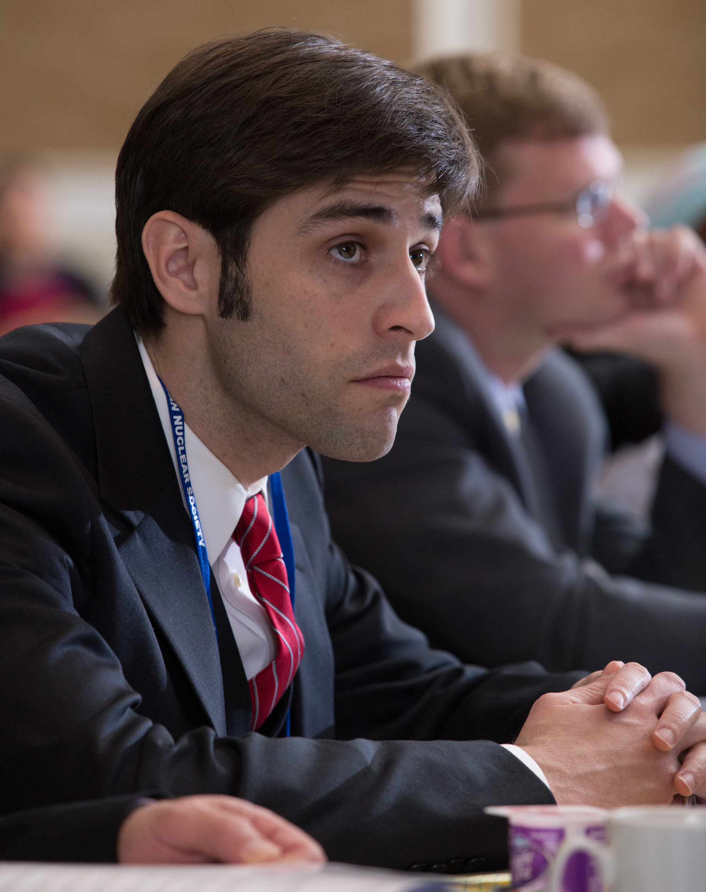
Mission
The American Nuclear Society provides its members with opportunities for professional development, serves the nuclear community by creating a forum for sharing information and advancements in technology, and engages the public and policymakers through communication outreach.

Slide 3
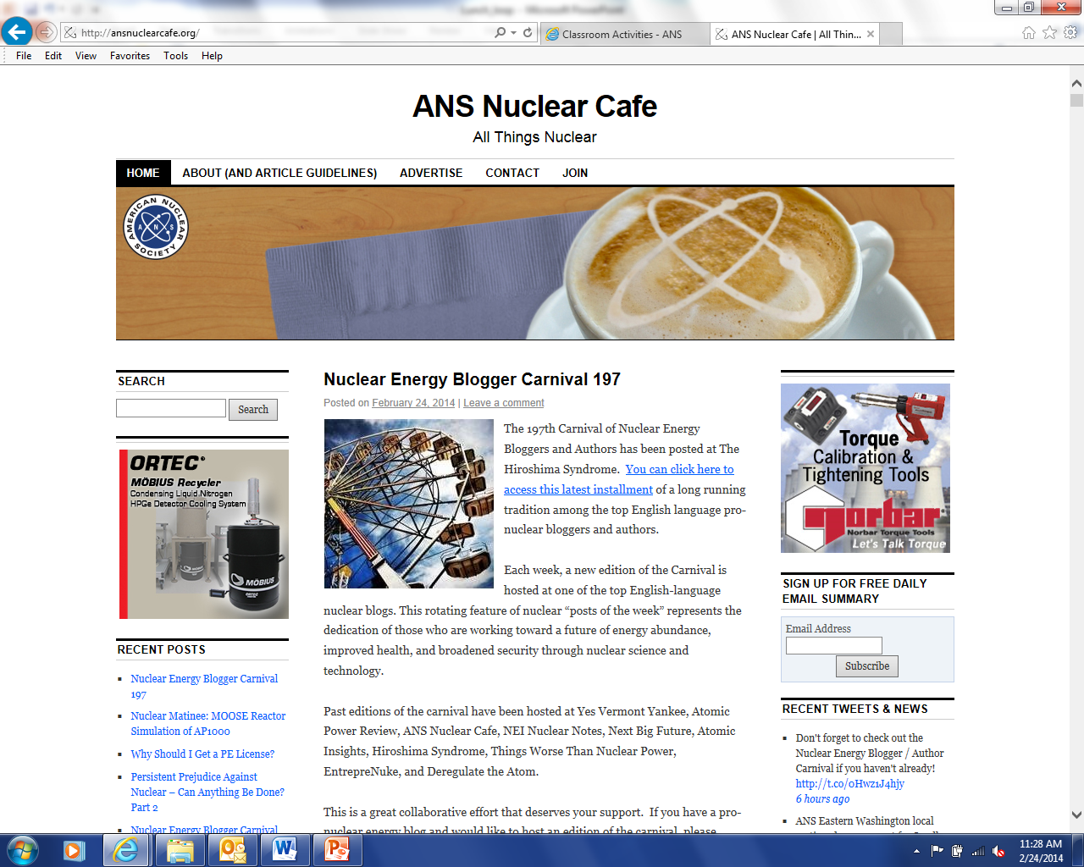
ANS Nuclear Cafe
The official blog of ANS. Ranked by Technorati as a Top 100 Green blog.
Features perspectives of ANS members and updates and developments of interest to ANS members and other nuclear advocates.

Slide 4
Inform. Engage. Inspire

Slide 5
As an initiative of the American Nuclear Society (ANS), the Center for Nuclear Science and Technology Information was conceived to increase understanding of the basic science of the atomic nucleus. Our focus is on the principles of nuclear science and technology, and how brilliant people are employing these principles to improve the human condition. Our goal is to change the conversation about nuclear.

Slide 6
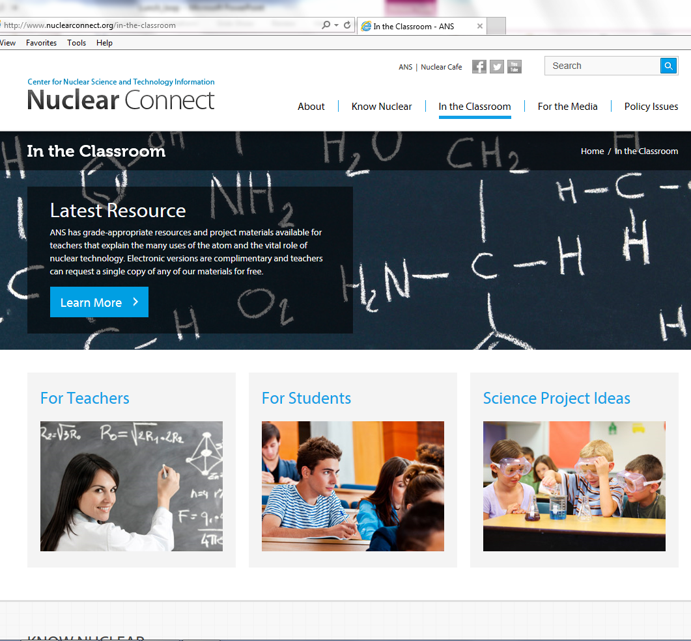

Slide 7
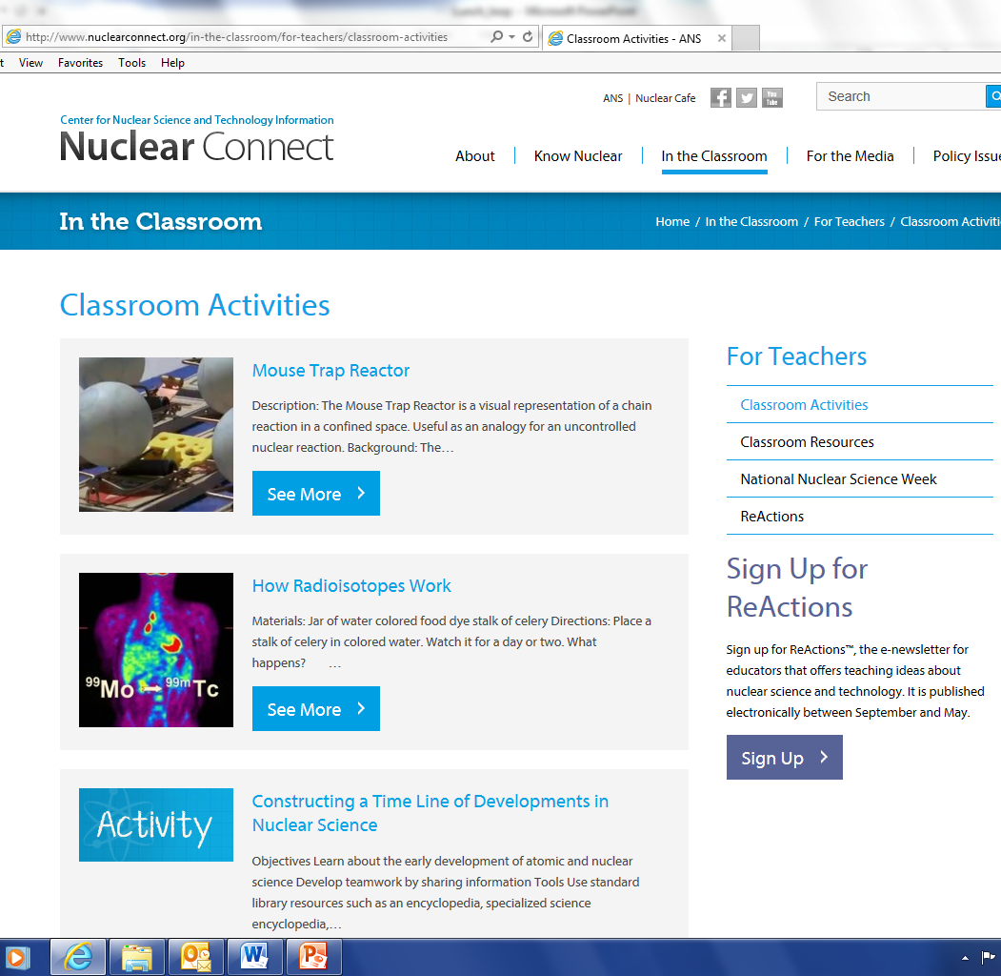
Add Nuclear Science to your curriculum
Text

Slide 8
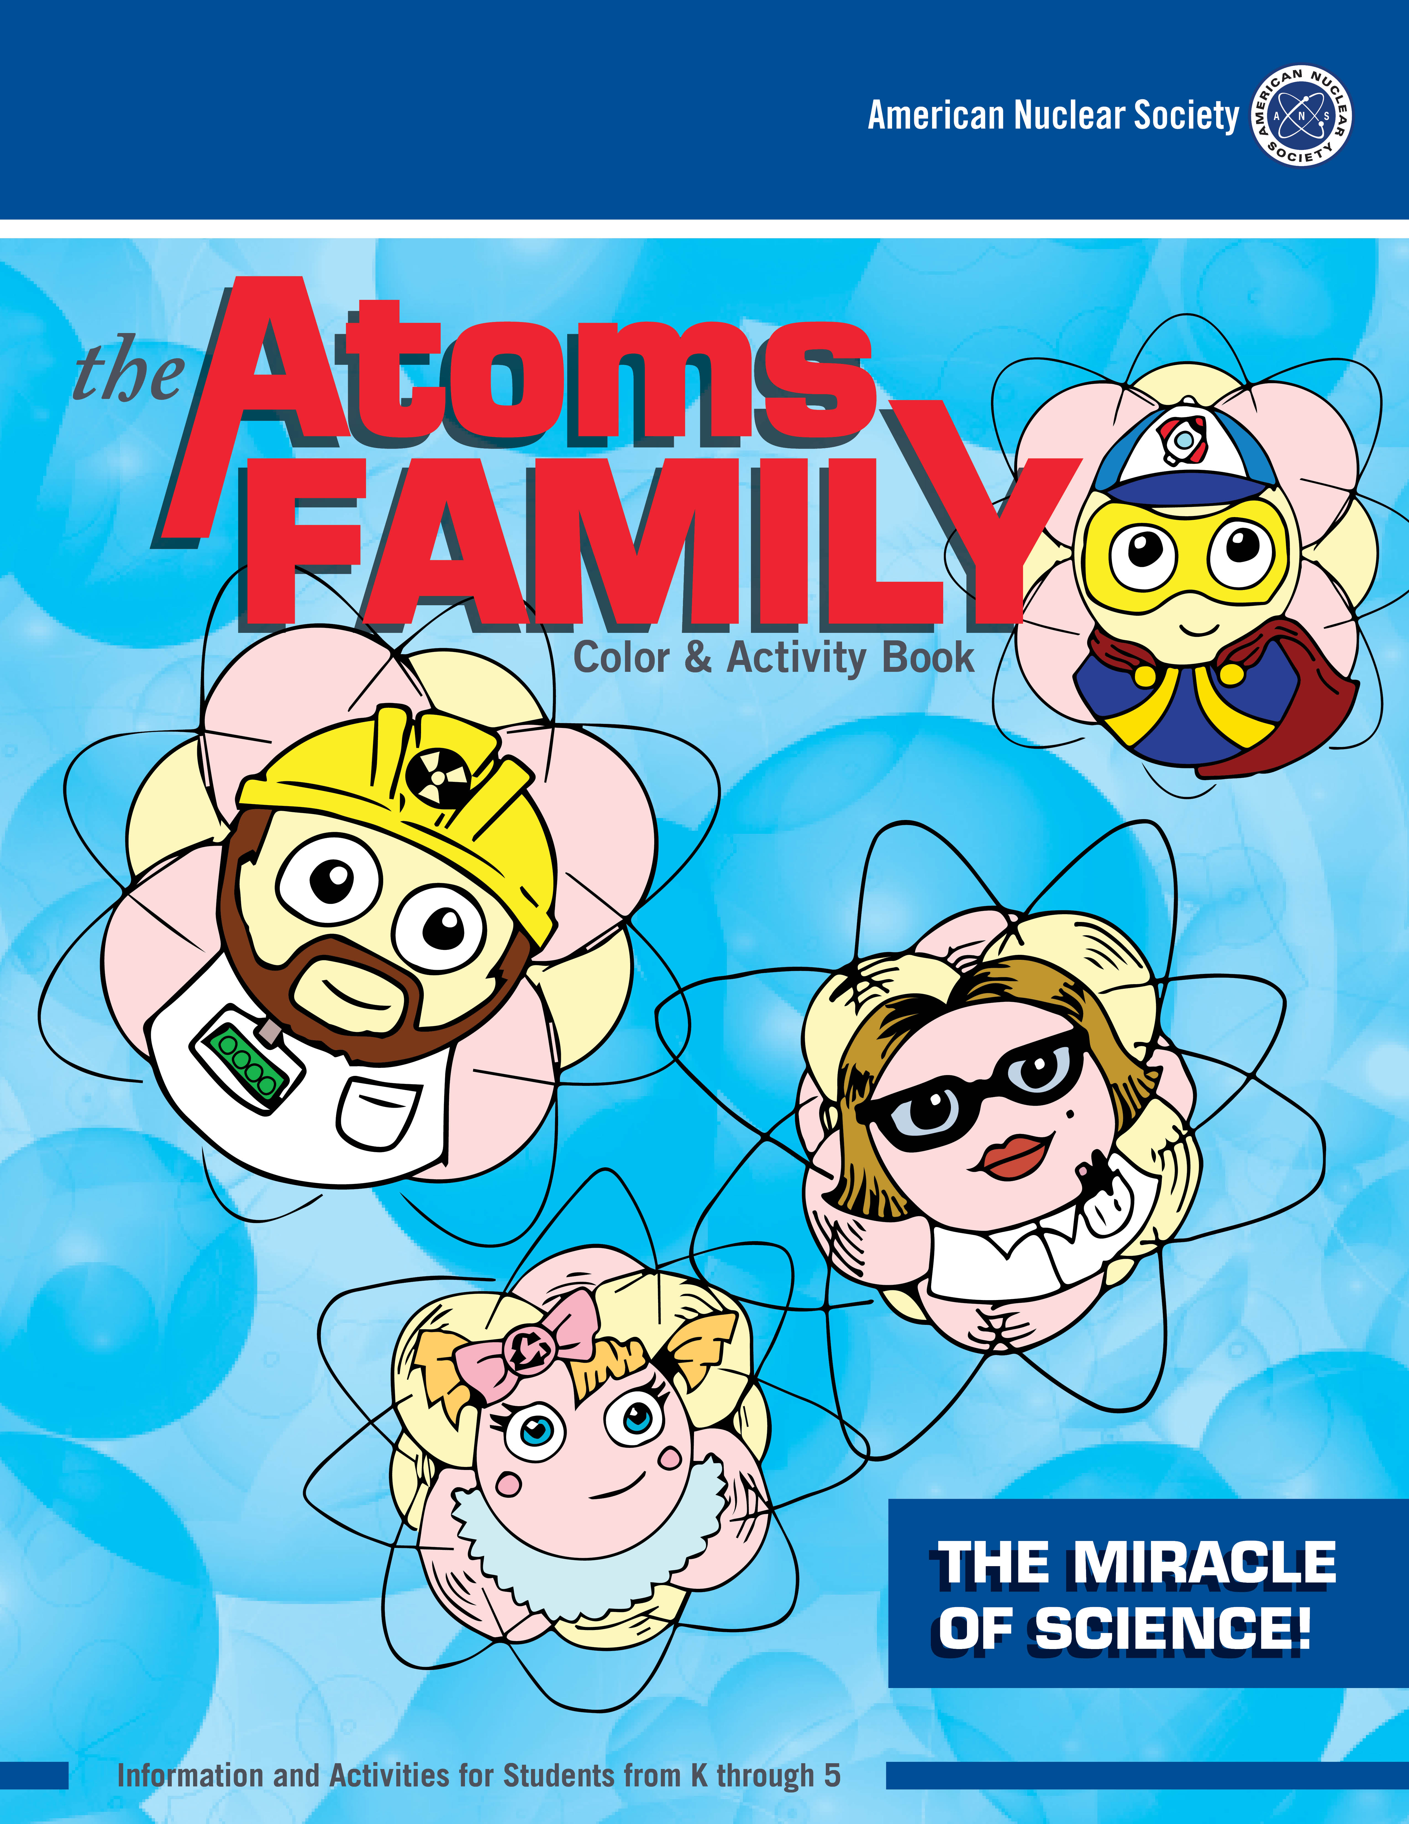
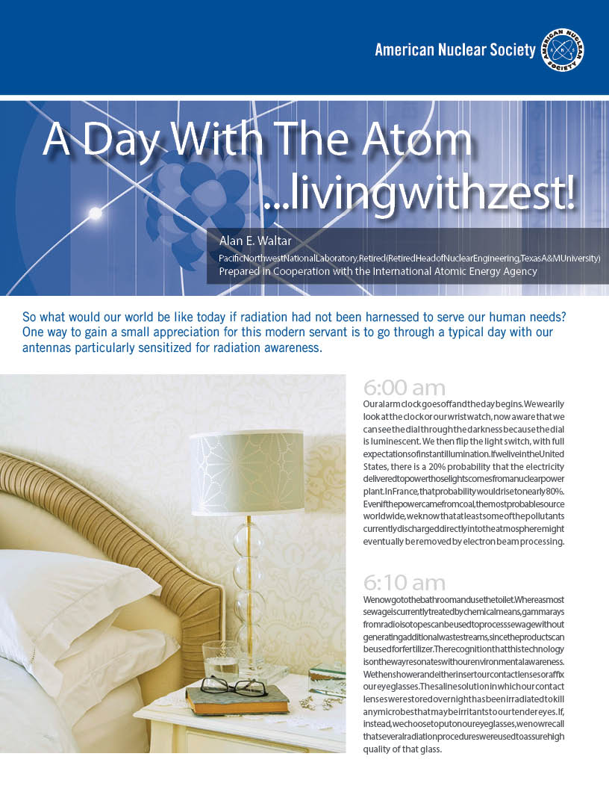
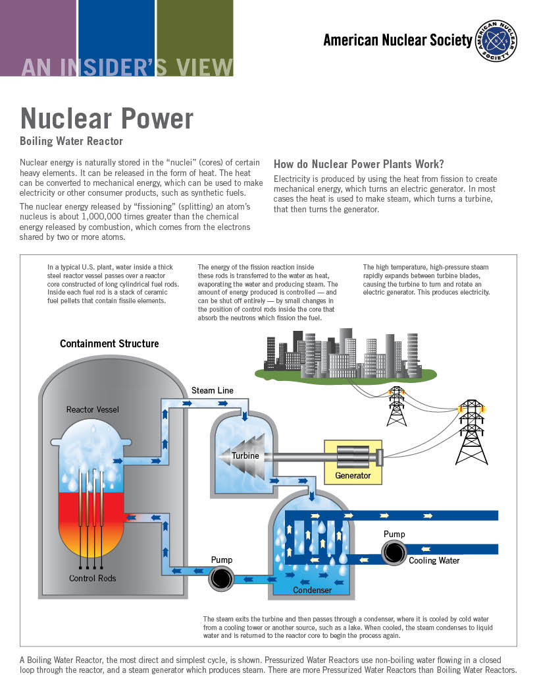
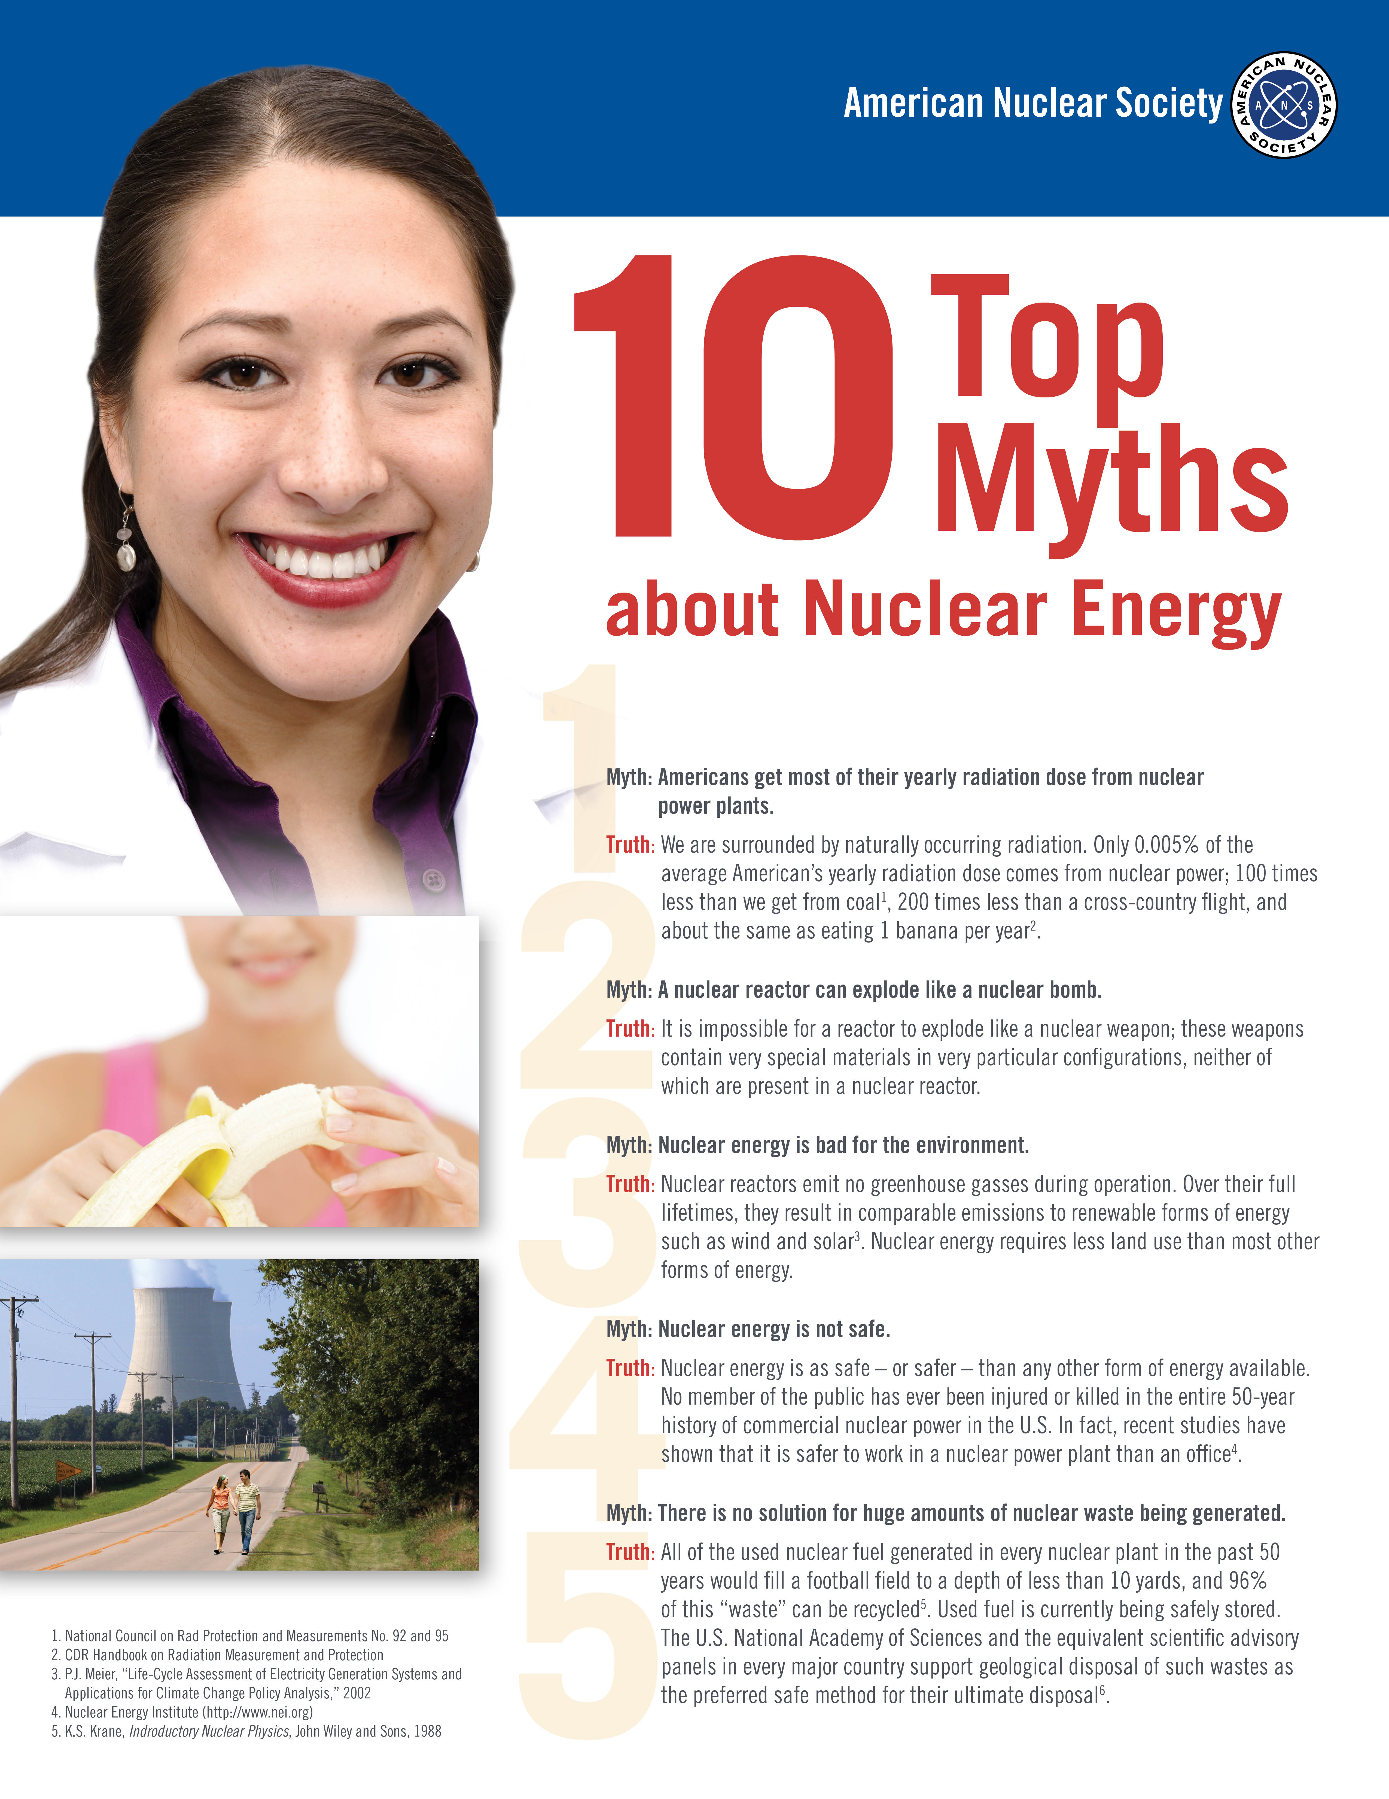

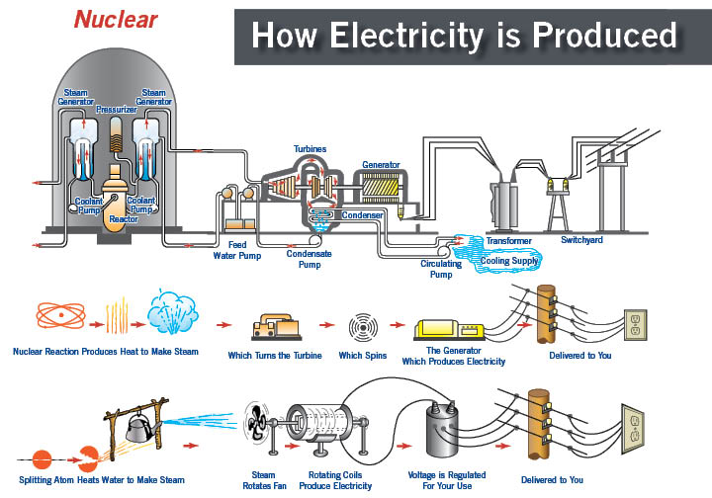
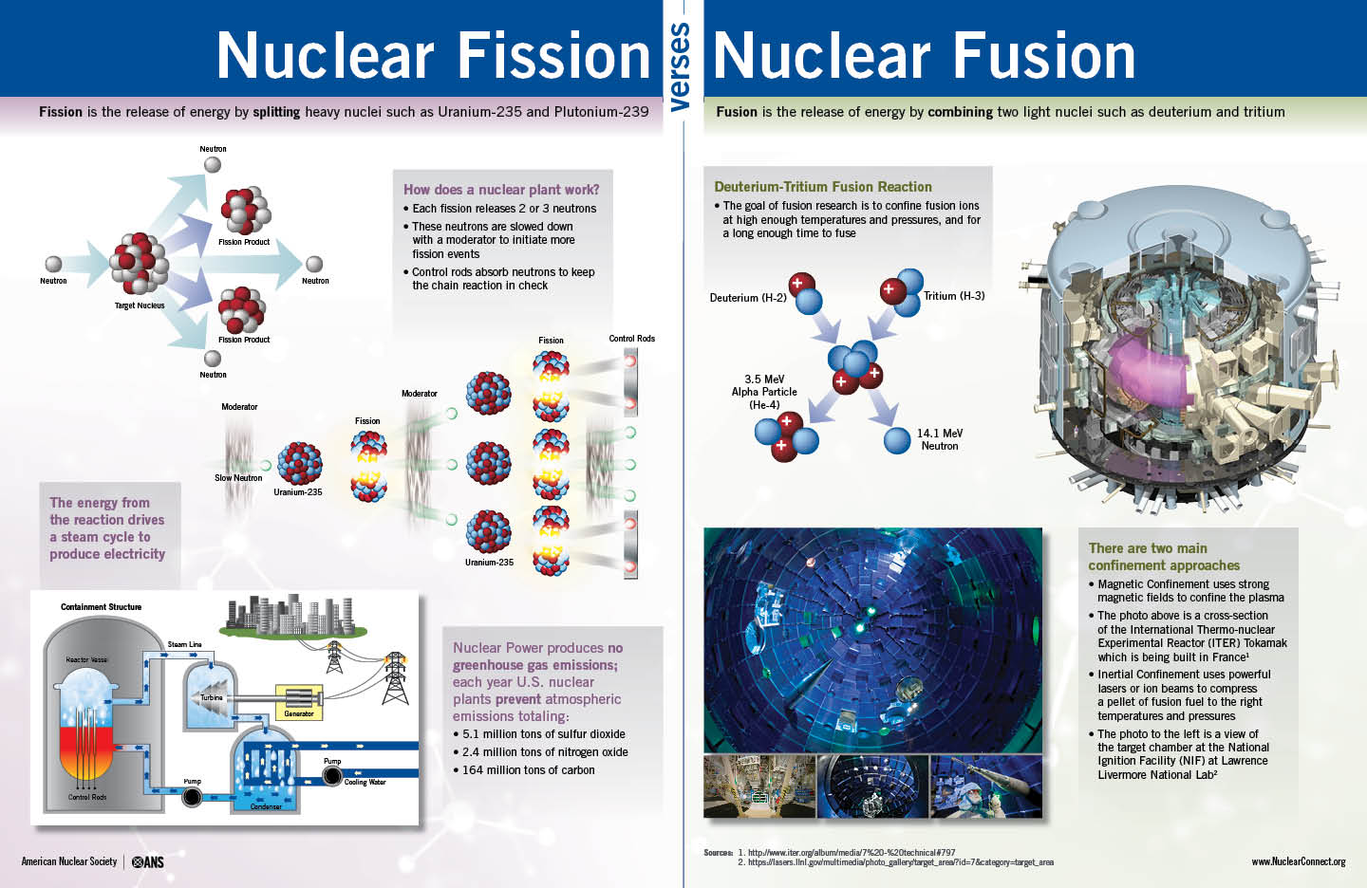
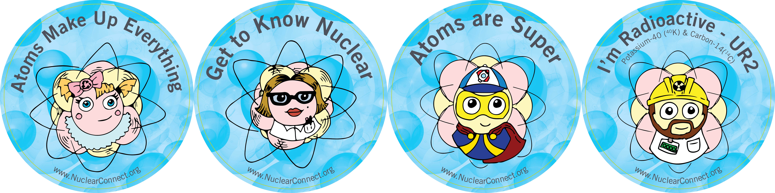
Public Resources

Slide 9
