Slide 2
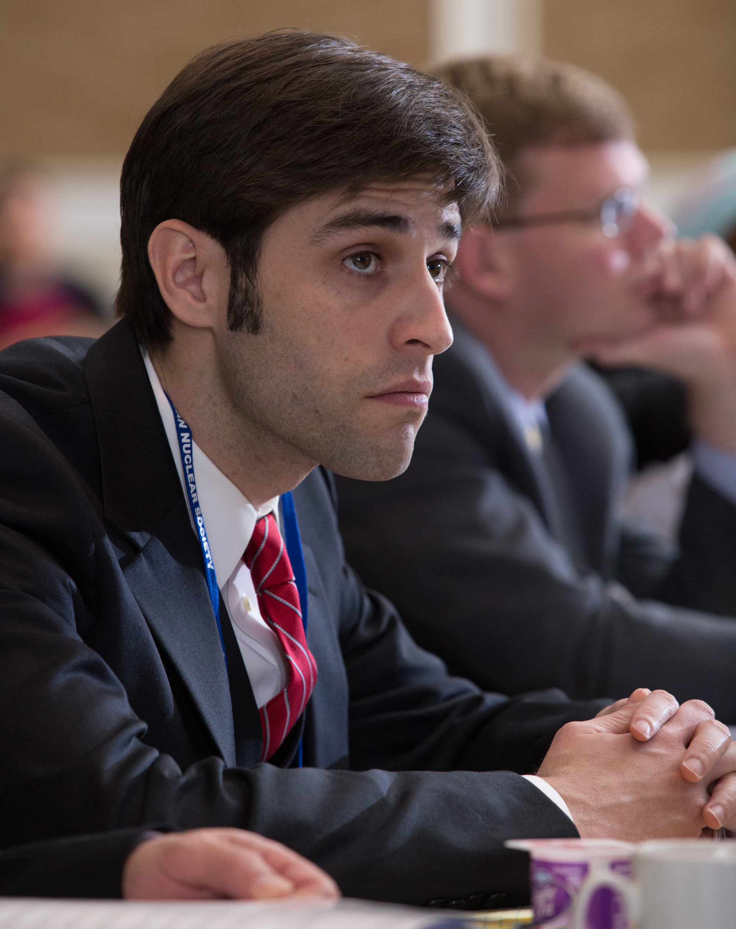
Mission
The American Nuclear Society provides its members with opportunities for professional development, serves the nuclear community by creating a forum for sharing information and advancements in technology, and engages the public and policymakers through communication outreach.

Slide 3
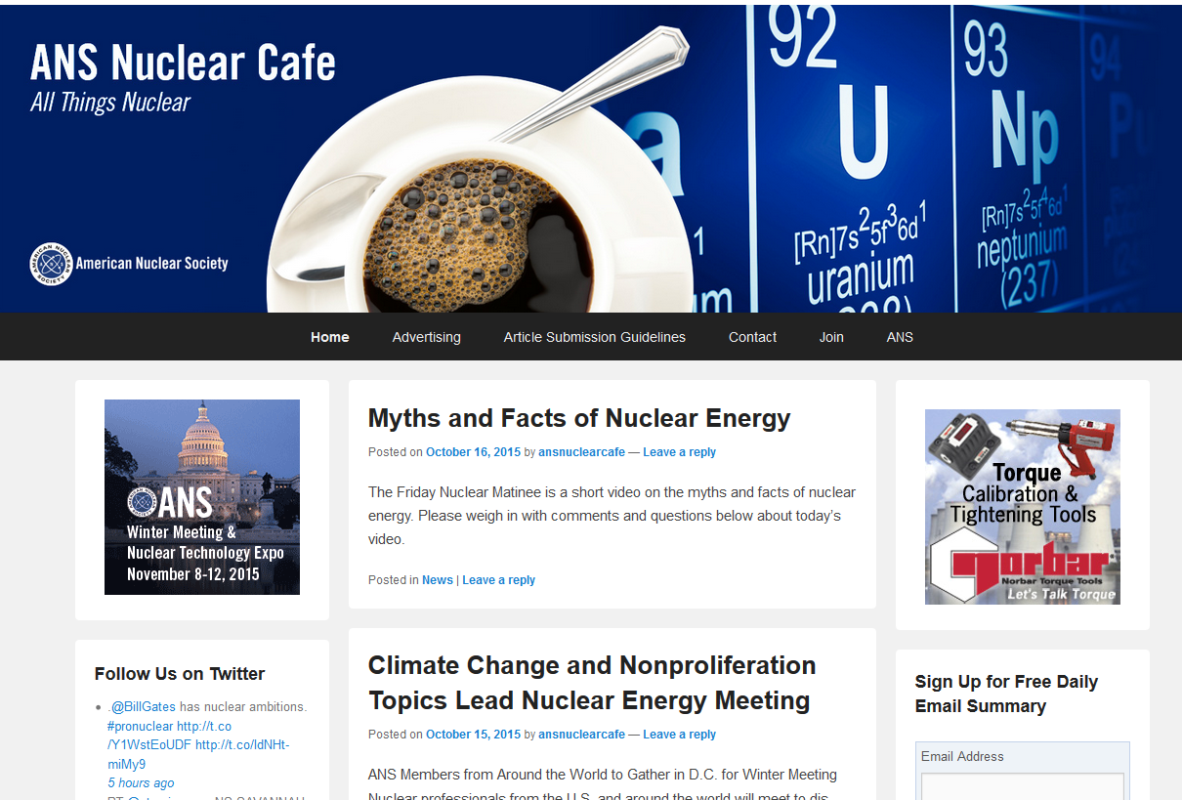
ANS Nuclear Cafe
The official blog of ANS. Ranked by Technorati as a Top 100 Green blog.
Features perspectives of ANS members and updates and developments of interest to ANS members and other nuclear advocates.

Slide 4
www.NuclearConnect.org

Slide 5
What We Do
The Center makes the complex nuclear world easier to understand for the general public. We encourage and inspire fun nuclear education for K-12 students. Most of all, we help people learn the many benefits that nuclear science and technology brings to their lives – from their health to their safety and many conveniences in their everyday lives. Explore our site to find out what you may not know about nuclear!

Slide 6
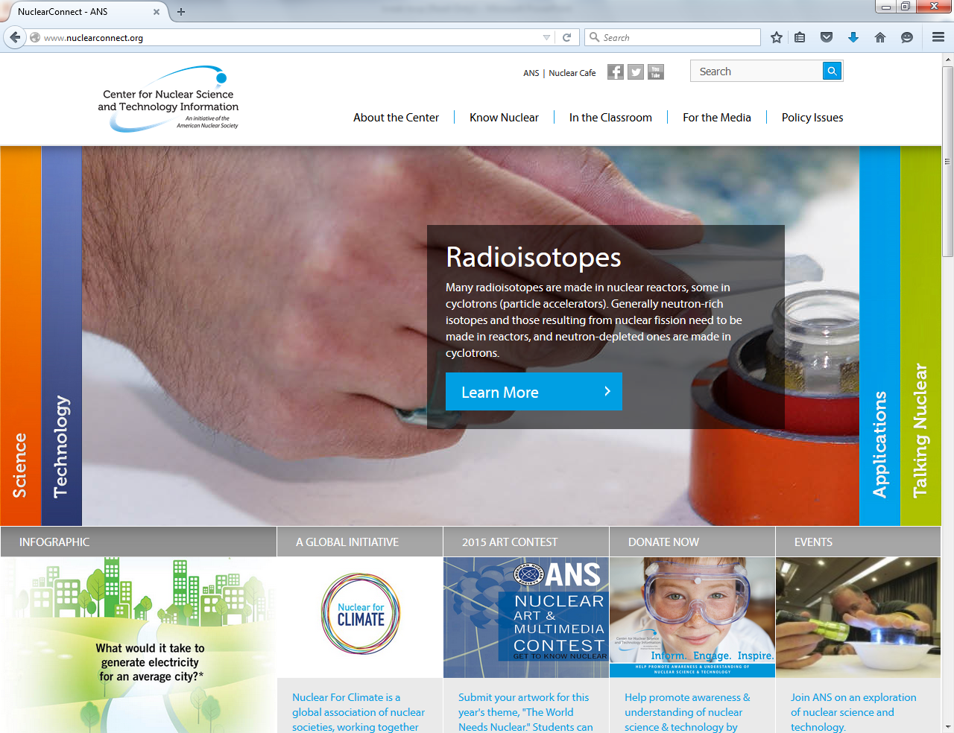

Slide 7
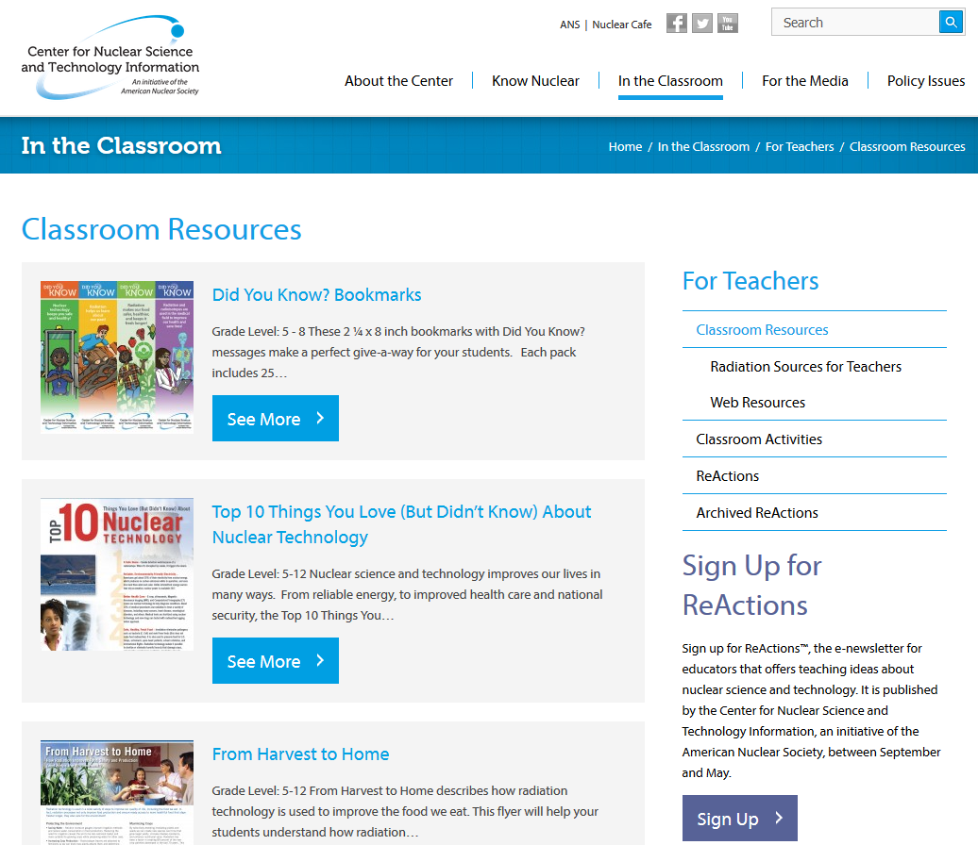
Add Nuclear Science to your curriculum

Slide 8
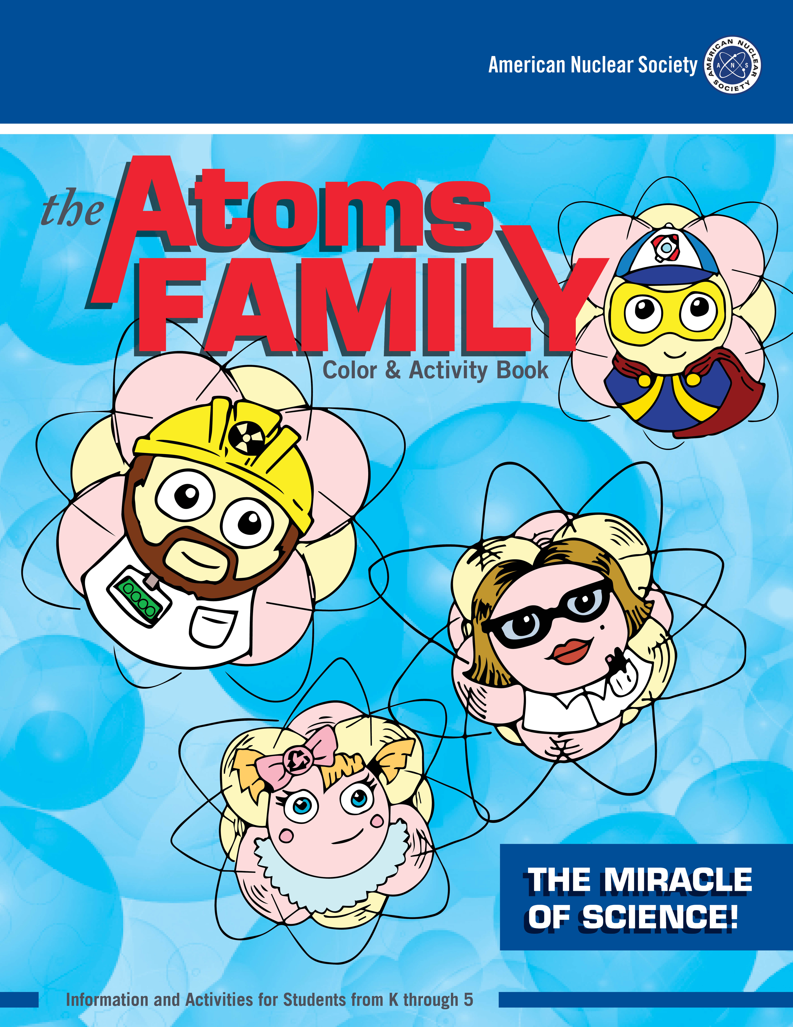
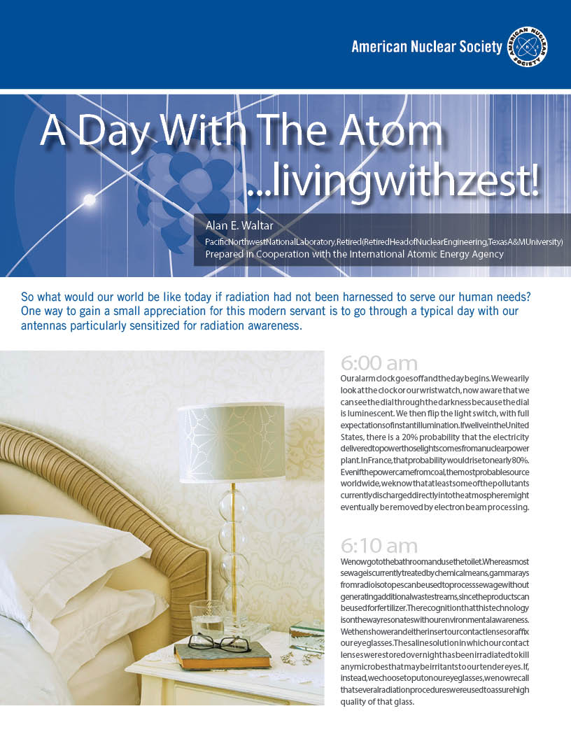
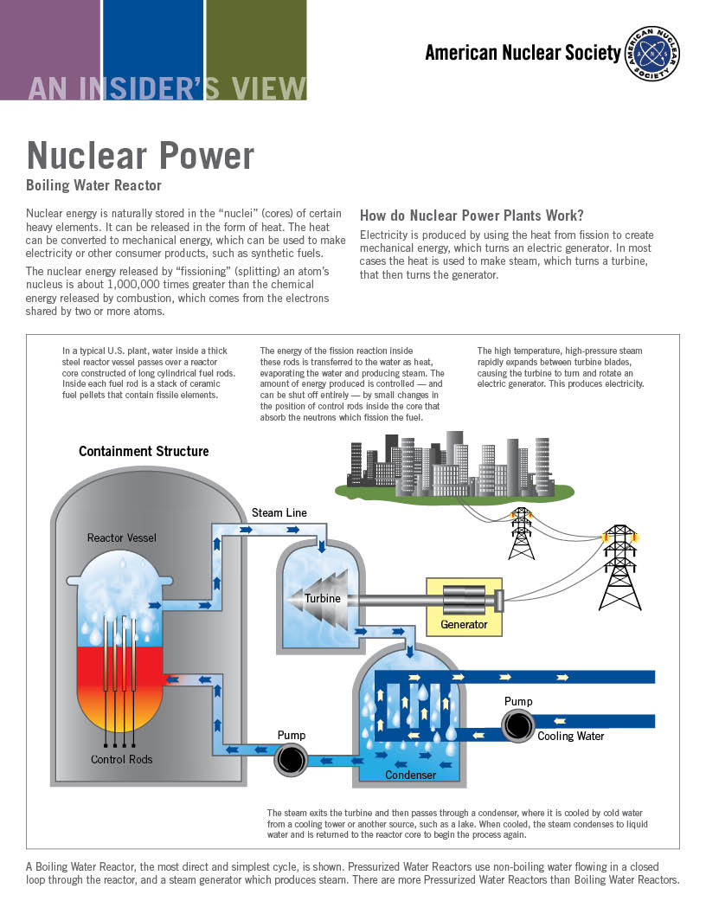
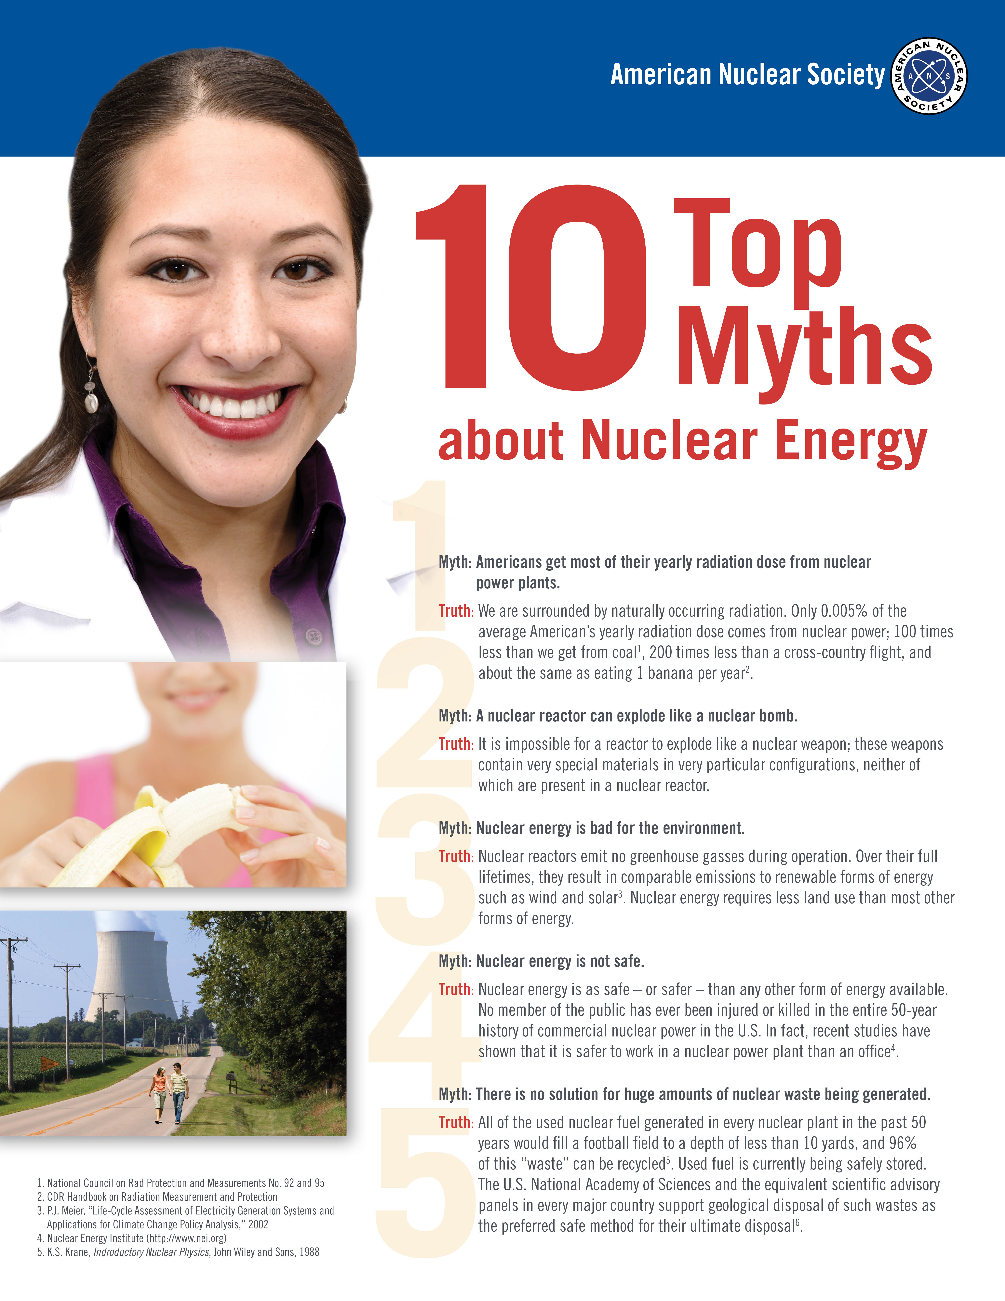

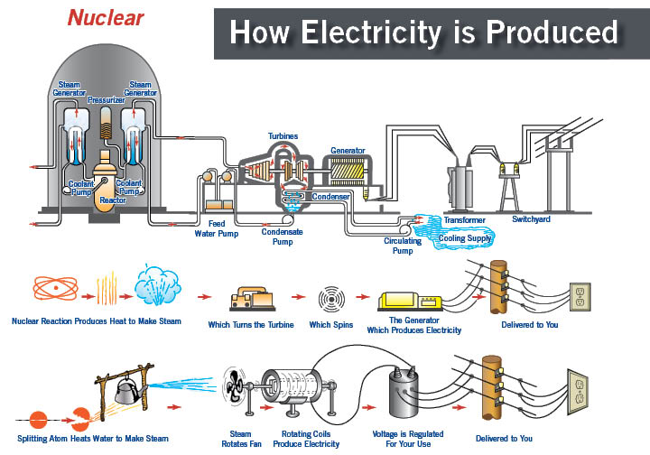
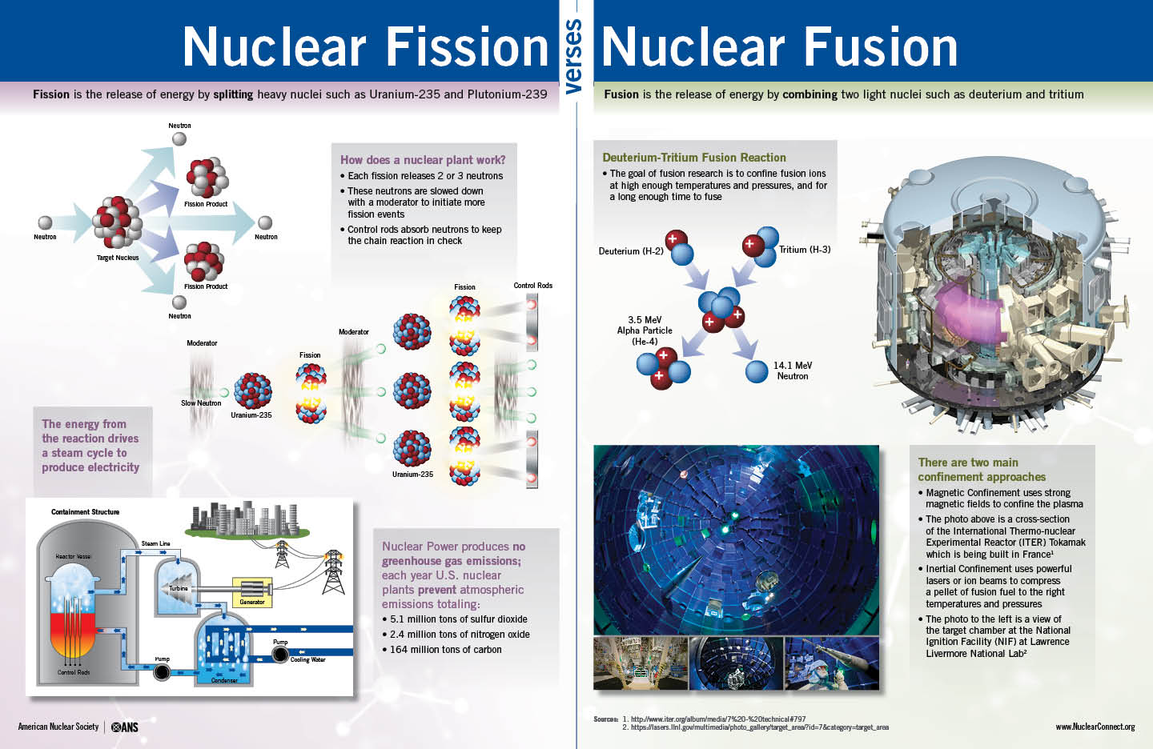
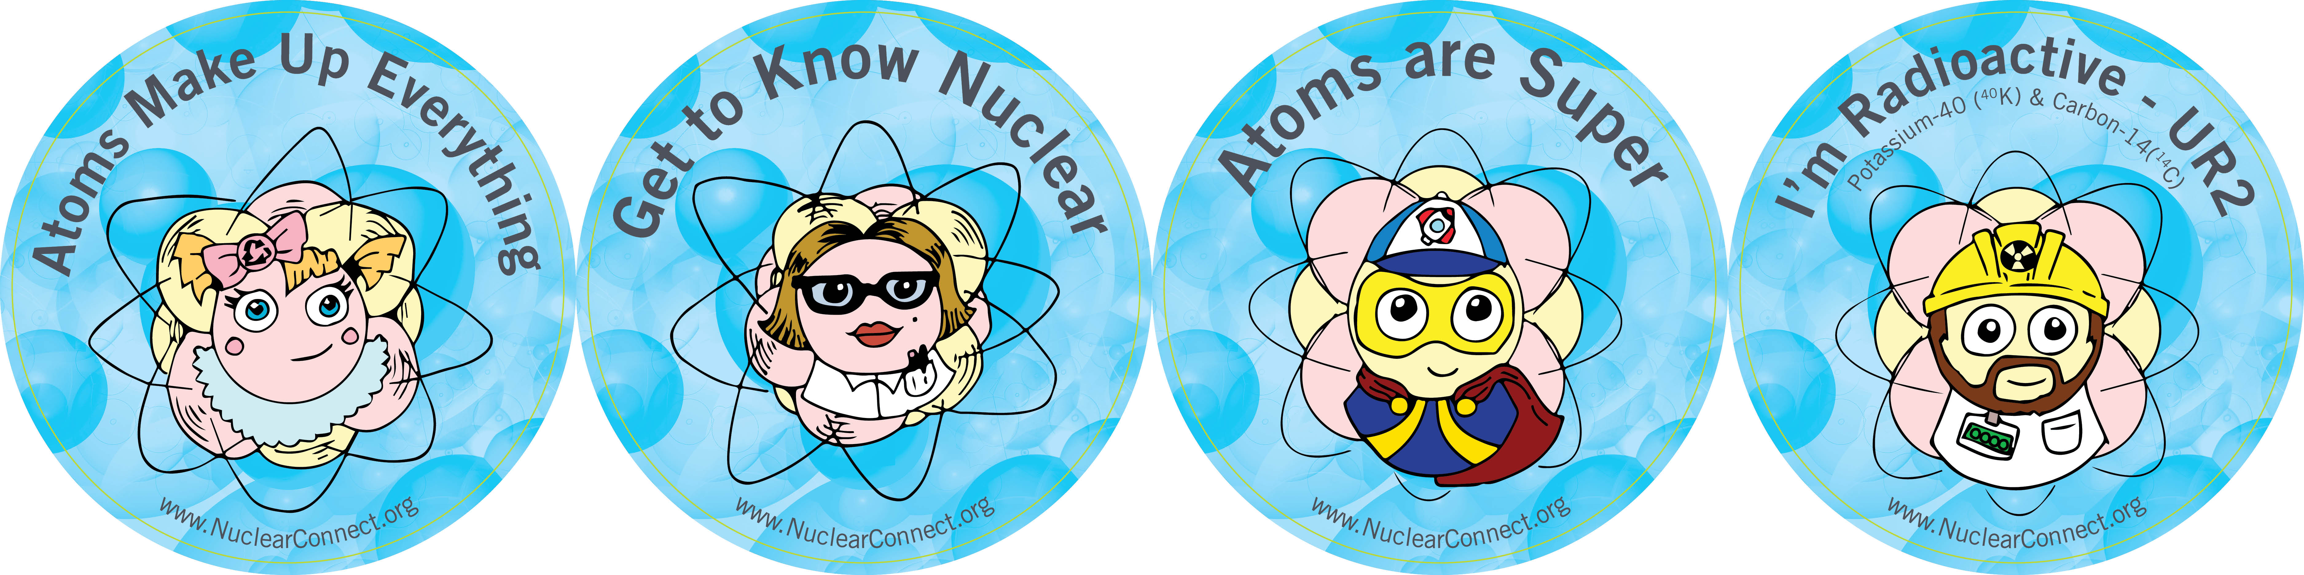
Classroom Resources

Slide 9
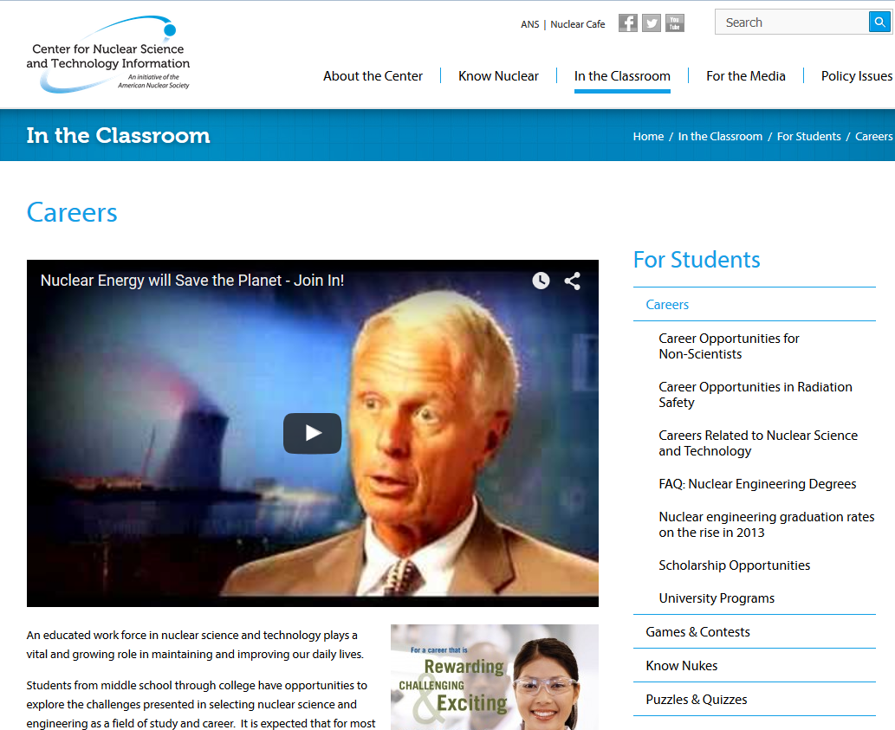
Learn about career opportunities in Nuclear Science

Slide 10
