Slide 1
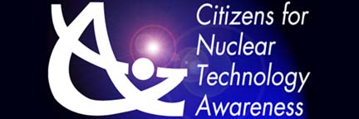
Journey to the Center of the Atom
Bill Wabbersen
Past-Chairman, American Nuclear Society-Savannah River Section
Education Committee, Citizens for Nuclear Technology Awareness
Councilor – South Carolina Academy of Science
Notes:
Describe the organizations that seek to inform the public on the positive attributes of nuclear technologies.

Slide 2
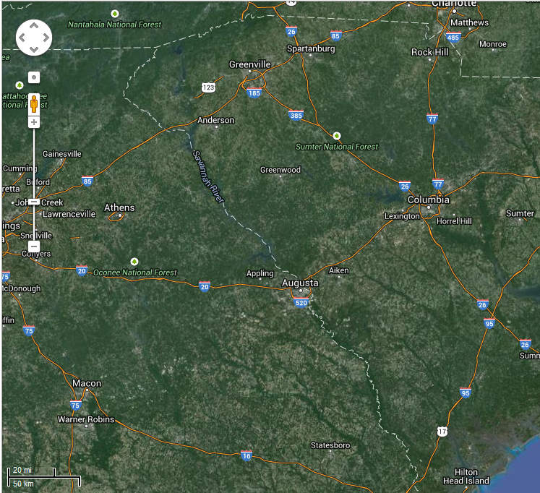
Savannah River Site (SRS)
310 square mile Federal Site (DOE managed)
~ 20 Miles Across
90% forested (USFS)
Produced Nuclear Materials for National Defense, Space Exploration, and Medicine
Savannah River National Laboratory
Savannah River Ecology Laboratory
Designated as a National Environmental Research Park in 1972
Only Nobel Prize awarded in SC (1995, 1956 Neutrino discovery)
Workforce > 10,000 nuclear professionals

Slide 3


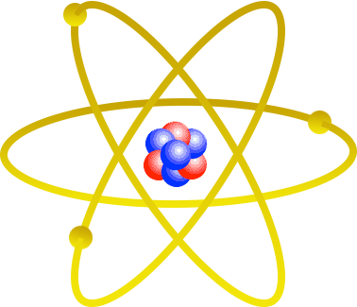
Structure of the Atom
Nucleus
Protons - Charge = +1
Neutrons - No Charge
Mass = 1 amu
Mass = 1 amu (Atomic Mass Unit)
Electron Cloud
Electrons - Charge = -1
Mass = 1/1836 amu
Notes:
Describe the structure of the atom
- State that knowledge of the units is not important, just the relationship
between the atoms parts
+1 ecu to -1 ecu
1 amu to 1/1836th amu
Any Questions?
Basics are important

Slide 4
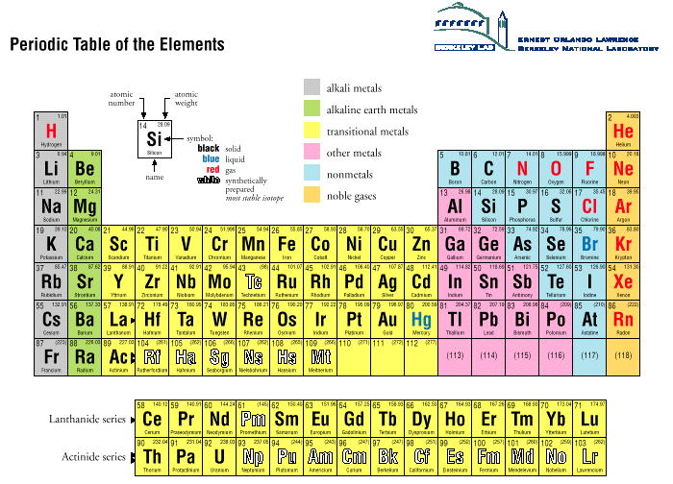
Periodic Table
Notes:
Periodic Table
Describes the chemical properties of elements
Dependent upon the number of protons (charge)
Arranged by the number of protons

Slide 5
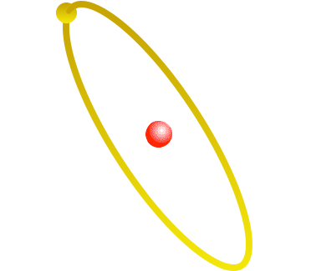
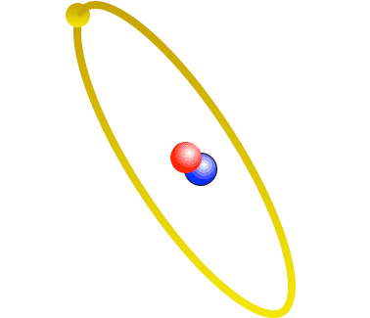
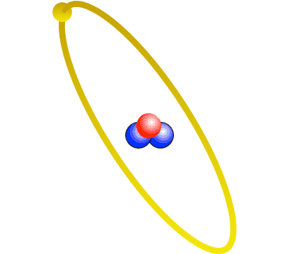
Isotopes
Three Isotopes of Hydrogen
Hydrogen
H-1
Deuterium
H-2
Tritium
H-3
Notes:
ISOTOPES
Each element can have a varied number of neutrons
This does not change the chemical properties of the element, but it does change the weight of the atom.
Hydrogen – Weighs 1 amu
Deuterium – Weighs 2 amu (same chemical properties as Hydrogen)
Tritium – Weighs 3 amu (same chemical properties as Hydrogen) (Made at SRS)

Slide 6
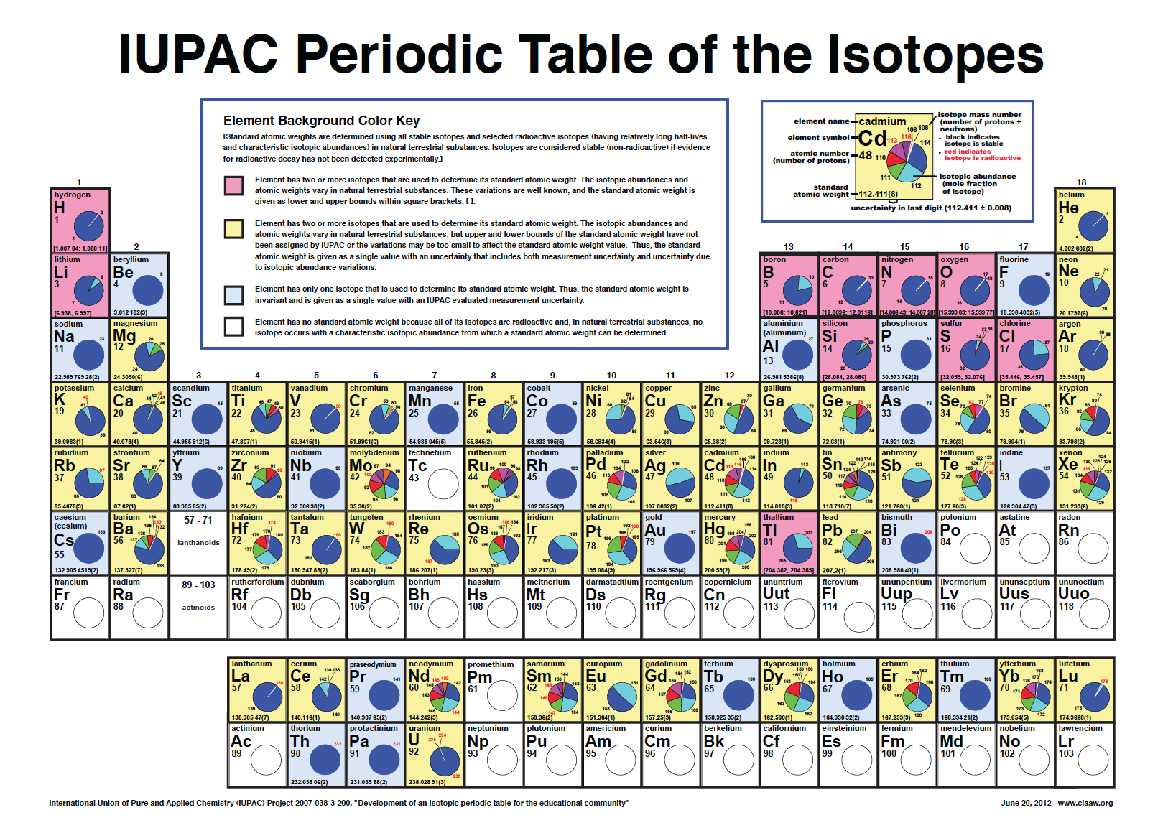
Notes:
Pink: Element has two or more isotopes that are used to determine its standard atomic weight. The isotopic abundances and
atomic weights vary in natural terrestrial substances. These variations are well known, and the standard atomic weight is
given as lower and upper bounds within square brackets, [ ].
Yellow: Element has two or more isotopes that are used to determine its standard atomic weight. The isotopic abundances and
atomic weights vary in natural terrestrial substances, but upper and lower bounds of the standard atomic weight have not
been assigned by IUPAC or the variations may be too small to affect the standard atomic weight value. Thus, the standard
atomic weight is given as a single value with an uncertainty that includes both measurement uncertainty and uncertainty due
to isotopic abundance variations.
Blue: Element has only one isotope that is used to determine its standard atomic weight. Thus, the standard atomic weight is
invariant and is given as a single value with an IUPAC evaluated measurement uncertainty.
White: Element has no standard atomic weight because all of its isotopes are radioactive and, in natural terrestrial substances, no
isotope occurs with a characteristic isotopic abundance from which a standard atomic weight can be determined.

Slide 7
Standard Nuclear Notation
Mass Number
A = Z + N
(N = # of Neutrons)
Chemical Symbol
A
X
Z
Atomic Number
# of Protons
12
C
13
C
14
C
12
C
13
C
14
C
or
6
6
6
Notes:
Standard Nuclear Notation or Standard Atomic notation is used in chemistry and physics to indicate the atomic number and mass number of an isotope.
Nuclear notation is formed by writing an elemental symbol preceded by a subscript indicating its atomic number (number of protons) and a superscript indicating its mass number (number of nucleons).
For example, carbon-12 has an atomic
number of 6 and a mass number of 12.
It is common to drop the atomic number.
It is redundant with the symbol.

Slide 8
Let’s Practice using Standard Nuclear Notation
How many Protons are in ?
1
Mass Number
A = Z + N
(N = # of Neutrons)
H
Chemical Symbol
1
One
A
X
7
Li
How many Neutrons are in ?
3
Four
Z
Atomic Number
# of Protons
17
O
How many Protons are in ?
8
Eight
1
H
How many Neutrons are in ?
1
Zero

Slide 9
Building a 3D Periodic Table
Stack Elements
by atomic mass
Smallest on top
Largest on bottom
Notes:
9

Slide 10
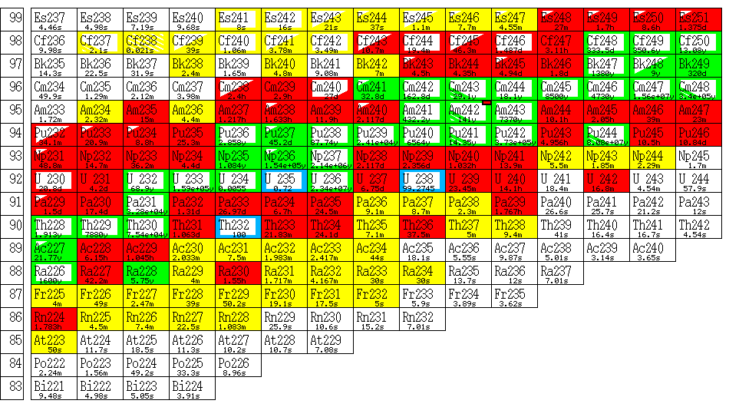
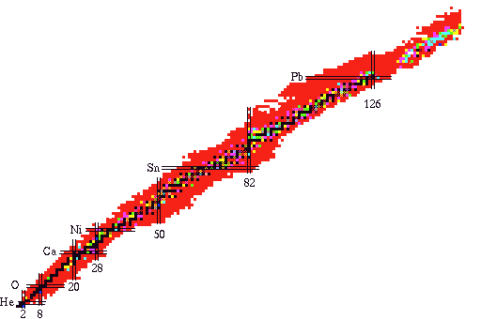
Chart of the Nuclides
Notes:
CHART OF NUCLIDES
A different way to look at the Periodic Table.
It contains much more detailed information regarding all of the elements/isotopes known to man.
Describes the radioactive materials that are known.
The details are not important for this lecture, but there is one concept that is important:
LINE OF STABILITY
The chart of nuclides is a graph of protons versus neutrons
The stable isotopes (non-radioactive) are shown along the “Line of Stability”
Low weight elements tend to balance equal number of protons to neutrons. The heavier you get the more neutrons you need to keep things together.
The protons all have a “+” charge and they repel each other (like magnets)
The neutrons act as glue holding everything together with a strong nuclear force

Slide 11


Interactive Nucleus
at the
Ruth Patrick Science Education Center
at the
University of South Carolina- Aiken

Slide 12
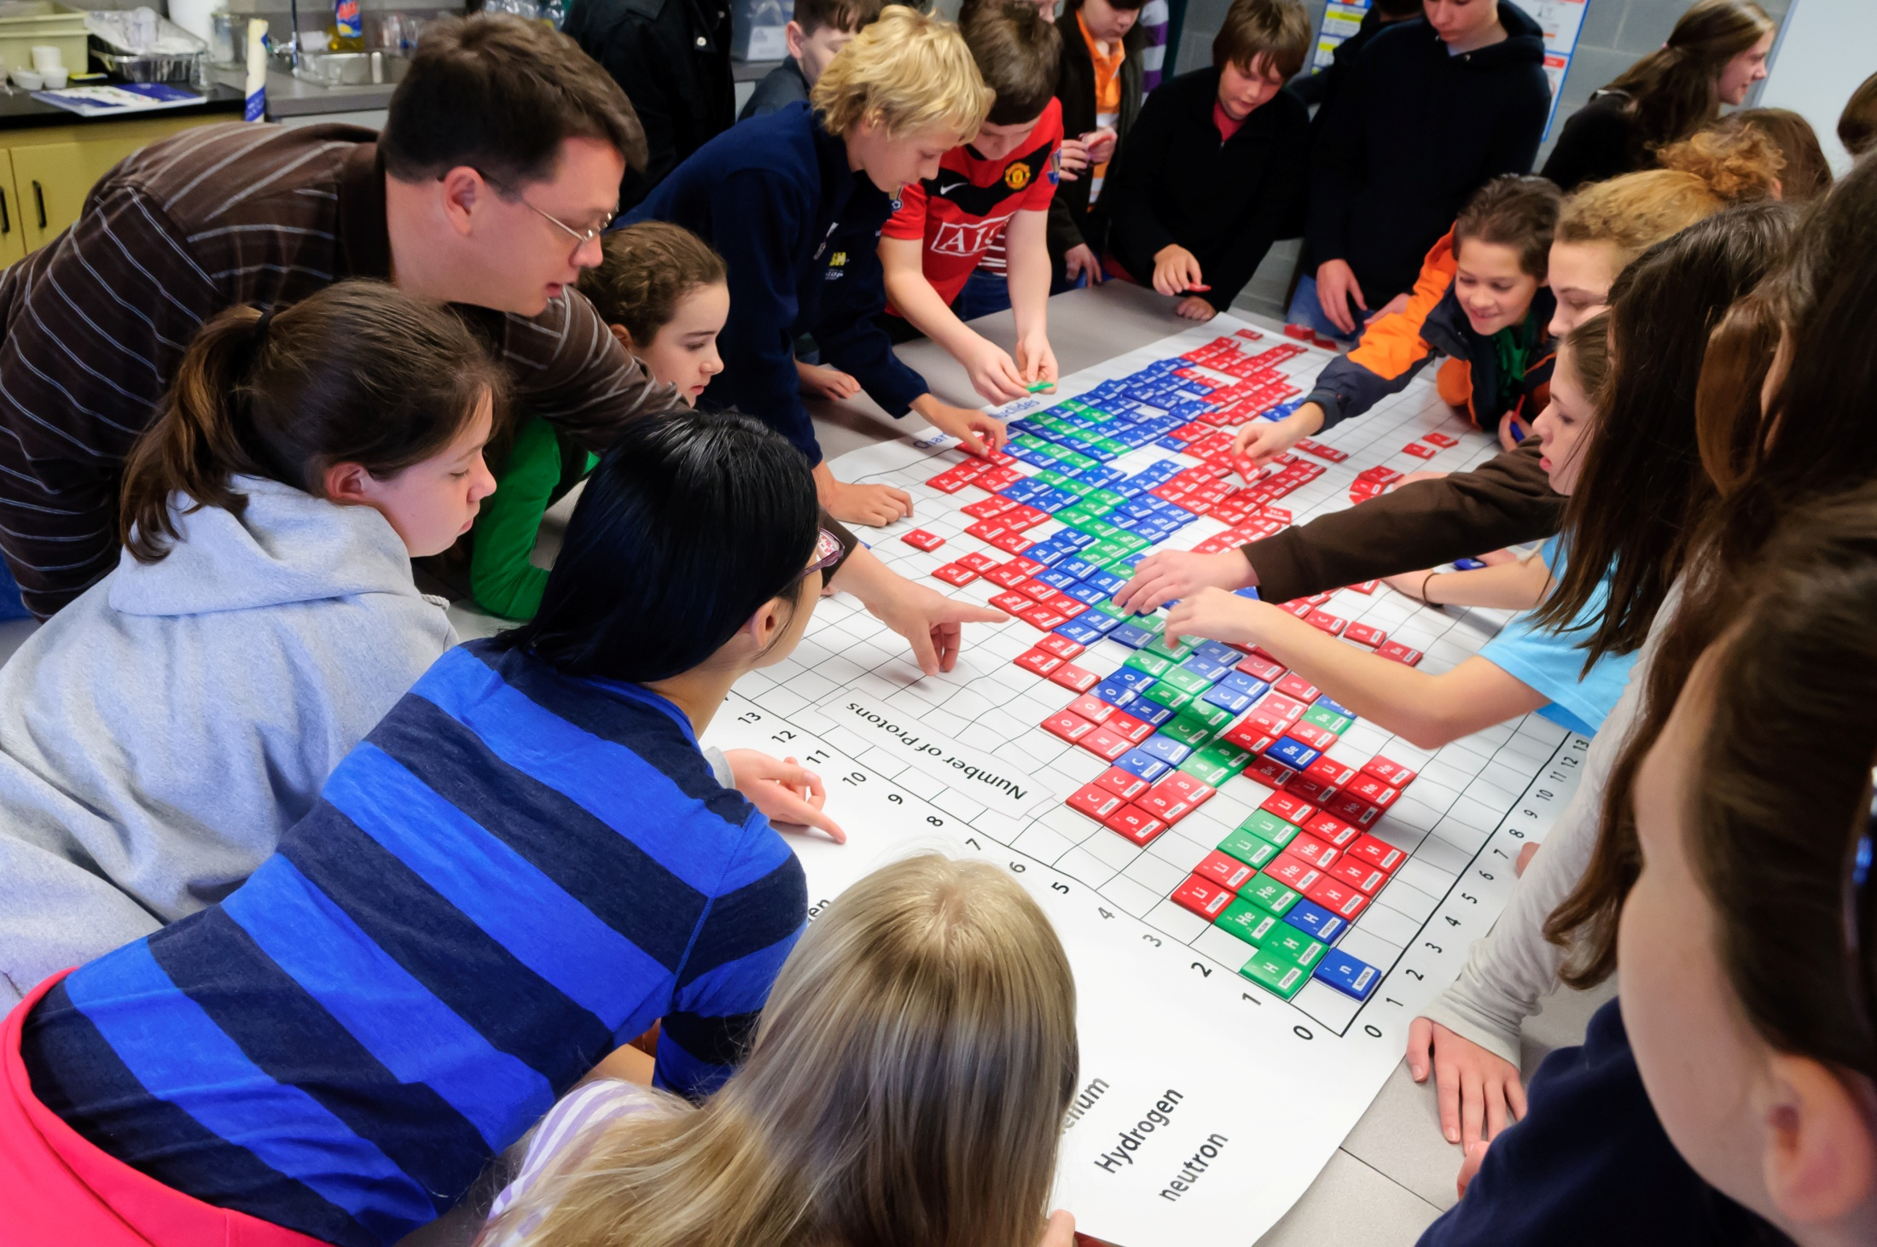

Slide 13
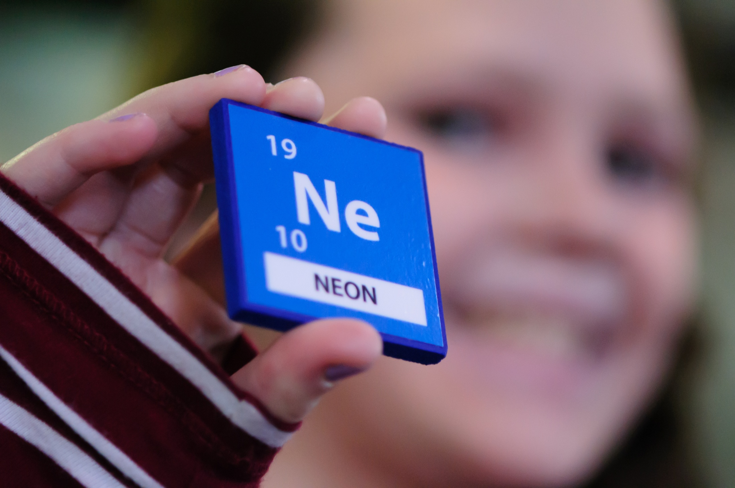

Slide 14


Slide 15


Slide 16


Slide 17
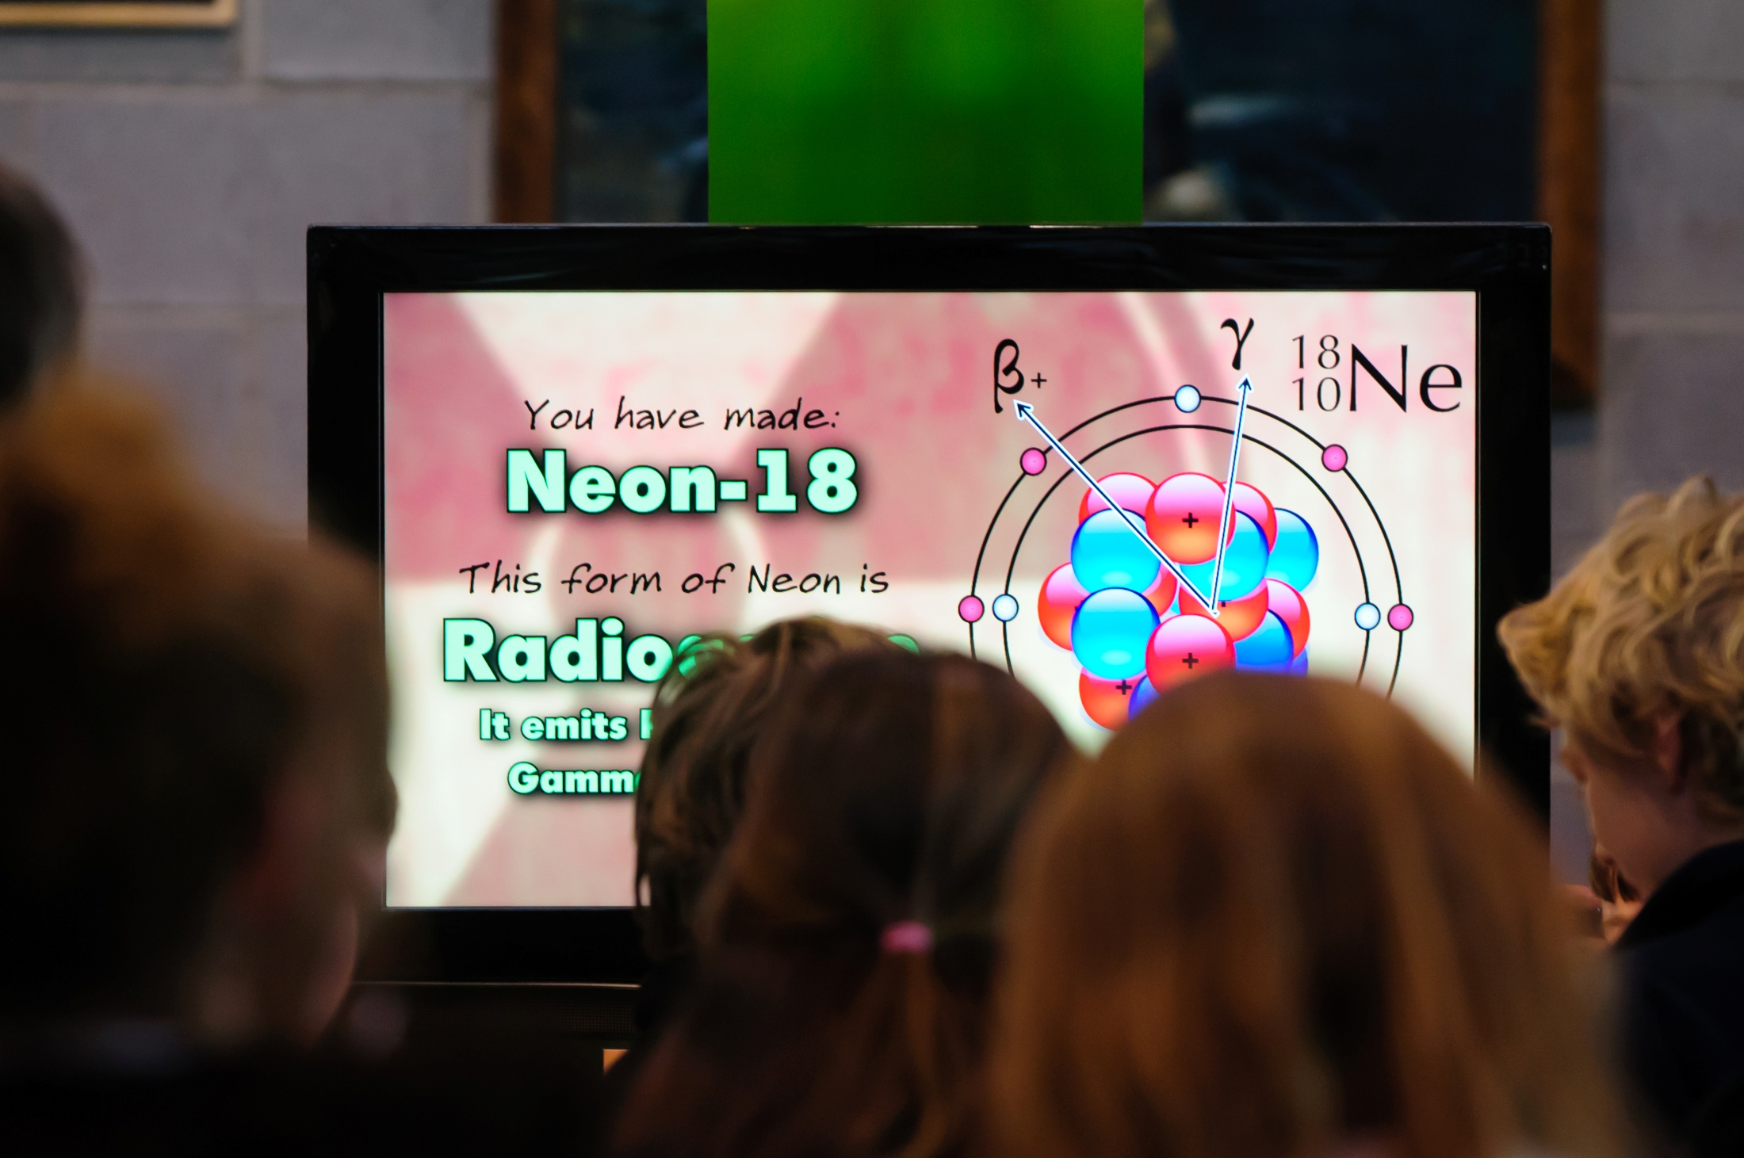

Slide 18
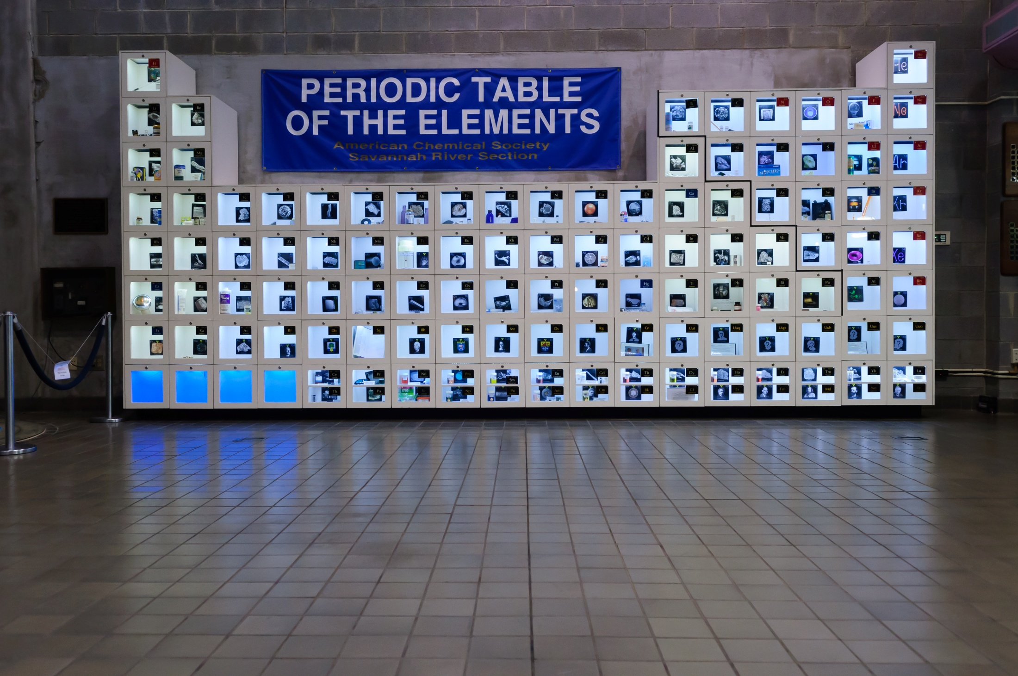

Slide 19


Slide 20
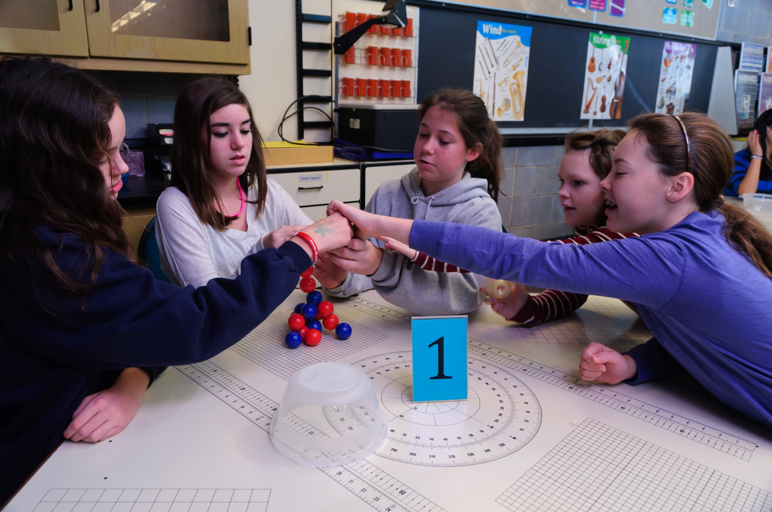


Slide 21
Why is this important to students in the southeastern states?

Slide 22
Nuclear Facilities in the Southeast
Nuclear Materials
Plant
Existing Nuclear Power Plants (15)
New Power Plants (4)
Southeastern Universities (9)
Fuel Fabrication Plants (2)
Nations Only Fuel Recycling Plant
Naval Nuclear Training Facilities
Potential New Nuclear Power Plants (2)

Slide 23
Questions?

