Slide 1
Radiation Applications
Application Cards
Find the type of radiation used for your application. Note: If more than one type – choose one
Group according to type of radiation
Compare and contrast applications
Discuss
Choose 1 or 2 applications that are most interesting to present
Group presentation
Each radiation type will be presented as a group
First - read the title (application) of all cards
Ask if any other people in room have this type of radiation on card - read title
Group members provide a short summary of group discussion
One or two people will present their application in more detail

Slide 2
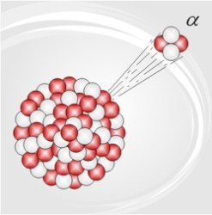
Alpha Radiation
Helium nucleus
Positively charged (+2)
Easily shielded
High Linear Energy Transfer (LET) – a lot of energy deposited in a short distance
http://www.universetoday.com/45096/alpha-radiation/

Slide 3
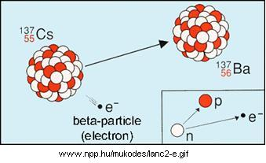
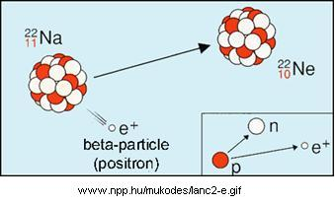
Beta Radiation
Electrons – that come from the nucleus during radioactive decay
The electrons can be positively charged (positron) or negatively charged (negatron – most common)
Since particle is smaller requires more shielding than Alpha
High energy beta particles can cause secondary interactions with high Z materials such as lead

Slide 4
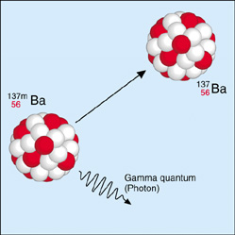
Gamma Radiation
Photon
Electromagnetic radiation (high frequency – short wavelength)
Very penetrating
Low LET Linear Energy Transfer (LET) – very little energy deposited per unit distance
Can accompany Alpha & Beta decay
Meta-stable state (m) is gamma only emission
http://reich-chemistry.wikispaces.com/k.+Pachecho+powerpoint+presentation

Slide 5
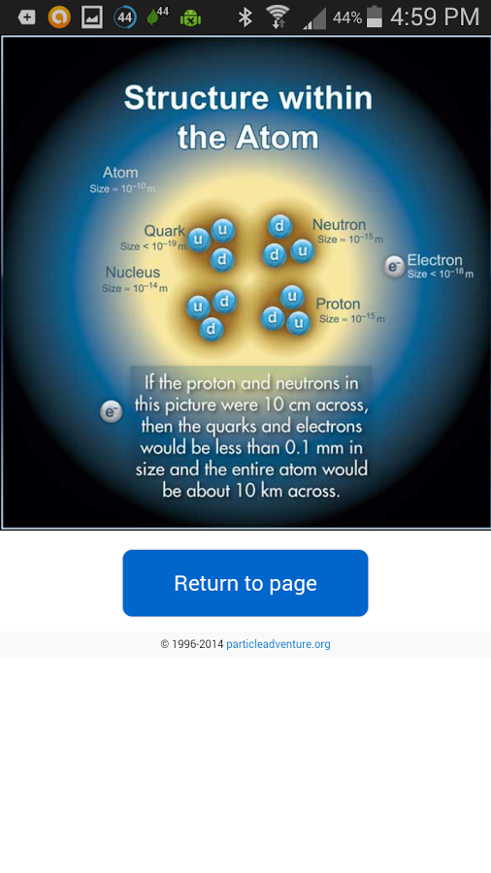
Neutrons
Neutral particles found in the nucleus
Only a few atoms decay by giving off a neutron (mostly from fission products)
Neutrons can cause reactions, make materials “radioactive” and are emitted from the fission process

Slide 6
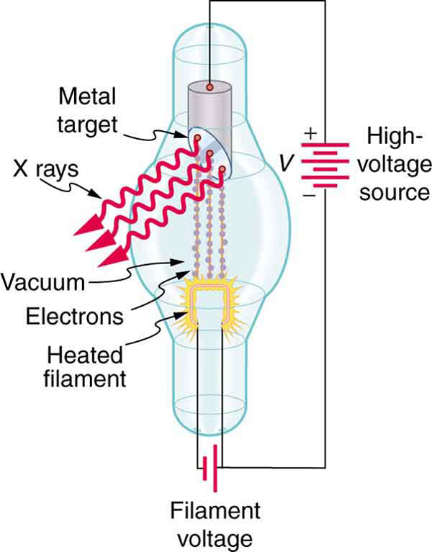
X-rays
Photon – defined by origination
Electromagnetic radiation (high frequency – short wavelength)
Very penetrating
Low LET Linear Energy Transfer (LET) – very little energy deposited per unit distance
Source: http://voer.edu.vn/m/photon-energies-and-the-electromagnetic-spectrum/15d6c4d0

Slide 7
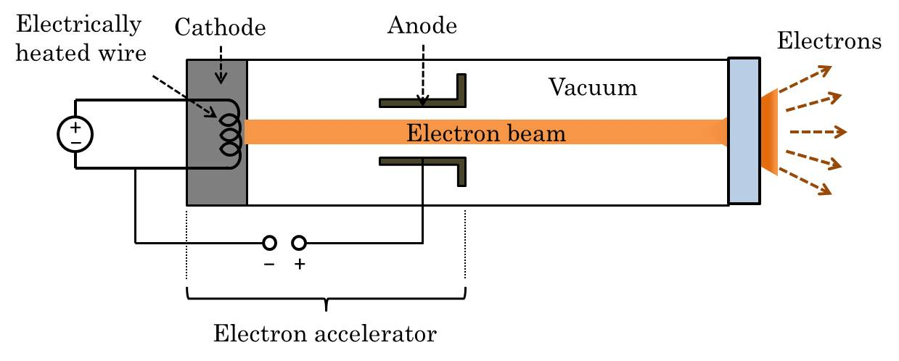
E-beam
E-beam is a beam of electrons - generated by an accelerator
Negatively charged electrons
dik electron beam generator,علوم مهندسرشته زبان ..
1239 x 498 44.5KB
dik.ir

