Slide 1
Introduction to Nuclear Energy
Candace Davison
Senior Reactor Operator
Penn State University

Slide 2
Energy in the United States
43%
24%
19%
11%
2%
Notes:
Electricity generation over time in the United States.

Slide 3
Energy in the United States
Notes:
Q: It looks like energy use per capita has plateaued in the last ~30 years. Does that mean that we have no need for new energy production?
Q: What historical/economic events can you point out on this graph?
A: Among others: oil crisis and recession of late 1970s/early 1980s; Great Recession of late 2000s.

Slide 4
How Much Electricity?
Notes:
This is for the US

Slide 5
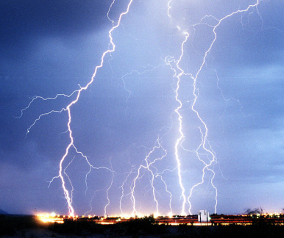
What is electricity?
Electricity is the flow of electrons.
Sometimes you see it in the sky in a lightning streak.
Sometimes you hear it crackle when you take off a sweater.
How is Electricity Made?
Notes:
Ask students: Is electricity a primary or secondary source of energy? (Answer: Secondary) Is coal a primary or secondary source? (Answer: Primary)
Ask students: Have you ever had to do without electricity for a while? What did you have to stop doing?

Slide 6
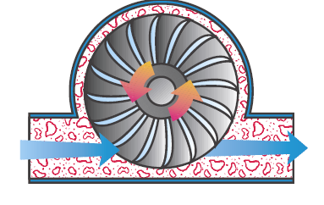
Generating Electricity
Burn fuel or
split atoms
Heat water to make steam
Steam turns turbine
or
Turbine turns generator
Electricity is generated!
Moving water or wind turns turbine
Notes:
Pause here for students who are visual learners to draw their own picture notes. The drawing illustrates a turbine. As steam flows over the blades of the turbine, kinetic energy turns the shaft. A coil of wire attached to the shaft of the generator turns inside a magnet. This causes
electrons to flow in the coil – and the flow of these electrons creates electricity.
Define the word generate as “to produce”. Generate is a word often used in describing the production of electricity.

Slide 7
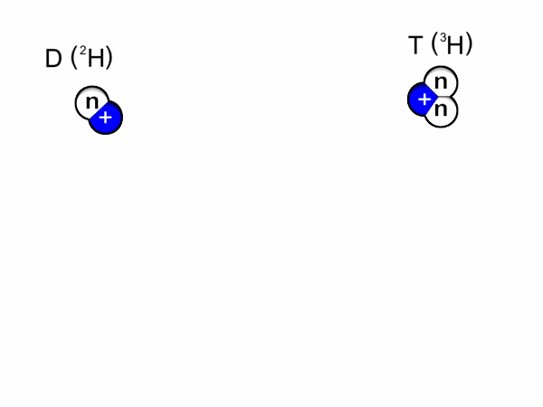
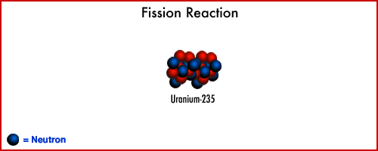
Fusion vs. Fission
Fusion
Two hydrogens collide
Making Helium and energy
Average of 3.5 MeV per fusion
Fission
Uranium 233, 235, 238
Average of 207 MeV per fission
Notes:
Use fusion and the sun to help tour understand the idea of fission and how they are different.
commons.wikimedia.org
giphy.com

Slide 8
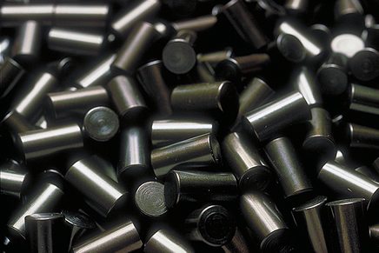
Energy From Fission
Energy from one Uranium Fuel Pellet can equal…
Notes:
Expand on just how much energy fission can produce and why its useful. Use the comparisons on the slide for energy references.
geoinfo.nmt.edu
forum.nationstates.net
www.pv-magazine.com
www.101qs.com

Slide 9
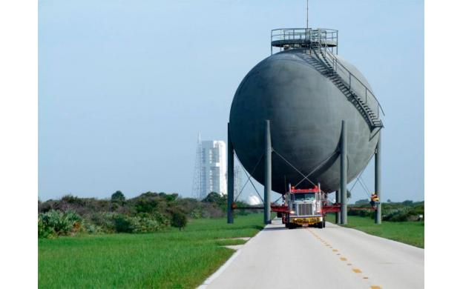
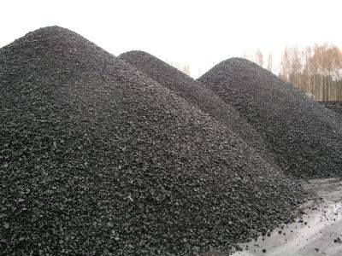
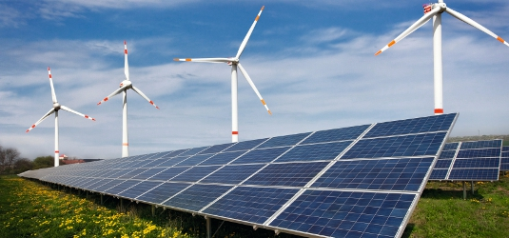
Energy From Fission
About 1 ton of coal
17,000 ft³ of natural gas
32 mi² of Solar Panels or Wind Turbines
Notes:
Expand on just how much energy fission can produce and why its useful. Use the comparisons on the slide for energy references.
geoinfo.nmt.edu
forum.nationstates.net
www.pv-magazine.com
www.101qs.com

Slide 10
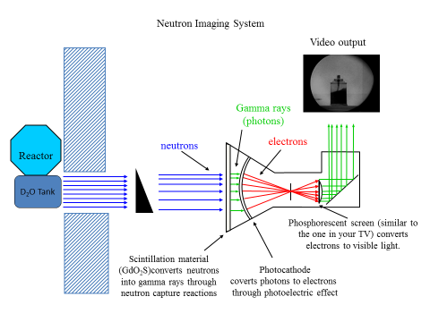
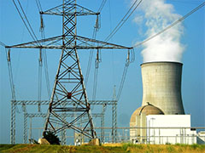
Fission
Nuclear Reactors harness fission for various reasons.
Producing clean electricity
Research
Notes:
Explain the difference between Research Reactors and Power Generation Utilities and how they utilize fission.
safetyfirst.nei.org
www.cpepweb.org

Slide 11
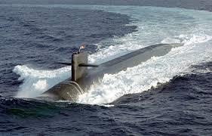
Nuclear Propulsion

Slide 12
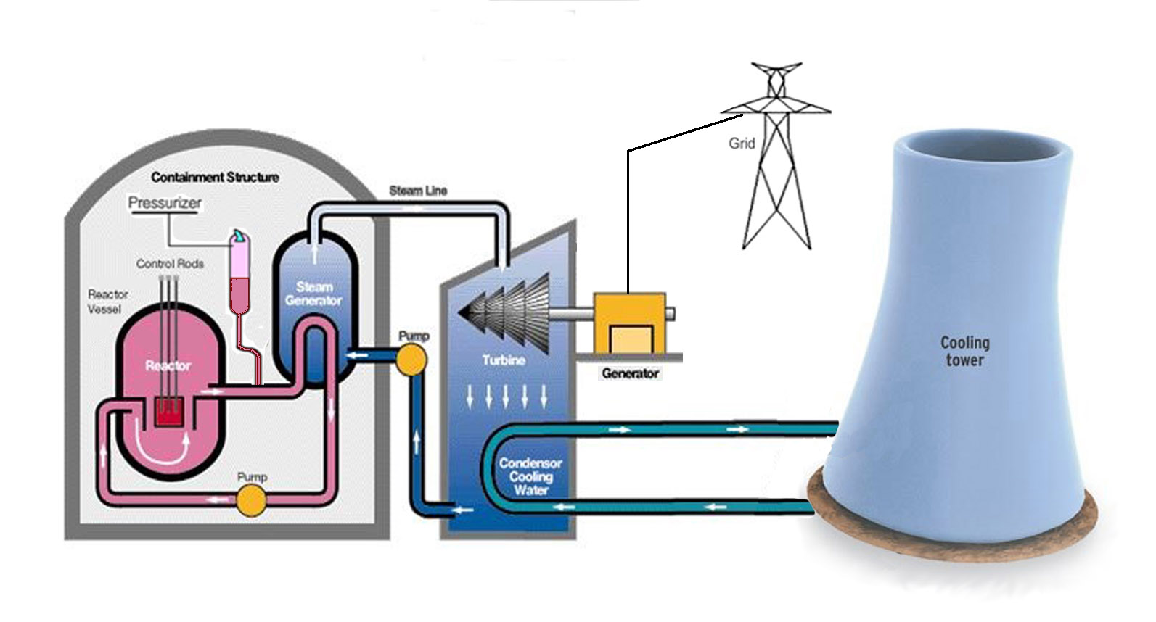
Nuclear Energy
Notes:
Explain process of using a reactor to generate electricity.
galleryhip.com

Slide 13
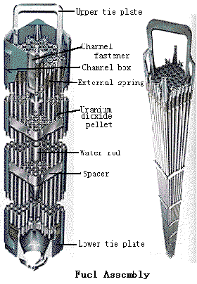
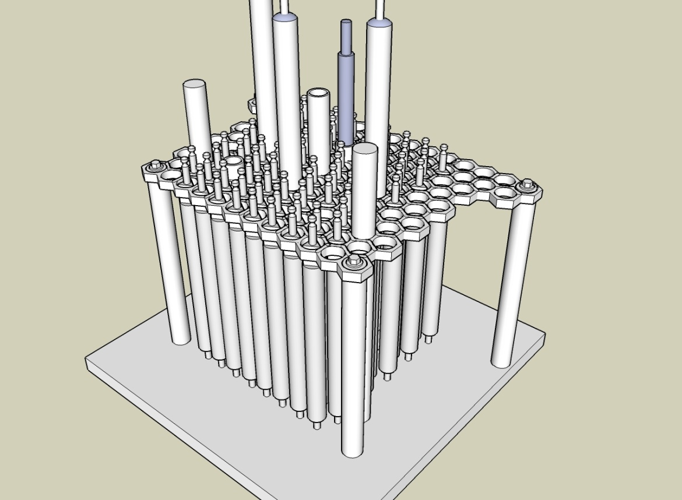
Fuel Assembly Designs

Slide 14
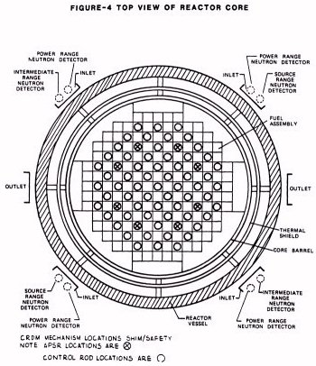
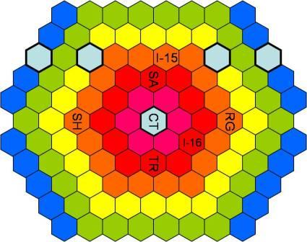
Core Loadings

Slide 15
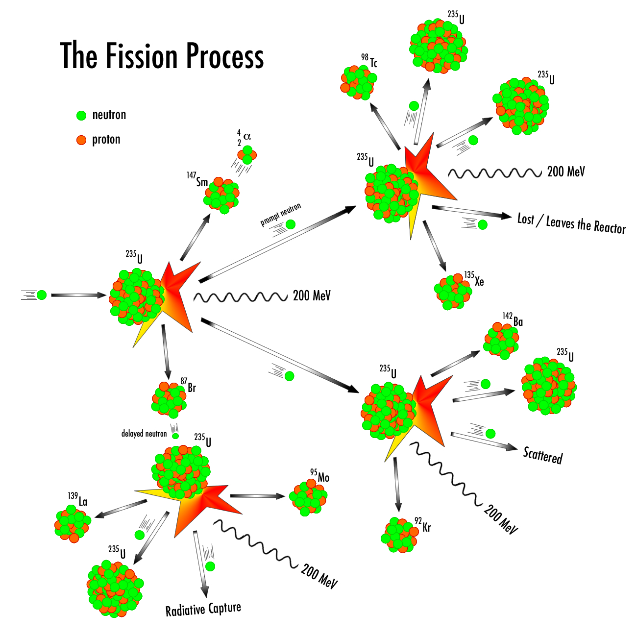
Notes:
Elaborate on fission process and chain reaction. Briefly discuss criticality.
physics.tutorvista.com

Slide 16
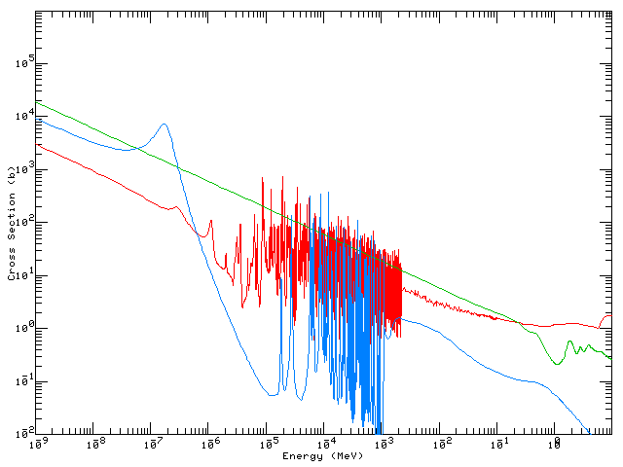
Control Rods
Control Rods balance the fuel and allow the reactor to be started up and shut down.
Control Rod materials have a higher probability of neutron absorption than the fuel.
Boron 5x higher
Cadmium 30x higher
Gadolinium 350x higher
TRIGA had 4 control rods
Power reactors have dozens of rods

Slide 17
Nuclear Power Reactors
Nuclear power reactors are classified by their:
Neutron energy
Thermal, < 1 ev
Fast, >150 keV
Neutron moderator: H₂O, D₂O, graphite
Coolant: H₂O, D₂O, gas (CO₂, He), liquid metal (Na)

Slide 18
Nuclear Power Reactors
LWR: Light water reactor
BWR: Boiling water reactor
PWR: Pressurized water reactor
VVER: Russian PWR (Vodo-Vodyanoi Energetichesky Reaktor, water-water energetic reactor)
PHWR: Pressurized heavy water reactor
CANDU: CANadian Deuterium Uranium reactor
Coolant ⬇ | Moderator
 | H₂O | D₂O | Graphite | None
H₂O | LWR: BWR, PWR, VVER |  | LWGR: RBMK
D₂O |  | PHWR: CANDU
Gas |  |  | Magnox AGR
Liquid Metal |  |  |  | LMFR

Slide 19
Nuclear Power Reactors
LWGR: Light water graphite reactor
RBMK: Russian Reaktory Bolshoy Moschnosti Kanalniy, high power channel-type reactor
Gas-graphite reactors
Magnox
AGR: Advanced Gas-cooled Reactor
FBR: Fast Breeder Reactor
Coolant ⬇ | Moderator
 | H₂O | D₂O | Graphite | None
H₂O | LWR: BWR, PWR, VVER |  | LWGR: RBMK
D₂O |  | PHWR: CANDU
Gas |  |  | Magnox AGR
Liquid Metal |  |  |  | LMFR

Slide 20
Pressurized Water Reactors (PWR)
Developed in the U.S. by Westinghouse
Designed and manufactured in many countries:
U.S.: Westinghouse and ABB/CE
France: Framatom/Areva
Germany: Brown Boviera
Russia
Notes:
Cochran and Tsoulfanidis, The Nuclear Fuel Cycle: Analysis and Management, p. 4.

Slide 21
Pressurized Water Reactors (PWR)
PWRs are based on the reactor system developed for naval propulsion.
The first commercial PWR was the Shippingport Atomic Power Station outside of Pittsburgh, PA
Designed by Westinghouse
Operated as a standard PWR
Operated as a light water breeder reactor (LWBR) using a thorium blanket to breed ²³³U
PWRs make up 66% of the U.S. commercial nuclear reactor fleet (as of 2009), and about the same percentage world-wide
Notes:
Kok, Nuclear Engineering Handbook, Ch. 1

Slide 22
Pressurized Water Reactors (PWR)
Uses a closed primary loop and a secondary loop that powers a steam turbine.
Primary loop is pressurized to ~15.5 MPa to prevent boiling
Extensive heat exchanger systems between loops
Secondary loop prevents any reactor contamination from reaching turbine systems, allowing for simpler maintenance, replacement, and disposal.
http://www.tva.gov/power/wbndiag.htm
Notes:
Cochran and Tsoulfanidis, The Nuclear Fuel Cycle: Analysis and Management, p. 4.

Slide 23
Boiling Water Reactor (BWR)
The boiling water reactor was developed by Argonne National Laboratory (ANL)
They built the Experimental Boiling Water Reactor (EBWR) in Illinois:
Initial testing at 5 MWt and 20 MWt
Operated from 1957 to 1967 at up to 100 MWt
The first commercial BWR was the Dresden Nuclear Power Plant in Illinois
200 MWe
1960 to 1978
BWRs comprise 34% of the commercial nuclear portfolio in the U.S. (as of 2009)
Notes:
Kok, Nuclear Engineering Handbook, Ch. 1

Slide 24
Boiling Water Reactors (BWR)
Developed in the U.S. by General Electric
Uses a single loop:
Light water coolant/moderator boils in the reactor vessel
Steam dryers allow direct connection to steam turbines
http://theenergylibrary.com/node/11853

Slide 25
Nuclear Worldwide
Kok, Ch. 1

Slide 26
Generation IV Reactors
What makes a reactor a Generation IV reactor?

Slide 27
Generation IV Reactors
Goals of Generation IV reactors:
Sustainability:
Provide near carbon-free energy
Use fuel cycles that maximize energy efficiency and minimize waste for the good of long-term stewardship and public health
Economics:
Gen IV systems should have cost savings over other energy types
The financial risk for investing in Gen IV reactors should be similar to the financial risk of other energy production methods
Safety and reliability:
Very low chance of core damage in emergency scenarios
Design should remove the need for off-site emergency response
Proliferation resistance:
Fuel cycles must be the least attractive source of nuclear materials
Gen IV systems should have more physical protections from terrorism than previous generations
Notes:
Kok, Ch. 6

