Slide 1
The Nuclear Fuel Cycle
Mary Lou Dunzik-Gougar, PhD
ANS Teachers’ Workshop
2014

Slide 2
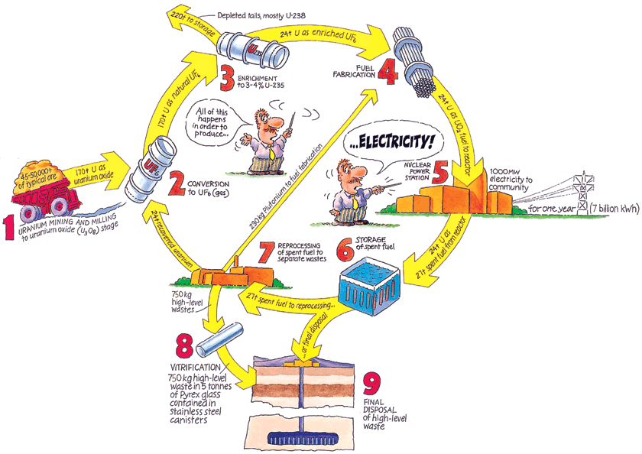

Slide 3
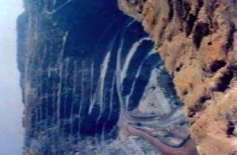
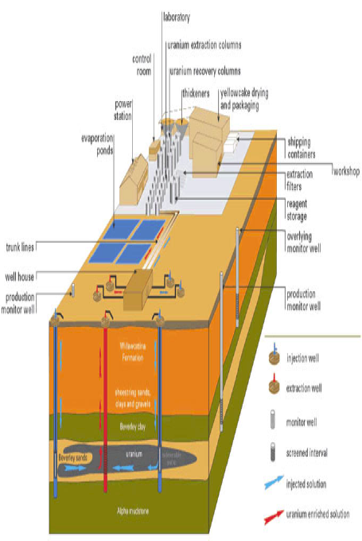
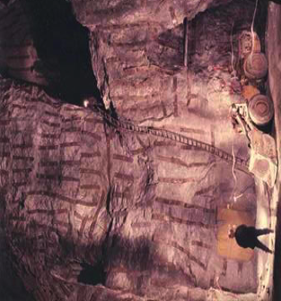
Uranium Mining
Open pit (strip) mining
Underground mining
In situ leaching

Slide 5
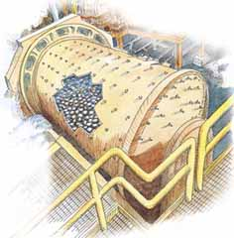
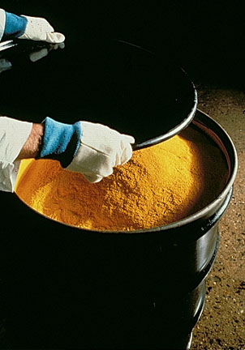
Uranium Milling
Ore is crushed
Uranium is separated
U₃O₈ “yellow cake” produced

Slide 7
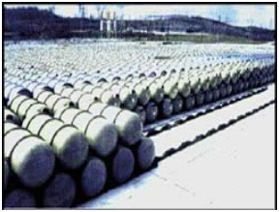
Uranium Conversion (to UF₆ gas)
Impurities removed
Uranium combined with fluorine
UF₆ gas produced
- Gaseous form facilitates
enrichment
UF6 containers

Slide 9
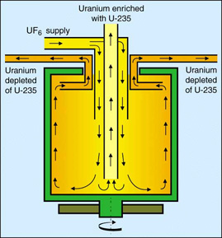
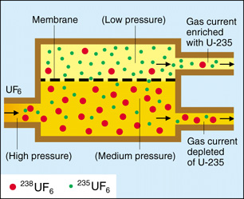
U Enrichment
Natural U is > 99% ²³⁸U and only ~ 0.7% ²³⁵U
Separation of ²³⁵UF₆ and ²³⁸UF₆ based on (very small) mass difference
UF₆ enriched from 0.7% ²³⁵U to 3%-5% ²³⁵U
Diffusion
Centrifugation

Slide 11
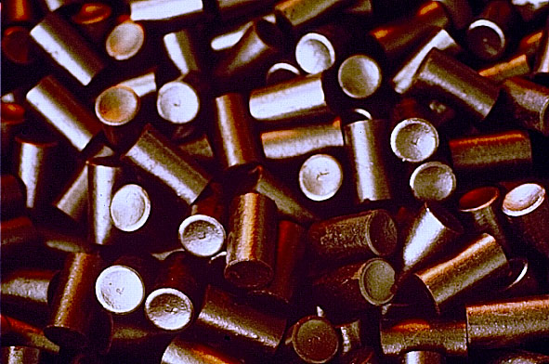
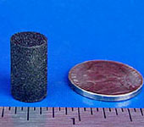
Fuel Fabrication
Enriched UF₆ gas converted to uranium oxide (UO₂) solid
Uranium Oxide Ceramic Fuel Pellets
Notes:
Finally, the uranium hexafluoride is shipped to a fuel fabricator, where it is manufactured into solid ceramic pellets, about the size of the end of a finger.

Slide 12
Fuel Fabrication
Fuel rods filled with ceramic pellets are
grouped into fuel assemblies

Slide 13
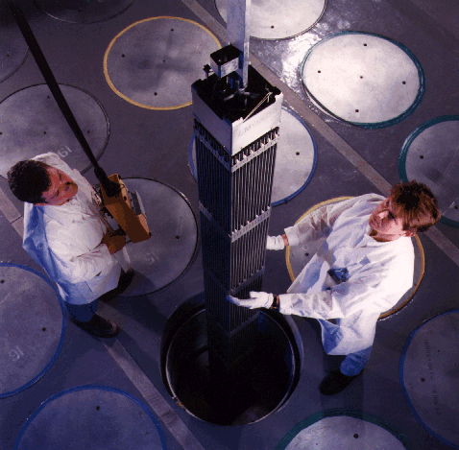
Fuel Fabrication
A pressurized water reactor fuel assembly

Slide 15
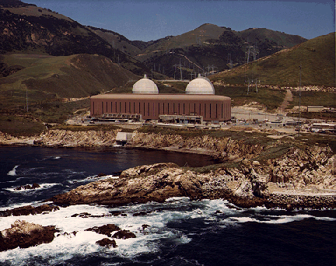
Reactors
Diablo Canyon nuclear power plant in the U.S.

Slide 17
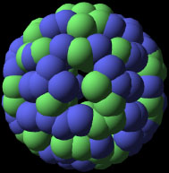
In the reactor, ²³⁵U fissions to produce . . .
Energy
Neutrons
Neutron
Fission Products
Neutrons may
Cause new fissions to occur
Be absorbed to form unstable, radioactive nuclide

Slide 18
Fuel Consumption in the Reactor
Fuel is in reactor for 4 – 6 years
U consumed, fission products and transuranics (mostly Pu) produced
Fresh Fuel
4%
96%
²³⁵U
²³⁸U
Pu
3.5%
94%
Used Fuel
Fission
Products
Transuranics
(or Actinides)
Notes:
I like to talk about this in a simple way as: things lighter than U <---> U <---> things heavier than U

Slide 20
Used Nuclear Fuel Storage
Used fuel first stored in pool at least 5 years
Cooling and shielding
Older fuel can move to dry casks
Air cools
Steel and concrete shields

Slide 22
Fuel recycle/reprocessing
Fresh Fuel
4%
96%
²³⁵U
²³⁸U
Pu
3.5%
94%
Used Fuel
Fission
Products
Transuranics
(or Actinides)

Slide 24
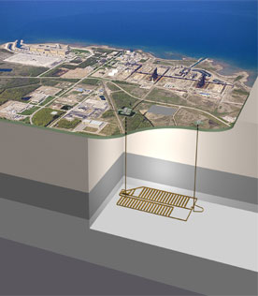
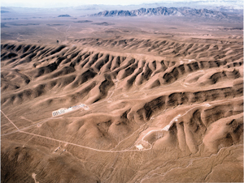
Geologic Repository
The choice of countries worldwide
U.S. has studied Yucca Mt., Nevada as potential location

Slide 25
The End . . .

