Slide 1
Applications of Radiation
Mary Lou Dunzik-Gougar, Ph.D.
Idaho State University and Idaho National Laboratory
with special thanks to
Candace Davison
Brenden Heidrich
Penn State University
Michael Erdman
PSU Milton S. Hershey Medical Center

Slide 2
Overview
General applications by radiation type
Radiography - process
Medical Research
Medical Applications
Space

Slide 3
Alpha Radiation
α
Highly ionizing
Removes Static Charge
Alpha Particle
Static Charge

Slide 4
Uses of Alpha Radiation
• Pacemakers (Older models)
• Airplanes
• Copy Machines
•Smoke Detectors
•Space exploration

Slide 5
Beta Radiation
Small electron particle
More penetrating than alpha
β
e⁻

Slide 6
Beta radiation is used in thickness gauging
The thicker the material the less radiation will pass through the material.

Slide 7
Gauging is used to
Measure and control thickness of paper, plastic, and aluminum.
Measure the amount of glue placed on a postage stamp
Measure the amount of air whipped into ice cream.
Measure the density of the road during construction.

Slide 8
Back Scattering
Detector

Slide 9
Gamma Radiation
γ
A penetrating wave

Slide 10
Uses for Gamma Radiation
Food irradiation
Sterilization of medical equipment
Creation of different varieties of flowers
Inspect bridges, vessel welds and Statue Of Liberty

Slide 11
What were original uses of mysterious rays?
Becquerel’s discovery
Roentgen x-ray of wife’s hand
Marie Curie – WWI – x-ray unit

Slide 12
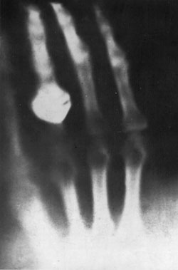
Early X-ray http://www.uihealthcare.com/depts/medmuseum/galleryexhibits/collectingfrompast/xray/xray.html

Slide 13
Radiographs
X-ray
Radiograph - radiation energy passes through object
Autoradiograph - use radiation from object itself
Photo-Film

Slide 14
Radiography
Let’s explore two different methods of using radiation to capture images
X—rays
Neutrons
The next graph shows attenuation of the radiation vs. atomic number. The shading on the right shows how much radiation is blocked – black indicates completely blocked.

Slide 15
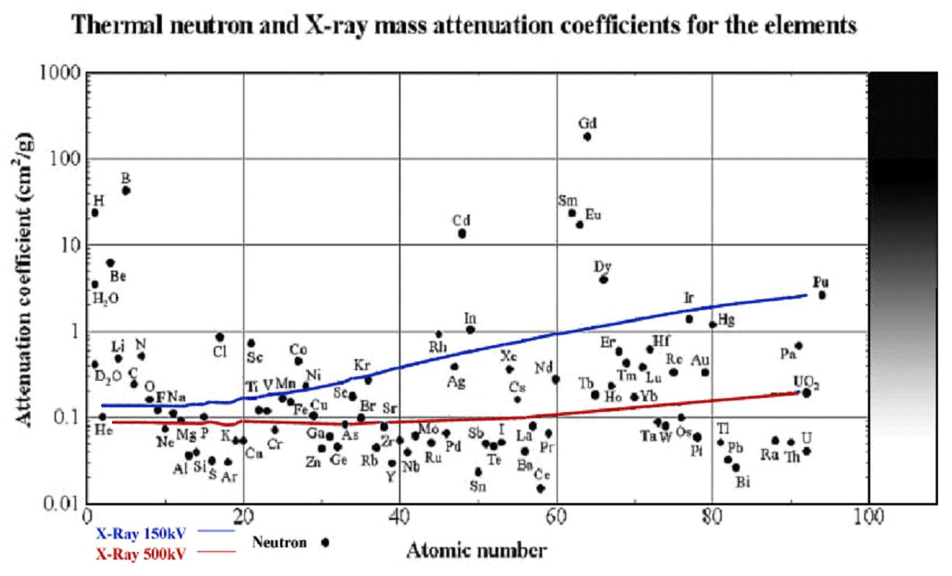
(0.025 eV)

Slide 16
Comparing Different Materials
Cadmium ( Cd )
Lead ( Pb )
Polyethylene [ (CH₃)_{n} ]

Slide 17
CODE Box at Penn State
Student Project to Demonstrate X-Ray/Neutron Radiography
Was originally in cardboard shoe box,
but was replaced by more durable aluminum.

Slide 18
Cadmium = red
Lead = white
C O
D E

Slide 19
X-Ray Image

Slide 20
Cadmium = red
Lead = white
Polyethylene = gray
C O
D E
P S U

Slide 21
Neutron Radiograph

Slide 22
Hydrogen Fuel Cell Imaging
Fuel Cell research conducted at RSEC

Slide 23
Hydrogen Fuel Cell Imaging
Water Calibration Wedge

Slide 24
Hydrogen Fuel Cell Imaging

Slide 25
Hydrogen Fuel Cell Imaging

Slide 26
Clinical Uses of Radioactive Materials

Slide 27
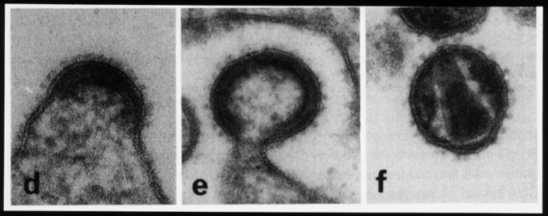
Understanding the Replication Process of the HIV Retrovirus
DNA sequencing, using ³⁵S and ³²P, is used to investigate the process by which new viruses “bud” or form from host cells

Slide 28
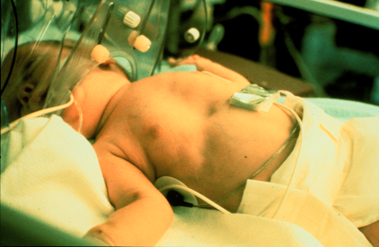
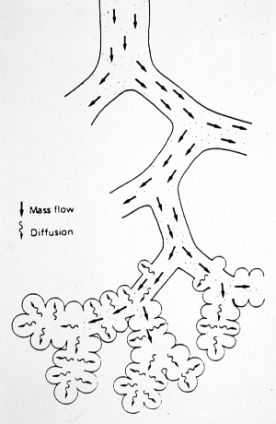
5000 Premature Infants Die Annually from Respiratory Distress/SIDS
The infant lacks a protein which produces a surfactant in the lung alveoli
Without the surfactant, there is too much surface tension – the lung is too weak to expand. A respirator is needed.
³²P-research identified the missing protein
Gene therapy may one day be available

Slide 29
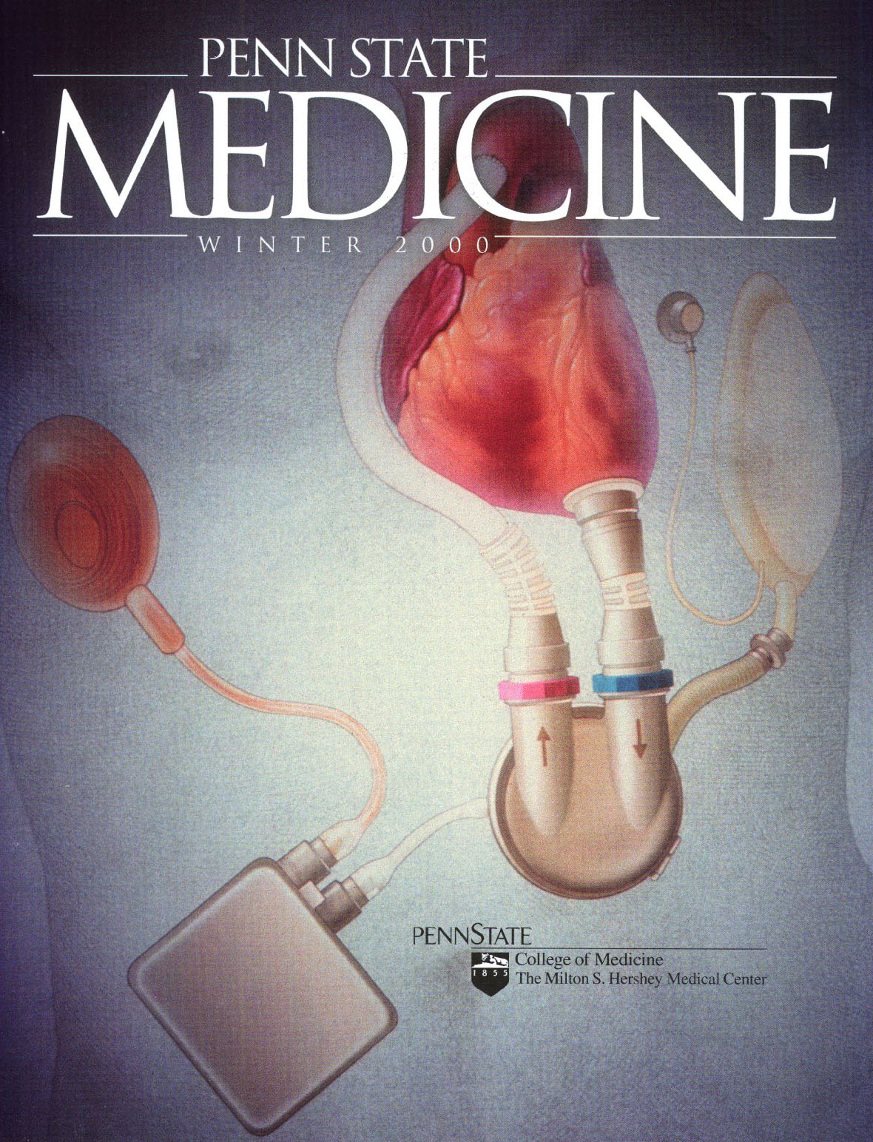
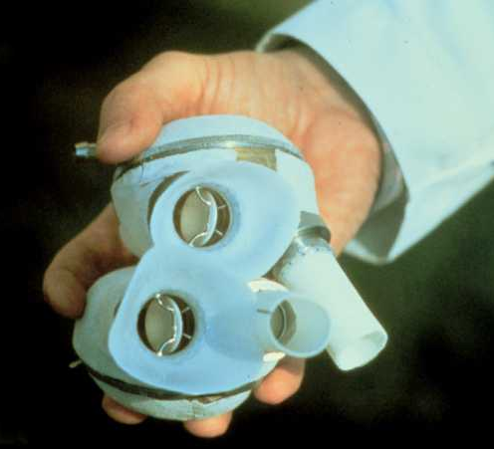
Benefits from Radioisotope Research
The Penn State Artificial Heart

Slide 30
RIA (Radio Immuno Assay)
Extremely sensitive test for the presence of radiolabeled antibodies in blood serum samples
Dr. Rosalyn Yalow developed the technique ca. 1961, won 1977 Nobel Prize
Many tests exist for
Adrenal Function - Reproductive Hormones
Anemia - Therapeutic Drugs
Diabetes and Related - Thyroid Function
Drugs of Abuse - Tumor Markers
Newborn Screening - Veterinary Tests

Slide 31
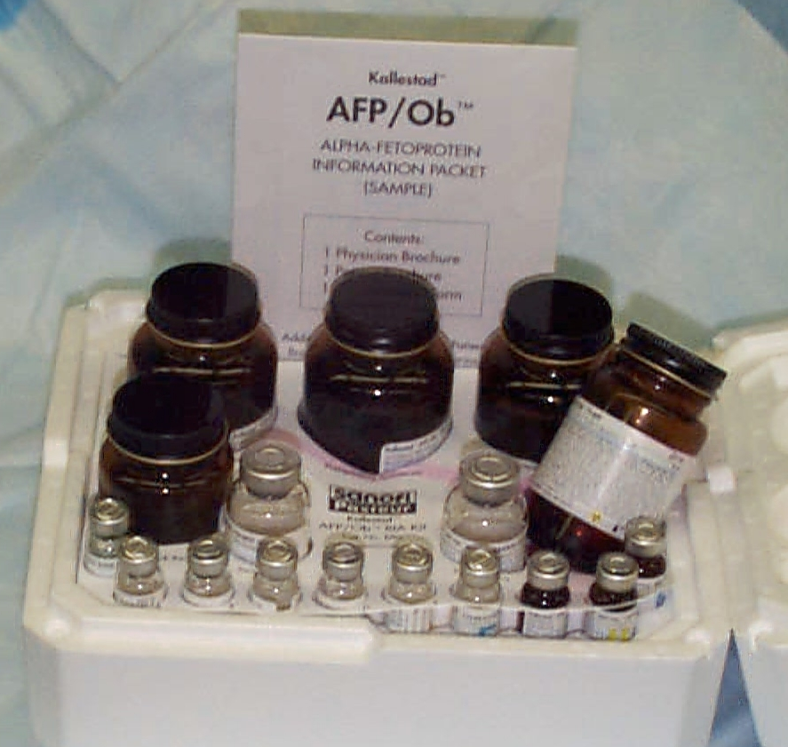
RIA Kit
A standard test kit includes reagents, antigens, and a minute amount of radioactivity
One kit can be used to test 100 to 500 patient serum samples

Slide 32
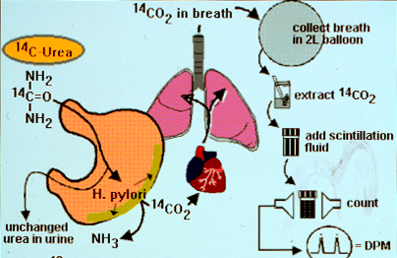
¹⁴C Test for Helicobacter pylori
H. pylori is often implicated in Gastric Reflux Disease
If present, a specific antibiotic can be prescribed to eliminate it
The use of radioactive ¹⁴C provides a simple and sure test

Slide 33
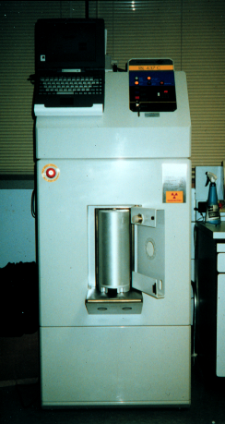
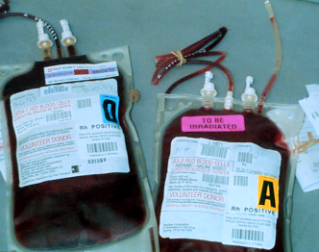
¹³⁷Cs Blood Irradiator
Delivers 2500 rads to blood products
Reduces potential for Graft-vs-Host Disease
Essential for bone marrow transplants

Slide 34
Diagnostic Radiology Modalities
X-Ray Radiography
Angiography
Mammography
Fluoroscopy
Cardiac Catheterization
CT (Computed Tomography)

Slide 35
Heart Image
Gated study of radiolabeled cardiac muscle
Allows visualization of heart tissue viability

Slide 36
Bone Scan with ^{99m}Tc-HDP
Active bone surface is labeled
Note “hot spots” and kidneys

Slide 37
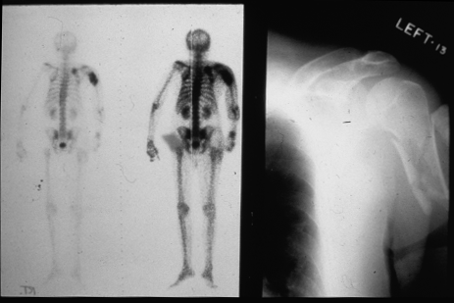
Nuc Med & Radiographic Images Compared
Metabolic hotspots highlighted – possibly cancerous
X-ray image shows break, but no metabolic information

Slide 38
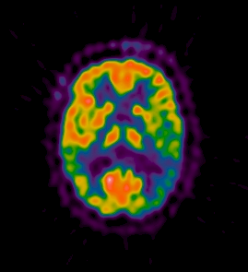
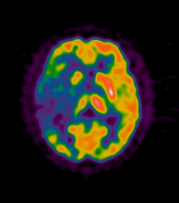
The New(er) Kid on the Block: PET Positron Emission Tomography
¹⁸FDG Images of a normal vs. an epileptic brain
Rapidly growing in popularity for tumor imaging

Slide 39
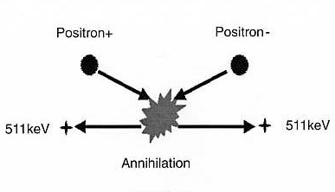
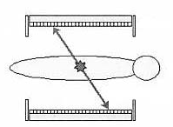
Positron Decay and Coincidence Photon Detection
p⁺ à n⁰ + e⁺ + ν
Positron escapes the nucleus
Two oppositely directed photons result from the annihilation of the positron with an electron
Negatron-
PET Scanner Coincidence Detectors

Slide 40
¹⁸FDG
Fluorodeoxyglucose
Most commonly used PET radiocompound
A glucose analog, useful for
Differentiating malignant from benign tumors
Differentiating scar from viable myocardial tissue
Brain function studies

Slide 41
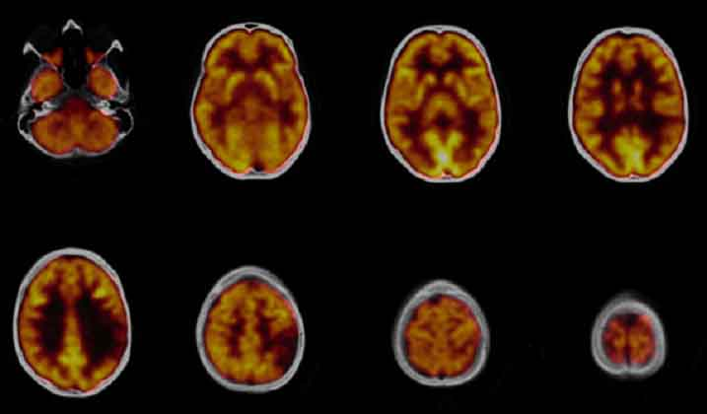
Cerebral Glucose Metabolism
Brain tumor diagnosed
MRI scan suspicious for low-grade astrocytoma
PET/CT scan shows large hypo-metabolic area in left posterior temporal lobe Siemens Clinical Solutions, www.medical.siemens.com

Slide 42
Other PET Applications
Neurological studies
Epilepsy
Alzheimers
Parkinson’s Disease
Addictions
Cancer imaging and localization
In demand by Oncologists
Cardiology studies

Slide 43
The ‘Historical’ Problem in Modern Radiology
Images obtained from Nuclear Medicine were obtained on a computer platform different from those obtained from CT, and also from MRI, Ultrasound, etc.
Thus, images could not be easily overlaid
A common software was needed to make best use of the information from each modality

Slide 44
Radiation Doses from Medical X-rays
Medical Radiation (Effective Whole Body Dose Equivalent)
Chest X-ray: 8 mrem (0.08 mSv)
Head CT scan: 111 mrem (1.11 mSv)
Barium Enema: 406 mrem (4.06 mSv)
Extremity X-ray: 1 mrem (0.01 mSv)
Source: NCRP Report 100

Slide 45
Radiation Doses and Dose Limits
Flight from Los Angeles to London 5 mrem
Annual public dose limit 100 mrem
Annual natural background 300 mrem
Fetal dose limit 500 mrem
Barium enema 870 mrem
Annual radiation worker dose limit 5,000 mrem
Heart catheterization 45,000 mrem
Life saving exposure (NCRP-116) 50,000 mrem
Mild acute radiation syndrome 200,000 mrem
LD_{50/60} for humans (bone marrow dose) 350,000 mrem
Radiation therapy (localized & fractionated) 6,000,000 mrem
Notes:
7. Radiation Doses and Dose Limits
Radioactive material has always been a natural part of the earth. It has existed for millions of years in the crust of the earth, in building materials, in the food we eat, the air we breathe, and in nearly everything that surrounds us. Radiation from these materials, as well as cosmic radiation from the sun and universe, makes up the natural background radiation to which we are constantly exposed. On the average, persons are exposed to about 300 millirem per year from natural sources.
The guidance from NCRP Report No. 116, Limitation of Exposure to Ionizing Radiation, states that for life saving or equivalent purposes, workers may approach or exceed 50,000 mrem to a large portion of the body. Emergency exposures are considered once-in-a-lifetime. This is below the threshold for the acute radiation syndrome, discussed later.
If an individual is exposed to more than 100 rem at one time, predictable signs and symptoms will develop within a few hours, days, or weeks depending on the magnitude of the dose. About half of all people exposed to a single dose of 350 rem will die within 60 days (LD_{50/60}) without medical intervention. The large doses used in medicine for radiation therapy, while higher than this dose, are given to only part of the body and are typically given over a period of weeks.
The dose limits are highlighted in orange.

Slide 46
Electricity in Space - RTG
Nuclear Options
Radioisotope Thermoelectric Generators (RTG)
Work on principle of radioactive decay
Energy proportional to activity
Activity proportional to half-life and amount of material
More material and shorter half-life means more power
Shorter half-life runs out sooner
Must balance energy supply and mission length

Slide 47
RTGs in Space - Theory
Work on the thermoelectric principle also known as the ‘Seebeck Effect’
~10% efficiency

Slide 48
RTGs in Space – Half-Life
US RTGs use Pu²³⁸ as the radioactive material
Half-Life of 87.7 years
96% of energy (activity) after 5 years
50% of energy after 87.7 years
Old US and Russian RTGs used Po²¹⁰
Half-Life of 138 days

Slide 49
RTGs in Space - Radiation
²³⁸Puand ²¹⁰Po are alpha (α) emitters
Alpha radiation cannot penetrate very far
Stopped by a sheet of paper or 10cm of air
Turns into heat in the RTG material
Very little radiation gets out of the shielding
Not ‘weapons grade’ material
Ceramic form that is very heat and impact resistant

Slide 50
RTGs in Space - History
1959: Atomic Energy Commission members show President Eisenhower the new ‘nuclear battery’ for use in US satellites

Slide 51
RTGs in Space - History
Original RTG in space was for a US Navy navigation satellite
1961 SNAP-3 unit (Space Nuclear Auxiliary Power)
2.7 watts of electrical power
Lasted for 15 years
RTGs were used in 25 other missions from 1961 to 2005 from military satellites to the Apollo missions

Slide 52
RTGs in Space - History
1972: Pioneer 10 & 11 launched to explore the outer planets
Both survived high radiation around Jupiter
Both crafts left solar system after mission performed and continued to send data for 17 years
Still in contact with crafts

Slide 53
RTGs in Space - History
1977: Voyager 1&2 launched to explore the outer planets
Transmitted high speed data and first high-quality pictures
Both crafts left solar system after mission was performed and continue to send data

Slide 54
RTGs in Space - History
1990: Ulysses launched to explore top and bottom of sun
Mission extended after initial successes
First mission to explore solar system outside the ‘disk’ of the planets
Can you see the RTG?

Slide 55
RTGs in Space - History
1989: Galileo launched to explore Jupiter and her moons
Took the long-way to Jupiter; by Venus and Earth twice
Required long-lived power supply to make the 4-year flight
Operated for 14 years
Can you see the RTG?

Slide 56
RTGs in Space - History
Galileo also needed heat for its long mission
120 - 1watt Radioactive Heater Units (RHU) placed all over the spacecraft
Safety design similar to RTGs

Slide 57
RTGs in Space - History
1997 -Cassini Mission to Saturn and moons
3 General Purpose Heat Source RTGs (current generation)
4-year mission once the craft gets to Saturn.
Great results coming back from craft
Recently discovered new moon of Saturn

Slide 58
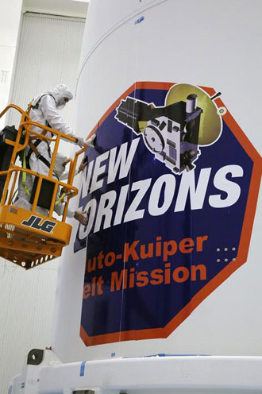
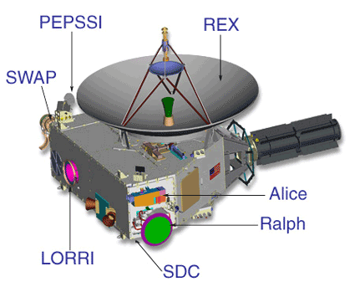
RTGs in Space - History
January 2006
New Horizons Mission
Pluto & Charon
Kuiper Belt Objects

Slide 59
RTGs in Space - History
Viking Landers- 1975
Used RTGs for power
6 Years on Nuclear Power
Mars Pathfinder-1997
Rover used RHUs for heat
3 months on solar power

Slide 60
Thank you

Slide 61
MRI: Radio Waves & Magnetic Fields

Slide 62
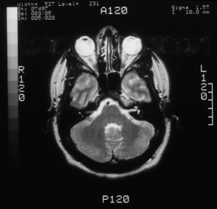
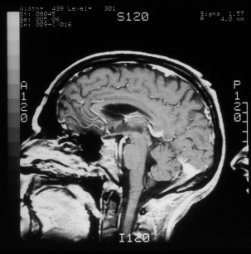
MRI – Magnetic Resonance Imaging
Utilizes magnetic fields and RF (radio-frequency) energy to gain information via Nuclear Magnetic Resonance
No ionizing radiation is used in this process

