Slide 1
American Nuclear Society Robotics and Remote Systems Division
Presentation to the
ANS Board of Directors
Presenter: Reid Kress, PhD, PE
June 19, 2013 Atlanta, GA

Slide 2
Robotics and Remote Systems Division (RRSD) Mission
Taken from the RRSD Website:
The Mission of the Robotics and Remote Systems Division is to promote the development and application of robotic and remote systems for hazardous environments for the purpose of reducing hazardous exposure to individuals, reducing environmental hazards and reducing the cost of performing work.
We are a small division (3% of ANS), but we work hard!

Slide 3
RRSD Governance
Officers (all move into next position after June 2013)
Chair: Reid L. Kress (Past Chair: Tom Nance)
Vice-Chair: James S. Tulenko
Secretary: Mark W. Noakes
Treasurer: William Chris Eason (Future Treasurer: Mitch Pryor)
Executive Committee (Leave Exec. Com. in June of year listed)
Just Left-2013 2014 2015 Just Started-2016
Sean Peterson Richard Minichan Miles Close Steven Canfield
Mitch Pryor Timothy McJunkin John Jansen Matthew Cole
Duane Schmoker Jeffrey Coughlin Bruce Legge Leonel Lagos
BOD Liaison
Mingguang Zheng

Slide 4
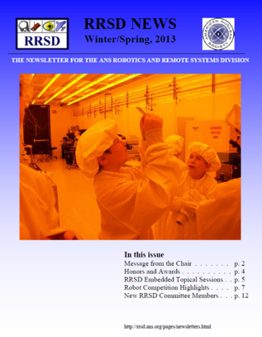
Division Governance
Bylaws & Rules submitted/approved in 2007
Strategic Planning Status
Div. 1-yr: Update Jan. 2013 and 5-yr: Good through 2014
RRSD supports ANS Strategic Plan goals/objectives
Professional Development
Topical 2011, embedded topical with Decom., Decon. & Reutil. (DD&R) in 2014
Ray Goertz: 2011 Norbert Grant; 2014 planned for award at embedded topical
Student Support: travel, best paper awards, booth at student conference
Sharing Information and Technology
RRSD website
Newsletter
Engaging the Public
Sponsorship of K-12 lego robotics teams: 4 awards totaling $1750 in 2012
Engaging Policy Makers
Planning to coordinate with ANS HQ on emergency response robotics
Communication:
Website (http://rrsd.ans.org/)
Newsletter
Most Recent is Winter/Spring 2013
All available at: (http://rrsd.ans.org/pages/newsletters.html)

Slide 5
Division Membership Trend – RRSD is growing
Increase since 2010
Members: 8.5%
Student Members: 65.2%
2011 Topical
Targeting Students (e.g. in 2012/3)
Current secretary (Mark Noakes) made presentation to UTK chapter of IEEE Robotics and Remote Systems
Future treasurer (Mitch Pryor) worked heavily at UTA with students and student papers
Current treasurer (Chris Eason) and future treasurer (Mitch Pryor) worked with student conference at MIT hosting an RRSD booth

Slide 6
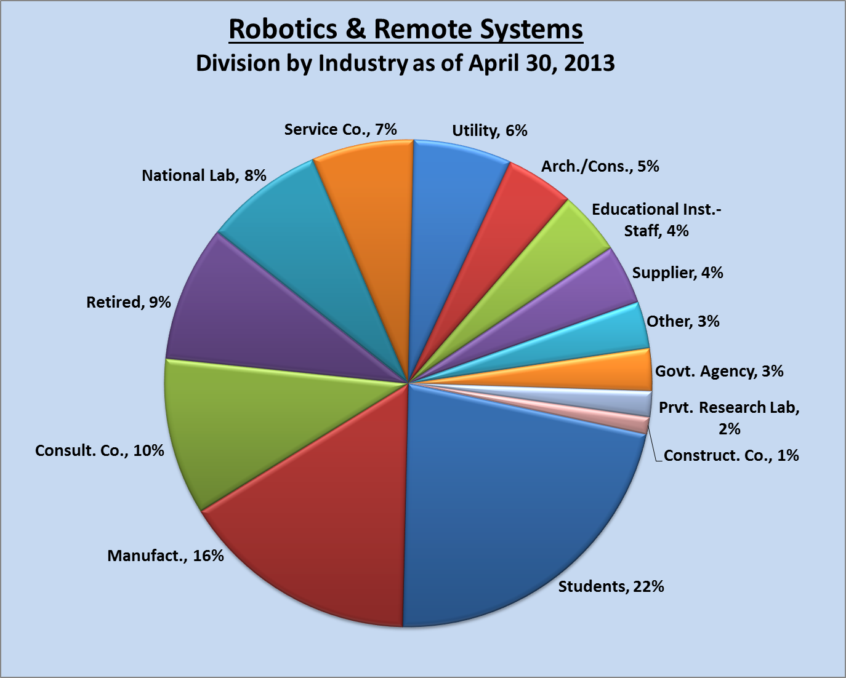
Division Membership

Slide 7
Division Finances
Meetings
Class III Embedded Topical with DD&R June 2014
Class I Joint Topical with ESD September 2011
Sessions at National Meetings
2013 Summer – 1
2012 Summer - 1
2011 Winter – 1
Endowed Funds at Start of 2013
Ray Goertz $57,623
Student Support $58,031

Slide 8
Division Finances
Entire 2013 budget focus is on student support (except for $255 for plaques)
2011 topical income for RRSD (after student support) ~$3000
2014 embedded topical should bring additional funds
Will give Ray Goertz award of $2500 from endowed fund in 2014

Slide 9
Division Contributions to Society
Student Support through conference support, travel money, K-12 lego team support, best paper awards
Topical (2011) and embedded topical (2014)
Sessions at national meetings
Information disbursement through website, newsletters, and blog
Exploring an affiliation with IEEE Robotics and Automation Society

Slide 10
Summary
Biggest Success – Membership has grown primarily by targeting students (65% increase in student members since 2010)
2011 Topical Statistics
>150 attendees, > 120 papers and talks, 17 exhibitors, 3 panel sessions
Sponsorship of robotics contest concurrent with conference, total of $2000 of prizes
Total of $1200 of best student paper awards
Focus for Future Action
Continue to target student membership as area for growth
Hold a successful embedded topical in 2014
Continue our collaboration with DD&R
Information for the BOD
DOE travel restrictions hurt RRSD: ~1/3 of Ex Com are from DOE and generally ~1/2 of our papers (52/120 at last topical) from DOE
Becoming ANS fellow is difficult for RRSD members

