Slide 1
American Nuclear Society
Isotopes and Radiation Division (IRD)
Presentation to the
ANS Board of Directors
Ned Wogman; Acting Chair
John Metzger Chair - deceased
June 2013 - Atlanta, Georgia

Slide 2
IRD Mission and Focus
The Isotopes and Radiation Division (IRD) is focused on fundamental and applied technology related to the production of isotopes, nuclear methods of analysis, and the measurement of radionuclides. Specific areas of interest to IRD members include:
Production, characterization, and utilization of isotopes for medicine and industry,
Nuclear methods for material characterization including ionizing radiation beam techniques and activation analysis,
Radiometric and radiochemistry techniques for quantitative analysis, nuclear data measurements, and the study of radionuclide behavior in the environment, and
Measurement techniques as they apply to nuclear security including treaty monitoring and verification, nuclear nonproliferation, safeguarding nuclear materials, and nuclear forensics.

Slide 3
IRD Governance
Officers:
  Ned Wogman - Acting Chair (John Metzger Chair - deceased)
  Sam Glover -Vice Chair -2014
  Donna O’Kelly – Secretary – 2014 (Exec 2015)
  Lei Cao – Treasurer – 2014 (Exec 2015)
Executive Committee:
  Steve Biegalski (Vice Chair 2014)
  Jack Brenizer 2013
  Robert Downing - 2013
  Lin-Wen Hu - 2014
  Kenan Unlu – 2015
  Hyoung Koo Lee - 2015
  Igor Jovanovic – 2015
  Steve LaMont - 2015
  Michael Heibel (2016-new)
  Eric Smith (2016 - new)
  Kim Burns (2016 - new)
  Brian Collins – Young Member Group Liaison
  Santiago San Antonio – Board Liaison; Bonnifer Ballard – Staff Liaison
  Ned Wogman Ex Officio 2014
  Hans Cougar – Prof Division Liaison and Ex Officio

Slide 4
IRD Governance – Metrics
See Conferences/Topicals/Awards
Bylaws & Rules Status
  Update started in 2012 being pursued by Chair, now deceased. Thus, the EC is restarting in ATL.
Strategic Planning Status
  -Update started in 2010 being pursued as above. EC is restarting in ATL.
  Identify specific ANS Strategic Plan goals/objectives which the Division supports
1. Professional development
-Work with students via support to their Conferences as well as at specific Topicals such as the MARC and Safeguards. Hold workshops on Activation Analysis.
2. Sharing information and advancements in technology
-Host Topical meetings such as the MARC and Safeguards which are International in scope, multiple sessions at each ANS mtg., cosponsor Topicals with ANS Divisions & INMM, etc.
3. Engaging the public
-Respond to requests as received -- normally explaining the technologies and how they support US Technology & Policy.
4. Engaging the policy makers
-Our members pursue technology and invite the policy makers to our sessions and Topicals. We have had specific sessions relating to the Nonproliferation and Safeguards technologies that the US/IAEA/Euratom policy makers attend and make presentations.
Communication: website (http://ird.ans.org/) and newsletter status (Chairman’s message from January 2012 is available; recent chair is deceased)

Slide 5
IRD Annual Membership

Slide 6
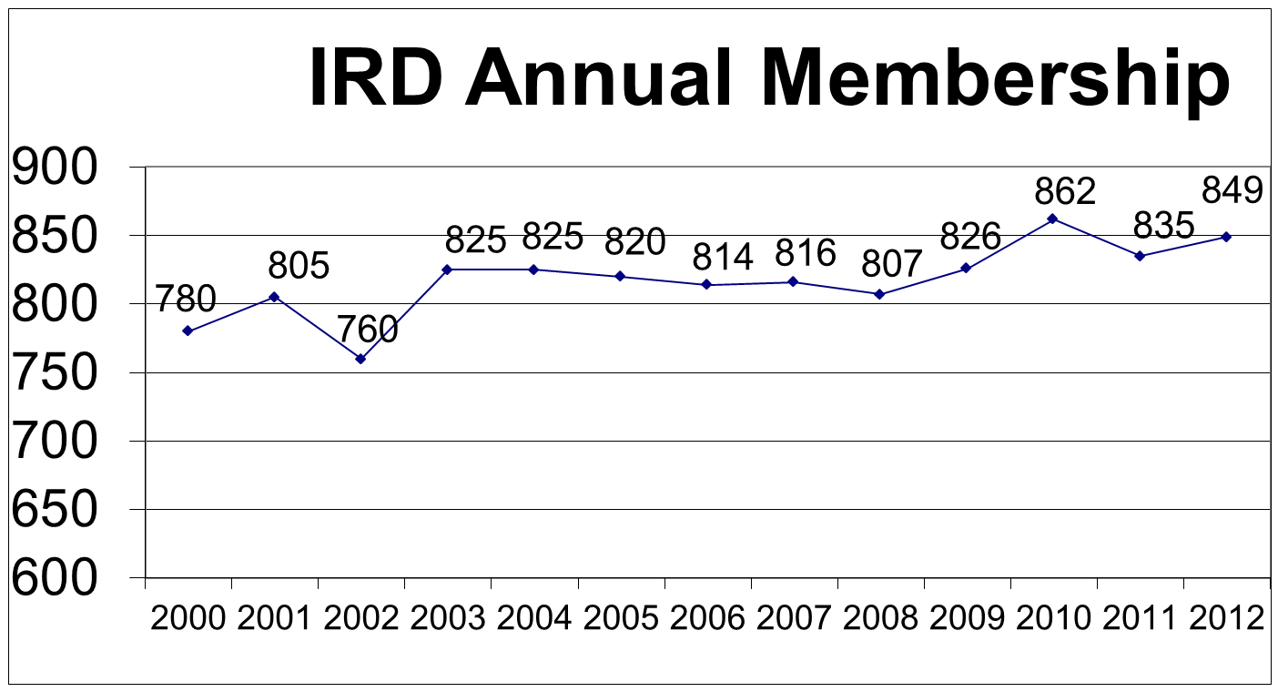
Students as of April 2013 (included in the total by year)
2004 | 2005 | 2006 | 2007 | 2008 | 2009 | 2010 | 2011 | 2012 | 2013
91 | 106 | 116 | 119 | 141 | 128 | 154 | 190 | 168 | 213

Slide 7
Isotopes & Radiation (IRD)
Total Membership as of April 30, 2013
Students | 24% | 213
National Lab | 14% | 130
Educational Inst.-Staff | 12% | 106
Retired | 11% | 98
Govt. Agency | 10% | 86
Manufacturer | 7% | 66
Consulting Co. | 7% | 60
Utility | 5% | 41
Other | 3% | 24
Prvt. Research Lab | 2% | 21
Service Co. | 2% | 18
Arch./Engr. | 1% | 12
Medical Inst. | 1% | 12
Supplier | 1% | 10
Test Lab | 0.2% | 2
Construction Co. | 0.2% | 2
Total | 100% | 901

Slide 8
(Staff and Students)

Slide 9
Income/Expense Data for 2012

Slide 10
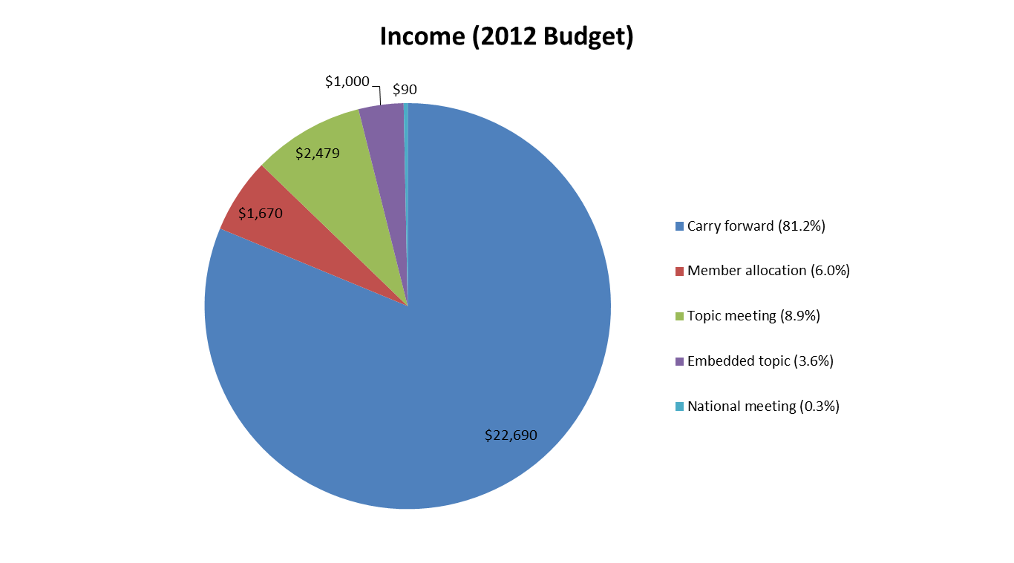
IRD Finances
See Conferences/Topicals/Awards VG for details on Class I, II, III, IV meetings; detail on National meetings, and Professional Development/Workshops

Slide 11
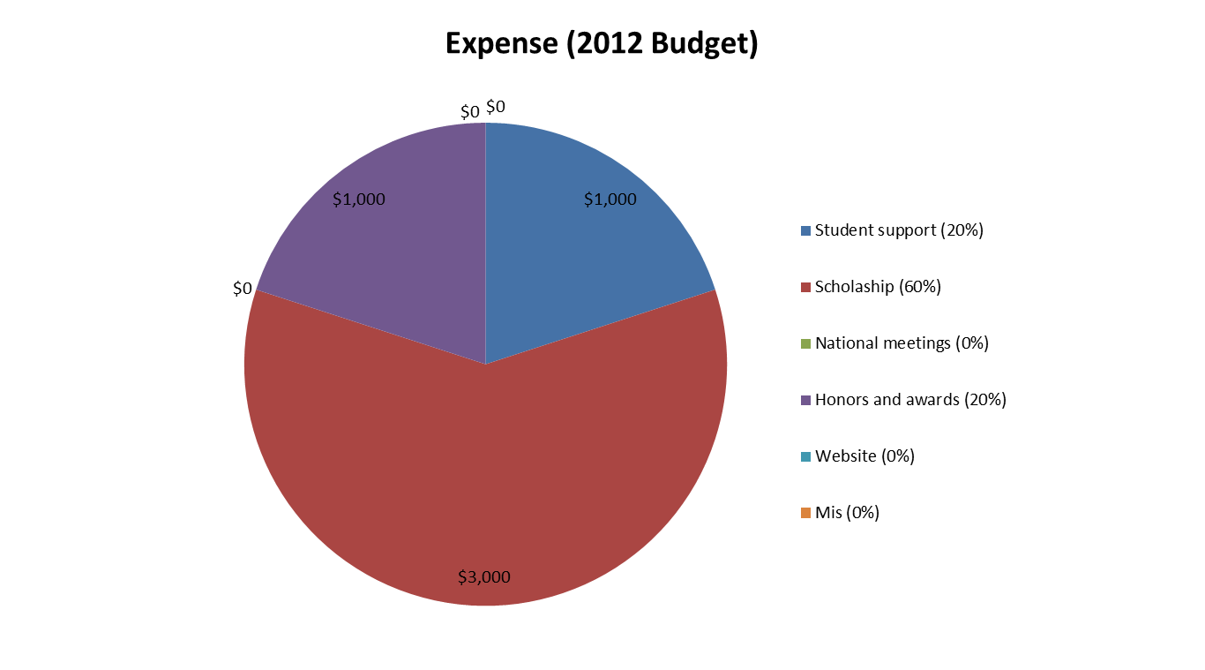
IRD Finances - continued
IRD Award and Vogt Award are endowed. Honors/Awards given at Topicals/National Meetings in IRD Sessions. Student support given to Topicals and Student Conferences. Website is up with new data being entered.

Slide 12
IRD Contributions to Society
Standards
  Work on Radiation Standards, Standards discussed/pursued by IRD are typically those produced by NIST(NBS), the IAEA, and Euratom; our members often make measurements that confirm/modify these standards per NIST protocols.
Position Statements
  IRD has supported ANS Position Statements via review and comment – none specific to creation by IRD recently.
Affiliations with other technical organizations
  Work with INMM/IAEA/Euratom/ESARDA in pursuit of joint meetings.
See Conferences/Topicals/Awards VG for additional data.

Slide 13
Conferences/Topicals/Awards
9th International Conference on the Methods and Applications of Radioanalytical Chemistry (MARC-IX) 3/2012 (Class I)
9th International Conference on Facility Operations-Safeguards Interface (ICFO-SI-9) 9/2012 (Class I)
8th International Conference on Isotopes and Expo (ICI-8)8/2014 (Class I)
INMM/ANS/IRD - Pacific Northwest International Conference on Global Nuclear Security - the Decade Ahead 4/ 2010 (Class I)
Embedded Topical : Isotopes for Medicine and Industry 11/2010 (Class III)
Embedded Topical with NNTG: Nuclear Nonproliferation – First Fission to the Future 11/2013 (Class III)
Joint Topical with Robotics Division being planned (either Class I or III)
3rd International Meeting on Advancements in Nuclear Instrumentation (ANIMMA)6/2013 (Class IV)
10th International Conference on Nuclear Analytical Methods in Life Sciences (NAMLS-10) 12/12 (Class IV)
8th International Conference on Nuclear and Radiochemistry (NRC-8) 9/2012 (Class IV)
13th International Conference on Modern Trends in Activation Analysis (MTAA-13) 3/2011 (Class IV)
3rd International Nuclear Chemistry Congress (3rd-INCC) 9/2011 (IRD Related)

Slide 14
Conferences/Topicals/Awards
(continued)
Active Participation and Support of:
ANS Position Papers – Societal Benefits of Radiation, US Radioisotope Supply, and Civilian Utilization
GLOBAL 2013
National Organization of Test, Research, and Training Reactors (TRTR) IRD Sponsor/cosponsor one session at National Mtgs.
NPC, SCNN, Standards, Scholarships
Prof Development – Series of Workshops on Activation Analysis Methods and Applications
Awards:
Vogt Scholarship – fully endowed –one $3000/year ; IRD Award – fully endowed – considered each year.
Support for Activation Analysis (ICAA) Young Scientist Award, Radiation Science and Technology Award, Mishima Award
Student Support an ANS National mtgs. and IRD Class I Topicals

Slide 15
IRD Summary
Areas of Success
  Multiple Technical Sessions at Every National Mtg.
  See Prior VG on Conferences/Topicals/Awards
  Successful MARC & Predecessors for >40 years
  Successful ICFO-SI-9 (International Conference on Facility Operations-Safeguards Interface)
  Growth of students within IRD
Focus for Future Action
  MARC/ICFO/See Prior VG on Conferences/Topicals/Awards
Complete update to Bylaws & Rules Status (update to standard Div. B&R guidelines),
Strategic Planning Status (update to Div. 1- and 5-yr plans).
Any requests/info for the BOD/officers
  BOD must reign in (Monitor) Nonproliferation Technical Group – they are NONPROLIFERATION POLICY NOT NONPROLIFERATION TECHNOLOGY – see next VGs for overlap illustration.
  Scope creep by the NNTG could endanger existing IRD Conferences which have a long history of supporting Technology associated with this field.

Slide 16
Nuclear NonproliferationTechnical Group/Professional Division (NNTG)
Charter (Mission)
The mission of the Nuclear Nonproliferation, (NN) Technical Group (TG) [Professional Division (PD)] is to promote the peaceful use of nuclear technology while simultaneously preventing the diversion and misuse of nuclear material and controlled technologies through the promotion of new and accepted nuclear nonproliferation policies. In order to achieve this mission, the objectives of the NN TG are to:
Promote policy that discourages the proliferation of nuclear technology and material to inappropriate entities.
Provide information to ANS members, the technical community at large, opinion leaders, and decision makers to improve their understanding of nuclear nonproliferation issues.
Become a recognized resource on nuclear nonproliferation, safeguards, and security issues.
Serve as the integration and coordination body for nuclear nonproliferation activities for the ANS.
Work cooperatively with other ANS divisions to achieve these objectives.

Slide 18
Special Announcement
First issue of NNTG News
Dear Bonnifer,
Welcome to the first of what we hope to be a bi-annual Nuclear Nonproliferation Technical Group (NNTG) newsletter. NNTG is the newest Technical Group within the American Nuclear Society (ANS). Our mission is to enhance the technical prowess of the ANS by fostering the application of technology to address nonproliferation-related problems and issues. It's kind of like the old BASF advertisement - "We don't make the products, we make the products BETTER." As a group, we seek to enhance our members' understanding of nonproliferation issues in the hope that we can use our knowledge to help solve problems and issues in nonproliferation.
Read More

