Slide 2
NPC (National Program Committee)
Sunday June 7, 2015
San Antonio, TX
Local Sections Committee Meeting
Ray Klann, NPC Chair
Kurshad Muftuoglu, Vice-Chair
Linda Hansen, NPC Vice-Chair

Slide 3
Contact Information
Ray Klann, NPC Chair
Ray.Klann@pnnl.gov
509-375-2134
630-863-6988
Kurshad Muftuoglu, NPC Vice-Chair
Kurshad.muftuoglu@ge.com
Linda Hansen, NPC Vice-Chair
hansen@anl.gov
630-863-5895
Paula Cappelletti, ANS Director of Meetings
pcappelletti@ans.org
708-579-8214

Slide 4
NPC
National Program Committee
Responsible for assuring that technical meetings sponsored (and co-sponsored) by ANS meet the Society's standards for technical and scientific contributions

Slide 5
NPC
In executing our responsibility, the NPC considers:
appropriateness of the proposed subject,
scheduling,
publication plans,
financial viability,
appropriateness of location,
ability of the organizing group to fulfill its commitments.

Slide 6
NPC Committees
National Program Committee
Comprised of standing members and division reps
Responsible for technical program of National meetings
Screening Committee
Comprised of standing members only
Responsible for all aspects of topical meetings
National Meetings Committee
Comprised of standing members only
Provides recommendations and oversight of National Meetings

Slide 7
ANS Meetings
National Meetings
Topical Meetings
Class I – Stand-alone ANS Topical meeting
Class II – Meeting outside the U.S. run by another organization with strong ANS technical participation (usually rotates to ANS on a recurring basis)
Class III – Embedded topical meeting at an ANS National Meeting
Class IV – Meeting run by another organization with ANS co-sponsorship

Slide 8
So Where Can Local Sections Get Involved?
National Meetings
Class I – Stand-Alone Topical Meetings
Why get involved?
To support the Society!!!
To earn revenue for the local section!!!

Slide 9
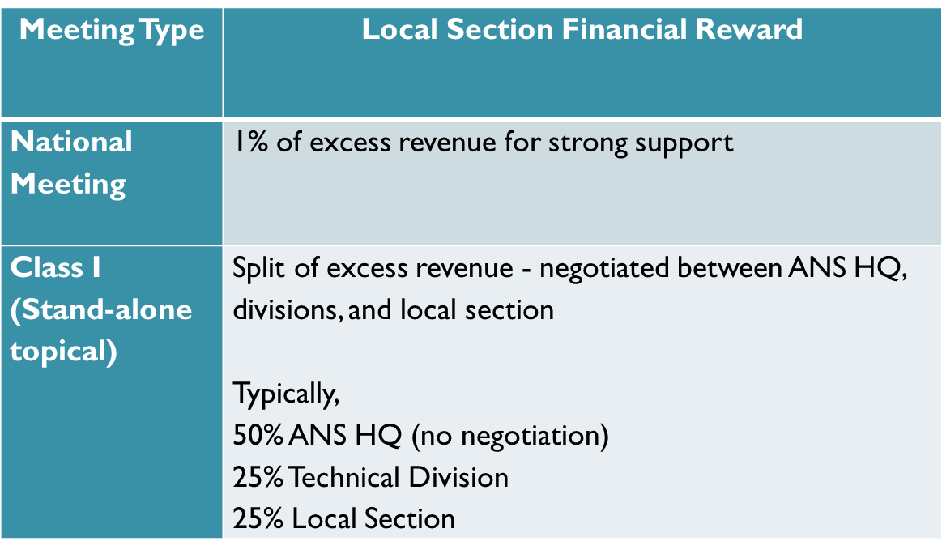
Revenue Sharing with Local Sections
NOTE: The local section is not authorized to distribute or use the funds until the closeout report has been approved by NPC

Slide 10
What does NPC expect from Local Sections – for National Meetings
Support the General Chair by participating in the local organizing committee
Finance Chair (fundraising)
Special Events Chair
Technical Tours Chair
Student Chair
Spouse/Guest Program
Provide volunteers at the meeting to assist ANS HQ
The time to get involved is 12-18 months before the meeting!

Slide 11
What does NPC expect from Local Sections – for Topical Meetings
Organize and host topical meetings
Follow the ANS Topical Meeting Manual
NPC expects local section volunteers to be performing all functions related to a meeting
This is how the local section earns their share of the revenue

Slide 12
Class I Topical Meeting Cycle
Divisions determine which section will host their topical meeting
Usually solicit bids for hosting ~2-3 yrs before
The meeting organizers must come to Screening Committee to get approvals:
Calendar Placement - ~2 years before
Preliminary Approval -~12-18 months before
Final Approval - ~6 months before
Meeting Closeout – Financial Report and Closeout Report- ~3 months after meeting or publication
New – organizers must provide status reports to NPC quarterly

Slide 13
Important Budget Items for Topical Meetings
Budget Approval
Required before signing a hotel contract
Required for preliminary meeting approval
including signed distribution of revenue form
Must be a conservative estimate of attendees and donations (not your hopes and dreams)
Must include copies of all contracts/bids
Once your budget is approved, all variances to it must be approved by NPC
Closeout Report
Must contain the actuals compared to the budget
Must describe/explain any differences

Slide 14
Topical Meeting Policies
NPC expects local section volunteers to be performing all functions related to a meeting
This is how the local section earns their share of the revenue
Local sections are still allowed to use contractors for conference services
If you use ANS, it is supported by the general meeting fund
If you use non-ANS services, these are supported by the local section funds

Slide 15
Topical Meeting Policies
NPC is considering ways to include incentives for host performance (i.e. adherence to schedule, and rewarding successful meetings)
Initiatives
NPC is currently working on initiatives to make it easier for topical meetings to be organized, run, hosted, and monitored

Slide 16
Important Contract Items for Topical Meetings
Hotel Contracts
ANS HQ must sign all hotel contracts
If the local section signs the contract, the local section is financially liable
This includes large special events contracts, as well
Contracts for services shall be bid
You must get a quote from ANS
All contracts shall be included in budget paperwork
Must also include justification for selection

Slide 17
We are here to help
Our primary goal is to make sure that ANS meetings are
organized and hosted in a professional and consistent manner
technically stimulating
financially successful
Don’t be afraid to contact us with questions and ISSUES as soon as they arise!

